Slide 1
Novati Wafer Studies
Initial studies with Novati wafers shows good VI and CV curves with a couple of peculiarities.
Guard rings break down below 500 V. It is common that the breakdown is higher in initial tests than subsequent measurements. This is particularly true of the p-spray + p-stop devices.
The active area does not break down until higher (as yet undetermined) voltage.
CV curves on the 500 micron devices show depletion at about 400V

Slide 2
CV from Novati_FNAL_tests.xlsx
CV curves indicate depletion at 400V, resistivity about 6 kOhm-cm
Does the second structure correspond to GR breakdown?
Neff Calc
 | mup= | 502 | cm2/Vs
 | eps= | 11.9
 | eps0= | 8.85419E-14 | F/cm
 | D | 0.05 | cm
 | q0 | 1.60218E-19
 | Vdep | 400 | V
 | Neff | 2.10E+12
 | Resistivity | 5.91E+03 | Ohm-cm

Slide 3
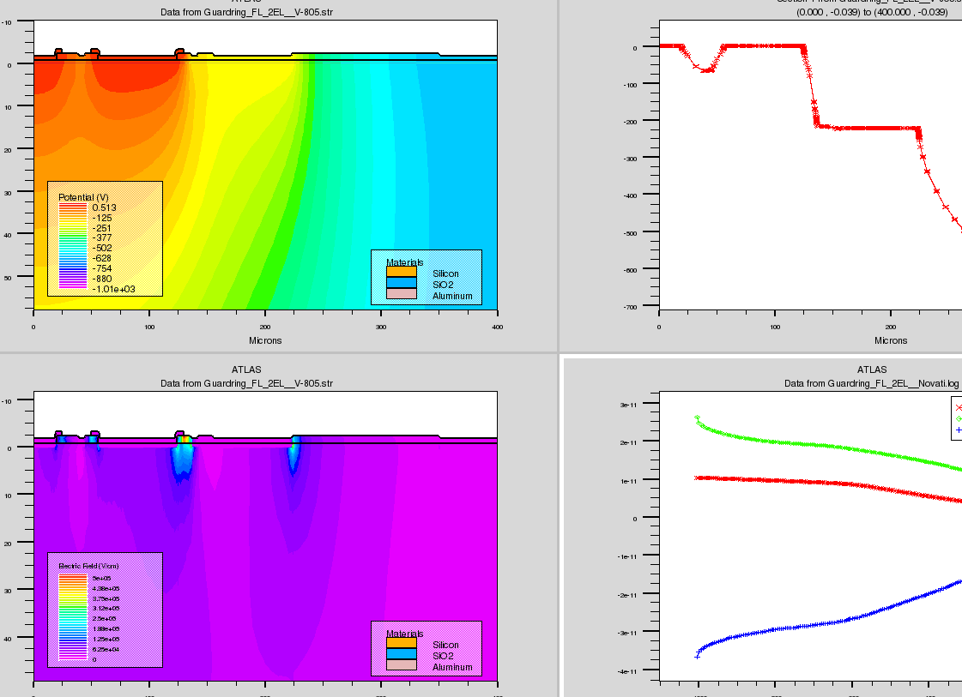
Silvaco Model of TS edge
Model of edge of test structure 805V
Breakdown beginning?
Rerun with extended
Vbias

Slide 4
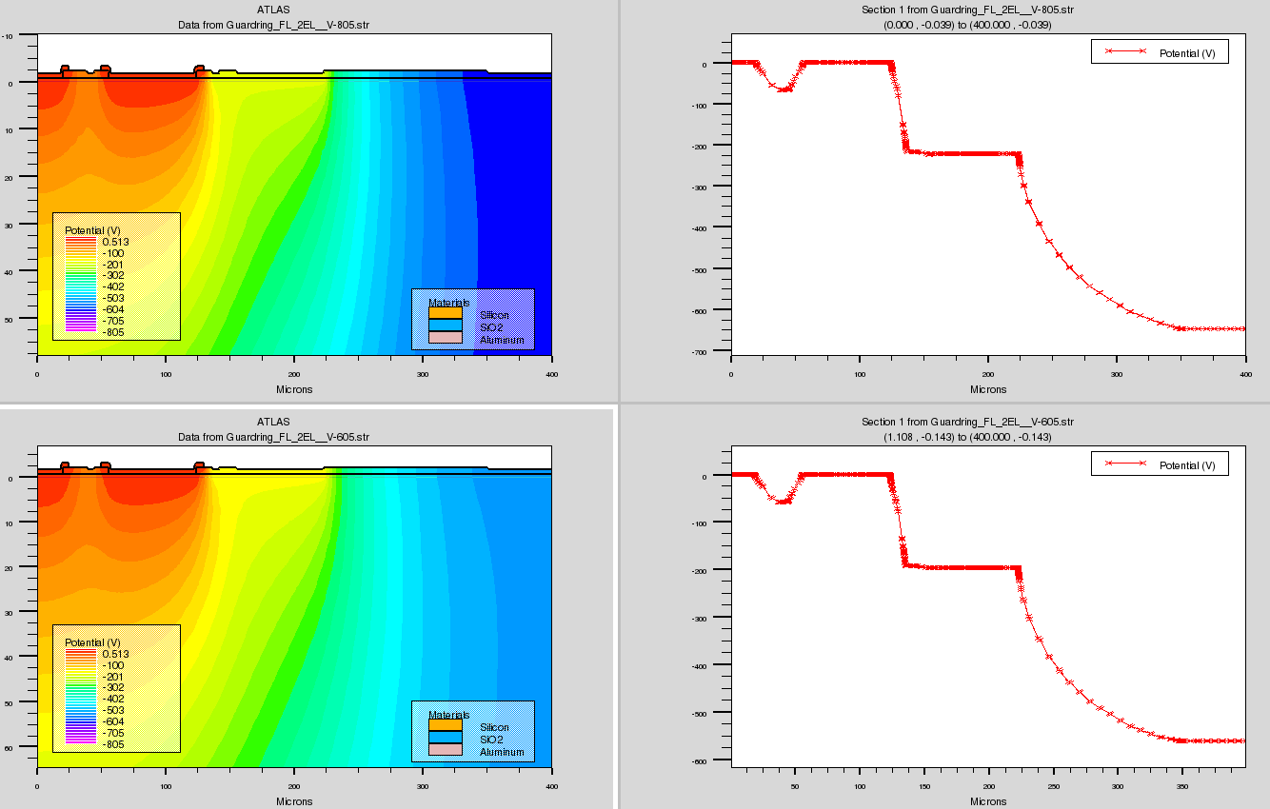
Silvaco Model of TS edge
Model of edge of test structure 605, 805V

Slide 5
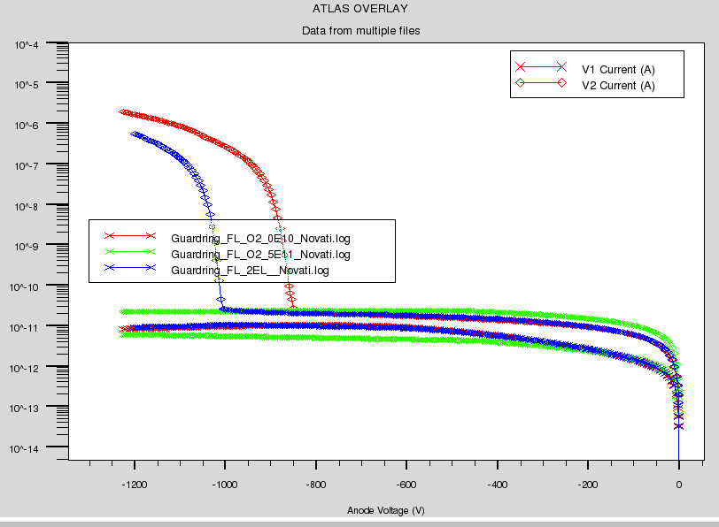
Oxide charge effect
Varied oxide charge from 0, 5e10, 5e11. Breakdown decreases with increasing oxide charge

Slide 6
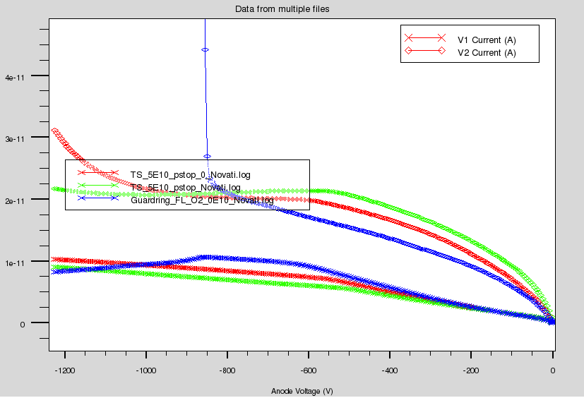
Pstop only
P stop + p spray 0 oxide charge
P stop only 0 oxide charge
P stop only 5E10 oxide charge
Guard Currents

