Slide 1
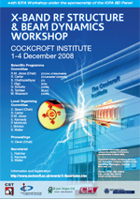
X-Band cavities – dynamics issues in light sources
(WG1)
Hywel Owen
University of Manchester/Cockcroft Institute
44th ICFA Workshop on X-Band Structures
1st December 2008

Slide 2
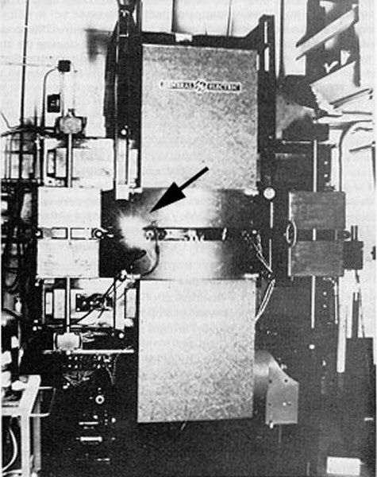
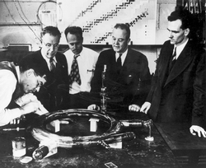
The General Electric Synchrotron, 1946
Herbert Pollock:
  ‘On April 24, Langmuir and I were running the machine and as usual were trying to push the electron gun and its associated pulse transformer to the limit. Some intermittent sparking had occurred and we asked the technician to observe with a mirror around the protective concrete wall. He immediately signaled to turn off the synchrotron as "he saw an arc in the tube." The vacuum was still excellent, so Langmuir and I came to the end of the wall and observed. At first we thought it might be due to Cherenkov radiation, but it soon became clearer that we were seeing Ivanenko and Pomeranchuk radiation.’
  Physical Review 71 (11), 829-830 (1947)
D.Ivanenko, I. Pomeranchuk, Phys. Rev. 65, 343 (1944), & Akad. Nauk. Dokl. 44, 315
J. Schwinger, Phys. Rev. 70, 798 (1946), 75, 1912 (1949)
http://www.physicstoday.org/pt/vol-54/iss-8/pdf/vol28no1p9-11.pdf
  ‘If the accelerator tube of the 100-MeV betatron at Schenectady had not been opaque, the visual observation would probably have been made three years earlier by Westendorp or Blewett soon after the publication of your letter to the Physical Review (Phys. Rev. 65:343, 1944). Unfortunately they were not able to see through the silvered wall of the betatron donut.’

Slide 3
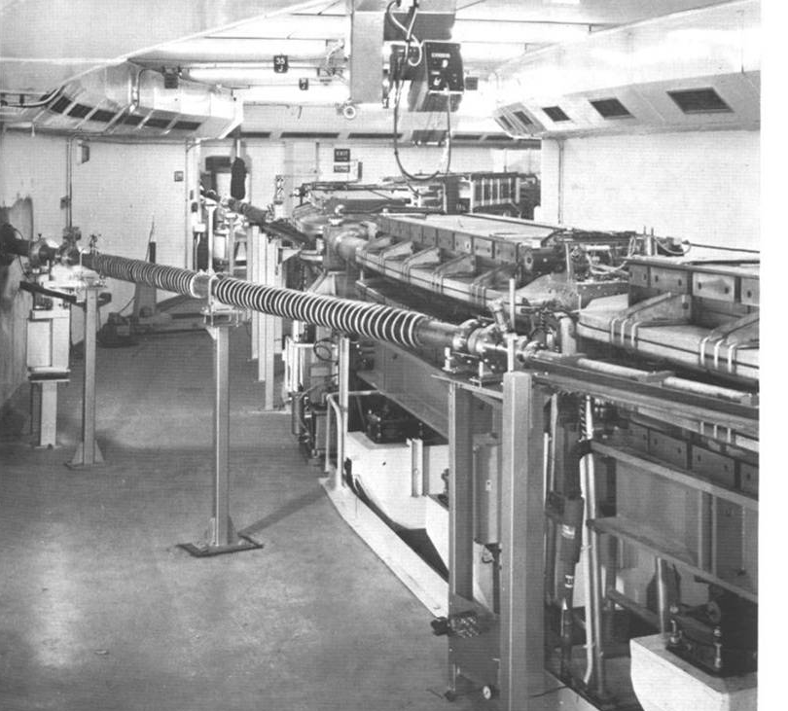
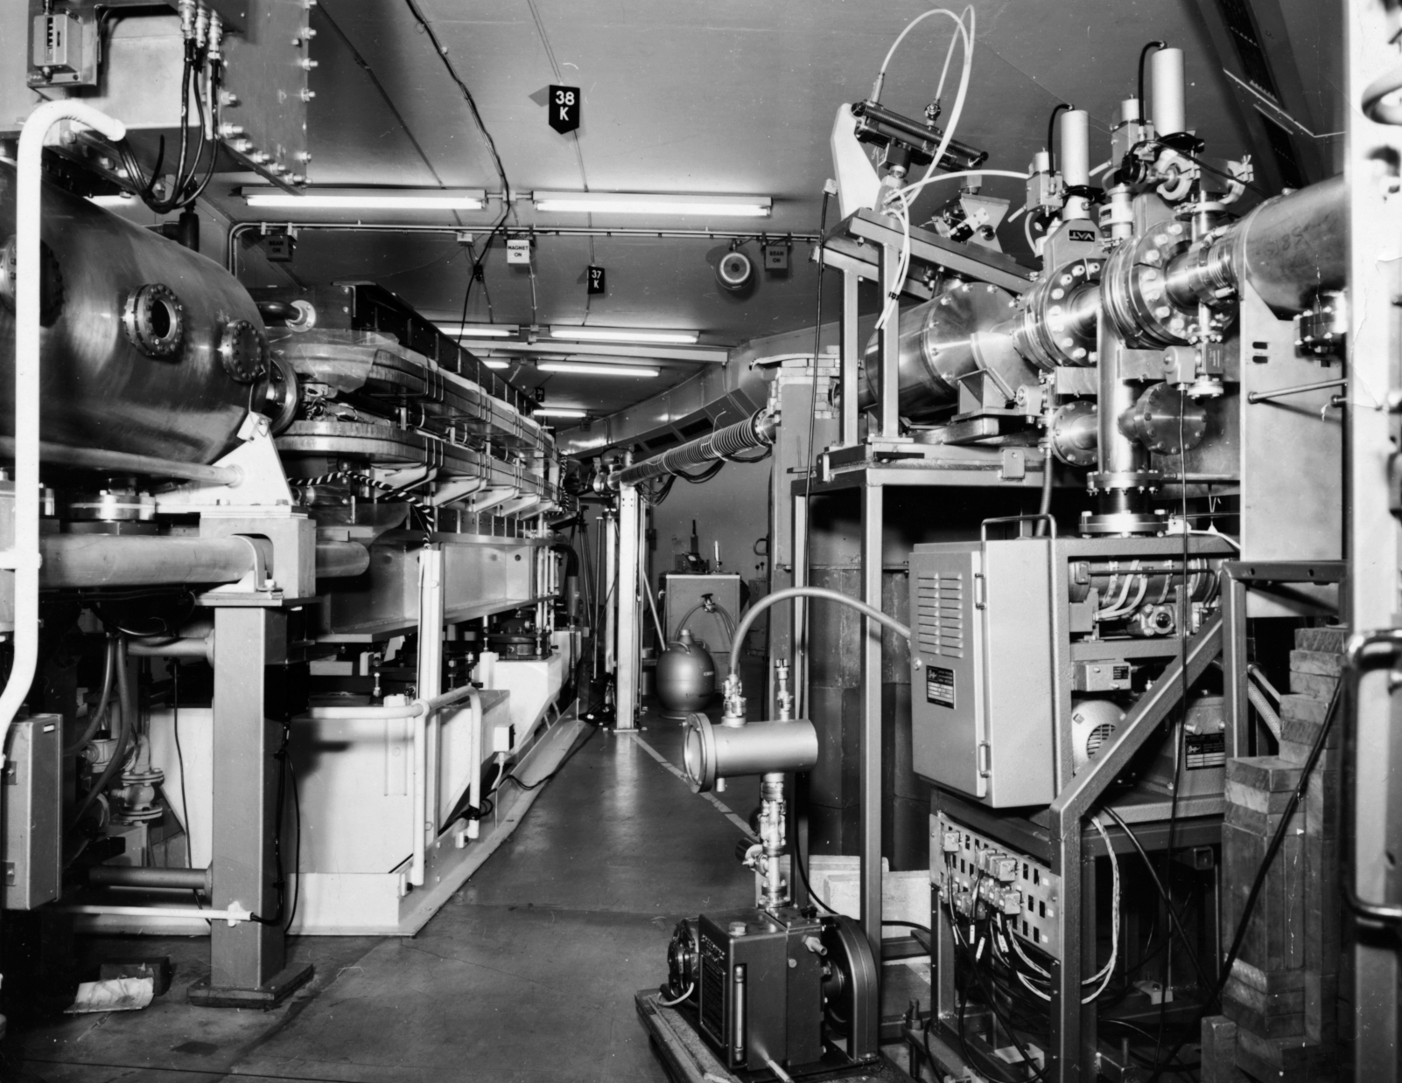
1G – The Parasite
Electron synchrotrons built for particle physics generate unwanted SR at the dipoles
Other physicists seize the opportunity and start to make use of this light
In the UK, the NINA synchrotron at Daresbury was used for SR experiments from 1968 until 1977
NINA operated at 53Hz, up to 5 GeV, with up to 35mA of circulating beam

Slide 4
2G – The Dedicated Source
The use of SR was so successful that dedicated “Storage Rings” were proposed
The dipoles were foreseen as the main sources of the SR
In the UK the 2 GeV SRS was built at Daresbury – the first X-ray facility
 | SRS-1 | SRS-2
Number of Cells | 8 | 16
Natural Horizontal Emittance (nm rad) | 1500 | 110
Natural Bunch Length (mm) | 60 | 35

Slide 5
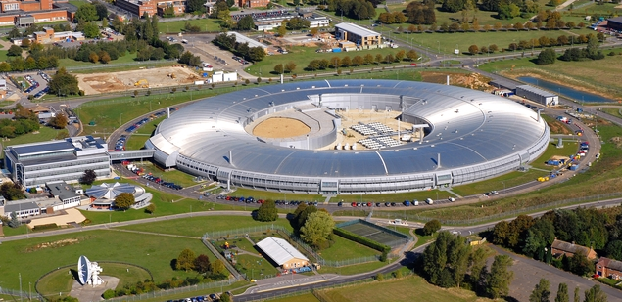
DIAMOND (2007 - ?)
RAL
 | SRS-1 | SRS-2 | DIAMOND
Number of Cells | 8 | 16 | 24
Natural Horizontal Emittance (nm rad) | 1500 | 110 | 2.7
Natural Bunch Length, FWHM (mm) | 60 | 35 | 8

Slide 6





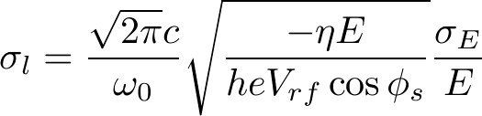


4th Generation Light Sources
The recirculation of electrons leads to equilibrium properties of the electron bunch different from the initial, injected ones.
Lots of equations, but given a particular lattice it is straightforward to calculate these properties.
Typically, a GeV-scale electron storage ring has:
Previously, this was better than an injector could make
Now, injectors can make smaller values than these

Slide 7
A UK-based light source
The recent NLS project is an example of the reasoning behind the demands of a user community:
STFC-led project to examine and propose a 4th Generation synchrotron user facility for the UK with unique and world leading capabilities (NLS is a working title)
Three stages:
      Science Case
      Technical Design Study
      Funding and Location
Science Case presented to STFC - PALS on 15rd Oct (www.newlightsource.org). From executive summary…
    IMAGING NANOSCALE STRUCTURES: Instantaneous images of nanoscale objects can be recorded at any desired instant allowing, for example, nanometer scale resolution of sub-cellular structures in living systems.
    CAPTURING FLUCTUATING AND RAPIDLY EVOLVING SYSTEMS: Rapid intrinsic evolution and fluctuations in the positions of the constituents within matter can be characterized.
    STRUCTURAL DYNAMICS UNDERLYING PHYSICAL AND CHEMICAL CHANGES: The structural dynamics governing physical, chemical and biochemical processes can be followed by using laser pump- X-ray probe techniques.
    ULTRA-FAST DYNAMICS IN MULTI-ELECTRON SYSTEMS: New approaches to measuring the multi-electron quantum dynamics, that are present in all complex matter, will become possible.

Slide 8
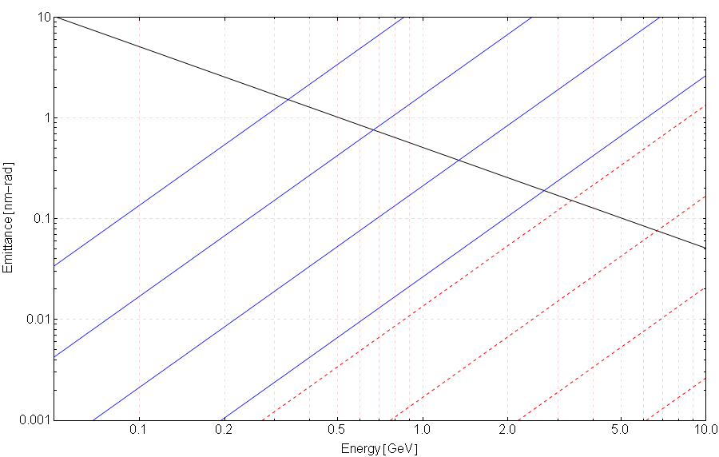
Transverse Brightness ⇒ Not a Storage Ring!
TME 6-cell (100 m)
TME 12-cell (200 m)
TME 24-cell (400 m)
Linac: 1 mm-mrad
(state of the art @ 1 nC charge)
TME 48-cell (800 m)
Storage Ring
Horizontal Emittances
Storage Ring
Vertical Emittances
(0.1% Coupling)
TME (theoretical minimum emittance) is the smallest emittance possible in a ring, based on minimising

Slide 9

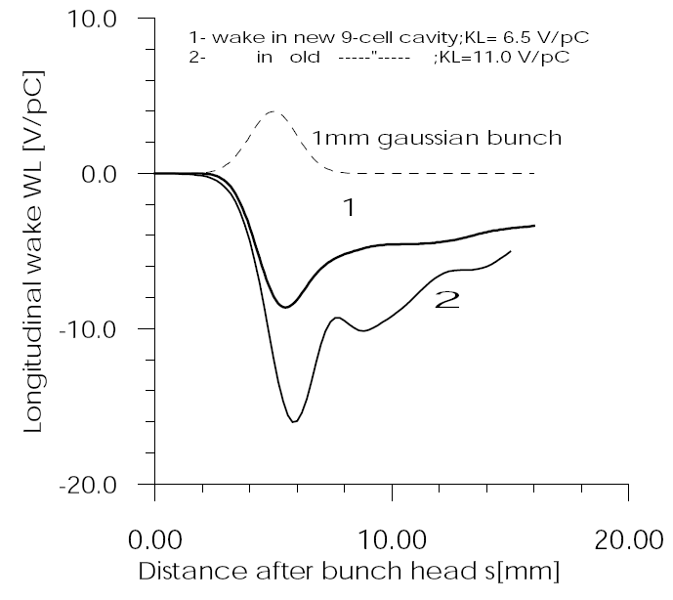
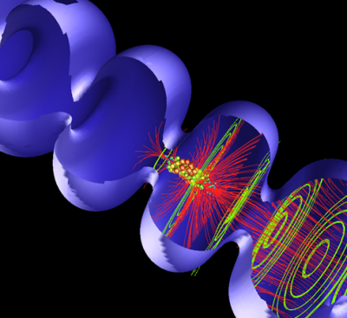

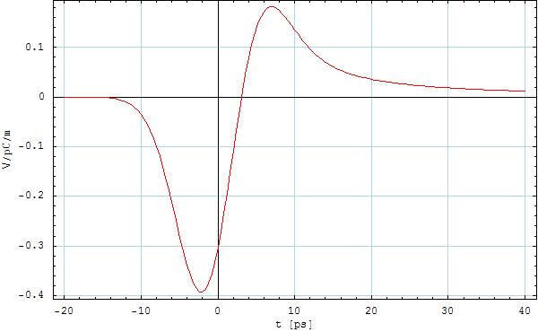
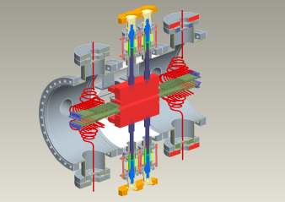
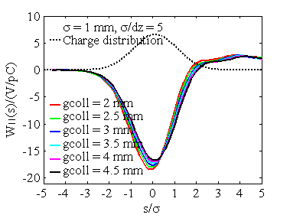
Compression Scheme Design Non-Trivial
BC1
BC2
L1
3H/4H
L2
L3
Main RF
3rd Harmonic Cavity
Final Linearised Chirp
λ_{h}=λ₀/h
ϕ₀
ϕ_{h}= π
Resistive wall wakes
Collimator wakes
Longitudinal cavity wake
E.g. Trade off large CSR in transporting
short bunch with jitter caused by large R56

Slide 10
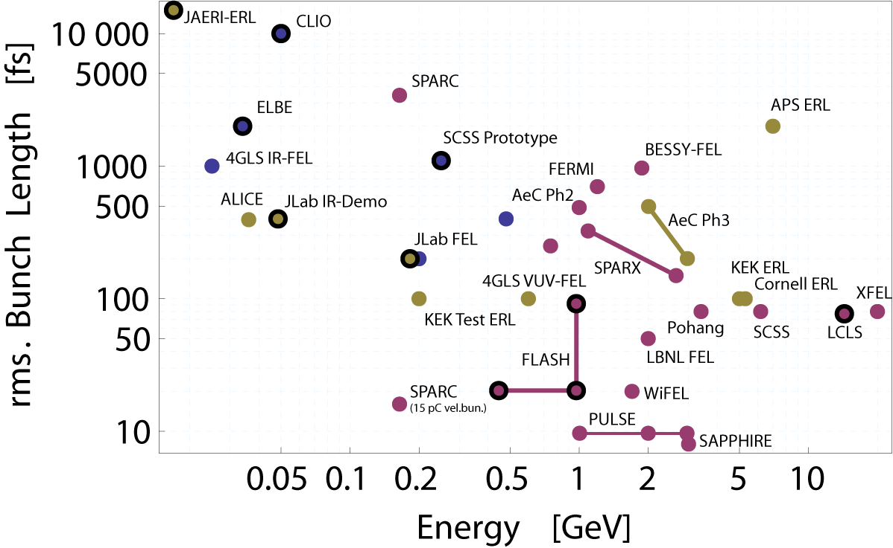
4th Generation Machines Worldwide
Blue – single-stage
Red – multi-stage (inc. harmonic correction)
Yellow – ERL (various methods)
Bold – they have measured that bunch length
NLS SC Design
NLS NC Design
Users want 1kHz rep. rate, 20fs pulses, 3 GeV ideally
Our initial interpretation, a ~1 GeV SC linac, upgradable to 3 GeV
Other approach, a 3 GeV NC linac (R. Bartolini)
Recirculating option being developed

Slide 11
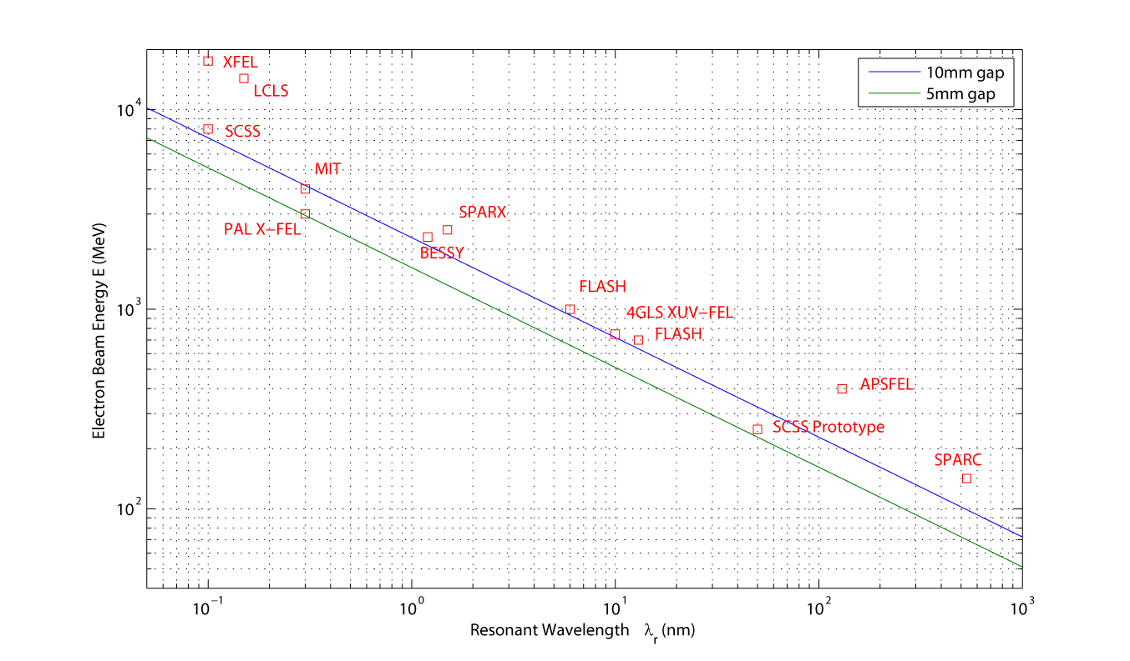
FEL Resonance Condition
Approximate minimum beam energy required for a given FEL wavelength,
for 10mm and 5mm undulator gap. Also shown are data from current and proposed FEL projects

Slide 12
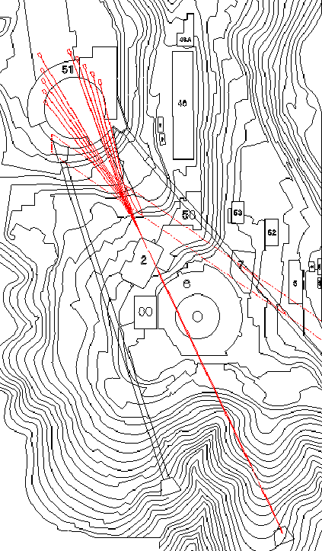
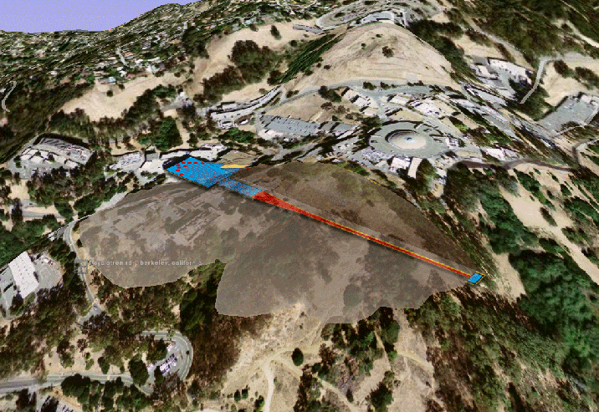
Similar Schemes to a SC NLS
Both about 2 GeV
Both about 600 m (facility)
WiFEL
LBNL

Slide 13
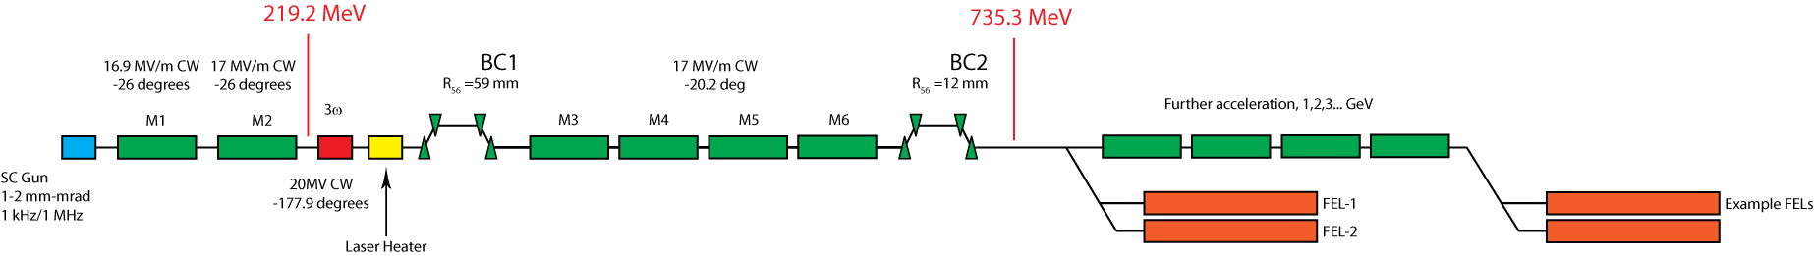
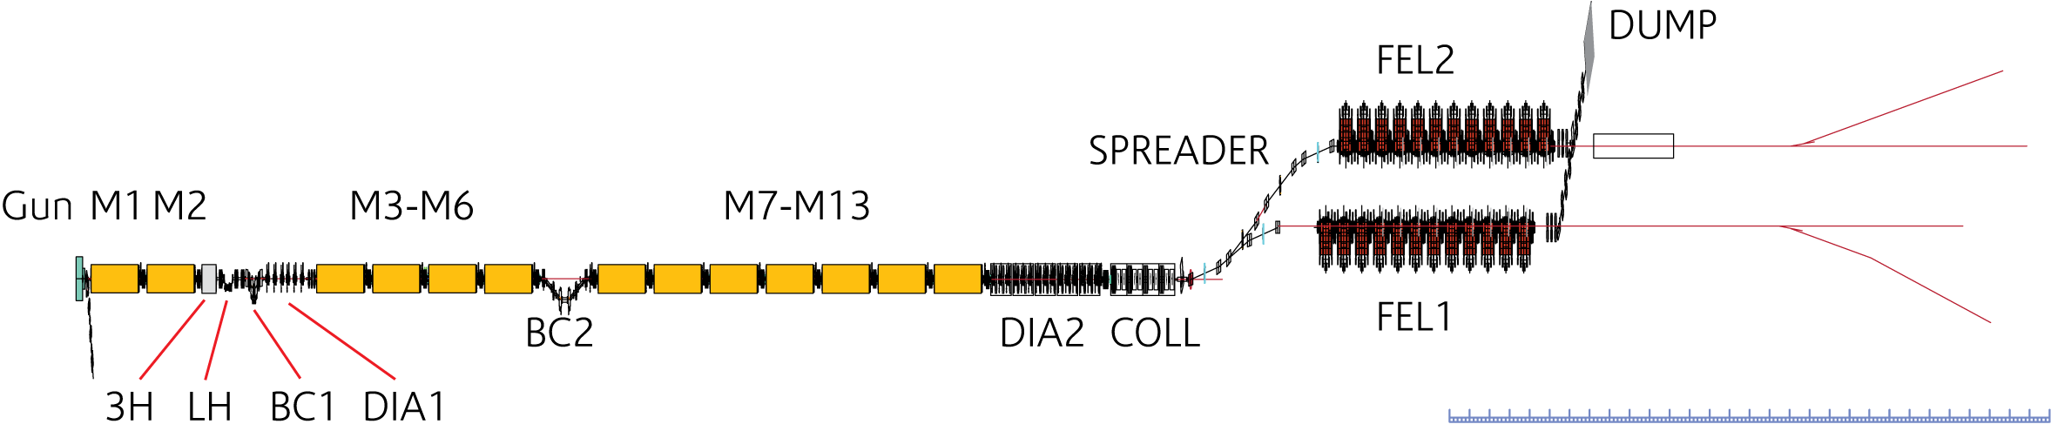
An NLS SC Design (Hywel Owen and Peter Williams)
Parameter | Value
Bunch Charge | 200 pC
Fundamental RF | 1.3 GHz
Bunch Rate | 1 kHz to 1 MHz
Gradient | 17 MV/m
3.9 GHz Total Voltage | 20 MV
Transverse Slice Emittance | < 2 mm-mrad
rms Energy Spread | 4.1 MeV
Bunch Length | 10 fs
735 MeV chosen as it corresponds to 1 nm, the limit for HHG seeding i.e. this is a possible extraction energy where we want short bunches
Compression scheme must be carefully designed – linearisation, cavity wakefield compensation, CSR, LSC
200 pC bunch charge chosen, based injector on XFEL
EPAC08: MOPC034, MOPC035 available at www.jacow.org
PR-STAB in preparation

Slide 14
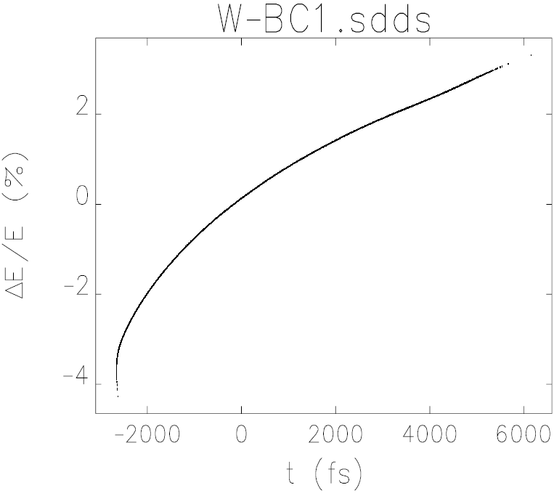
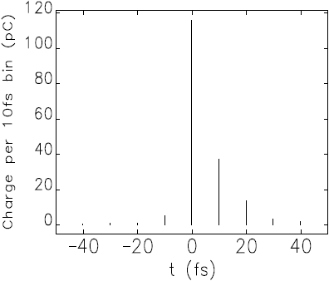
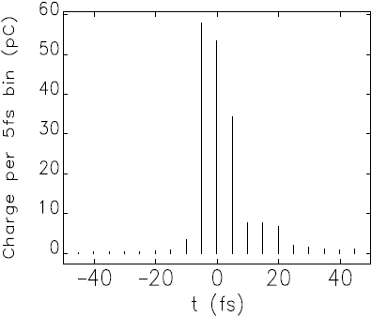
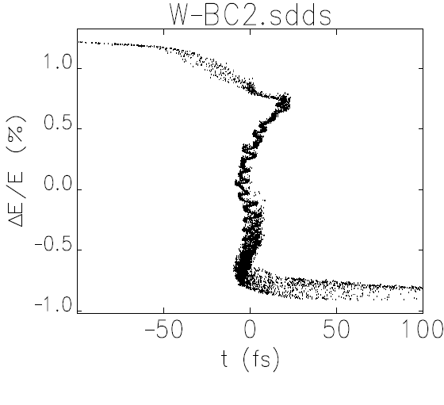
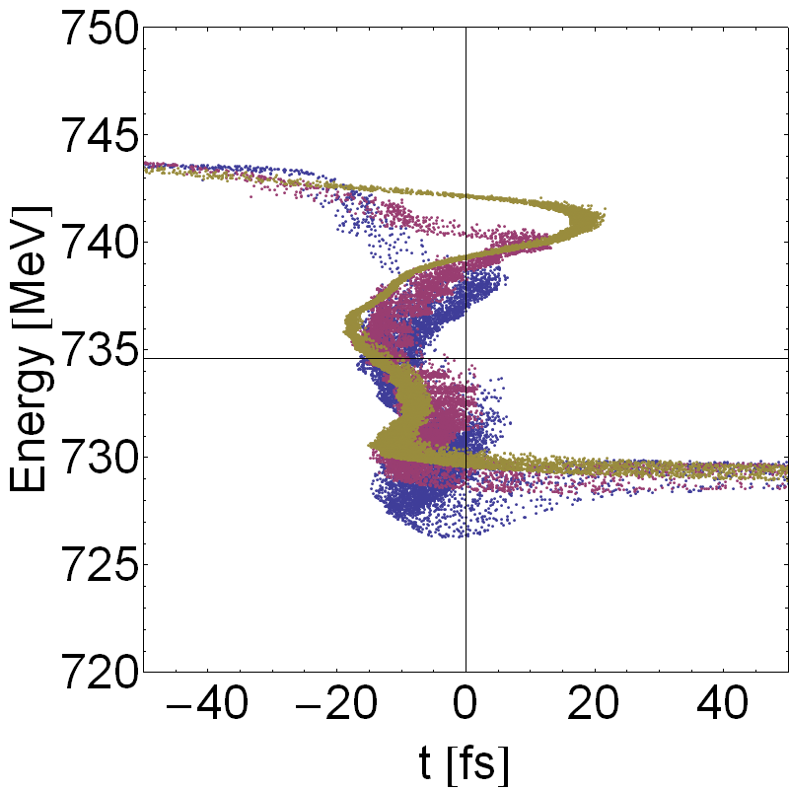
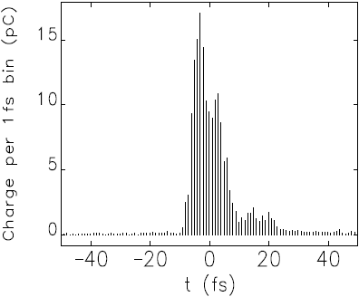
An NLS SC Simulation – The Upright Bunch
Peak currents
(for FEL lasing)
Central Bin Width | Slice Emittance | Charge | Equivalent Current
1 fs | 1.32 mm-mrad | 16.9 pC | 16.9 kA
5 fs | 1.43 mm-mrad | 57.5 pC | 11.5 kA
10 fs | 1.91 mm-mrad | 104 pC | 10.4 kA
After first
compressor
11.8 kA
Parameter | Projected (ELEGANT) | 3D Method (CSRtrack)
Projected Emittance | 2.98 mm-mrad | 4.95 mm-mrad
Slice Emittance (5 fs) | 1.43 mm-mrad | 1.85 mm-mrad
Slice Energy Spread (5 fs) | 0.29 % | 0.27 %
Peak Current (1 fs) | 16.6 kA | 14.5 kA
11.4 kA
Numerical LSC microbunching
Elegant Projected
CSR e-spread
CSRtrack Projected
16.6 kA
After second
compressor
CSRtrack 3D

Slide 15
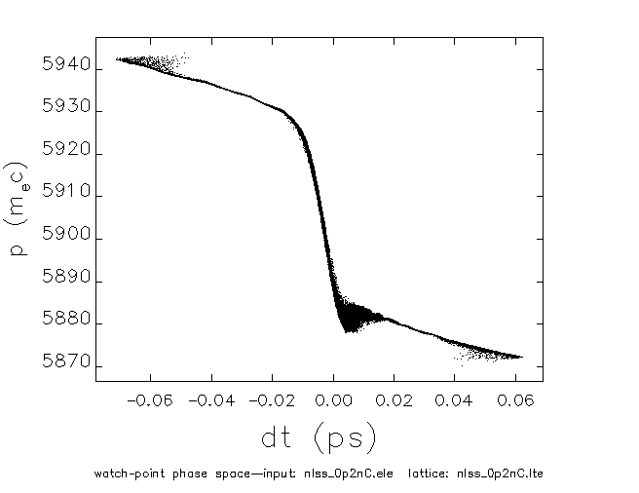
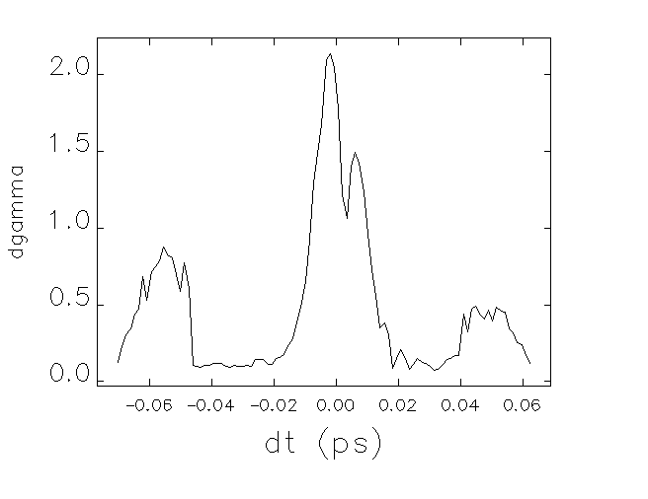
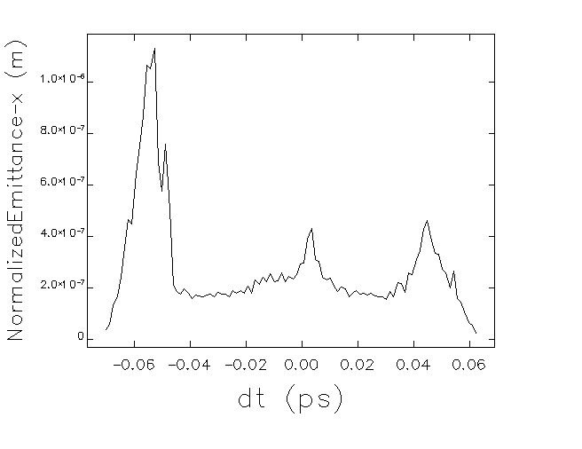
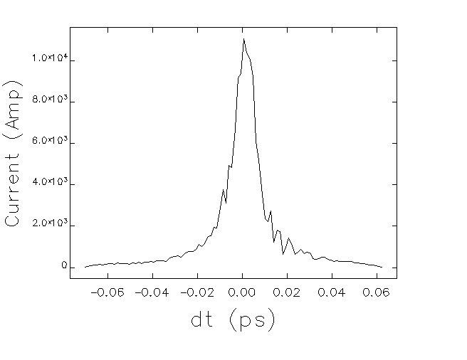
An NLS NC Simulation – R. Bartolini (DLS)
Gun
S01
S02
S03
X01
BC1
S04
S05
S06
BC2
S07
S08
S09
S10
S11
S12
DL
undulators
Astra
elegant
genesis
3 GeV NC S-Band linac with 2 stage compression, 200 pC bunches chosen
NC RF S-band gun, 0.21 mm mrad at injector exit – more later
CSR – yes, LSC – no. Bin width ~1 fs
Long. PS
Energy Spread
Emittance
Current

Slide 16
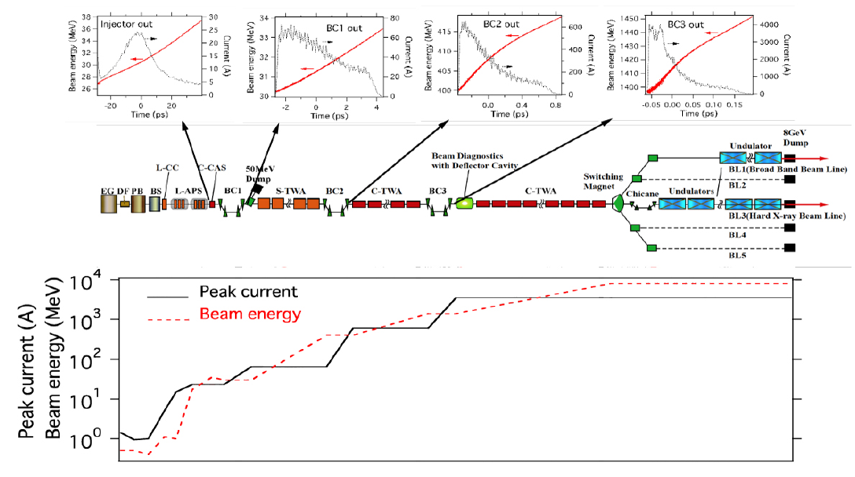
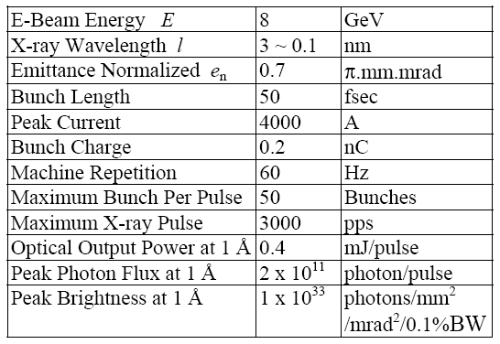
SCSS (SPRING-8/XFEL) – 5.7 GHz, 35 MV/m, 60 Hz
c. 400m
EPAC2008::MOPC031

Slide 17
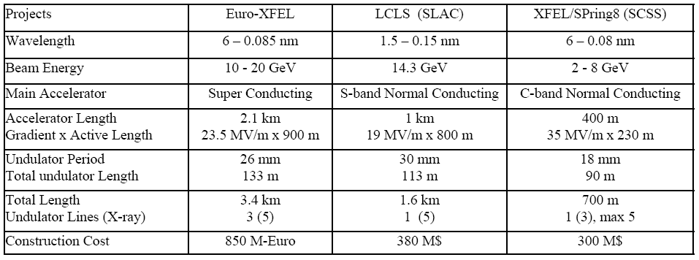
Comparison of High-Energy Designs
But, can only use C band at higher energies
– still need to use S-band after injector

Slide 18
Why superconducting in the UK?
‘Mega-facilities’ already under construction – LCLS, XFEL, SCSS, with different pulse patterns, but all ‘low rep. rate’. Provide short wavelength output c. 1 A.
Lower-energy ‘low rep. rate’ facilities already operating, under construction or proposed – FLASH, FERMI, MAXLAB etc.
Low rep. rate machine (e.g. up to 400 Hz) can use NC cavities, e.g. S-band, C-band, using established technology – therefore cheap, but not competitive
User advantages of SC all from higher rep. rate
  Bunch properties about the same
  Synchronisation might be easier
  Experiments faster, or different ones possible
Disadvantages:
  Greater Capital cost (about 1.7 times cf. NC on NLS)
  Cryoplant
  Lower gradient than C-band (about the same as S-band) – up to 20 MV/m
An X-band solution should compete on:
  Higher gradient
  Lower cost cf. SC
  Rep. rate higher than 1 kHz to compete against S-band
  At lower energies, want all X-band to minimise facility length
  Wakefields an issues for short bunch production (important)

