Slide 1
CMS Computing Model Simulation
Stephen Gowdy/FNAL

Slide 2
Overview
Want to look at different computing models for HL-LHC
  To use caching (eg CDN, NDN)
  Where to place caches
  How large they need to be
Discussion with others to possibly collaborate
Writing a basic Python simulation
  Can consider to change to C++ if better performance is needed

Slide 3
Simulation
Time driven discrete simulation
  100 seconds used as time slices currently
Takes account of slots in sites
Allows for transfers between sites
Code is in https://github.com/gowdy/sitesim

Slide 4
Methodology
Flat files read to load in site, network, job and file information
Setup sites and links
Next setup catalogue of data
Read in simulation parameters for CPU efficiency, remote read penalty and file transfer rates
Start processing jobs in sequence
  Use list of jobs from dashboard to feed simulation
  See how it performs to process current jobs

Slide 5
Simulation Parameters
CPU Efficiency derived from actual jobs
Latency between sites guessed at the moment
CPU Efficiency penalty when reading remotely
  0ms: 0, >=1ms 5%, >=50ms 20%
Single file transfer maximum speed
  0ms: 10Gbps, >=1ms 1Gbps, >=50ms 100Mbps, >=100ms 50Mbps

Slide 6
Site
Batch
Job
EventStore
name
disk
bandwidth
network [[site, bandwidth, quality, latency] … ]
batch
qjobs [ Job ]
rjobs [ Job ]
djobs [ Job ]
cores
bandwidth
site
cpuTime
inputData
fractionRead
start
end
runTime
dataReadTime
dataReadCPUHit
theStore
catalogue {lfn:[site…]}
files {lfn:size, …}

Slide 7
Site Information
Extracted from SiteDB pledge database
  Use information for 2014, most recent update
  If site has no pledge just assume 10TB and 100 slots
    Tier-2s default is larger, should probably update
  No internal bandwidth information so assume 20GB/s at all sites
Recently only considering US Tier-1 and Tier-2 sites
  Sizes taken by hand from REBUS (could probably automate also)
  Vanderbilt assumed to be the same as others

Slide 8
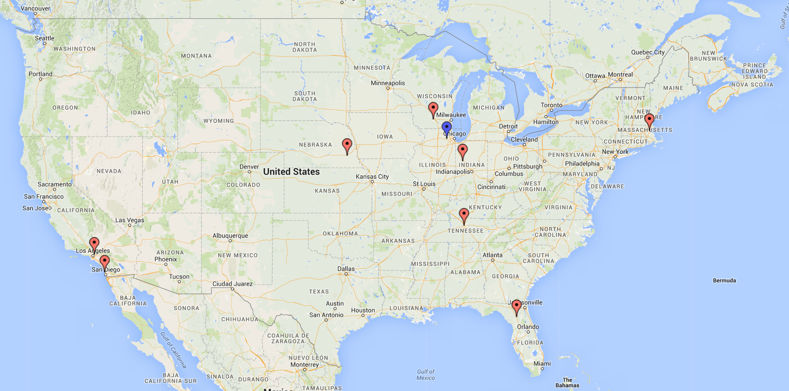
FNAL has;
17690TB disk
10400 cores
Each Tier-2 has;
1000TB disk
1224 cores

Slide 9
Job Information
Site, Start Time, Wall Clock, CPU time, files read
Extracted job information from dashboard
  A week from 15th to 22nd February
  About 5% of jobs have no site information (discarded)
  About 33% have no CPU time (derived from wall clock)
  <<1% have no start time (use CPU time before end time)
  <<1% have no input file defined (discarded)
Will compare wall clock in simulation with actual for quality of simulation check
Compare overall simulated wall clock time to compare different scenarios

Slide 10
File Information
Extract network mesh from PhEDEx
  Using the links interface
  Also get reliability information
    If not present assumed 99%
  No actual transfer rate information available for links
    Use what is available to get a number between 1GB/s and 10GB/s, not at all accurate. Default 1GB/s.
Extract file location and size information from PhEDEx
  No historical information is available
  When updating job information need to get an update for file locations
  Only get information on files used by jobs
    Some of jobs read a file outside the US, place copy at FNAL to allow job to work when considering only US sites

Slide 11
Startup output when only using US T1 and T2 sites;
$ python python/Simulation.py
Read in 9 sites.
Read in 72 network links.
Read in 99266 files.
Read in 279178 locations.
Read in 3 latency bins.
Read in 4 transfer bins.
Read in 10 job efficiency slots.
About to read and simulate 113899 jobs...
…

Slide 12
Caching
Need to add different caching strategy later
  Cache hierarchy
Including cache cleaning if getting full
Currently simulation allows no transfers, or transfers. Also can discard transfers.
Won’t transfer if there is no space available at a site
Implement different models
  With new version of xrootd can read while still transferring

Slide 13
Scenarios Considered
Run standard set of 56949 US jobs
  Each job ran twice to spread load across all Tier-2 sites more evenly
Run with a similar situation to today
  Vast majority of data already placed at execution site
  Small number of jobs will transfer data from another site (usually FNAL)
Only use a local cache, data initially at FNAL
Only read data from FNAL, no local copy (no local disk needed)

Slide 14
Vary Input Parameters
Total wall clock time used in billions of seconds
Each box has three values: Preplaced Data/Transfer File/Remote Read
    There is a very small difference in the Transfer File time with the change in transfer speed
 | Half CPU Hit | Normal CPU Hit | Double CPU Hit
Half Tran. Speed | 2.77/3.32/3.78 | 2.77/3.32/3.94 | 2.77/3.32/4.25
Normal Tran. Speed | 2.77/3.32/3.78 | 2.77/3.32/3.94 | 2.77/3.32/4.25
Double Tran. Speed | 2.77/3.32/3.78 | 2.77/3.32/3.94 | 2.77/3.32/4.25

Slide 15
Plots from running with different parameters
Grid of three by three graphs, similar to previous table
  Left to right vary Remote Read penalty
    Half: 0ms: 0, >=1ms 2.5%, >=50ms 10%
    Normal: 0ms: 0, >=1ms 5%, >=50ms 20%
    Double: 0ms: 0, >=1ms 10%, >=50ms 40%
  Top to bottom vary maximum single file transfer rate
    Half: 0ms 5Gbps, >=1ms 500Mbps, >=50ms 50Mbps, >=100ms 25Mbps
    Normal: 0ms 10Gbps, >=1ms 1Gbps, >=50ms 100Mbps, >=100ms 50Mbps
    Double: 0ms 20Gbps, >=1ms 2Gbps, >=50ms 200Mbps, >=100ms 100Mbps

Slide 16
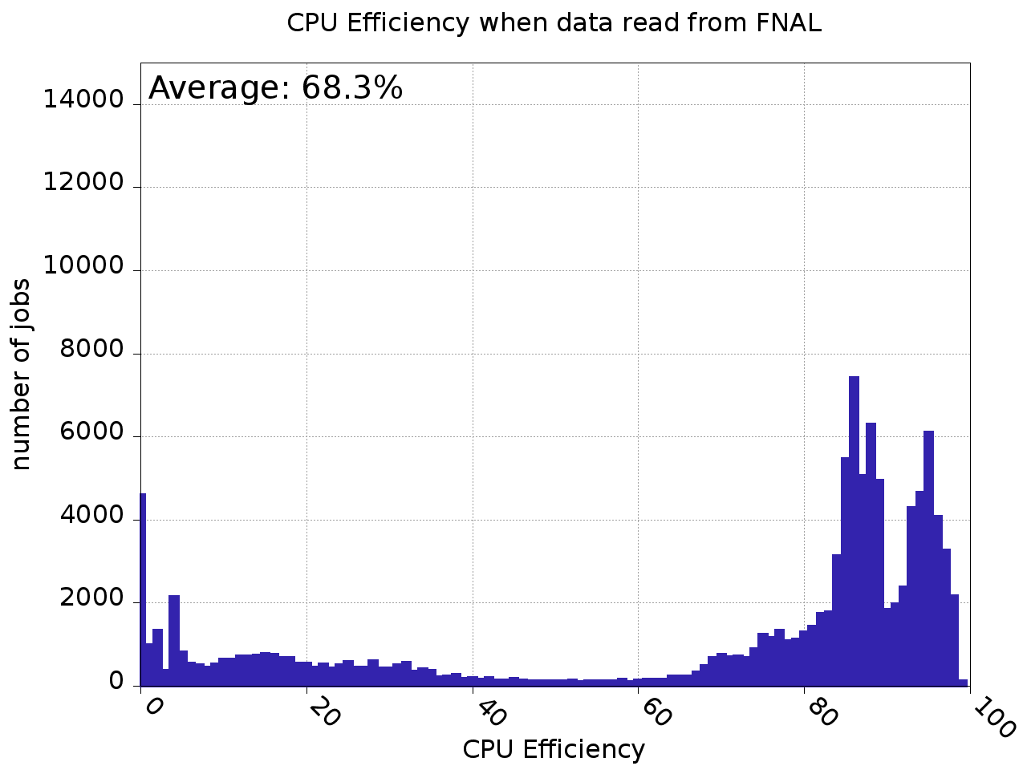
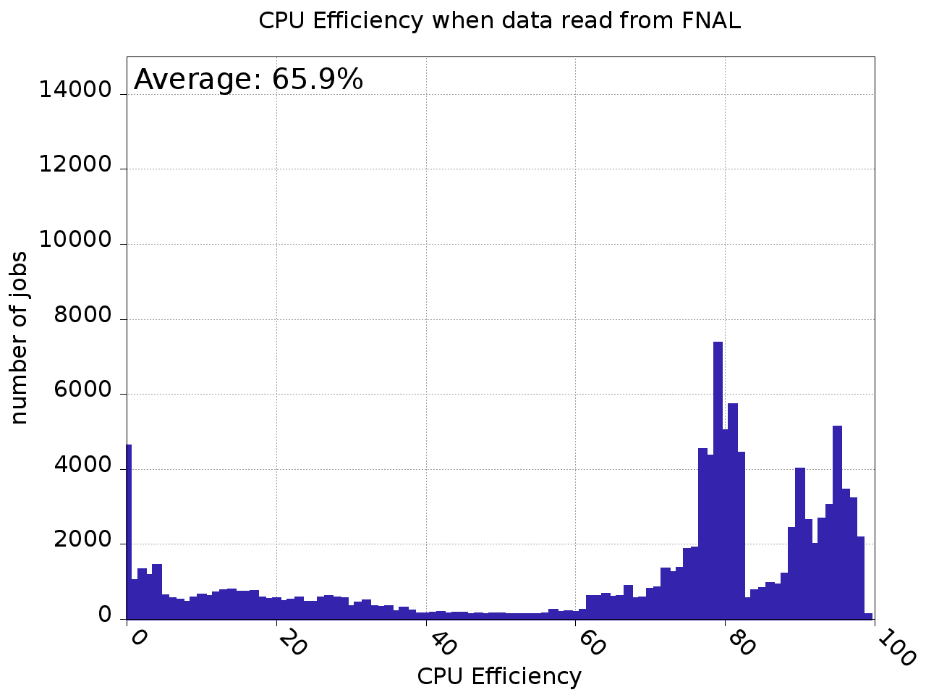
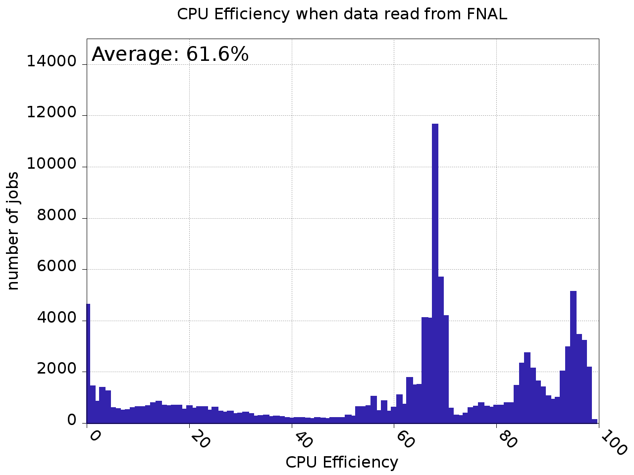
CPU Efficiency when Data Read from Fermilab

Slide 17
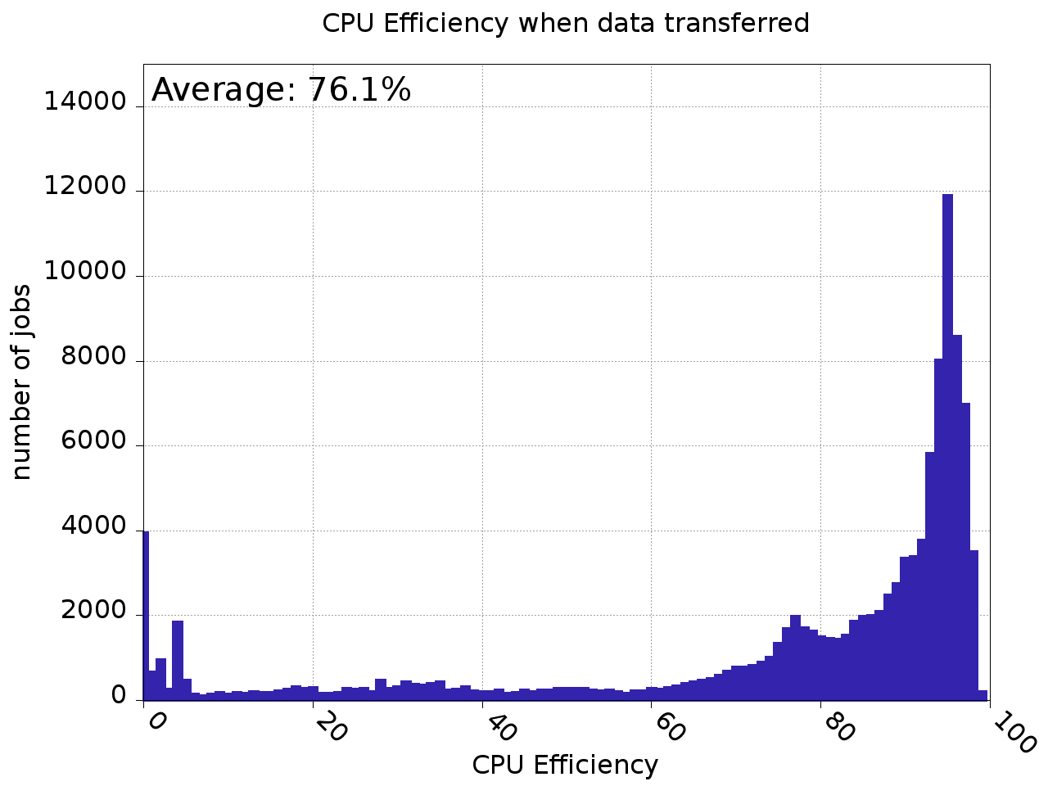


CPU Eff. when data copied from Fermilab

Slide 18
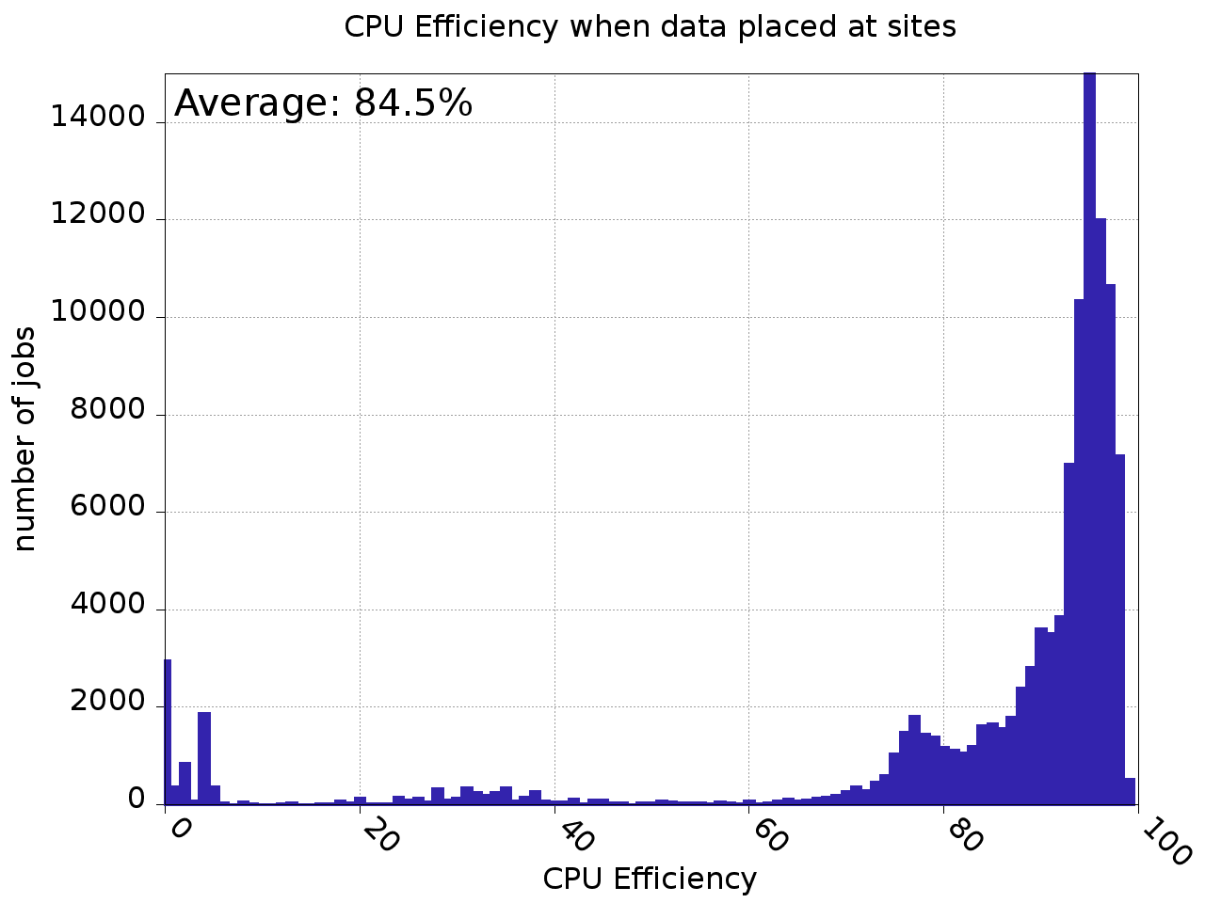


CPU Efficiency when data mostly preplaced

Slide 19
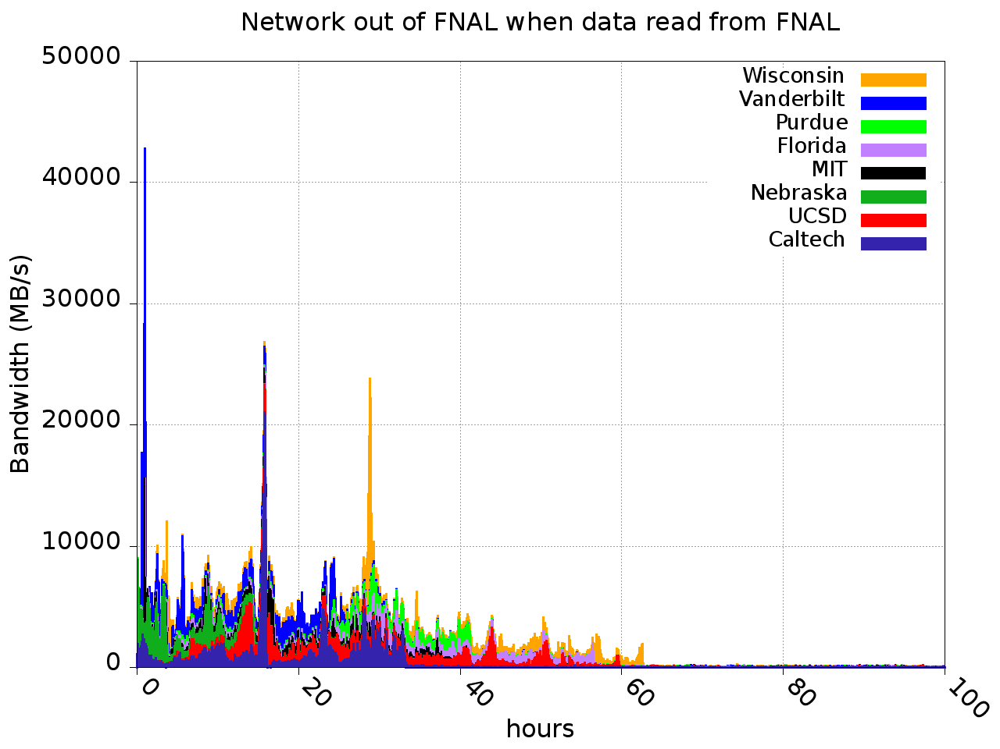
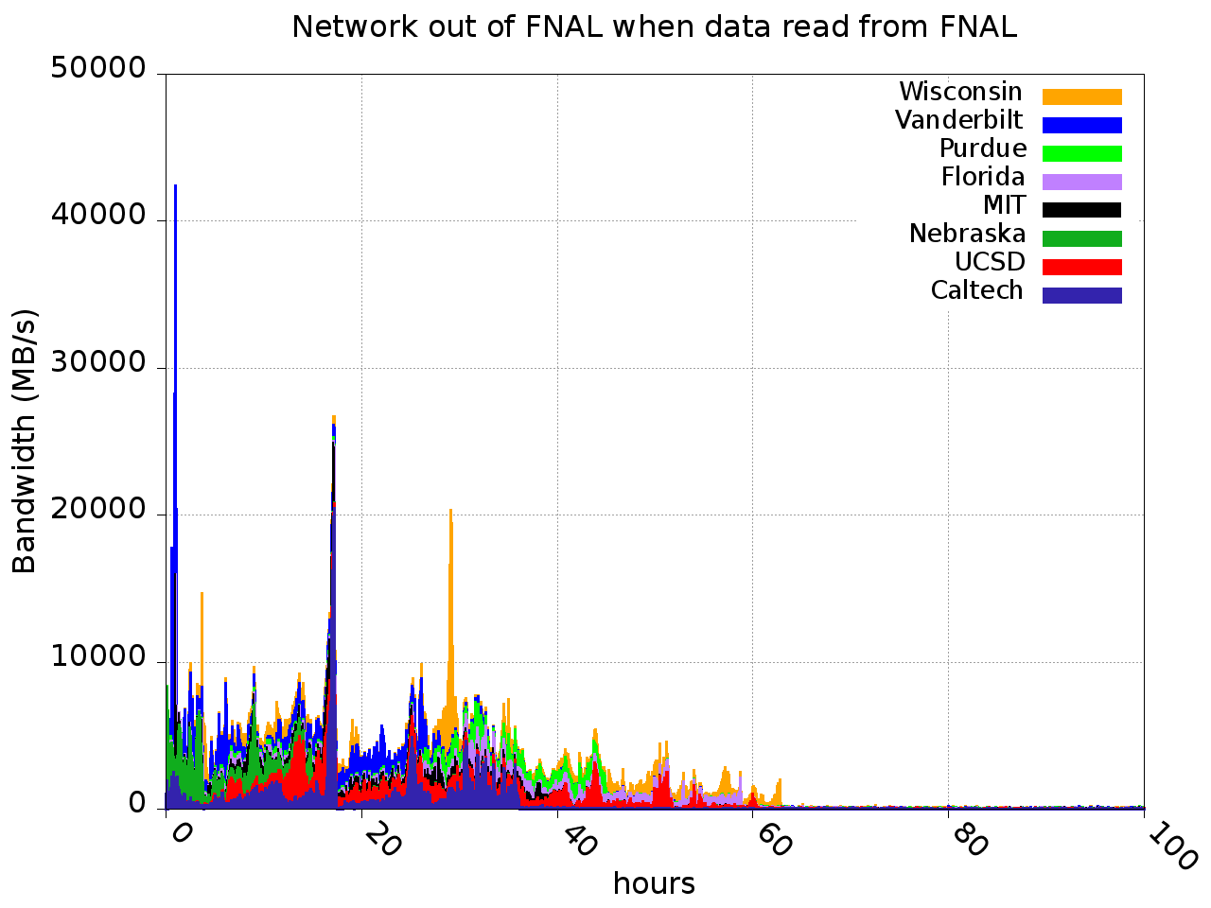
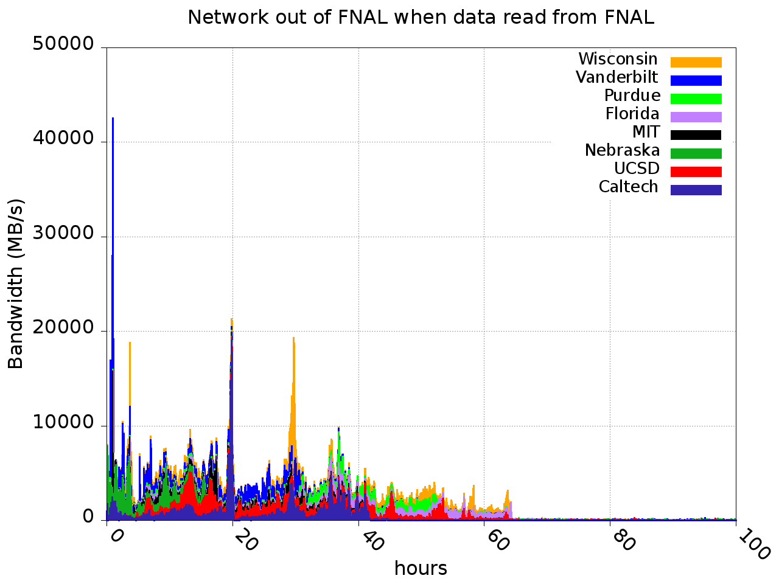
Rate from FNAL when data read from FNAL

Slide 20
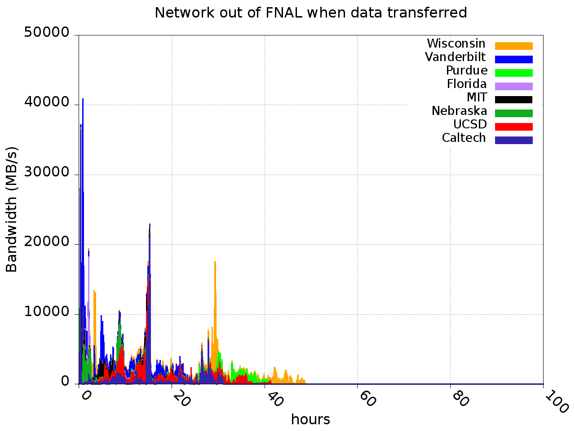


Rate from FNAL when data copied from FNAL

Slide 21
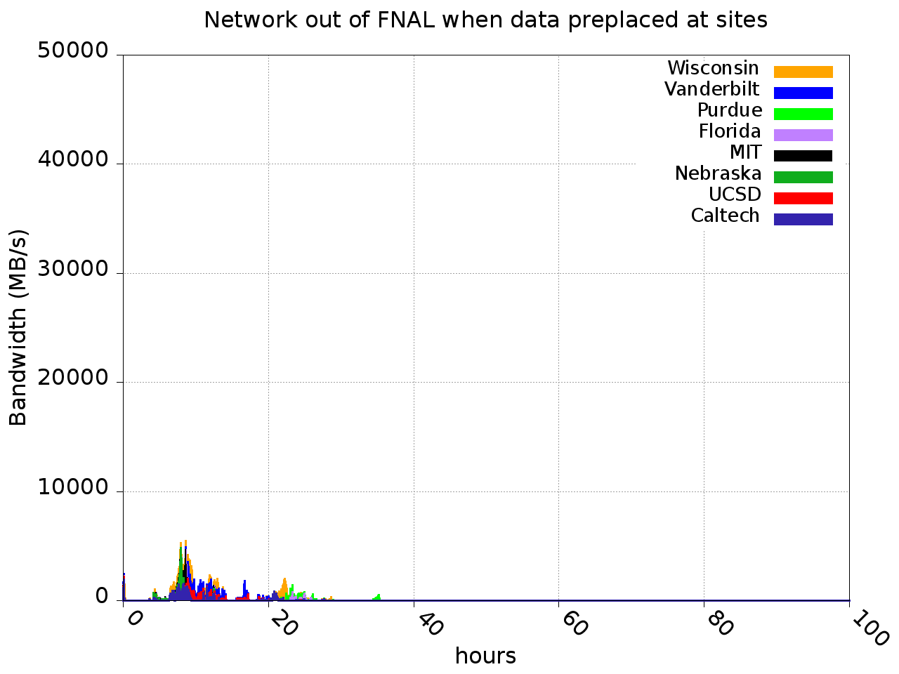
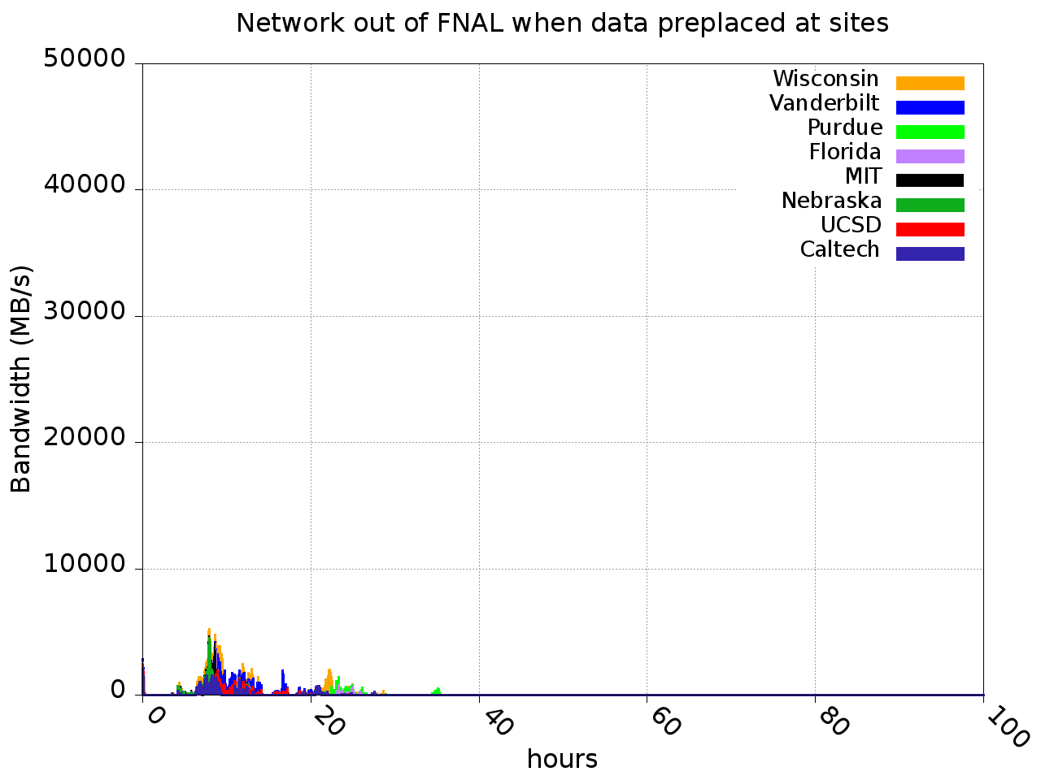

Rate from FNAL when data mostly preplaced

Slide 22
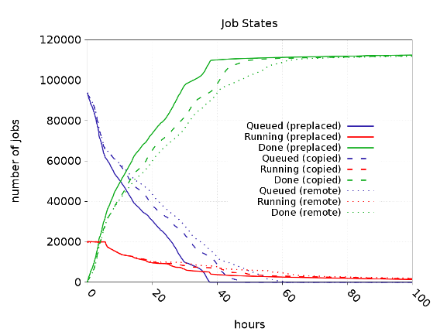

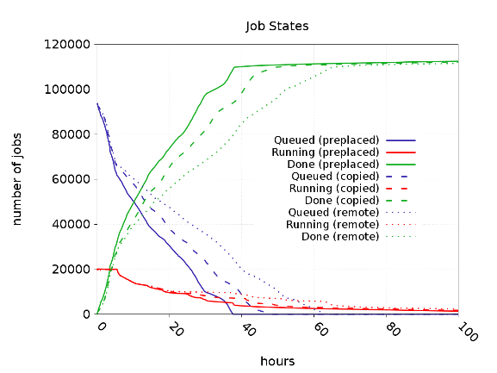






Job States

Slide 23
Summary
Can simulate CMS computing system
Concentrating on US infrastructure, simpler system to understand, and perhaps experiment on
  Eg Turn off local disk access for a short amount of time
Can use current infrastructure to determine input parameters better
Scale up job throughput to capacity of system

Slide 24
BACKUP SLIDES

Slide 25
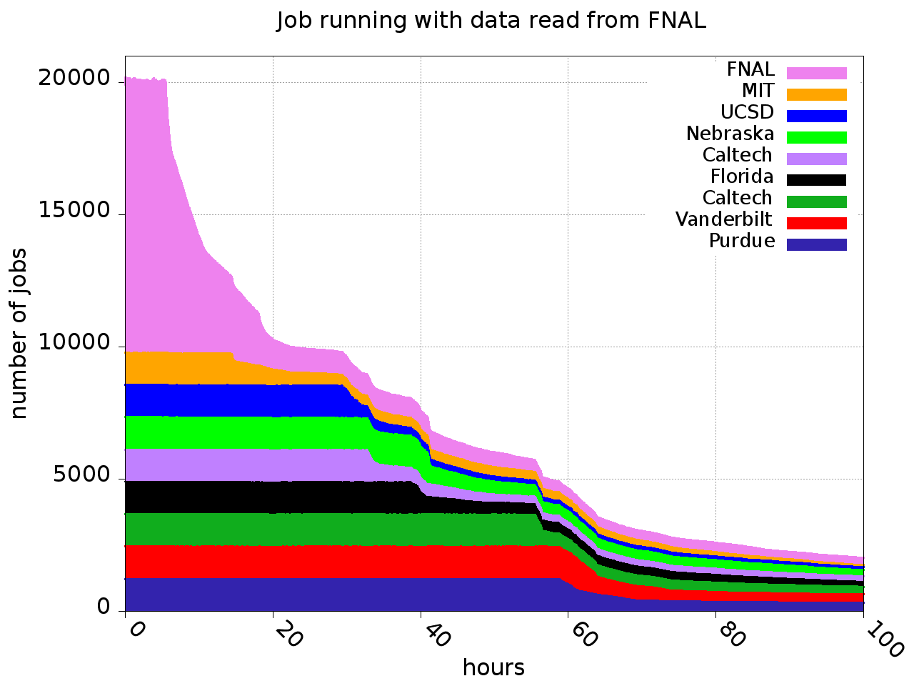
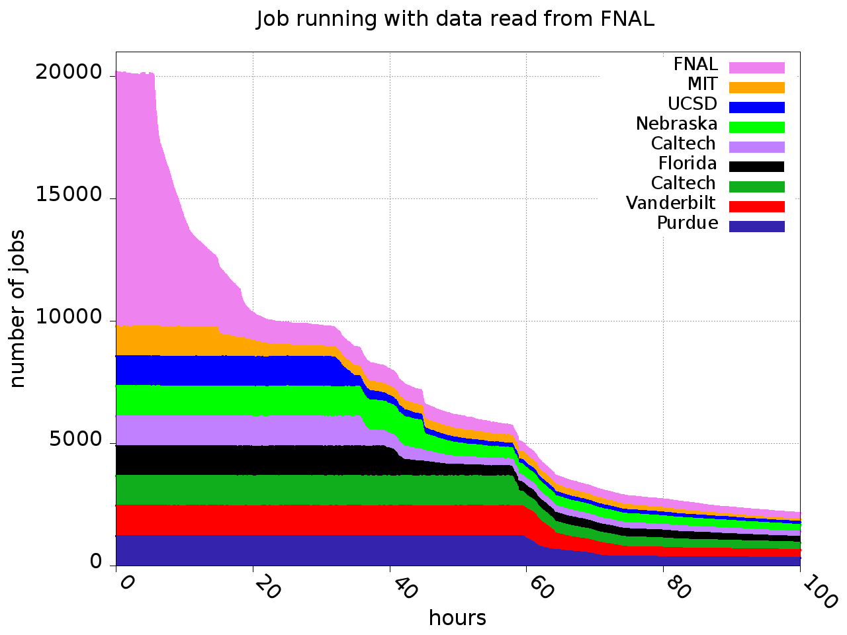
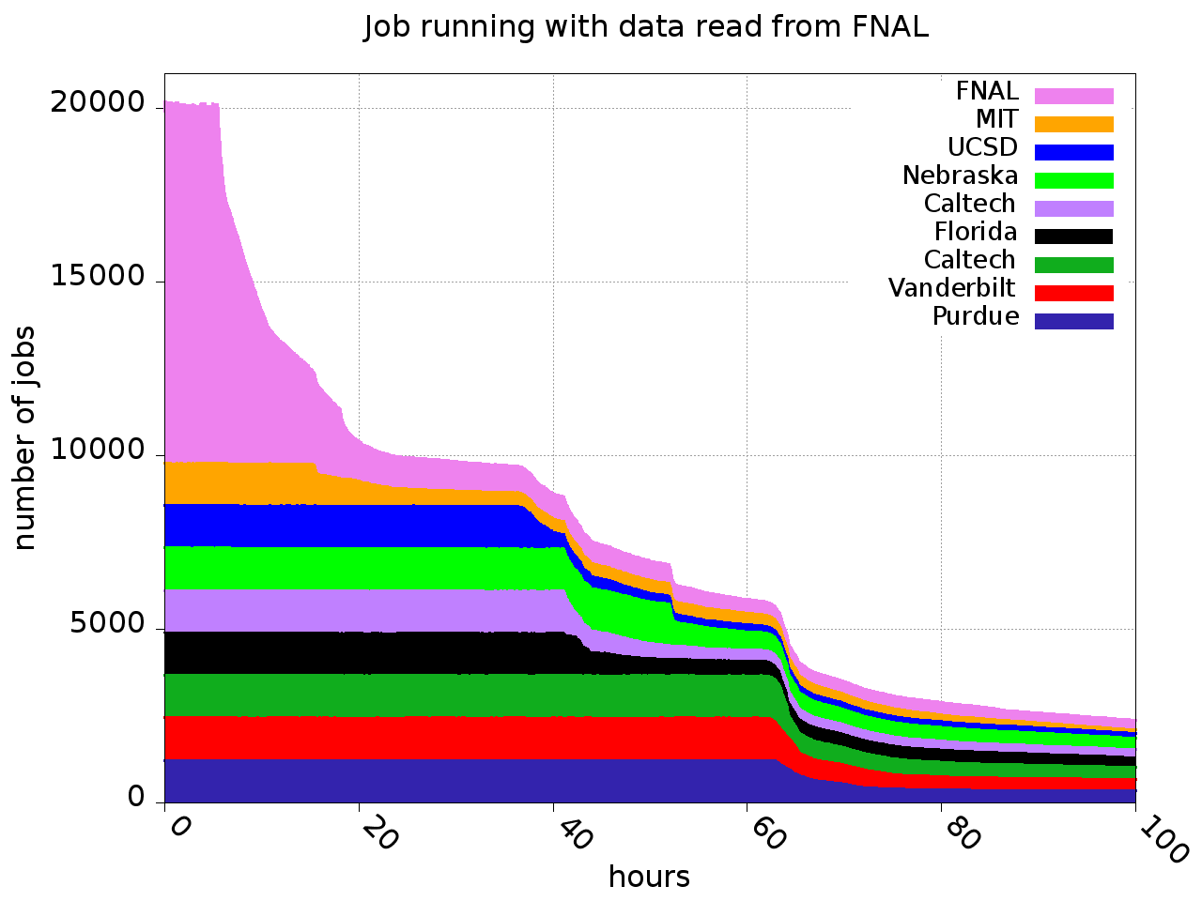
Jobs running when data read from FNAL

Slide 26
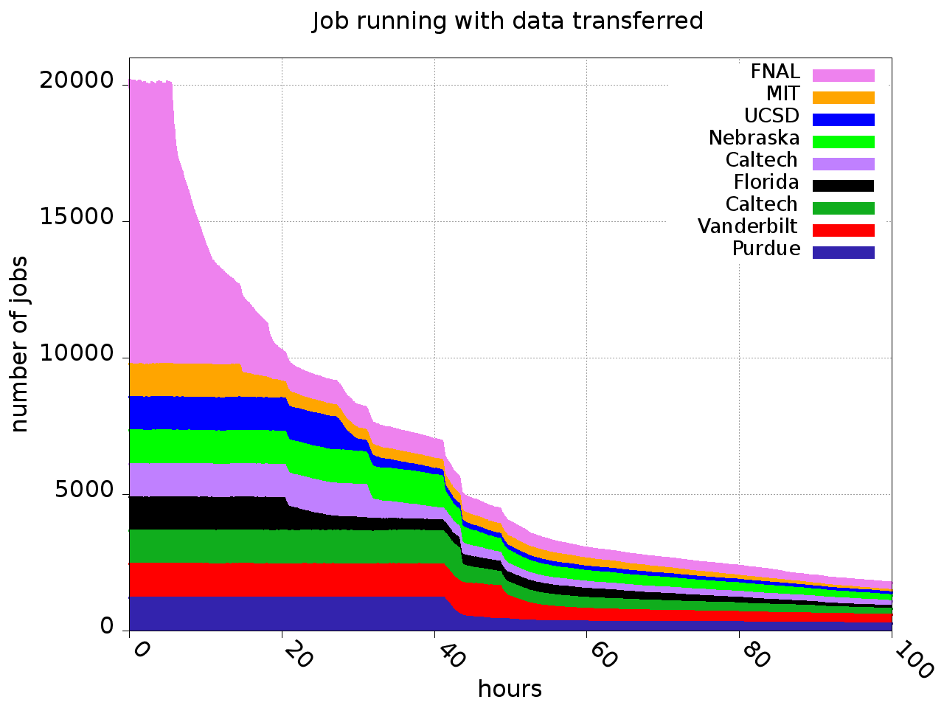


Jobs running when copied from FNAL

Slide 27
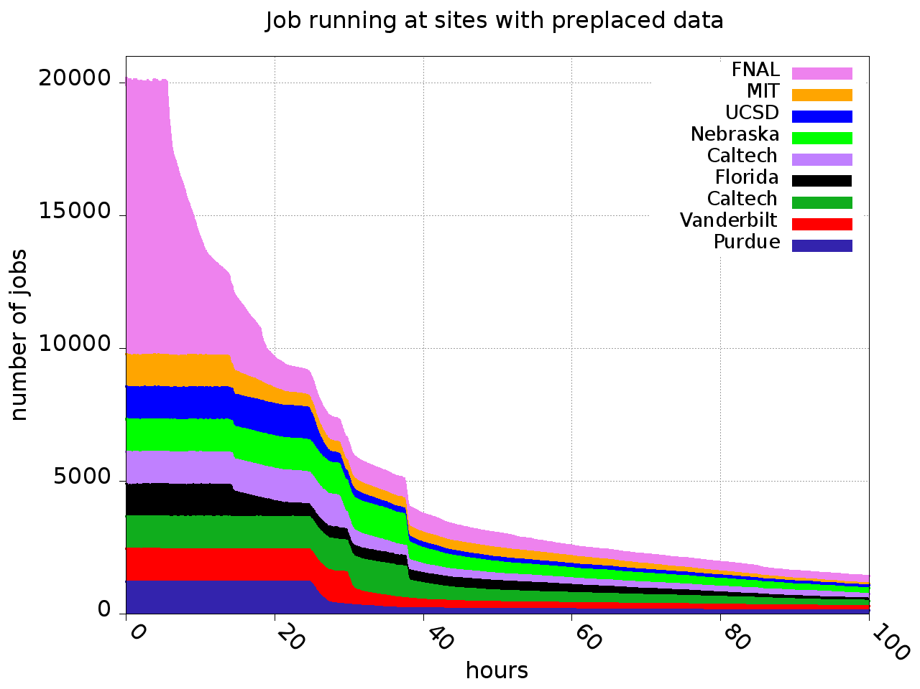


Jobs running when data mostly preplaced

Slide 28
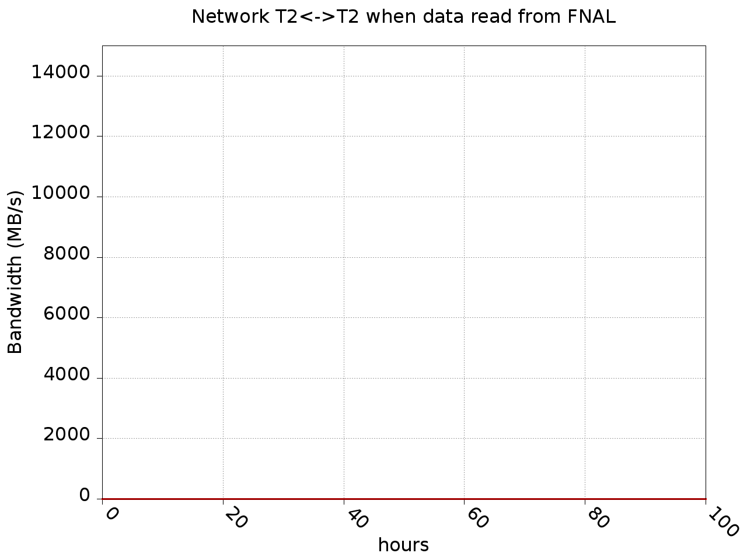
Inter-Tier2 rate when data read from FNAL

Slide 29
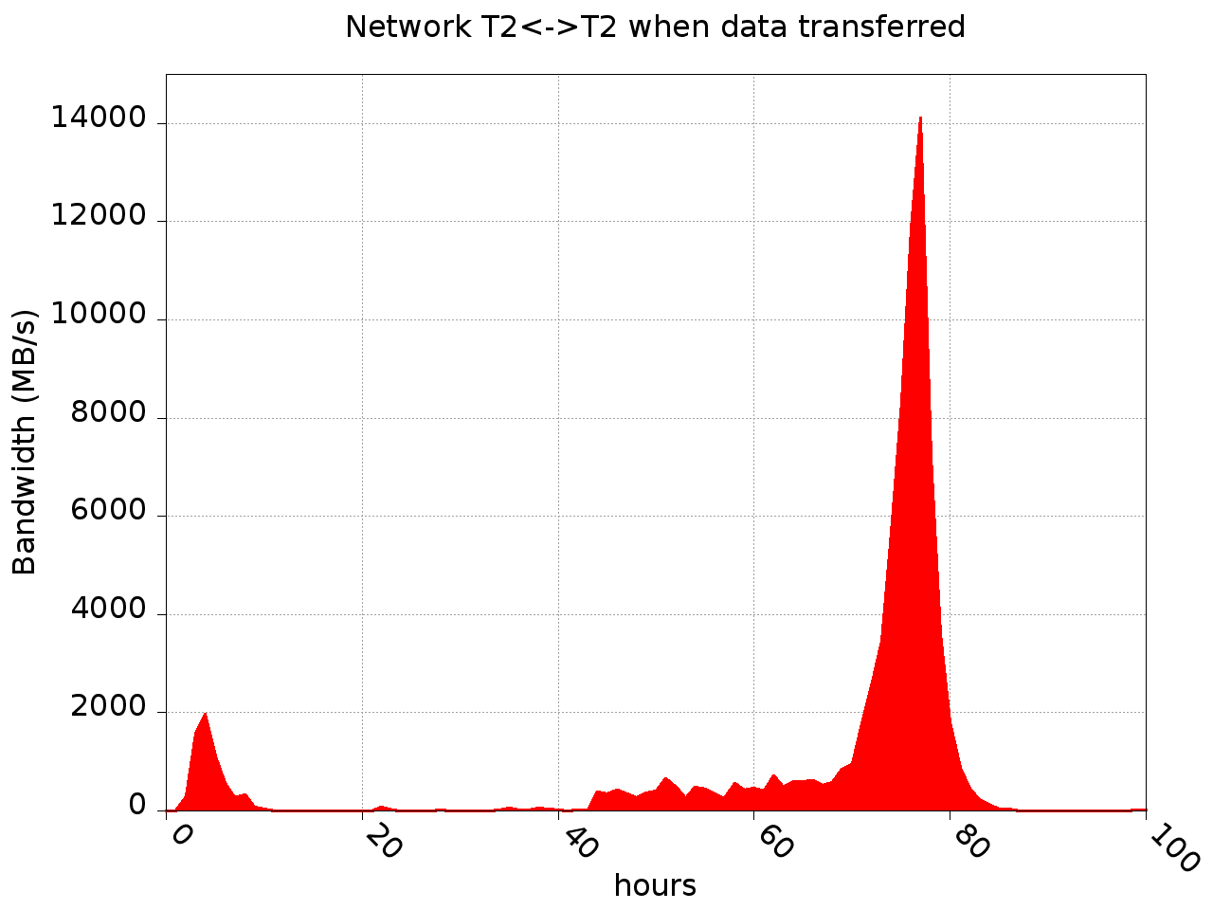
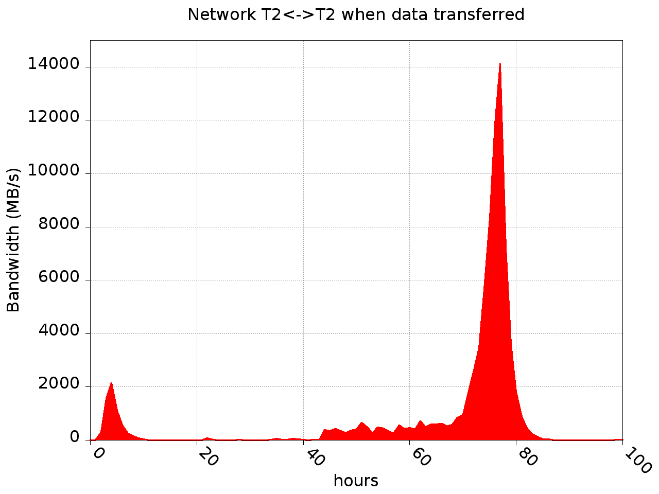

Inter-Tier2 rate when data copied from FNAL

Slide 30
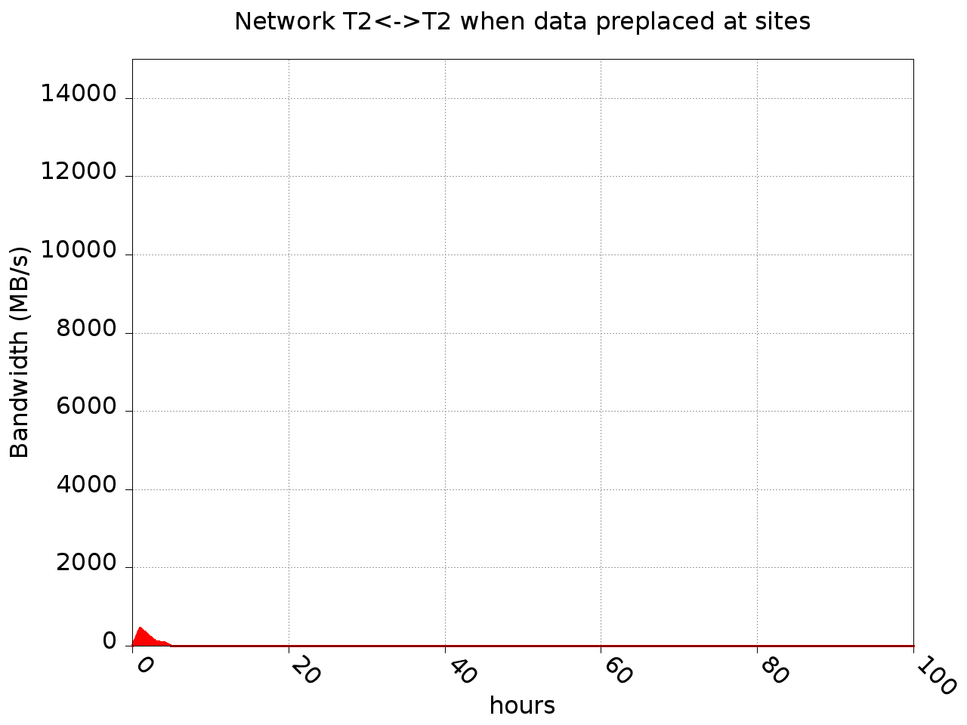
Inter-Tier2 rate when mostly preplaced

