Slide 1

Gentner Programme
Started October 2007
    after CERN visit of State Secretary Meyer-Krahmer from German BMBF (Federal Ministry of Education and Research)
  special German Doctoral Student Programme
    in addition to the existing CERN Doctoral Student Programme
    (almost) identical conditions
    basic difference: funding (subsistence) by BMBF, also extra funds for travel to Germany
  mid- and long term goals
    better usage of CERN resources by Germany
    better connection between German Universities and CERN
    more German staff at CERN (long-term)
      presently only ~7.3% German staff (184/2512), but ~20% contribution of DE to CERN budget
3 parties involved: CERN – BMBF – DESY
    Programme Coordination by DESY (Manfred Fleischer)
    + local Coordinator at CERN (MH)

Slide 2
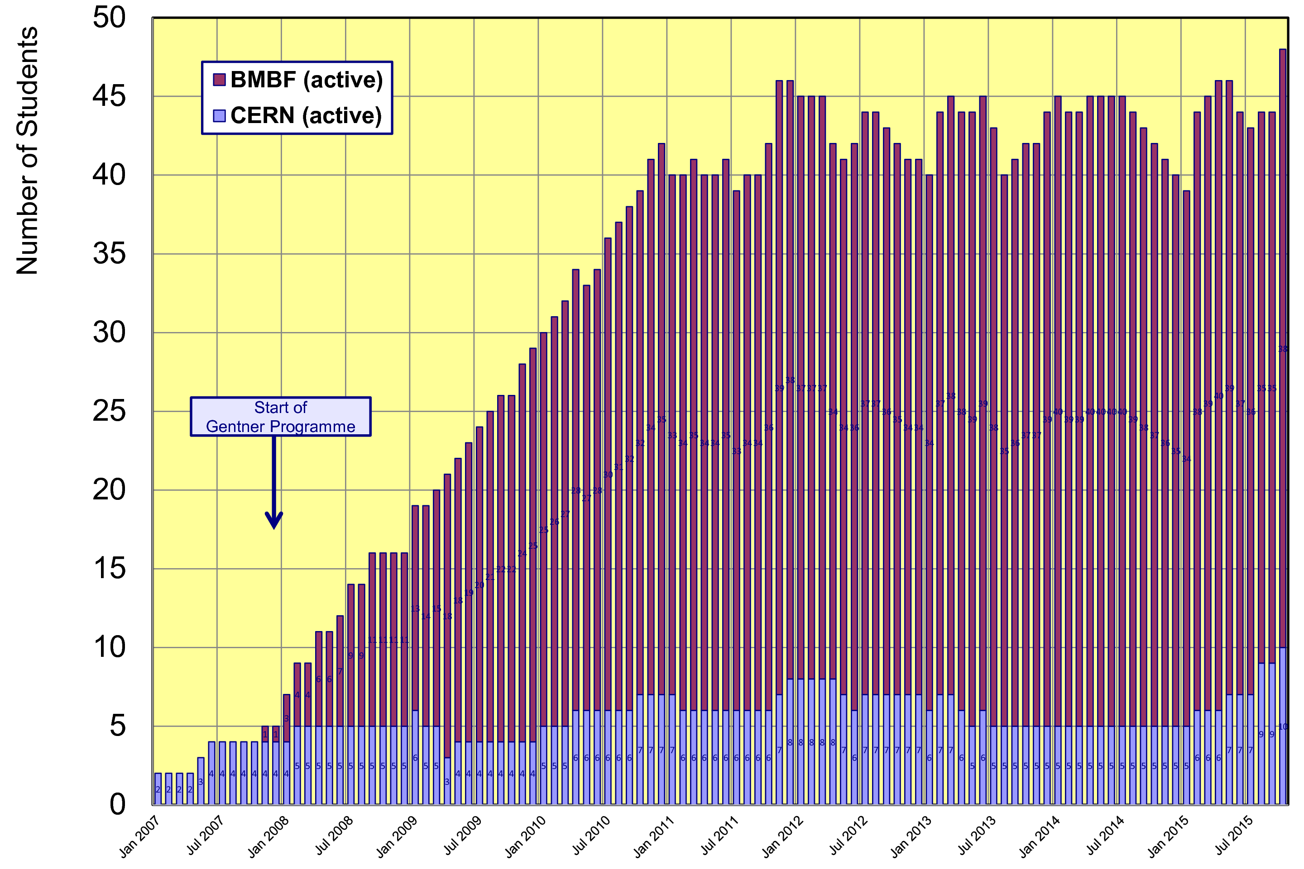
Status Gentner Programme
Presently 38 active Gentner Students (12 female = 32%)
    + 10 Germans in regular CERN Programme
    Number of Gentner Students ~stable since 2011

Slide 3
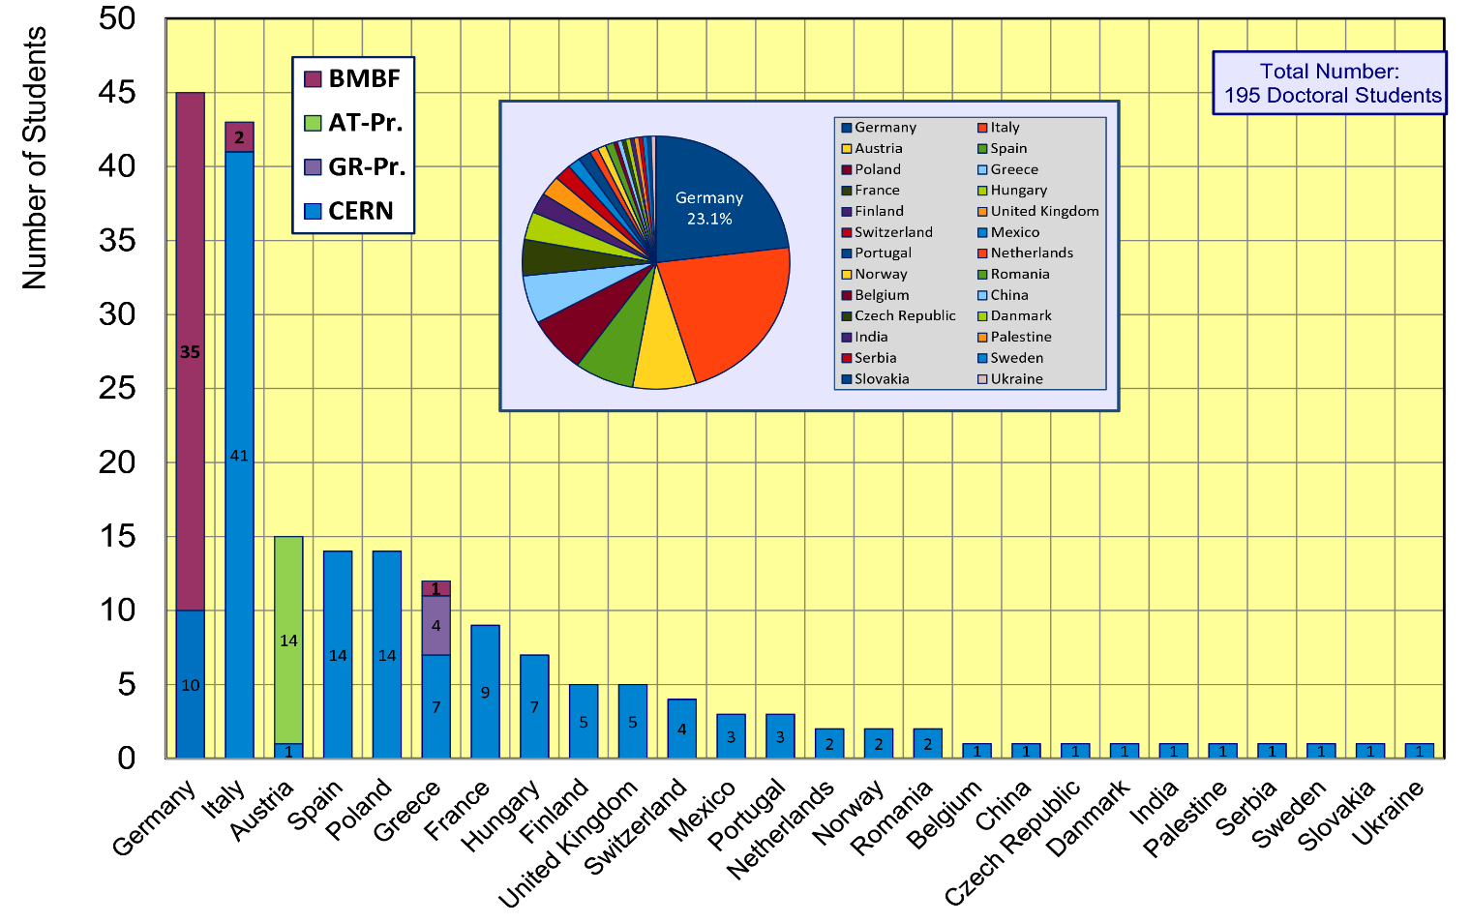
CERN Doctoral Students
Nationalities of all Doctoral Students at CERN
  Germany + Italy are dominating (~23% each)

Slide 4
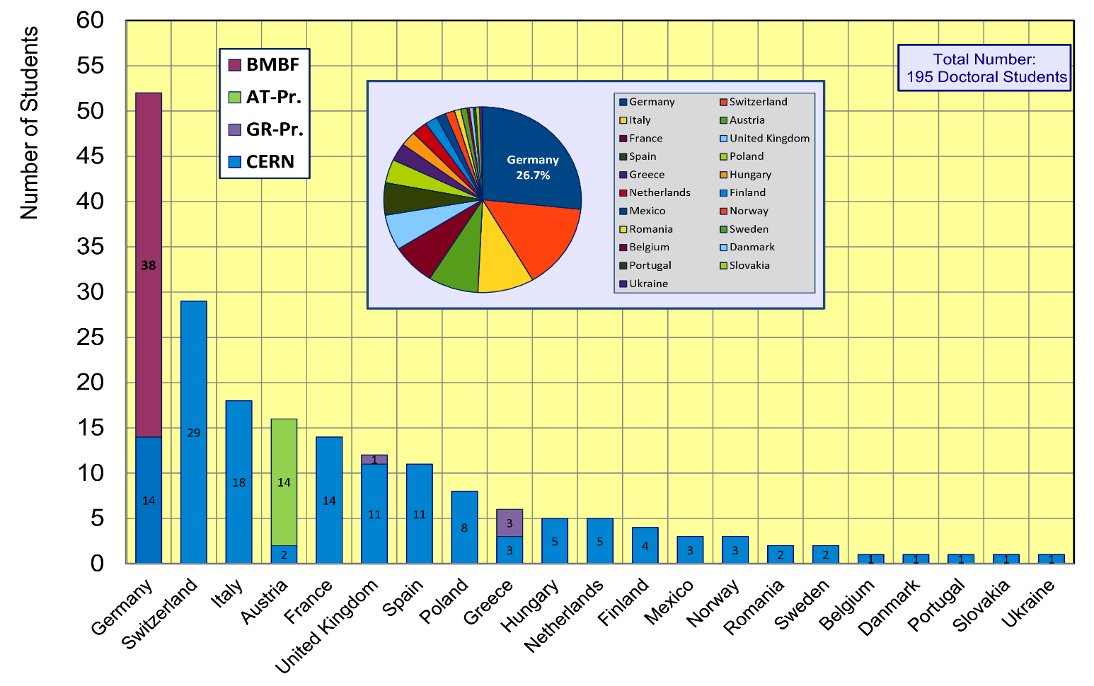
CERN Doctoral Students
Institute Country of all Doctoral Students
  Germany ahead of other countries (~27% at an institute in Germany)

Slide 5
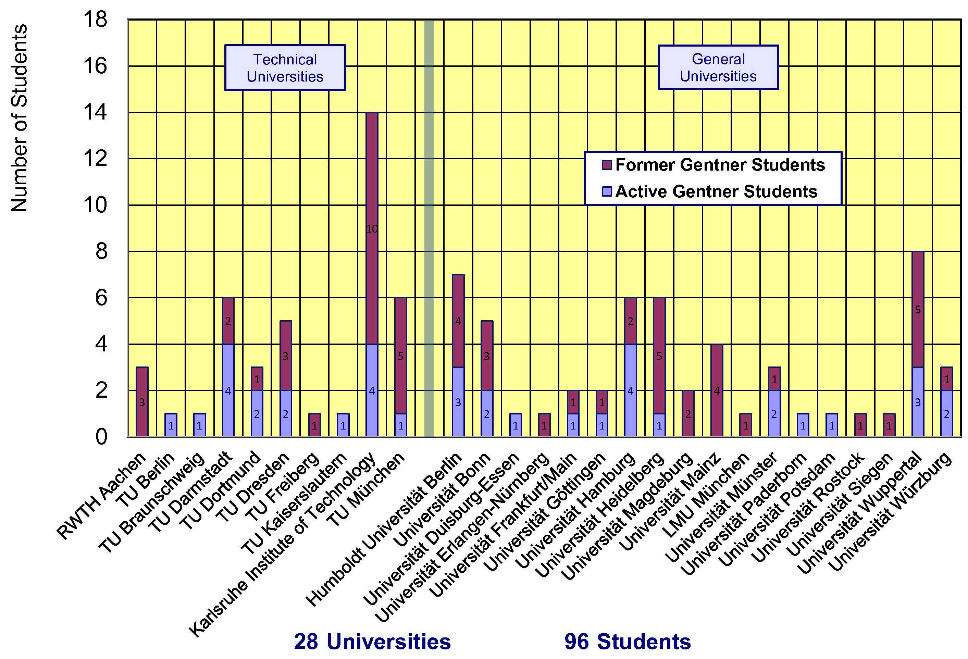
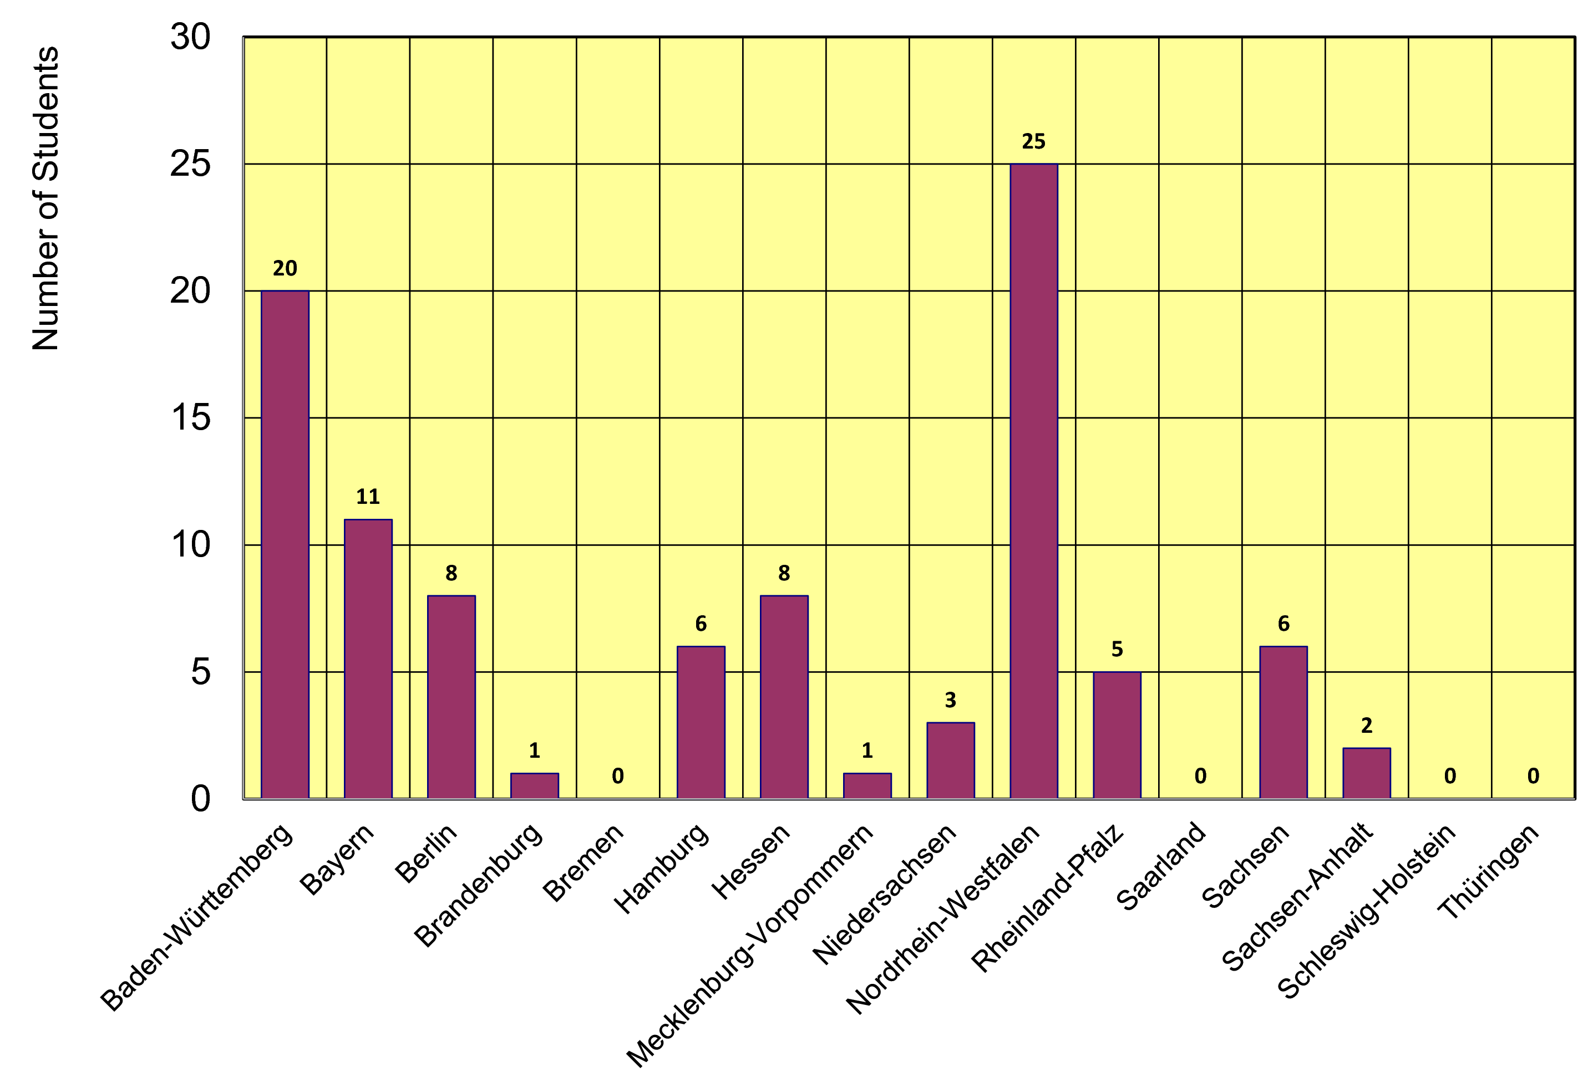
Gentner Students
  coming from 28 different Universities in DE
    also from university groups who had no or only little CERN contacts
  43% of Gentner Students from Technical Universities
  12 German States
    NRW and BW are dominating
    only a few small(er) States are missing

Slide 6
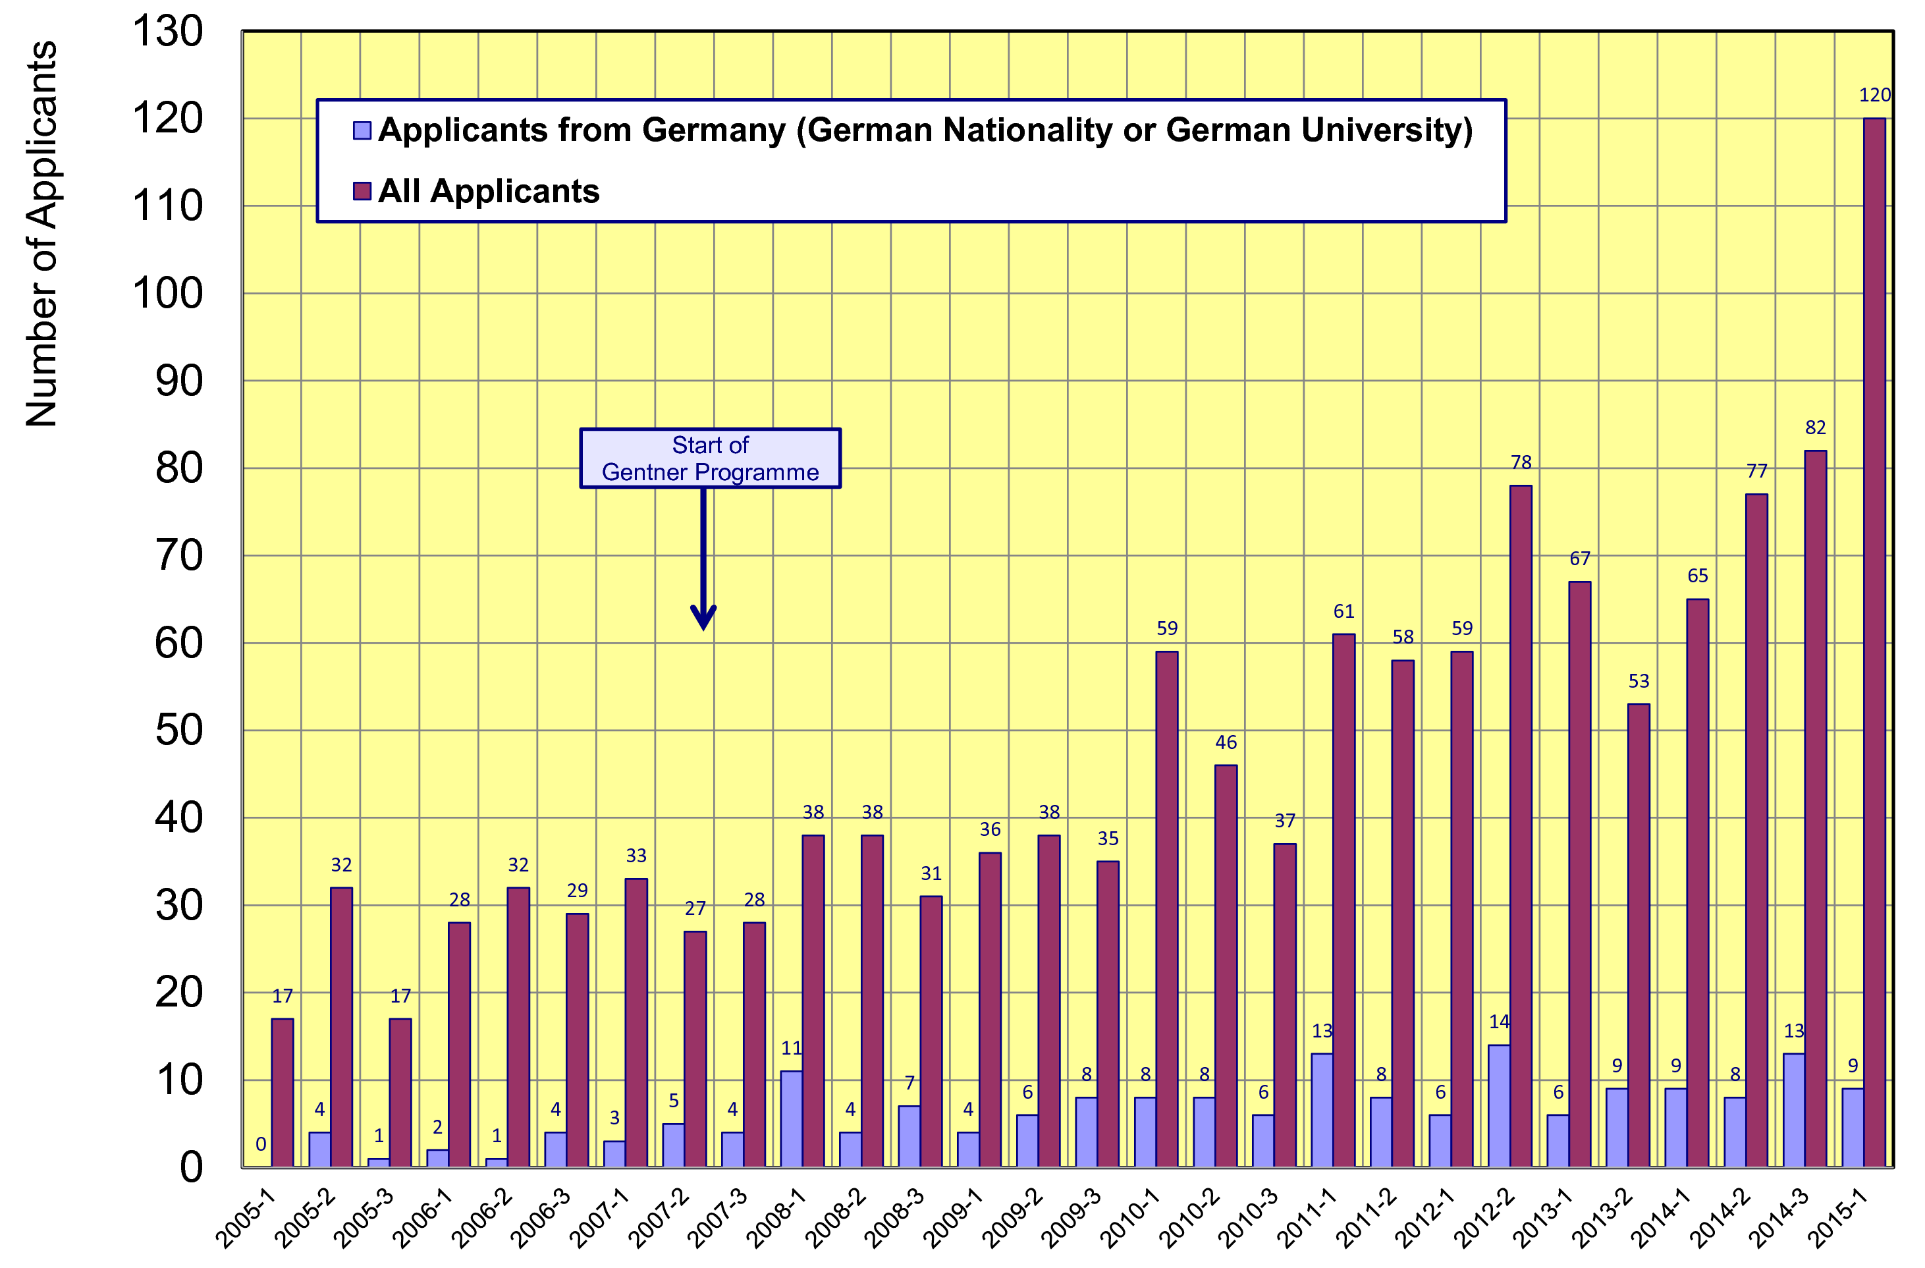
Doctoral Student Applications
  pre-Gentner (before 2007) about 8% from Germany
  post-Gentner (since 2008) about 15% from Germany

Slide 7
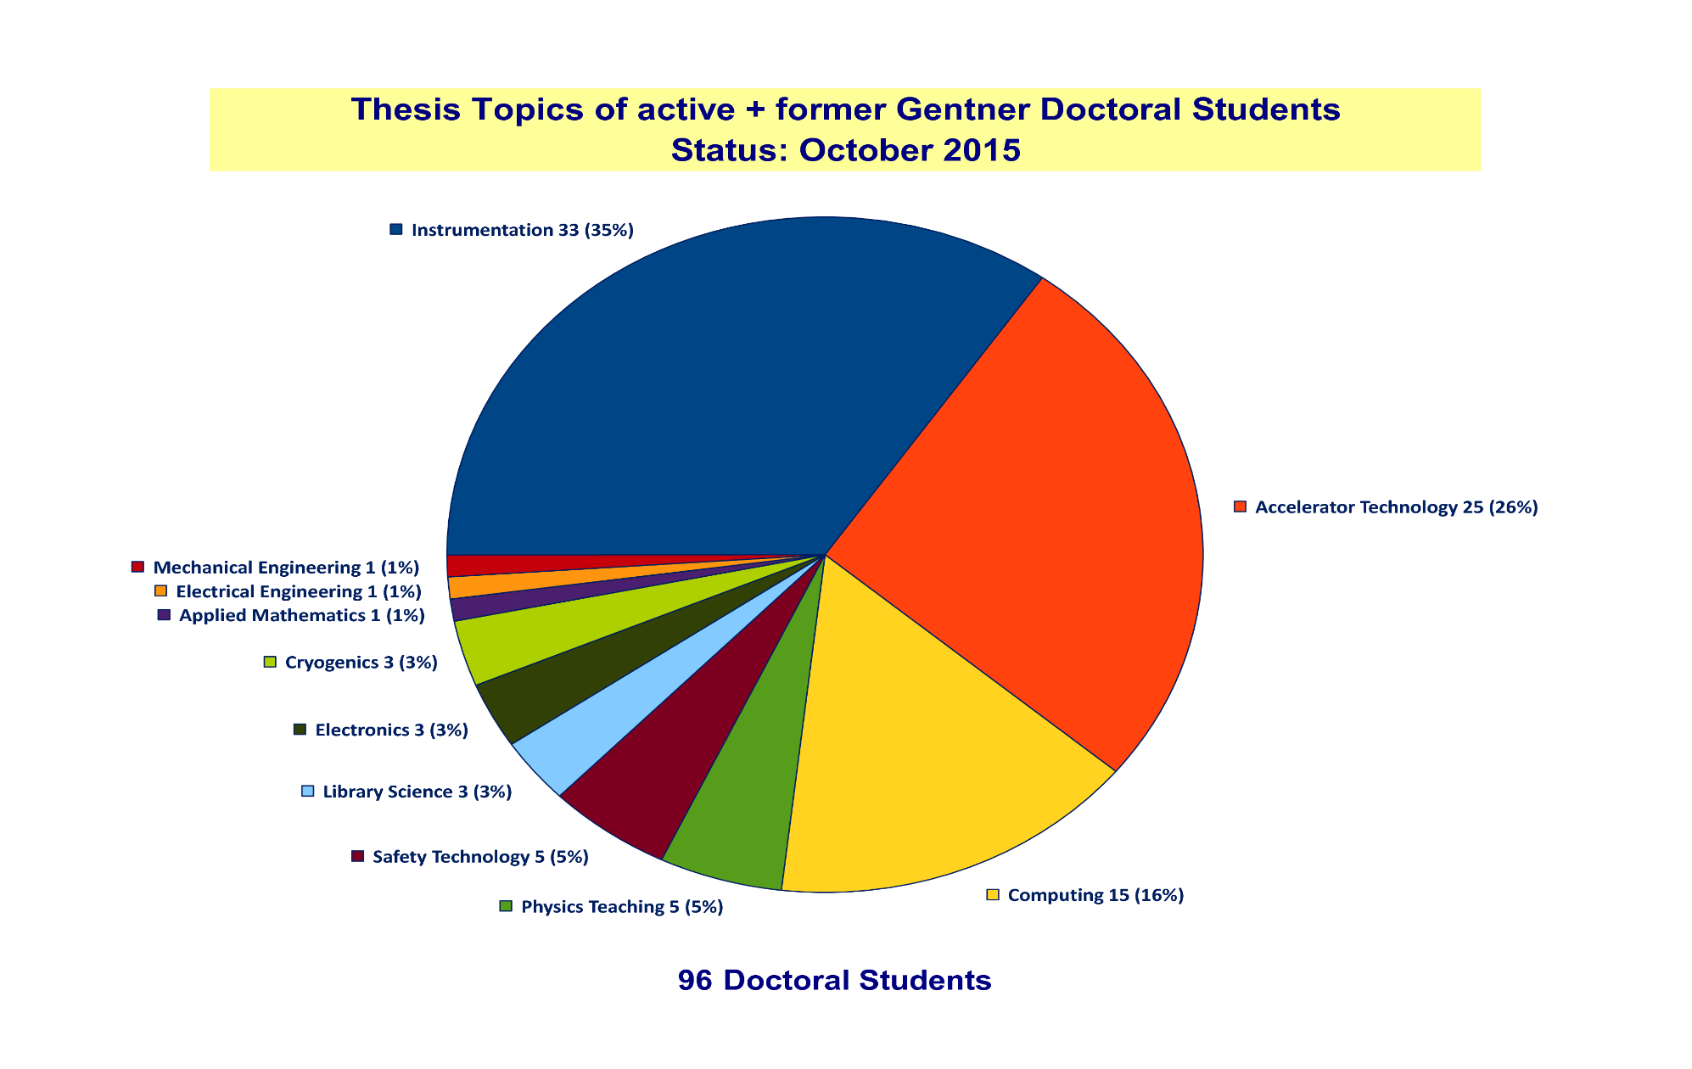
Thesis Topics of Gentner Students
(active + former)
Majority of topics in Instrumentation (35%), Accelerator Technology (26%), Computing (16%)

Slide 8
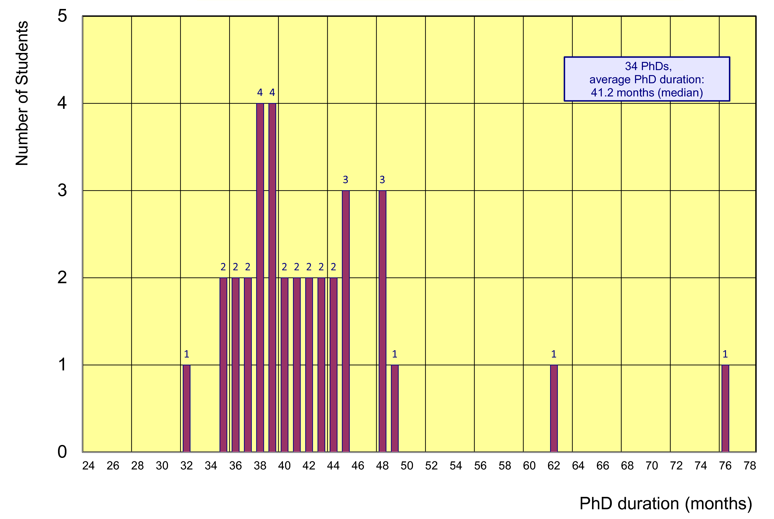
Former Gentner Students
34 PhDs so far (10 female = 29%), 3 Students have cancelled their PhD
    average age at PhD (defense): 30.7 years (median)
    average duration of PhD: 41.2 months (median) = 5.2 months after end of CERN 3-years contract
Physics PhDs in Germany (2014)
20% of PhDs students female
30.7 years (median) at PhD
50.4 months (median) duration of PhD

Slide 9
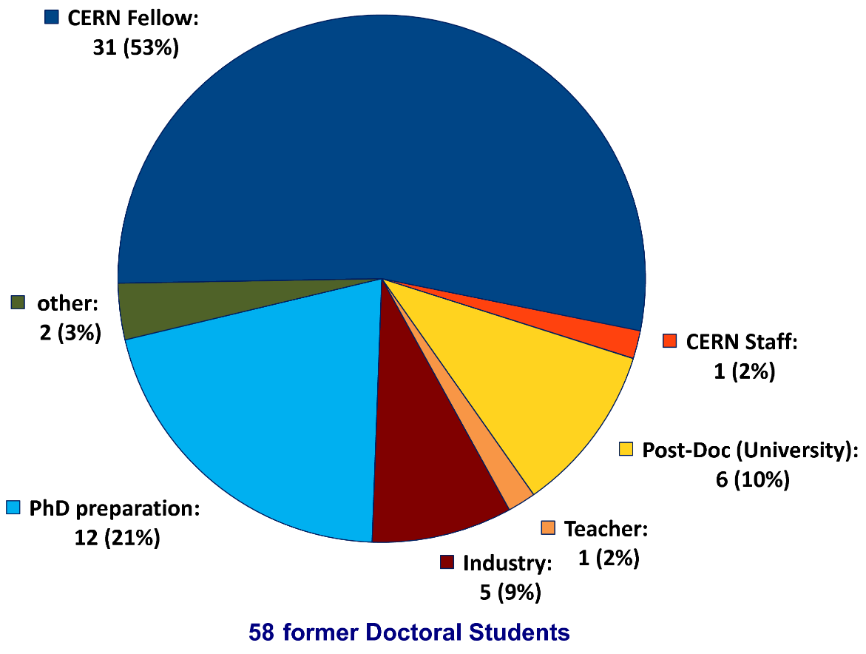
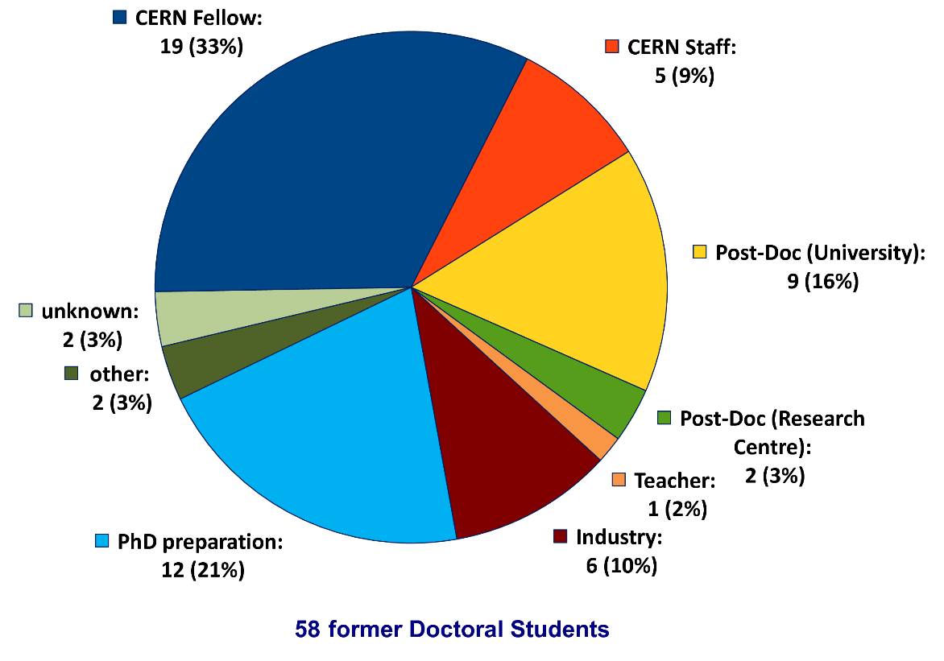
Whereabouts of Gentner Students
  First employment of >50% of the Gentner Students: CERN Fellow
First Employment
Present Employment
presently 5 CERN Staff Members

Slide 10
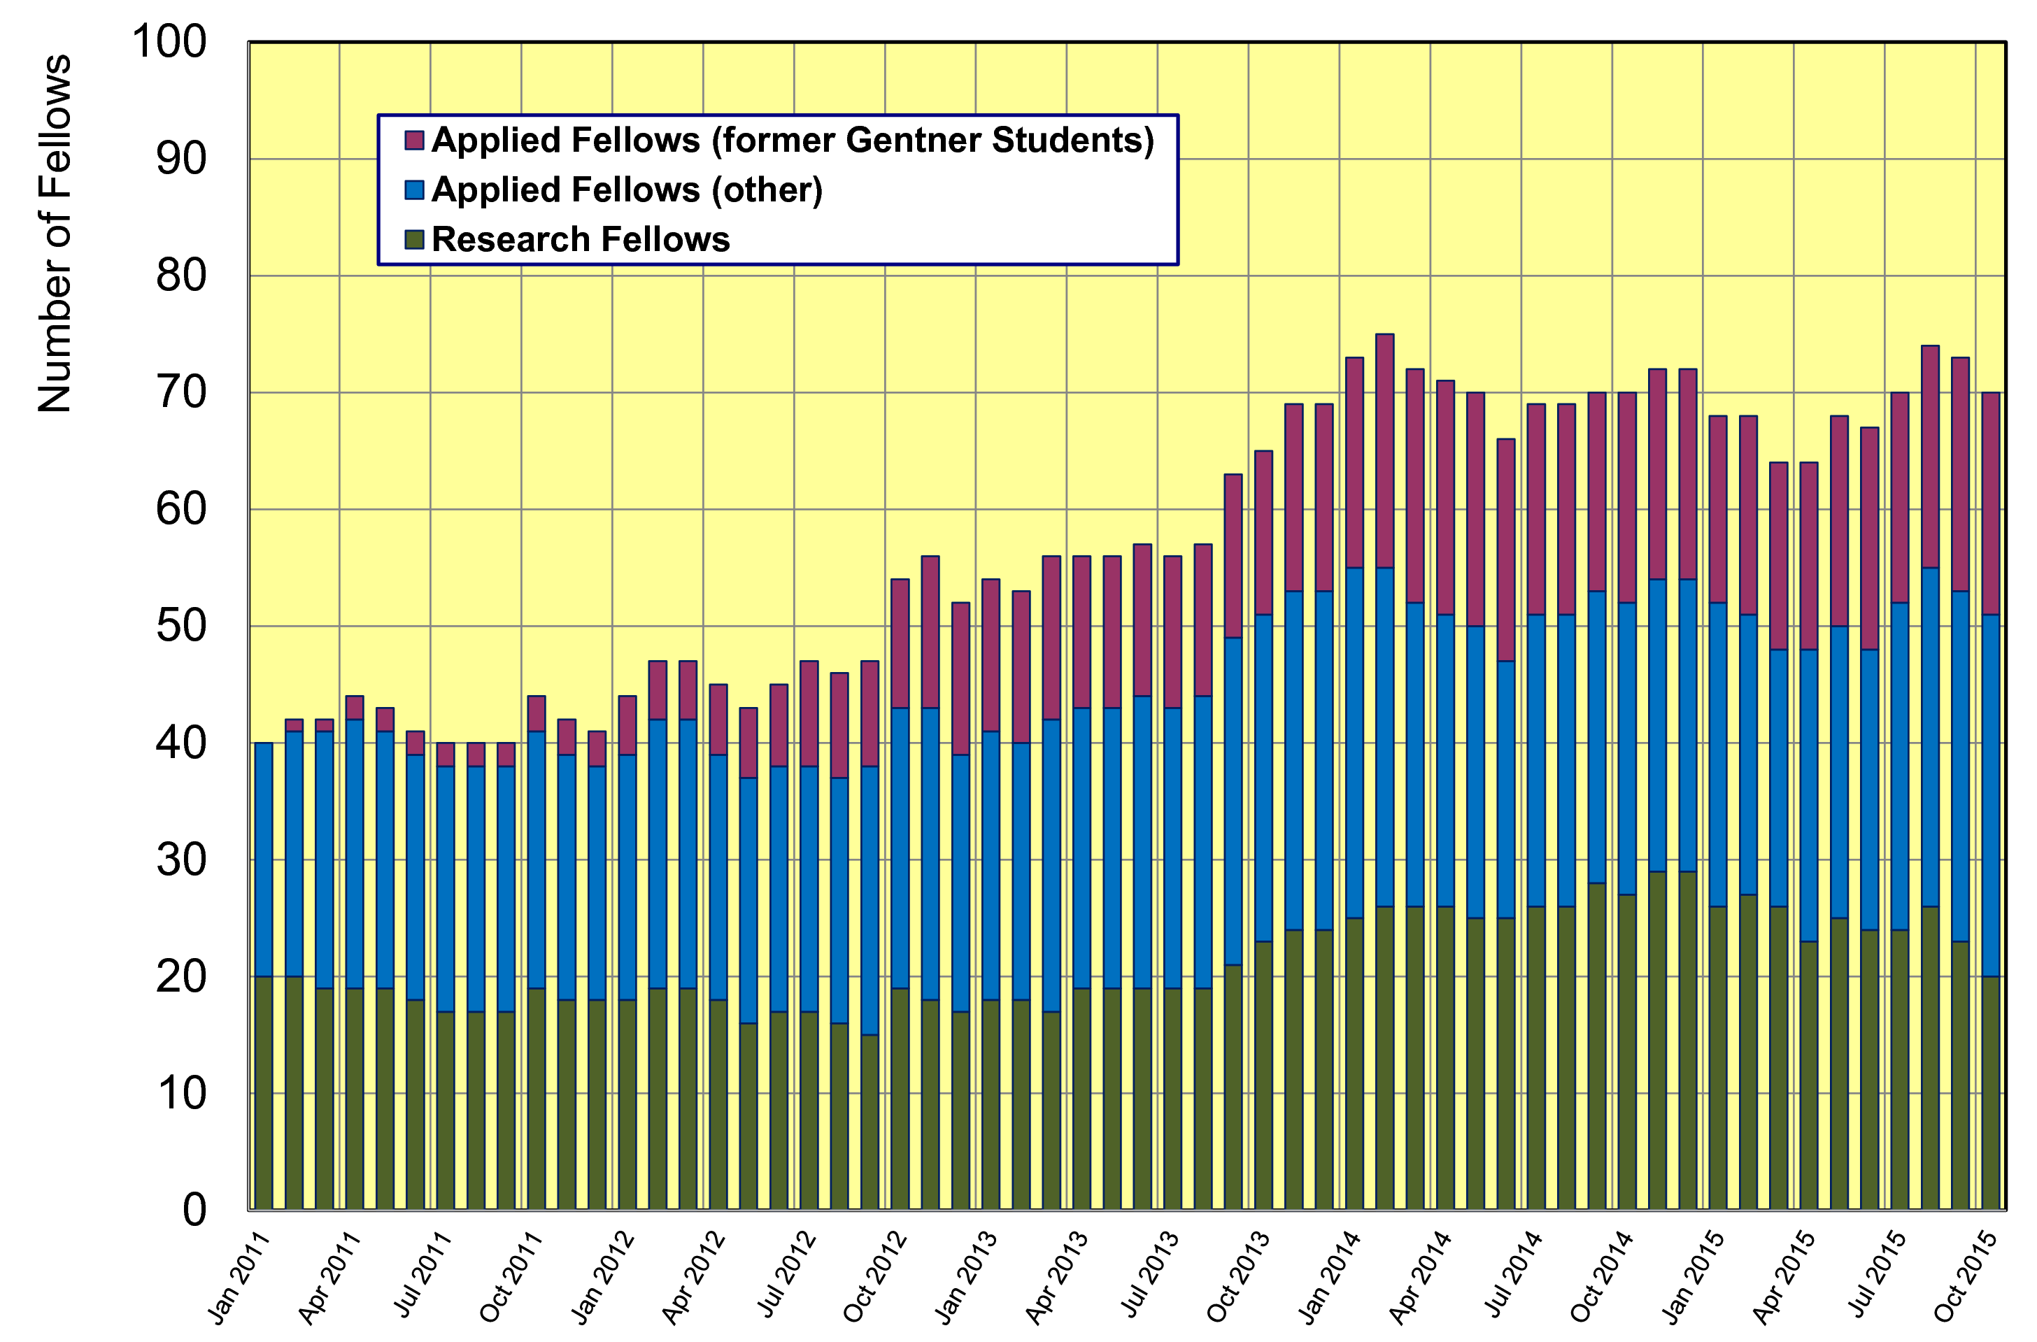
Gentner Students → Fellows
  significant increase of DE Fellows by former Gentner Students
    about 40% of German Applied Fellows are former Gentner Students

Slide 11
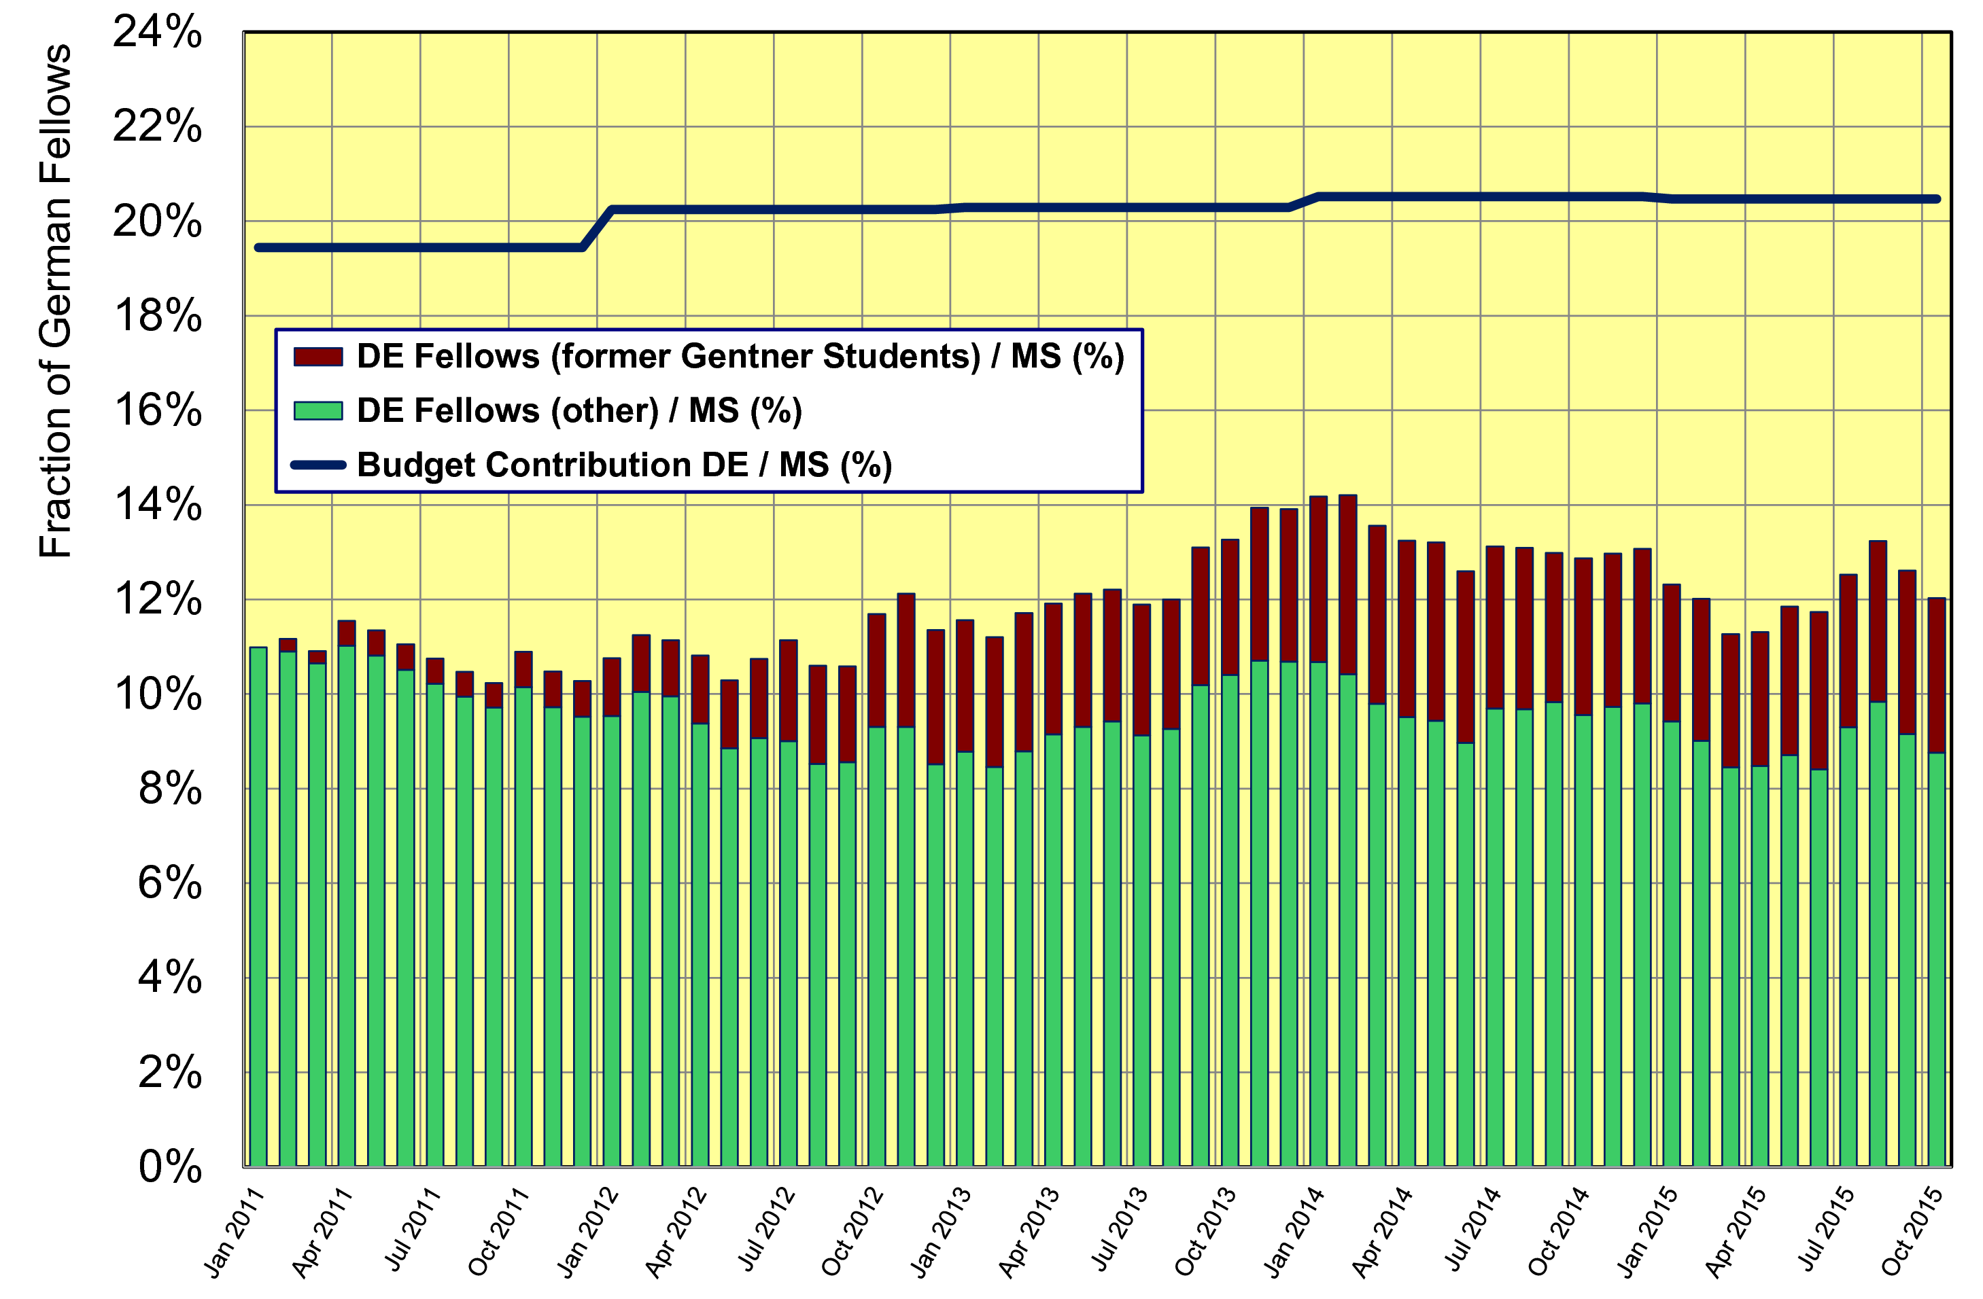
Gentner Doktoranden → Fellows
  without additional former Gentner Students → fraction of German Fellows w.r.t. to all Member States would be below <10%

Slide 12
Gentner Programme Continuation
Extension + funding secured until end of 2017
  contract renewal needed after 2017
  funding in 2015 - 2017: 5.15 M€
  funding was based on 1 € = 1.20 CHF, sufficient for (on average) 39 Students
Consequences of discontinuation of CHF–EUR minimum exchange rate by Swiss National Bank (if continueing on present level)
  no extra funding from BMBF to mitigate impact
    no consequences to present Students (don‘t be afraid): noone will be „fired“, support continues on same level for 3 years max., also beyond end of 2017
  long-term: need to slightly reduce overall number of Students
    reduction depends on future development of CHF–EUR exchange rate
  short-term: carefully follow situation + adapt at each selection round
    next deadline for applications: 30 October, selection board: 8 December, earliest start 1 February 2016

Slide 13

Misc
Gentner Webpage
  Some updates on FAQ: http://cern.ch/gentner/de/faq.php
  Logos from BMBF for presentations/posters: http://cern.ch/gentner/de/logos.php
Next German Physical Society Spring Meetings (DPG Tagung)
    Physics Education → Hannover, 29 February - 4 March 2016
    Particle Physics → Hamburg, 29 February - 4 March 2016
    Hadronic and Nuclear Physics, Accelerator Physics → Darmstadt, 14 - 18 March 2016
  deadline for abstracts: 1.12. (Hannover), 15.12. (Hamburg, Darmstadt)
    please send abstracts for talks/posters, travel paid by Gentner Programme
Gentner Broschure (in German) from 2013 reprinted
  (many) copies available at my office + A3 poster
    please contact me and collect them whenever you travel to your home university

Slide 14
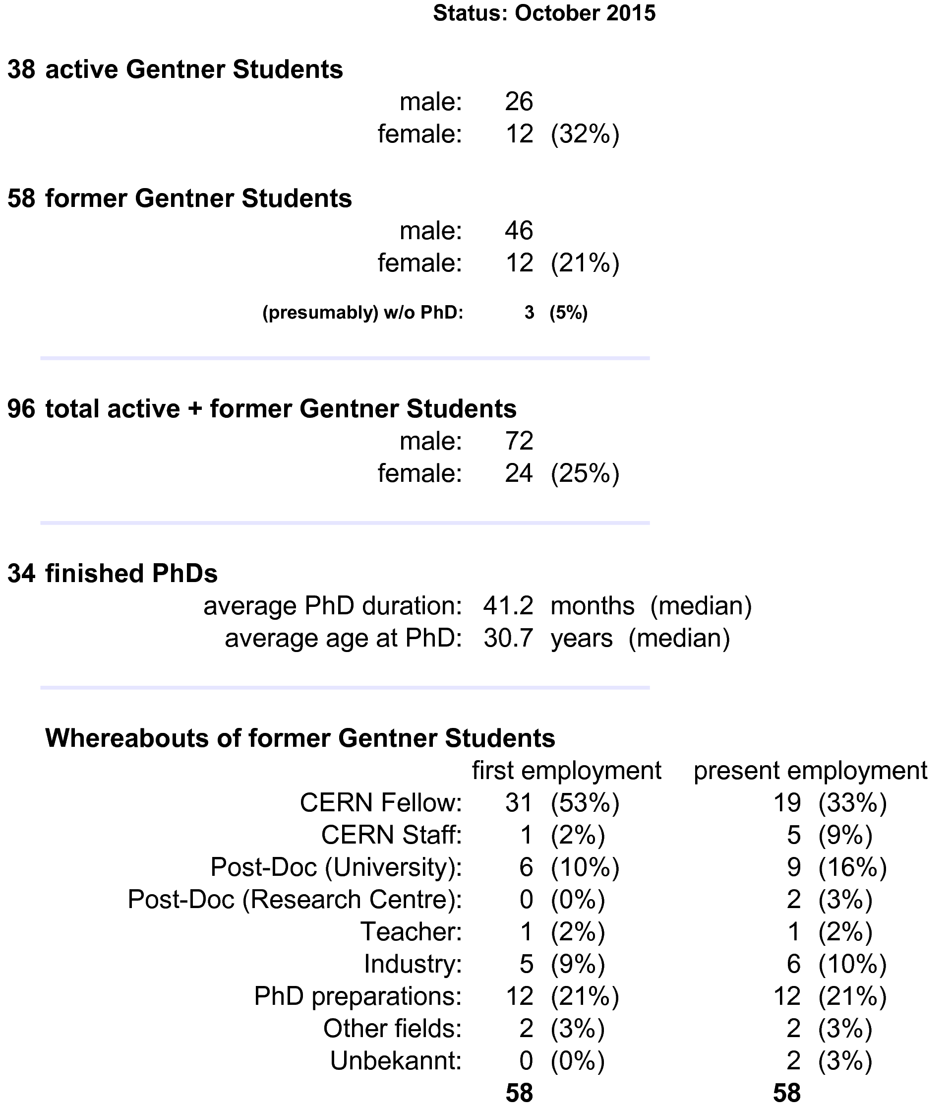
Summary Gentner Programme
Physics PhDs in Germany (2014)
20% of PhDs students female
30.7 years (median) at PhD
50.4 months (median) duration of PhD
CERN Fellows
≈ 40% of German Applied Fellows
are former Gentner Students

