Slide 1




A novel technique at the leading Penning trap mass spectrometer ISOLTRAP
Andree Welker
28.10.2015
8th Gentner Day

Slide 2

Outline
Motivation
Setup
Overview of ISOLDE
ISOLTRAP-Tools:
    Multi Reflection Time-of-Flight Separator/Spectrometer (MR-ToF)
  Precision Penning-Traps
New technique
Phase Imaging-Ion Cyclotron Resonance Technique (PI-ICR)
First results
Conclusion
Andree Welker, 8th Gentner Day 2015, CERN, 28.10.2015
1

Slide 3
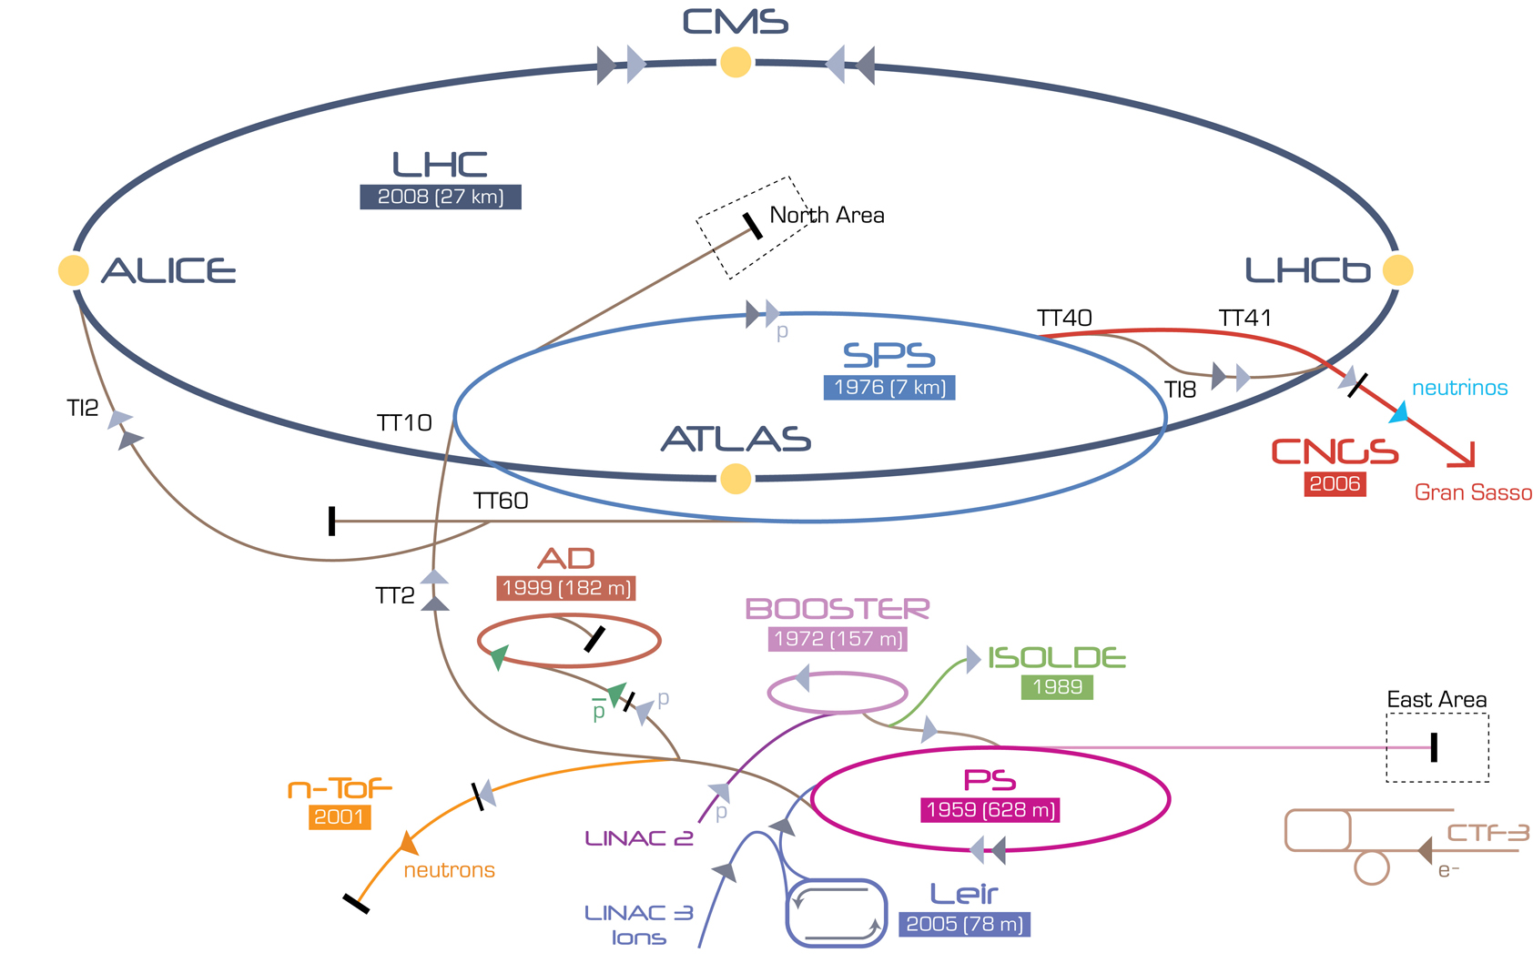
ISOLTRAP@ISOLDE@CERN
Andree Welker, 8th Gentner Day 2015, CERN, 28.10.2015
2

Slide 4
ISOLTRAP@ISOLDE@CERN
Andree Welker, 8th Gentner Day 2015, CERN, 28.10.2015
2

Slide 5
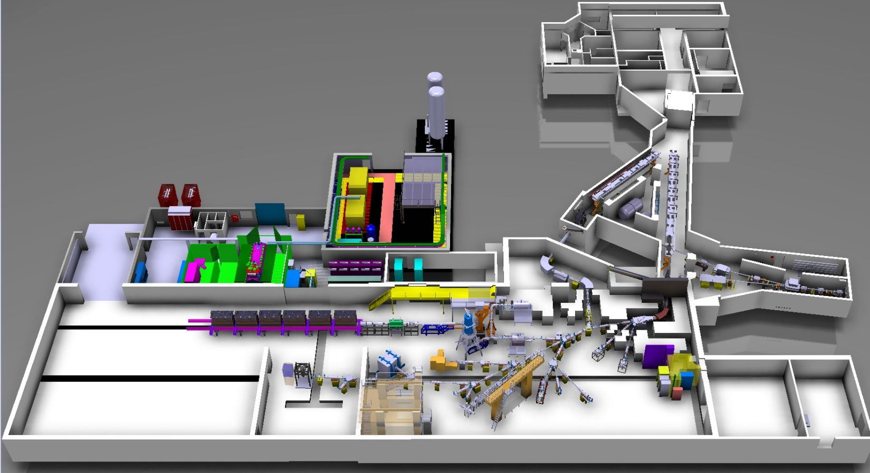
ISOLTRAP@ISOLDE@CERN
HRS
1.4-GeV protons
from PSB
GPS
Radioactive beams
ISOLTRAP
Andree Welker, 8th Gentner Day 2015, CERN, 28.10.2015
3

Slide 6
Nuclides
K.Blaum
Andree Welker, 8th Gentner Day 2015, CERN, 28.10.2015
4

Slide 7
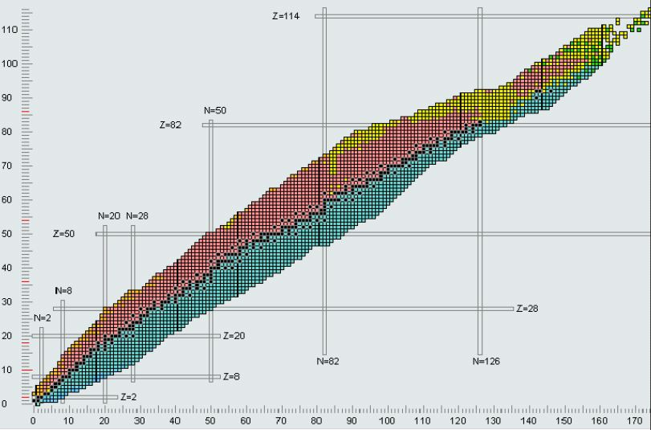
Table of Nuclides
Andree Welker, 8th Gentner Day 2015, CERN, 28.10.2015
Nucleonica.net
4

Slide 8
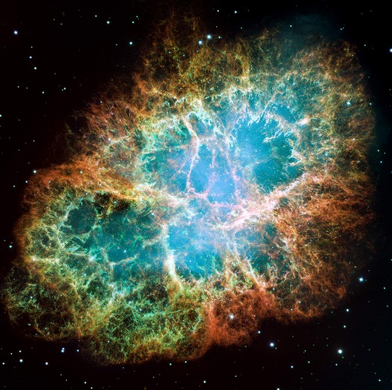
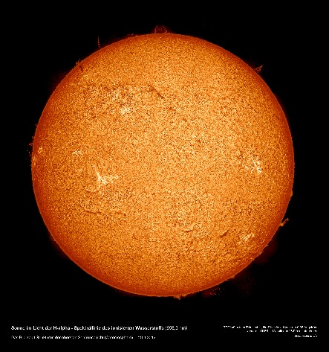
Table of Nuclides
Evolution of Universe
Shell structure of Nuclides
Possible Neutrino masses
CKM matrix element calculation
Masses help to understand:
Crab Nebula
Our Sun
Andree Welker, 8th Gentner Day 2015, CERN, 28.10.2015
Nucleonica.net
sdo.gsfc.nasa.gov
5

Slide 9
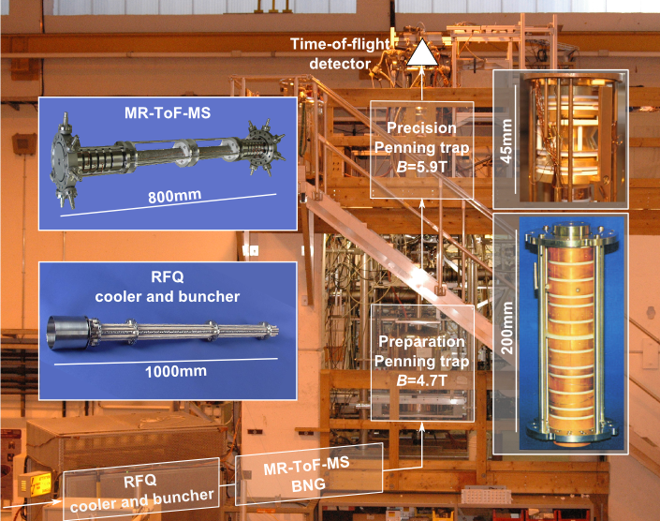
ISOLTRAP@ISOLDE@CERN
1987
2010
1999
1994
M. Mukherjee et al., Eur. Phys. J. A 35, 1 (2008), S. Kreim et al., Nucl. Instrum. Methods B 317, 492 (2013).
Andree Welker, 8th Gentner Day 2015, CERN, 28.10.2015
6

Slide 10
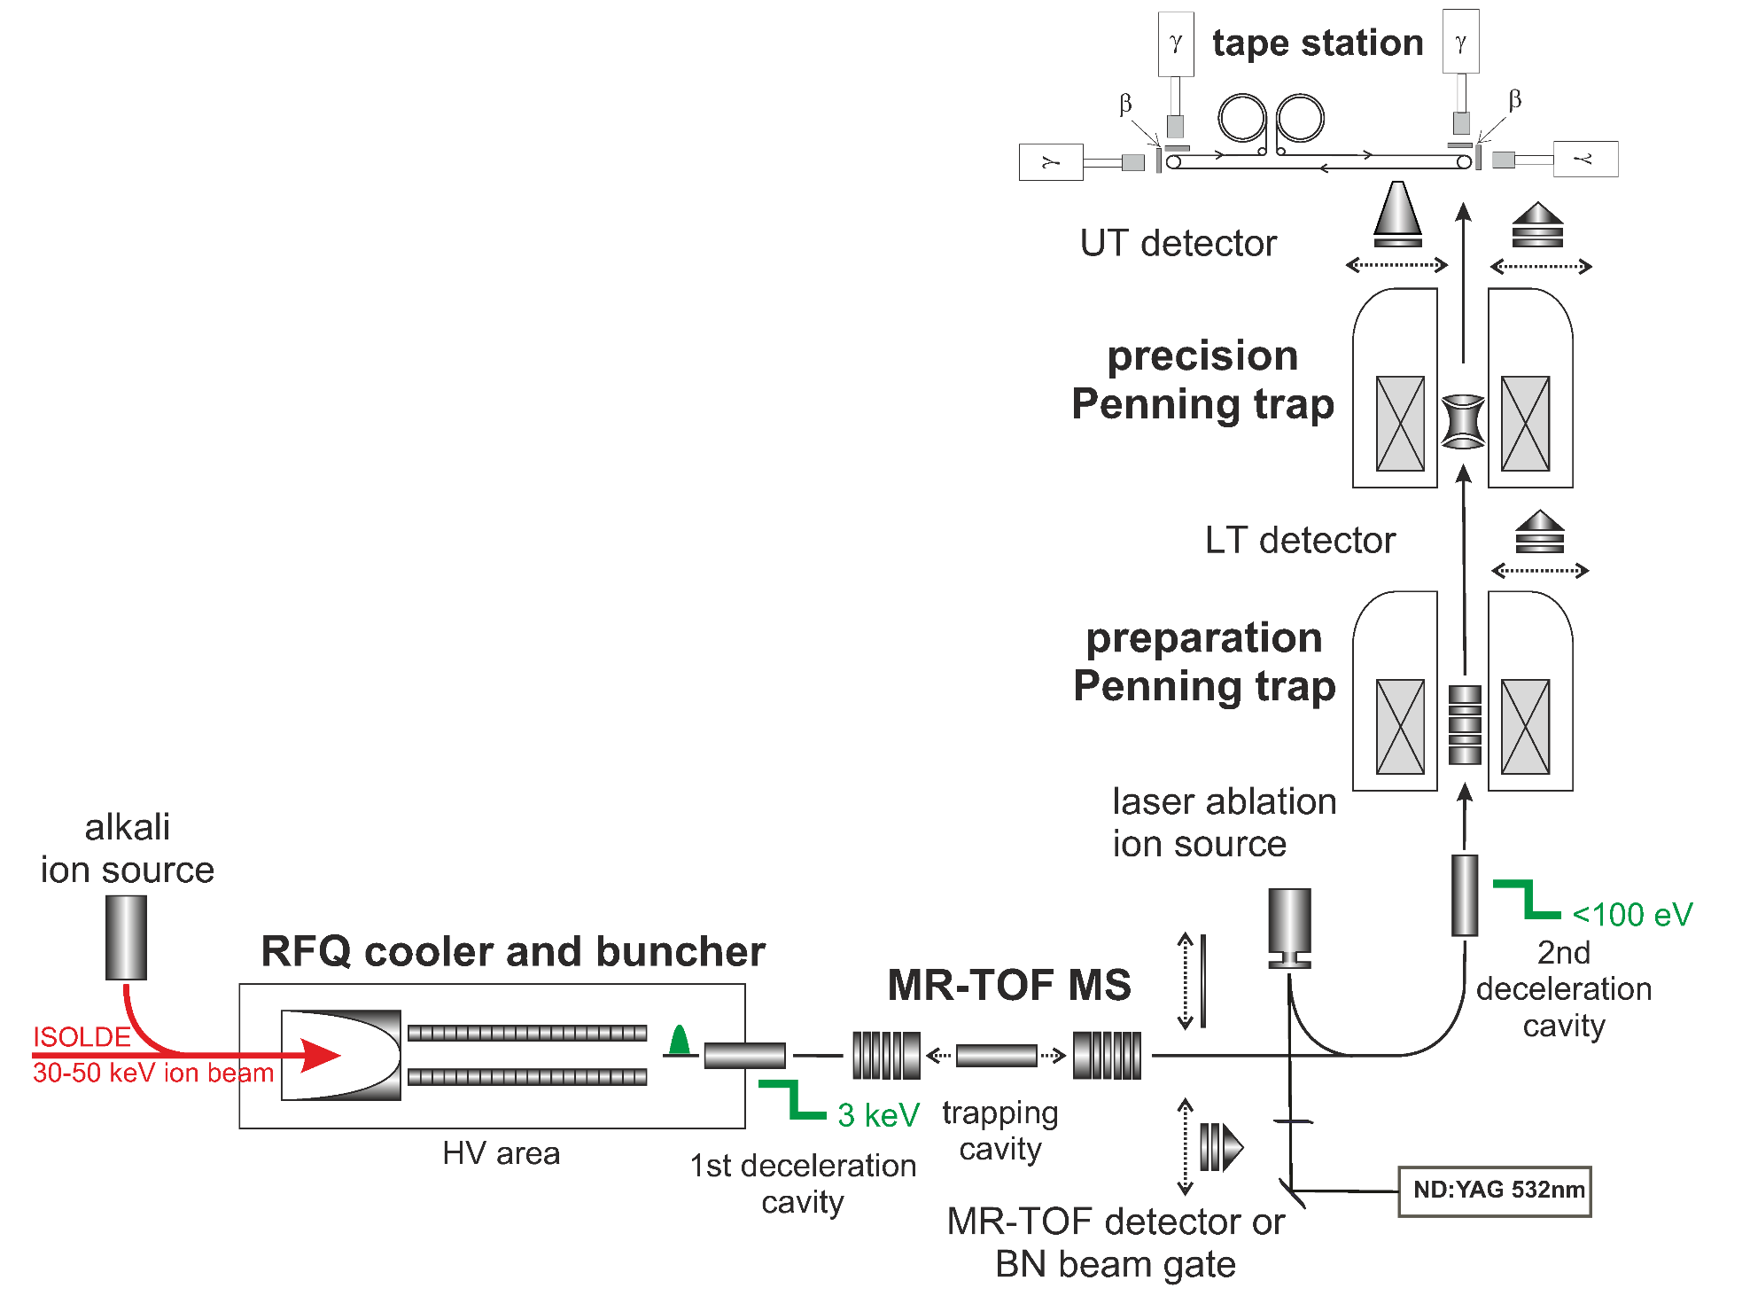
Tools of ISOLTRAP
F. Herfurth et al., NIM A 469, 254 (2001).
R. N. Wolf et al., Int. J. Mass Spectrom 313, 8 (2012).
G. Savard et al., Phys. Lett. A 158, 247 (1991).
M. König et al., Int. J. Mass Spectrom. 142, 95 (1995).
Andree Welker, 8th Gentner Day 2015, CERN, 28.10.2015
7

Slide 11
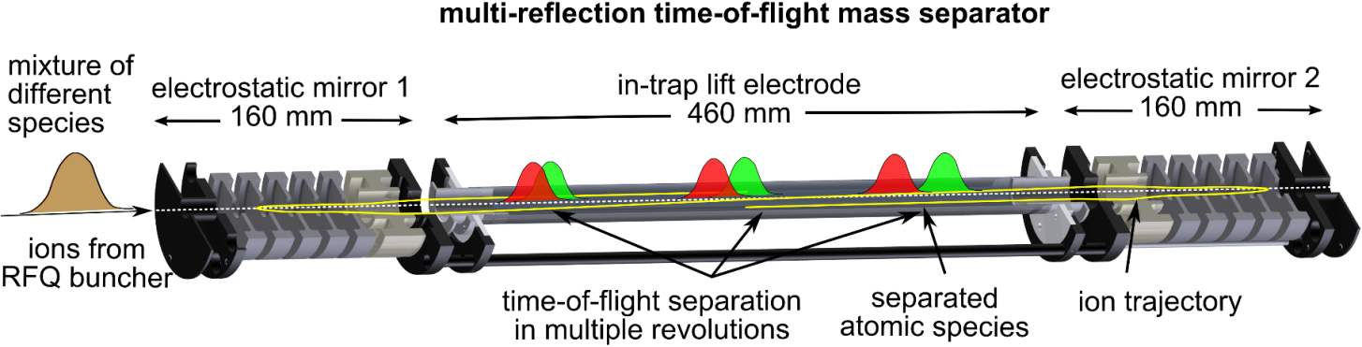
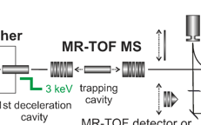
Tools of ISOLTRAP: MR-ToF
F. Herfurth et al., NIM A 469, 254 (2001).
R. N. Wolf et al., Int. J. Mass Spectrom 313, 8 (2012).
G. Savard et al., Phys. Lett. A 158, 247 (1991).
M. König et al., Int. J. Mass Spectrom. 142, 95 (1995).
Andree Welker, 8th Gentner Day 2015, CERN, 28.10.2015
8

Slide 12
Tools of ISOLTRAP
F. Herfurth et al., NIM A 469, 254 (2001).
R. N. Wolf et al., Int. J. Mass Spectrom 313, 8 (2012).
G. Savard et al., Phys. Lett. A 158, 247 (1991).
M. König et al., Int. J. Mass Spectrom. 142, 95 (1995).
Andree Welker, 8th Gentner Day 2015, CERN, 28.10.2015
9

Slide 13
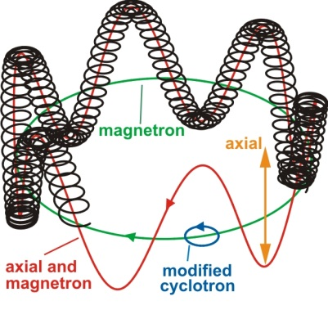
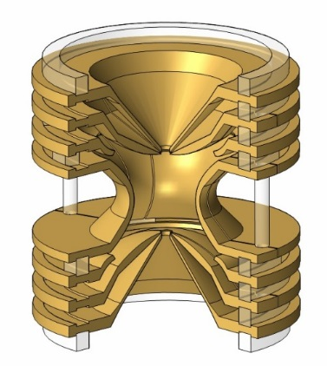
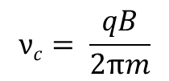

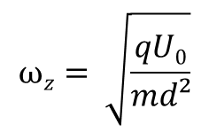
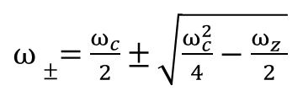
Tools of ISOLTRAP: Penning trap
Eigen motions:
Penning trap: Storage of ions by the superposition
of electric and magnetic fields
z
B
2,5 cm
x
y
Hyperbolic
Penning trap
Three harmonic oszillators:
+ : Magnetron frequency
- : Modified Cyclotron
z : Axial frequency
$ω±=$ $\frac{ω_{c}}{2}±\sqrt{\frac{ω_{c}^{2}}{4}−\frac{ω_{z}^{}}{2}}$
$ω_{c}^{}=$ $\sqrt{ω_{+}^{2}+ω_{−}^{2}+ω_{z}^{2}}$
$$ωz= \sqrt{\frac{qU0}{md²}}$$
$$νc= \frac{qB}{2πm}$$
Andree Welker, 8th Gentner Day 2015, CERN, 28.10.2015
10

Slide 14
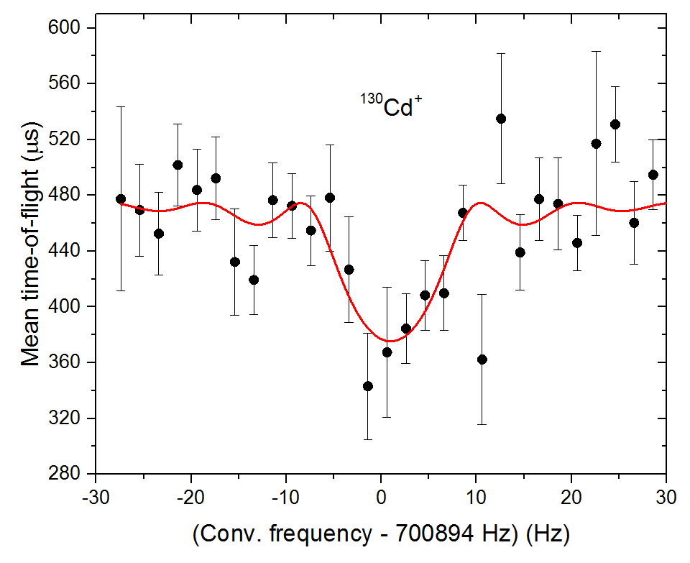

Tools of ISOLTRAP: Penning trap
$$ν_{c}=\frac{qB}{2π m}$$
First ToF-ICR of ¹³⁰Cd⁺
F. Herfurth et al., NIM A 469, 254 (2001).
R. N. Wolf et al., Int. J. Mass Spectrom 313, 8 (2012).
G. Savard et al., Phys. Lett. A 158, 247 (1991).
M. König et al., Int. J. Mass Spectrom. 142, 95 (1995).
Andree Welker, 8th Gentner Day 2015, CERN, 28.10.2015
11

Slide 15
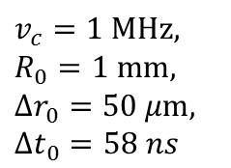
Limits of different ICR techniques
20
$$v_{c}=1 MHz,$$
$$R_{0}=1 mm,$$
$${Δr}_{0}=50 μm,$$
$${Δt}_{0}=58 ns$$
50
R. Wolf et al. IJMS 349-350 (2013) 123-133
S. Eliseev et al. Appl. Phys. B, 13 (2013)
Andree Welker, 8th Gentner Day 2015, CERN, 28.10.2015
12

Slide 16
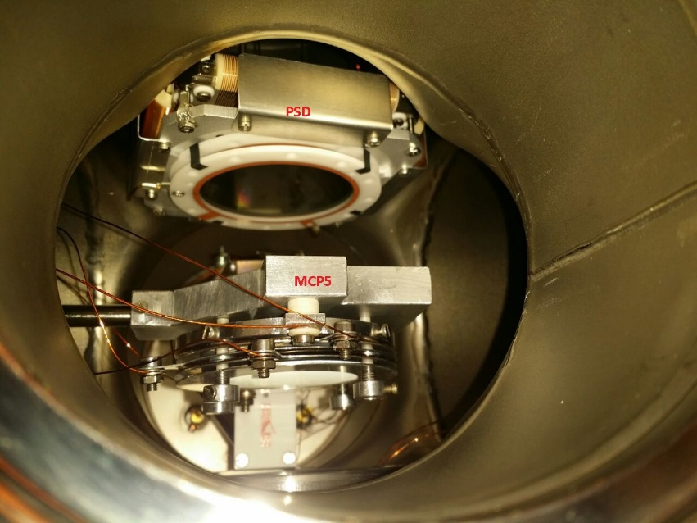
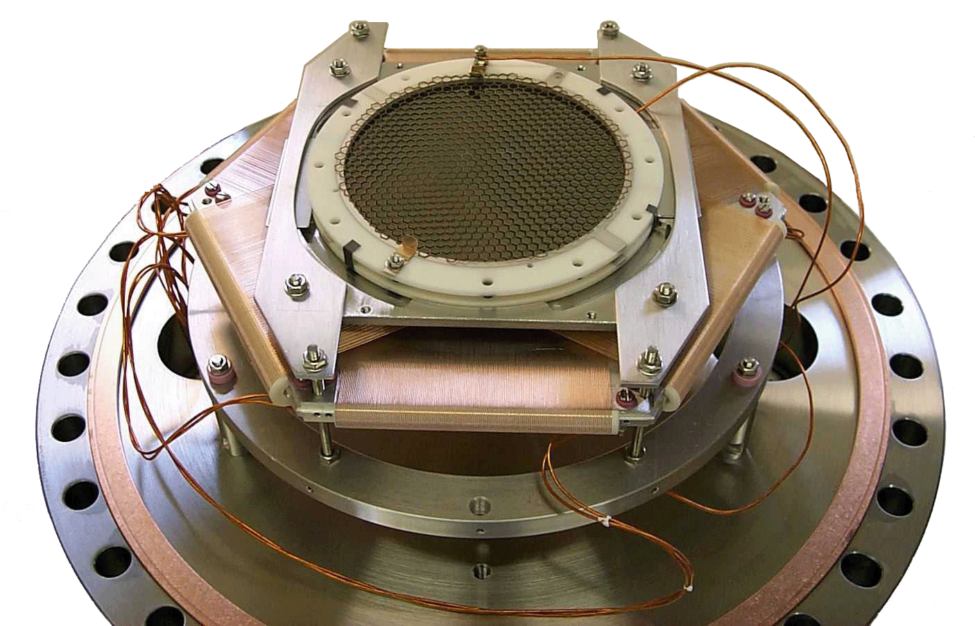
Position sensitive detector
Active diameter | 42 mm
Channel diameter | 25 μm
Open area ratio | >50 %
Position resolution | 70 μm
Max. B-field | a few mT
Time resolution | ~ 10 ns
Mounted on top of ISOLTRAP
Andree Welker, 8th Gentner Day 2015, CERN, 28.10.2015
13

Slide 17

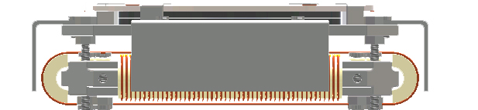
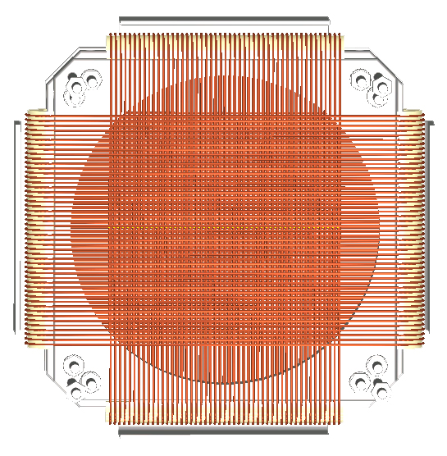
Position sensitive detector
Side view:
Ion
MCP
Back view (Delay lines):
X1
Y1
Y2
X2
Andree Welker, 8th Gentner Day 2015, CERN, 28.10.2015
14

Slide 18
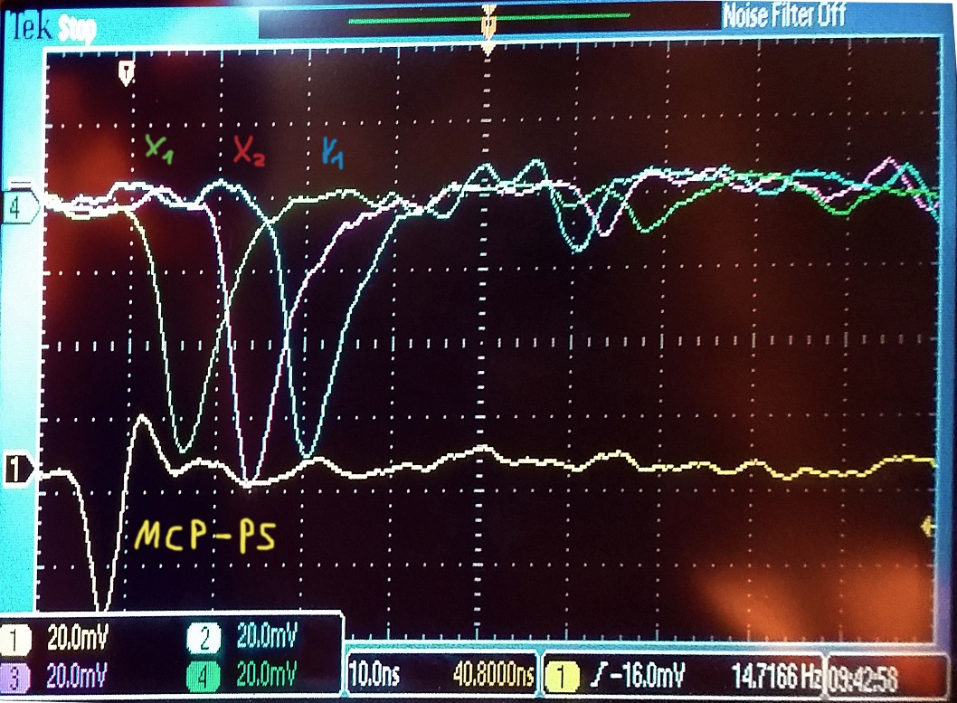
Position sensitive detector
Side view:
Ion
MCP
Signal answer of the detector and the delay lines
Back view (Delay lines):
X1
Y1
Y2
X2
Andree Welker, 8th Gentner Day 2015, CERN, 28.10.2015
14

Slide 19
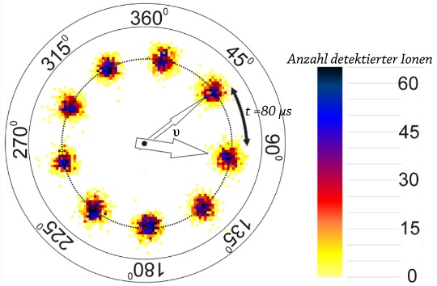
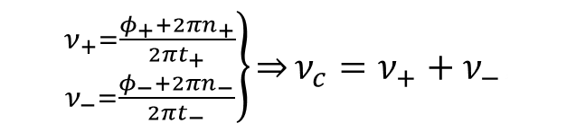
Phase Imaging- ICR (PI-ICR)
Phase Clock:
No. of detected ions
Only a small effort of information is needed:
Need some “raw assumption”
of the mass
2 ions are enough
to determine a mass
$\left.{ν_{+}=\frac{φ_{+}+2πn_{+}}{2πt_{+}} \atop ν_{−}=\frac{φ_{−}+2πn_{−}}{2πt_{−}}}\right\}\overset{⇒}{}ν_{c}=ν_{+}+ν_{−}$.
Andree Welker, 8th Gentner Day 2015, CERN, 28.10.2015
15

Slide 20
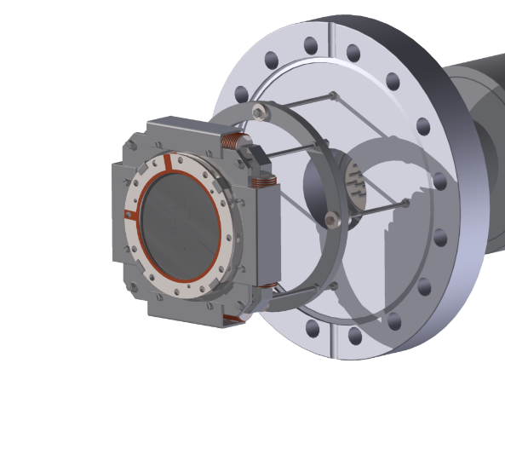
Phase Imaging- ICR (PI-ICR)
Projecting:
- Ions follow the magnetic
field lines
- Hit the detector
afterwards
B
B
Andree Welker, 8th Gentner Day 2015, CERN, 28.10.2015
16

Slide 21
Phase Imaging- ICR (PI-ICR)
Projecting:
- Ions follow the magnetic
field lines
- Hit the detector
afterwards
B
B
Andree Welker, 8th Gentner Day 2015, CERN, 28.10.2015
16

Slide 22
Phase Imaging- ICR (PI-ICR)
Projecting:
- Ions follow the magnetic
field lines
- Hit the detector
afterwards
B
B
Andree Welker, 8th Gentner Day 2015, CERN, 28.10.2015
16

Slide 23
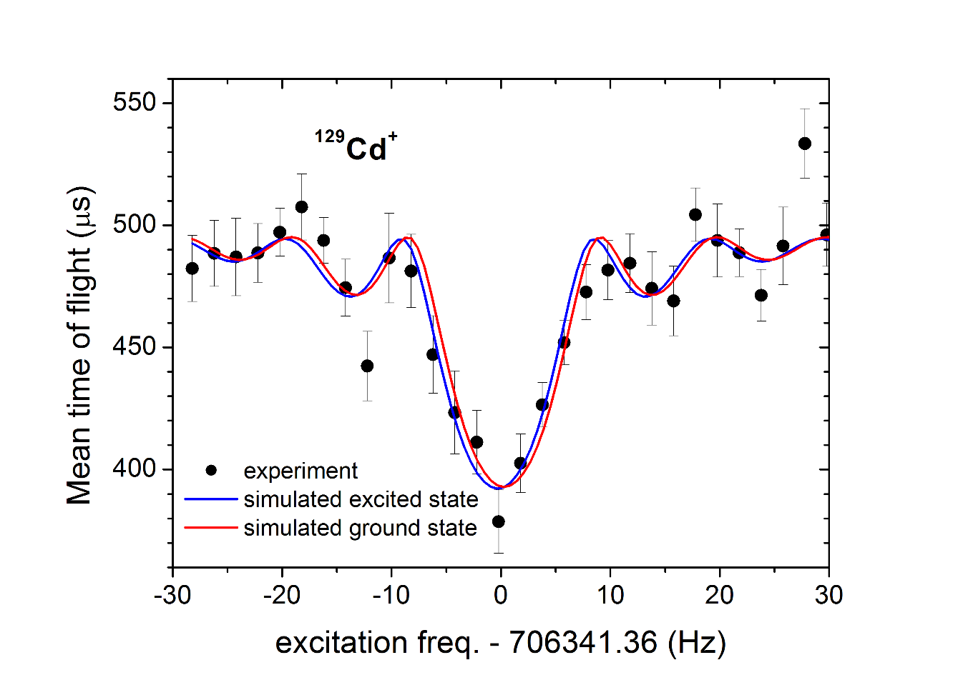
Phase Imaging- ICR (PI-ICR)
Example of the limit of ToF-ICR:
Unseparable with ToF-ICR
11/2⁻
m: isomer
3/2⁺
g: ground state
¹²⁹Cd
β⁻
β⁻
g: T_{1/2} = 242 ms
m: T_{1/2} = 104 ms
¹²⁹In
Andree Welker, 8th Gentner Day 2015, CERN, 28.10.2015
17

Slide 24
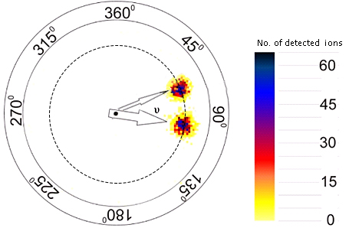
Phase Imaging- ICR (PI-ICR)
Resolving differences in ToF-ICR and PI-ICR:
Unseparable with ToF-ICR
Easy separable with PI-ICR
Andree Welker, 8th Gentner Day 2015, CERN, 28.10.2015
18

Slide 25
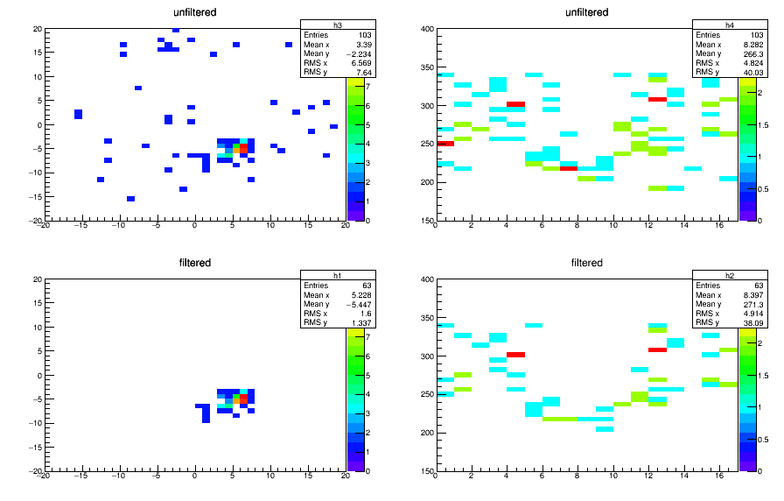
First results: Beam time
First use in a beam time to suppress the background noise low ion yields:
New detector makes the ³⁴Al beam time possible:
  5 ions/h and 5 ions/h dark counts
Position [mm]
ToF [us]
Position [mm]
Frequency [Hz]
Andree Welker, 8th Gentner Day 2015, CERN, 28.10.2015
19

Slide 26
First results: Beam time
First use in a beam time to suppress the background noise low ion yields:
New detector makes the ³⁴Al beam time possible:
  5 ions/h and 5 ions/h dark counts
Position [mm]
ToF [us]
Position [mm]
Frequency [Hz]
Position [mm]
ToF [us]
Position [mm]
Frequency [Hz]
Andree Welker, 8th Gentner Day 2015, CERN, 28.10.2015
19

Slide 27
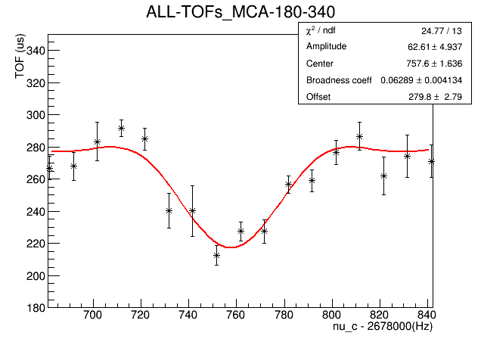
First results: Beam time
First use in a beam time to suppress the background noise low ion yields:
New detector makes the ³⁴Al beam time possible:
  5 ions/h and 5 ions/h dark counts
Andree Welker, 8th Gentner Day 2015, CERN, 28.10.2015
20

Slide 28
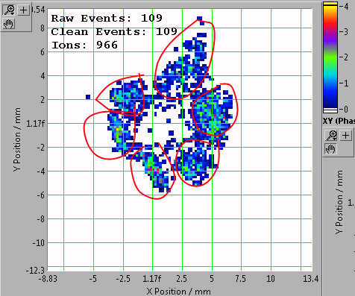
First result: PI-ICR
First result of an image:
After some effort, we have good starting conditions, but still a long way to go.
Andree Welker, 8th Gentner Day 2015, CERN, 28.10.2015
21

Slide 29
Summary
Setup:
Presented the ISOLTRAP setup and possibilities.
Technical part:
Compared the main different image cyclotron resonance techniques.
Showed some interesting physic cases which will be accessible for the first time with the PI-ICR technique.
Outlook:
The setup and the position sensitive detector will be configured, that we might be to use the new technique in the beginning of 2016.
Andree Welker, 8th Gentner Day 2015, CERN, 28.10.2015
22

Slide 30



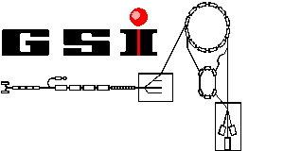

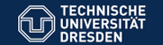




Acknowledgements
N. Althubiti, P. Ascher, G. Audi, D. Atanasov, D. Beck, K. Blaum, G. Bollen, Ch. Borgmann, M. Breitenfeldt, R. B. Cakirli, T. Cocolios, S. Eliseev, T. Eronen, S. George, F. Herfurth, A. Herlert, D. Kisler, M. Kowalska, S. Kreim, J. Kluge, Yu. A. Litvinov, D. Lunney, V. Manea, E. Minaya-Ramirez, M. Mougeot, S. Naimi, D. Neidherr, M. Rosenbusch, A. de Roubin, L. Schweikhard, F. Wienholtz, M. Wang, A. Welker, R. Wolf, K. Zuber, S. Schwarz
Thank you very much for your attention
Grants No.:
05P12HGCI1
05P12HGFNE
ISOLDE Target
and Technical Group
http://isoltrap.web.cern.ch

Slide 31
Backup

Slide 32
Table of Nuclides
Applied filters:
André Welker for ISOLTRAP, EuNPC 2015, Groningen, 31.08.2015
2

Slide 33
Why neutron-rich nuclides?
Sr
Rb
Cr
André Welker for ISOLTRAP, EuNPC 2015, Groningen, 31.08.2015
3

Slide 34
Tools of ISOLTRAP
Measurement of cyclotron frequency:
100 ms – 1 s trapping for σ_{m}/m = 10⁻⁶-10⁻⁸
Beam purification:
1 s trapping for
m/Δm =10⁵-10⁶
Beam purification:
200-300 ms trapping
for m/Δm =10⁴-10⁵
Beam purification:
30 ms trapping
for m/Δm = 10⁵
F. Herfurth et al., NIM A 469, 254 (2001).
R. N. Wolf et al., Int. J. Mass Spectrom 313, 8 (2012).
G. Savard et al., Phys. Lett. A 158, 247 (1991).
M. König et al., Int. J. Mass Spectrom. 142, 95 (1995).
Andree Welker, 8th Gentner Day 2015, CERN, 28.10.2015
6

Slide 35
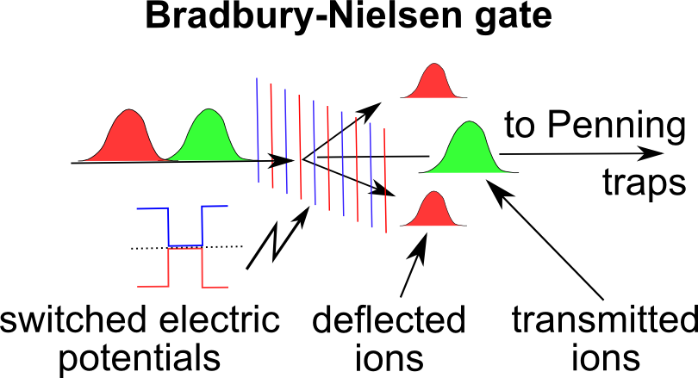
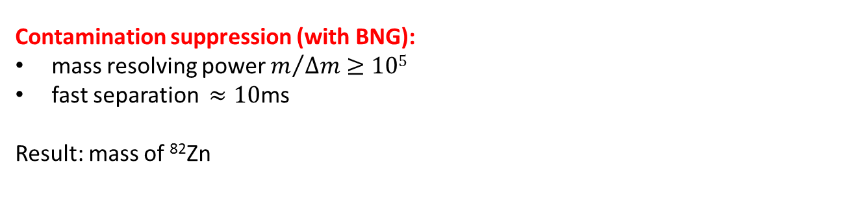
The MR-ToF MS
Contamination suppression (with BNG):
mass resolving power $m/{∆m≥105}$
fast separation $≈10\text{ms}$
Result: mass of ⁸²Zn
mass
separator
Mass determination:
relative precision better than 10⁻⁶
Result: mass of ⁵⁴Ca
mass
spectrometer
Wollnik & Przewloka, Int. J. Mass Spectrom. Ion Proc. 96, 267 (1990)
Wolf et al., IJMS 349-350, 123 (2013)
Wienholtz et al., Nature 498, 346-349 (2013)
André Welker for ISOLTRAP, EuNPC 2015, Groningen, 31.08.2015
2

Slide 36
Tools of ISOLTRAP: MR-ToF
¹⁰²Sr,¹⁰²Rb measurement
Hints for nucleus deformation,
impact in theory
F. Herfurth et al., NIM A 469, 254 (2001).
R. N. Wolf et al., Int. J. Mass Spectrom 313, 8 (2012).
G. Savard et al., Phys. Lett. A 158, 247 (1991).
M. König et al., Int. J. Mass Spectrom. 142, 95 (1995).
Andree Welker, 8th Gentner Day 2015, CERN, 28.10.2015
7

Slide 37
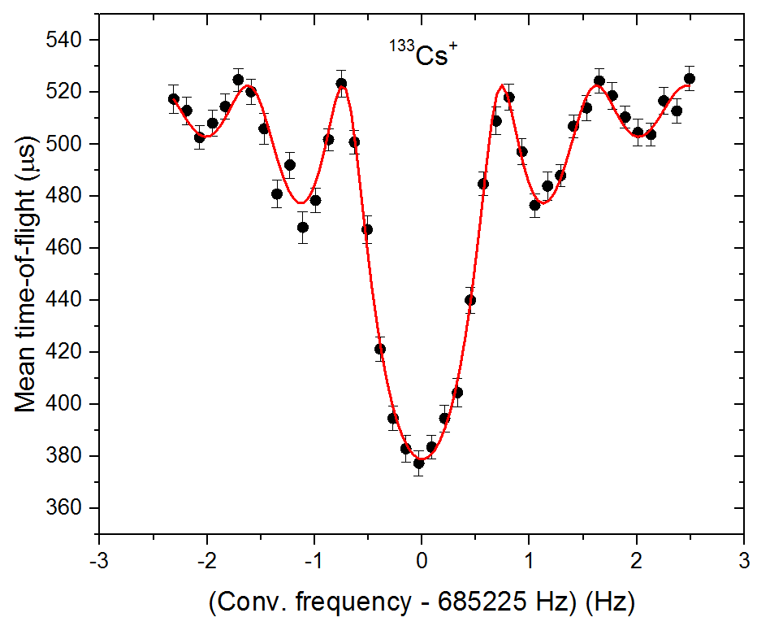
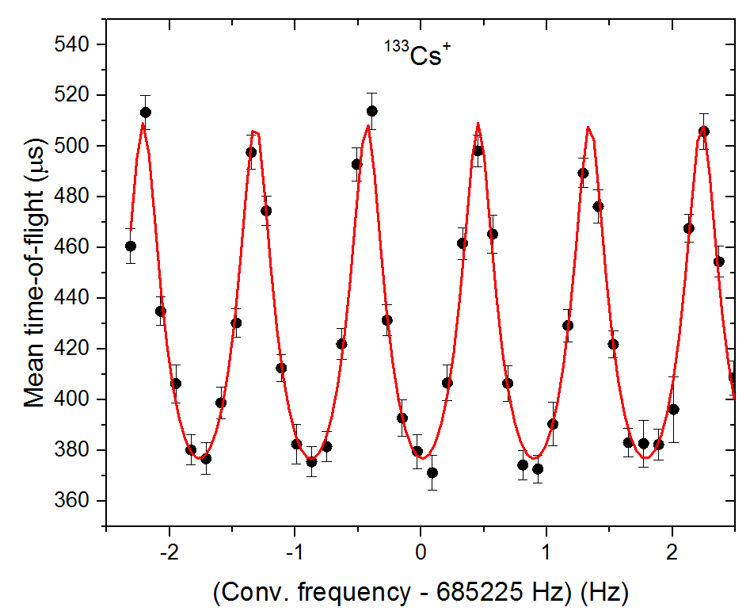

Tools of ISOLTRAP
Measurement of cyclotron frequency:
100 ms – 1 s trapping for σ_{m}/m = 10⁻⁶-10⁻⁸
Beam purification:
1 s trapping for
m/Δm =10⁵-10⁶
Beam purification:
200-300 ms trapping
for m/Δm =10⁴-10⁵
Beam purification:
30 ms trapping
for m/Δm = 10⁵
$$ν_{c}=\frac{qB}{2π m}$$
First ToF-ICR of 2014
F. Herfurth et al., NIM A 469, 254 (2001).
R. N. Wolf et al., Int. J. Mass Spectrom 313, 8 (2012).
G. Savard et al., Phys. Lett. A 158, 247 (1991).
M. König et al., Int. J. Mass Spectrom. 142, 95 (1995).
André Welker for ISOLTRAP, EuNPC 2015, Groningen, 31.08.2015
2

Slide 38
ISOLTRAP@ISOLDE@CERN
1987
2010
1999
1994
M. Mukherjee et al., Eur. Phys. J. A 35, 1 (2008).
S. Kreim et al., Nucl. Instrum. Methods B 317, 492 (2013).

Slide 39
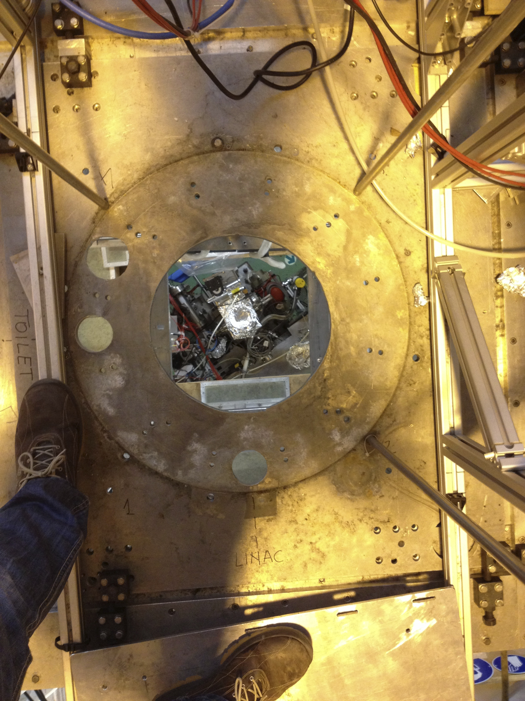
ISOLTRAP@ISOLDE@CERN
1987
2013
2010
!
1999
1994

Slide 40
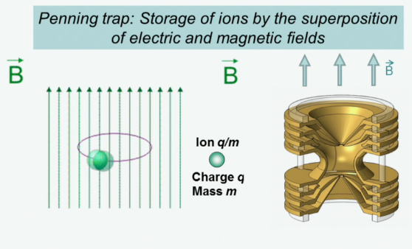
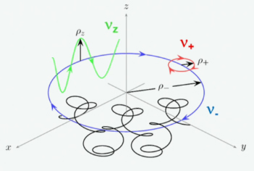
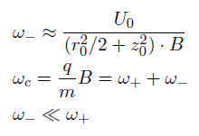


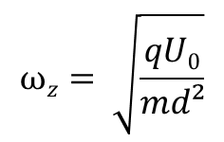
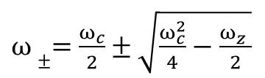
Penning-Trap
Hyperbolic
Penning-Trap
Motions:
$$νc= \frac{qB}{2πm}$$
B
2,5 cm
Three eigenmotions:
K. Blaum
- : Modified Cyclotron/
+ : Magnetron frequency
z : Axial frequency
$ω±=$ $\frac{ω_{c}}{2}±\sqrt{\frac{ω_{c}^{2}}{4}−\frac{ω_{z}^{}}{2}}$
$ω_{c}^{}=$ $\sqrt{ω_{+}^{2}+ω_{−}^{2}+ω_{z}^{2}}$
$$ωz= \sqrt{\frac{qU0}{md²}}$$
André Welker, Group Meeting, IKTP Dresden, Oct. 25, 2014
16

Slide 41
Penning-Trap
Hyperbolic
Penning-Trap
Function:
2,5 cm
K. Blaum
André Welker, Group Meeting, IKTP Dresden, Oct. 25, 2014
16

Slide 42
Penning-Trap
Hyperbolic
Penning-Trap
Motions:
$$νc= \frac{qB}{2πm}$$
2,5 cm
Three eigenmotions:
K. Blaum
- : Modified Cyclotron/
+ : Magnetron frequency
z : Axial frequency
$ω±=$ $\frac{ω_{c}}{2}±\sqrt{\frac{ω_{c}^{2}}{4}−\frac{ω_{z}^{}}{2}}$
$ω_{c}^{}=$ $\sqrt{ω_{+}^{2}+ω_{−}^{2}+ω_{z}^{2}}$
$$ωz= \sqrt{\frac{qU0}{md²}}$$
André Welker, Group Meeting, IKTP Dresden, Oct. 25, 2014
16

Slide 43
Penning-Trap
Hyperbolic
Penning-Trap
Motions:
$$νc= \frac{qB}{2πm}$$
B
2,5 cm
Three eigenmotions:
K. Blaum
- : Modified Cyclotron/
+ : Magnetron frequency
z : Axial frequency
$ω±=$ $\frac{ω_{c}}{2}±\sqrt{\frac{ω_{c}^{2}}{4}−\frac{ω_{z}^{}}{2}}$
$ω_{c}^{}=$ $\sqrt{ω_{+}^{2}+ω_{−}^{2}+ω_{z}^{2}}$
$$ωz= \sqrt{\frac{qU0}{md²}}$$
André Welker, Group Meeting, IKTP Dresden, Oct. 25, 2014
16

Slide 44
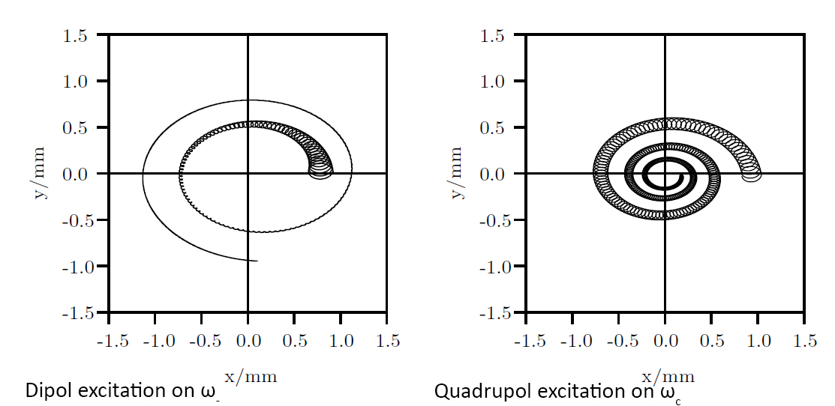

Penning-Trap
Motions:
With cooling gas in trap
-
+
-
+
-
+
+
-
$ω_{c}^{}=$ $\sqrt{ω_{+}^{2}+ω_{−}^{2}}$
André Welker, Group Meeting, IKTP Dresden, Oct. 25, 2014
17

Slide 45
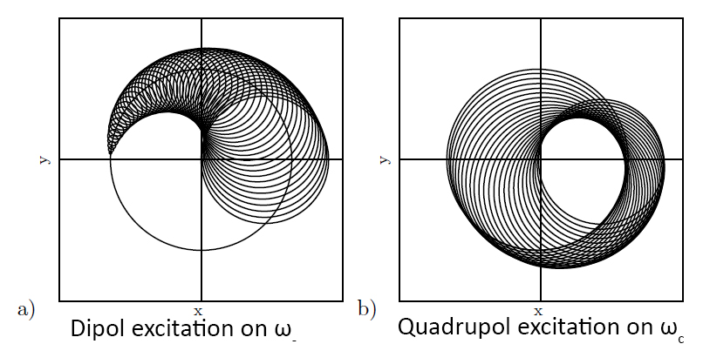
Penning-Trap
Motions:
Without cooling gas in trap
-
+
-
+
-
+
+
-
André Welker, Group Meeting, IKTP Dresden, Oct. 25, 2014
18

Slide 46
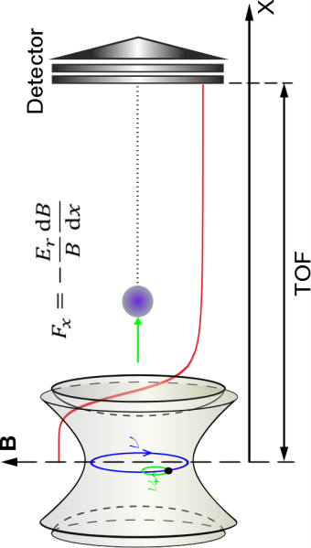


Penning-Trap
Motions conversion:
18

Slide 47
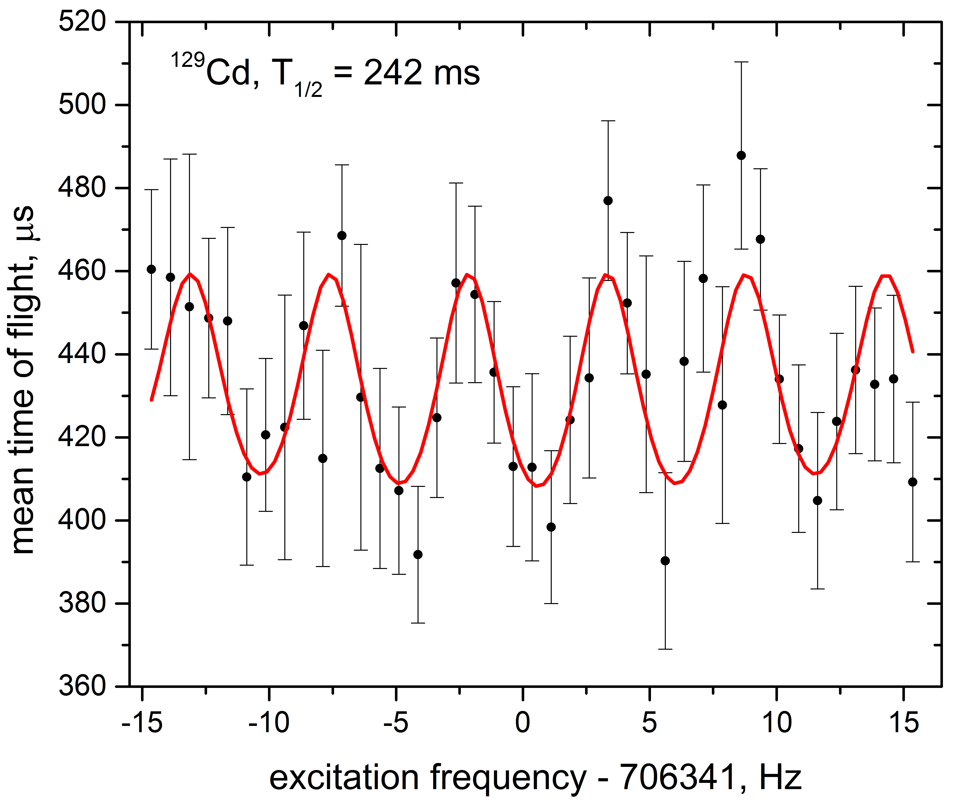
129Cd, 130Cd – Mass measurement
¹²⁹Cd Ramsey-type resonance
20ms – 160ms – 20ms
¹³⁰Cd Ramsey-type resonance
10ms – 80ms – 10ms
¹²⁹Cd, T_{1/2}=242(8)ms
¹³⁰Cd, T_{1/2}=162(7)ms
≈6300 ions/s from ISOLDE; 1539 ions
4 ToF-ICR resonances
  1 normal, 3 Ramsey
→ Δm/m≈1.2E-7
≈625 ions/s from ISOLDE; 588ions
¹³⁰Cd/cont. ≈ 0.2; only R ≈ 15k needed
3 ToF-ICR resonances
  1 normal, 2 Ramsey
→Δm/m≈1.6E-7
Frank Wienholtz NUSTAR 2015

