Slide 1
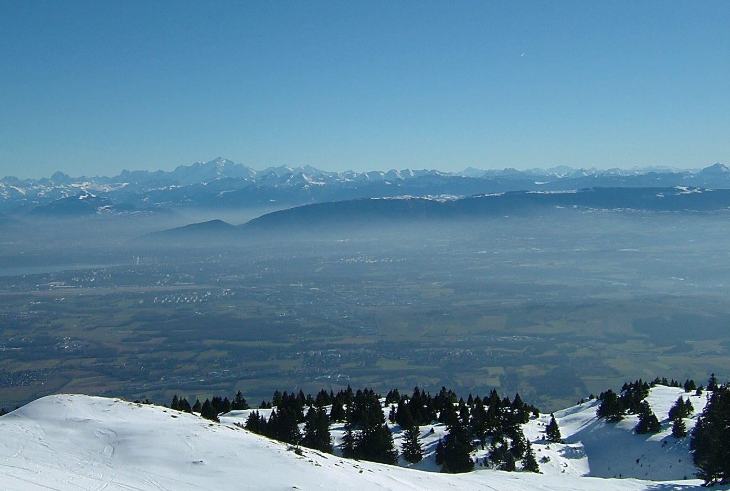




Lattice design for FCC-ee
Bastian Haerer (CERN BE-ABP-LAT, Karlsruhe Institute of Technology (KIT))
8th Gentner Day, 28 October 2015

Slide 2
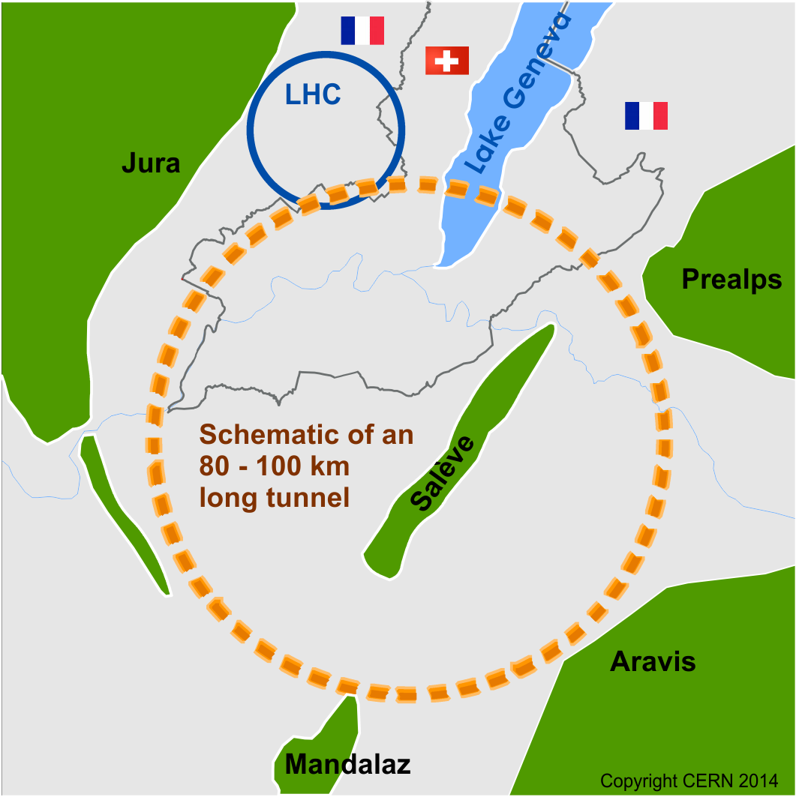
Future Circular Collider Study
100 km storage ring
FCC-hh (=long-term goal):
High-energy hadron collider
Push the energy frontier to 100 TeV
FCC-ee (TLEP):
e⁺/e⁻-collider as intermediate step
FCC-he
Hadron-lepton collider option
Deep inelastic scattering

Slide 3
Physics goals of FCC-ee
Provide highest possible luminosity for a wide physics program ranging from the Z pole to the tt production threshold.
  Beam energy range from 45 GeV to 175 GeV
Main physics programs / energies (+ scan around central values):
  Z (45.5 GeV): Z pole, high precision of M_{Z} and Γ_{Z,}
  W (80 GeV): W pair production threshold,
  H (120 GeV): H production,
  T (175 GeV): tt threshold.
All energies quoted refer to BEAM energies

Slide 4
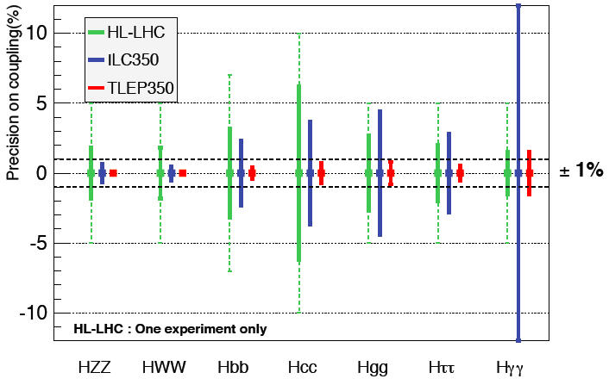
Coupling precision
J. Ellis & P. Janot

Slide 5
Linear Beam Dynamics
Particle trajectory:
x’
Beta Function β
Emittance ε
x
A = πε
δ = Δp/p
Particles with energy deviation:
Dispersion function D

Slide 6
Challenges: the parameter list
Design & optimize a lattice for 4 different energies
Interaction region layout for a large number of bunches
Horizontal emittance is increasing with reduced energy
Extremely small vert. beta* (β_{y}* = 1 mm)
High chromaticity
Challenging dynamic aperture
High synchrotron radiation losses include sophisticated absorber design in the lattice
 | Z | W | H | tt
Beam energy [GeV] | 45.5 | 80 | 120 | 175
Beam current [mA] | 1450 | 152 | 30 | 6.6
Bunches / beam | 16700 | 4490 | 1330 | 160
Bunch population [10¹¹] | 1.8 | 0.7 | 0.46 | 0.83
Transverse emittance ε Horizontal [nm] Vertical [nm] | 29.2 0.06 | 3.3 0.007 | 0.94 0.0019 | 2 0.002
Momentum comp. [10⁻⁵] | 18 | 2 | 0.5 | 0.5
Betatron function at IP β* Horizontal [mm] Vertical [mm] | 500 1 | 500 1 | 500 1 | 1000 1
Energy loss / turn [GeV] | 0.03 | 0.33 | 1.67 | 7.55
Total RF voltage [GV] | 2.5 | 4 | 5.5 | 11

Slide 7
FCC-ee Layout
100 km circumference
2 experiments
50 m FODO cell
S
Q
S
Q
S
B
B
B
B
S
Q
P. Lebrun & J. Osborne
B = bending magnet, Q = quadrupole, S = sextupole

Slide 8
Optical functions (175 GeV)
Arc FODO cell
Mini straight section

Slide 9
My PhD thesis so far:
Maintain the lattice for FCC-ee (Arcs)
Horizontal emittance tuning
Chromaticity correction using the arcs
Baseline parameter list:
Beam energy [GeV] | 45.5 | 80 | 120 | 175
Horizontal emittance ε [nm] | 29.2 | 3.3 | 0.94 | 2

Slide 10
1) Emittance tuning
L_{cell} = 50m
L_{cell} = 100m
L_{cell} = 150m

Slide 11
Lattices for 80 and 45.5 GeV
175 GeV and 120 GeV: L_{cell} = 50 m, Ψ = 90°/60°
Half-bend dispersion suppressor
80 GeV: L_{cell} = 100 m, Ψ = 90°/60°
Dispersion suppressor based on quadrupoles
45.5 GeV: L_{cell} = 300 m, Ψ = 90°/60°
250 m
200 m
200 m
Arc cells
Straight matching section (with RF)
Dispersion Suppressor
Straight cells (with RF)

Slide 12
Optics with larger cell lengths
80 GeV beam energy
MADX Emit: ε_{x} = 1.70 nm
45.5 GeV beam energy
MADX Emit: ε_{x} = 14.2 nm

Slide 13
Optics with larger cell lengths
80 GeV beam energy
MADX Emit: ε_{x} = 1.70 nm
Re-matched Dispersion Suppressor

Slide 14
2) Chromaticity
Dispersion in the quadrupoles modifies focusing strength
Tune shift for particles with energy deviation δ = Δp/p
Particles hit resonances and get lost
δ > 0
δ = 0
δ < 0
Quadrupole
Tune
1st order
2nd order
3rd order chromaticity

Slide 15
Chromaticity correction
Correction with sextupole magnets in non-dispersive regions
δ > 0
δ = 0
δ < 0
Quadrupole
Sextupole

Slide 16
Phase advance FD – 1st Sext.
Final doublet
First arc FODO cell
…
IP
MQDIR1
MQFIR1
SD1
SD1
SF1
SF1
μ_{x} = m*π
μ_{y} = n*π
(m,n integer)

Slide 17
FCC-ee sextupole scheme
SD1
SD1
SF1
SF1
SD2
SD2
SF2
SF2
SD3
SD3
SF1
SF1
SD1
SD1
μ_{x} = 90° = π/2
μ_{y} = 60° = π/3
μ_{x} = 180° = π (→ -I transformation)
Even number of sextupoles per family!

Slide 18
W functions in the half-ring
V17_RT9060_1m1mm
IP
IP

Slide 19
Optimising the momentum acceptance
Q’_{y} = 0
[-0.15%, 0.07%]
half-integer
half-integer
add linear chromaticity
[-0.21%, 0.07%]
Q’_{y} = 15

Slide 20
Mom. acceptance for different β*
β*_{y} = 1 mm:
[-0.21%, 0.07%]
β*_{y} = 2 mm:
[-0.29%, 0.11%]

Slide 21
Different sextupole scheme
Vary individual sextupole pairs to flatten Q(Δp/p)
6 sextupole families per arc per plane
[-0.49%, 0.69%]
6 sextupole families + 12 free sextupole pairs
per arc per plane

Slide 22
Summary
Lattice design for a future e+/e- collider
Linear lattice design
→ Horizontal emittance tuning
Non-linear dynamics
→ Higher order chromaticity correction
→ Momentum acceptance optimisation

Slide 23
Thank you for your attention!

