Slide 1
Elaboration of a
Semantically-operating risk management information system (SoRMIS) and its practical implementation at CERN
8th Gentner Day
10/28/2015
Sven Langhoff, DGS-DI

Slide 2
General Information in advance
About me
  University of Wuppertal
  HSE (Occupational Health & Safety and Environmental Protection Unit)
  Supervisor: Ralf Trant
About my work
  Knowledge representation in the domain of Safety
  Focus on semantical methods
About this presentation
  Part 1: Introduction
  Part 2: Basic idea of SoRMIS
  Part 3: Incident Management versus Incident Prevention

Slide 3
Part 1: Introduction
Managing Safety is managing Safety Knowledge
Place of work
Causes
Example:
Risk analysis
Tools
Losses
Work activity
Workers
Hazards
1. Information about all relevant contexts
Type
Work object
Elements
Prevention
…
Maintenance
2. Detailed information for each context
Notes:
Safety Work is Knowledge Work, lets take an example
If you perform risk analysis you want to know something about …
You need often immediate further information to things and questions
You want information on the context width and depth of specific things
TRANSITION:
This is actually how you want an information management to work, but if you look into the situation nowadays…

Slide 4
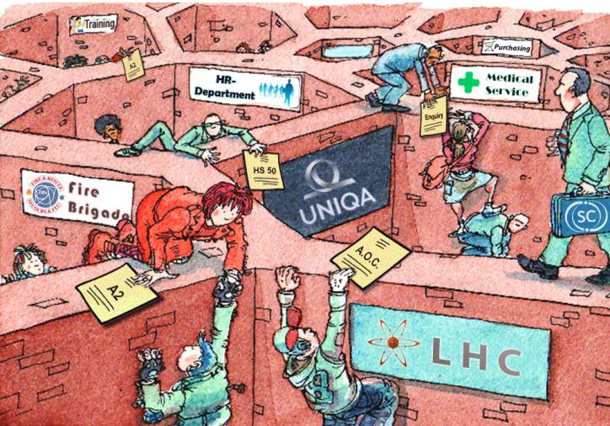
Part 1: Introduction
The situation nowadays: Knowledge barriers and silos
Barriers:
Access restrictions
Different formats
Semantic barriers
Redundancies…
Notes:
Lot of individual systems which are independent form each other
Culture and language
Focus on documents
TRANSITION:
To overcome these barriers is the goal of the SoRMIS project…

Slide 5
Part 1: Introduction
SoRMIS project
Key question:
How to make context information better available for safety experts?
Current project group:
Lars Aprin (Fellow, former Gentner student) & me
Approach:
Applying Semantic Web technology to the field of Safety Knowledge Management
Semantic Web
  Advancement of the World Wide Web
  Classes, Instances and Relations instead of Documents
  Making the web more machine readable
  Growing importance and increasingly more projects that are started
Notes:
TRANSITION:
How this looks like I‘d like to explain using an example…

Slide 6
Part 2: Basic Idea of SoRMIS
Semantical Mapping of Activities, Incidents & Preventions
prerequesite
For
Prevention
#2
leadsTo
Incident
#2
Person
#10
Driving
course
#2
location
investigator
influences
Location
#B
cause
midPoint
Activity
#1
leadsTo
Route
#1
hazard
Critical
Event
#1
start
route
equipment
Location
#A
action
end
Location
#C
Driving
Driver
Truck
#12
Road shoulder
performer
is
hits
Person
#23
name
John Doe
age
43
Notes:
Every real world object as well as concepts has a unique identifier that can be refered to
and is described by relations to other objects
Conceptualizing all these relations create the SoRMIS ontology
TRANSITION:
If you map these relevant and related information with each other then a huge set of linked data arises…

Slide 7
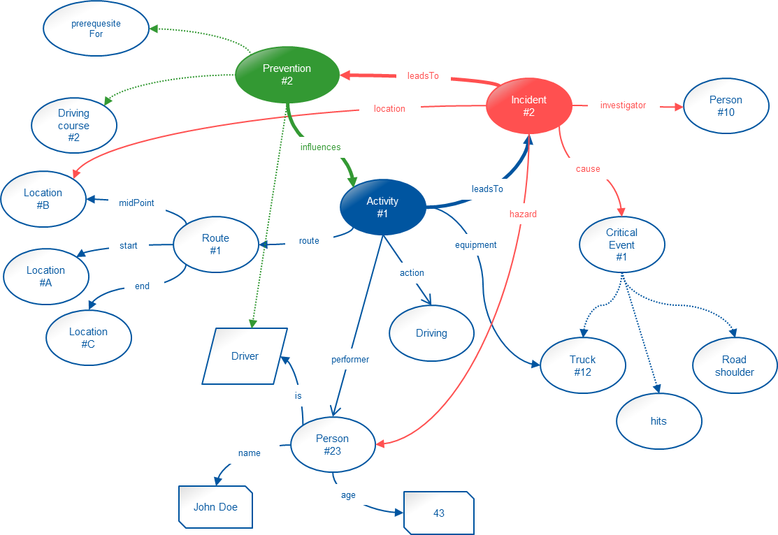
Part 2: Basic Idea of SoRMIS
The SoRMIS Ontology
???
object
Activity
#???
equipment
person
???
???
Notes:
Information from different domains merge together
Based on currently planned activity look for past activities within the database that are similar to a certain extend
TRANSITION:
The question now is how to get data in and out considering different views and information needs from different actors.
Therefore we go back to the example of the incident…

Slide 8
Part 3: Incident Management versus Incident Prevention
Incident Analysis: Different Facets, Different Views
Prevention
Management
Legislation
Management
Hazards
Training & Education
Personal Protective
Equipment
Work
Environment
Incident
Incident
Management
Notes:
TRANSITION:
Challenges that arise out of this multitude of facets and views are…

Slide 9
Part 3: Incident Management versus Incident Prevention
Questions and Tasks
How to bridge the gap between the technical level and the field of practice ?
  Development of a application that support involved people with the process of knowledge transfer into the SoRMIS ontology.
How to integrate SoRMIS into the currently prevailing practice?
  Analyze current workflows.
  Identify different actors and there information needs.
How to derive results for risk analysis and illustrate these?
  Application of statistical methods and development of search algorithms.
Notes:
TRANSITION:
In addition to the search for solutions to these questions,
theres is another major challenge to cope with…

Slide 10
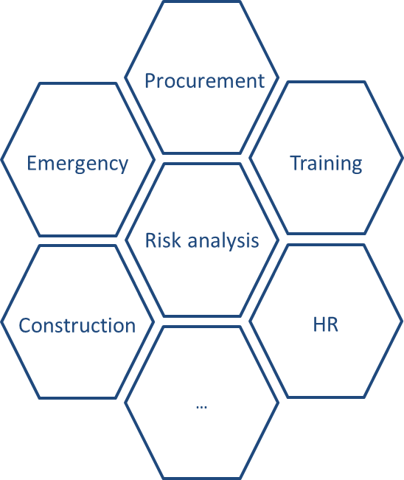
Major Challenge - Development of the Ontology
Conceptualize relevant domains
Transfer information from existing databases
Collaborative process with safety experts and experts from other domains
Notes:
TRANSITION:
Coming to the summary and the conclusion…

Slide 11
Summary and Conclusions
The quality of the outcome of a risk analysis (as a tool for preventing incidents) is a function of knowledge.
  Thus it is important to provide as much relevant information as possible
  The Incident Management is a crucial knowledge source
  (lessons learned)
Semantic technologies are very suitable to interlink the information demands in Prevention Management with the information supply from Incident Management
CERN is a good area of application since all is in one place.
Strategic outlook:
Other CERN domains apart from Safety can benefit from a semantically structured knowledge base

Slide 12
Thanks for listening.
Sven.Langhoff@cern.ch

