Slide 1
HCAL Pulse Shape analysis in MC and Data
Yalcin Guler, İbrahim Soner Zorbakir,
Emine Gurpinar, Bayram Tali, Aysel Kayis Topaksu

Slide 2
Some Info
Setup information:
We will be followed 3 step for this analysis.
We just analyzed 1000 events
Step 1:
  CMSSW_7_3_5_patch2
  process.GlobalTag = GlobalTag(process.GlobalTag, 'GR_P_V50::All', '')
    Reconstranction keeping HCAL DIGIs in the output reco file
  Analyezed Data sample: /Run2012D/JetHT/RAW/v1/ (Run=208307)
Step 2:
  We generated MC samples for getting "simHcalDigis''
  CMSSW_7_4_0
    cmsDriwer.py DYToLL_M_50_TuneZ2star_8TeV_pythia6_tauola_cff.py -s GEN,SIM,DIGI,L1,DIGI2RAW,RAW2DIGI,RECO -n 10 --no_exec --eventcontent FEVTDEBUGHLT --conditions=auto:mc
    process.GlobalTag = GlobalTag(process.GlobalTag, 'auto:mc', '')
Step 3:
  CMSSW_7_4_0
  process.GlobalTag.globaltag = 'GR_R_62_V1::All'
    Access the adc count in HcalDigis and simHcalDigis (for pulse shape analysis)
    We analyzed this output root files with same edAnalyzer

Slide 3
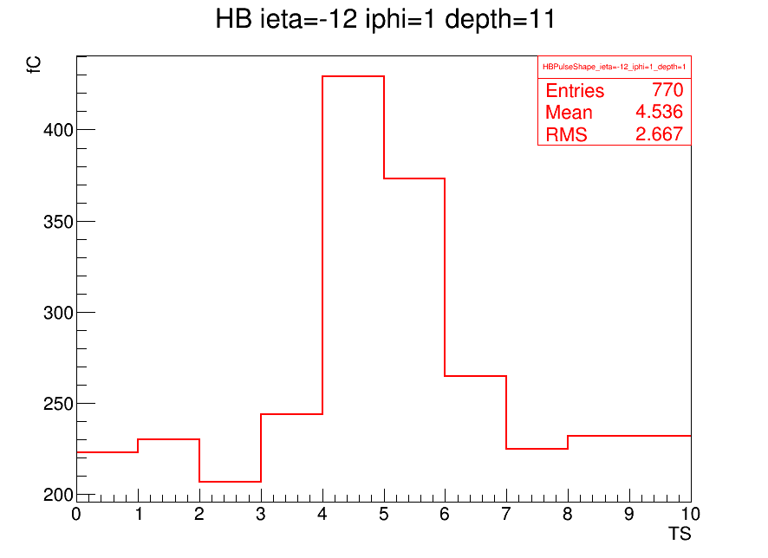
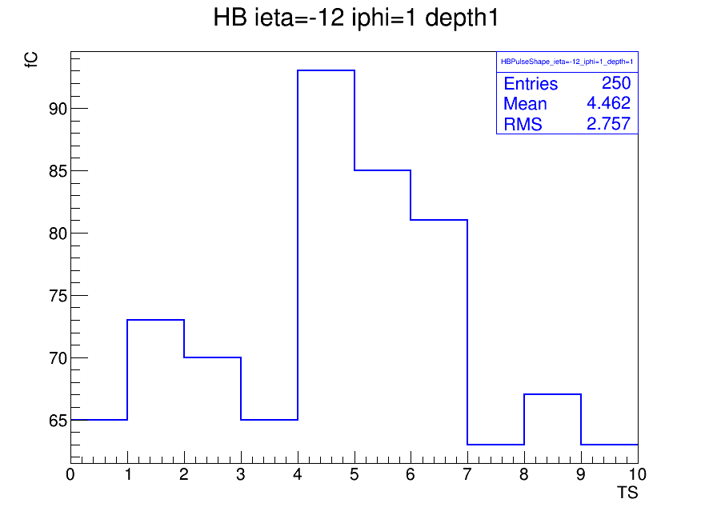
DATA
MC

Slide 4
Next step:
generate more events both data and MC.
check all HCAL channels for data and MC.
And we will be able to see them in a row.

