Slide 1
Bottom connection and splice at corner pieces
PH-DT Engineering Office, CERN
CERN, May 11th 2015

Slide 2
Status today
Bolted connection at bottom – capacity likely to decrease: calculating new joint with rows of two bolts
Splice position and size of corner piece: studies ongoing
Short side walls: analyses yet to be done
  longitudinal force retaining system, bracings
  Pinned or M connection at top
  M connection at bottom
Behaviour of bottom elements (floor): yet to be optimised
Buckling final results and bracings: add bracing, ignore grid
Understanding requirements Pm+Pb < 1.5 S for div 1 and div 2
Interpretation of bolt stresses according to ASME (?)
Seismic calculations (no time for the review)
Material x the review (8 working days left, some people absent)

Slide 3
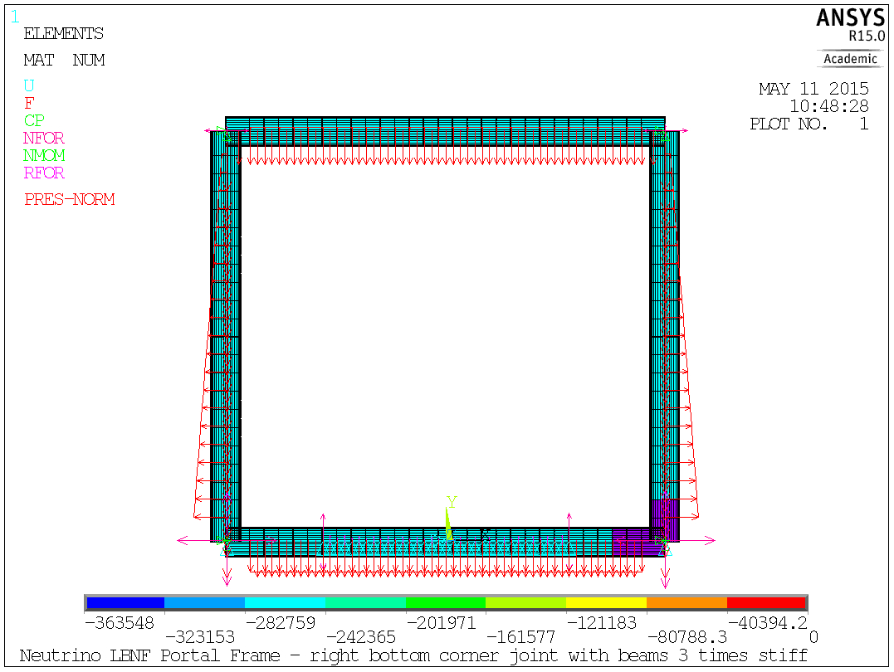
Static analysis results – corner piece
Scope: analysis moment inversion point and dispersion vs corner stiffness:
HL1100-548: beam
Corner solid piece (3 times stiffer)

Slide 4
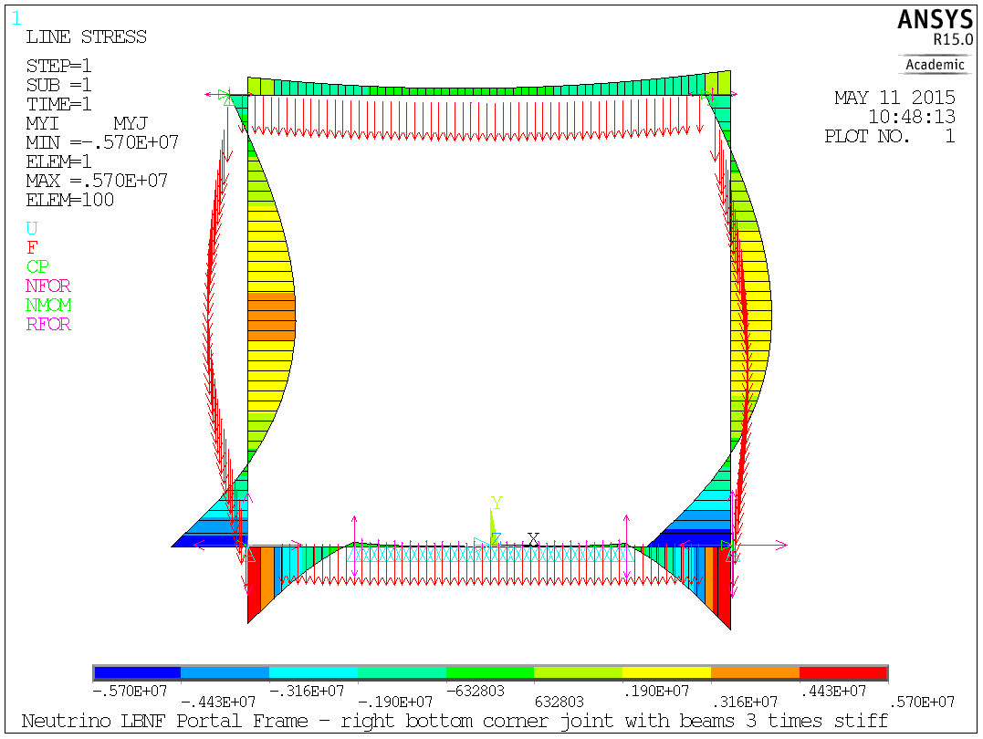
Static analysis results – corner piece

Slide 5
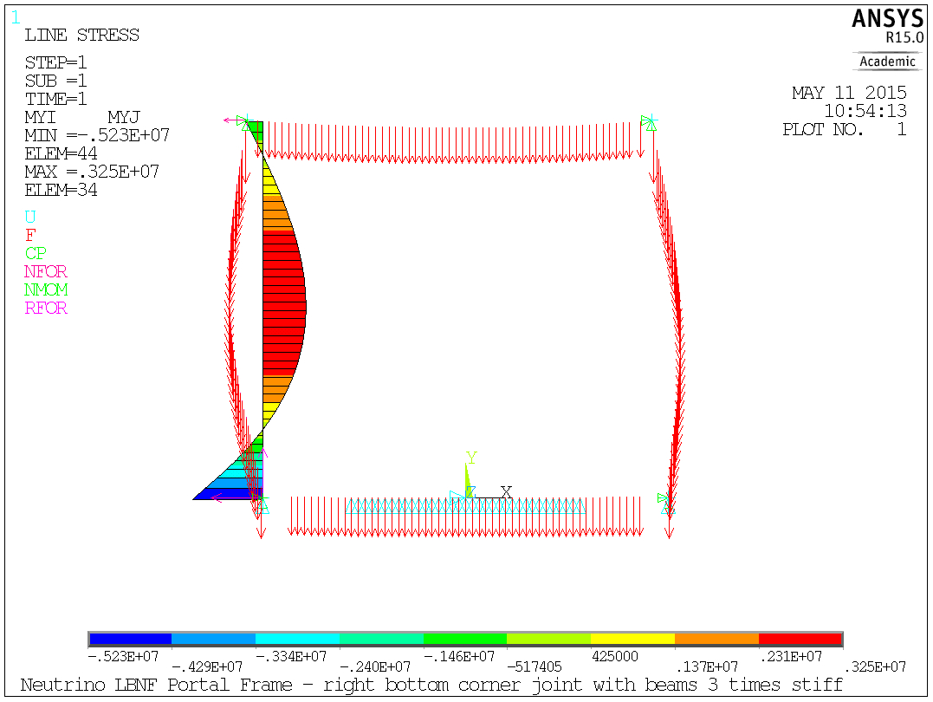
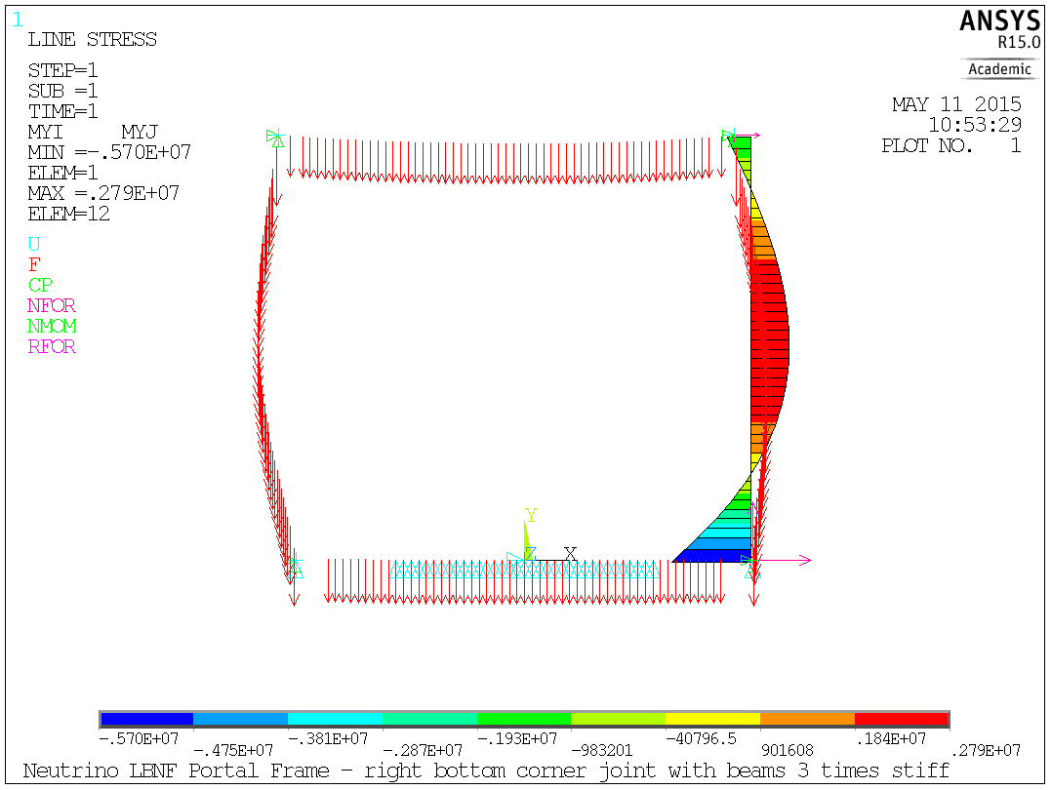
Static analysis results – corner piece
Bottom picture: Moment = 0 at 3.36 m height (mid beam axis)
Top picture: Moment = 0 at 3 m height (mid beam axis)

Slide 6
Corner piece dimensions
M=0 @ 3.5 m
M=1.7 MN m @ 2 m
M=0 @ 3.1 m

Slide 7
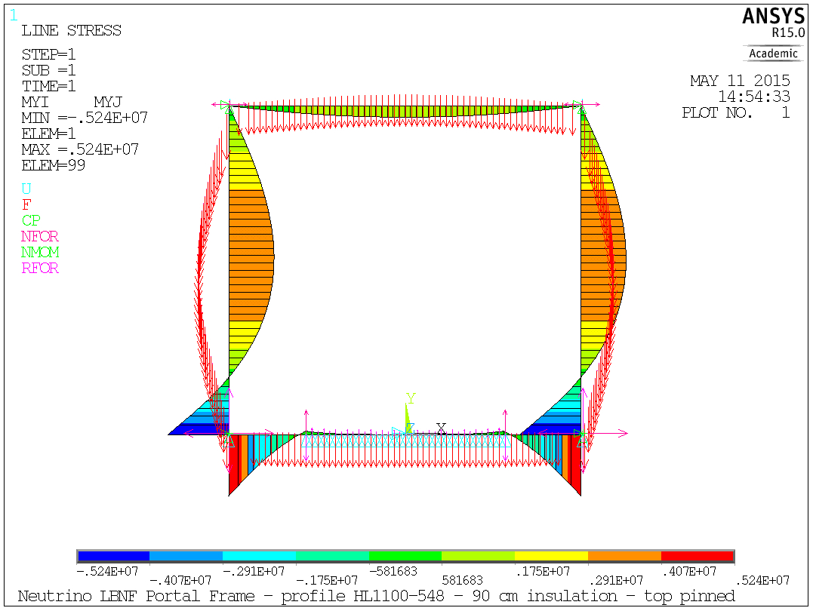
Static analysis results – top pinned
Scope: analysis top pinned connection (also applicable to short side wall)
Consequence: bottom connection M increasing (by 0.7 MN m) – see next slide

Slide 8
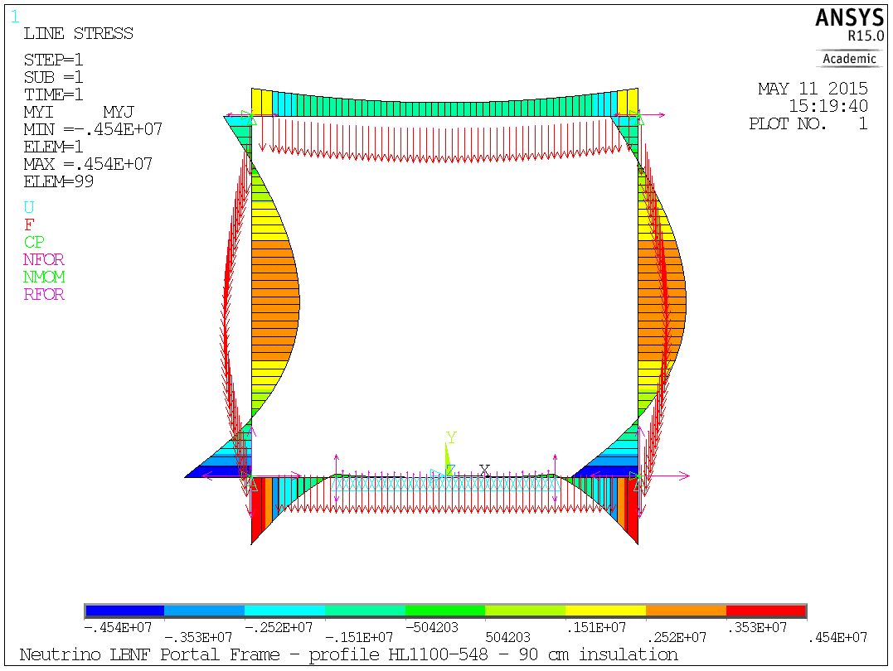
Rem: static analysis results – top built in

Slide 9
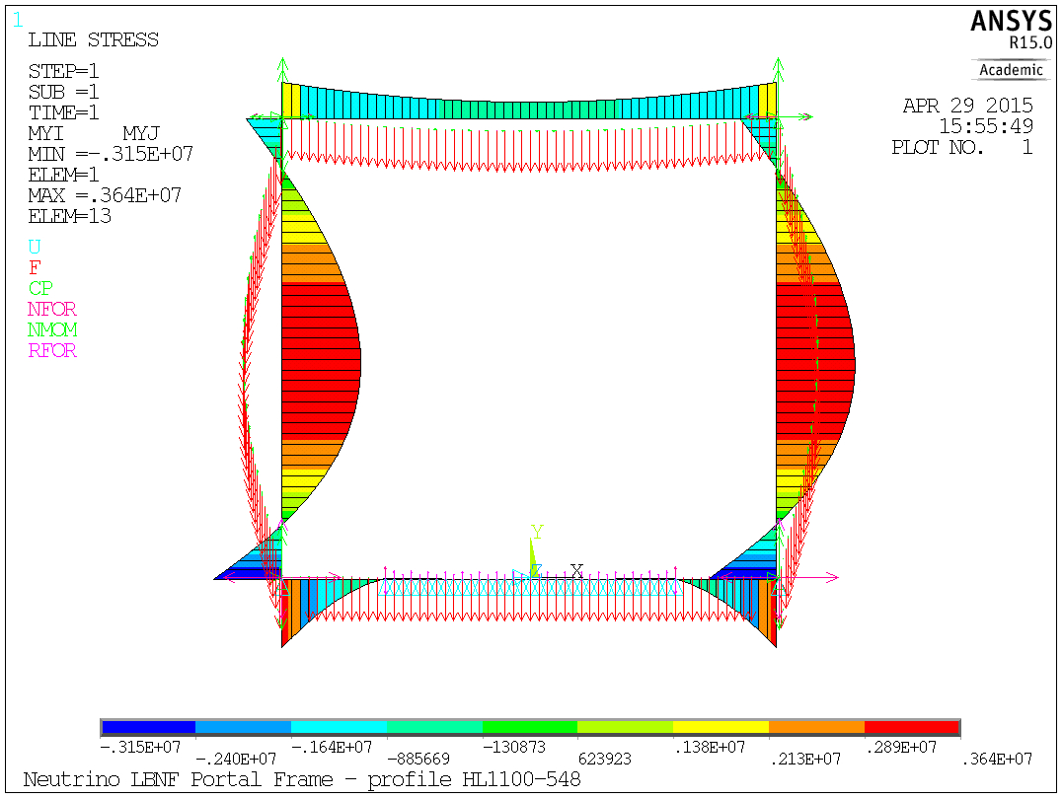
Rem: static analysis results – top built in
With (former) bottom bolted compliance included

Slide 10
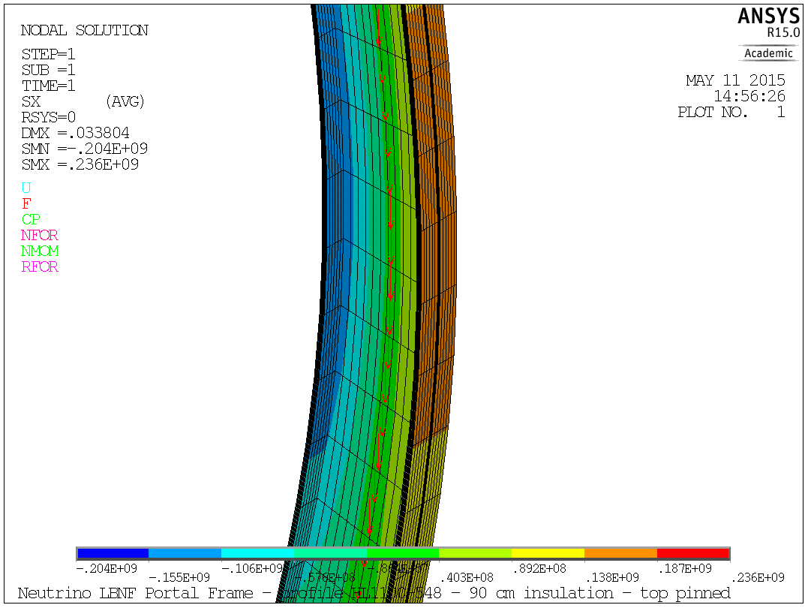
Static analysis results – top pinned
155 MPa

Slide 11
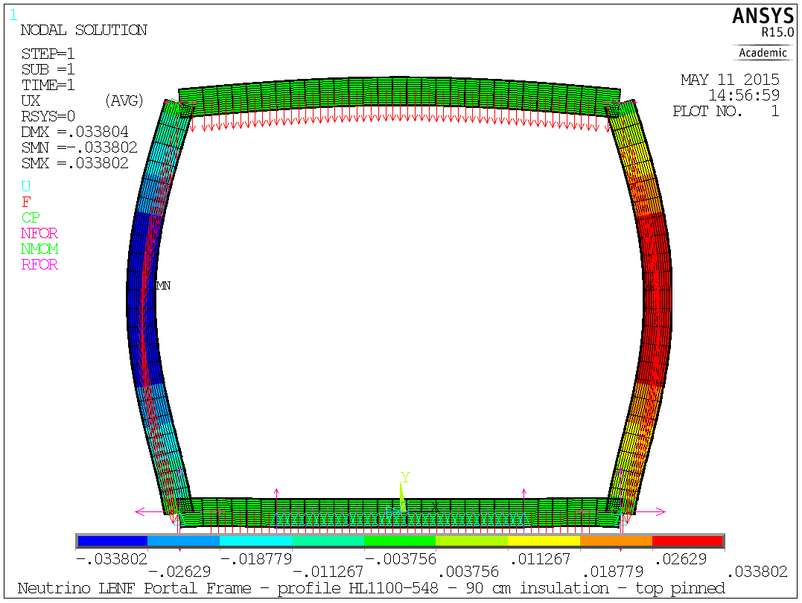
Static analysis results – top pinned

Slide 12
Steel Grades
Steel S355 (EC properties for t>40mm)
  σ_{y}=335 MPa → σ_{y}/1.5=223 MPa
  UTS=470 MPa → UTS/3.5=134 MPa → UTS/2.4=195 MPa
Small Improvements by moving to S450 (EC properties for t>40mm):
  σ_{y}=410 MPa → σ_{y}/1.5=273.3 MPa
  UTS=550 MPa → UTS/3.5=157 MPa → UTS/2.4 =229 MPa

Slide 13
Material

