Slide 1
Connections
PH-DT Engineering Office, CERN
CERN, May 2015

Slide 2
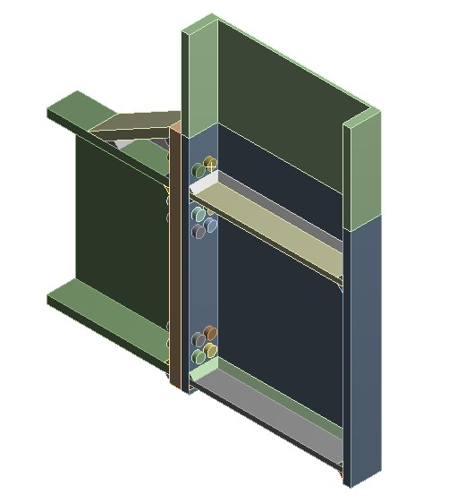
Bottom Moment Connection
Not possible to use 4xM48 bolts per row due to space constraints
  Problems even reduction bolt size to M36, there is no space for the tool
Possible solution: 2xM52 bolts per row (approximately the same cross section area than 4xM36 bolts, which allows for ~5.3MNm)

Slide 3
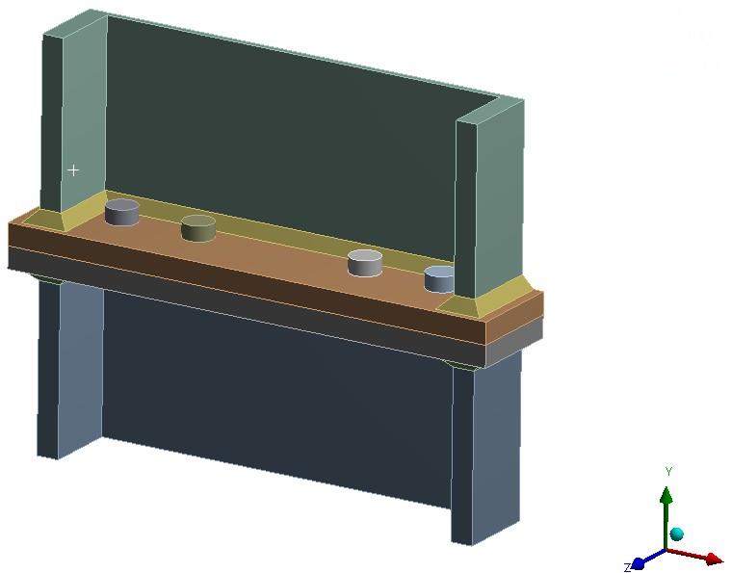
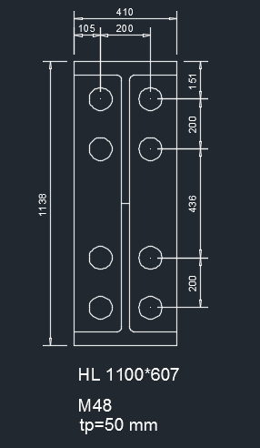
Splice Connection
Combination of two splice connections and a pre-manufactured moment connection at the bottom
Splice connection: 2xM48 bolts per row
Positions of the splice connections to be carefully chosen to minimise the moment that they need to withstand (parametric study underway for risk assessment).

Slide 4
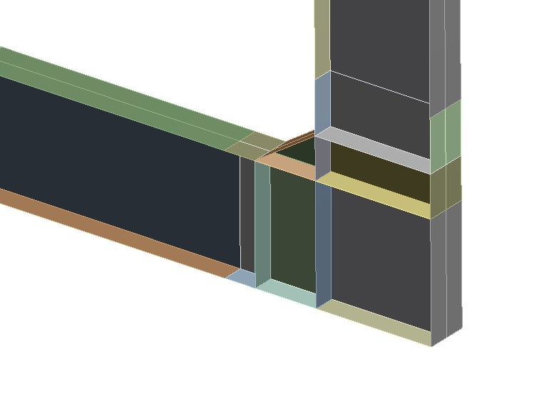
Splice Connection
Problem: Size of the pre-manufactured moment connection could be incompatible with elevator size.
~3.5m
~3.5m

