Slide 1
Bottom built in and pinned top connections
PH-DT Engineering Office, CERN
CERN, May 13th 2015

Slide 2
Status today
Baseline:
  Solid corner pieces at bottom: splice connection at 3.4 m from bottom (shaft available envelope 3.7 m)
  Splice must be able to take moment of 1-2 MN m and Shear of 3 MN (this to cope with possible uncertainties in transition point)
  Bolted connection on top (better stability, splice calculated)
Bolted connections all calculated (Joao will summarise results)
Short side walls: analyses yet to be done
  longitudinal force retaining system, bracings
  Pinned or M connection at top → see next slides for pinned connection
  M connection at bottom → verify transverse connection to floor I beams
Behaviour of bottom elements (floor): option to be discussed for the review (Piet)
Work ahead:
  Final proposal short side walls design
  Static and Buckling final results and bracings: add bracing, ignore grid
  Full run of SCIAeng EC3 verification
  Verification of ASME requirements Pm+Pb < 1.5 S for div 1 and div 2
  Verification of ASME requirements for welds
  Verification of ASME requirements for bolts
  Seismic calculations (no time for the review)
  Material x the review

Slide 3
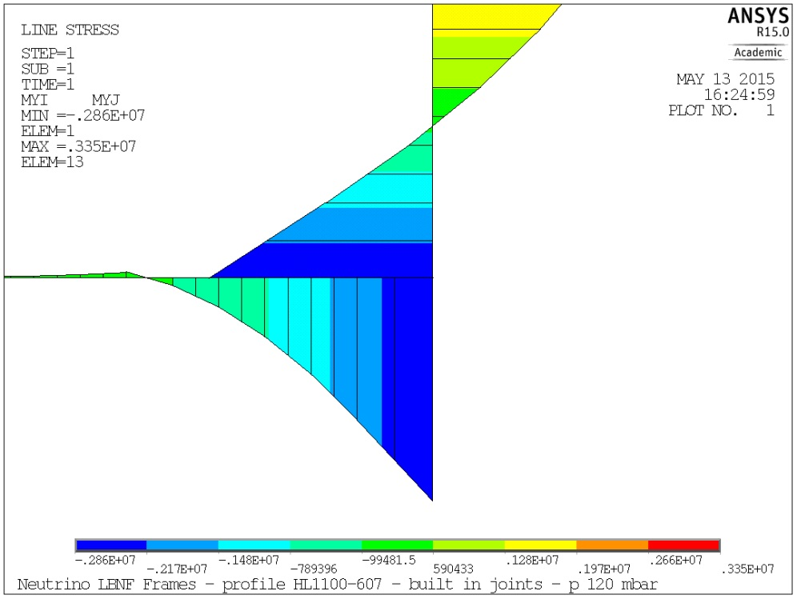
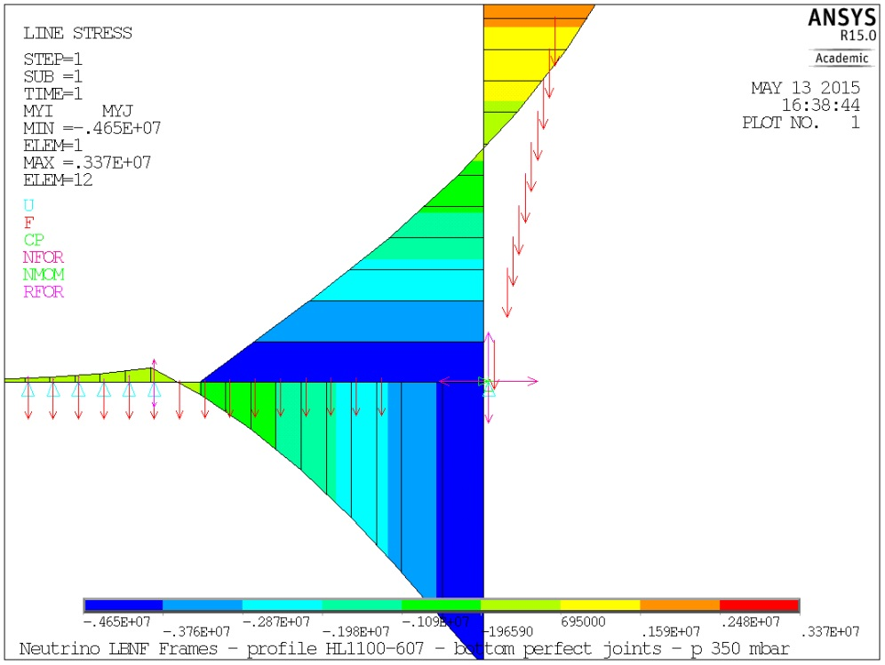
A note on the moment transition
The transition point of M along the vertical beam is highly affected by:
  The rotational stiffness of the bottom joint
  The position of the bottom support (or contact point)
  (The behaviour of the floor beam)
The top pressure 20, 120, 350 mbar does not influence the transition point
The splice joint (seen these effects) must be capable of taking Moments and Shear with some good safety factors
Transition at 1.9 (+0.55) for RotStiff =1250 MN m/rad and at 2.66 (+0.55) for perfect joint stiffness

Slide 4
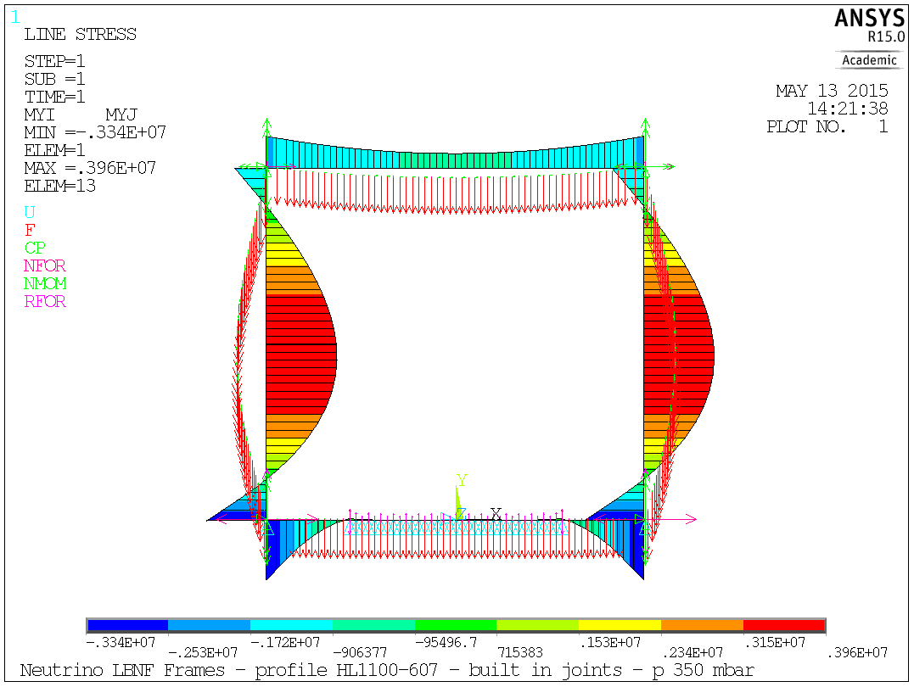
Baseline: all M connections
HL1100-607 : beam – joint stiffness calculated and accounted for in FEA

Slide 5
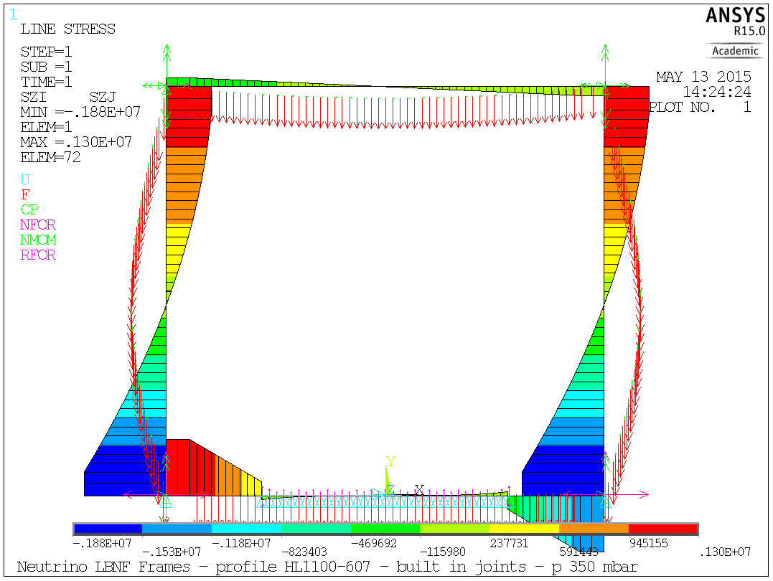
Baseline: all M connections

Slide 6
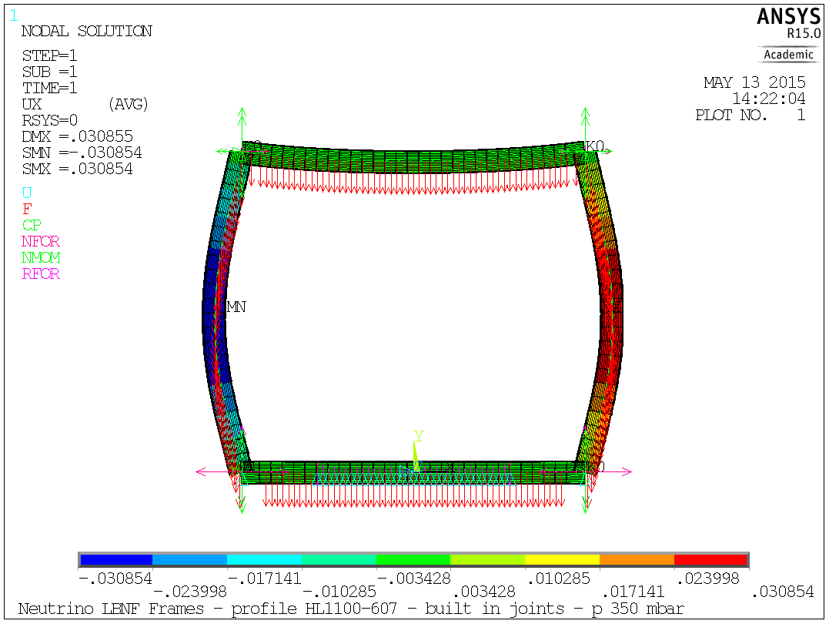
Baseline: all M connections

Slide 7
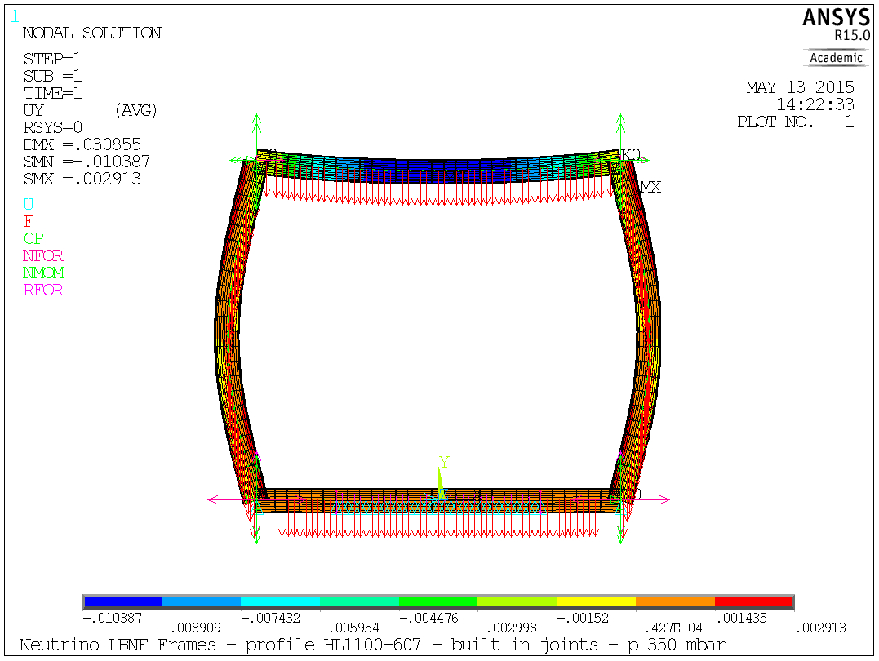
Baseline: all M connections

Slide 8
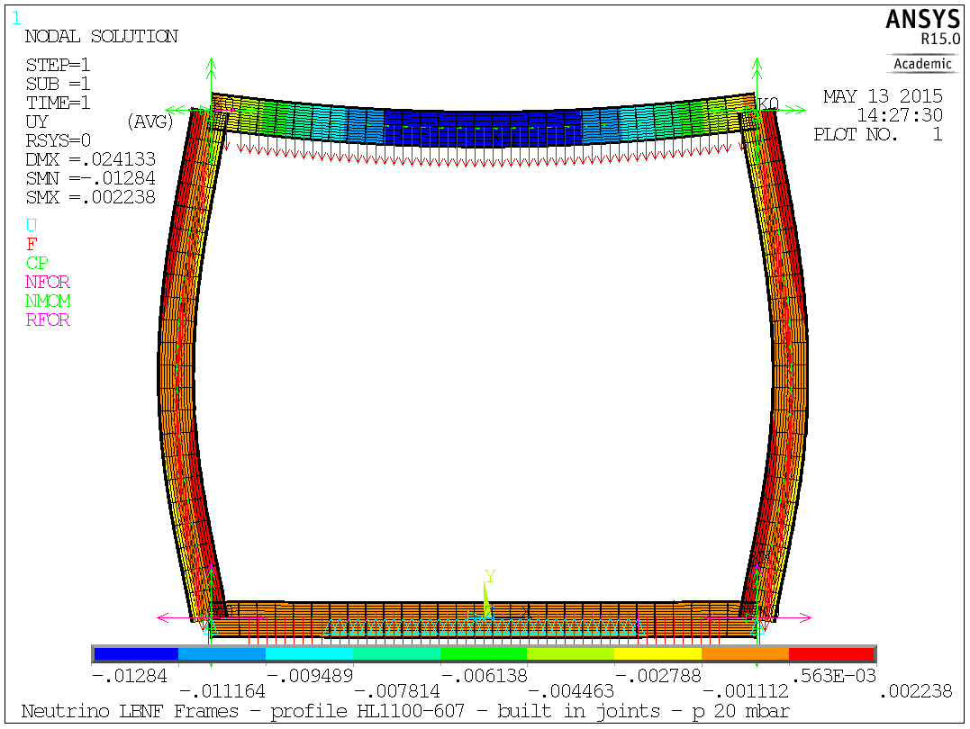
Baseline: all M connections

Slide 9
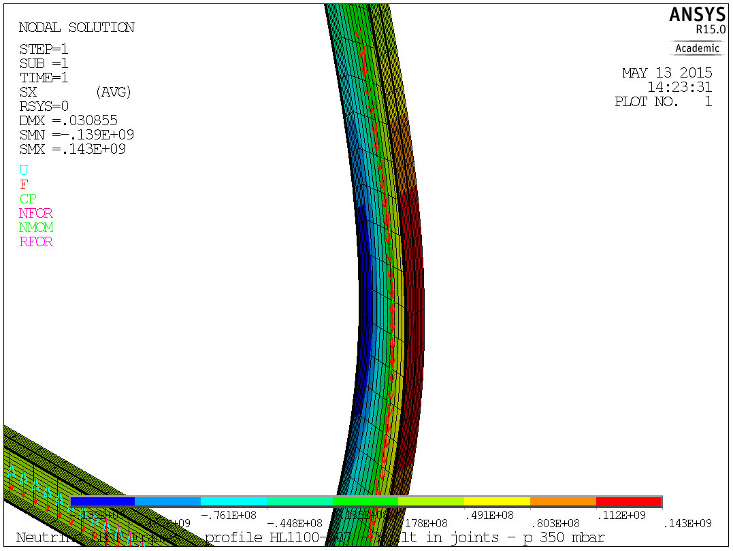
Baseline: all M connections

Slide 10
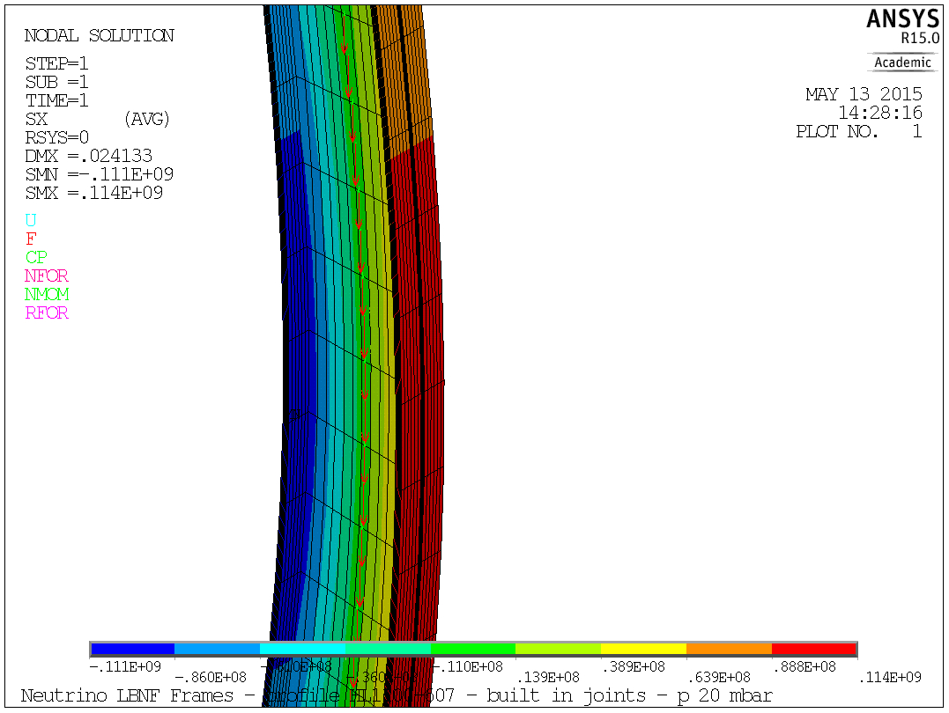
Baseline: all M connections

Slide 11
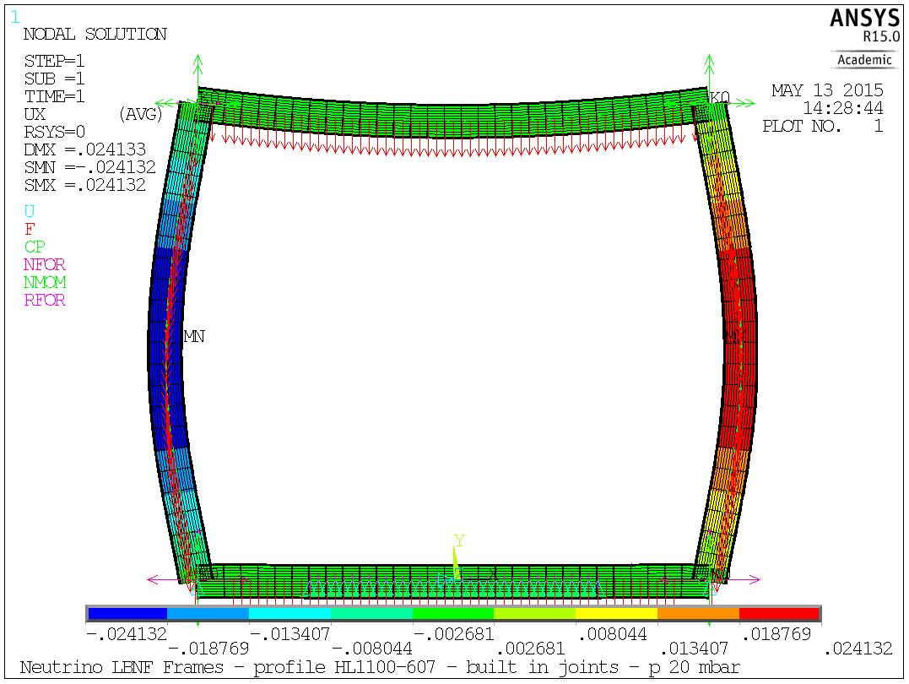
Baseline: all M connections

Slide 12
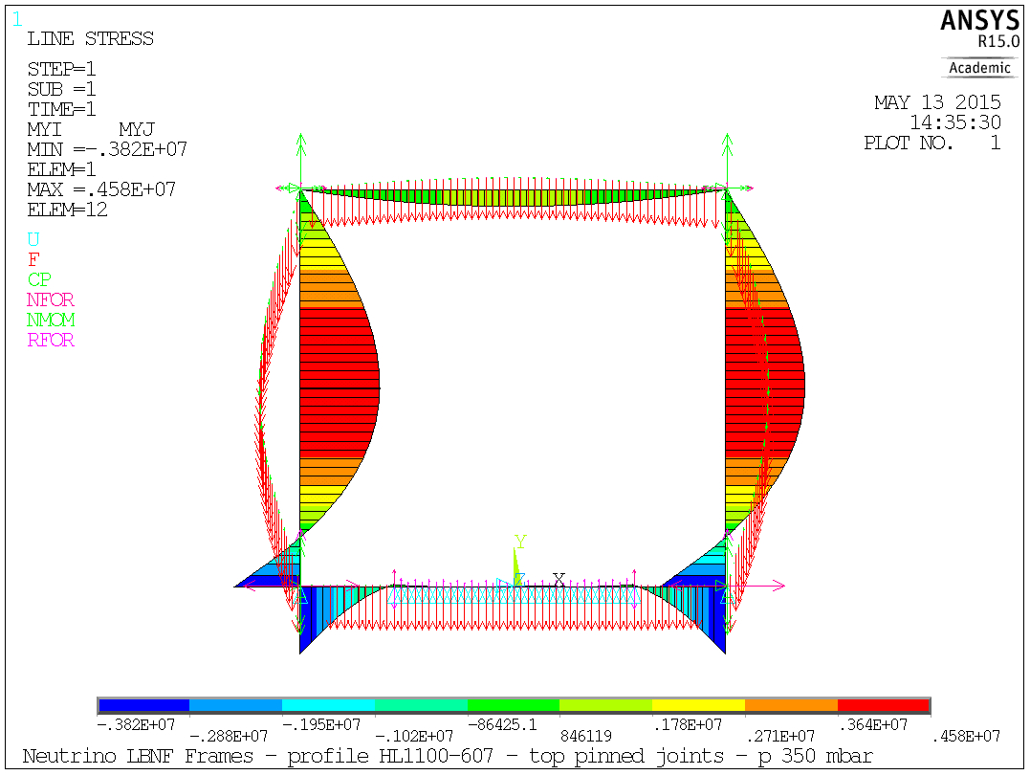
Top connections pinned

Slide 13
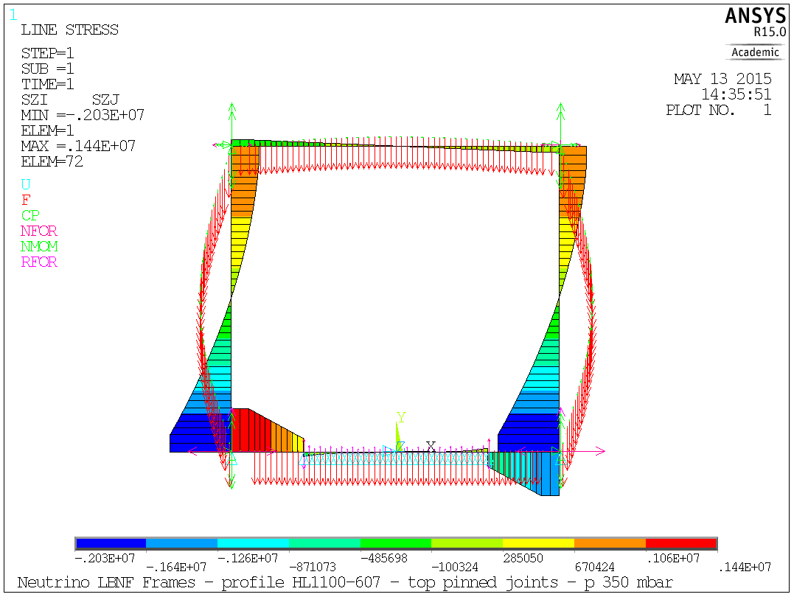
Top connections pinned

Slide 14
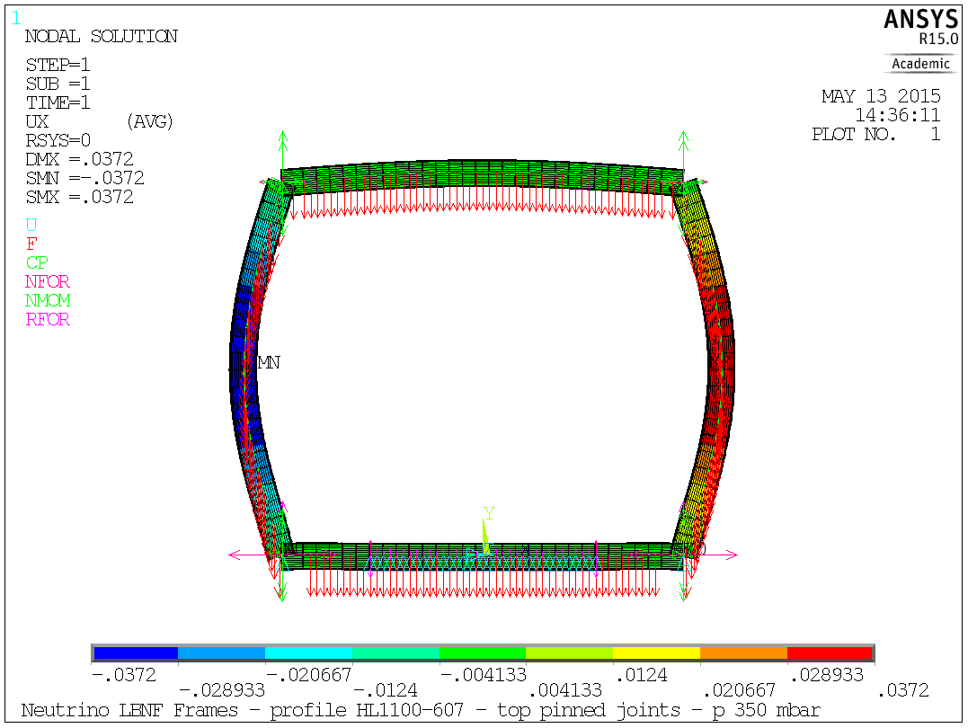
Top connections pinned

Slide 15
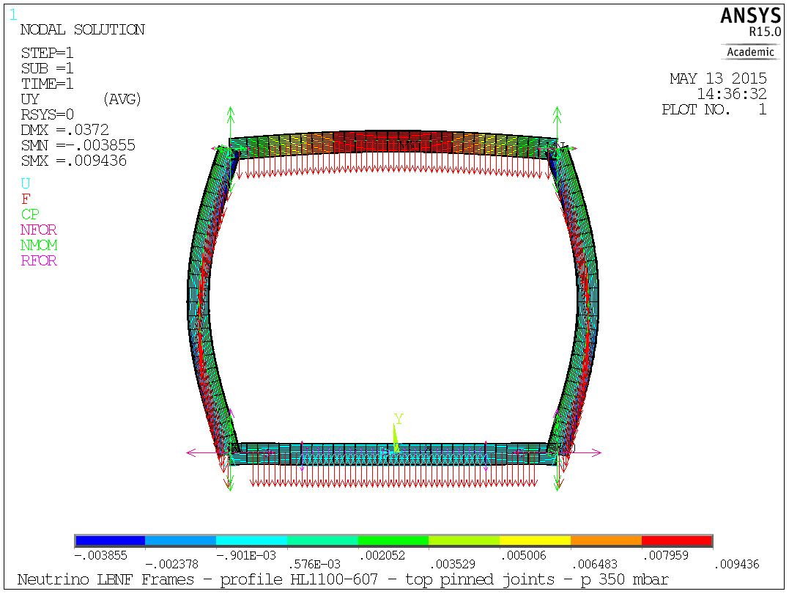
Top connections pinned

Slide 16
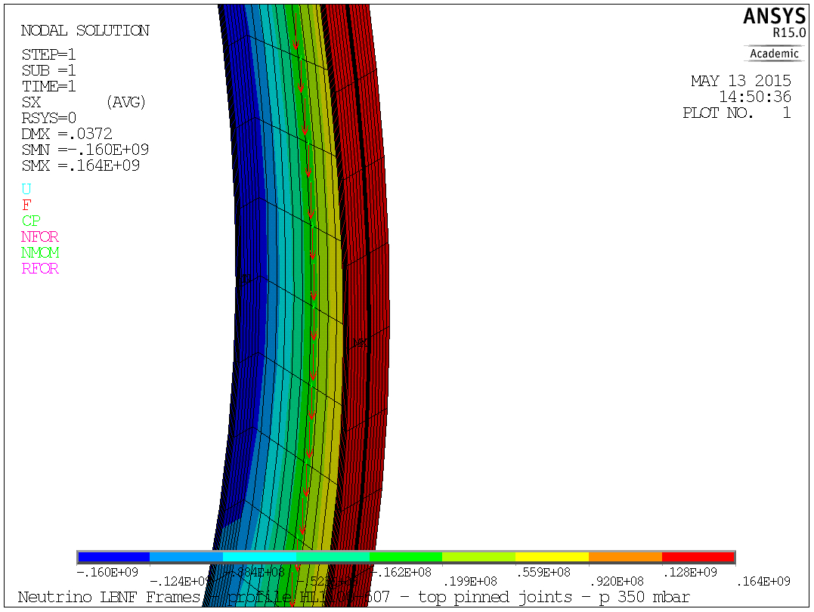
Top connections pinned

Slide 17
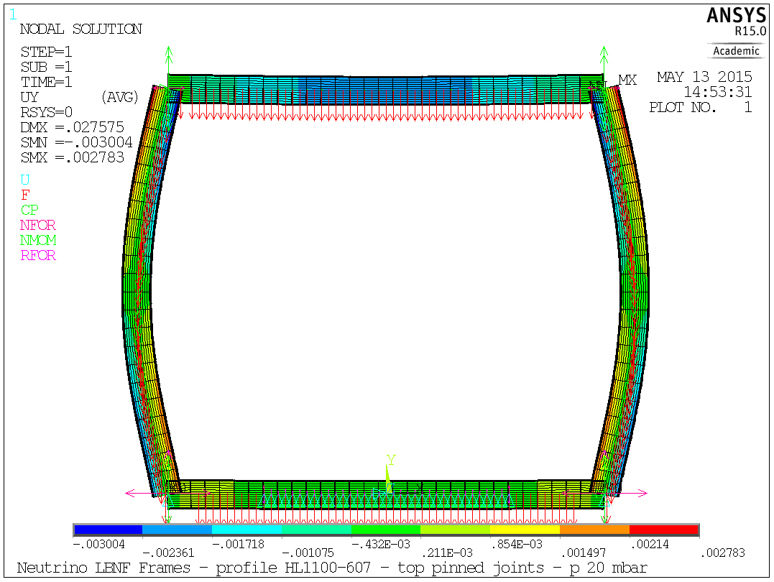
Top connections pinned

Slide 18
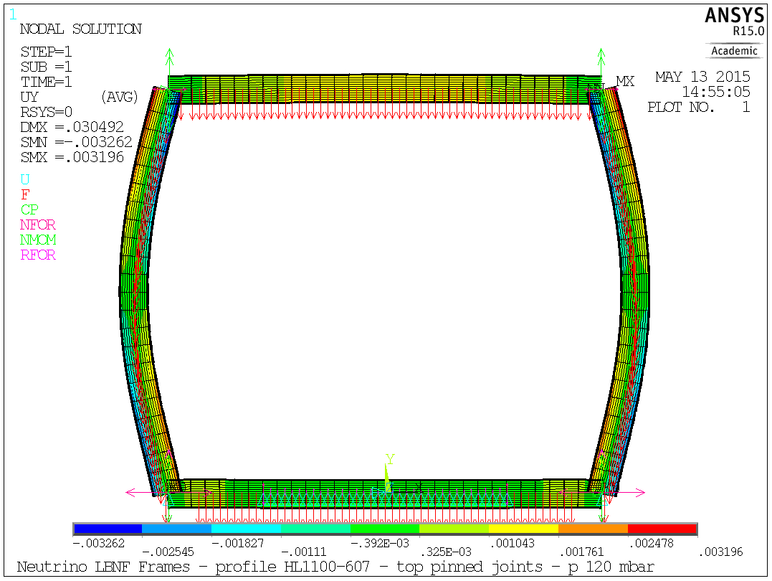
Top connections pinned

Slide 19
Material

Slide 20
Steel Grades
Steel S355 (EC properties for t>40mm)
  σ_{y}=335 MPa → σ_{y}/1.5=223 MPa
  UTS=470 MPa → UTS/3.5=134 MPa → UTS/2.4=195 MPa
Small Improvements by moving to S450 (EC properties for t>40mm):
  σ_{y}=410 MPa → σ_{y}/1.5=273.3 MPa
  UTS=550 MPa → UTS/3.5=157 MPa → UTS/2.4 =229 MPa

