Slide 1
Connections: FEA
PH-DT Engineering Office, CERN
CERN, May 2015

Slide 2
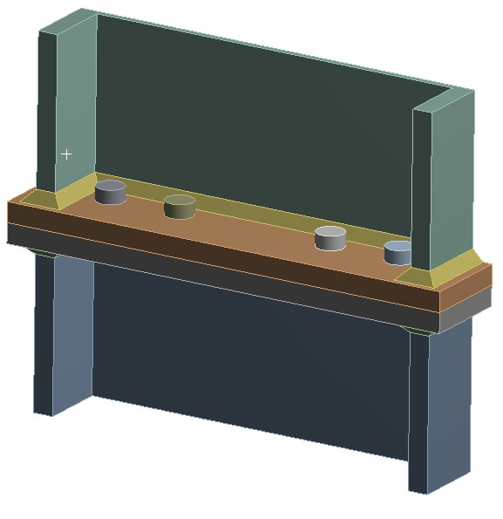
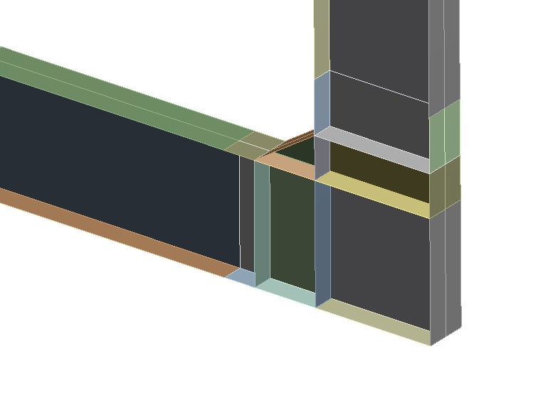
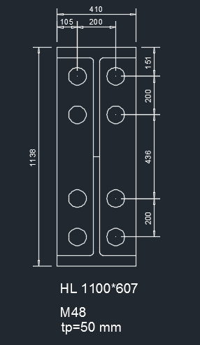
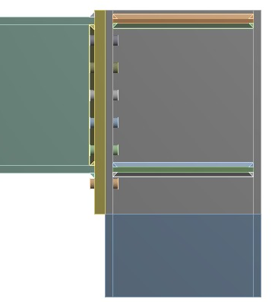
Splice Connection
Combination of two splice connections and a pre-manufactured L-shaped moment connection at the bottom
0.4m
0.6m
Splice Connection
Pre-manufactured, L-Shaped Connection
Vertical positions of the splice connections to be carefully selected so as to minimise the bending moment that they must withstand
Top Connection: Pinned or Moment Connection?

Slide 3
Joint Validation: Proposed FEA Methodology
Extract rotational stiffness of bottom (“pre-manufactured”) and top (bolted) connections (i.e. K_{bot} and K_{top} respectively) using detailed joint models or analytical EC3 calculations.
Introduce the values of K_{bot} and K_{top} in a beam model of the main frame to obtain the bending moment distribution along the main vertical beam.
  Initial position for the splice connection corresponds to the location of the zero-bending moment.
Run a shell model of the main portal. (The bottom connection will be explicitly included in this model, but the imperfect nature of the top connection should be accounted for via a revolute joint with rotational stiffness equal to K_{top}).
Use the results of step 3 to run a sub-model of the various connection and evaluate the stresses in the bolts/welds. The nominal position of the splice connection would correspond to that extracted in step 2, but a sensitivity analysis should be performed to assess the effect of the positional error. Bolt pre-tension and nominal loads should be taken into account in this step.

Slide 4
Joint Validation: Proposed FEA Methodology
The rotational stiffness of the top and bottom connections in the full shell model seems very close to that extracted from the detailed analysis (numerical and analytical) when they operate below their maximum capacity.
Run a shell model of the main portal.
Use the results of step 3 to run sub-models of the various connection and evaluate the stresses in the bolts/welds. The nominal position of the splice connection would correspond to that extracted in step 2, but a sensitivity analysis should be performed to assess the effect of the positional error. Bolt pre-tension and nominal loads should be taken into account in this step.
  Bypass the beam model and work directly with the full shell model of the main portal to determine the optimum position of the splice connection and the imported BCs for the top and bottom joints (K_{bot} and K_{top are directly} included in the model).
  Determine the initial position of the vertical splice, which corresponds to the location of the zero-bending moment.

Slide 5
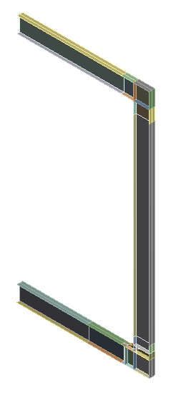
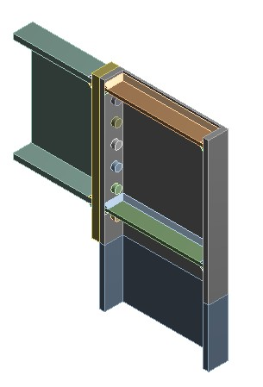
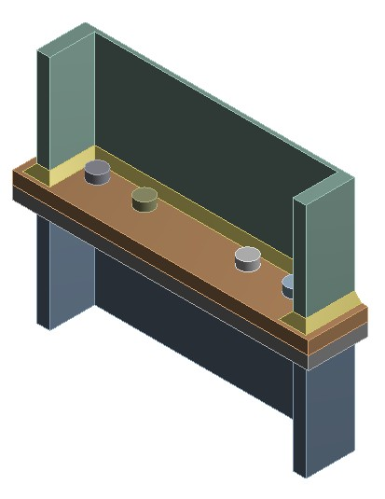
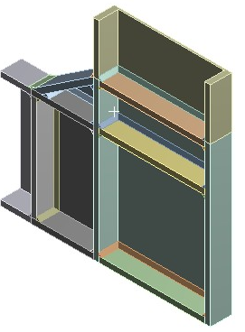
Joint Validation: Proposed FEA Methodology
  Sub-models of the connections
  Shell model of main portal

Slide 6
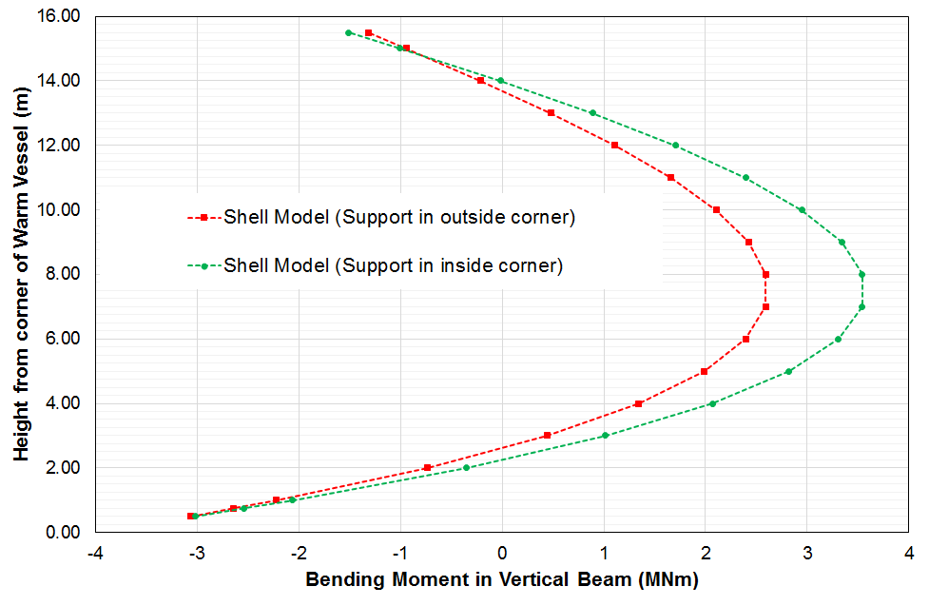
Shell Frame: Preliminary Results
Significant effect of the location of the local vertical support for the bottom corner
  Case 1: Support inside corner → Optimum position ~2.25m
  Case 2: Support outside corner → Optimum position ~2.65m
1
2
* The length shown in the graph is measured from the internal corner of the box. So, for 2.25m the total height of the bottom joint would be 2.25+1.138=3.388m from the floor (assuming that the bottom beam remains HL 1100x607)

Slide 7
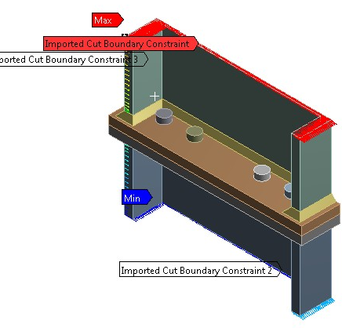
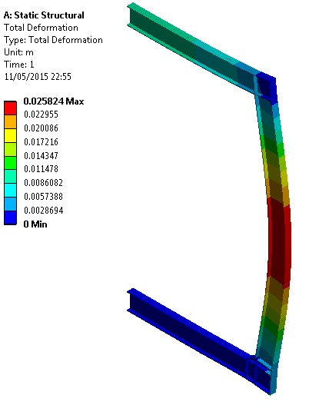
Joint Validation: Shell Frame + Sub-modelling
Analysis of the all-shell frame with nominal loads
Sub-modelling of the various connections (.
  Imported BCs for the corresponding position (parametric)
  Frictional contacts (µ=0.25)
  Welds (30mm)
  Non-linear materials (S355 for beams, 10.9 for bolts)
  Bolt Pre-tension=625kN (M48)
  No washers

Slide 8
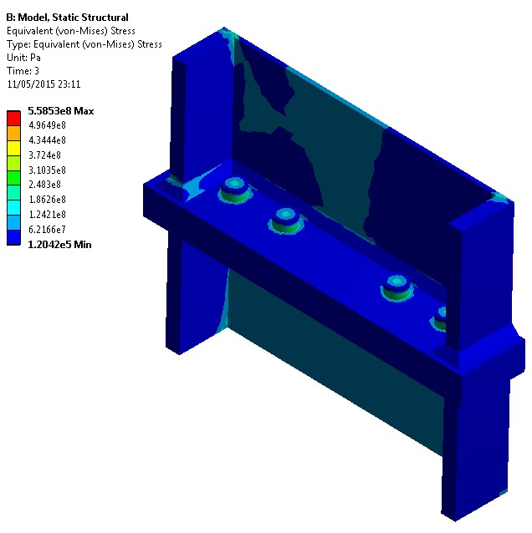
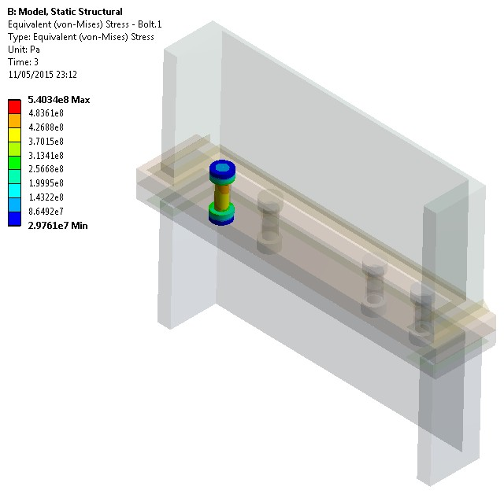
Case 1: Splice Connection Analysis
Nominal Position: 2.25m from inside corner
Good News!!
  For the optimal position of the splice connection, even the peak stresses in the bolts & welds are below 2/3 σ_{y.}
  Average Stresses to be calculated next according to ASME

Slide 9
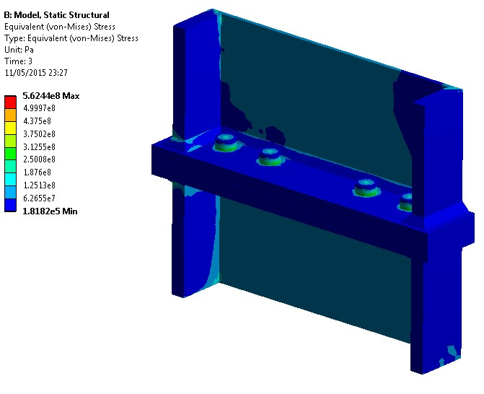
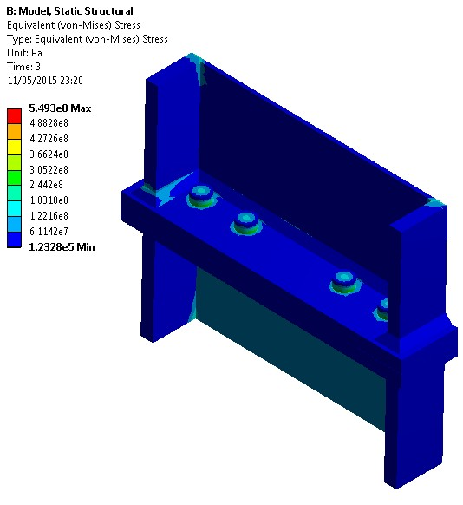
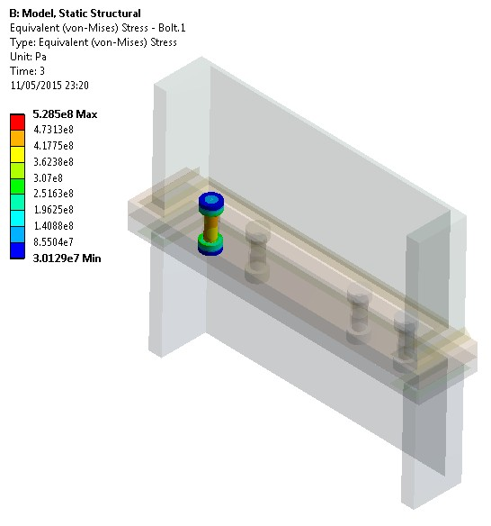
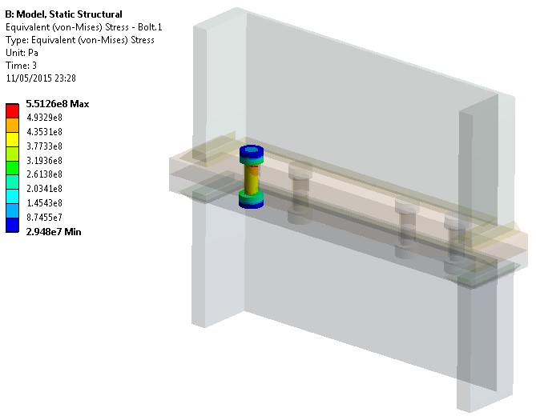
Case 1: Splice Connection Analysis
Variation of the position of the spliced joint ±500mm (i.e. position 1.75m and 2.75m) and repeated the analysis.
  Even the peak stresses in bolts & welds remain below 2/3 σ_{y}
~1.75m
~2.75m

Slide 10
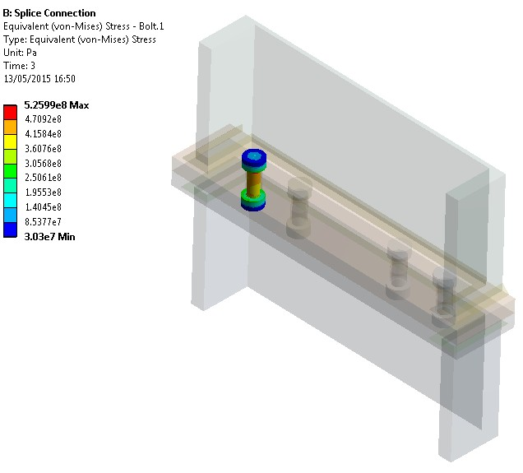
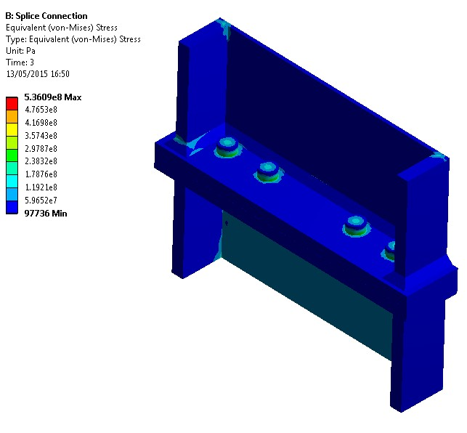
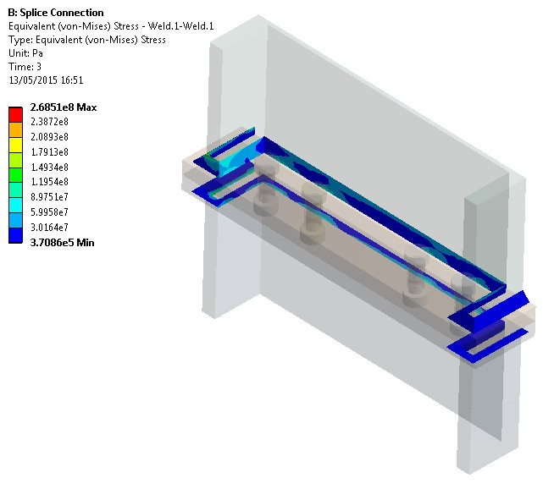
Case 2: Splice Connection Analysis
Nominal Position: 2.65m from inside corner

Slide 11
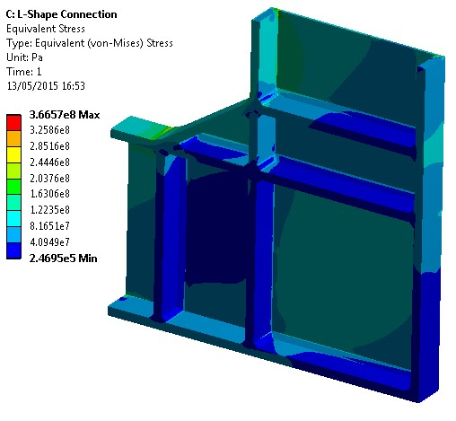
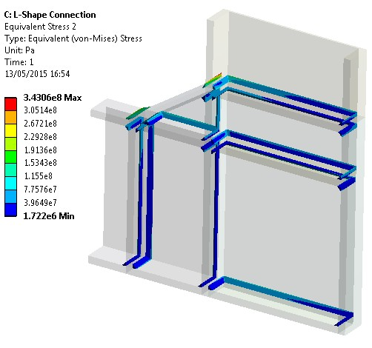
Case 2: Bottom Connection Analysis

Slide 12
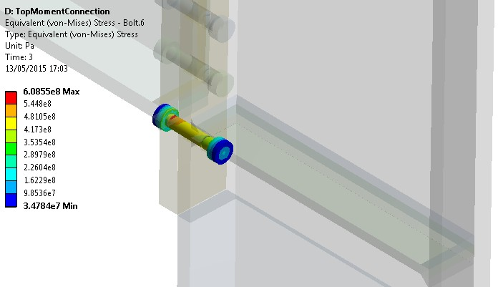
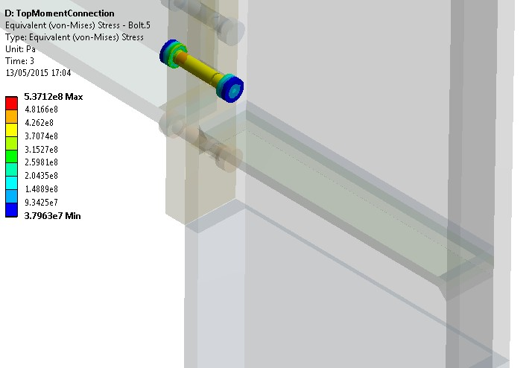
Case 2: Top Connection Analysis

