Slide 1
Jet quenching in small systems, and more on Mach cones
Edward Shuryak
(ALICE jet workshop at Yale, May 2015)
Based on works with Derek Teaney, Jorge Casalderrey-Solana, Jinfeng Liao, Pilar Staig, Tigran Kalaydzhyan, Yuji Hirono

Slide 2

The content
1.Why quenching should be enhanced near Tc
2.How large should jet quenching in “small systems”
(central pA, high multiplicity pp) be?
3.Can one still find a Mach cone?
How can it be useful?

Slide 3

Jet quenching and a bit of (my) history: the v2 issue
The Azimuthal asymmetry at large p(t) seem to be too large for a `jet quenching'
E.V. Shuryak (SUNY, Stony Brook). Dec 2001. 3 pp.
Published in Phys.Rev. C66 (2002) 027902, e-Print: nucl-th/0112042
geometric limit on v2
Angular Dependence of Jet Quenching Indicates Its Strong Enhancement Near the QCD Phase Transition
Jinfeng Liao (SUNY, Stony Brook & LBL, Berkeley), Edward Shuryak (SUNY, Stony Brook). Oct 2008. 4 pp.
Published in Phys.Rev.Lett. 102 (2009) 202302 arXiv:0810.4116
solves the v2 problem by making a peak at Tc
Why is Tc special? Monopole plasma (with Liao) or string balls (with Kalaydzhyan)

Slide 4
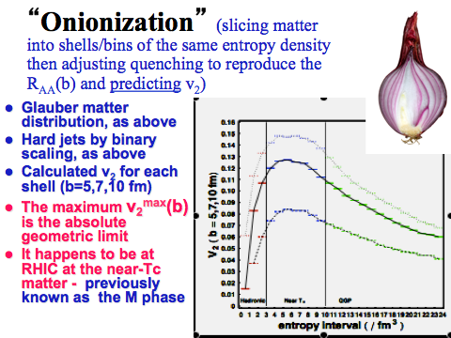

Slide 5
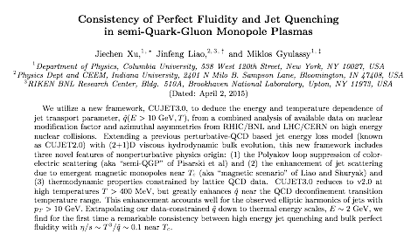
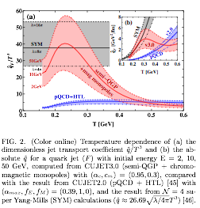
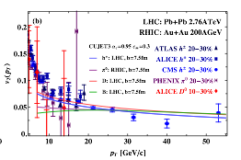

Slide 6
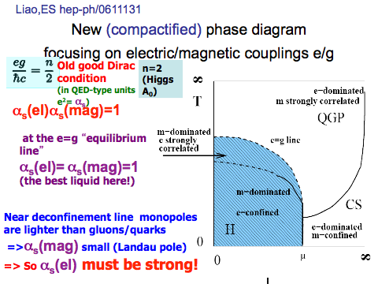

Slide 7
jet quenching in “small systems”
(central pA and high multiplicity pp)

Slide 8
Extremely naive BDMPS/QGP scaling
based on scale invariance
Note that QGP hydro equations themselves
do not change
as both EOS and viscosity are scale invariant
Thus (extemely naive) conclusion
from BDMPS is that the jet quenching
in a smaller-but-hotter fireball should be
k times larger

Slide 9

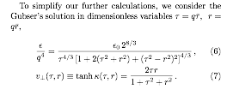



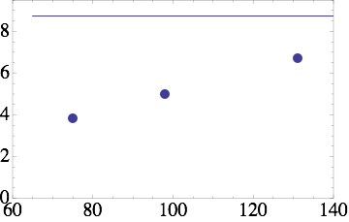
Naive evaluation, for
real T,L in pp/pA
Kalaydzhyan, ES
arXiv:1503.05213
high multiplicity pp
AuAu
Thus (naive) conclusion:
jet quenching
in a smaller-but-hotter pp
fireball is smaller
but not by much
CMS tracks

Slide 10
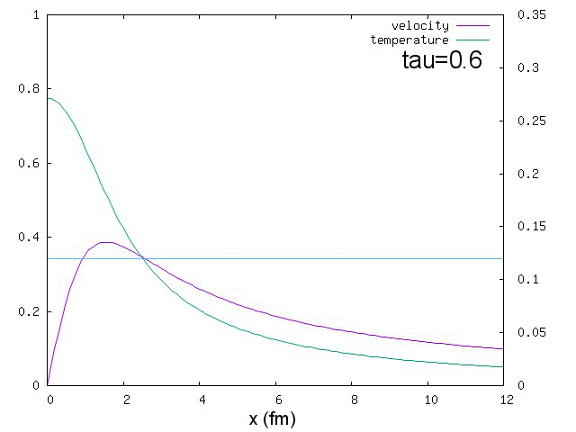
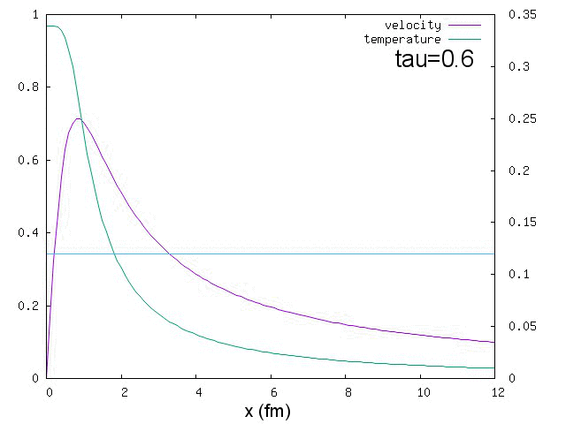
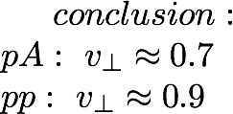
In order not to be naive, let us do:
(i) hydro with realistic EOS and freezeout
T(GeV)
T(GeV)
q=0.7 or central pA
q=1.7 or high mult. pp
Yuji Hirono,ES, arXiv:1412:0063
HBT for pp, radii(kt) show flow

Slide 11


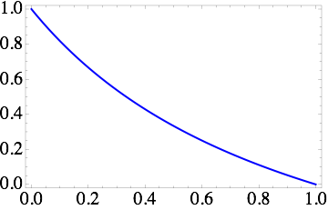
(ii) preliminary account for matter motion
for a jet comoving from the center dt=dr
and thus I get another suppression
factor inside the integral for late time
This effect
suppresses
jet quenching by
another
factor 5-10
and explain why
we do not see it
small systems are more explosive that AA,
and spend much less time near Tc =>
less quenching

Slide 12
Back to Mach cones
Conical flow induced by quenched QCD jets
J. Casalderrey-Solana, E.V. Shuryak, D. Teaney (SUNY, Stony Brook). Nov 2004. 4 pp.
J.Phys.Conf.Ser. 27 (2005) 22-31, Nucl.Phys. A774 (2006) 577-580 hep-ph/0411315
Sound edge of the quenching jets
Edward Shuryak, Pilar Staig (SUNY, Stony Brook). Jul 9, 2013. 11 pp.
Phys.Rev. C88 (2013) 5, 054903 arXiv:1307.2568
to be discussed now

Slide 13
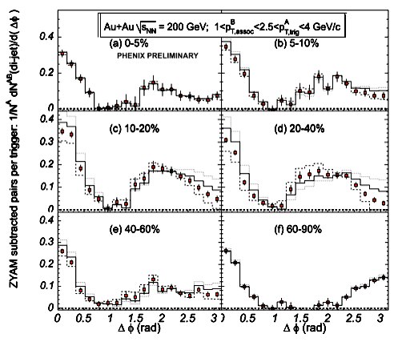
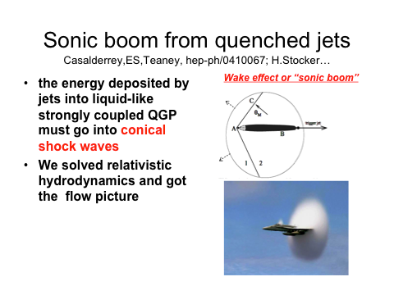
a slide from my talk years ago: suggesting Mach cone:
but then the interpretation of correlation function completely changed: what went wrong?

Slide 14
a decade ago everyone (?) thought
that a trigger hadron with 2.5 GeV < pt < 4 GeV
must be from a jet
(turned out to be wrong: no jets needed, hydro works fine there)
Furthermore we later learned that
high flow harmonics
(due to initial state fluctuations)
not only reach such pt but in
fact have a maximum at 3-4 GeV

Slide 15
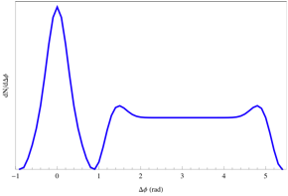
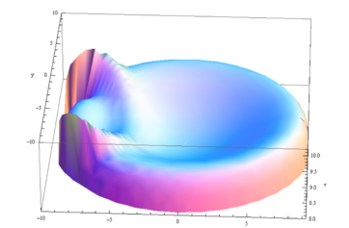
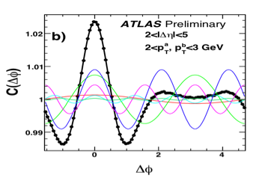
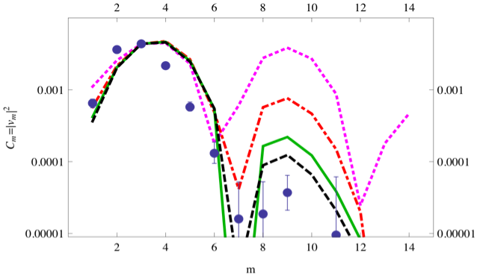
high harmonics of flow
Pilar Staig, Edward Shuryak Phys.Rev. C84 (2011) 044912
arXiv:1105.0676

Slide 16
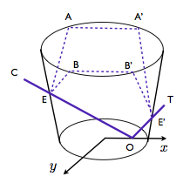
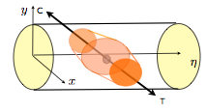
Geometry: the sound surface
t
(3d) picture including the transverse coordinates x, y and the proper time τ (vertical direction). The lower and upper cir- cles indicate the initial and final surfaces. The jet origination point is called O, the two exit points are E and E’. The sound surface consists of two parts, OEAA′E′ and OEBB′E′, in- dicated by the dashed lines. The value b = 0 is chosen for simplicity.
A schematic view of the sound surface in coordinates x, y and (spatial) rapidity η. Trigger and companion jets are chosen to have the same rapidity, for simplicity.
at pt=3-4 GeV only the modification
of the fireball rim matters!

Slide 17
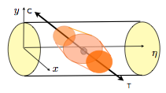

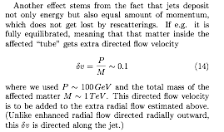
Large energy deposition create two
distinct “sub-events”
At deposited E⊥ ∼ 100 GeV the number of extra secodaries
is about Nextra ∼ 200, to be compared to dN/dη ∼ 2400.
The multiplcity increase is about 8%. Since multiplicity scales as T³, the increase of the temperature (if homogeneous) is about
δT/T ∼ 2.7%. increasing the freezeout radius by the square root of it, or 4% in our example. The Hubble law of expansion then tell us that it will increase flow velocity linearly with r, or also by 4%.
The boost exponent however can easily increase the contrast to be as large as 100%, for example

Slide 18
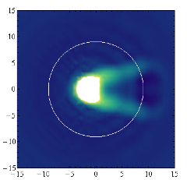
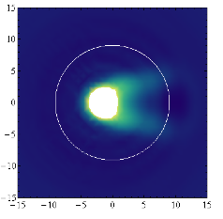
Mach cone, viscosity
and an inhomogeneous energy deposition
the Mach cone
in the transverse plane (x,y) (in fm), induced by a jet generated at the point (6.1,0) and moving to the left along the diameter with the speed of light. In the upper plot the energy deposition dE/dx = const and viscosity is put to zero,
in this version
dE/dx ∼ x and realsitic viscosity-to-entropy combination 4πη/s = 2.
the Mach cone is weakened by still seen:
yet its overlap with the fireball rim
(the white circle) is nearly gone!

Slide 19
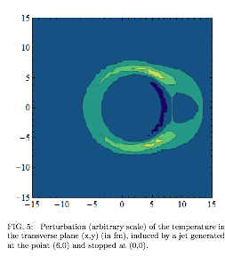
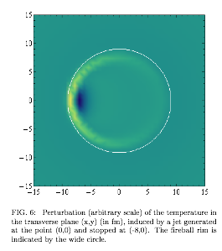
Jets which die in the middle of fireball
leave only a very diffuse signal on the fireball’s rim
and can hardly be observed

Slide 20
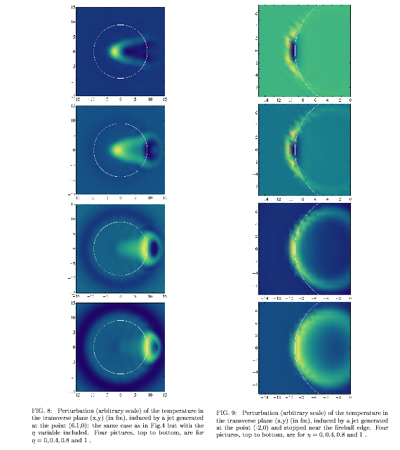
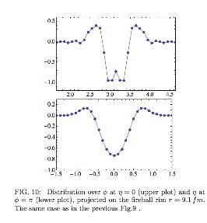
The pictures sliced in rapidity

Slide 21
summary
Enhanced q-hat(T=Tc): monopoles (or stringballs)
Quenching in small systems (pA,pp) should be small because they are very “explosive” and spend little time near Tc
quenching jets produce perturbations at the intersection of Mach cone and the fireball rim: “the jet edge”. Geometry variations are large but typically it is +- 1 rad in phi-eta around a jet.
the whole interior of the sound surface is affected => a distinct sub-event with different flow is expected in asymmetric dijets

