Slide 1
New Developments in the EGI Accounting Repository
Adrian Coveney,
Stuart Pullinger, John Gordon,
Greg Corbett
Notes:
The EGI Accounting Repository collects accounting data from sites participating in the EGI and WLCG infrastructures as well as from sites belonging to other Grid organisations that are collaborating with EGI. It generates statistical summaries that are available through the Accounting Portal to Users, VO Managers and Site Administrators.
This session will cover current and upcoming developments of the Accounting Repository under EGI-Engage.

Slide 2
Outline
Accounting System Overview
Recent Updates
Data Set Accounting
Cloud Accounting
Big Data Tools
Storage (Space) Accounting
GPGPU/Accelerator Accounting

Slide 3
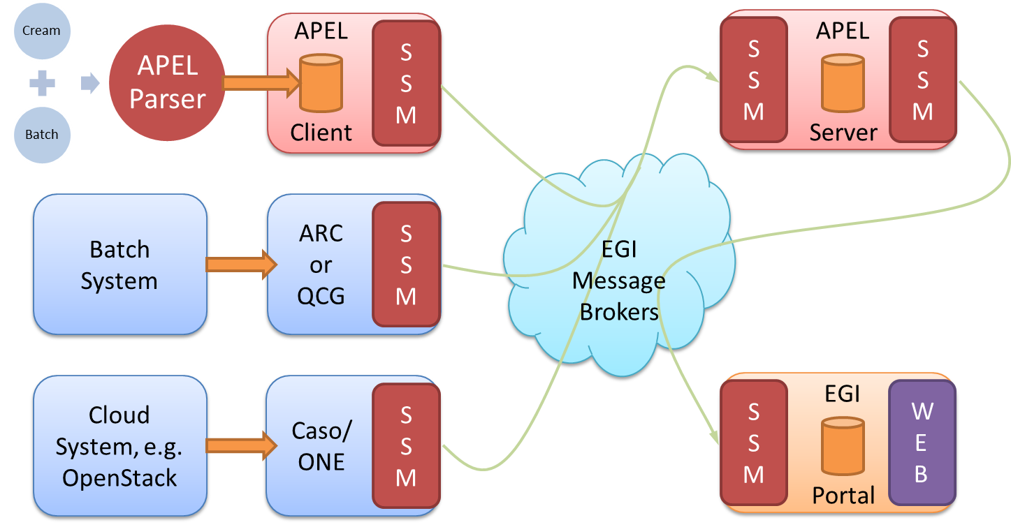
Accounting System Overview
Notes:
APEL clients can run an APEL parser to extract data from a batch system and place it in their client database, or they can use third-party tools to extract batch or cloud data. This data is then unloaded into a message format suitable for transmission.
APEL clients run a sending Secure Stomp Messenger (SSM) to send these messages containing records via the EGI Message Brokers the central APEL server. The messages can contain either Job Records or Summary records. This is configurable in the APEL client.
The central APEL server runs an instance of the SSM, which receives these messages and a “loader” processes the records in the messages and loads them into a MySQL database.
A “summariser” process runs to create summaries of any Job Records received and load them in a “SuperSummaries” table along with any Summary records. This summariser runs as a cron job approximately once a day.
A database “unloader” process unloads the summary records into the message format to be sent on by the sending SSM via the EGI Message Brokers to the EGI Accounting Portal.
https://github.com/apel/ssm

Slide 4
Recent Updates
Software Releases:
  APEL version 1.5.1
    Bug fixes and support for new version of Torque
  SSM version 2.1.7 released simultaneously
    Bug fixes
  Not in UMD3 yet
Team changes
  Stuart Pullinger, John Gordon (till September 2016)
  Adrian Coveney, Greg Corbett
Support is via GGUS
  apel-admins@stfc.ac.uk as a last resort

Slide 5
Data Set Accounting
Data Set = a logical set of files which may exist in several places at once and to which it is possible to assign some form of persistent unique identifier
Assists site and experiment administrators
  make decisions about the location and storage of data sets to make more efficient use of the infrastructure
  assist scientists in assessing the impact of their work
Clear interest from the surveyed communities
  user-access, data set PID logging, and recording transfer operations
Many systems with no consistent approach to recording usage
Will investigate related projects eg. WLCG & OneData

Slide 6
Cloud Accounting 1
New fields in the cloud accounting record (V0.4)
  BenchmarkType
  BenchmarkValue
  PublicIPCount
  CloudComputeService
  Ready to go into production
Display of CPU counts in the Portal
  Data is in the central repository, but not in the summaries sent to the Portal
  Some development needed to change this
  Will be moved to production with changes above

Slide 7
Cloud Accounting 2
Long-running VMs
  Currently, all of a VM’s usage is assigned to the month when the VM started
  Long-running (multi-month duration) VMs are not properly accounted for
  Solution
    After several attempts and avoiding changes to client software & message format
    Calculate a ‘MeasurementTime’
      StartTime + SuspendDuration + WallTime
    Assign usage based on last MeasurementTime of the month
    Initial version to be released in April for testing and feedback

Slide 8
Big Data Tools
Central processing stage for the CPU accounting data takes many hours
Big Data tools provide an opportunity to improve performance and resilience
Report completed: Analysis on Techniques to Manage Big Data on the EGI Accounting System
3 Broad categories:
  Optimised use of the MySQL database
  Replacement with Apache Hadoop and the Hadoop Distributed File System
  Replacement with a time series databases
  Testing of technologies to start soon

Slide 9
Storage Accounting
Accounting data extracted from DPM and dCache
Sends StAR records using SSM
Sites send instantaneous reading every day
Assumed valid for previous 24 hours (under discussion)
How to summarise? GB/days?
Have identified the issues that need resolving to get correct storage accounting
Once resolved, we will aim to get more sites publishing
Instructions: https://wiki.egi.eu/wiki/APEL/Storage

Slide 10
GPU/Accelerator Accounting: Issues
GPUs are usable by multiple users/jobs
  batch systems do not attribute usage to a job/user.
On the other hand, GPUs are attached to cloud VMs in the hypervisor
  only attached to one VM at a time
  for the lifetime of the VM?
  removes the multiple user issue.
Cloud systems currently return wallclock time only
  Ie. No separate CPU time
    (We hope that this can be improved.)
  GPU Time == WallClockTime ??
More meaningful to attempt cloud GPU accounting first.

Slide 11
What’s needed for accounting
Batch systems should report GPU usage in the batch logs.
  APEL would then parse the logs files to retrieve the data.
Or GPU monitoring recording usage in a database
  with job or VM identifier,
  will enable the APEL client to join it with existing data
  create an extended Usage Record.
The existing cloud extraction tools oneacct and cASO can be extended to include cloud GPU usage if a GPU expert can identify the relevant fields.
The accounting portal would define new views to display GPU usage in a similar way to existing CPU views.

Slide 12
Accounting for Locked Resources
Large memory jobs can effectively block CPUs
  The node does not have enough memory to run other jobs on spare CPUs
Accounting approach – rejected?
  Account for CPUs effectively locked rather than just CPUs used
  Unlikely that this is simple to achieve ie. not confident data is in the batch logs alongside the accounting data
  But could make an interesting project!
Improved utilisation approach
  Ensure systems are configured to combine small + large memory jobs

