Slide 1

WLCG Workshop
Julia Andreeva, Maria Alandes CERN-IT
GDB
14 September 2016

Slide 2
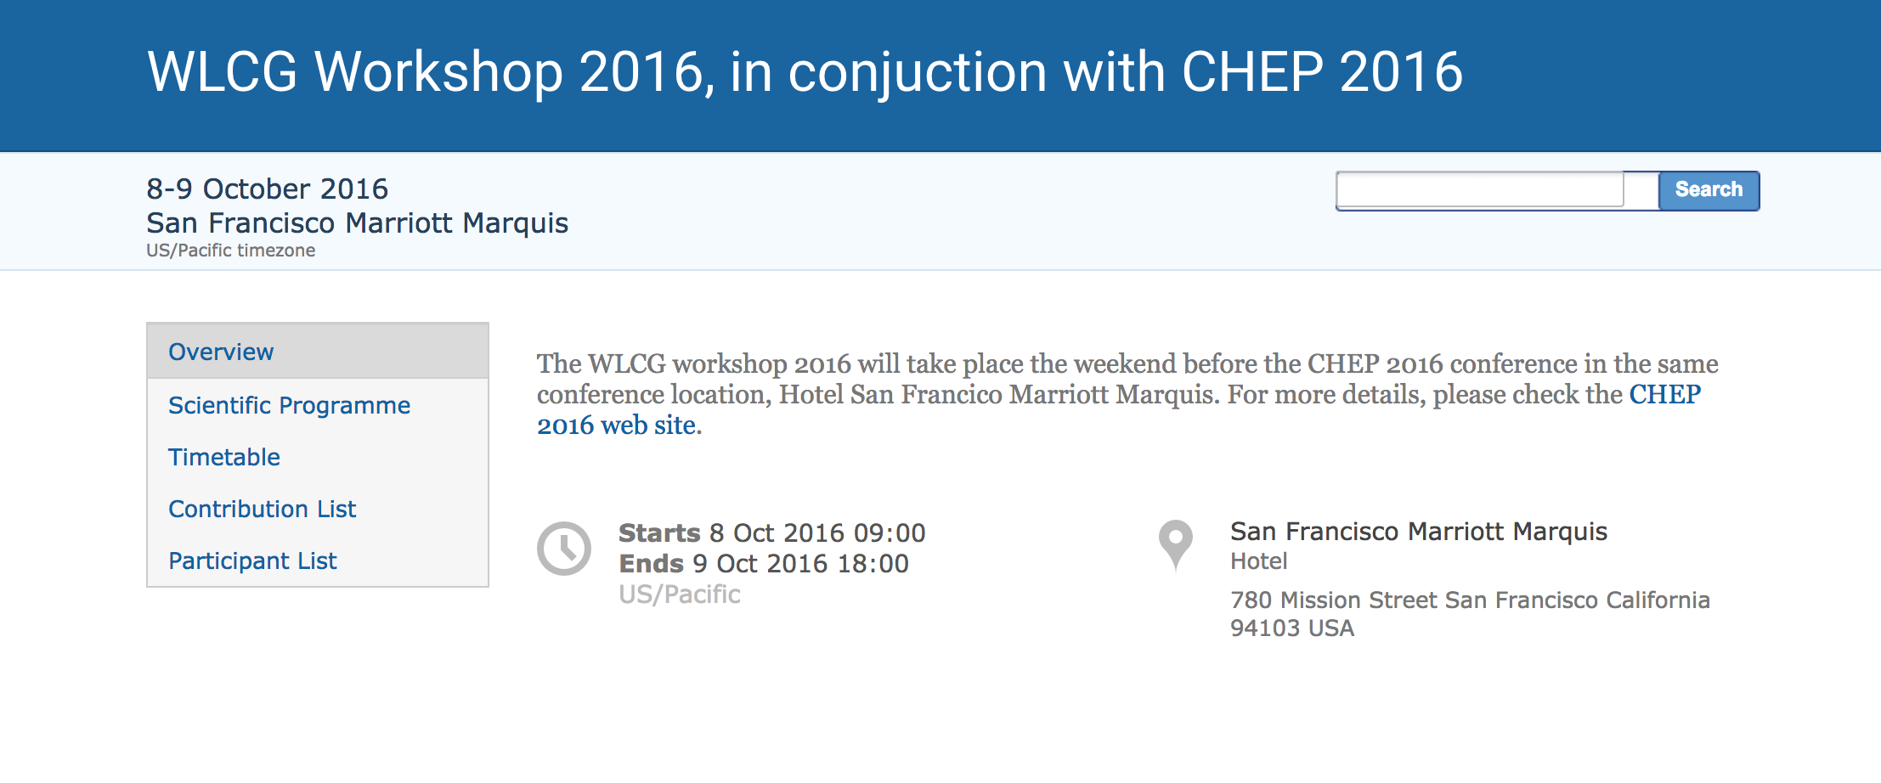
WLCG Workshop will be held in conjunction with CHEP 2016
https://indico.cern.ch/event/555063/

Slide 3
Agenda (1)
2 days of discussion and brainstorming on WLCG evolution
Follow up on some key areas discussed in Lisbon (data management, cloud provisioning, security)
Include topics which were not covered in Lisbon ( network, software efficiency and understanding of the performance of the experiment workflows)
Aim to have interactive sessions with a lot of discussions rather than just status reports

Slide 4
Agenda (2)
Following the outcome of the Lisbon workshop some new task forces were organized (Accounting Task Force) and some issues were followed up in already existing task forces and working groups (IS evolution)
We do not intend to review all those areas of work in case they were sufficiently presented at other forums (GDB) and desired progress was demonstrated
Did not include in the agenda monitoring where a lot of work is currently being performed, waiting for more user experience with the new implementation
Try to avoid overlap with CHEP presentations
Many thanks to the session conveners and people who are helping in organizing particular sessions though do not go to CHEP (Markus Schulz, Marian Babik, Edoardo Martelli).

Slide 5
Agenda 8th of October
Before lunch - presentation from Ian Bird on update on the requirements, data management and security sessions
After lunch network session, presentation on technology evolution and collaboration board
The detailed content of the sessions is still evolving. Further details provided at the next slides represent initial drafts from the session conveners. Not all conveners yet confirmed their participation, so some names are missing in the agenda.

Slide 6
Data management session
The session content was discussed at yesterday pre-GDB. Though initially intended to discuss the disruptive changes, after yesterday discussion decided to concentrate on current activities and issues:
  protocols
  - SRMless operation
  - resource reporting
  storage consolidation
  - caching
  - multi-site storage
  - local federations
  - cloud storage

Slide 7
Security session
Work of the WLCG WG on Security Operations Centres
Traceability and isolation paradigm
Trust frameworks

Slide 8
Network session
Update on IpV6
LHCOPN/LHCONE status
LHC Network Evolution
LHC schedule + DDM network predictions
Invited to participate ESNet people who are based in San Francisco

Slide 9
Agenda 9th of October
Afternoon is dedicated to HSF
Morning is split in two sessions : performance and efficiency (workflows and software) and cloud procurement experience

Slide 10
Performance session
First part is dedicated to the analysis of the efficiencies of the experiment workflows and T0 efficiency. This includes current state of understanding of the performance. Do we have all necessary tools? Progress in this area from Lisbon
Second part is to discuss software efficiency and low level analysis. Lessons learned. Commonalities. Are we working together?

Slide 11
Cloud session
T0 experience with cloud procurement (T-systems, HNSciCloud)
Tier-1s work with Amazon
Tier-2 cloud experience
Open floor discussion
  Local shared storage vs. higher network bandwidth
  Can cloud technology help simplify setting up and running a Tier-2?
  …

