Slide 1
IPv6 at FZU
Jiří Chudoba, Alexandr Mikula
3. 6. 2016
Institute of Physics of the CAS

Slide 2
IPv6 at FZU
All WNs and storages (DPM and xrootd) dual stack
Local traffic uses a lot of IPv6 (but not exclusively)
Remote traffic mostly IPv4

Slide 3
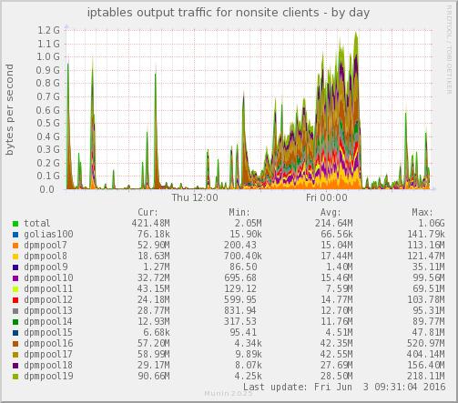
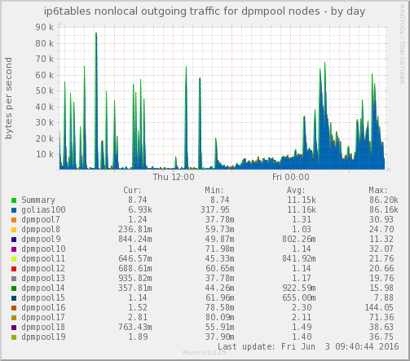
DPM – external transfers
IPv4
IPv6
Daily graph of external traffic. Transfers using IPv4 at the level of 1 GB/s, transfers using IPv6 bellow 100 KB/s.
IPv6 traffic mostly to the DPM head node, actual file transfer uses IPv4.

Slide 4
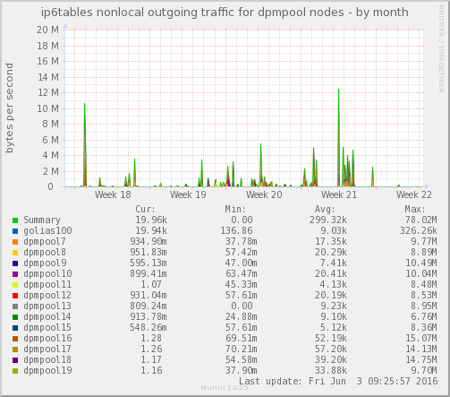
DPM – example of external IPv6 transfers
There are some file transfers to remote sites via IPv6, monthly graph show peaks above 10 Mbyte/s.
Examples of remote sites with data transfers from our site via IPv6:
ce01.grid.uio.no
lcg-lrz-dc02.grid.lrz.de
tux4u01.ific.uv.es
dc023.pic.es
cetest01.grid.hep.ph.ic.ac.uk
IPv6

Slide 5
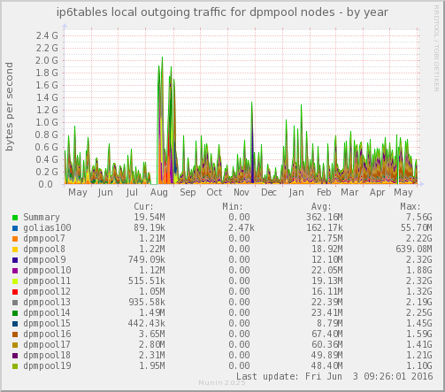
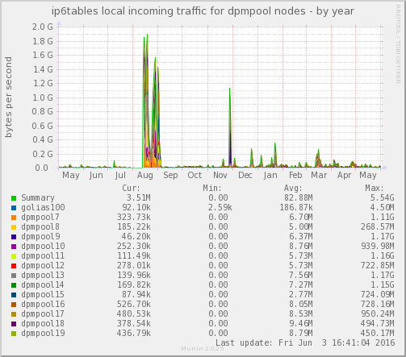
DPM – local IPv6 transfers
IPv6 from DPM
IPv6 to DPM
Local transfers from/to DPM to/from Worker Nodes uses IPv6, but not exclusively. Peaks in august are transfers between DPM pool servers.

Slide 6
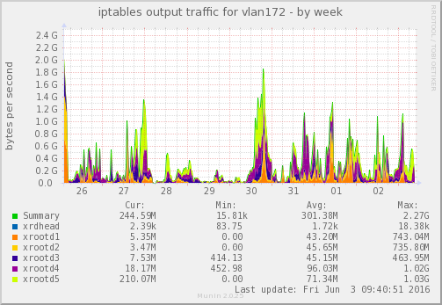
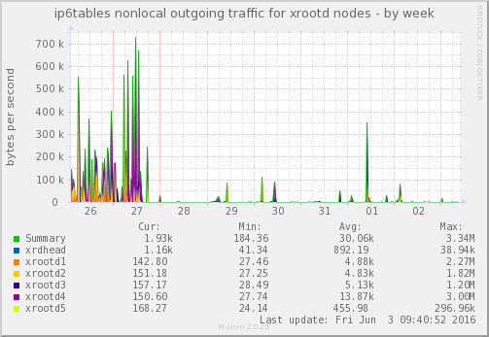
xrootd – external transfers
IPv4 and IPv6
IPv6 only
Similar to DPM. Weekly graph of external traffic from xrootd servers. Transfers using IPv4 at the level upto 2 GB/s, transfers using IPv6 bellow 1 MB/s. IPv6 traffic often only to the xrootd head node, actual file transfer mostly uses IPv4.

