Slide 1
perfSONAR
Marian Babik (IT/CM)
IPv6 pre-GDB
7th June 2016
Parts of this presentation are a result of work by the perfSONAR Project and are licensed under CC BY-SA 4.0 (https://creativecommons.org/licenses/by-sa/4.0/).

Slide 2
Motivation
Soft vs Hard network failures
“Hard failures” are the kind of problems every organization understands
  Fiber cut, Power failure takes down routers, Hardware ceases to function
“Soft failures” are different and often go undetected
  Basic connectivity (ping, traceroute, web pages, email) works
  Performance is just poor
TCP was intentionally designed to hide all transmission errors from the user:
  “As long as the TCPs continue to function properly and the internet system does not become completely partitioned, no transmission errors will affect the users.” (From IEN 129, RFC 716)
Some soft failures only affect high bandwidth long RTT flows
  Local testing will not find it !
Hard failures are easy to detect & fix
  Soft failures can lie hidden for years!
One network problem can often mask others
Notes:
Introduction to what and why we measure
- there has been focus on latencies/packet loss recently – explained on the next slide

Slide 3
perfSONAR
perfSONAR provides a number of standard metrics we can use
Latency measurements provide one-way delays and packet loss metrics
  Packet loss is almost always very bad for performance
Bandwidth tests measure achievable throughput and track TCP retries (using Iperf3)
  Provides a baseline to watch for changes; identify bottlenecks
Traceroute/Tracepath track network topology
  All measurements are only useful when we know the exact path they are taking through the network.
  Tracepath additionally measures MTU but is frequently blocked

Slide 4
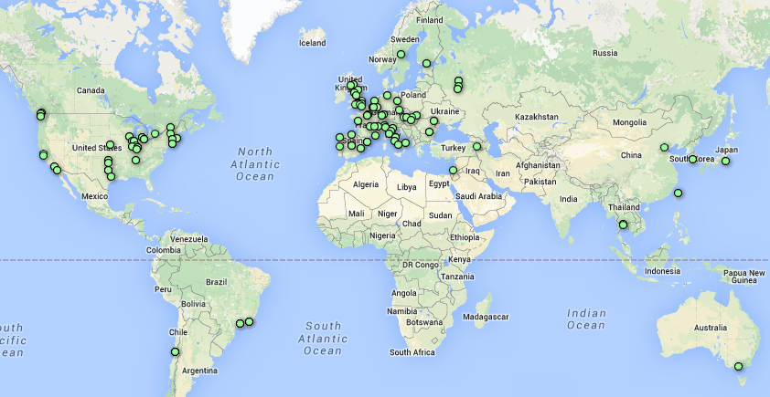
Current perfSONAR Deployment
http://grid-monitoring.cern.ch/perfsonar_report.txt for stats
246 Active perfSONAR instances
202 Running latest version (3.5+)
- 95 sonars in latency mesh
  8930 links measured at 10Hz
  packet-loss, one-way latency, jitter, ttl, packet-reordering
- 115 sonars in traceroutes mesh
  - 13110 links
  - hourly traceroutes, path-mtu
- 102 sonars in bandwidth mesh
  - 10920 links (iperf3)
https://www.google.com/fusiontables/DataSource?docid=1QT4r17HEufkvnqhJu24nIptZ66XauYEIBWWh5Kpa#map:id=3
Initial deployment coordinated by WLCG perfSONAR TF
Commissioning followed by WLCG Network and Transfer Metrics WG
Notes:
Overview of our current deployment and commissioning, our major achievement is that we’re now able to take measurement with high efficiency and run a stable network – which given it’s size and frequency of measured metrics is one of the biggest (if not the biggest) network perf. monitoring network based on open-source

Slide 5
Overview of perfSONAR Pipeline
The diagram on the right provides a high-level view of how WLCG/OSG is managing perfSONAR deployments, gathering metrics and making them available for use.
Notes:
Some Plans:
OSG monitoring (psomd) – will be moved to a standardized SAM/Nagios monitoring (it will still be hosted at OSG)
Configuration interface has been major success – there is open source project now in the works that will be part of perfSONAR 3.6

Slide 6
perfSONAR Toolkit
The “perfSONAR Toolkit” is an open source implementation and packaging of the perfSONAR measurement infrastructure and protocols
  http://www.perfsonar.net
All components are available as RPMs, DEBs, and bundled as a CentOS 6-based “netinstall”
  perfSONAR tools are much more accurate if run on a dedicated perfSONAR host
Very easy to install and configure
  Usually takes less than 30 minutes
Deployment considerations
  Recommended to install on bare metal, but VMs are also an option
    VMs require special setup (SR-IOV, pinned CPU, etc.)
  Since 3.4+ support for multiple NICs
  We recommend installing/updating to 3.5.1 and enable auto-updates
Dual-stack supported out of the box
  A and AAAA DNS should resolve to the same hostname
WLCG perfSONAR SU is here to help

Slide 7
WLCG throughput
Support unit to coordinate responses to potential network issues
  Tickets opened in the support group can be triaged to the right destination
  Many issues are potentially resolvable within the working group
  Real network issues can be identified and directed to the appropriate network support centers
Documented at https://twiki.cern.ch/twiki/bin/view/LCG/NetworkTransferMetrics#Network_Performance_Incidents
Bi-weekly meetings taking place, WLCG and North American throughput calls
  Oversight of the perfSONAR network infrastructure
  Coordination of the WLCG network performance incidents
  Detection and follow up on issues seen by the perfSONAR network
Advanced notification remain a major challenge - currently too many network issues seen in the perfSONAR network – we’re missing tools to help filter out the important ones
  We’re currently working on this, but a full featured solution requires a lot of effort
Notes:
https://twiki.cern.ch/twiki/bin/view/LCG/NetworkTransferMetrics#Network_Performance_Incidents

Slide 8
Demo

Slide 9
Summary
perfSONAR is the best tool to assess network performance and debug issues
  For both IPv4 and IPv6
  All sites can easily enable dual-stack and use command line tools to test their performance
  Growing network of dual-stack perfSONARs
    Also outside of WLCG
WLCG perfSONAR network
  Runs regular testing activities to baseline the performance
  Currently focused on IPv4, we need to plan how we gradually introduce IPv6
    Dual-stack mesh already available
WLCG perfSONAR SU is here to help with deployment

Slide 10
References
Network Documentation https://www.opensciencegrid.org/bin/view/Documentation/NetworkingInOSG
Deployment documentation for OSG and WLCG hosted in OSG
  https://twiki.opensciencegrid.org/bin/view/Documentation/DeployperfSONAR
Measurement Archive (MA) guide http://software.es.net/esmond/perfsonar_client_rest.html
Modular Dashboard and OMD Prototypes
  http://maddash.aglt2.org/maddash-webui https://maddash.aglt2.org/WLCGperfSONAR/check_mk
OSG Production instances for OMD, MaDDash and Datastore
  http://psmad.grid.iu.edu/maddash-webui/
  https://psomd.grid.iu.edu/WLCGperfSONAR/check_mk/
  http://psds.grid.iu.edu/esmond/perfsonar/archive/?format=json
Mesh-config in OSG https://oim.grid.iu.edu/oim/meshconfig
  Being updated to a new standalone mesh-config application (ready for v3.6?)
Use-cases document for experiments and middleware https://docs.google.com/document/d/1ceiNlTUJCwSuOuvbEHZnZp0XkWkwdkPQTQic0VbH1mc/edit
R&D projects
  https://docs.google.com/document/d/1P_L5XElAVmqpe5fx9OHU-YnHlaE5rG42aRtEdAsjhiA/edit#heading=h.3sc5fkcezdfy

Slide 11
Backup slides

Slide 12

Latency and packet loss matters
Performance is poor when RTT exceeds ~10 ms
Performance is good when RTT is < ~10 ms
Source
Campus
R&E
Backbone
Destination
Campus
S
D
  0.0046% loss (1 out of 22k packets) on 10G link
  with 1ms RTT: 7.3 Gbps
  with 51ms RTT: 122Mbps
  with 88ms RTT: 60 Mbps (factor 80)
Switch with small buffers
Regional
Regional
© 2015, http://www.perfsonar.net
June 7, 2016
12
Notes:
2 messages here:
latency determines the throughput you can achieve and is at the core of why it’s so difficult to find the “soft” network failures – if you have packet loss (switch with small buffer dropping packets) – you won’t see this locally unless you have special equipment since network will be fast to recover from any loss
for higher latencies, however performance will be poor (even with 0.0046% packet loss – you’re down to factor 80 of throughput on 10G link with RTT (round-trip time) 88ms, which is quite a usual latency you get for ATLAS T2s)
perfSONAR can measure one-way latency and packet loss at 10Hz so we’re getting a very precise measurements on this already

Slide 13
Packet ordering and jitter matters
Source
Campus
R&E
Backbone
Network introducing delays and out of order packets
Destination
Campus
S
D
  At 70ms RTT on 10G link, 60 seconds test
  with 1% re-ordering, 0.2 ms jitter: 8.45 Gbps
  with 1% re-ordering, 1ms jitter: 1.1 Gbps
Regional
© 2015, http://www.perfsonar.net
June 7, 2016
13
Notes:
2 messages here:
latency determines the throughput you can achieve and is at the core of why it’s so difficult to find the “soft” network failures – if you have packet loss (switch with small buffer dropping packets) – you won’t see this locally unless you have special equipment since network will be fast to recover from any loss
for higher latencies, however performance will be poor (even with 0.0046% packet loss – you’re down to factor 80 of throughput on 10G link with RTT (round-trip time) 88ms, which is quite a usual latency you get for ATLAS T2s)
perfSONAR can measure one-way latency and packet loss at 10Hz so we’re getting a very precise measurements on this already

