Slide 1





IPv6 Security
David Kelsey (STFC-RAL)
IPv6 workshop pre-GDB, CERN
7 June 2016

Slide 2
Outline
MORE MATERIAL HERE THAN TIME TO PRESENT & DISCUSS
(BUT SLIDES AVAILABLE FOR LATER REFERENCE)
IPv6 security & threats
IPv6 protocol attacks
Issues for site network & security teams
Issues for sys admins
Where to find more information
Summary and outlook
With MANY thanks to my colleagues in the
HEPiX IPv6 Working Group and EGI CSIRT

Slide 3
New features of IPv6 (1998) https://tools.ietf.org/html/rfc2460
Larger address space
Streamlined protocol headers
Stateless auto-configuration
Privacy
Multicast
Jumbograms
Network layer security
Quality of Service
Anycast
Mobility

Slide 4

IPv6 security and threats

Slide 5
IPv6 security pros/cons
Advantages of a new design
  Security: important part of the IPv6 initial design
Down-sides
  Lack of maturity
  New vulnerabilities and attack vectors
  Need IPv6-compliant monitoring and tools
  Lack of education and experience
  Problems of transition – dual-stack, tunnels
BUT - Many threats/attacks happen at layers above/below the network layer
  And are therefore exactly the same as in IPv4
  Malware, phishing, buffer overflows, cross-site scripting, DDoS etc etc

Slide 6
Immediate IPv6 concerns
IPv6 may be on by default (and not controlled or monitored)
End systems have multiple addresses (and changing)
Searching logs will not always work
  Formatting when writing the logs is still broken
  Same address but different formats (drop zero or not)
What is wrong with tunnels?
  Site may not be in control
  Tunnels traverse the IPv4 perimeter firewall and NAT gateways
Reputation-based (IP address) web protection does not fully exist for IPv6

Slide 7
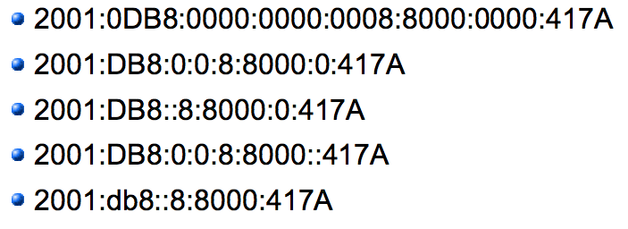
IPv6 deployment risks
The attacker community can make good use of IPv6
  They are IPv6 experts
  E.g. for tunneling leaked info out from compromised systems
Vulnerabilities present in IPv6, including day zero issues inherent in any new or revised system
  242 CVE entries with keyword “IPv6” since 2002
  44 in 2015
Lack of vendor support

Slide 8
IPv6 security myths
Internet Society has published 10 myths of IPv6 security
https://www.internetsociety.org/deploy360/blog/tag/ipv6-security-myths/
Myth 2: IPv6 has security designed In
Reality: IPv6 was designed 15-20 years ago

Slide 9
Network scanning
IPv6 Security Myth #4 – IPv6 Networks are Too Big to Scan (Internet Society)
Myth: IPv6 networks are too big to scan
Reality: Many addressing techniques reduce the search space
Scanning an IPv4 /24 subnet (256 addresses) is trivial
An IPv6 /64 subnet has 1.8 * 10¹⁹ addresses
BUT - SLAAC, DHCPv6 and manual configuration all tend to introduce order into the sparse address space
For LANs, can use one compromised host to scan via use of Neighbor Discovery

Slide 10
Some IPv6 protocol attacks

Slide 11
Some IPv6 protocol attacks
Extension Headers
Neighbor Discovery
Rogue RA
Duplicate Address Detection
ICMPv6
see backup slides for more details

Slide 12
Draft guidance from HEPiX IPv6 working group
Issues for Sites

Slide 13
IPv6 issues for security/network teams
Control IPv6 if not using it
Use Dual-stack and avoid use of tunnels wherever possible
Drop packets containing RH Type 0 and unknown option headers
Deny packets that do not follow rules for extension headers
Filter IPv6 packets that enter and leave your network
Restrict who can send messages to multicast group addresses
Create an Address management plan
Create a Security Policy for IPv6 (same as IPv4)
Block unnecessary ICMPv6
Protect against LAN RA, ND and DHCP attacks
  NDPMON and RAFIXD on critical segments
Check/modify all security monitoring, logging and parsing tools

Slide 14
Draft guidance from HEPiX IPv6 working group
Issues for Sys Admins

Slide 15
IPv6 issues for sys admins
Follow best practice security guidance
  System hardening as in IPv4, see for example
  https://access.redhat.com/documentation/en-US/Red_Hat_Enterprise_Linux/6/pdf/Security_Guide/Red_Hat_Enterprise_Linux-6-Security_Guide-en-US.pdf
  Specific advice on IPv6 hardening, see for example
  https://www.ernw.de/download/ERNW_Guide_to_Securely_Configure_Linux_Servers_For_IPv6_v1_0.pdf
Check for processes listening on open ports
  # netstat, lsof
Review neighbour cache for unauthorised systems
  # ip -6 neigh show
Check for undesired tunnel interfaces
  # ip -6 tunnel show, # route –A inet6

Slide 16
IPv6 for Sys admins (2)
Ensure not unintentionally forwarding IPv6 packets
  /proc/sys/net/ipv6/conf/*/forwarding files
  Or net.ipv6.conf.*.forwarding sysctl
Use OS embedded IPv6 capable stateful firewall
  filter based on EH and ICMPv6 message type
Manage ip6tables
IPv6 aware intrusion detection
  E.g. Snort, Suricata, Bro
  https://www.sans.org/reading-room/whitepapers/detection/ipv6-open-source-ids-35957
IPv6 penetration testing
  http://tools.kali.org/information-gathering/thc-ipv6

Slide 17
More Information?

Slide 18
More information
Many IETF RFC documents on IPv6!
  https://tools.ietf.org/wg/opsec/
IPv6 Security – Protection measures for the next Internet Protocol, Scott Hogg and Eric Vyncke, Cisco Press (2009)
NIST Guidelines for the Security Deployment of IPv6 (NIST SP800-119)
http://csrc.nist.gov/publications/nistpubs/800-119/sp800-119.pdf
Internet Society – top 10 IPv6 security myths
https://www.internetsociety.org/deploy360/blog/tag/ipv6-security-myths/

Slide 19
Summary and Outlook
In many ways IPv6 security is similar to IPv4
  But with new twists and new vulnerabilities
It has taken ~ 30 years to learn how to cope with IPv4 security
There will be lots of fun ahead with IPv6
Enjoy the next 20-30 years!

Slide 20
Questions?

Slide 21
Backup slides

Slide 22
IPsec
Was first developed in 1995 for IPv4 internet layer
  SSL and TLS operate at Application Layer
A framework of standards
  End to end authentication, data integrity and privacy (encryption)
Can be used site to site (gateway to gateway)
  As a Virtual Private Network (VPN)
Or host to host
All major aspects are same in IPv6 as IPv4
Does not fully support protection for multicast traffic
  Key management is one-to-one
No longer mandatory (rfc6434 – MUST -> SHOULD)

Slide 23
Extension Header vulnerabilities
Routing Header Type 0
  Source Routing
  Lots of security issues with RH0
  Destination address in packet is replaced at every Layer 3 hop
  Difficult for firewalls to determine the actual destination and compare with policy
  Can be used for DoS traffic amplification
  RH0 deprecated (rfc5095)
Fragmentation issues
  Upper-layer info may be in second packet (and not inspected by firewall)
  IPv6 standard defines every link to have MTU of at least 1280 bytes
    Smaller fragments should be suspicious
Hop-by-hop extension header also dangerous
Solutions include
  Filter on allowed and expected EH

Slide 24
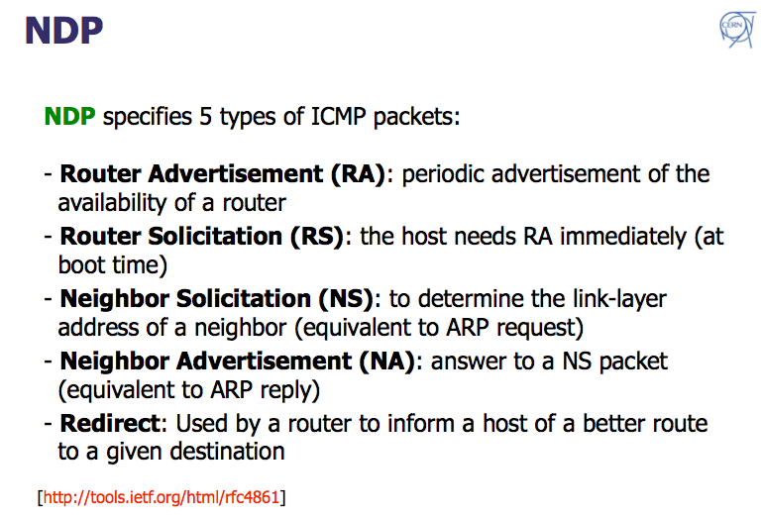
IPv6 Neighbor Discovery
Edoardo Martelli (CERN)

Slide 25
Neighbor Discovery Protocol
NDP authenticates neither the requestor or responder
  Spoofing is possible
SLAAC, NDP and DAD include protection mechanisms
  Source address for RA and NS messages must be unspecified (::)
  Hop limit must be 255 (the maximum)
  RA and NA messages must be rejected if hop limit is not 255
  This prevents a remote attacker sending forged RA or NA messages
    scope is always local
Secure Neighbor Discovery (SEND) (rfc3971)
  Uses Cryptographically Generated Addresses (rfc3972)
  BUT – problems managing the keys

Slide 26
Rogue RA
No authentication mechanism built into SLAAC
Malicious host can send rogue RA and pretend to be a router
  Can capture or drop packets
Badly configured systems too

Slide 27
Detecting rogue RA messages
Use generic IDS with customised signatures
  RA whose source MAC or IP is not in a configured list
    Lots of manual configuration!
Use tool NDPMon
  And check against XML config file
  also monitor all NS and NA
  To check when NA contradicts a previous one
Intelligent switches – known RA source
Cisco RA Guard
Rafixd (and ramond)
  Detect all rogue RA messages and immediately transmit another forged RA with lifetime 0 seconds (to clear the rogue info on all nodes)

Slide 28
DAD
Duplicate Address Detection
  Host checks whether its address is already in use
  Sends NS asking for resolution of its own address
  An attacker can launch a DoS attack by pretending to own all IPv6 addresses on the LAN

Slide 29
ICMPv6
Internet Control Message Protocol (rfc4443)
An important component of IPv6
Redefines ICMPv4 with additions and changes
  Ping, destination unreachable, neighbor discovery, path MTU discovery
  Error messages (message number 1 to 127)
  Informational messages (128 to 255)
Essential to establish strict ICMP filtering policies
  Define ICMPv6 messages that can/cannot pass between the site and the internet
    E.g. PMTU and ND
Rfc4890 “Recommendation for Filtering ICMPv6 Messages in Firewalls”
  Each site needs to consider carefully!

