Slide 1
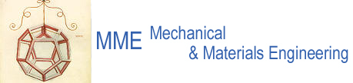
The EN/MME Group
Diego Perini – EN/MME
19 May, 2015
Engineering Department
EN

Slide 2
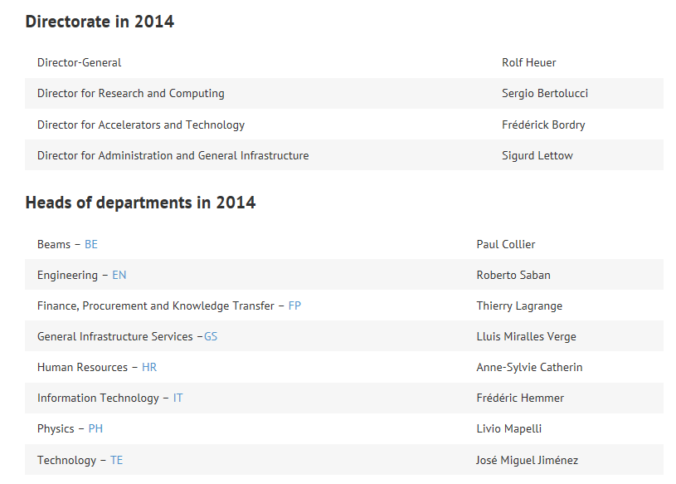
A&T Sector : Accelerators and Technology

Slide 3
EN : Engineering Department
Department Head:
R. Saban
Deputy: S. Baird
Operation
  Infrastructure
  Accelerators
  Experimental Areas
Projects
  Consolidation
  Upgrades
  New facilities
  Design & Manufacturing
Studies
Head of Department’s Office
(EN-HDO)
R. Saban
Cooling & Ventilation
(EN-CV)
M. Nonis
4
58
Electrical Engineering
(EN-EL)
S. Baird
General Management & Secretariats
(EN-GMS)
S. Prodon
64
11
Handlling Engineering
(EN-HE)
I. Rühl
Industrial Controls & Engineering
(EN-ICE)
Ph. Gayet
24
33
Machines & Experimental Facilities
(EN-MEF)
S. Baird
Mechanical & Materials Engineering
(EN-MME)
F. Bertinelli
86
74
Sources, Targets & Interactions
(EN-STI)
R. Losito
38

Slide 4
MME : domains of activities
Engineering & Design
Fabrication
Machining & Maintenance
Preparation & Subcontracting
Assembly & Forming
Materials & Metrology
Internal Design Office facilities, 40 designers (Staff and Industrial Support)
CATIA / SmarTeam, ANSYS
Mechanical measurements lab
4000 m² of internal workshop facilities, 50 technicians (Staff and Industrial Support): CNC machining, sheet metal work & welding, electron beam & laser, vacuum brazing
External subcontracting service
Free access Users workshop
Material selection, analysis & metallurgy: microscopy, mechanical testing
NDT: US, radiography, tomography
350 m² of internal metrology facilities

Slide 5
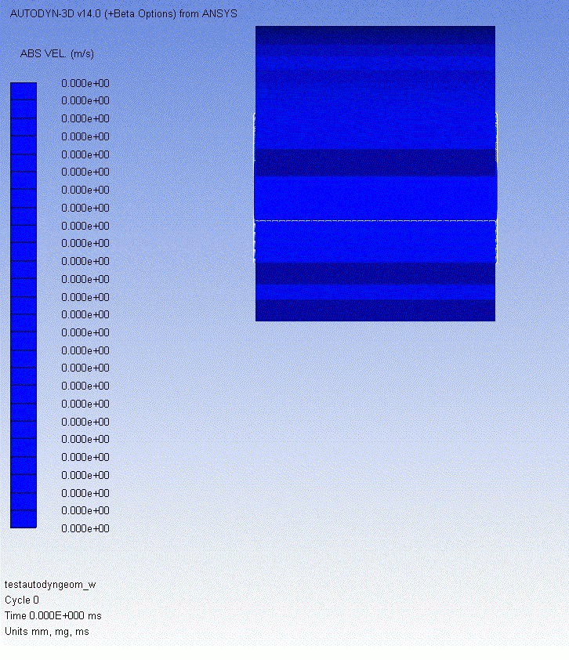
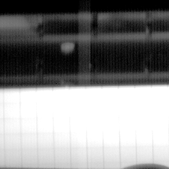
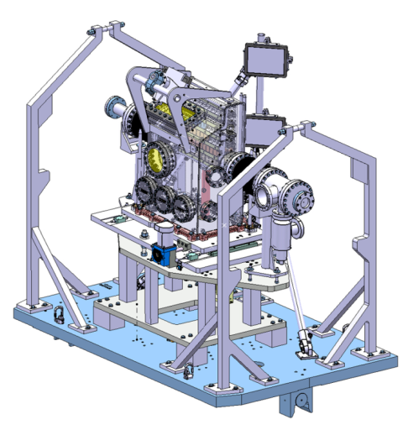
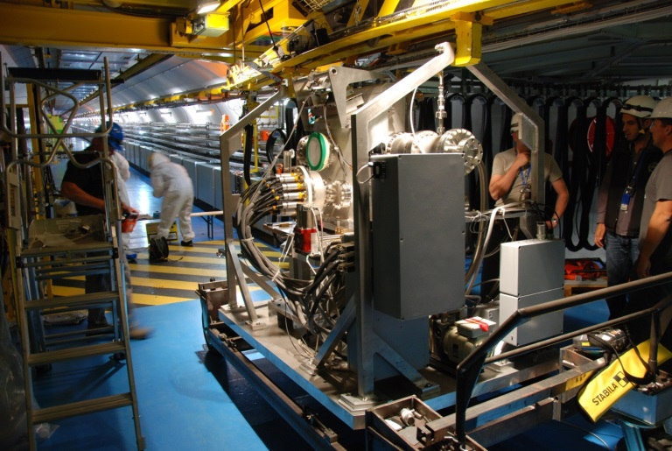
MME in one image
Mandate: provide to the CERN community specific engineering solutions combining mechanical design, production facilities and material sciences. The group owns, maintains and develops the know-how on the mechanical constructions in accelerators and physics detectors.
  Inermet : comparison Autodyn (SPH) between simulation and experiment
Beam

Slide 6
MME au 15 Janvier, 2015
Jan. 2012: ∼145
Jan. 2013: ∼165
Jan. 2014: ∼175

Slide 7
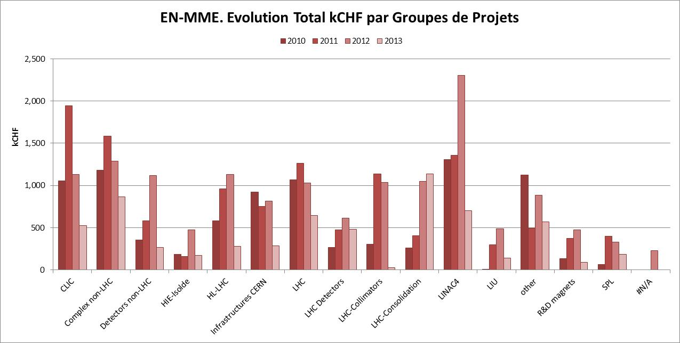
MME contributes to projects CERN-wide

Slide 8
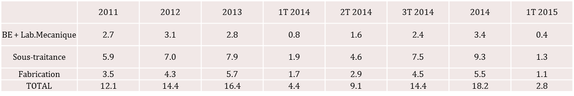

Slide 9
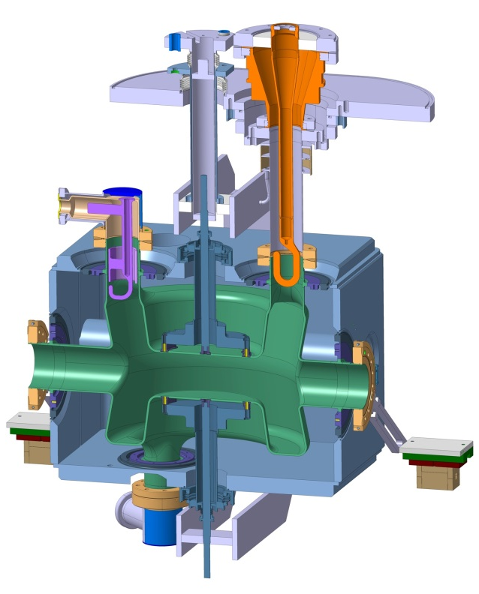
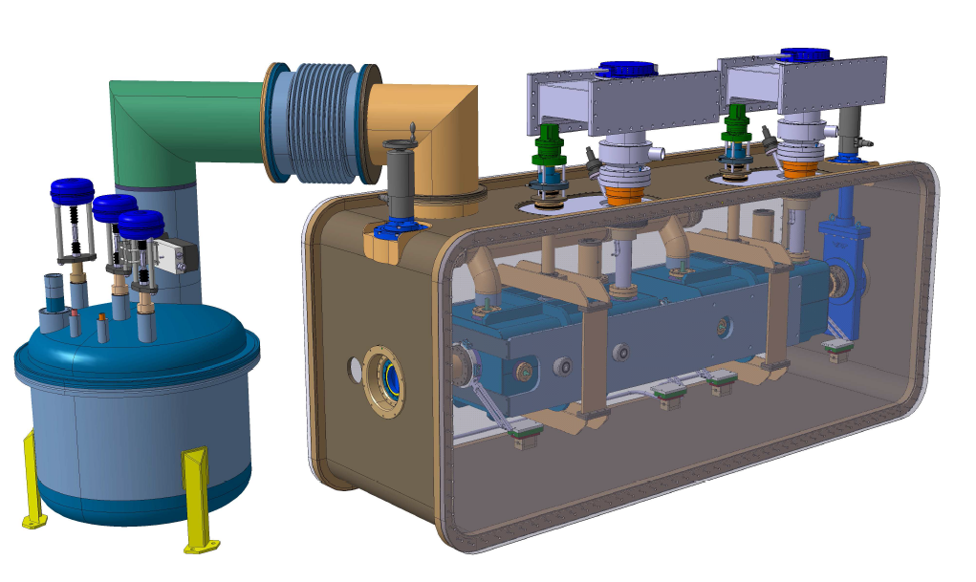
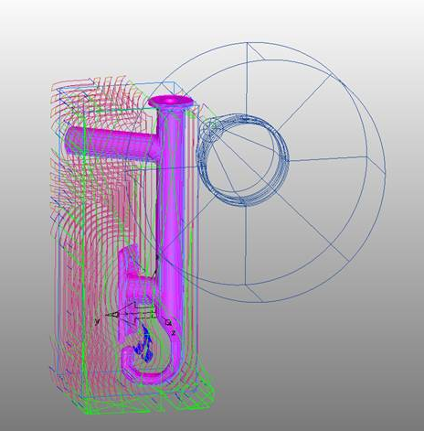
Design & fabrication HL-LHC Crab cavities
Development of Crab RF cavities in bulk niobium and corresponding cryomodule for validation tests with beam in SPS, prior LS2
MME developments in close collaboration with BE/RF, EN/MEF, TE/VSC, TE/CRG and US and UK Institutes
Crab RF cavity equipped with ancillaries
Two crab cavities cryomodule and service module for SPS tests
CNC program for the machining of complex shapes in niobium

Slide 10
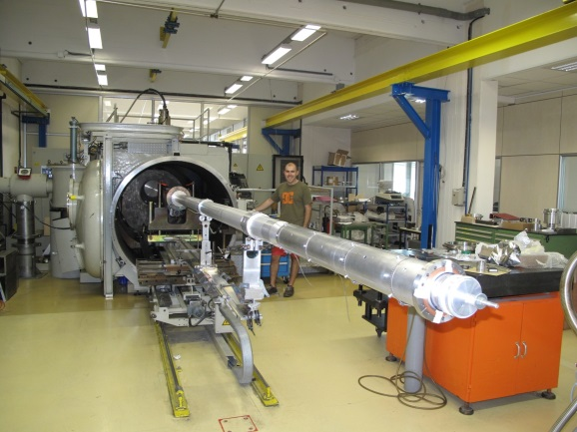
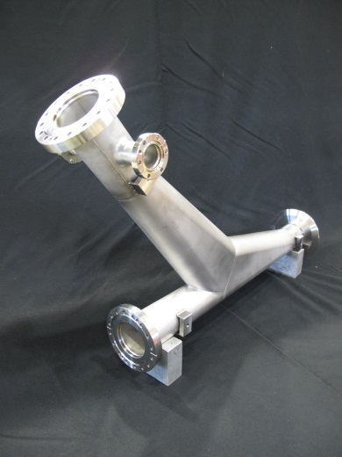
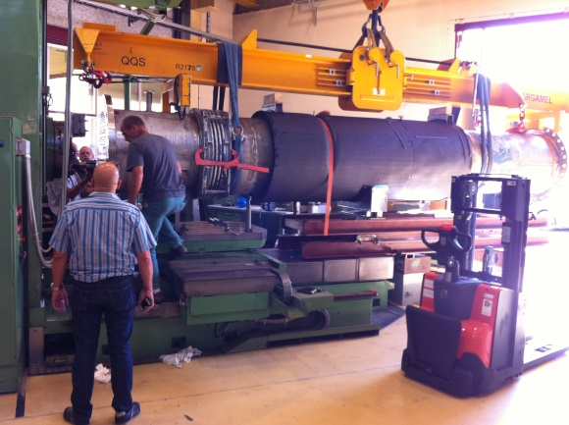
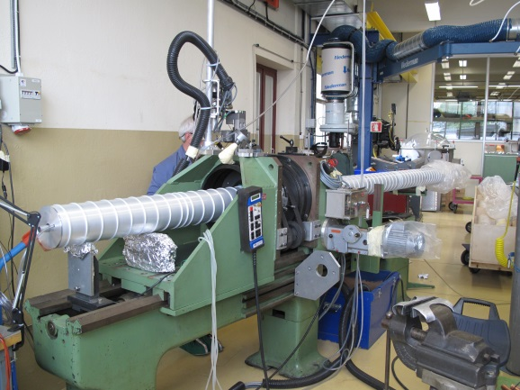
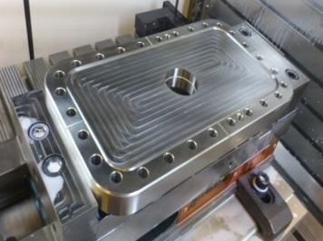
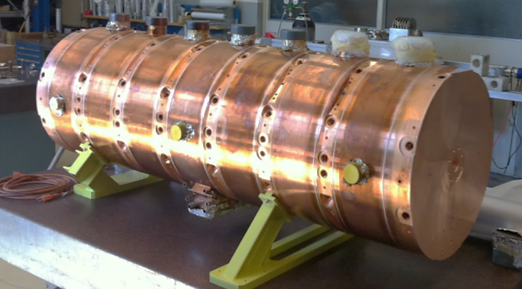
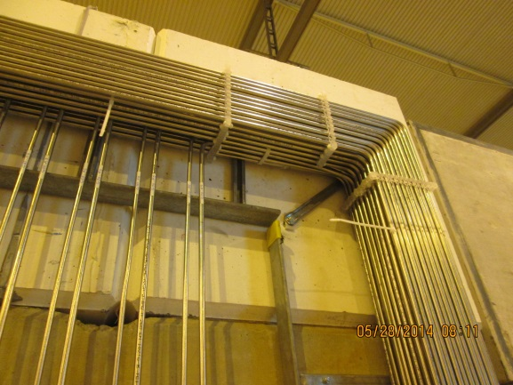
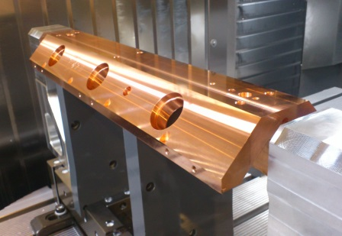
MME internal fabrication multi-activity
  Aluminium vacuum chambers (ATLAS VJ, NA62)
  First PIMS Linac4 tuning and assembly
  ATLAS condenser repair
  GIF: gas piping installation (5.5 km, 846 welds)
  BASE vacuum chamber
  HF-RFQ …

Slide 11
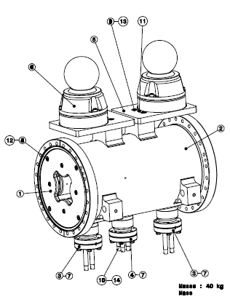
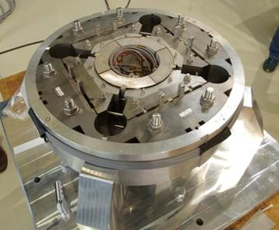
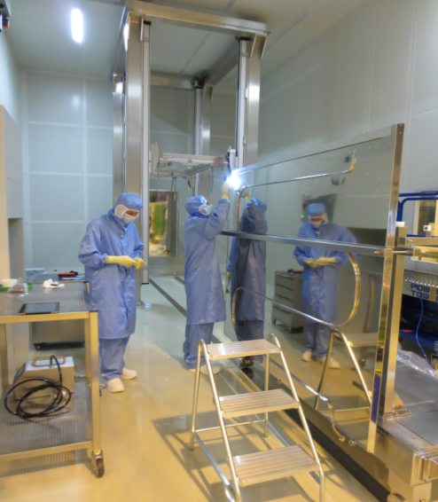
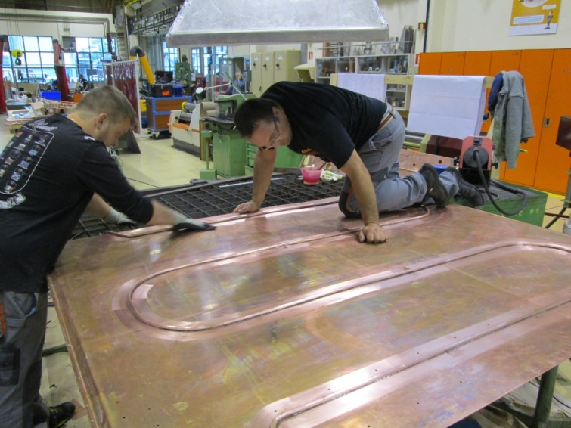
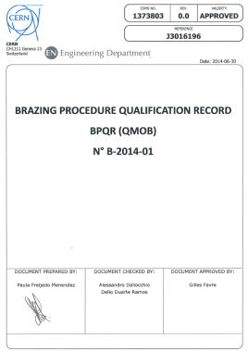
ELENA – Series production of electrostatic quadrupoles (x60).
Synergy between EN-MME Workshop
and NO-RS industrial suppliers.
MME subcontracting
9 MCHF
Strong contribution to multi-activity jobs with internal fabrication
Specific efforts to identify new partners and improve return to poorly balanced states (Serbia, Norway, Denmark, Greece)
HIE-ISOLDE Thermal Shield.
Produced by EN-MME (Design TE-MSC).
Ni-Plating in collaboration with FR firm
HL-LHC: new SQXF large aperture quadrupole short prototye.
Production managed by MME-FS
(RO-IT-FR-UK Suppliers)

Slide 12
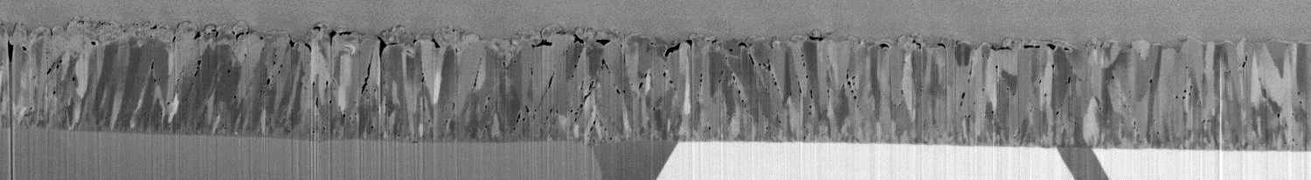
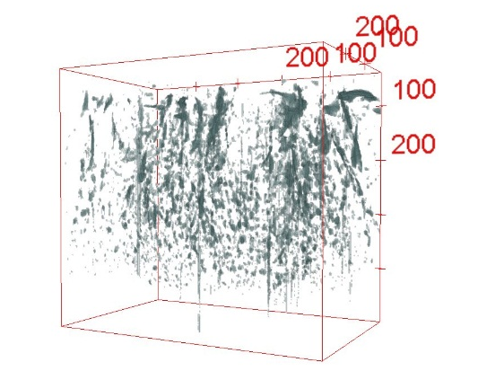

MME: advanced investigation techniques
3D tomography, Nb coating on Cu substrate for HIE-ISOLDE
2 μm
Orthoslice view
2 μm
courtesy M. Cantoni /EPFL and B. Bartova /EN-MME
New perspectives: Focus Ion Beam Scanning Electron Microscopy (FIB-SEM) in collaboration with EPFL
Pore reconstruction in a volume of Nb coating ⇒

Slide 13
Thank you for your attention !

