Slide 1
The HL-LHC project: goals and impact
Isabel Bejar Alonso - CERN
On behalf of the HL-LHC project team
CERN – 19 May 2015

Slide 2
Contents
The HL-LHC Project
The impact
Industry

Slide 3
The HL-LHC Project
Goals, schedule and technologies

Slide 4
Goal of High Luminosity LHC (HL-LHC) as fixed in November 2010
From FP7 HiLumi LHC Design Study application
The main objective of HiLumi LHC Design Study is to determine a hardware configuration and a set of beam parameters that will allow the LHC to reach the following targets:
A peak luminosity of L_{peak} = 5×10³⁴ cm⁻²s⁻¹ with levelling, allowing:
An integrated luminosity of 250 fb⁻¹ per year, enabling the goal of L_{int} = 3000 fb⁻¹ twelve years after the upgrade.
This luminosity is more than ten times the luminosity reach of the first 10 years of the LHC lifetime.
Concept of ultimate performance recently defined:
L_{ult} ≅ 7.5 10³⁴ cm⁻²s⁻¹ and Ultimate Integrated L_{int ult} ∼ 4000 fb⁻¹
LHC should not be the limit, would Physics require more…

Slide 5
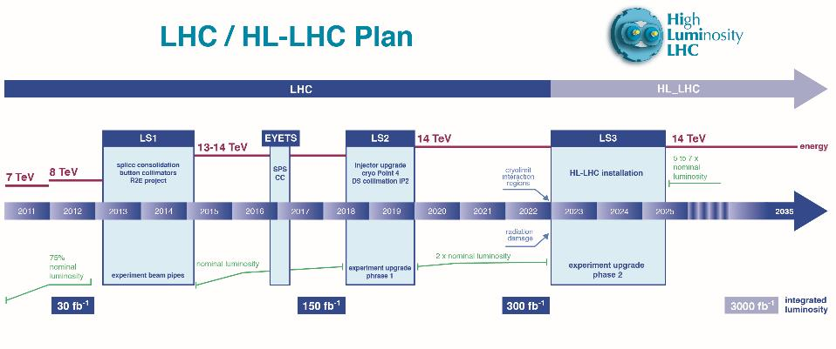
Run I
Run II
Run III
Run IV, V…
0.75 10³⁴ cm⁻²s⁻¹
50 ns bunch
high pile up ∼40
1.5 10³⁴ cm⁻²s⁻¹
25 ns bunch
pile up ∼40
1.7-2.2 10³⁴ cm⁻²s⁻¹
25 ns bunch
pile up ∼60
Technical limits to lumi increase (Machine & Experiments)
50 ⇒ 25 ns

Slide 6
Project: the way to day
Jul-10 |  | Mandate to L. Rossi by D.A.T. to set up FP7-Design Study
Nov-10 |  | Application FP7-HiLumi LHC Design Study
Dec-10 |  | Institution of the HL-LHC as a project inside D.A.T.
Mar-11 |  | Approval FP7-HiLumi LHC Design Study
Apr-11 |  | CERN kick-off meeting of DS
Nov-11 |  | Start of FP7 DS and 1st General Meetign @ CERN
Jul-12 |  | Document CERN-ATS-2012-236 describing HL-LHC for EU strategy
Jul-12 |  | Decision MQXF (IT quad) aperture 150 mm
Nov-12 |  | 2nd General Meeting @ Frascati
May-13 |  | HL-LHC 1st Priority in EU strategy update(Council @ Brussels)
May-13 |  | International Review on Collimation
Jun-13 |  | First partial insertion iof HL-LHC in the MTP
Oct-13 |  | RLIUP (Review of LHC and Inj Upgrade Plans by CMAC)
Oct-13 |  | First HL-LHC detector ECFA workshop
Nov-13 |  | HL-LHC Project kick-off and 3rd General meeting @ Daresbury
May-14 |  | International Review on CC @BNL
Jun-14 |  | MTP CERN incorporate HL-LHC budget
Oct-14 |  | International Review on MQXF NbSn Conductor @ CERN
Nov-14 |  | 4th General Meeting @ KEK
Nov-14 |  | Preliminary Design Report (PDR)
Dec-14 |  | International Reviews on MQXF and MBH design @CERN
Mar-15 |  | Cost & Schedule Review @ CERN by CMAC

Slide 7
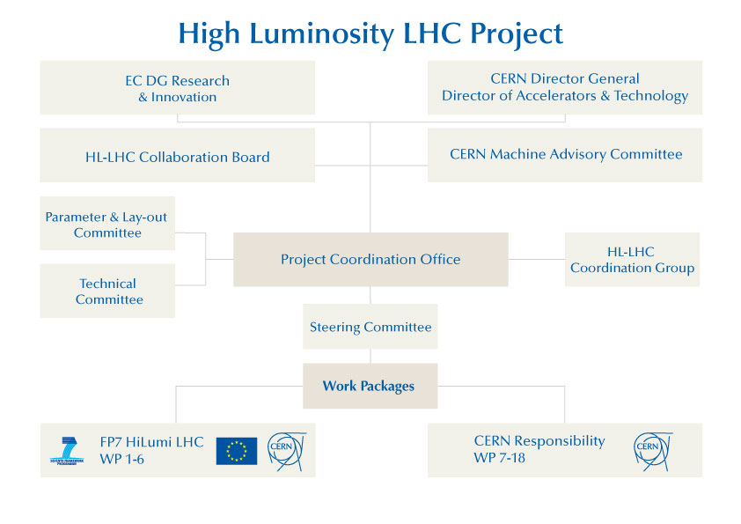

Slide 8
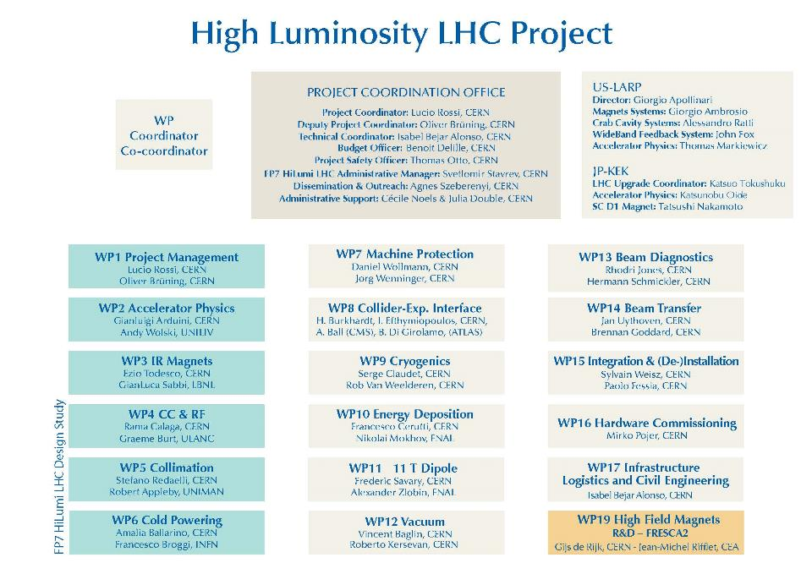

Slide 9






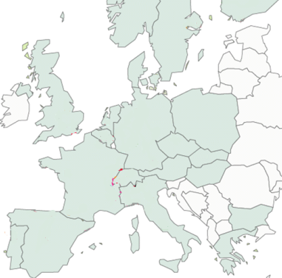












High Luminosity LHC Participants

Slide 10
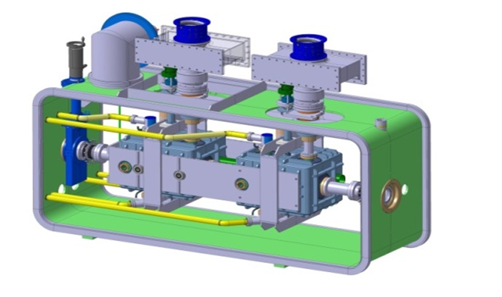
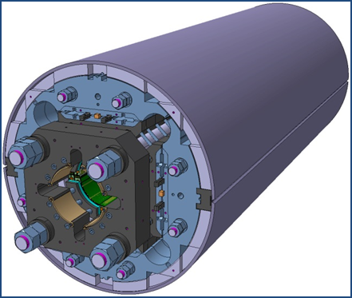
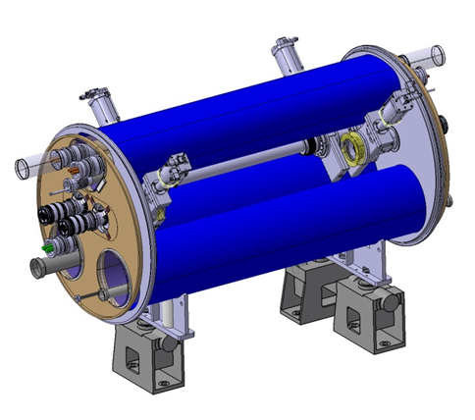
The largest HEP accelerator in construction
ATLAS
CMS
Dispersion Suppressor (DS)
Matching Section (MS)
Interaction Region (ITR)
Modifications
In IP2: new DS collimation with 11 T
In IP7 new DS collimation with 11 T
Complete change and new lay-out
TAN
D2
CC
Q4
All correctors
Q5 (Q6 @1.9 K?)
New MQ in P6
New collimators
Complete change and new lay-out
TAS
Q1-Q2-Q3
D1
All correctors
Heavy shielding (W)
Cryogenics, Protection, Interface, Vacuum, Diagnostics, Inj/Extr… extension of infrastr.
> 1.2 km of LHC !!
Notes:
Inner Triplet Magnets: Actual radiation damage on the Inner Triplets Magnets is expected already at the level of integrated dose of LHC. The replacement of the triplet must be anticipated before damage occurs, because of the serious and long intervention (requiring one to two years shutdown)
Collimation: The present collimation system will need an upgrade that takes in account the increased beam intensities and the need to protect the new triplets in IR1 and IR5. This would require the replacement of some of the LHC main dipoles with dipoles of equal bending strength (∼120 T⋅m), but obtained by a higher field (11 T) and shorter length (11 m) than those of the LHC dipoles (8.3 T and 14.2 m), gaining in this way enough room for installing the new special collimators.

Slide 11
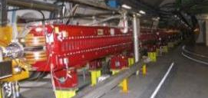
New Insertion Region lay out
(TAS, TAN, Q5 and collimators omitted)
Longer Quads; Shorter D1 (thanks to SC)
Interaction region length is unchanged
ATLAS
CMS
LHC
E. Todesco
ATLAS
CMS
HL LHC
Thick boxes are magnetic lengths -- Thin boxes are cryostats

Slide 12
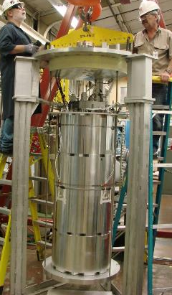
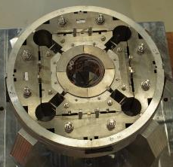
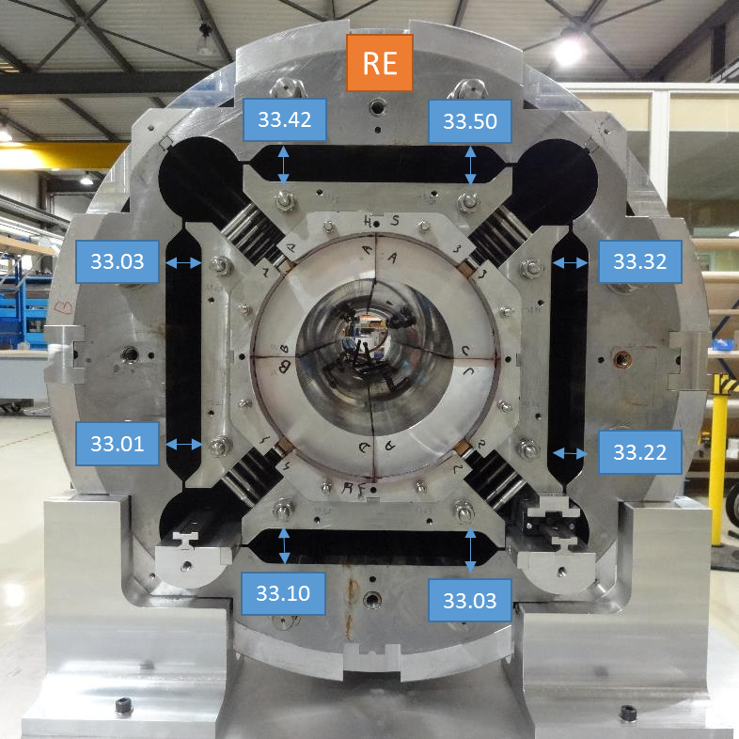
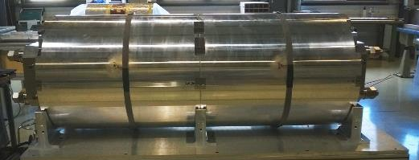
Working on the Inner triplet magnets
  1 mechanical model
  (15 cm long)
  2 short model structures with dummy coils
CERN
LARP
CERN

Slide 13
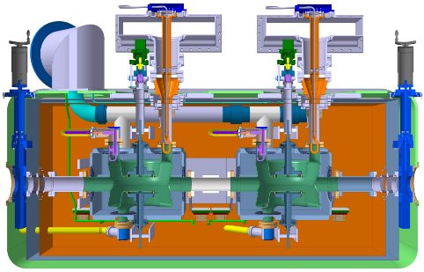
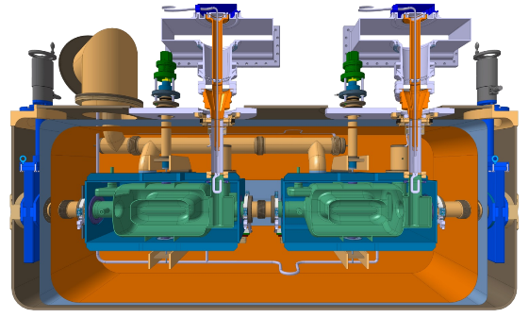
Working on Crab cavities
Mostly standardized interfaces and common platform
Main differences
Cavity symmetry & length
HOM couplers
Double Quarter Wave,
Vertical Deflection
RF Dipole
Horizontal Deflection

Slide 14
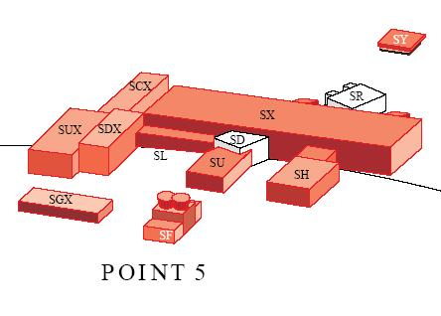
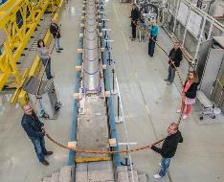
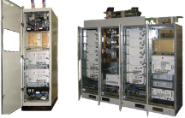
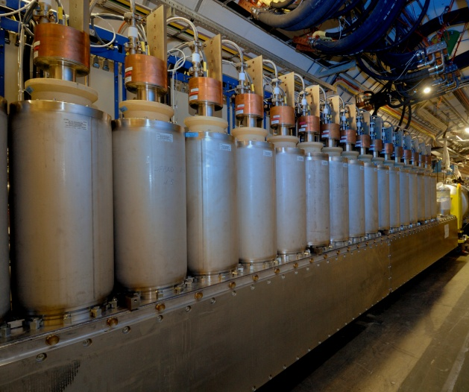
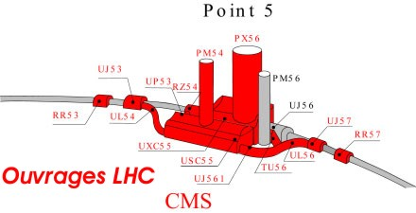
Increasing availability
4 pairs 300 m 150(+/- 75) kA for MS– LS3
4 pairs 300 m 100(+/-50) kA for ITR – LS3
All lines in MgB₂ (or HTS)
tens of 6-18 kA CLs pairs in HTS
Baseline: removal to surface buildings
Option of extra underground tunnel under way
2×150 kA
Notes:
R2E and SC links for remote powering of cold circuits: replacement of radiation sensitive electronic boards of the power converter system with radiation-hard cards and the displacement of power converters/equipment to distant locations out of the tunnel thanks to a novel technology: superconducting links (SCLs) made from HTS (YBCO or Bi-2223) or MgB₂ superconductors.

Slide 15
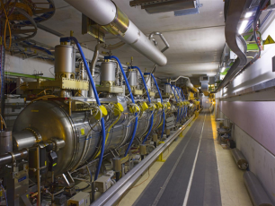
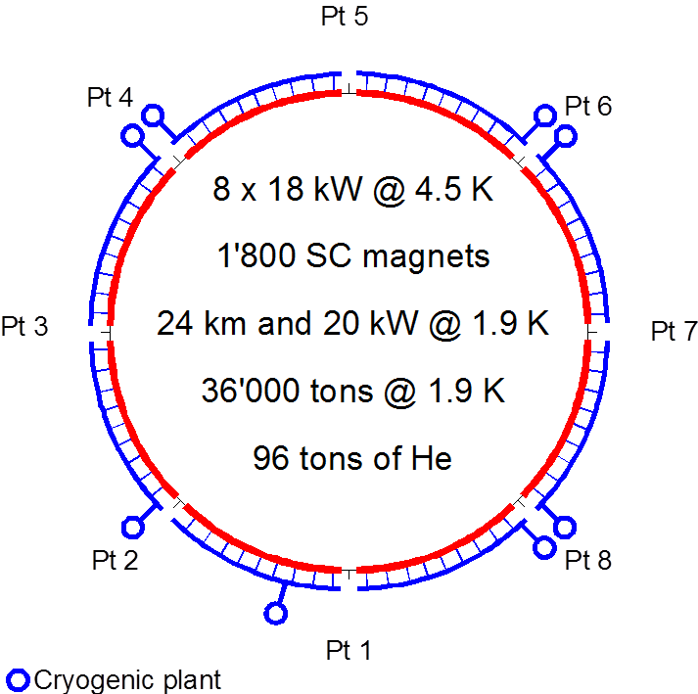
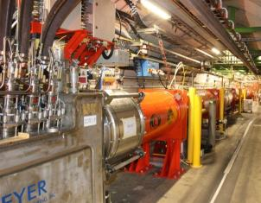
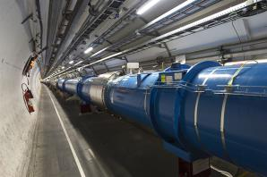
Eliminating Technical bottlenecks Cryogenics P4
IT
IT
RF
RF
Never good to couple RF with Magnets !
Reduction of availabe cryo-power and coupling of the RF with the Arc (thermal cycle requires > 3 months and tests)
IT
IT
IT
IT
IT
IT

Slide 16
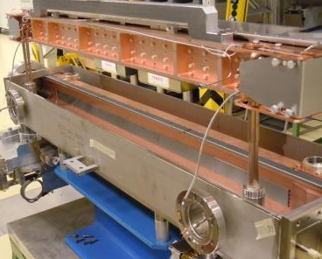
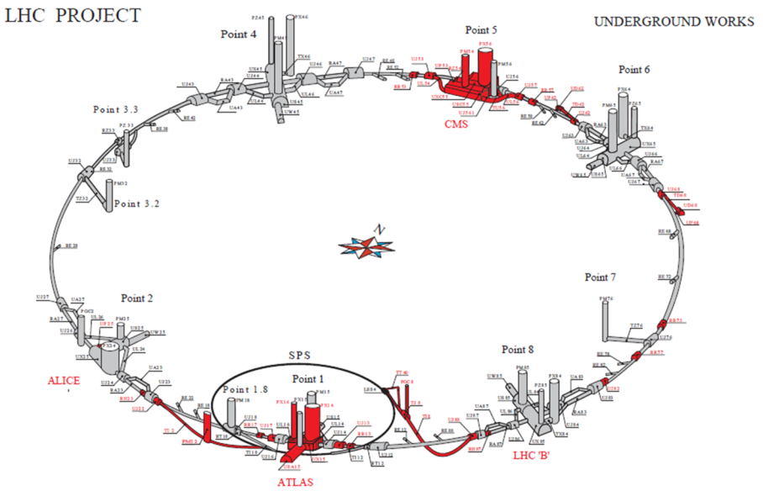
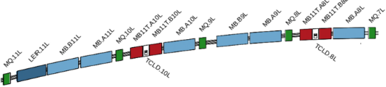

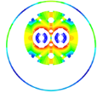
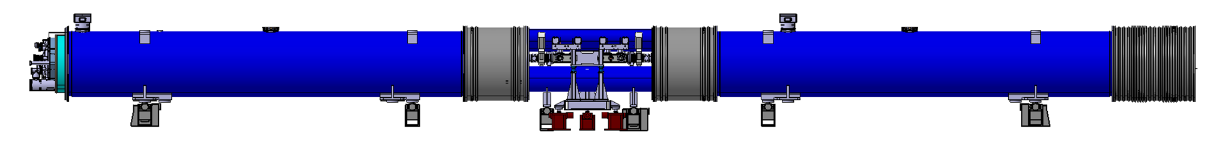
11 T Magnets
11 T Nb₃Sn

Slide 17

And many other improvements
Machine protection: improved robustness to mis-injected beams, to kickers sparks will be required. The kicker system, collimation and TDI, is the main shield against severe beam induced damage.
Quench Protection System of SC magnets to remake a 20 years old design.
Remote manipulation: the level of activation around 2020 requires development of special equipment to allow replacing/servicing collimators, magnets, vacuum components etc., according to ALARA principle. Remote manipulation, enhanced reality and supervision is the key to minimizing the radiation doses sustained during interventions.
Instrumentation …

Slide 18
Many points around the ring

Slide 19
HL-LHC
Impact on society

Slide 20
Technology areas
CERN has mapped in 2014 about 67 technology area of interests. There has been a steady growing number of new technologies between 1984 and 2004 at a rate of 1 new technology/year, then almost stable till today (→ there is need to innovate !!!)
The reference technology landscape is dominated, by size, connections to other areas and impact, by technologies embedded by accelerators, with 2259 patents.
HL-LHC is involved in all of the main mapped technological areas. Namely, NbTi, Nb3Sn, HTSC, cryogenics, vacuum. Of these many are showing a growing trend in the last years.

Slide 21
Impact: accelerators in Science, Industry and Society
70 companies involved ,
24000 accelerator in the world, (more than 30000 if medical are included)
1100 new systems deployed every year for about US$ 2.2B.
(if medical therapy is included, the bottom line figure will increase by 1 $B more)

Slide 22
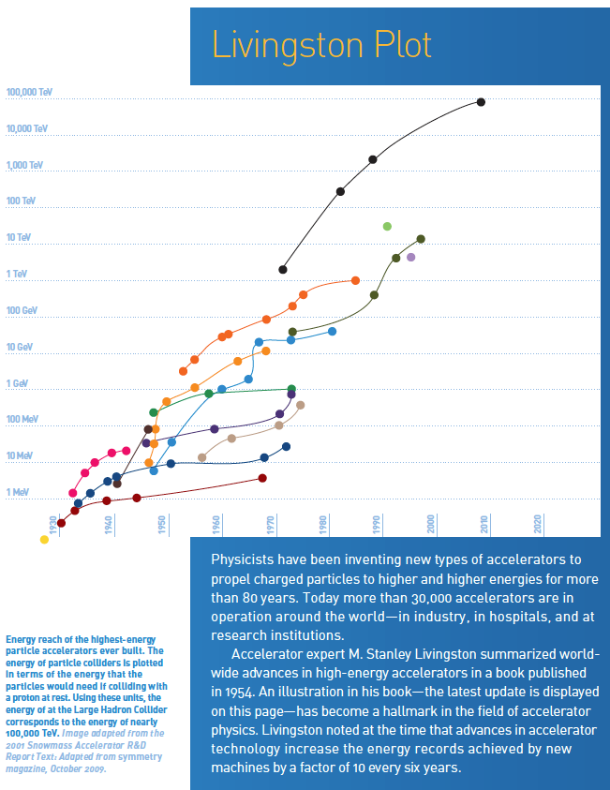
Impact on society
Application of accelerators has not yet
reached the full needs and opportunities
offered from many sectors.
Exploitation is expected even outside
of the known medical therapy field.
Examples: Accelerator-driven systems
able to provide a long-term strategy for
the growth of nuclear power –
Fusion energy - Industrial processes -
Gas and water cleaning - Demonstrations have shown the effectiveness and efficiency of particle-accelerator technology in treating flue gas emissions and polluted water.
Notes:
Advances in accelerator technologies advance the energy level by factor 10 every 6 y

Slide 23
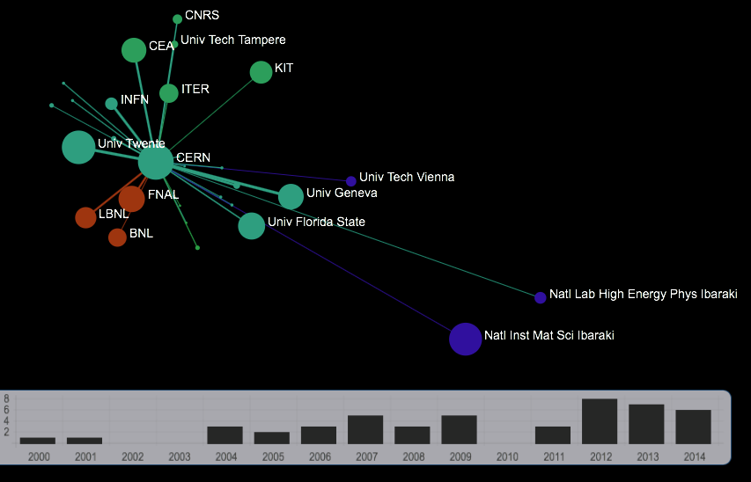
Nb3Sn technology links among institutions.
Map: Nb3Sn SC Publications
Current year: 2014 Organisations: 336
Clusters: 14 Publications:749
Map: Nb3Sn SC Patents
Current year: 2014- Organisations: 91, Clusters: 3 Patents: 217

Slide 24
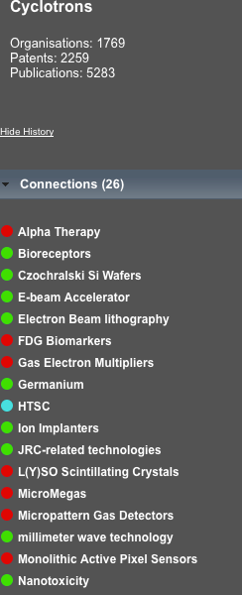
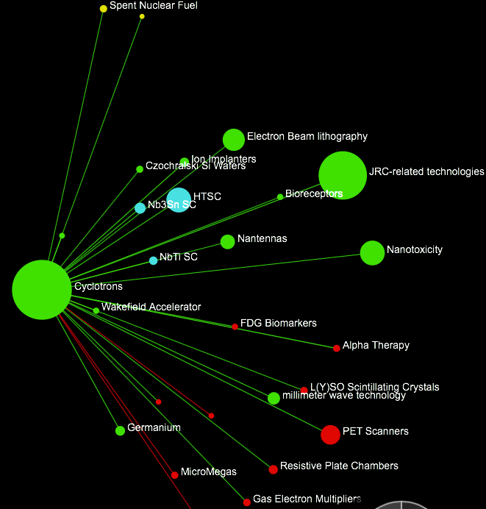
Links among cyclotron and technology sectors

Slide 25
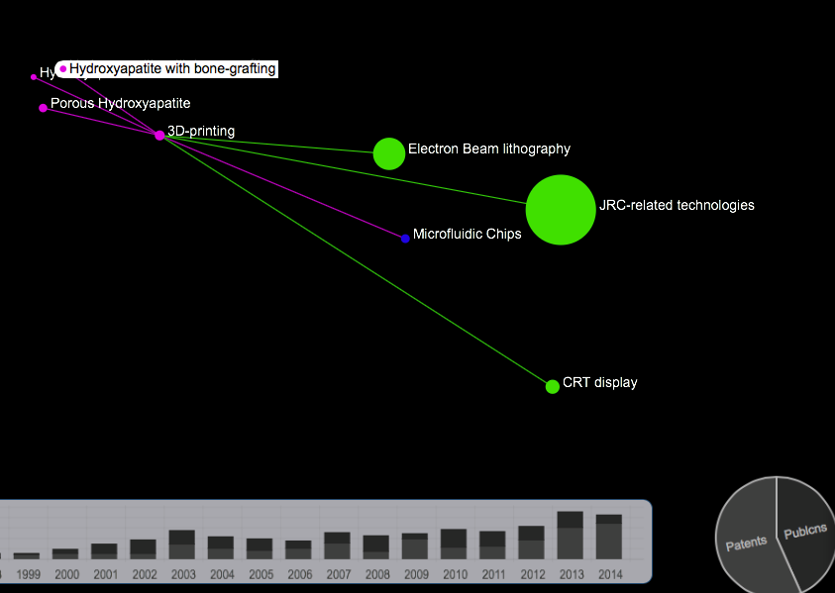
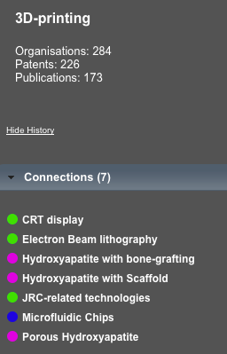
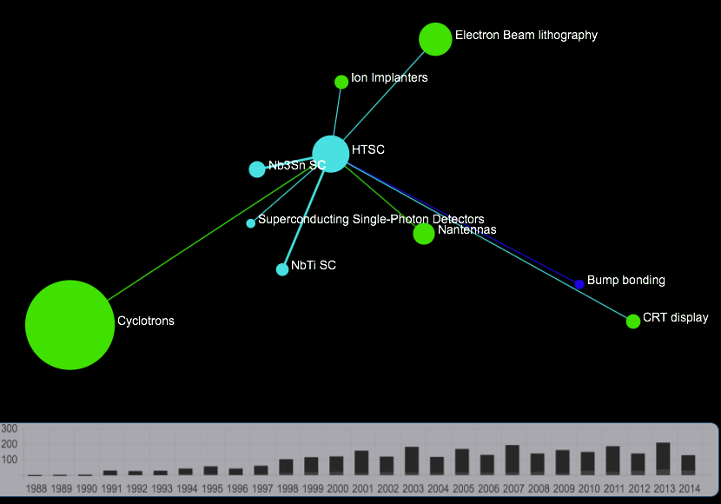
HTSC technology area map in 2014: 2291 publications, 536 patents, 1082 organizations involved,
9 connections with related technology areas.

Slide 26
Industry
Procurement from HILUMI to
HL-LHC

Slide 27
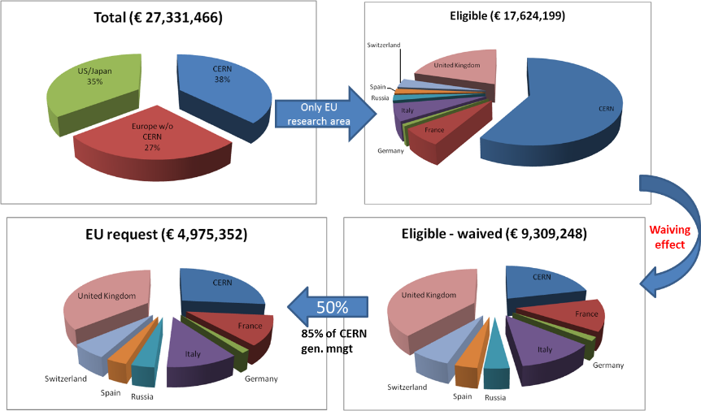
HILUMI FP7

Slide 28
HILUMI Procurement till Dec 2014

Slide 29
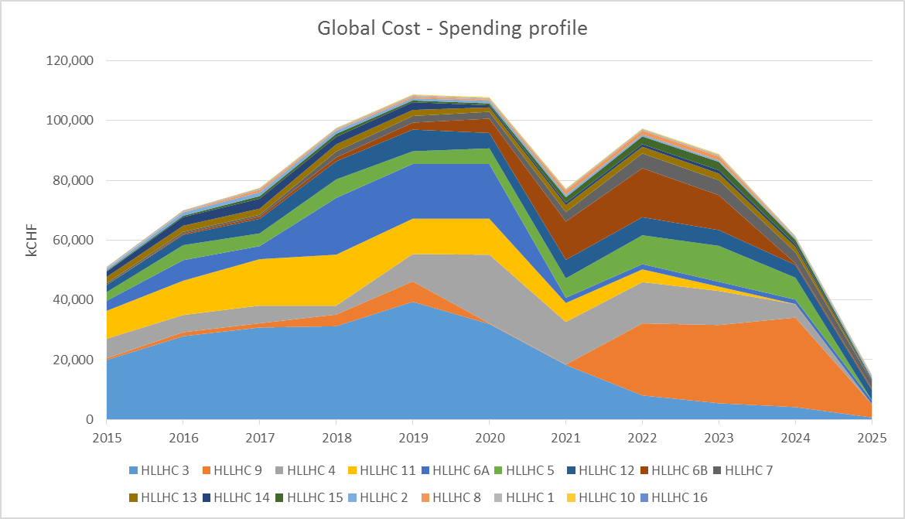
Notes:
Dip in 2021. Big contributors like WP3,4, 11,6A (show their global spending profile) will have engage much of the money by then, while another big contributor WP9 and 6B willstart launching big contracts for the refrigerators in P1 and P5 and power converters.
<2021 : in-house procurement
>2021 : outside procurement – industrial equipment purchase

Slide 30
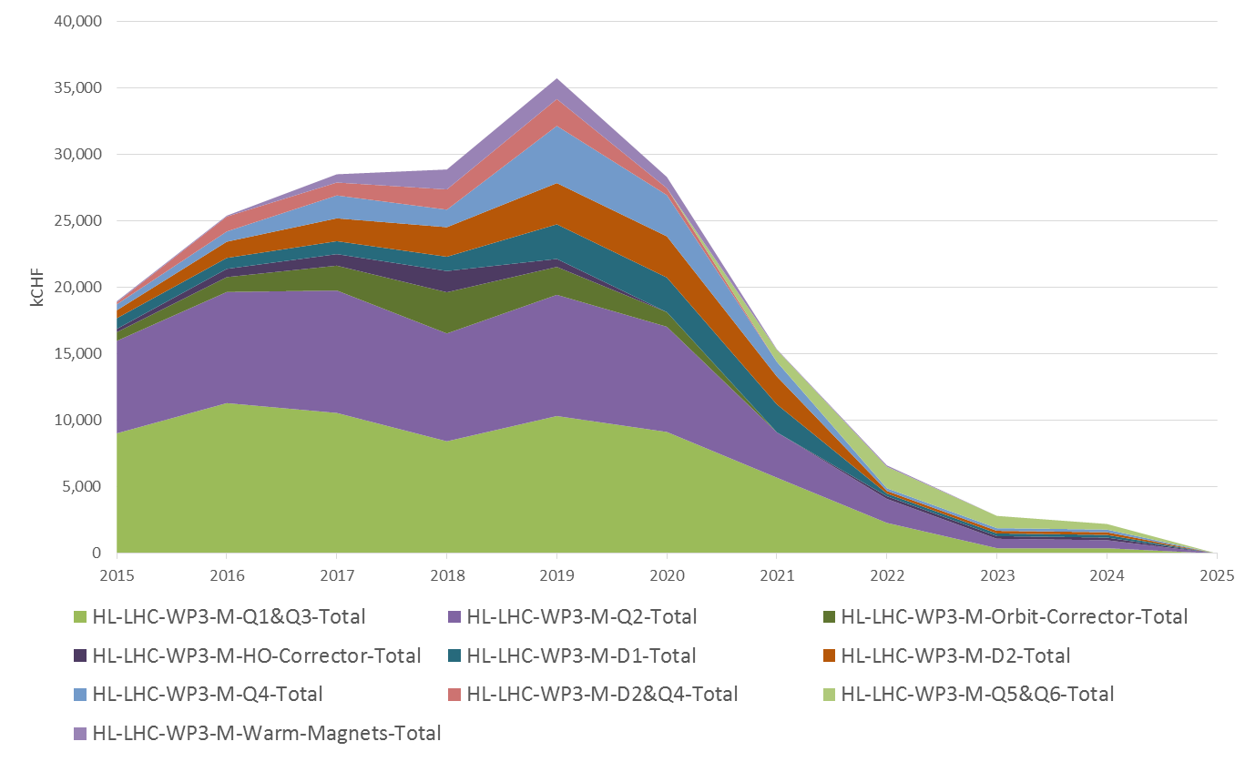
HL-LHC – IR Magnets
WP03 : most spending in GOODS, purchase of cables, cabling activities and components for Q1,Q2,Q3 magnets till 2020
In Kind USA
Notes:
Not all procurements – Some In kind

Slide 31
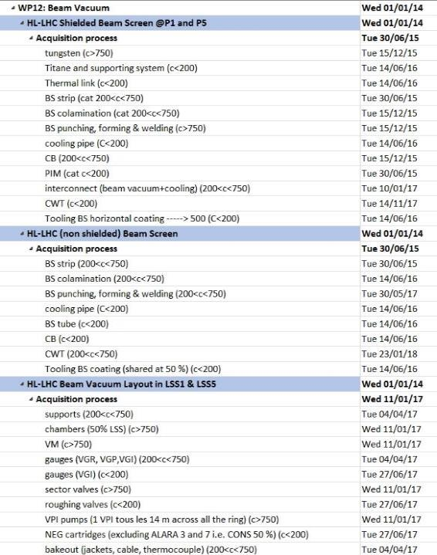
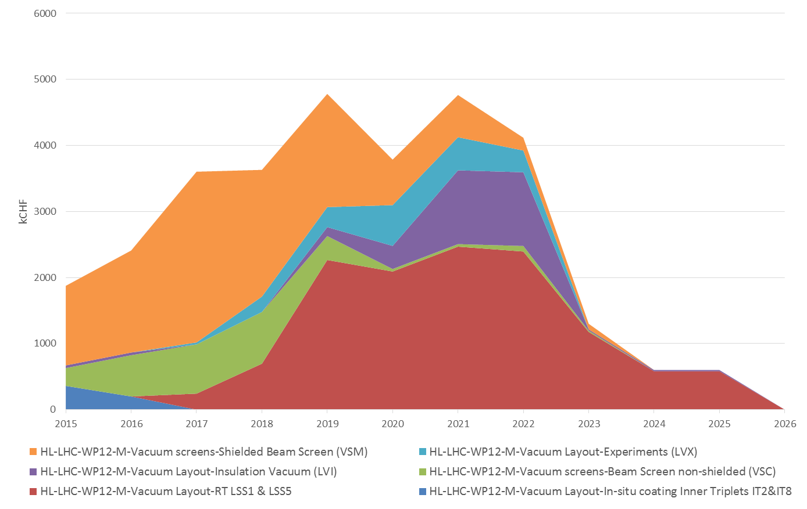
HL-LHC – Vacuum
Notes:
WP03 : most spending in GOODS, purchase of cables, cabling activities and components for Q1,Q2,Q3 magnets till 2020
WP11 : most spending in GOODS, purchase of cables, cabling activities and components for 11T series magnets till 2020
WP6B: Major contribution of family of 4-quadrant converters and high-current converters between 2021 and 2023
WP4: big purchases after 2019 – implementation of results form SPS tests
WP9: big contracts for P1/P5 refrigerators after 2021 – CE to be finished by then
WP5: purchase of TCTPM and TCL (IR cleaning)
WP6A : R&D before 2017, purchasing cables cryostats and main components between 2017 and 2021.

Slide 32
HL-LHC Industrial Event
An HL-LHC industrial event will be organized in CERN on June 25 -26.
We will provide specific info on the procurement to come, the technical and legal framework, a time line.
https://indico.cern.ch/event/387162/overview

Slide 33

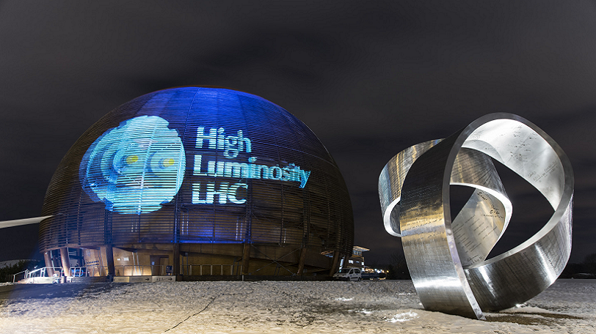

… and let light shining over LHC many years more…

