Slide 1
CERN – Zanon discussions
Ongoing SRF developments
Ofelia Capatina, on behalf of WP 4 collaboration

Slide 2
Crab cavities

Slide 3

SM18 Area
Cavity cold testing, clean room facilities & cryomodule qualification
SPS Test Prototype Module(s) before LS2
LHC Point 5 (horizontal)
4 cavities / IP side/ beam
to be installed during LS3
LHC Point 1 (vertical)
4 cavities / IP side/ beam
to be installed during LS3

Slide 4
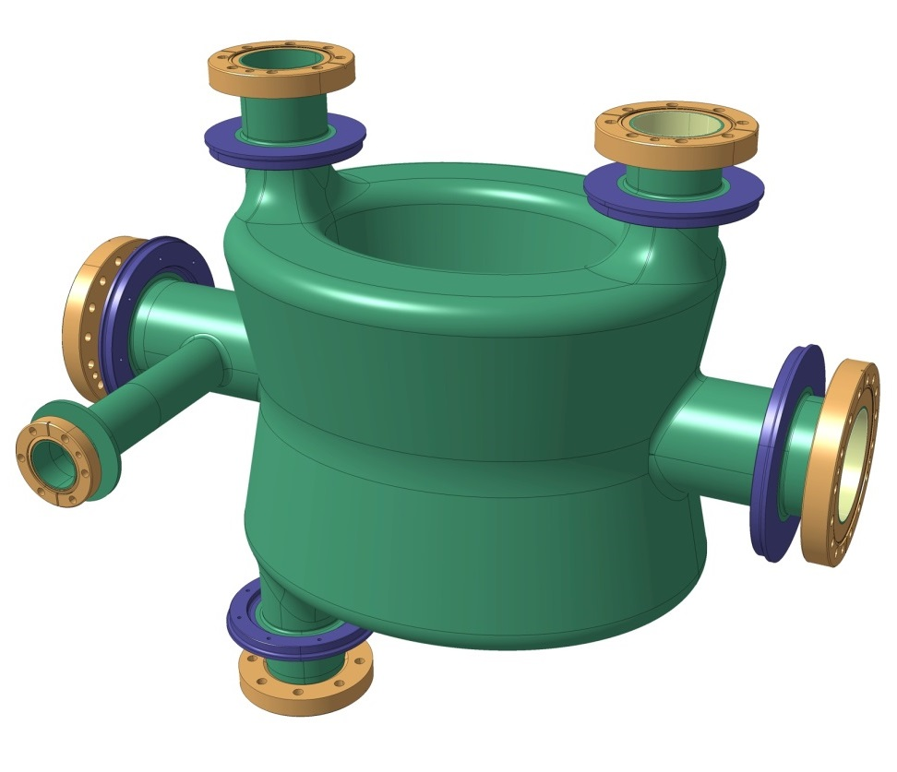
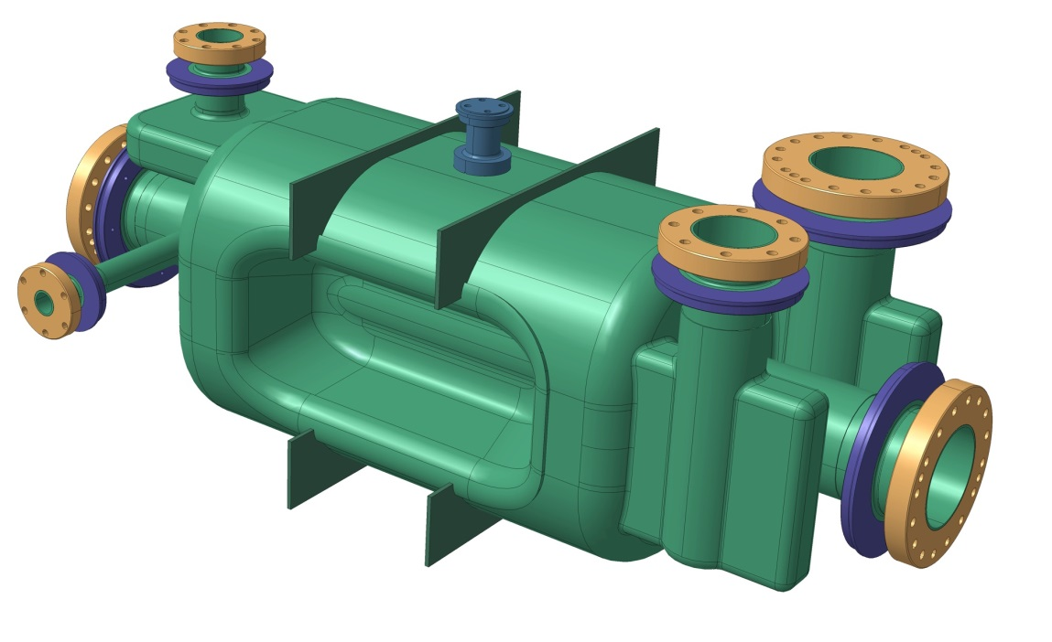
Cavities
Double Quarter Wave (DQW) cavity
RF Dipole cavity – Horizontal – to be used in Point 5 (CMS)

Slide 5
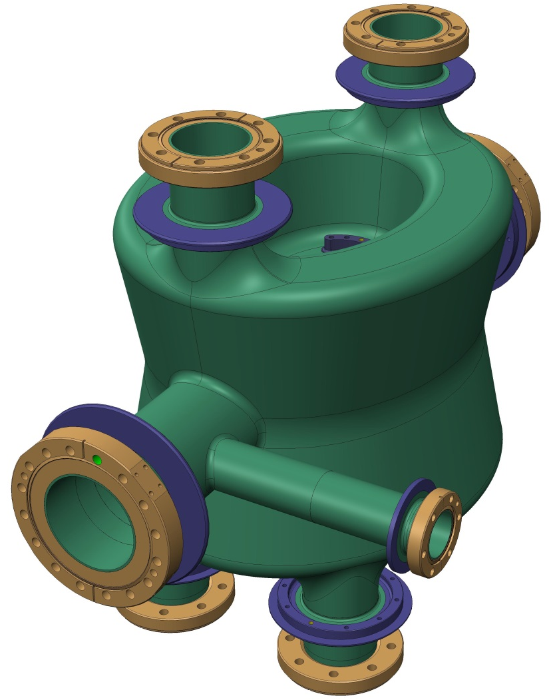
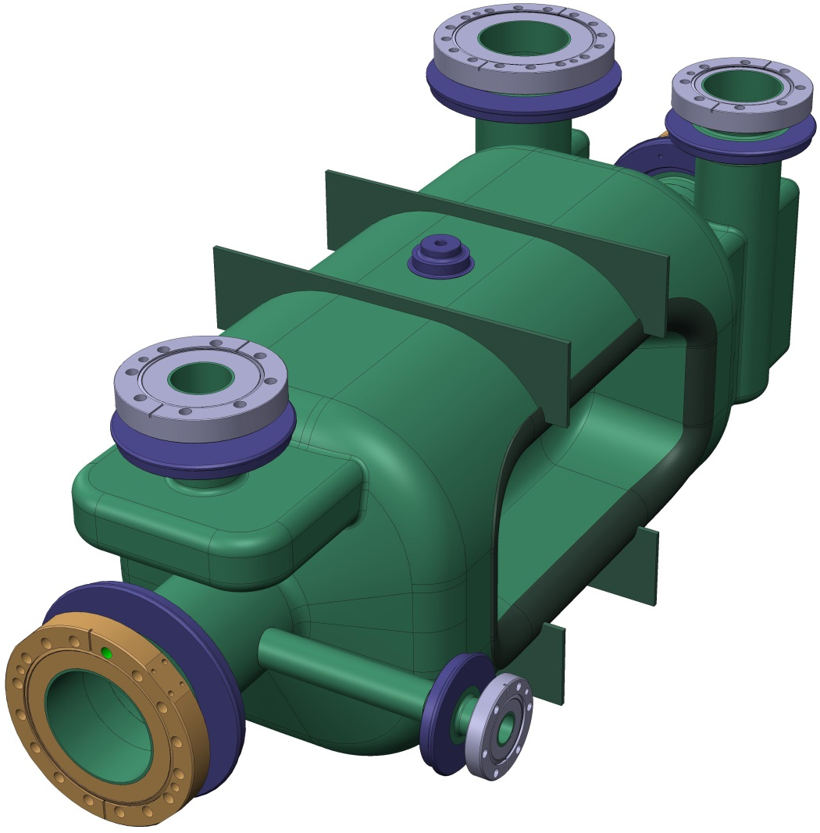
Cavity Designs
Fundamental Power Coupler Port
Coupler & Probe Ports
Double Quarter Wave
Tuner interface
Niobium RRR300 Cavity – 4mm wall thickness
Niobium-Titanium Transition pieces
Survey & Alignment Mounting Points
RF Dipole
Cavity Stiffening Ribs

Slide 6
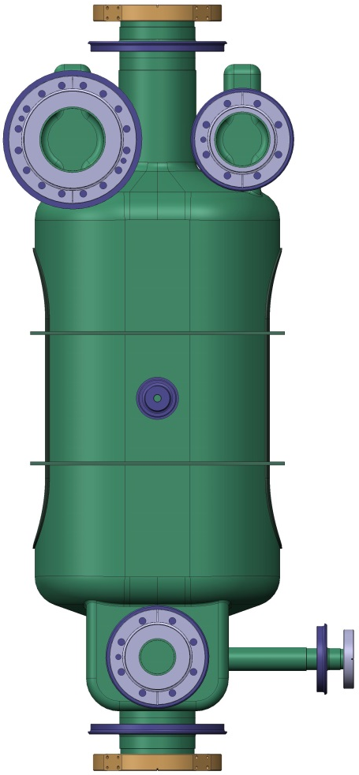
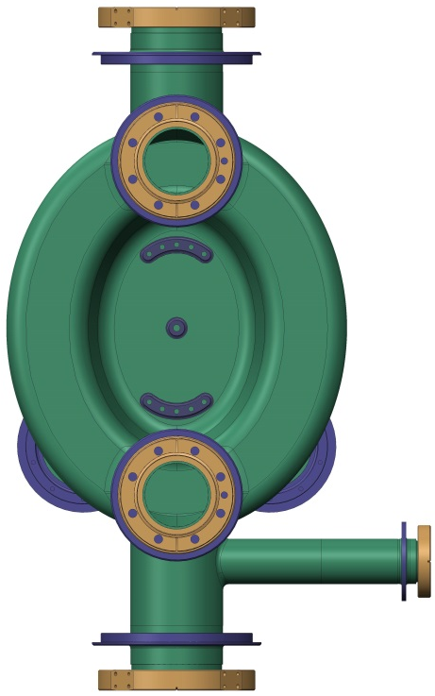
Double Quarter Wave
Mass: 50kg
659.6
904.7
410.5
Mass: 55kg
414

Slide 7
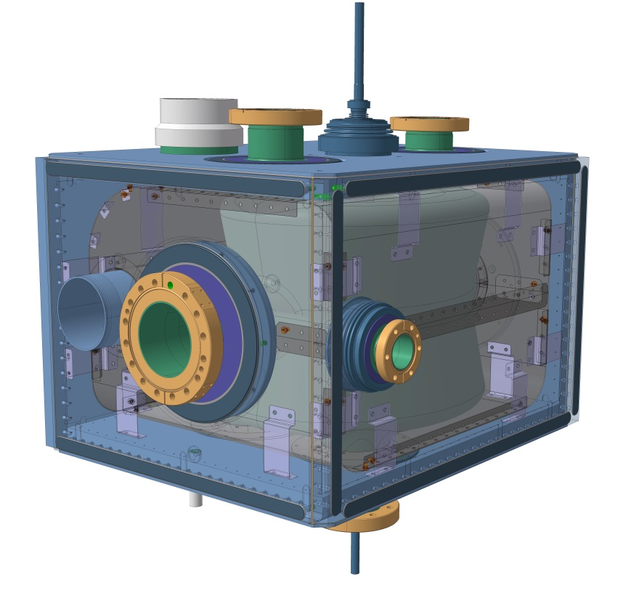
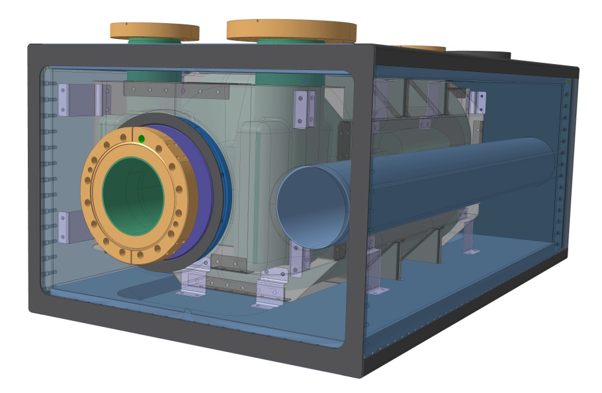
Dressed cavities

Slide 8
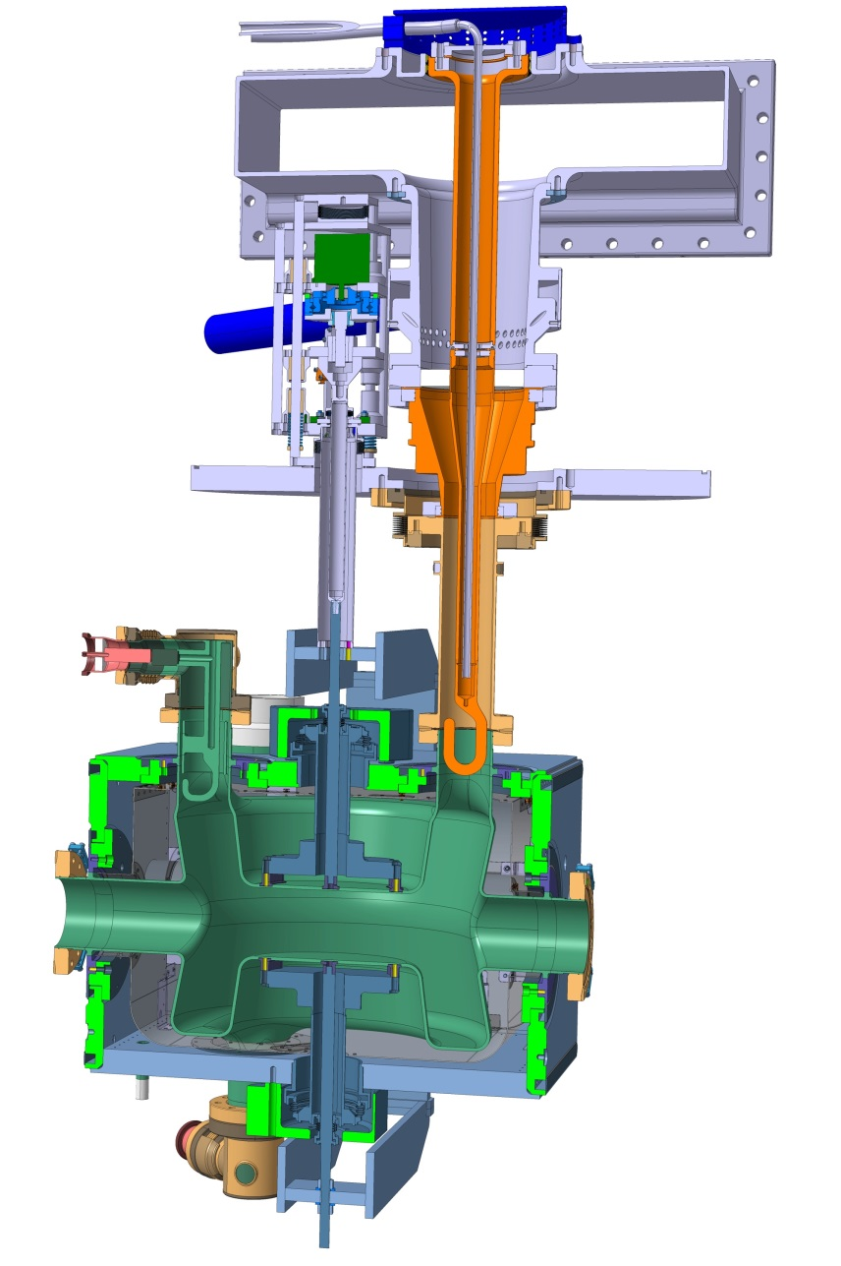
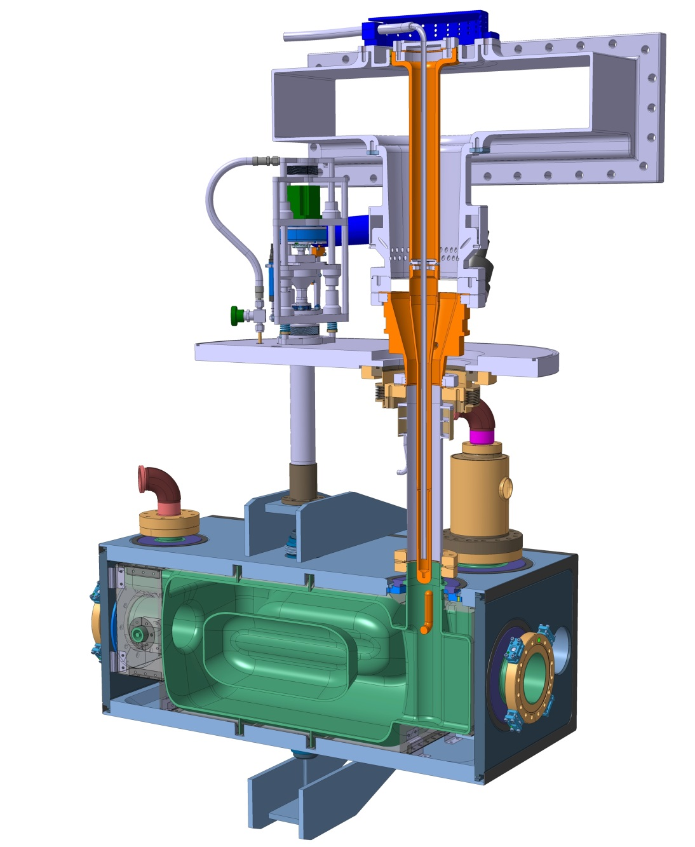
Dressed Cavities
Active (warm) Tuner Mechanism
Fundamental Power Coupler
HOM Coupler
OVC Interface
Helium Vessel
Cavity
Cold Magnetic Shield
Passive (cold) Tuning Component

Slide 9
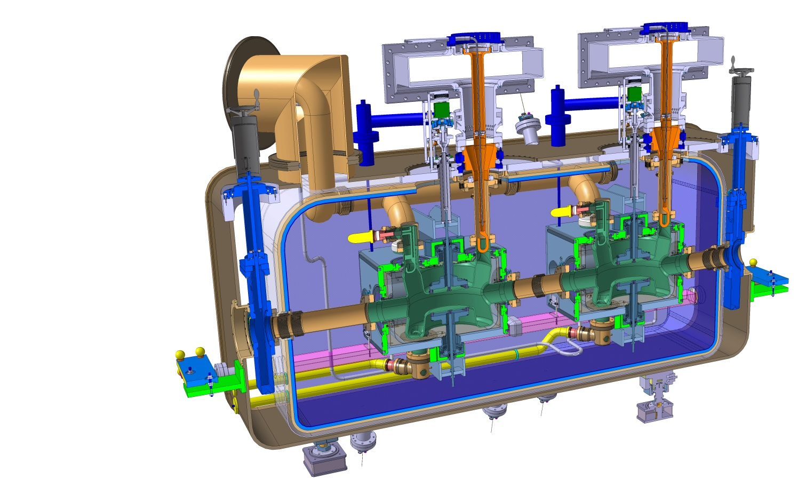
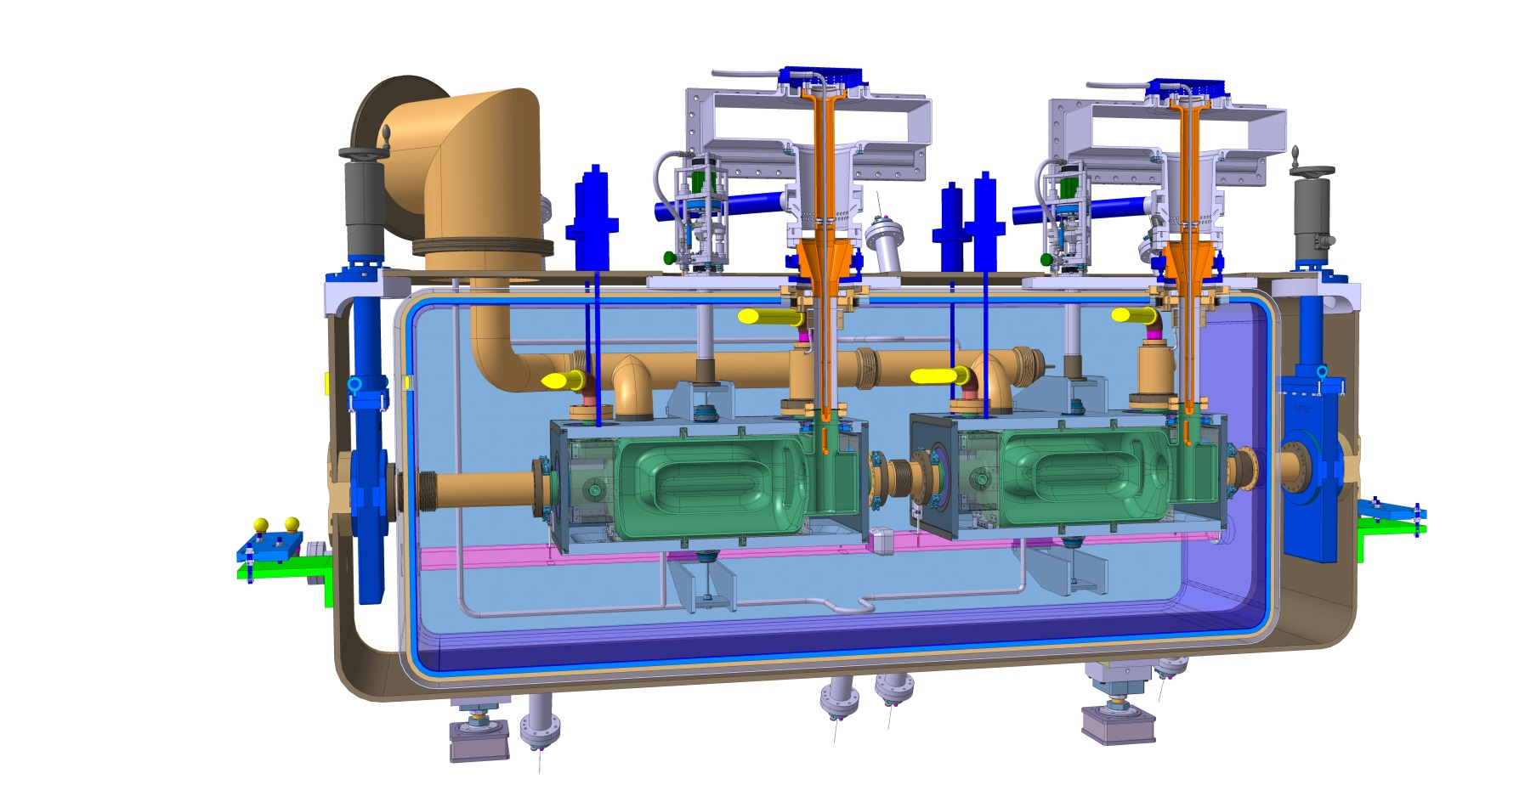
Cryomodules
Double Quarter Wave, Vertical Deflection
RF Dipole,
Horizontal Deflection

Slide 10
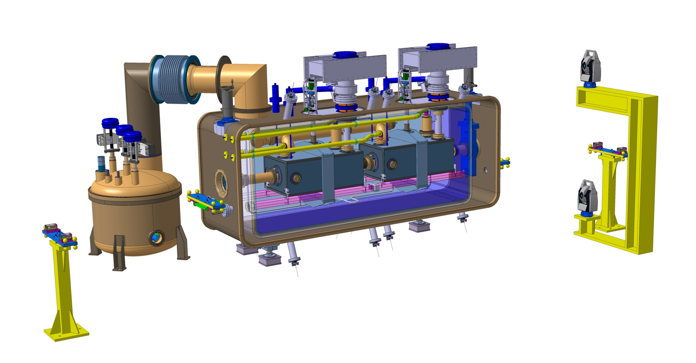
Cryomodule

Slide 11

Cryomodule

Slide 12
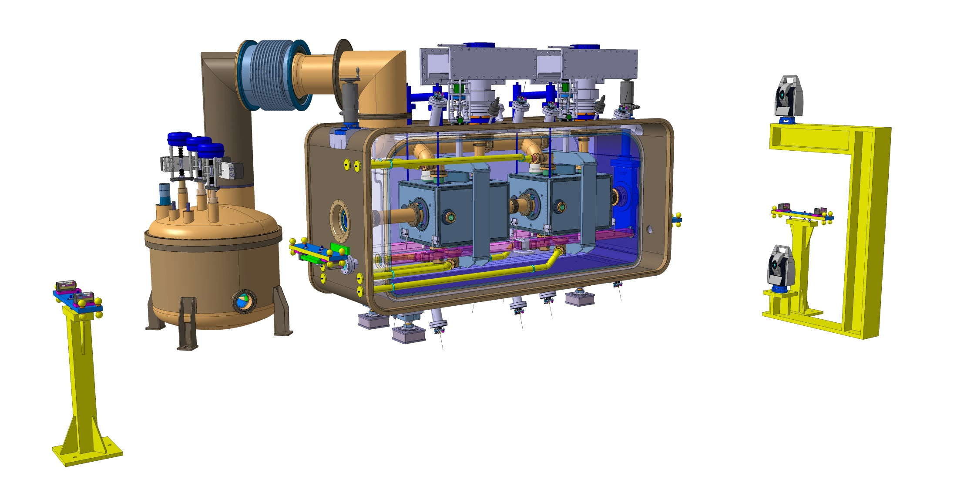
Cryomodule

Slide 13

Cryomodule

Slide 14
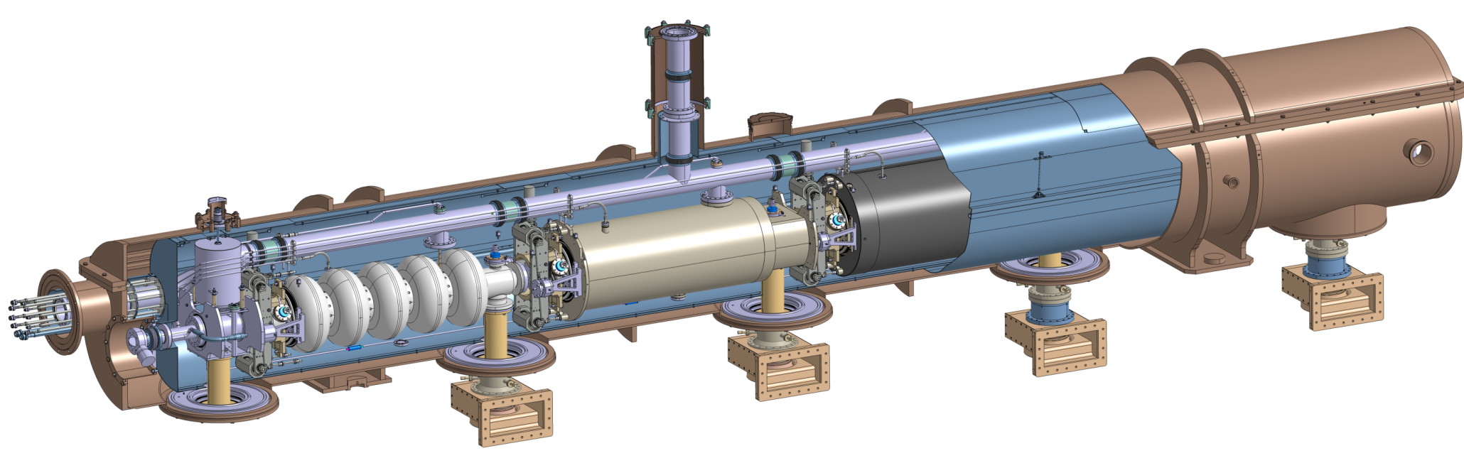
SPL R&D Study
Cryogenic circuit
burst disk
Insulation vacuum
relief plate
Thermal shield
Cryogenic lines port
Vacuum vessel
Helium tank
Magnetic shielding
Two-phase pipe
He phase separator
Thermal shield tie-rod
Cavity tuner
RF coupler
Inter-cavity
support
Gate valve
Cold-to-warm
transition
Cavity
Double-walled
tube

Slide 15
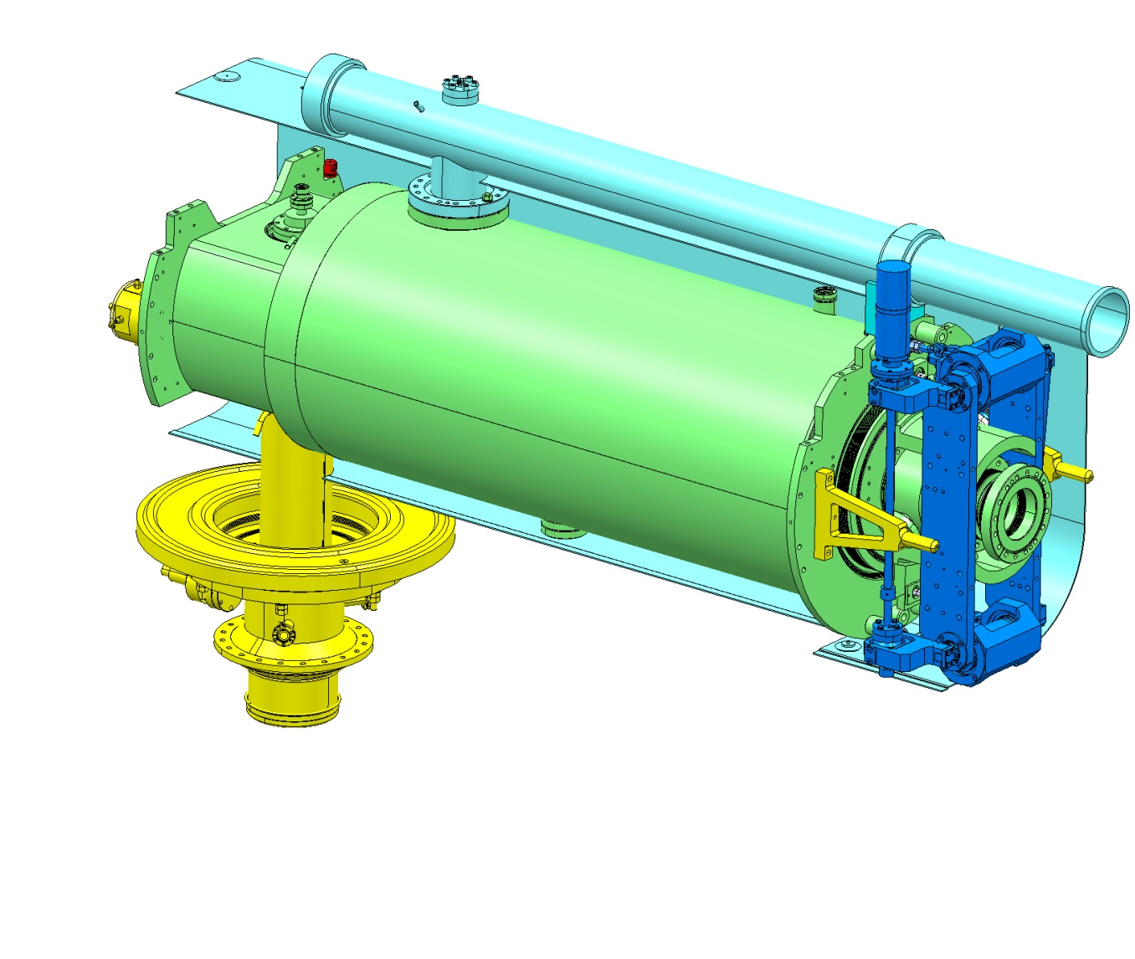
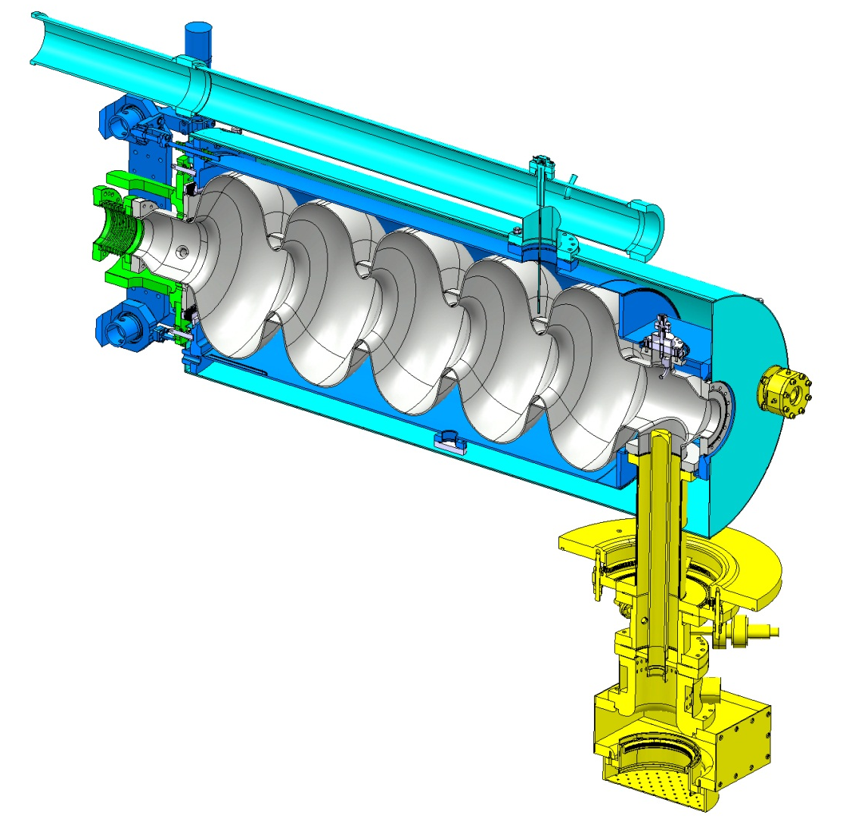
5-Cell Equipped Cavity
Pumping
Bulk Niobium 5Cells cavity
Tuners
5-cells 704 MHz niobium cavities
Stainless steel (316L /316LN) helium tank
Power coupler

Slide 16
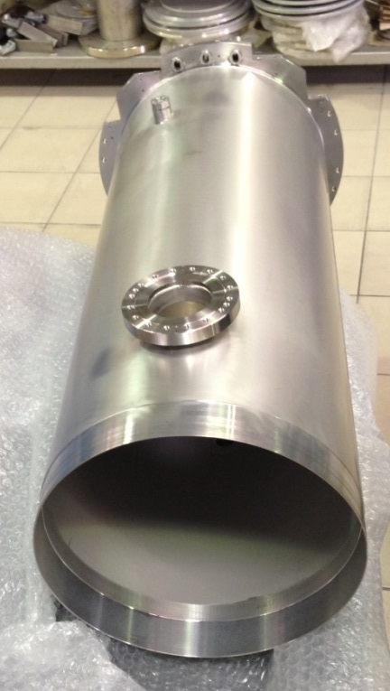
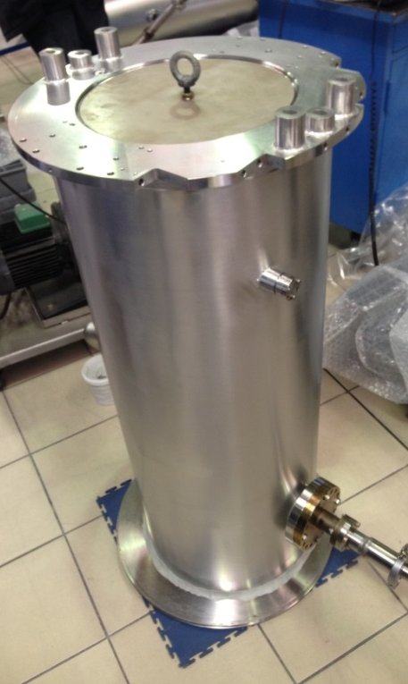

Slide 17
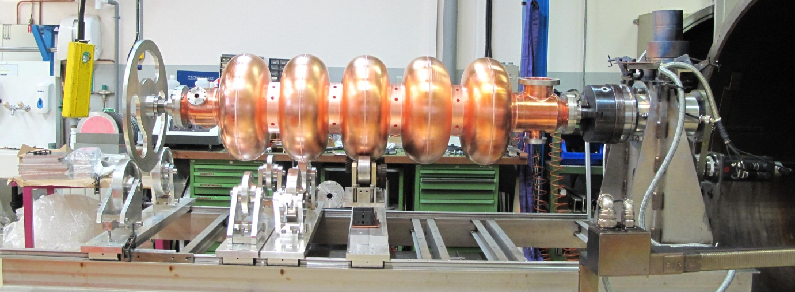
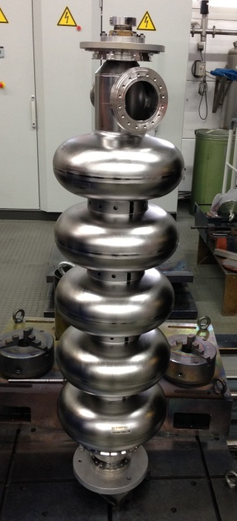
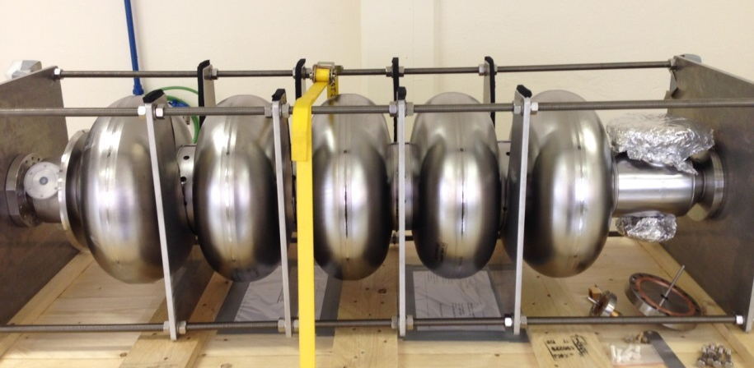

Slide 18
And others to come…

