Slide 1

Via Vicenza 113 - 36015 Schio ( VI )
Italia
SC cavities production at Ettore Zanon s.p.a.
Ing. G. Corniani Ettore Zanon s.p.a.
May 2015 -CERN

Slide 2

SC cavities production
Short Summary
Ettore Zanon s.p.a. Company
Overview of past production of SC cavities and cryomodules
Company participation to the R&D phase of the XFEL project and actual involvement (SC cavities serial production)
Cavities production lay-out and Infrastructures
E. Conclusion
May 2015 -CERN

Slide 3
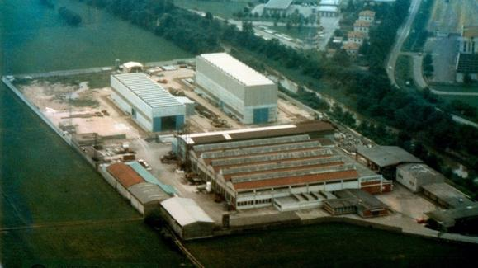
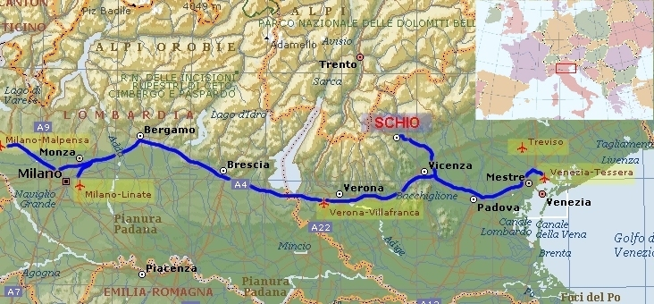
SC cavities production (A)
The company was founded in 1919
It is located in the North-east of Italy
90 KM from Venezia
Number of personnel 210
Shop’s workers 160
Machining , forming , welding and testing facilities
Standard production for chemical industry
(reactors, heat exchangers)
Production of special components
for research institutes and laboratories
(UHV , cryogenics , Fusion ,
Superconductivity )
May 2015 -CERN

Slide 4
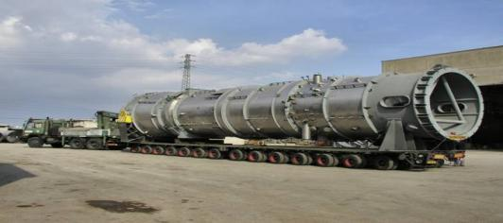
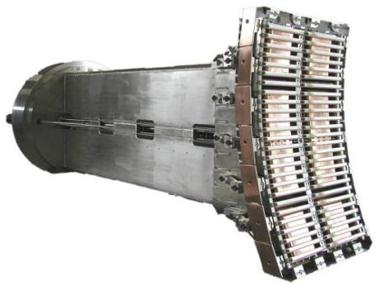
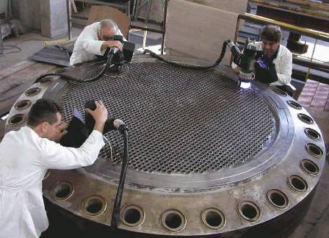
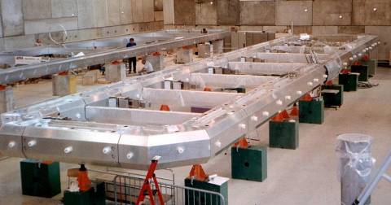
SC cavities production (A)
Standard productions
Special components for research
Oxychlorination reactor -Cladded material
Dimension Dia. 4,1 m X L. 20m , 165 Tons
ITER like ICRH antenna – 8 MW RF antenna (Inconel 625) EFDA-JET
Orbital welding of heat exchanger tubesheet
Material S.S. And Zirconium
Aluminium thermal shield for the ATLAS detector at CERN
May 2015 -CERN

Slide 5
SC cavities production (B)
Overview of past production of SC cavities and cryomodules
Ettore Zanon s.p.a has been working and manufacturing special components for superconducting applications since more than 20 years.
Experience with niobium superconducting cavities started in the early 90’s and has continued without interruption since nowadays.
In a similar way , by using the available in house production facilities and processes , the production and test of cryostats and cryomodules were successfully completed for many different scopes and projects.
Here a quick non-complete overview of past productions
May 2015 -CERN

Slide 6
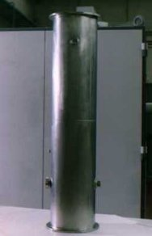
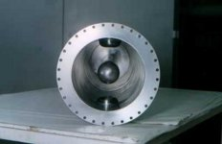
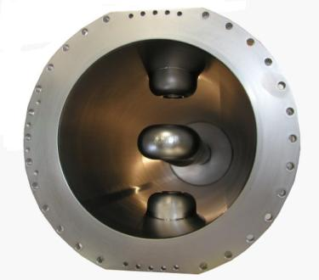
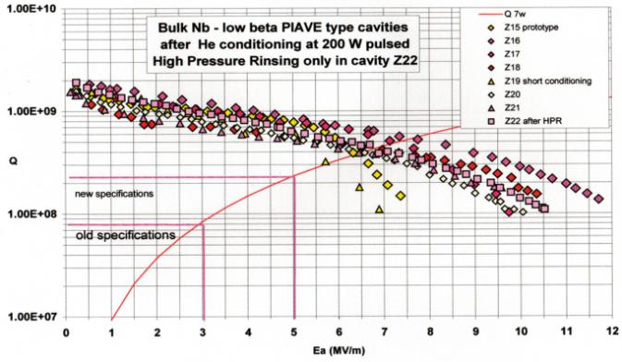
SC cavities production (B)
Quarter wave superconducting cavities for ALPI-PIAVE linacs INFN Laboratori Nazionali Legnaro –Italy
Quarter wave superconducting cavities for ISAC-II project
TRIUMF laboratories at Vancouver-Canada
Production in different steps
of 48 units
May 2015 -CERN

Slide 7
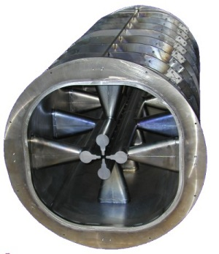
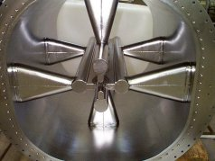
SC cavities production (B)
RFQ2 and RFQ1 quadrupole cavities for ALPI Linac
RFQ2 cavity , 80 MHz RF , full-niobium quadrupole superconducting cavity
overall dimensions ∅810mm x800mm. length
RFQ1 cavity , 80 MHz RF , full-niobium quadrupole superconducting cavity ,
overall dimensions ∅810mm x1410mm. length
Basically the union of two cavities SRFQ2
May 2015 -CERN

Slide 8
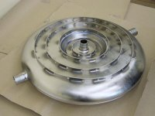
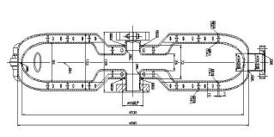
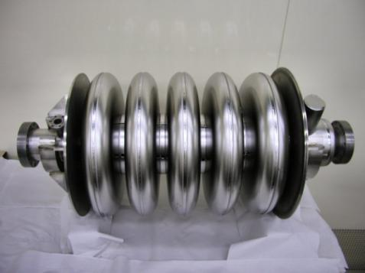
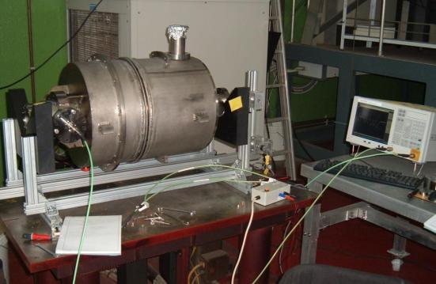
SC cavities production (B)
Re-entrant cavity (TRASCO program)
Double wall circular components made of RRR niobium sheets thickness 4mm.
inner shell diameter 536 mm ,outer shell diameter 560mm
5 cells superconducting cavity 700MHZ β=0,5 (TRASCO Program)
Titanium tank manufacture and cavity integration Tuning tooling design and manufacture , tuning operations
(collaboration with INFN lab. LASA) Similar design of the next ESS project
May 2015 -CERN

Slide 9
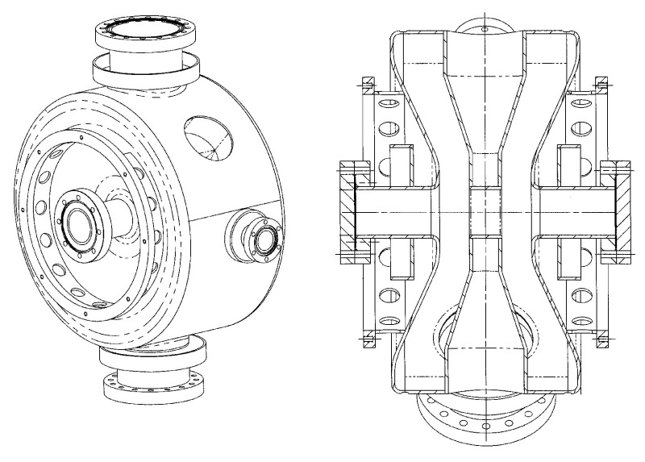
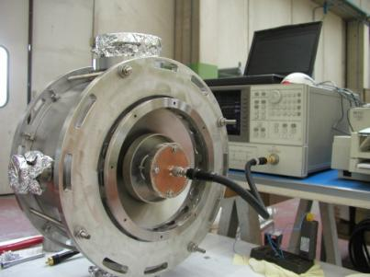
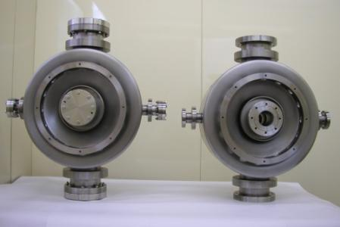
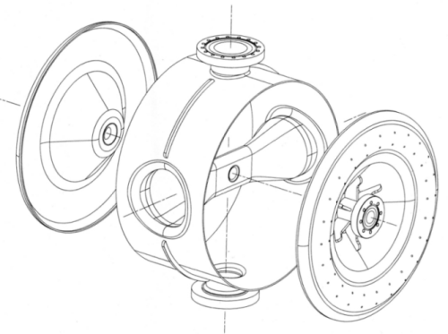
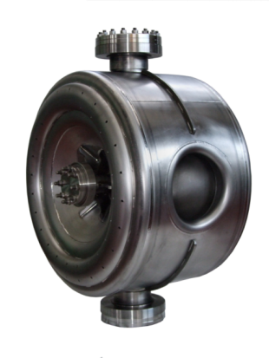
SC cavities production (B)
ß=0,175 2 GAP SPOKE RESONATORS
LANL Los Alamos National Laboratory Accelerator Driven Test Facility project
ß =0,22 , 325 MHz single Spoke Resonator -FERMILAB FNAL Proton Driver
May 2015 -CERN

Slide 10
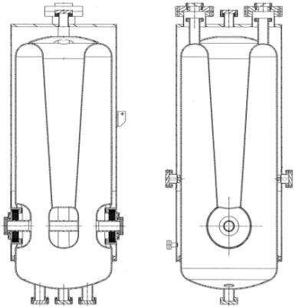
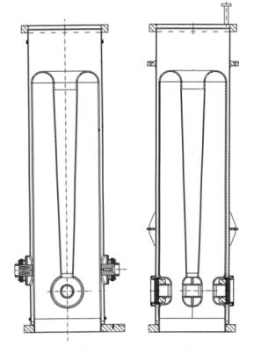
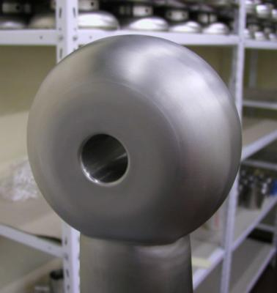
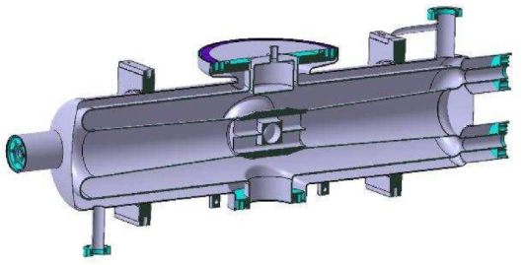
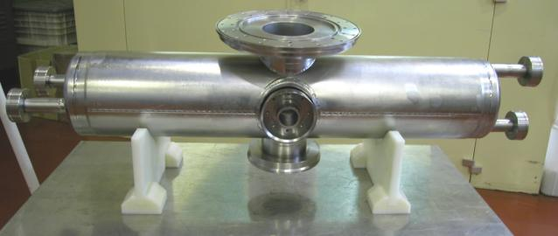
SC cavities production (B)
ß 0,12 and ß 0,07 , 88 MHz Quarter Wave Resonators
CEA , SPIRAL II Project – GANIL (several units with S.S. He tank)
ß 0,094 175 MHz Half Wave Resonator (and titanium He tank )
CEA , IFMIF –International Fusion Material Irradiation Facility (Prototype + 9 units in progress)
May 2015 -CERN

Slide 11
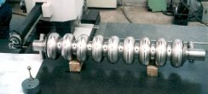
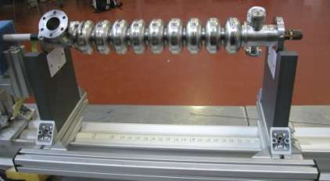
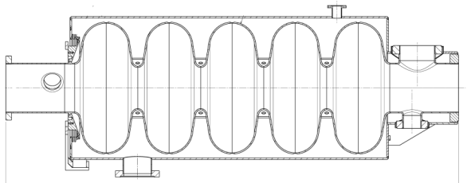
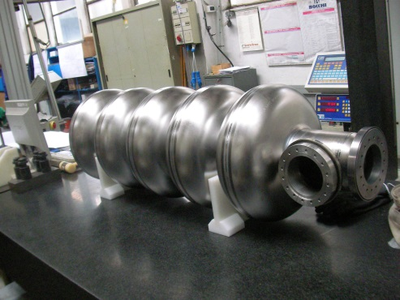
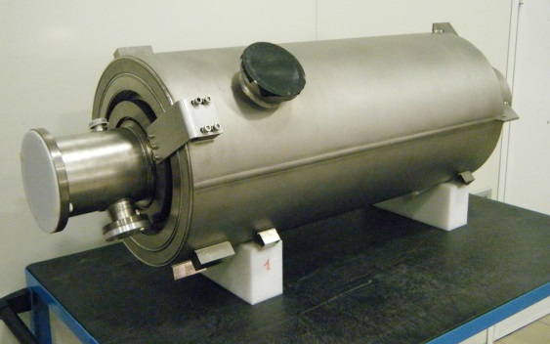
SC cavities production (B)
9 cells superconducting cavity 1,3GHz and 3.9 GHz for XFEL project (DESY)
Development and manufacture of 1,3GHz superconducting cavities (past delivery of 66 units - performances above 30MW/m) and infrastrucutre for serial production
Development and manufacture of the 3,9GHz superconducting cavities (3 units) and relevant toolings for BCP , RF and HPR operations
5 cells , 700 MHz SC elliptical cavities for EUCARD –ESS project
(CEA – two prototypes delivered )
May 2015 -CERN

Slide 12
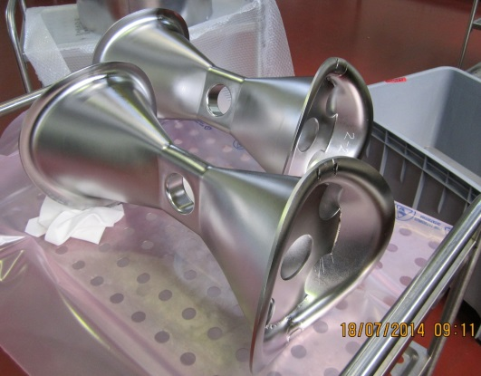
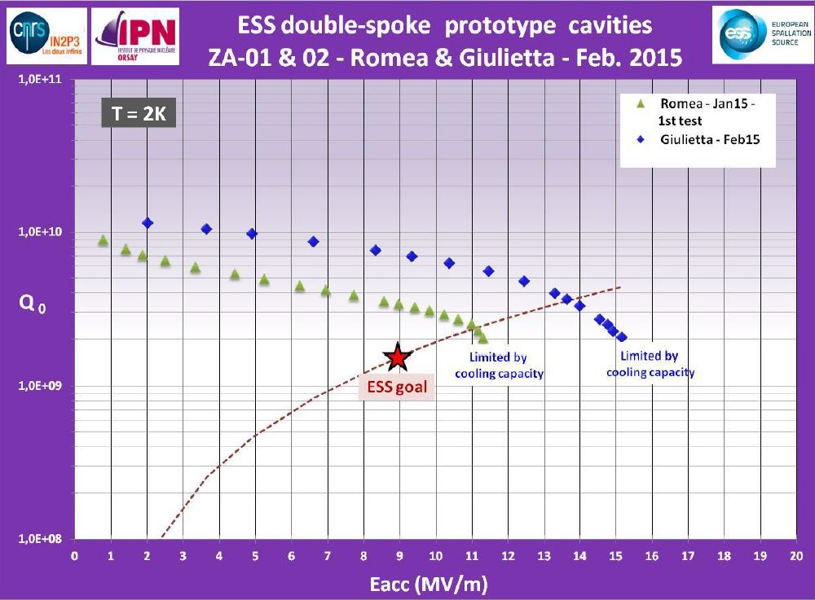
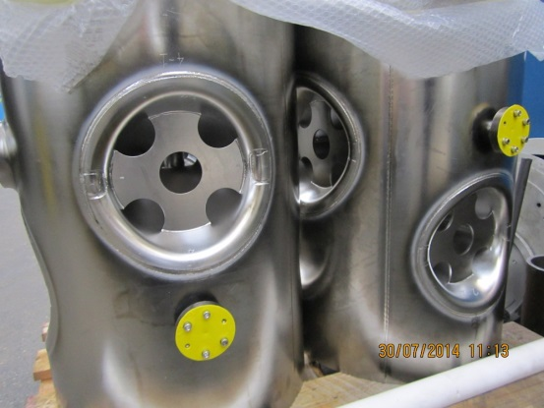
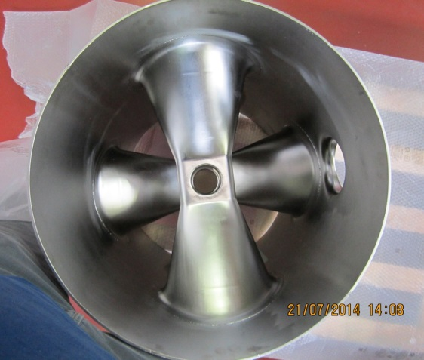
SC cavities production (B)
Double Spoke cavities for ESS project
(IPN ORSAY– two prototype )
May 2015 -CERN

Slide 13
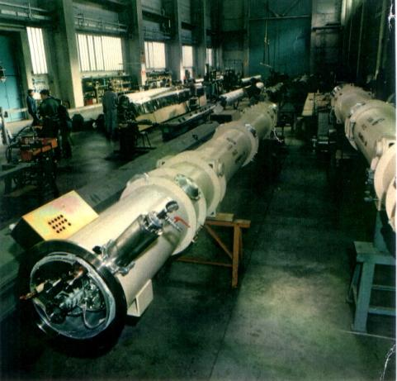
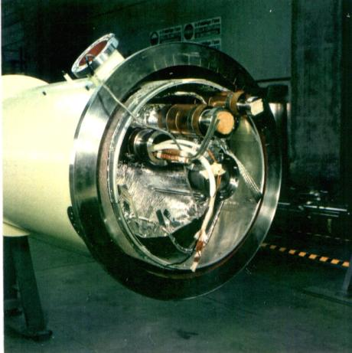
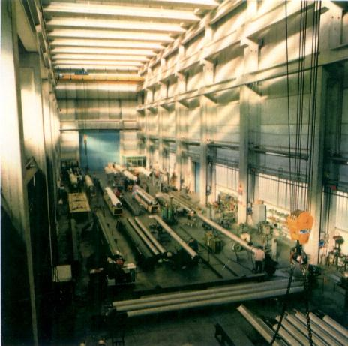
SC cavities production (B)
Production of cryostats and cryomodules for SC applications
HERA Project at DESY-Hamburg
Production and assembling of 242 cryostats for the
S.C. dipole magnets
May 2015 -CERN

Slide 14
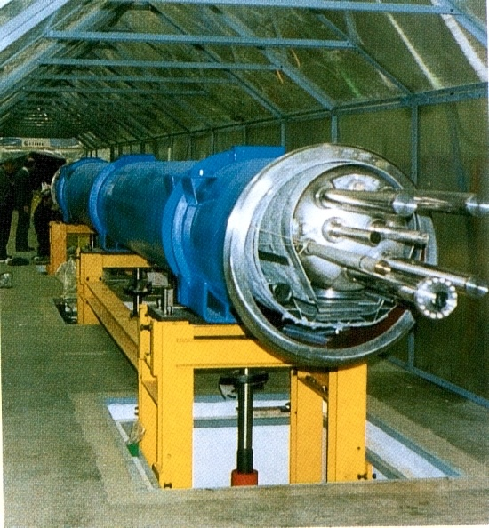
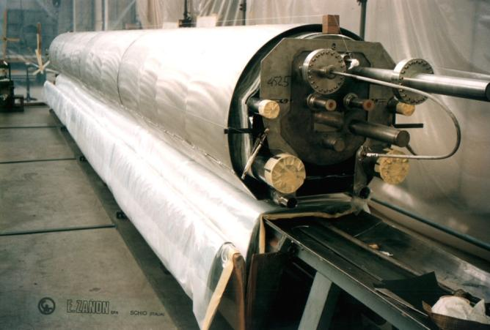
SC cavities production (B)
LHC Project at CERN-Geneve
Pre-series manufacturing and assembling of 10m. and 15m. long cryostats for the S.C. dipole magnets
May 2015 -CERN

Slide 15
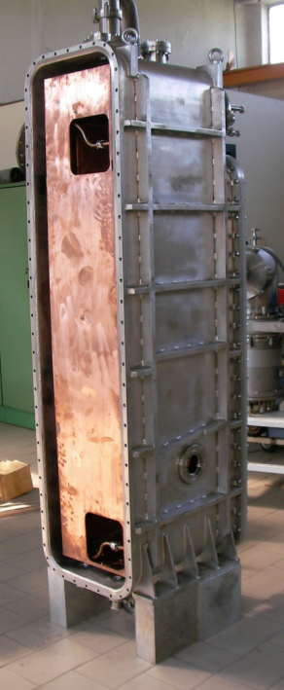
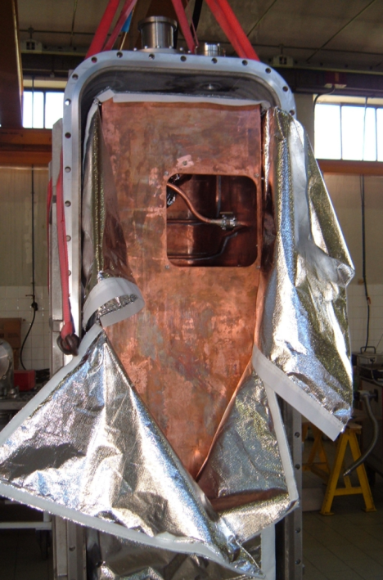
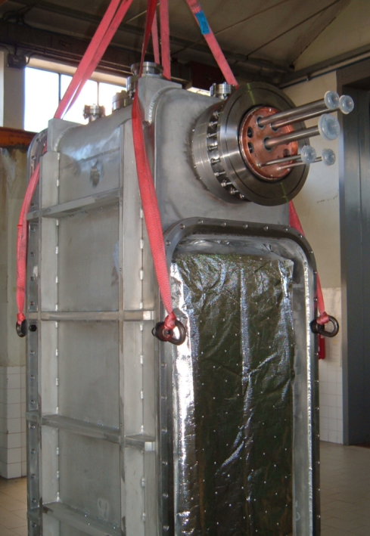
SC cavities production (B)
SPIRAL II Project – GANIL ,CEA
Series of cryomodule for SC cavities
May 2015 -CERN

Slide 16
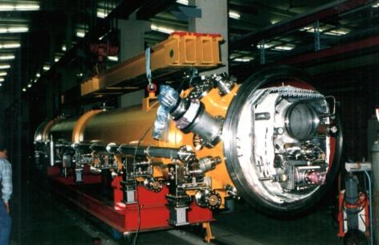
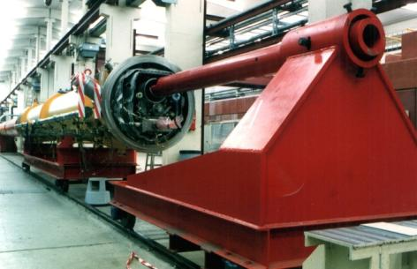
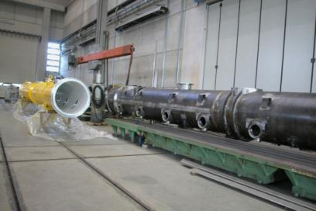
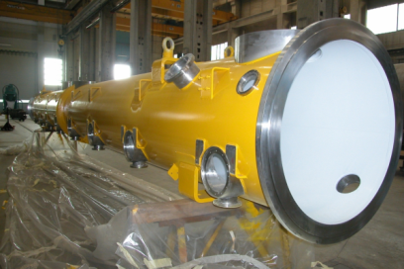
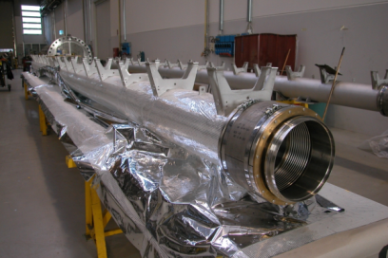
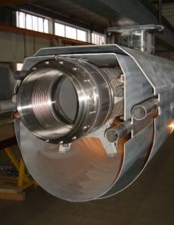
SC cavities production (B)
TESLA Test Facility – XFEL Project at DESY
Past production of cryomodule for R&D phase
Actual production of cryomodule for XFEL
May 2015 -CERN

Slide 17

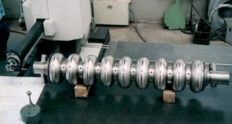



SC cavities production (C )
Company participation to the R&D phase of the XFEL
project and actual involvement
(SC cavities serial production)
Development and manufacture of the cryomodules and assembling tooling ( 10 units supplied )
Development and manufacture of 1,3GHz superconducting cavities
(66 units supplied - performances above 30MW/m))
Development and manufacture of the 3,9GHz superconducting cavities
Manufacture of the Titanium helium tanks (111 units supplied)
Manufacture of the titanium blade tuner
(40 units , alternative design solution to the standard tuners)
May 2015 -CERN

Slide 18



SC cavities production (C)
Actual involvement to the XFEL project
August 2010 to 2011 , Award of DESY contracts for
A) Manufacture and final treatement of 420 units of the 9 cells , 1,3GHz SC cavities
Scope of work includes :
Manufacture of the 1,3GHz cavities / Manufacture of their Titanium Helium tanks
Integration of the cavities into their tank /Treatments and Surface cleaning treatments
Components manufacture and certification according to PED (Presssure Equipment Directive)
Delivery production rate 4 units/week
Like above for 10+10 units of 3,9GHz SC caviites of the injector module
B) Manufacture and testing of 45 units of XFEL Cryomodules
Scope of work includes
Vacuum vessel and cold-mass prefabrication and testing
Delivery to the assembly site ( CEA-France)
C) Manufacture and testing of 146 units of Titanium Helium tanks
Scope of work includes
Tank prefabrication and He leak check
Delivery to DESY
May 2015 -CERN

Slide 19
SC cavities production (C)
Staus of the XFEL project production at EZ
(MAY 2015)
A) Cavity production 423 units welded - 378 units surface treatted and delivered
Performance of the delivered units up to 40 MV/m
Production end expected October 2015
B) 45 units of XFEL Cryomodules completed and delivered
C) 146 units of Titanium Helium tanks completed and delivered
D) 10 units of 3,9GHz cavity completed and delivered
Performance of the delivered units up to 25 MV/m
May 2015 -CERN

Slide 20
SC cavities production ( D )
Cavities serial production lay-out and Infrastructures
The cavity production has been organized with a dedicated lay-out into two dedicated buildingd separate from others Ettore Zanon s.p.a. production
( building lot I and building lot IV )
Building lot I
prefabrication of cells , dumb-bell ,subassemblies , end groups
EB welding , chemistry
Building lot IV (renewed building)
Final cavity welding , integration with Helium tank , surface treatments
(Prefabrication of the titanium Helium tank in the “standard” shop)
Building Lot IV shall be assigned for future similar productions
May 2015 -CERN

Slide 21

SC cavities production ( D )
Cavity’s production lay-out
Building lot I about 600 m²
Building lot IV 1200 m² (plus 600 m² for services)
May 2015 -CERN

Slide 22




SC cavities production ( D )
Building lot I
Clean room ISO7
UPW production unit (18MΏcm)
Dedicated 200T forming press (cells , tube's pulling , reshaping ) CNC turning machine (cell Dumb-bell machining, others)
Electron beam plant
150KV-30KW with cryogenic pump
*
May 2015 -CERN

Slide 23


SC cavities production ( D )
Building lot I
Material (Niobium) storage area and incoming controls
Dimensional controls
Electropolishing with UPW plant(18MΏcm)
UT and BCP treatment of sub-components
May 2015 -CERN

Slide 24
SC cavities production ( D )
Building lot IV
The building has been completely “restored” for thie scope of XFEL production with installation of central conditioning system too
(clean environment)
Into the building
Designed–optimized lay-out for the cavities serial production
Organization by manufacturing/testing station (MTS) located to suit the production flow
Outside of the building
“Service area” to concentrated all the equipments/services for the MTS
May 2015 -CERN

Slide 25


SC cavities production ( D )
Building lot IV Service area
May 2015 -CERN

Slide 26


SC cavities production ( D )
Maintenance area
Building lot IV Service area
Chemistry service area : storage of BCP acid tanks-cooling systems for BCP stations
Scrubber for acid gasses vent
Ultra pure Water (UPW ) production production up to 3m³/h at 18 MΩcm
5m³/h at >10 MΩcm
May 2015 -CERN

Slide 27


SC cavities production ( D )
Building lot IV Service area
Pumps
(water 18 MΩcm ,>100 bar 1,5 m3/h )
for High Pressure Rinsing cabinets
Storage tank for LN2
Venting of EBW machine
and of leak check groups
May 2015 -CERN

Slide 28


SC cavities production ( D )
Building lot IV
The buidling is organized
in three main areas
Chemical treatment area
Clean room ISO7/ISO4
Controls , Integration ,
800°C -120°C treatments
and testing area
May 2015 -CERN

Slide 29


Infrastructure status for XFEL (D)
Building lot IV
Chemical treatment area
Preparation and drying areas
Automatic pluritank station for
UT cleaning , rinsing
water 10 MΩcm and 18 MΩcm
Automatic BCP treatment line
2 cooled acid baths for Niobium
and Nb-55-Ti
1 bath first rinsing 1 bath final rinsing
water 10 MΩcm and 18 MΩcm
protection tunnel ,fumes extraction to the scrubber
May 2015 -CERN

Slide 30

SC cavities production ( D )
Building lot IV Clean room ISO7/ISO4
Dedicated to
clean assembling , final surface treatments , final assembling for the RFcold test
Total surface of about 450 m²
ISO7 area 220m² ISO4 area 200m²
Operators dressing rooms , air showers
All metallic floating floor
Customized treatment stations
May 2015 -CERN

Slide 31



SC cavities production ( D )
Building lot IV Clean room ISO7/ISO4
ISO 7
100 bar UPW cleaning
cabinet for ISO7 entrance
Pre-assembling stations
for cavity
EBW preparation
May 2015 -CERN

Slide 32


SC cavities production ( D )
Building lot IV Clean room ISO7/ISO4
ISO 7
Automatic pluritank station
for
UT cleaning and
rinsing baths
water 10 MΩcm
and 18 MΩcm
Cabinets for BCP close circuit
of the inner / outer cavity surfaces
Alcol rinsing , Others
May 2015 -CERN

Slide 33



SC cavities production ( D )
Building lot IV Clean room ISO7/ISO4
ISO 4
N° 2 cabinet for final HPR
UPW 18 MΩcm water p>100bar , 1.5m³/h
Cavity's rotation , vertical translation Nitrogen overlay
Station for final leak test
special equiments for
slow-controlled venting
of the cavity ,…others
Assembling stations for
FMS installation - RF antennas assembly
*
May 2015 -CERN

Slide 34




SC cavities production ( D )
Building lot IV Clean room ISO7/ISO4
ISO 4
*
*
May 2015 -CERN

Slide 35


SC cavities production ( D )
Building lot IV Control , Integration , 800°C -120°C treatments and testing area
The area is organized to suit part of the production and control operations
(good clean environment , not classified)
New EB welding plant : S.S. Chamber ,
size 3,4x2x2 m , oil free pumping group with cryogenic pump
(3x10⁻⁵ mbar 35 minutes)
nitrogen venting , RGA
May 2015 -CERN

Slide 36


SC cavities production ( D )
Building lot IV Control , Integration , 800°C -120°C treatments and testing area
Station with automatic TIG equipment for Cavity-tank final integration
Visual examination with
photo recording of the cavity
inner welds and surfaces
(boroscope)
*
May 2015 -CERN

Slide 37




SC cavities production ( D )
Building lot IV Control , Integration , 800°C -120°C treatments and testing area
Intermediate leak test (oil free equipments)
CMM , semi-automatic ControlMeasuring Machine for dimensional survey
*
*
May 2015 -CERN

Slide 38


SC cavities production ( D )
Building lot IV Control , Integration , 800°C -120°C treatments and testing area
Dedicated Desy equipment for sub-component RF control and cavity final tuning
Shielded pressure test area
(final PED certification)
Quarantine closed cabinet
(non conform pieces)
*
*
May 2015 -CERN

Slide 39



SC cavities production ( D )
Building lot IV Control , Integration , 800°C -120°C treatments and testing area
Inert gas oven for final treatment
(120°C , 1x10⁻⁵ mbar , 52 Hours)
Vacuum oven for 800 °C annealing Molibdenum Hot-chamber 0,6x0,6x1,5m
(4 units per batch)
cryogenic pumps , RGA
May 2015 -CERN

Slide 40

SC cavities production ( E )
Nowaday ( results and targets)
Ettore Zanon s.p.a. is going to complete successfully the XFEL cavity production.
With the available infrastructures , the gained experience and trained team EZ wish to continue the presence in the field , offering the possibility to Research organizations , laboratory and industry to develop and manufacture critical components in a properly dedicated infrastructure
.
Our production team for SC cavities
May 2015 -CERN

Slide 41
SC cavities production
END
Thanks for the attention
May 2015 -CERN

