Slide 1
Magnet cryostats test stations for HL-LHC
Overview May 2015

Slide 2
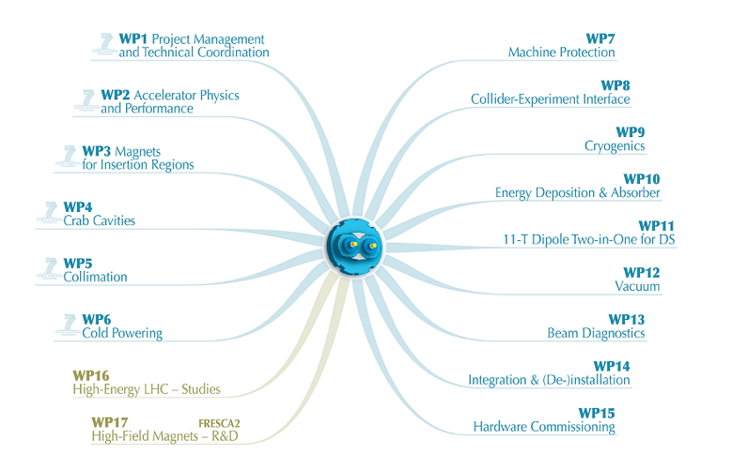
HL-LHC structure
☑
☑
☑
☑
☑
☑ = requires cryostat developments

Slide 3
Outline
Magnet cryostats
  WP3 (insertion regions)
  WP11 (11T dipoles and collimator)
Cryostats for cold powering: WP6
Cryostats for test stations
  HFM
  Cluster D
  Fresca2

Slide 4
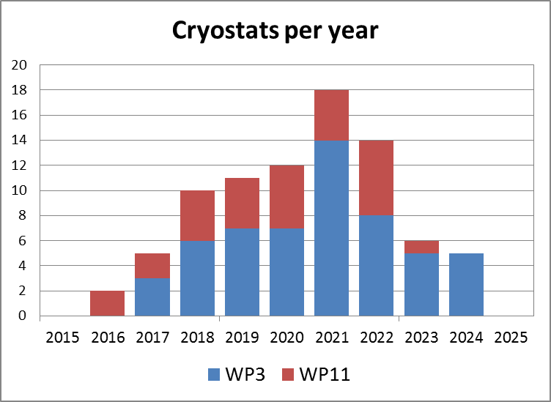
WP3 & WP11: Quantity of magnet cryostats to be assembled and provisional schedule
83 cryostat units
  55 units for WP3
  28 units for WP11

Slide 5
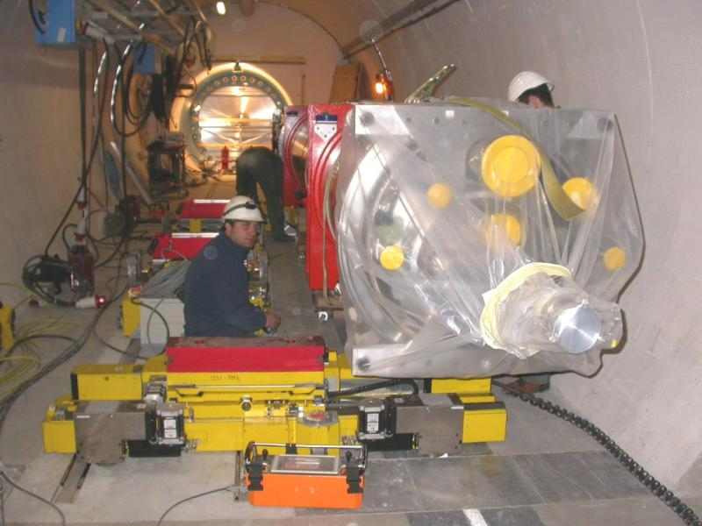
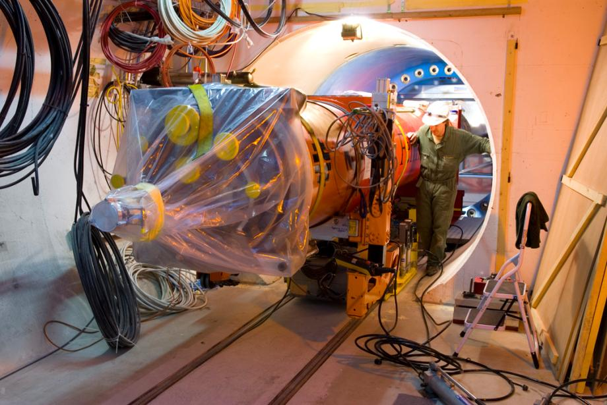
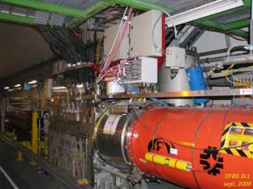
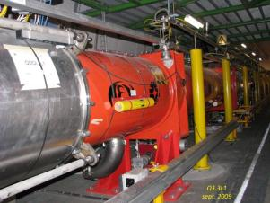
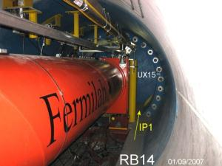
WP3: Q1 to D1 string to be replaced during LS3
Triplet Zone L1

Slide 6
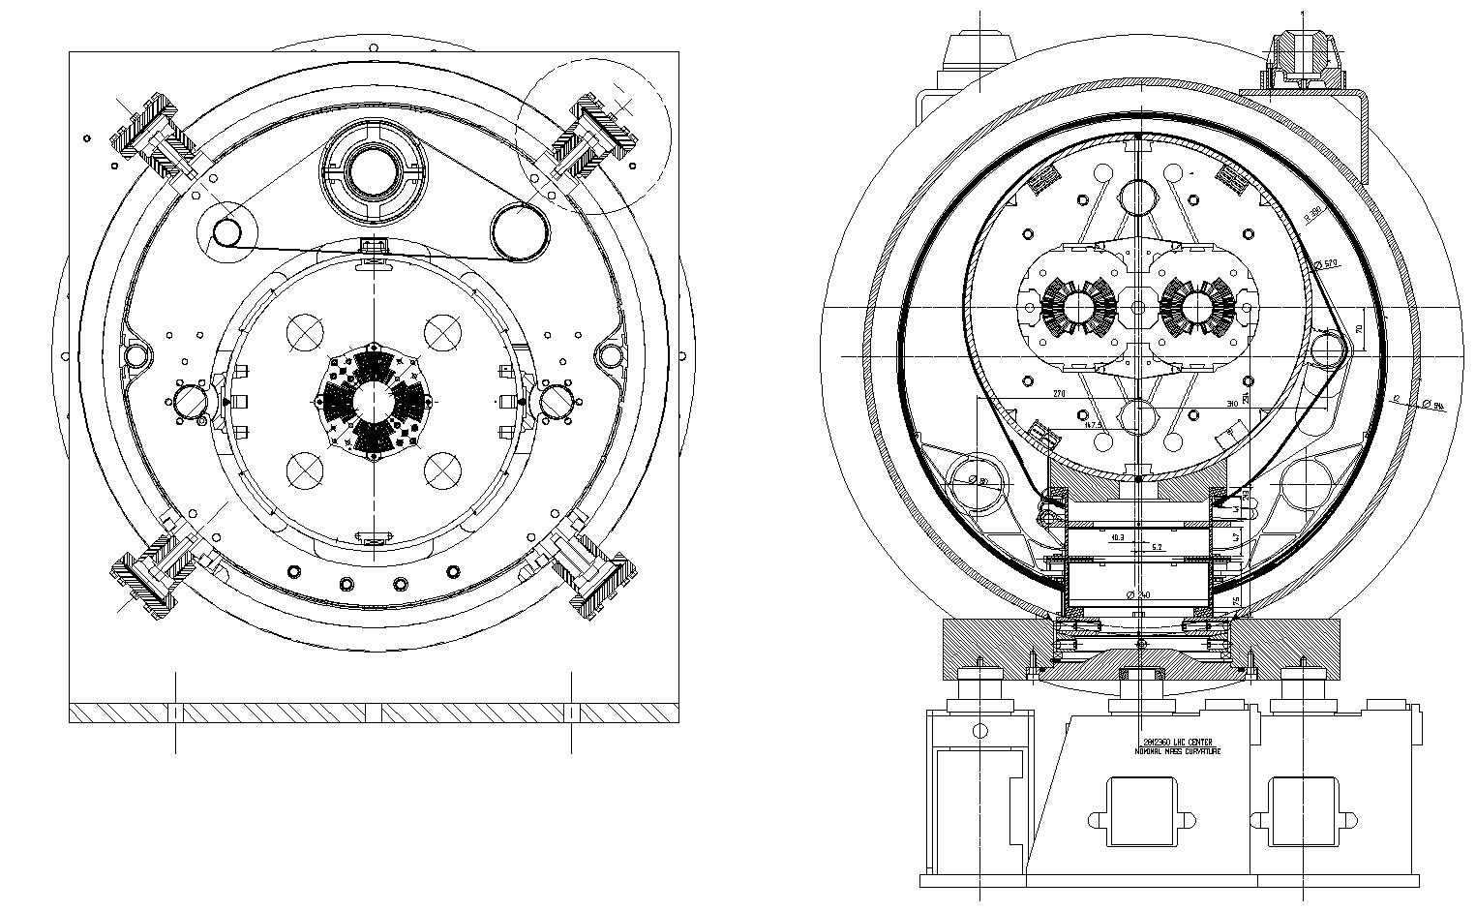
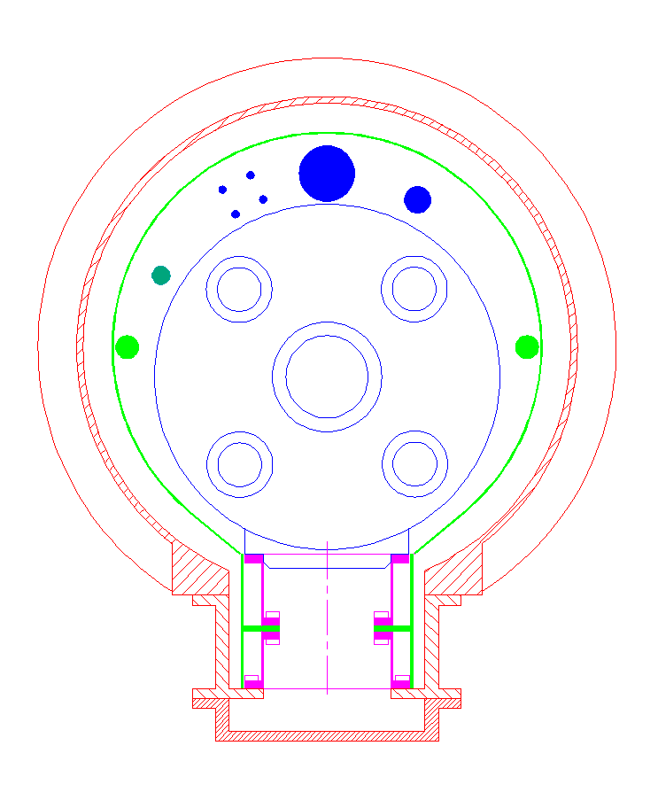
WP3: Q1-D1 Cryostat concept
Thermal shield supported on cold mass
Heat exchangers must be placed on the two upper CM holes
Requires space for sleds and rails
Conduction cooled support thermalization
Single stage heat extraction

Slide 7
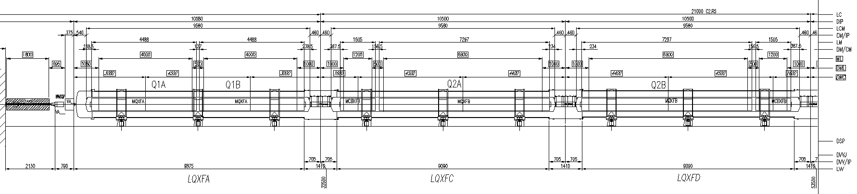
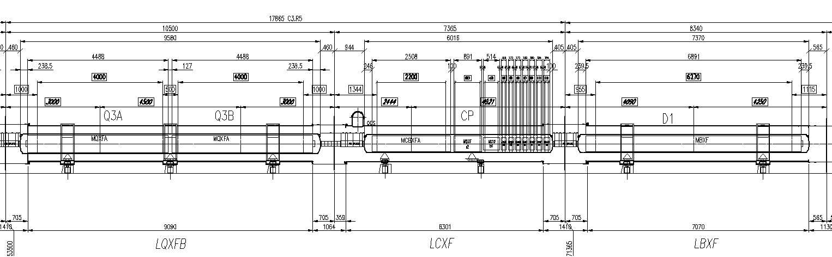
WP3: Layout Q1 to D1, IR1 and IR5
Installation during LS3

Slide 8
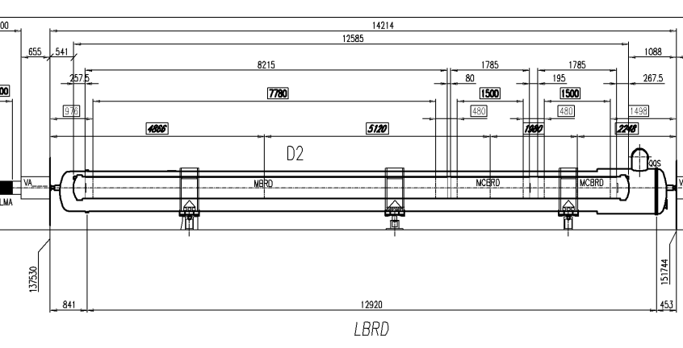
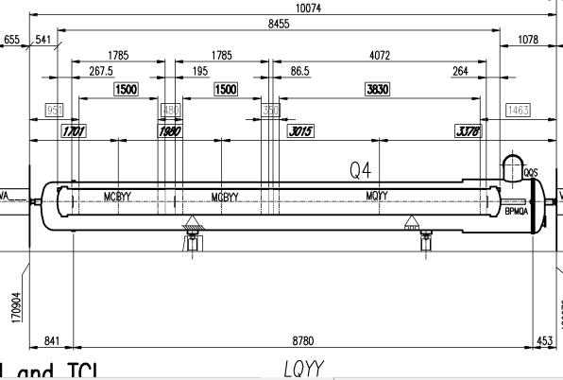
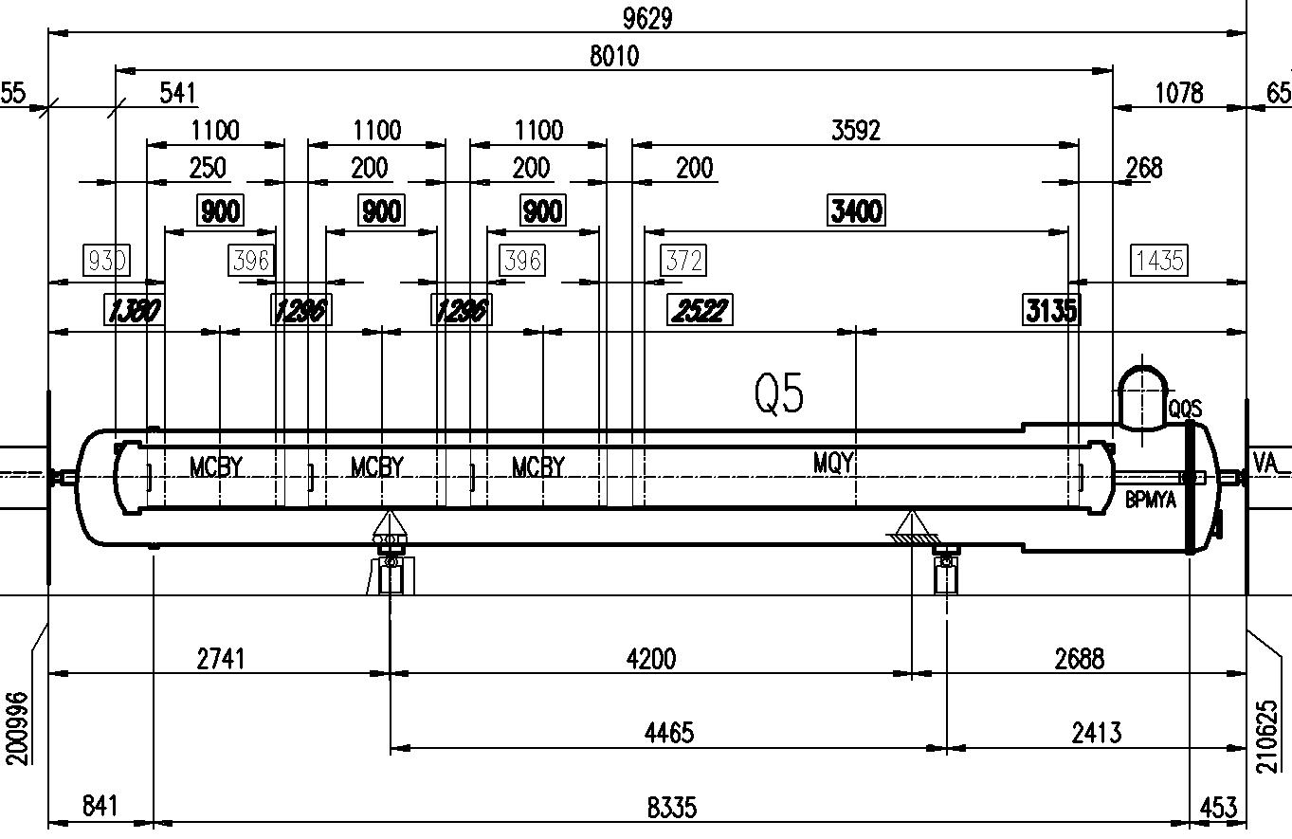
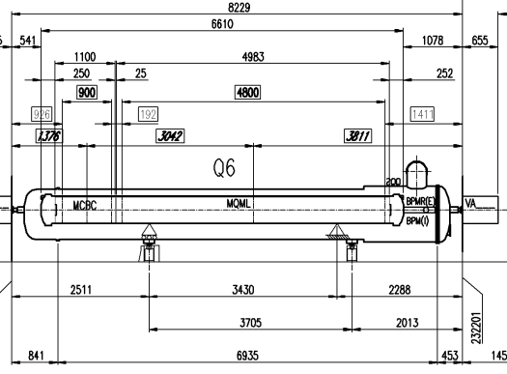
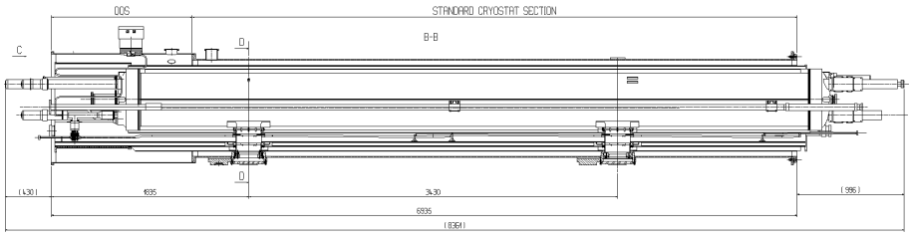
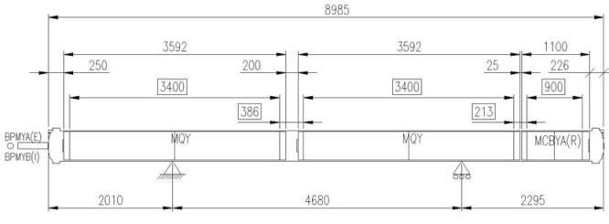
WP3: matching sections and dispersion suppressor magnets (LHC cryostat concept)
D2
Q4
Q5
Installation during LS3
IR1 and IR5
Q6
Q10
IR6
Q5
Installation during LS2

Slide 9
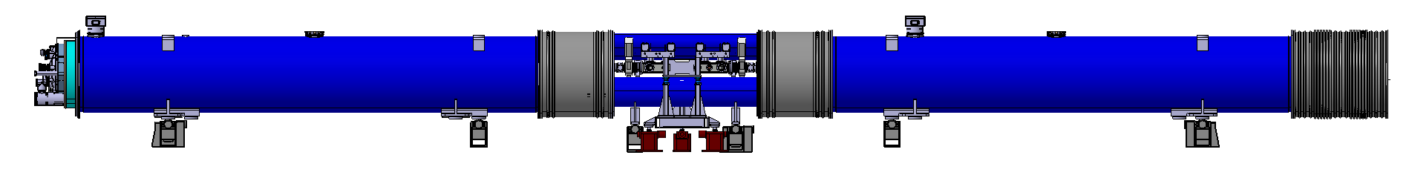
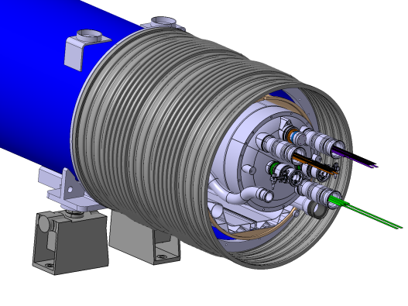
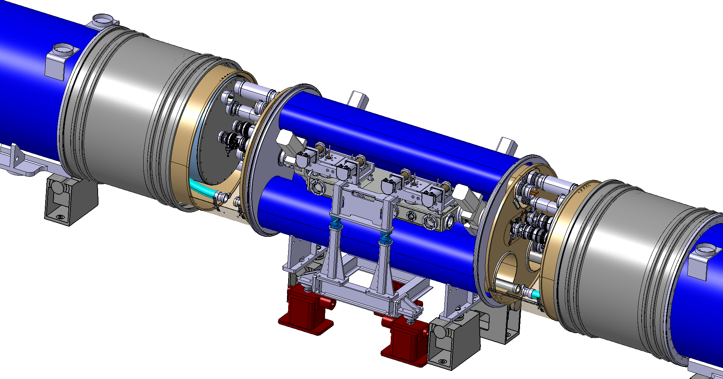
WP11: Cryostats for 11T dipoles and collimator integration
LHC MB replaced by 3 cryostats + collimator, all independently supported and aligned:
Same 15660 mm length between interconnect planes as an LHC MB
Bypass cryostat between two 11 T magnets to integrate the collimator
Same interfaces at the extremities: no changes to nearby magnets, standard interconnection procedures & tooling

Slide 10
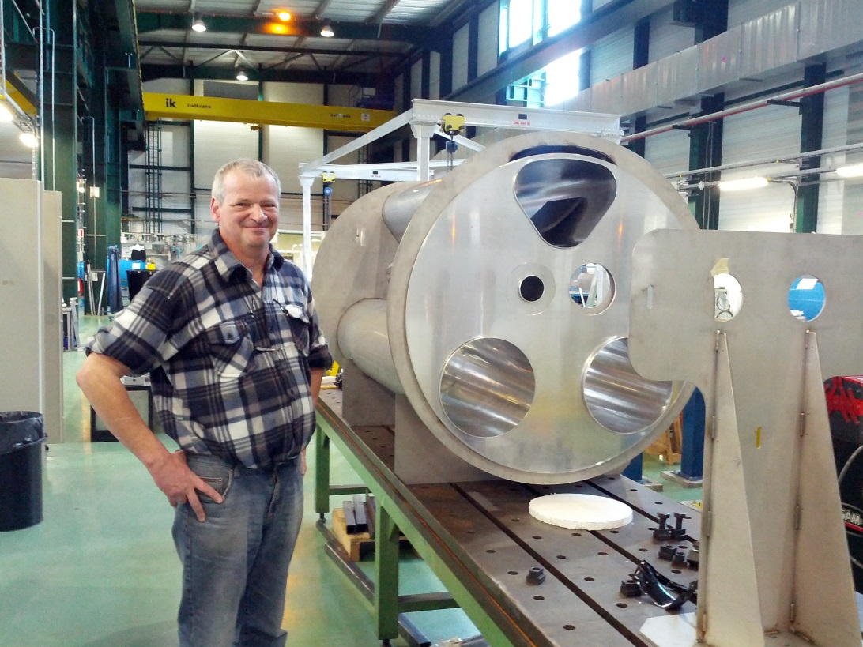
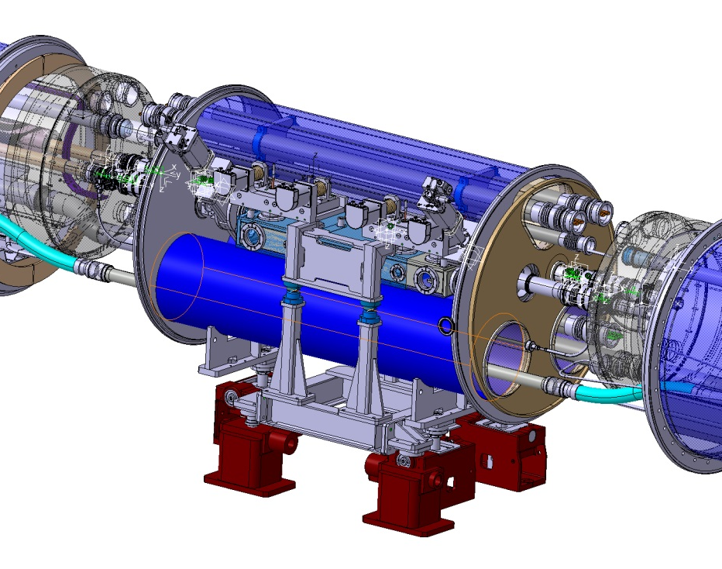
WP11: Design and mockup work on-going
Price enquiry for 11T dipole vacuum vessel prototype in July 2015

Slide 11
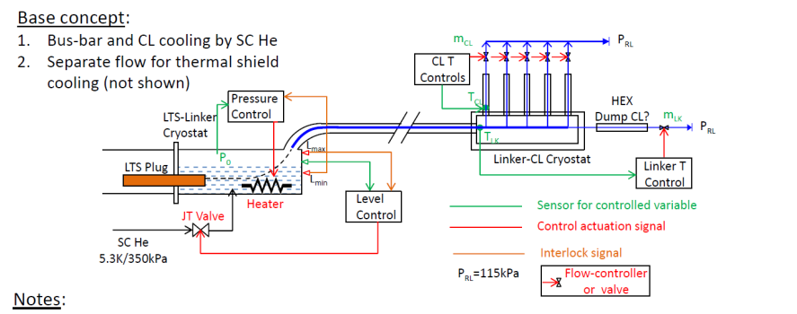
WP6: Current cryogenics feeding concept (all sites)
Helium at max. 17 K
Helium from line C
  The (assumed) 17 K limit for the MgB2 link allows only the
  5 K, 3.5 bar helium from line C as coolant.
  The link will be cooled by helium gas created by evaporating the liquid helium in the spice box.
  Thermal shield solution not shown.
Courtesy of U.Wagner, Y.Yang, A.Ballarino
Notes:
Here the base concept just issued by the Southampton university.
I show this to make clear we work together, they will show the same picture.
I consider it is very close to what we will end up with.
The control is much too detailed for the moment, but could e done like this.
We have basically no other option than take the gas from line C, expand it to liquid for the cooling of the splice LTS to MgB2 and create sufficient flow for the leads and link by heating away in the bath.
The thermal shield can either be taken from the line D (most probable for a nexans line solution) or from line E back to line F. but this requires a custom TL with two shield gas lines.
For the arc DFB the shield coming from line D will be mixed with the gas for the MgB2 cooling and can then cool the leads.
For the other DFB-s either we cool with line E/F or we have to warm up some of the gas for the link and feed this back to ambient.
For the new refrigerator /IT DFB we can imagine recovering the cold gas through a surface TL> I am even not certain if it will be worth the cost of the TL.

Slide 12
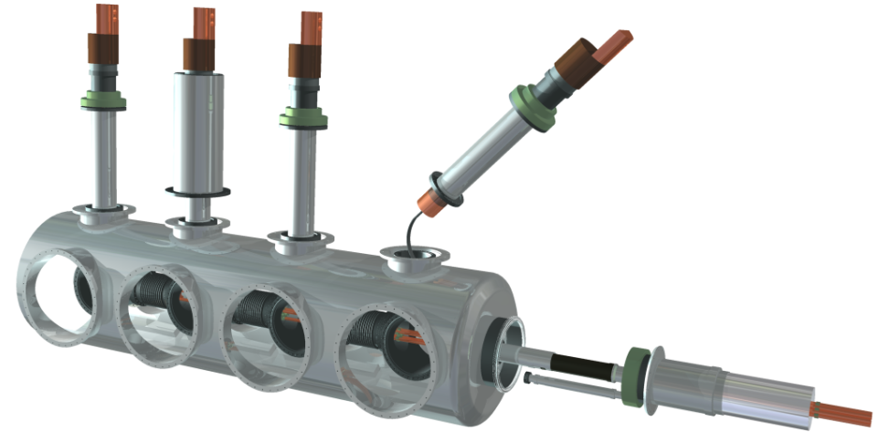
WP6: Current Leads Module concept
(Y.Yang et al., Univ.of Southampton)
Courtesy of U.Wagner, Y.Yang, A.Ballarino

Slide 13
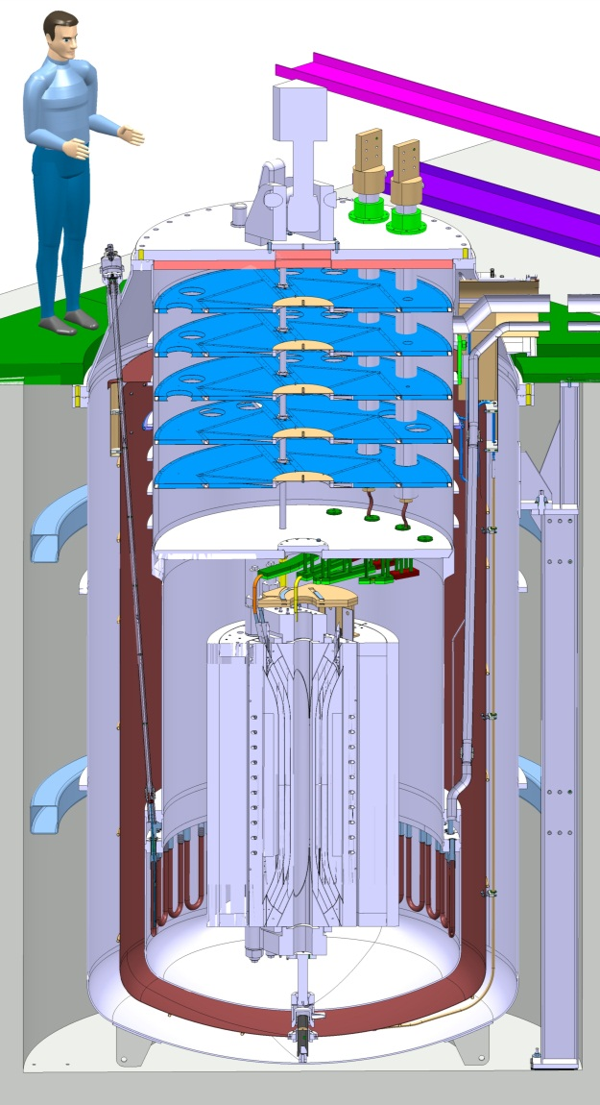
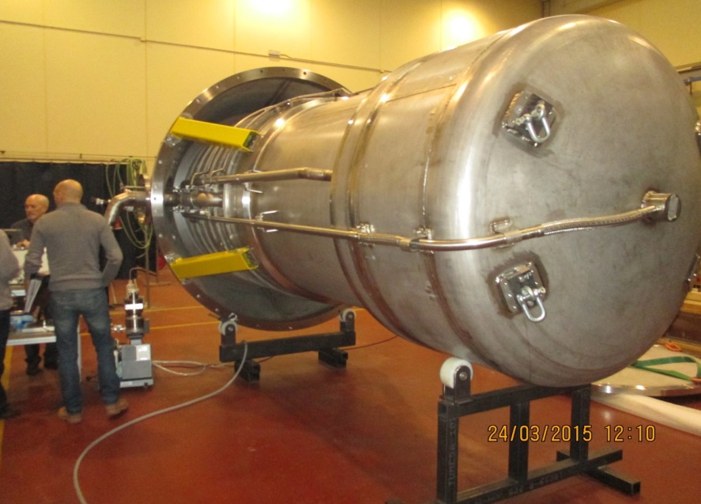
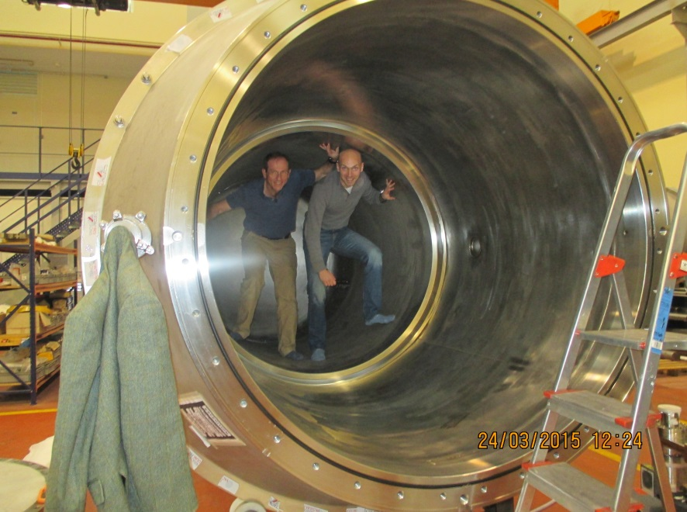
The HFM test cryostat

Slide 14
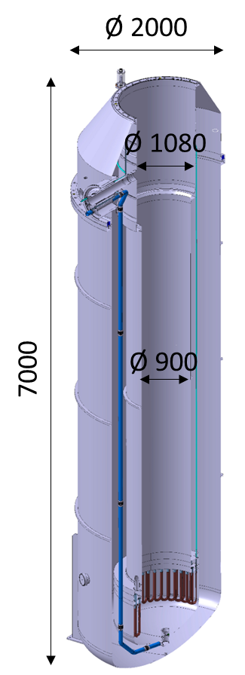
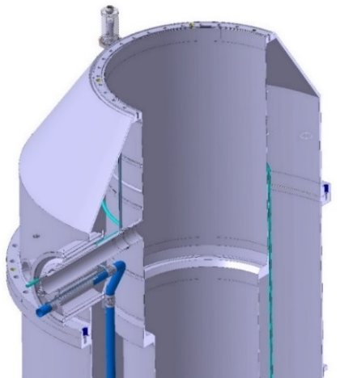
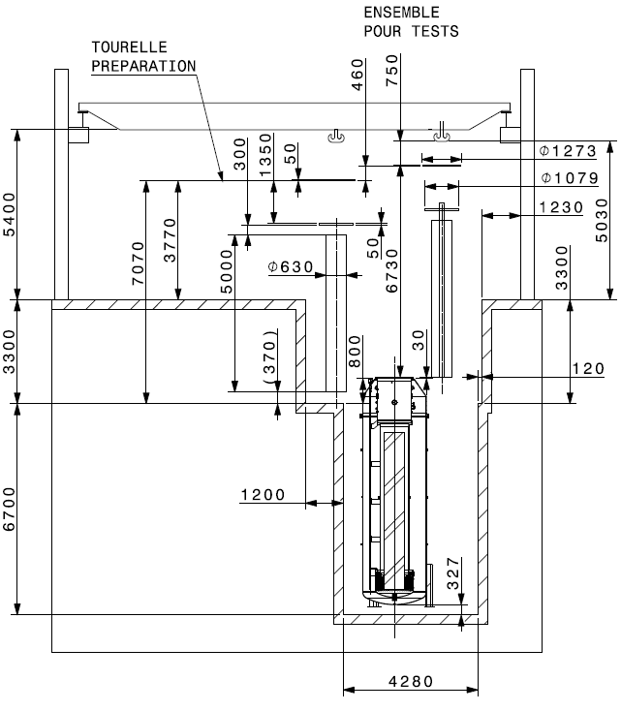
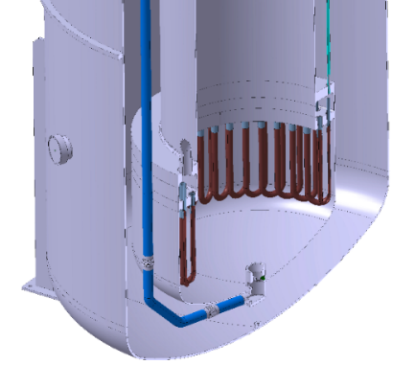
Cluster D test station
Invitation to tender in the coming weeks

Slide 15
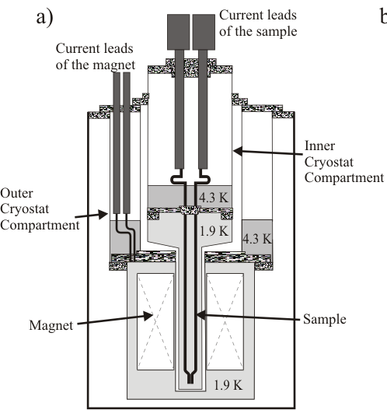
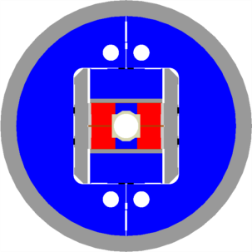
New cryostat for FReSCa 2
(Facility for the Reception of Superconducting Cables)
a re-scaling from HFM cryostat?
Key objective: FRESCA2
  Nb₃Sn dipole magnet
  13 T
  100 mm clear bore
  1.2 m magnetic length
Plans
  Fabrication and test of 2 Nb₃Sn coils in 2015
  FRESCA2 test in 2016
Vertical double cryostat, height about 4 meter
Outer cryostat holds the dipole magnet (about 7 tonnes), always kept at LHe temperature
Inner cryostat (100 mm inner diameter) holds the sample.
  Warm-up 15 hours, cool-down 5 hours.

