Slide 1

Updated scenario and simulations for the BBLR LHC test
Yannis PAPAPHILIPPOU, CERN
WP2 TL meeting, June 18th, 2015
Thanks to
F.Antoniou, G.Arduini, G.Campogiani, S.Fartoukh, R.Jones, R.deMaria, A.Patapenka, A. Rossi, T.Rijoff, H.Schmickler, A.Valishev, F.Zimmermann

Slide 2
Outline
Wire compensation basic considerations
Wire effect on the beam
  Multipole expansion,
  Orbit, coupling, tune, tune-spread
Test of wire compensation in the LHC
  Nominal and available positions
  Present simulation status
Experimental conditions, observables and associated instrumentation needs
SPS wires status and plans
Study plans

Slide 3
Wire compensation
Considering round beams and crossing in both planes, the BBLR kicks are
with
For an “infinite” round wire, the kicks are
with
For cancelling the effect for any position (large separations)
This gives 5.5 Am/encounter for the nominal LHC and 10.6 Am for HL-LHC

Slide 4
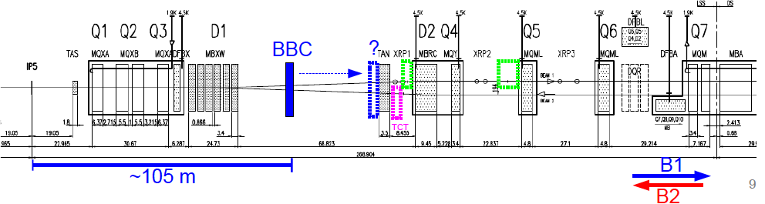
Basic considerations
J.P. Koutchouk, 2001
Locality of the compensation
  Close to the BBLR encounters which occur at ~π/2 from either IP side
  A lot of space available between D1 and TAN but integration may be difficult (idea of e-lens)
  Phase advance still close to π/2 even up to Q5

Slide 5
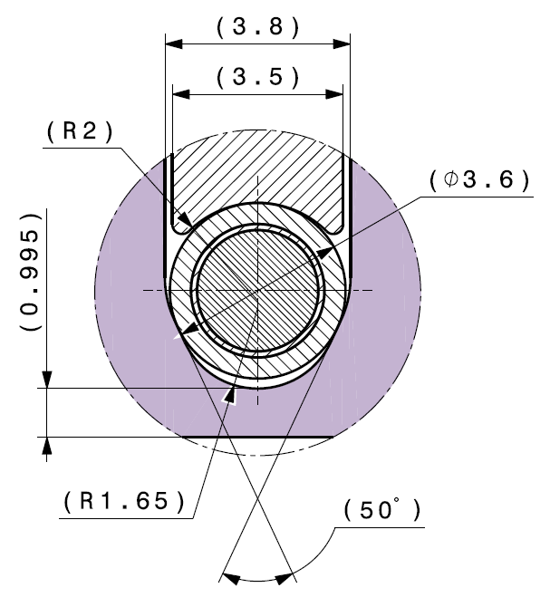
Basic considerations
Position of the wire with respect to the beam
  As close as average BBLR separation (9.5σ)
  Integrated kick is scaled inversely with distance, i.e. the smaller the distance the lower the required integrated current and vice versa
  Difficulty with wire-in-jaw collimator to approach the beam closer to ~12-13σ
  Some strength can be recovered by wire current but dependence is not uniform depending on resonance order (see below)
A. Bertarelli

Slide 6
Basic considerations
J.P. Koutchouk, 2001
Optics considerations
  Large and equal beta functions for efficient tune-shift compensations
  The optics functions equality may be not optimal for resonance driving term compensation
    Ratio of 2 or ½ is optimal
The absolute criterion should be non-linear compensation (increase of DA, i.e. lifetime, through combined reduction of non-linear resonances and tune-spread)
S. Fartoukh, 2015

Slide 7
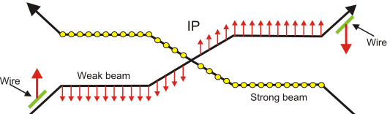
Two wires per IP
Integrated current can be reduced for the same correction reach
Powered independently to fit better the integrated kick on either side
Due to optics anti-symmetry and different plane crossing, effect of two wires in the two planes is also anti-symmetric

Slide 8
Wire multi-pole expansion
The multi-pole expansion of the wire can be written
with the radial distance of the wire to the beam
and the multipole coefficients
,
with the angle
The same expansion is applicable to the BBLR field for the round beam, approximation

Slide 9
Wire multi-pole expansion
For a wire positioned in the horizontal plane (or horizontal BBLR crossing), i.e.
  For , and
  For , and ,
For horizontal wire (or horizontal BBLR crossing), only normal multipoles are excited
Putting the wire in the opposite side with respect to the “strong” beam will cancel only half of the multipoles (odd or even depending on the polarity of the wire)

Slide 10
Wire multi-pole expansion
For a wire positioned in the vertical plane (or vertical BBLR crossing), i.e.
  For , and ,
  For , and ,
For vertical wire (or vertical BBLR crossing), even skew and odd normal multipoles are not excited
Putting the wire in opposite side with respect to “strong” beam cancels only half of the excited BBLR multipoles (odd skew or even normal, depending on the wire polarity)
Alternating crossing cancels the effect of

Slide 11
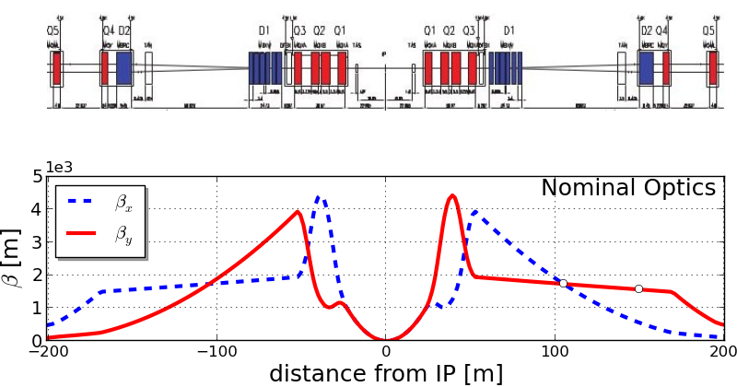
Optics at wire locations
ATLAS
TCL
IP
TCT
147 m
β_{y}= 1576 m
β_{y}= 250 m
IR5: upstream+downstream slots available in Xing plane.
IR1: only upstream slots available for Xing plane. Need to add a V collimator (TCL) for downstream side (non-IP side of Q4 magnet)

Slide 12
Status of wire-in-jaw collimators
4 “wire-in-jaw“ collimators ordered from CINEL
  Cost covered by HL-LHC
  Design finished in late 2014
  Delivery, although originally planned, will be impossible during 2015 (new estimated date 04/2016)
  Installation in winter stop 2016/2017 (vacuum group approval)
    Installing during a Technical Stop may not be easy but under investigation
  Cabling to be finalised for 4 individual power supplies
Full compensation of one beam: 2 collimators/IP
  Compensation of both beams in the ingoing or outgoing side (2 collimators on the same side in IP1 and IP5) does not provide optimal reduction of tune-spread and resonance driving terms

Slide 13
BBLR Simulations remarks
All previous simulations studies made with 7 TeV nominal optics using BBTRACK code (U. Dorda, F. Zimmermann, T.Rijoff)
  BBLR kicks lumped at the IP (phase advance of π/2)
    No difference found with respect to distributed kicks in “correct” positions
  No other effects included (noise, triplet non-linearities, PACMAN), although implemented in the code
Complementary studies for fixing the experimental set-up
  Simulate machine conditions after LS1 (optics, slightly lower energy then nominal, four wires, slightly modified locations,…)

Slide 14
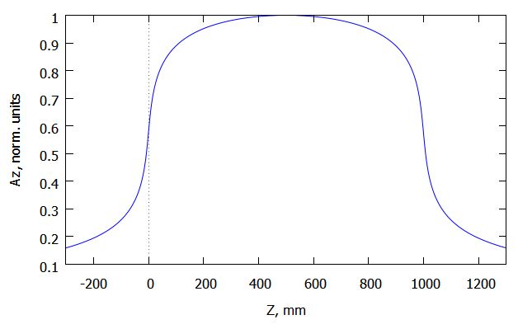
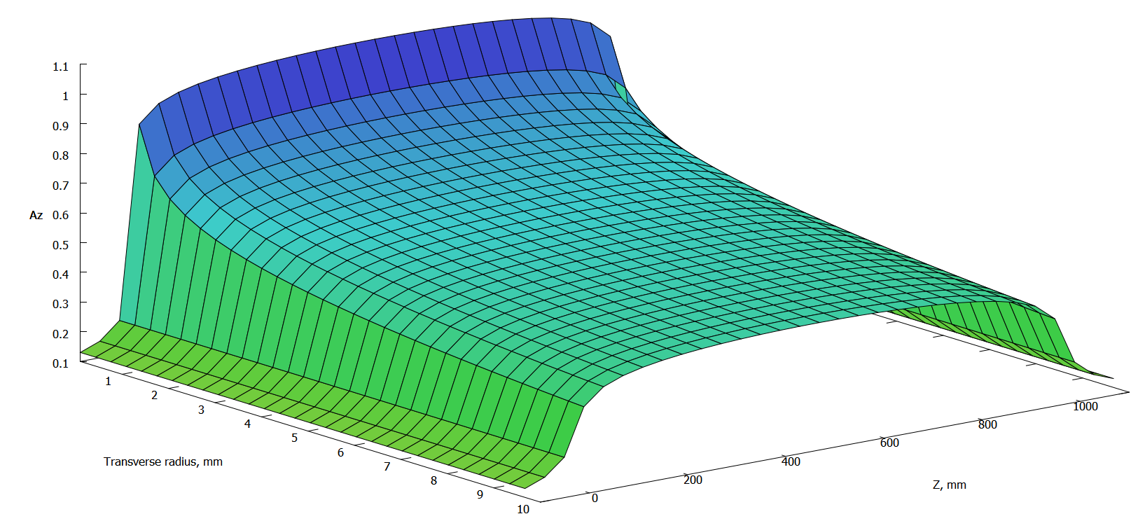
Wire modelling
A. Patapenka
Vector potential for finite straight wire
  Only one longitudinal component
  z-dependent, with central symmetry
Map constructed by integrating the kick over the z-direction
A_{z}
R, mm
z, mm

Slide 15
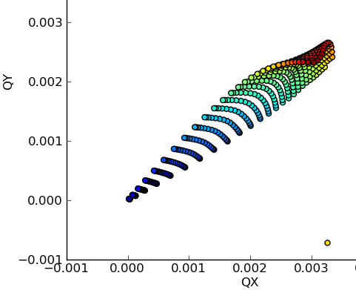
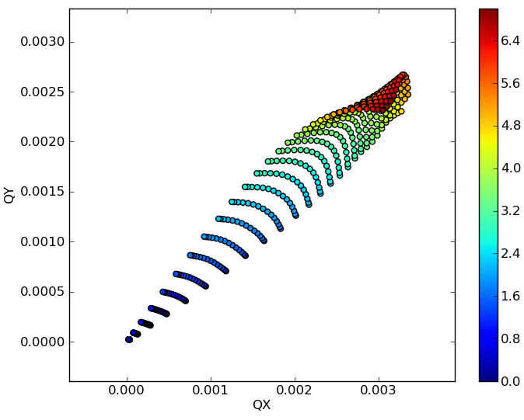
SIXTRACK implementation
Two models in SIXTRACK
  Existing one debugged and fixed see Erdelyi and Sen
  Implementation of a map for an arbitrary 3D vector potential, based on Euler integration method
    Ability to integrate a generic field coming from a model or magnetic measurements
  Tilts of the wire are treated as coordinate transformations before and after the element
  The two models produce identical results for the wire element
A. Patapenka
4D-map
6D-map

Slide 16
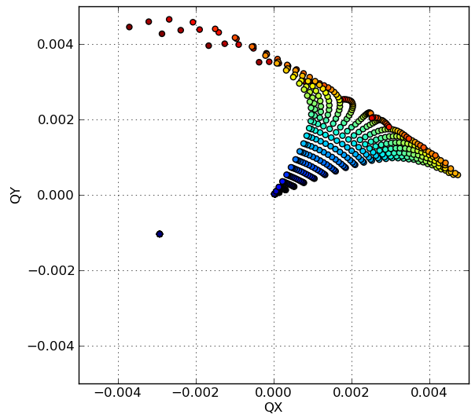
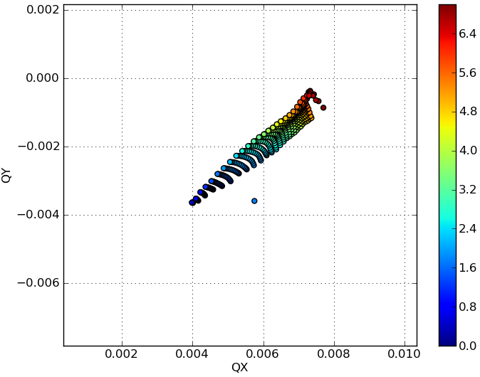
Wire compensation 1 IP
A. Patapenka
Compensation in IP1 with 2 wires of 110A in the BBC location (nominal 7TeV LHC beam parameters)
HO+LR in IP1
HO+LR+2Wires in IP1

Slide 17
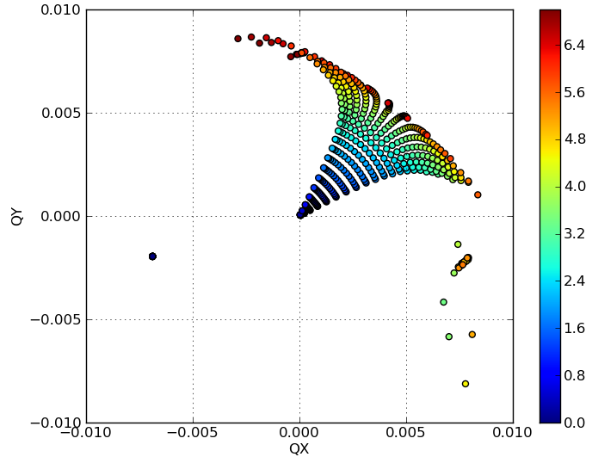
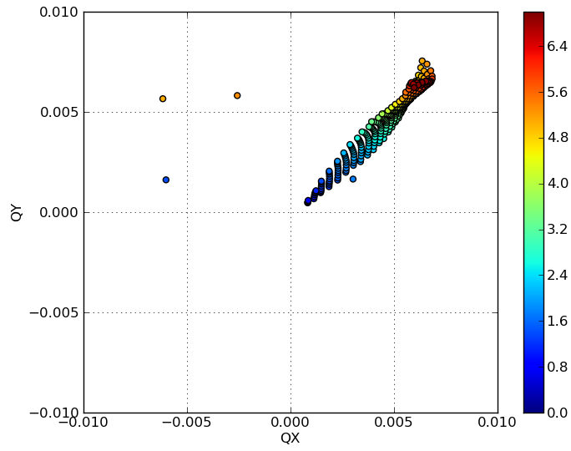
Wire compensation 2 IPs
A. Patapenka
Compensation in IP1 and IP5 with 4 wires of 110A in the BBC location (nominal 7TeV LHC beam parameters)
HO+LR+4 Wires
in IP1 and 5
HO+LR in IP1 and 5

Slide 18
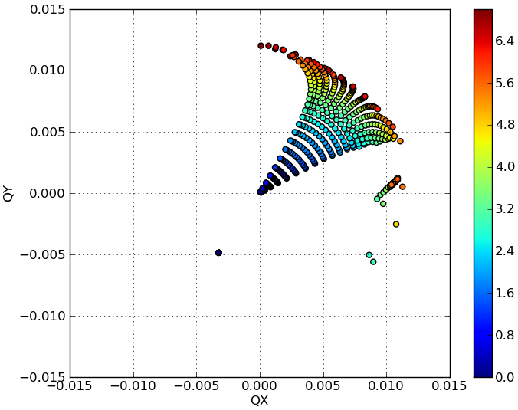
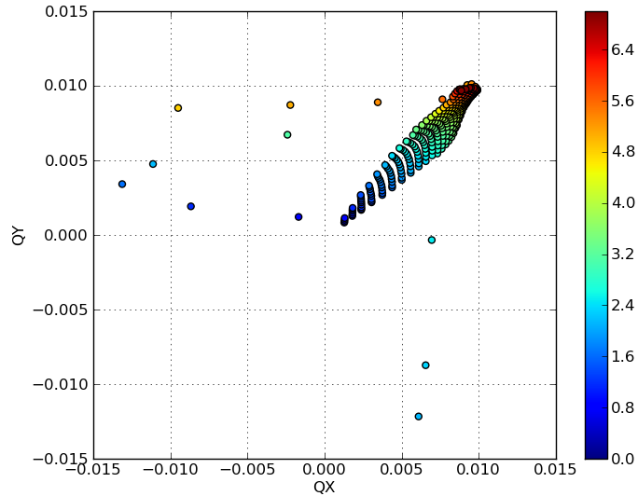
Wire compensation 4 Ips
Compensation in IP1 with 4 wires of 110A in the BBC location, including effect of IP2 and IP8 (nominal 7TeV LHC beam parameters)
A. Patapenka
HO+LR+ 4 Wires
all IPs
HO+LR all IPs

Slide 19
Wire simulations next steps
Create MADX mask files with “fake” wires (BB long range elements with infinite separation) in the TCT/L locations
  Eventually write a wire module for MADX
Run SIXTRACK simulations for LHC@6.5TeV
  For nominal but also BCMS beams
  Nominal but also reduced crossing angles to enhance LR effect
  Different wire separations and currents (average BB separation and larger separation taking into account collimator nominal settings)
  With/without HO, with/without IP2 and IP8
  Nominal and ATS optics
  All magnetic non-linearities, sextupoles @ nominal chromaticity, with/without Landau octupoles
  Different working points

Slide 20
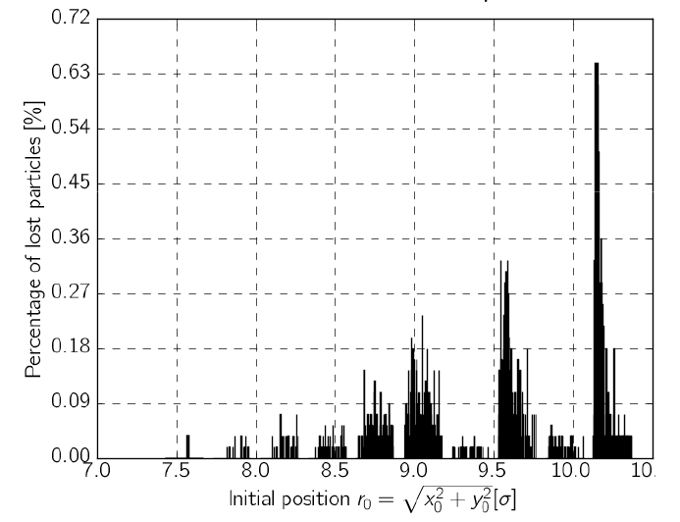
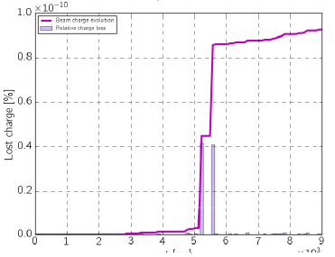
Wire simulations analysis
Dynamic aperture
Frequency maps
Resonance driving term estimation
Track distributions and correlate them with lifetime (diffusion of tails)
  Include IBS, burn-off, emittance blow-up (noise), synchrotron radiation
G. Campogiani

Slide 21
Experimental set-up - Train composition
Two trains with unequal number of bunches, to avoid “all” PACMAN
  Long one in non-compensated beam to cover twice the distance of long range collisions, i.e. at least ((16x2)+1)x2 = 66, neglecting the long-ranges inside D1
    Usual train with 72 bunches from PS covers 1 LR encounter inside D1
    New scheme of 80 bunches covers 3 LR encounters inside D1
  “Weak” beam composition with two flavors:
    Short train with maximum half the number of bunches as compared to the other beam, i.e. 36 to 40 bunches for nominal collimator settings and higher wire currents
    Single bunches with nominal current may allow approaching wire in “nominal” average BB separation (depending on collimation considerations)
Very short asymmetric trains may be interesting to study only effect in the area of “round” LR encounters (6-7 per IP side), while keeping their number equal for each bunch
Effect of head on collisions could be suppressed by timing one beam with respect to other by 12.5 ns, while maintaining number of long range collisions

Slide 22
Experimental set-up (cont.)
Beams should be initially separated in IP2 and 8
Number of LR may be adjusted depending on efficiency of correction (location and number of wires)
May need optics adjustment for optimising optics at wire location (need optics validation, may not be possible)
Separating in 1 IP and colliding in other may be used to test correction efficiency separately
If effect is weak, may need to reduce crossing angle
Final set-up should be tested in “running” LHC conditions
Different configurations need good preparation and sufficient amount of MD time (unfortunately 1 year already lost…)

Slide 23
Main observables
Lifetime (bunch-by-bunch)
  Need simulations to benchmark the experiments, i.e. track distributions with BBLR + compensation (on-going work of G. Campogiani)
  Disentangle BBLR with respect to other effects such as head on, burn-off, vacuum, IBS, noise,… (on going work of F. Antoniou for LHC luminosity modelling)
Tails evolution
  Losses on different collimator positions
  Halo diagnostics
Beam transfer function see Kim et al., HB2008
  Damper may not allow to have any relevant measurement (gating ?)
Orbit, tune, tune-spread (coupling, chromaticity)
  Last three are difficult to measure, while in collision

Slide 24
Required instrumentation
Diagnostics for one beam needed for the test (the one compensated by the wire)
Beam Current Transformer, tune-monitor, Beam Synchrotron Light monitor (BSRT), BPMs, Schottky, halo diagnostics
Bunch-by-bunch diagnostics are essential
For each observable, need to evaluate expected effect and compare with actual performance of instruments
Need realistic scaling of long-range effect (elliptic beams) and wire for all observables and corresponding simulations

Slide 25
Wire effect in single beam
Need to benchmark effect of wire
Calibrate position and current with observables:
  Orbit, tune, tunes-spread, coupling (alignment), resonance driving terms, effect on distribution (tails)
Could be done even at injection energy and conditions (only 1 beam)
  Experimental conditions and instrumentation as for LHC optics measurements
    BPMs in orbit and TBT mode, BSRT, wire scanners, Q-Kicker, AC-dipole, etc…
  A lot of information can be already gained with existing wires in SPS

Slide 26
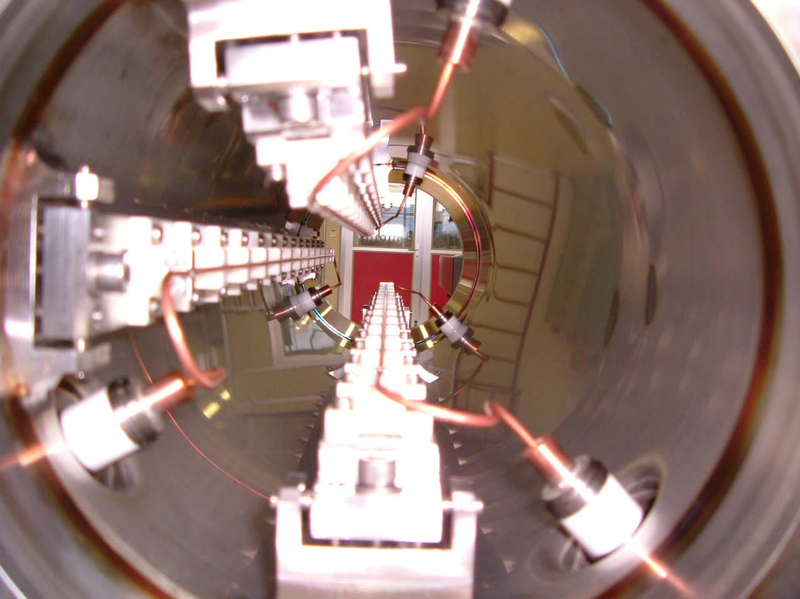
Wires at SPS
Two 60cm long 3-wire compensators installed in the CERN SPS
  Different “crossing” plane and even @ 45deg
Movable in vertical by +/- 5mm (remote controlled)
Water cooled
About equal beta functions in the transverse planes (~50m)
Separated by a phase advance of 3deg (similar between BBC and long range interactions in LHC)
Powered with integrated DC current of up to 360A m (~60 LR collisions in LHC)

Slide 27
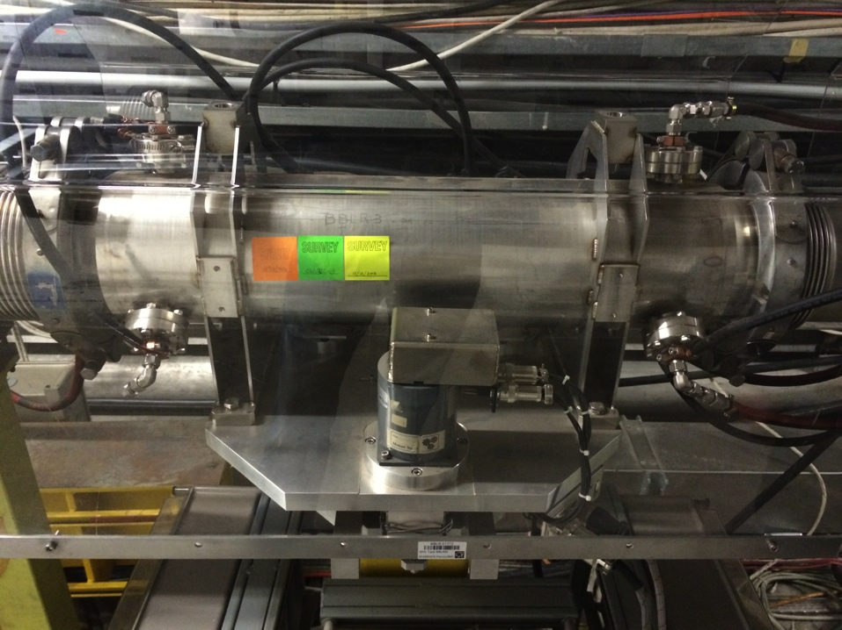
Wires at SPS
Set-up re-evaluated
  New power convertor able to pulse in PPM mode Powering H or V wire, with a switch
  Step motors verified and controller in good shape
  Vacuum integrity checked
  Fine tuning of the PC needed for experiments already this summer
BBLR 51772
MDs in 2015 for benchmarking wire models
  At SPS flat bottom in parallel MD cycle (single LHC-type bunches)
  Beam brought close to the wire with closed bump (already checked)
  Effect of wire on orbit, tune, tunes-spread, coupling (alignment), resonance driving terms, beam distribution (tails)

Slide 28
Optics at the SPS wires
Q26
Q20
BBLR2
BBLR2
Q26 optics (nominal for FT beam)
  β_{x} ~53m, β_{y} ~45m, D_{x}~-0.65m
Q20 optics (nominal for LHC beam)
  β_{x} ~63m, β_{y} ~55m, D_{x}~-0.75m

Slide 29
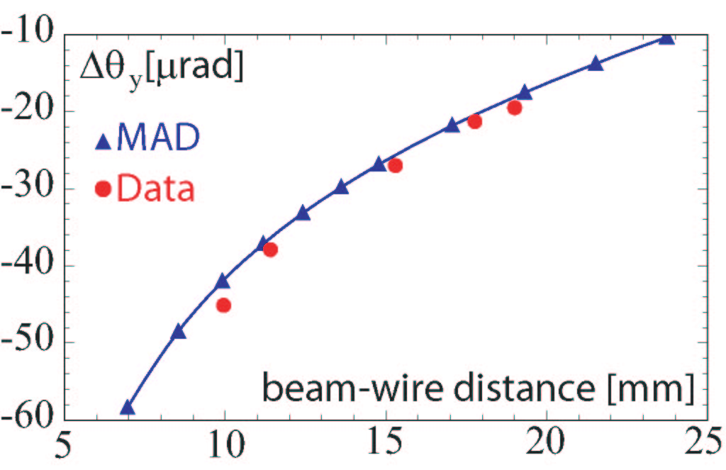
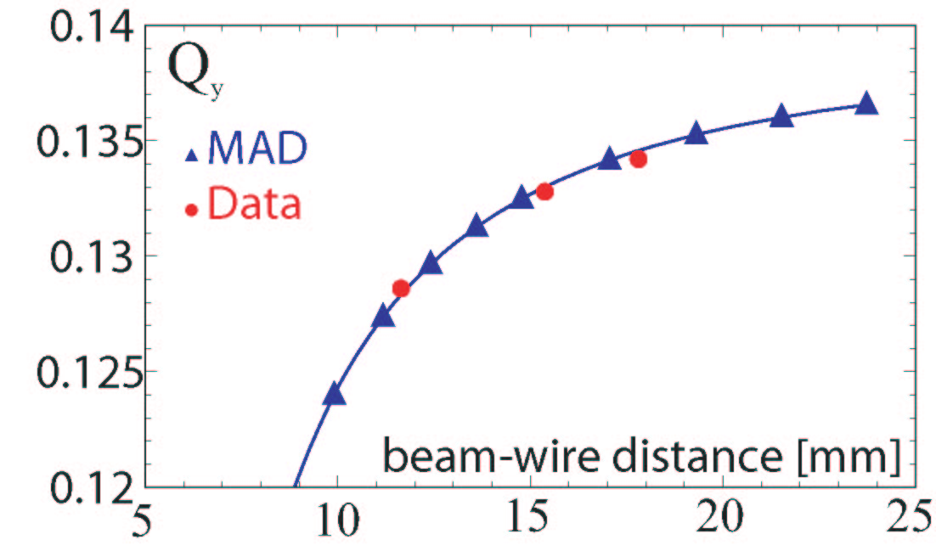
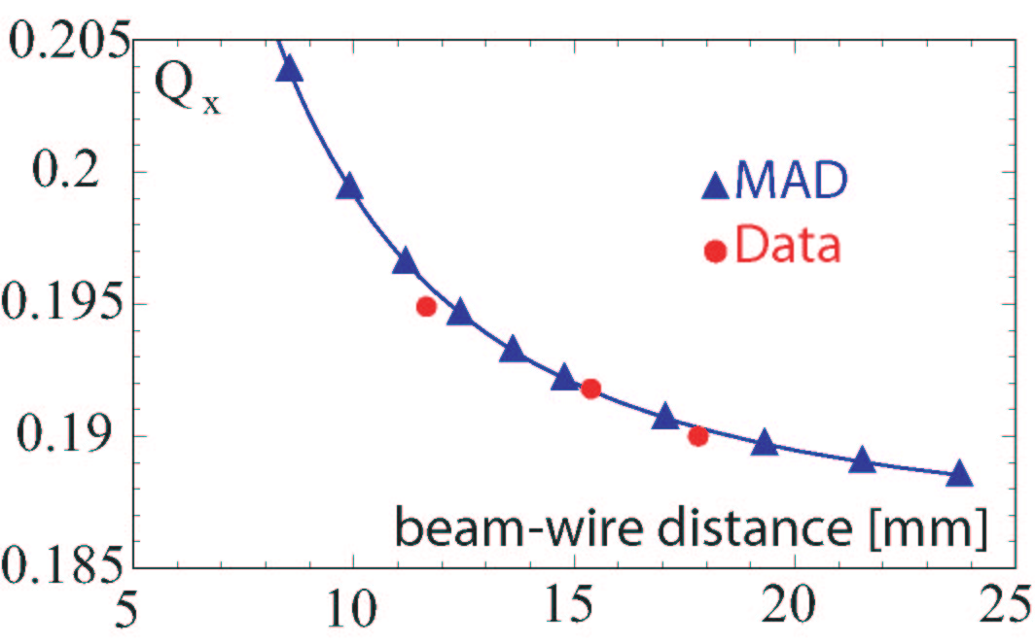
SPS wire calibration
F. Zimmermann et al.
y orbit
change
Q26 optics (nominal for FT beam)
  β_{x} ~53m, β_{y} ~45m, D_{x}~-0.65m
Q20 optics (nominal for LHC beam)
  β_{x} ~63m, β_{y} ~55m, D_{x}~-0.75m
x tune change
y tune
change

Slide 30
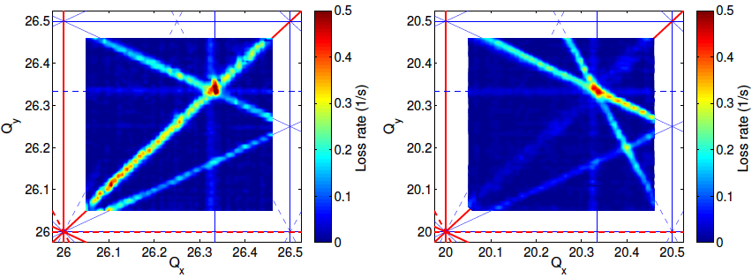
SPS frequency loss maps
H. Bartosik, PhD thesis
Experimental tune scans in the SPS with the nominal Q26 (left) and Q20 optics (right).
Color-code indicates the loss rate during a dynamic scan of the fractional tunes, as (averaging over 4 scan directions)
Study effect of wire in both optics (measure resonance driving terms)

Slide 31
BBLR study plans – Short term (2015)
Simulations considering the positions available with present layout, assuming nominal optics (also ATS)
Simulate effect on PACMAN bunches
Establish tolerances for positioning of the wire (hor/vertical alignment and tilt) and geometry (probably small effect)
Establish observables for demonstrator measurement campaign and develop experimental program
SPS wire experiments
Simulate effect of wire with nominal HL-LHC parameters and flat beams (nominal HL-LHC parameters)
  Integrate them in the present layout
    Different options for physical wires or e-lenses

Slide 32
BBLR study plans – Medium, Long term (2015-2018)
Establish wire 3D magnetic model and simulate
Compare global vs. local correction, wire vs. other methods (electron lens, multipole magnets)
Particle scattering on wire for heat deposition and damage (collimation/FLUKA team)
Check alternative crossing scenarios and filling schemes
  Same planes in both IPs, micro-bunches
Collective effects with wire compensation
  Impact on beam stability due to tune-spread reduction by wire
Impedance of wire (some results already exist)
Impact of noise
Considerations about different implementation of wire (material)
BBLR modelling (effect of dispersion, longitudinal slicing, non-Gaussian beam distributions,…)
Dynamics of e-lens and experimental program (work at FNAL)

Slide 33
Back up slides

Slide 34
Orbit effect due to wire
The wire induces an orbit shift due to a “dipole” kick expressed as
and
For only horizontal or vertical positioning of the wire, there is only an orbit kick in the corresponding plane
In either side of the IP, powering the wires accordingly (opposite sign and with current following the square root of beta functions ratio), orbit effect (π-bump)
  To be used for calibration purposes

Slide 35
Coupling due to wire
The minimum tune-split due to wire-induced coupling is
If the wire is positioned in one plane, there is no coupling
Maximum coupling is induced for φ_{W}=45º, giving around 6e-3 tune-shift for wire in BBC position
Global coupling can be cancelled, between wires in the two IPs , if wire is positioned in complementary phase φ_{W}=135º, in the opposite IP (and current follows square root of the product of beta functions)

Slide 36
Tune-shift due to wire
The linear tune-shift induced by a wire is expressed as
Equal beta functions in both planes chosen for having the same impact in both planes (BBC location)
Induced tune-shift between wires in two IPs cancelled, if wire is positioned in equal distance but different planes, and integrated current follows beta function change
  Alternating crossing idea for cancelling BBLR tune-shift
For equal distance of the wire in both planes at the same IP (φ_{W}=45º), tune shift is suppressed (true also for BBLR)

Slide 37
Tune spread due to wire
The first order tune-spread (octupole-like effect) is
For alternating crossing in optically symmetric IPs, tune-spread adds up (same polarity)
It can be cancelled for wire angle (or crossing) at π/8
Because of triplet optics symmetry, diagonal terms of anharmonicity matrix for BBLR are equal
  True also for the effect of two wires placed symmetrically in either side of the IP
Ratio of beta functions at wire position can be chosen as to cancel completely tune-spread

Slide 38
Resonance driving terms
The first order resonance driving terms are
For phase advances
Due to the IP optics anti-symmetry, the contribution to purely H/V even resonances, from either side, is symmetric

