Slide 1
HL-LHC V1.2
G. Arduini, R. De Maria, M. Fitterer, M. Giovannozzi
Thanks to, C. Garion, S. Fartoukh, P. Fessia,
C. Magnier, H. Prin, E. Todesco, B. Vasquez De Prada

Slide 2
Introduction and outline
Layout changes
Optics changes
Aperture studies
Further optimizations

Slide 3
Layout: V1.1 -> V1.2 in IR1 and IR5
Changes | by
Triplet gradient downgrade. New length, position; D1 position changed by 2.35 m towards the arc. | WP3, WP15
TAXS moved towards the IP by 0.33m (better integration) | WP2, WP8, WP15
D1/D2 angle from 33.4Tm to 35Tm (reduced CC voltage) resulting in TAXN-D2-CRAB rigid shift (0.18 m towards the arc) | WP2
no D2/Q4 mask, more space between TCTs/TCLs | WP10, WP15
MCBRD – MCBYY length (1.5 m -> 1.8 m) larger integrated strength? | WP3, WP2, WP15
D2, Q4 and Q5 orbit corrector orientations | WP2, WP15
Q4-Q5 position re-optimized (reduced CC voltage) | WP2
Minor changes of all interconnection lengths | WP15
Changes implemented in optics files. TODO:
  BPM position to be iterated with Blanca
  TCL.6 (maybe even the TCTs) to be iterated with Collimation team
  Renamed TCT.5 in TCT.6 (S. Chemli)
  Wire space reservation (WP2)

Slide 4
Optics V1.1 -> V1.2
Increase pre-squeeze β* 44 cm -> 48 cm (due to lower triplet gradient)
Increased peak β at constant β* by 5% (due to lower triplet gradient).
Typical ATS squeeze, injection, VDM updated.
Alignment optics for BPM calibration proved
Offset knobs ± 2mm introduced due to recent experimental requests.
Lumi scan knobs in the shadow of this knob with ~100 μm range.
TODO:
  β_{x,y} in Q4 tunability range.
  IR8 ATS with β*<3 m and IP shift for LHCb new requests
  Exotic optics: no ATS (no IP phase constraint), ATS2 (suboptimal arc matching) to increase Q4 β_{x,y} tunability range at the cost of chromatic correction and/or arc aperture.
  IR4 optics optimization for instrumentation and e-lens (received generic request but not formalized
  IR6 optics optimization (no feedback yet for dump area constraints)
  Include D1/D2 transfer function correction if powered in series.

Slide 5
Squeezed optics
β* pre-squeeze: 44cm -> 48cm
Crab cavity: 12 MV needed for 590 μrad
New squeeze transitions needed for flat optics to have β*=40 cm in the crossing plane.
Optics provided:
β* | 15 cm | 7.5cm/30cm | 20 cm | 10 cm/40 cm
Crossing angle | ± 295 μrad | ± 245 μrad | ± 255 μrad | ± 210 μrad
 | 12.5 σ | 14.5 σ | 12.5 σ | 14.5 σ
Separation | ± 2 mm | ± 0.75 mm | ± 2 mm | ± 0.75 mm

Slide 6
Aperture margins ingredients
Optics defines nominal orbit and beam sizes.
Geometry of the vacuum region (e.g. beam screens inner dimensions with tolerances are provided).
Operational tolerances on the beam size are added to the beam size.
Alignment and fiducialization tolerances are subtracted from available aperture.
The difference in unit of beam sigma is calculated and compared with the protected aperture tolerated by the collimation systems

Slide 7
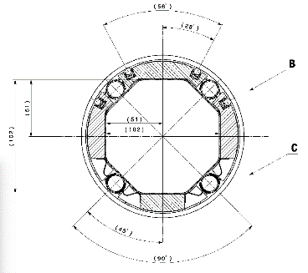
Triplet area aperture
Triplet beam screens, C. Garion
Octagonal beam screens for triplets/D1 with Tungsten shielding have been designed.
Expected straightness 0.5 mm and shape tolerance +- 1 mm (C. Garion 12/06/2015 ), to be confirmed by the prototype.
To be checked the possibility of reducing the W layer thanks to alternating crossing angle sign (F. Cerutti, S. Fartoukh).
cooling
shielding
Element | H,V gap [mm] | 45° gap [mm]
Q1 | 102-1.5 | 102-1.5
Q2-Q3-CP | 122-1.5 | 114-1.5
D1 | 122-1.5 | 114-1.5

Slide 8
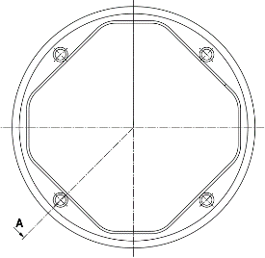
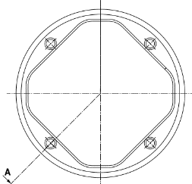
D2-Q4-Q5 Aperture
New D2-Q4 octagonal beam screens have been designed, no tolerances given yet.
Q5 beam screens (MQY) oriented for collision optics aperture optimizations.
Same triplet tolerances removed from the shape.
D2
C. Garion, no tolerance included
Element | H,V gap [mm] | 45° gap [mm]
MBRD | 87-1.5 | 78-1.5
MQYY | 78.5-1.5 | 63.8-1.5
Q5 | 57.8, 48 | n/a
Q4

Slide 9
Survey tolerances
 | Ground motion |  |  | Fiducializaton
 | r [mm] | h [mm] | v [mm] | r [mm] | h [mm] | v [mm]
TAXS (*) | 2.0 | 0 | 0 | 0 | 0.5 | 0.5
Triplets | 0.6 | 0 | 0 | 0 | 1.0 | 1.0
BPMs | 0 | 0 | 0 | 2.5 | 0 | 0
TAXN (*) | 0.84 | 0.36 | 0 | 0 | 1.0 | 1.0
D1 | 0.6 | 0.36 | 0 | 0 | 1.0 | 1.0
D2/Q4/Q5 | 0.84 | 0.36 | 0 | 0 | 0.9 | 0.6
r
v
h
Value derived from J. Jeanneret, LHC rep 1007 but to be validated by survey, WP3, WP8(*) teams

Slide 10
Beam tolerances and collimation apertures
Beam Tolerance | LHC Design | HL-LHC Inj./Coll.
Emittance [µm] (normalization only) | 3.75 | 3.5/3.5
β-beating [%] | 20 | 10/20
Orbit error [mm] | 4 | 4/2
Spurious Disp. [%] | 27.3 | 14/10
Energy error [10⁻³] | 8 | 6/2
Target aperture [σ] | 8.4 | 9⁽¹⁾/12(18⁽²⁾)
Beam tolerances have been re-defined by:
taking into account LHC Run I positive experience
adding safety margins based on possible unknowns.
For collimation:
magnet protected by TCT: ≥12 σ
magnet not protect by TCT: 18 σ⁽²⁾ or possibly less pending dedicated studies (R. Bruce) .
R. Bruce et al.
Minimum aperture not protected by TCT in collision and aperture targets at injection should be confirmed by WP5⁽²⁾ and WP14⁽¹⁾.

Slide 11
Orbit corrector knobs
IP crossing, separation, offset (x: ±295 μrad, , s: ±0.75 mm, o: ±2.0 mm)
beam based alignment of crab cavities: ccp, ccm (shift): ±0.5 mm, ccs (slope): ±0.25 mm
IT alignment and transfer function errors (err): ±0.5 mm transverse, ±10 mm longitudinal, ±2x10⁻³ relative gradient error, ±2x10⁻³ D2 relative field error.
orbit correction from the arc (to confirmed): arc 0.7 Tm;
lumi scan knobs (single beam IP shift for 100μm)
 | x-scheme [Tm] |  |  | cc alignment [Tm] |  |  | err [Tm] | arc [Tm] | lumi [Tm] | summary [Tm]
name | x | s | o | ccp | ccm | ccs | err | arc | lumi | tot | max | margin [%]
MCBX1 | 0.14 | 0.11 | 1.16 | 0.19 | 0 | 0 | 0.92 | 0 | 0 | 2.42 | 2.5 | 3.30
MCBX2 | 0.07 | 0.05 | 0.79 | 0.19 | 0 | 0 | 1.40 | 0 | 0 | 2.17 | 2.5 | 1.53
MCBX3 | 2.11 | 0.2 | 0.94 | 0.45 | 0.15 | 0 | 0.78 | 0 | 0 | 4.43 | 4.5 | 1.45
MCBRD4 | 2.97 | 0.09 | 0 | 0.28 | 0.15 | 0.52 | 0.11 | 0.35 | 0.27 | 4.60 | 4.5 | -2.89
MCBYY4 | 1.49 | 0.04 | 0.12 | 0.42 | 0.42 | 0.92 | 0 | 0.35 | 0.20 | 4.74 | 4.5 | -5.39
MCBY5 | 0 | 0 | 1.35 | 0.40 | 0.40 | 0.35 | 0 | 0 | 0 | 2.46 | 2.7 | 8.9
MCBY5 | 0 | 0 | 0 | 0 | 0 | 0 | 0 | 0.7 | 0 | 0.7 | 2.7 | 26
MCBC6 | 0 | 0 | 0.46 | 0 | 0 | 0 | 0 | 0.7 | 0 | 0.46 | 2.8 | 83.4
MCBC7 | 0 | 0 | 1.40 | 0 | 0 | 0 | 0 | 0.7 | 0 | 1.40 | 2.8 | 50
Studying re-sharing forces with new crossing and separation scenarios
  Likely MCBRD/YY 1.6 m -> 1.8 m needed

Slide 12
Aperture vs optics
 | Round 15 cm | Round 20 cm | Flat 7.5 cm | Flat 10 cm
 | [σ] | [σ] | [σ] | [σ]
TAXS | 9.9 | 12.1 | 9.6 | 11.3
MQXFA.[AB]1 | 13.2 | 16 | 12.3 | 14.2
MQXFB.[AB]2 | 9.4 | 11.7 | 9.7 | 11.2
MQXFA.[AB]3 | 9.5 | 11.8 | 10 | 11.6
MBXF | 10.7 | 13.1 | 10.6 | 12.3
TAXN | 11.6 | 13.8 | 9.5 | 11.0
MBRD | 13.1 | 15.3 | 11.1 | 12.8
MCBRD | 16 | 18.7 | 13.7 | 15.4
MCBYY | 15.4 | 17.9 | 13.4 | 15.5
MQYY | 16.3 | 18.9 | 13.9 | 16.1
TCLMB.5 | 20.3 | 23.5 | 14.5 | 16.8
MCBY[HV].5 | 20.6 | 23.9 | 15 | 17.3
MQY.5 | 21.4 | 24.7 | 15.3 | 17.7
TCLMC.6 | 21.2 | 24.6 | 15 | 17.4
MCBC[HV].6 | 24.7 | 28.5 | 17.4 | 20.1
MQML.6 | 21.8 | 25.2 | 15.7 | 18.1
Aperture includes worst case scenarios for all knobs (IP crossing, separation, offset, crab cavity offset)
Aperture margins in the triplets can be recovered by:
reducing aperture margins
reducing crossing angle (round optics) and separation (flat optics) if relying on β* levelling possible
This will allow:
more aperture in the triplet at constant β* or
more performance if matching section keep present margins.

Slide 13
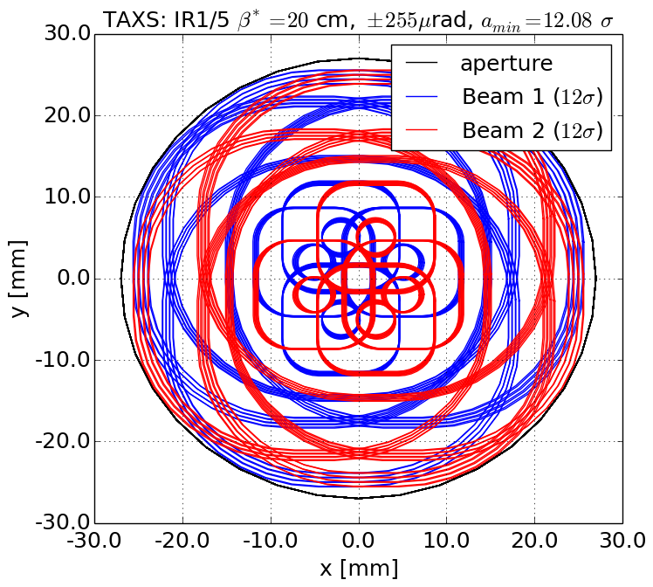
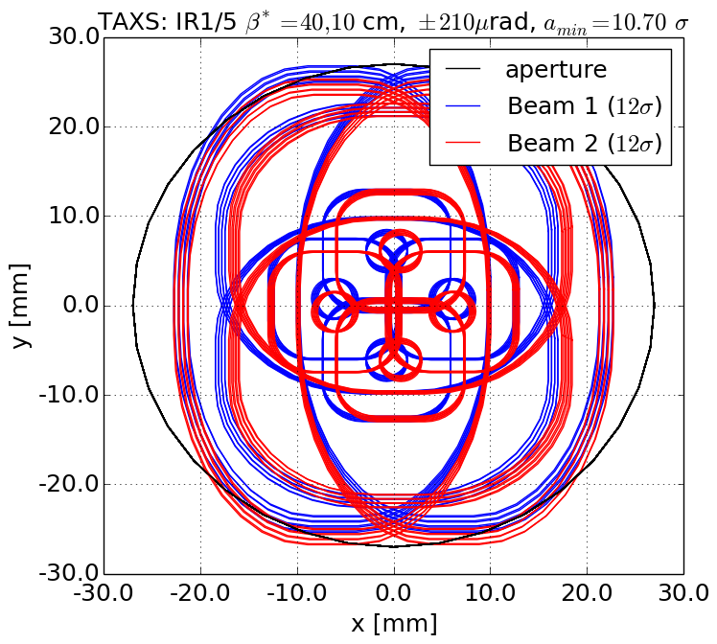
TAXS
Round
Flat
TAXS aperture needs to be increased to 60 mm.

Slide 14
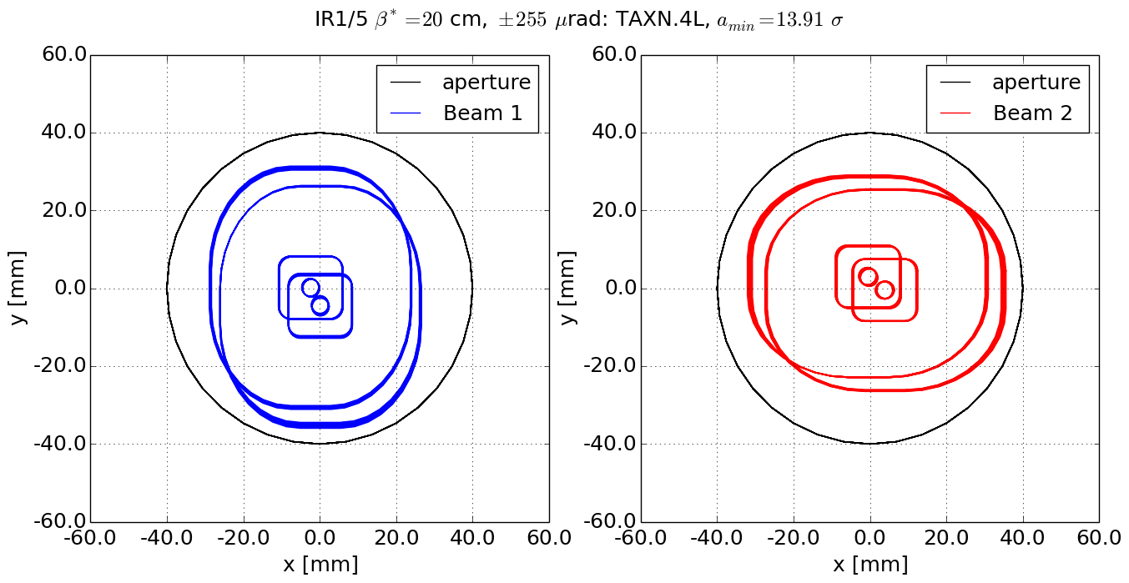
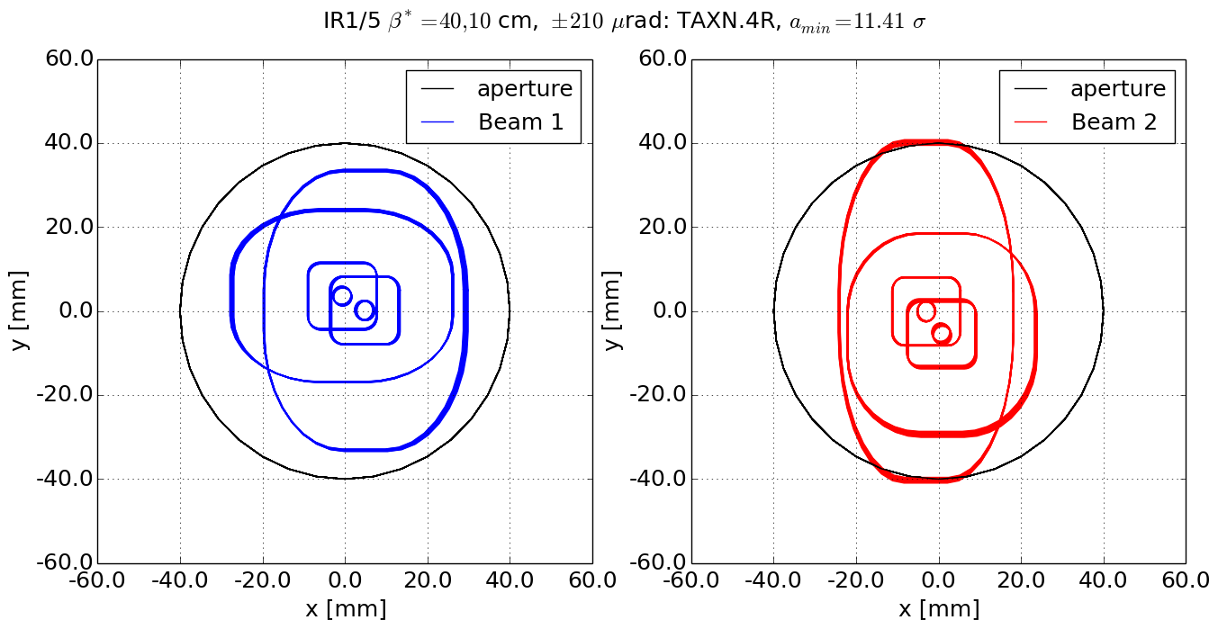
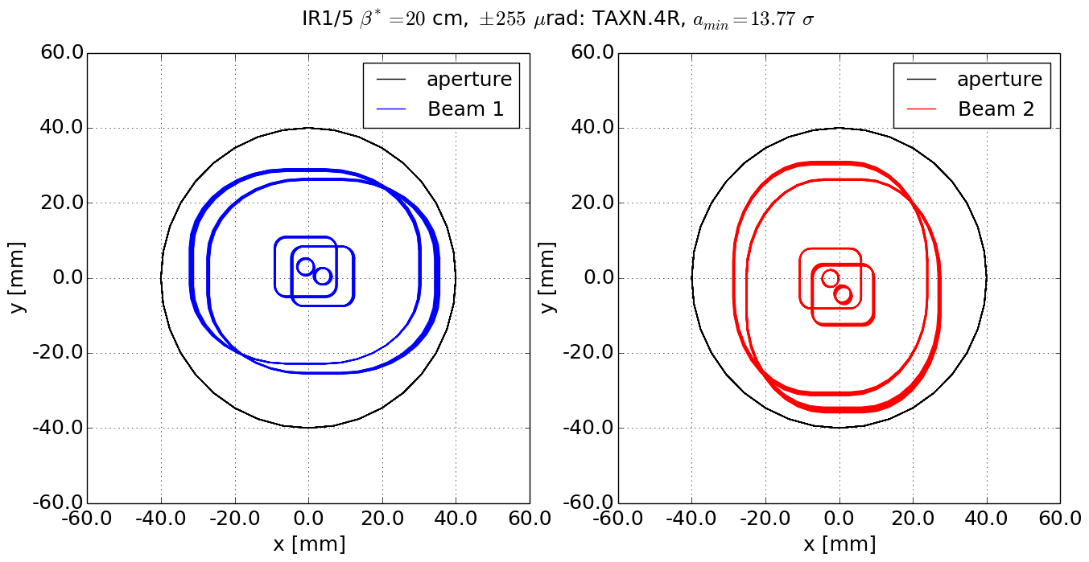
TAXN
Round
Flat
Left
Right
Aperture to be increased: 80mm to 85mm

Slide 15
Q4 options
 | Coil aperture | Beam¹ aperture | H,V² full gaps | Round 15 cm | Round 20 cm | Flat 7.5 cm | Flat 10 cm
 | [mm] |  | [mm] | [σ] | [σ] | [σ] | [σ]
MCBYY | 90 | Octagon | 73.8,73.8 | 15.4 | 17.9 | 13.4 | 15.5
MQYY | 90 | Octagon | 73.8,73.8 | 16.3 | 18.9 | 13.9 | 16.1
MCBYY | 80 | Octagon | 63.8,63.8 | 11.6 | 13.5 | 10.1 | 11.7
MQYY | 80 | Octagon | 63.8,63.8 | 12.3 | 14.2 | 10.5 | 12.1
MCBY | 70 | RectEllipse | 57.8,48 | 11.8 | 13.7 | 8.4 | 9.8
MQY | 70 | RectEllipse | 57.8,48 | 13 | 15.1 | 9.2 | 10.6
Aperture includes worst case scenarios for all knobs: IP crossing, separation, offset, crab cavity offset.
We exclude option MQY for robust flat optics operations.
MQYY at 80mm are not sufficient to provide enough flexibility because:
  Any improvements in triplet aperture would be useless in Q4 aperture is degraded.
  If Q4 needs to be pushed towards D2 more aperture is needed (about 0.7 σ).
  Offset knob with smaller MCBX strengths.
  Rectellipse can help only in specific cases: freezing optics constraints or crossing plane.
  Operation at 6.5 TeV
Impact energy deposition needs to be re-evaluated for reduction of coil aperture.

Slide 16
Further optimization (in progress)
TAXS aperture and TAXN aperture redefined validation needed.
The position of Q4 can be pushed towards the IP by 4m to make room in the Q4-Q5 region for Wire e/o additional TCTs.
Shifting crab cavity towards the arc Voltage needed increase by 200kV/m. Can we reduce again D1-D2 lengths by increasing D1/D2 field? E.g. 10% more field reduce voltage by 1.17 MV (and aperture in TAN-D2 by 10%).

Slide 17
Conclusion
New layout and optics increased of β* function for the squeeze and pre-squeeze optics.
Re-evaluations of aperture taking into account all constraints learned by Run I and very recent experience.
Orbit correctors margins re-evaluated taking into account all known sources of imperfections: -> additional strength plus re-sharing of the budget to be revised.
MQY for Q4 not suited for the present scenarios, for a new MQYY design aperture can re-discussed in terms of benefits/costs.

Slide 18
Actions and validations list
Layout revalidation/debugging (Q4-Q5 position) | WP15, WP2
Wire space reservation | WP2
Total review energy deposition (IT, W protection, MS, TAN, Q4) | WP10
Confirm ground motion and fiducialization assumptions | Survey, WP3, WP8
Validation minimum protected aperture (collimation, injection, dump) | WP5, WP14
Validation aperture TAXS and TAXN with experiments | WP8
Beam screen tolerances | WP12
Validation, dump (IR6), injection (IR2, IR8) | WP14
Validation requirements orbit correction from the arc | WP2/OP

Slide 19
Back-up

Slide 20
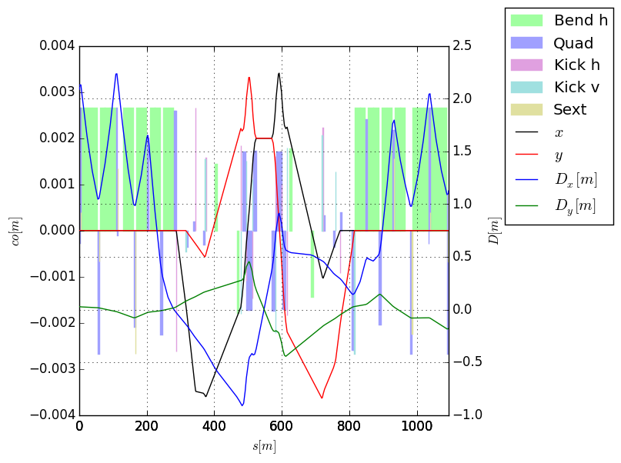
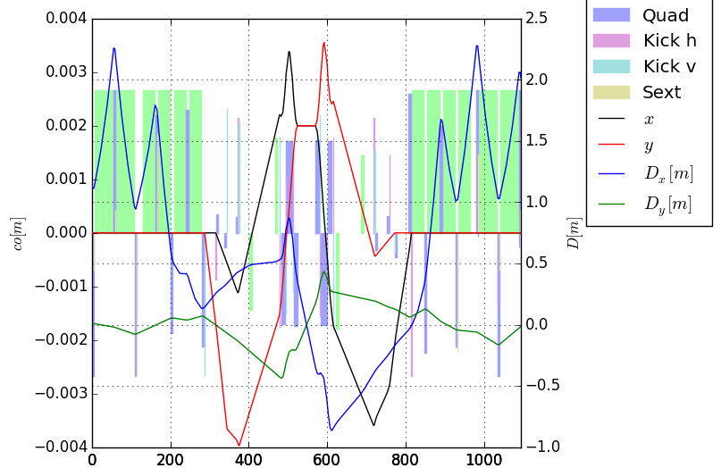
Offset knob – 2mm

Slide 21
Orbit corrector knobs - 1.5 m, 3T
IP crossing, separation, offset (x: ±295 μrad, , s: ±2.0 mm, o: ±2.0 mm)
beam based alignment of crab cavities: ccp, ccm (shift): ±0.5 mm, ccs (slope): ±0.25 mm
IT alignment and transfer function errors (err): ±0.5 mm transverse, ±10 mm longitudinal, ±2x10⁻³ relative gradient error, ±2x10⁻³ D2 relative field error.
orbit correction from the arc (to confirmed): arc 0.7 Tm;
lumi scan knobs (single beam IP shift for 100μm)
 | x-scheme [Tm] |  |  | cc alignment [Tm] |  |  | err [Tm] | arc [Tm] | lumi [Tm] | summary [Tm]
name | x | s | o | ccp | ccm | ccs | err | arc | lumi | tot | max | margin [%]
MCBX1 | 0.14 | 0.29 | 1.22 | 0.19 | 0 | 0 | 0.92 | 0 | 0 | 2.63 | 2.5 | -5.2
MCBX2 | 0.07 | 0.14 | 0.55 | 0.19 | 0 | 0 | 1.4 | 0 | 0 | 2.54 | 2.5 | -1.42
MCBX3 | 2.11 | 0.54 | 0.94 | 0.45 | 0.15 | 0 | 0.78 | 0 | 0 | 4.43 | 4.5 | 1.45
MCBRD4 | 2.97 | 0.24 | 0 | 0.28 | 0.15 | 0.52 | 0.08 | 0.35 | 0.27 | 4.53 | 4.5 | -0.63
MCBYY4 | 1.49 | 0.12 | 1.12 | 0.42 | 0.42 | 0.92 | 0 | 0.35 | 0.2 | 4.81 | 4.5 | -6.98
MCBYS5 | 0 | 0 | 1.35 | 0.4 | 0.4 | 0.44 | 0 | 0 | 0 | 2.46 | 2.7 | 8.9
MCBY5 | 0 | 0 | 0.47 | 0 | 0 | 0 | 0 | 0 | 0 | 0.47 | 2.8 | 83.31
MCBC6 | 0 | 0 | 1.4 | 0 | 0 | 0 | 0 | 0 | 0 | 1.4 | 2.8 | 50
MCBC7 | 0.14 | 0.29 | 1.22 | 0.19 | 0 | 0 | 0.92 | 0 | 0 | 2.63 | 2.5 | -5.2
Notes:
Q4_8m/opt_presqueeze.madx

Slide 22
Orbit corrector knobs – 1.8 m
IP crossing, separation, offset (x: ±295 μrad, , s: ±0.75 mm, o: ±2.0 mm)
beam based alignment of crab cavities: ccp, ccm (shift): ±0.5 mm, ccs (slope): ±0.25 mm
IT alignment and transfer function errors (err): ±0.5 mm transverse, ±10 mm longitudinal, ±2x10⁻³ relative gradient error, ±2x10⁻³ D2 relative field error.
orbit correction from the arc (to confirmed): arc 0.7 Tm;
lumi scan knobs (single beam IP shift for 100μm)
 | x-scheme [Tm] |  |  | cc alignment [Tm] |  |  | err [Tm] | arc [Tm] | lumi [Tm] | summary [Tm]
name | x | s | o | ccp | ccm | ccs | err | arc | lumi | tot | max | margin [%]
MCBX1 | 0.19 | 0.28 | 0.88 | 0.19 | 0 | 0 | 0.92 | 0 | 0 | 2.27 | 2.5 | 9.04
MCBX2 | 0.09 | 0.14 | 0.14 | 0.19 | 0 | 0 | 1.4 | 0 | 0 | 1.9 | 2.5 | 24.06
MCBX3 | 2.29 | 0.54 | 0.41 | 0.45 | 0.15 | 0 | 0.78 | 0 | 0 | 4.08 | 4.5 | 9.37
MCBRD4 | 3.55 | 0.28 | 0 | 0.28 | 0.15 | 0.52 | 0.08 | 0 | 0.27 | 4.76 | 5.4 | 11.91
MCBYY4 | 1.07 | 0.08 | 2.1 | 0.42 | 0.42 | 0.92 | 0 | 0.7 | 0.2 | 4.96 | 5.4 | 8.24
MCBYS5 | 0 | 0 | 1.23 | 0.4 | 0.4 | 0.44 | 0 | 0 | 0 | 2.34 | 2.7 | 13.51
MCBY5 | 0 | 0 | 0.0 | 0 | 0 | 0 | 0 | 0.7 | 0 | 1.26 | 2.8 | 83.31
MCBC6 | 0 | 0 | 1.26 | 0 | 0 | 0 | 0 | 0 | 0 | 1.26 | 2.8 | 55.17
MCBC7 | 0 | 0 | 1.4 | 0 | 0 | 0 | 0 | 0 | 0 | 1.4 | 2.8 | 50
Notes:
Q4_8m/opt_presqueeze_1_8m_mcbrd_mcbyy.madx with cd2q4=0.3

Slide 23
Effect of the knobs
 | Coil aperture | Beam¹ aperture | H,V²full gaps | Sep. knob | Crossing Knob | Crab shift knob | Crab slope knob | Offset knob
 | [mm] |  | [mm] | [mm] | [mm] | [mm] | [mm] | [mm]
TAXS | 54 | Circle | 54, 54 | 0.8 | 6.1 | 0.0 | 0.0 | 2.0
MQXFA.[AB]1 | 150 | Octagon | 102, 102 | 0.8 | 11.2 | 0.0 | 0.0 | 2.4
MQXFB.[AB]2 | 150 | Octagon | 122, 122 | 1.2 | 16.7 | 0.2 | 0.0 | 3.6
MQXFA.[AB]3 | 150 | Octagon | 122, 122 | 0.8 | 16.6 | 0.4 | 0.0 | 2.8
MBXF | 150 | Octagon | 122, 122 | 0.5 | 15.5 | 0.5 | 0.0 | 2.4
TAXN | n/a | Circle | 80, 80 | 0.2 | 5.5 | 0.9 | 0.0 | 3.0
MBRD | 105 | Octagon | 87, 87 | 0.1 | 3.3 | 1.0 | 0.0 | 3.3
MCBRD | 105 | Octagon | 87, 87 | 0.1 | 1.7 | 1.0 | 0.1 | 3.4
MCBYY | 90 | Octagon | 73.8,73.8 | 0.0 | 0.1 | 1.0 | 0.5 | 4.0
MQYY | 90 | Octagon | 73.8,73.8 | 0.0 | 0.0 | 1.0 | 0.5 | 3.9
TCLMB.5 |  | RectEllipse | 57.8, 48 | 0.0 | 0.0 | 0.4 | 0.2 | 3.7
MCBY[HV].5 | 70 | RectEllipse | 57.8, 48 | 0.0 | 0.0 | 0.0 | 0.0 | 3.6
MQY.5 | 70 | RectEllipse | 57.8, 48 | 0.0 | 0.0 | 0.2 | 0.1 | 3.5
TCLMC.6 | 56 | RectEllipse | 45.1,35.3 | 0.0 | 0.0 | 0.0 | 0.0 | 2.3
MCBC[HV].6 | 56 | RectEllipse | 45.1,35.3 | 0.0 | 0.0 | 0.0 | 0.0 | 2.1
MQML.6 | 56 | RectEllipse | 45.1,35.3 | 0.0 | 0.0 | 0.0 | 0.0 | 2.1
¹Either Beam screen or beam pipe;
² Rectellipse types are exchanges the H,V orientation depending on the polarity

Slide 24
Effect of the knobs – 1.8 m
 | Coil aperture | Beam¹ aperture | H,V²full gaps | Sep. knob | Crossing Knob | Crab shift knob | Crab slope knob | Offset knob
 | [mm] |  | [mm] | [mm] | [mm] | [mm] | [mm] | [mm]
TAXS | 54 | Circle | 54, 54 | 0.8 | 6.1 | 0.0 | 0.0 | 2.0
MQXFA.[AB]1 | 150 | Octagon | 102, 102 | 0.8 | 11.2 | 0.0 | 0.0 | 2.5
MQXFB.[AB]2 | 150 | Octagon | 122, 122 | 1.2 | 16.7 | 0.2 | 0.0 | 3.4
MQXFA.[AB]3 | 150 | Octagon | 122, 122 | 0.8 | 16.6 | 0.4 | 0.0 | 2.6
MBXF | 150 | Octagon | 122, 122 | 0.5 | 15.5 | 0.5 | 0.0 | 1.7
TAXN | n/a | Circle | 80, 80 | 0.2 | 5.5 | 0.9 | 0.0 | 3.1
MBRD | 105 | Octagon | 87, 87 | 0.1 | 3.3 | 1.0 | 0.0 | 3.4
MCBRD | 105 | Octagon | 87, 87 | 0.1 | 1.7 | 1.0 | 0.1 | 3.7
MCBYY | 90 | Octagon | 73.8,73.8 | 0.0 | 0.1 | 1.0 | 0.5 | 4.3
MQYY | 90 | Octagon | 73.8,73.8 | 0.0 | 0.0 | 1.0 | 0.5 | 4.2
TCLMB.5 |  | RectEllipse | 57.8, 48 | 0.0 | 0.0 | 0.3 | 0.1 | 3.7
MCBY[HV].5 | 70 | RectEllipse | 57.8, 48 | 0.0 | 0.0 | 0.0 | 0.0 | 3.6
MQY.5 | 70 | RectEllipse | 57.8, 48 | 0.0 | 0.0 | 0.1 | 0.1 | 3.5
TCLMC.6 | 56 | RectEllipse | 45.1,35.3 | 0.0 | 0.0 | 0.0 | 0.0 | 2.3
MCBC[HV].6 | 56 | RectEllipse | 45.1,35.3 | 0.0 | 0.0 | 0.0 | 0.0 | 2.1
MQML.6 | 56 | RectEllipse | 45.1,35.3 | 0.0 | 0.0 | 0.0 | 0.0 | 2.1
¹Either Beam screen or beam pipe;
² Rectellipse types are exchanges the H,V orientation depending on the polarity
Notes:
Q4_8m/opt_presqueeze.madx

Slide 25
Q5 non-options
 | Coil aperture | Beam¹ aperture | H,V²full gaps | Round 15 cm | Round 20 cm | Flat 7.5 cm | Flat 10 cm
 | [mm] |  | [mm] | [σ] | [σ] | [σ] | [σ]
TCLMB.5 |  | RectEllipse | 57.8,48 | 20.6 | 23.9 | 15.0 | 17.8
MCBY[HV].5 | 70 | RectEllipse | 57.8,48 | 21.4 | 24.7 | 15.3 | 18.4
MQY.5 | 70 | RectEllipse | 57.8,48 | 21.2 | 24.6 | 15.0 | 17.6
TCLMB.5 | 56 | RectEllipse | 45.1,35.3 | 15.9 | 18.4 | 11.3 | 13.0
MCBC[HV].5 | 56 | RectEllipse | 45.1,35.3 | 16.1 | 18.6 | 11.5 | 13.3
MQML.5 | 56 | RectEllipse | 45.1,35.3 | 16.6 | 19.3 | 11.8 | 13.6
Aperture includes worst case scenarios for all knobs (IP crossing, separation, offset, crab cavity offset.
The rectellipse are oriented in opposite way w.r.t the LHC.
The choice of a new MQYY option for Q4 implies an MQY for Q5 including the fact that additional orbit correctors are needed in Q5.
The MQY aperture would allow no need TCT protecting the aperture .

Slide 26
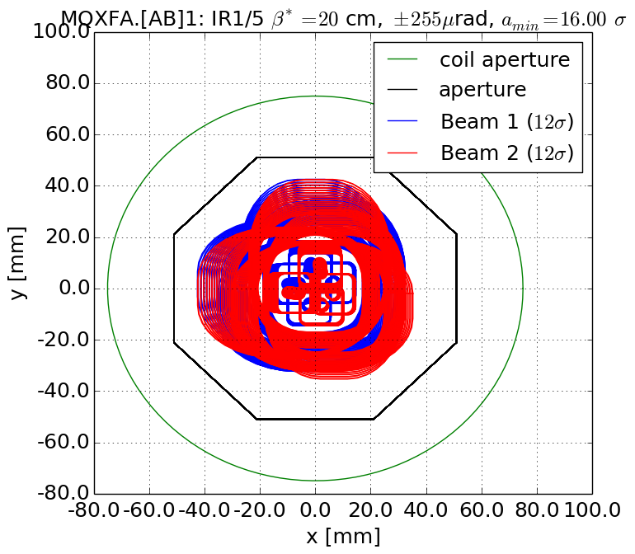
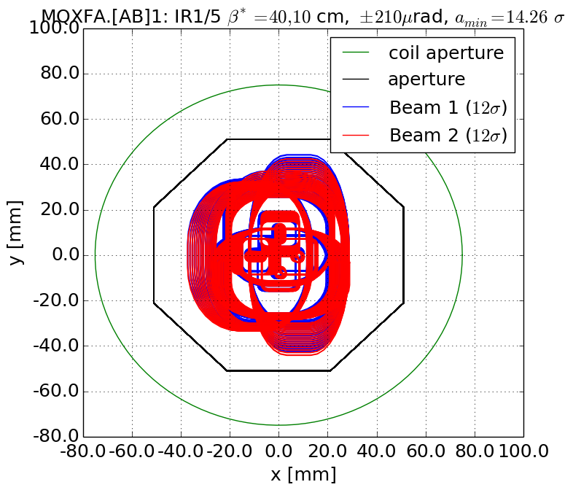
Q1
Round
Flat
Q1 OK

Slide 27
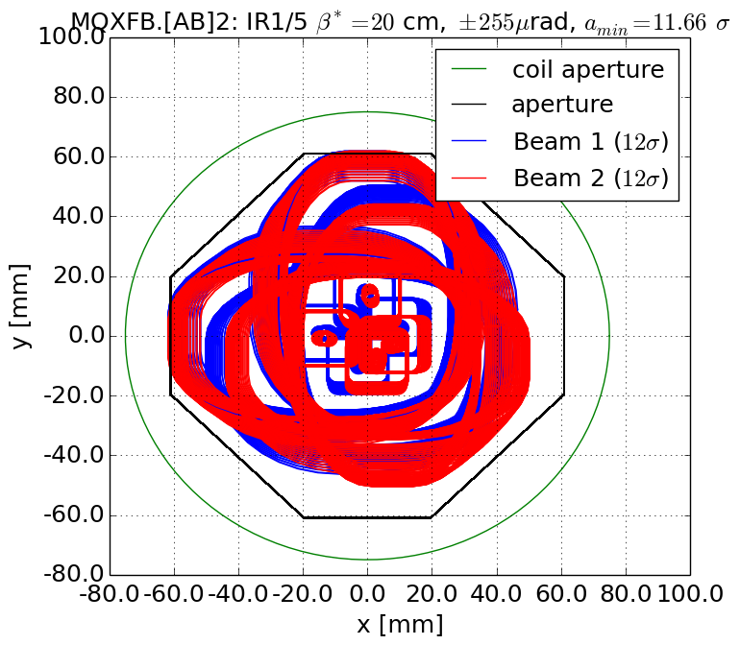
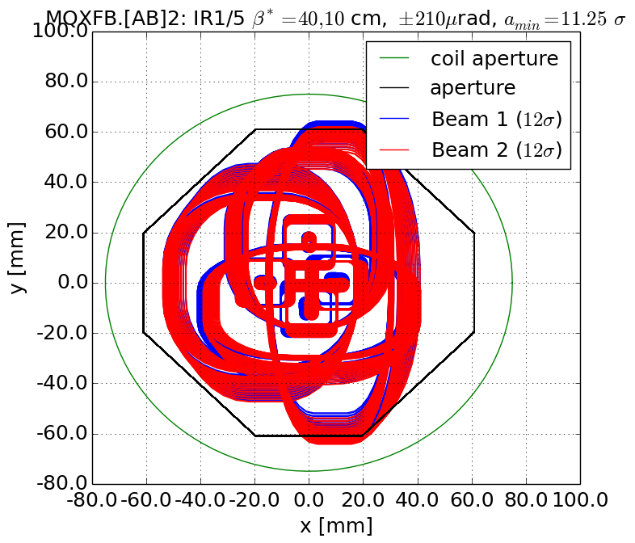
Q2
Round
Flat
Q2 OK

Slide 28
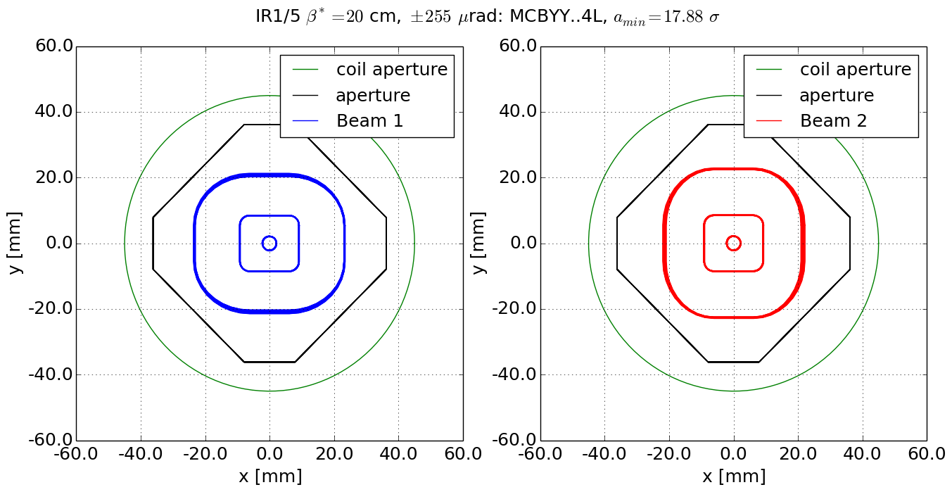
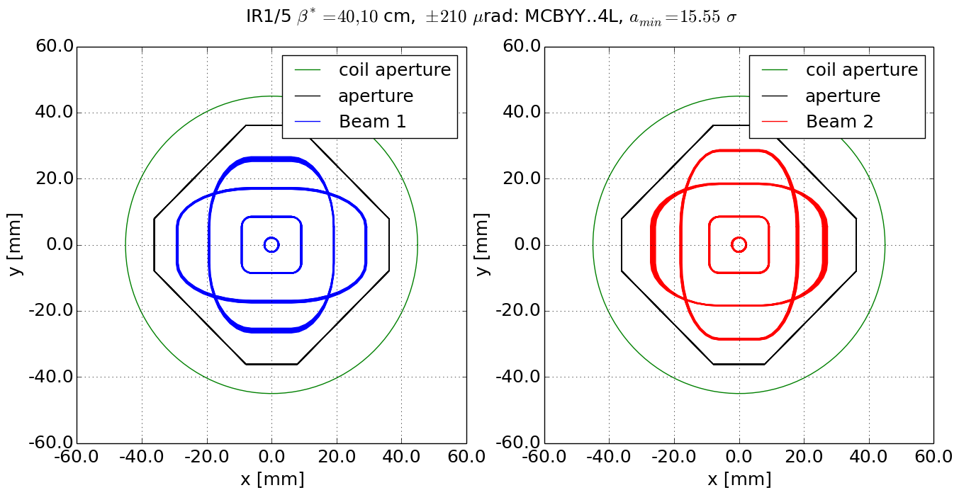
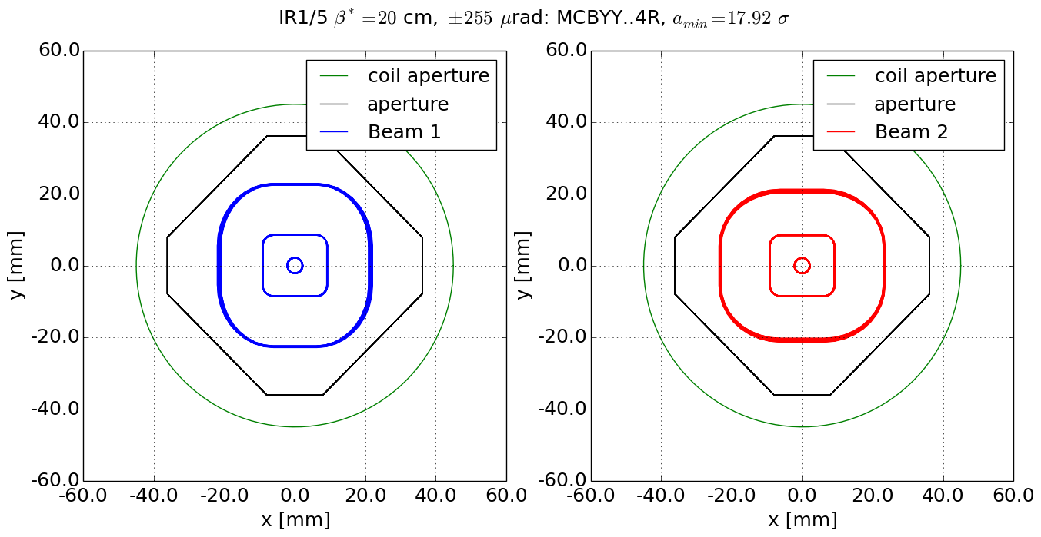
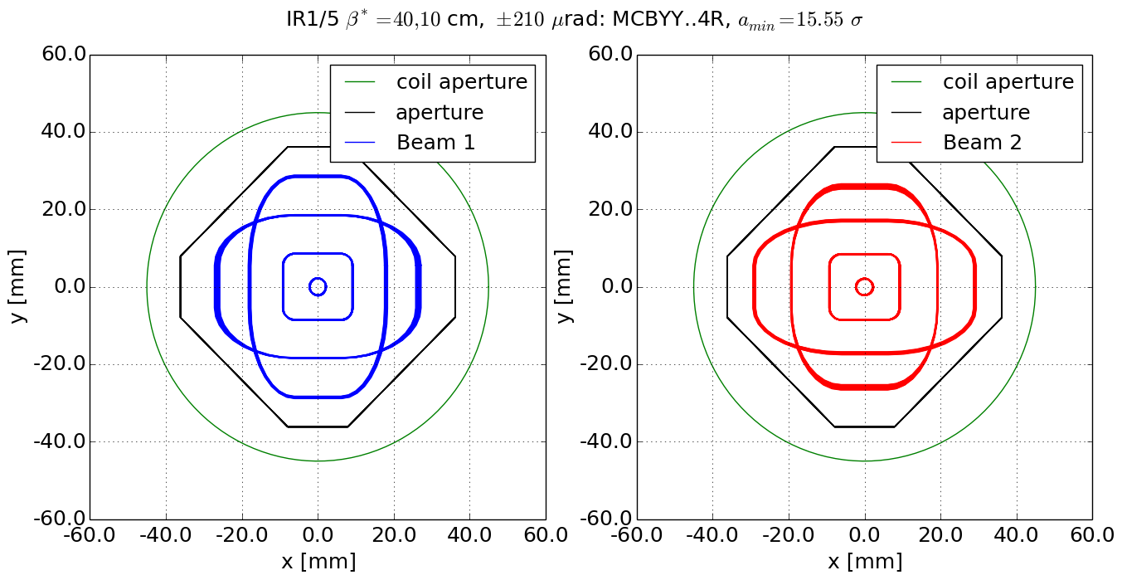
Q4: MQYY with 90 mm coils
Round
Flat
Left
Right
MQYY: OK.

Slide 29
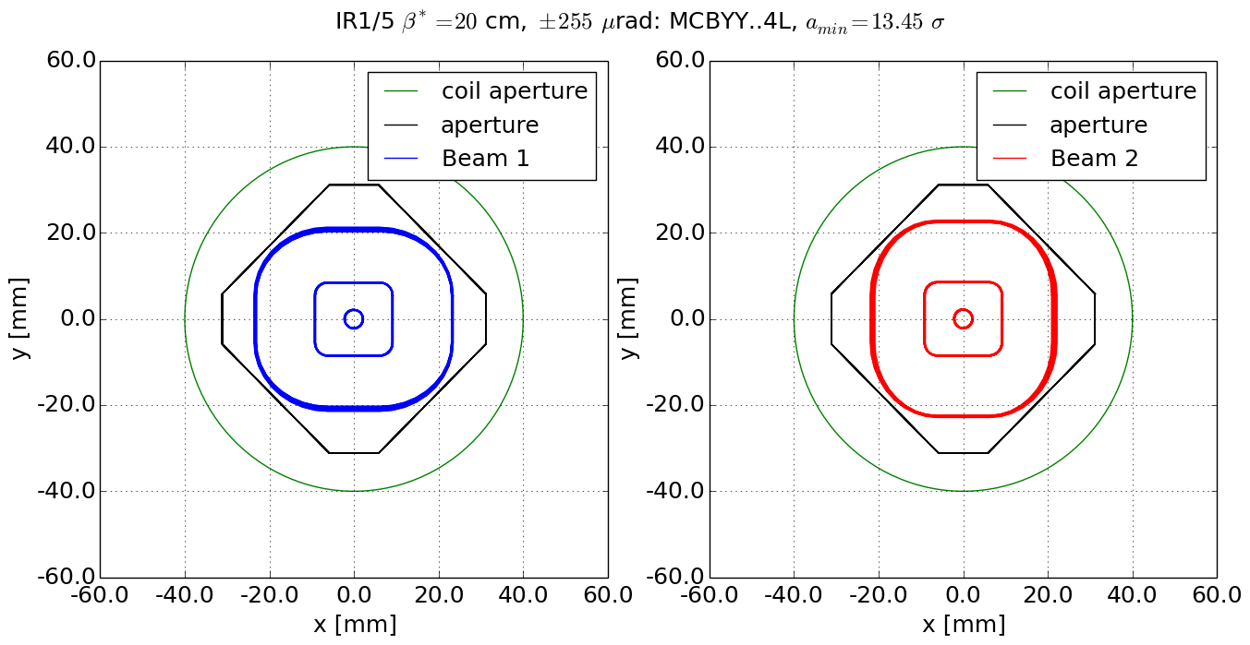
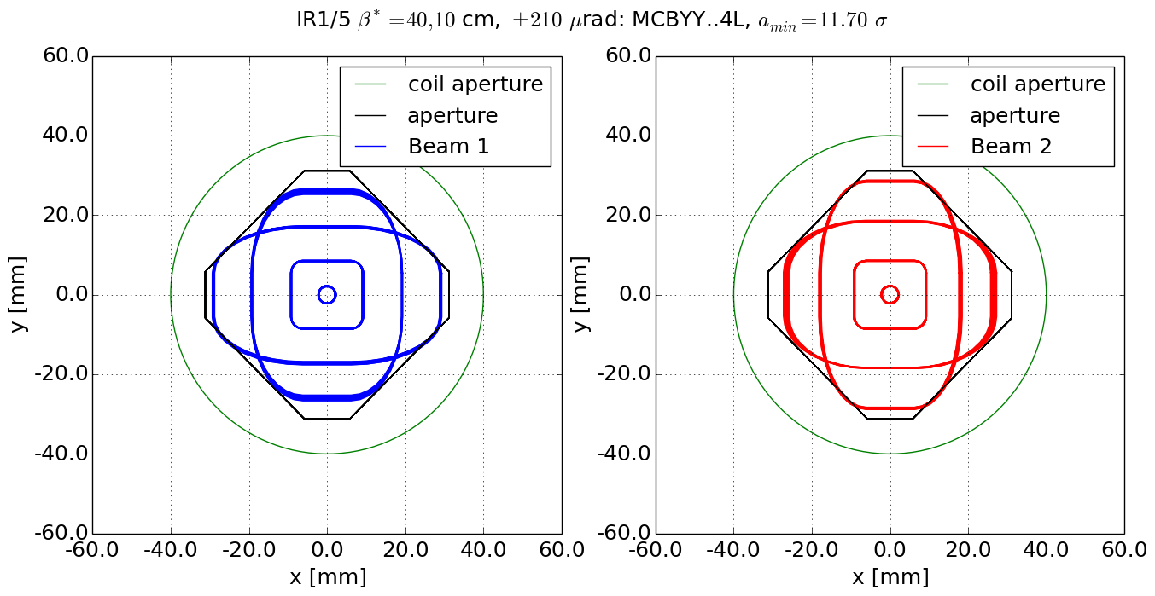
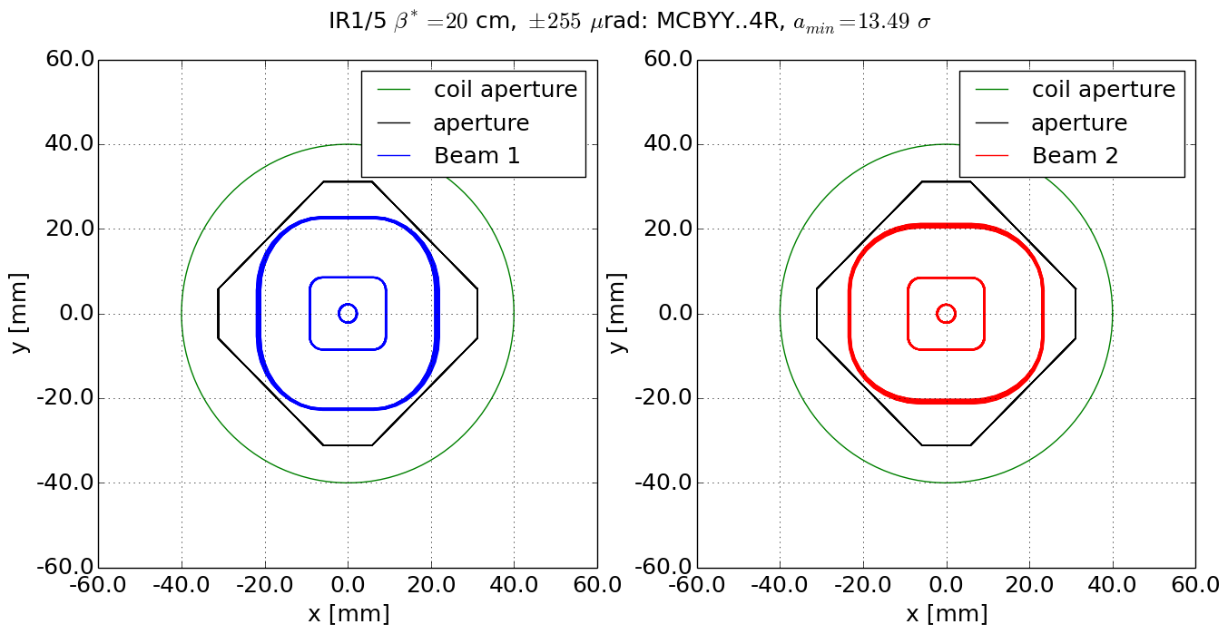
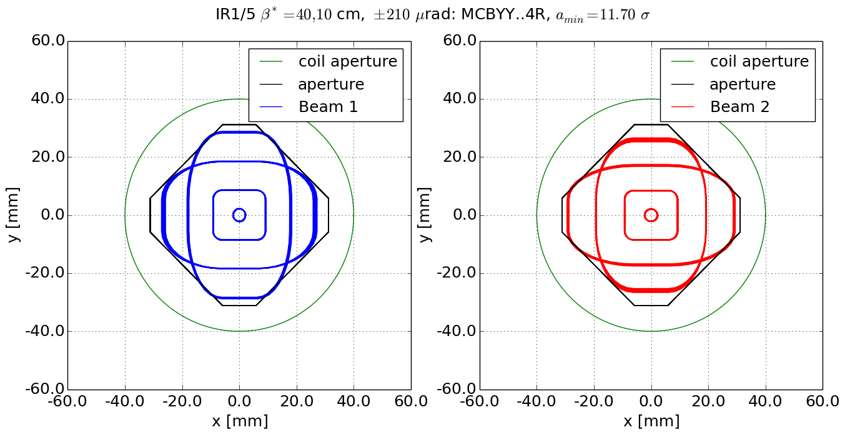
Q4: MQYY with 80 mm coils
Round
Flat
Left
Right
MQYY with 80mm coil not OK. Rectellipse option can help only for special cases.

Slide 30
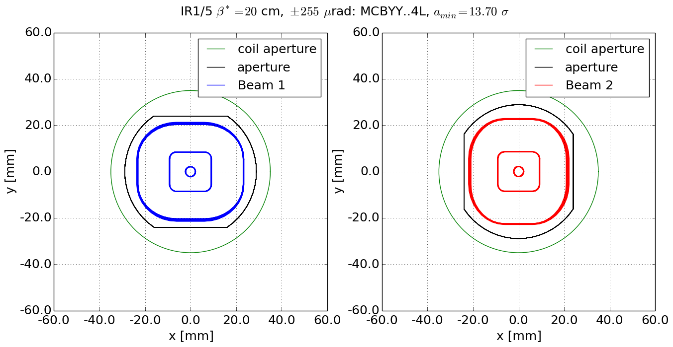
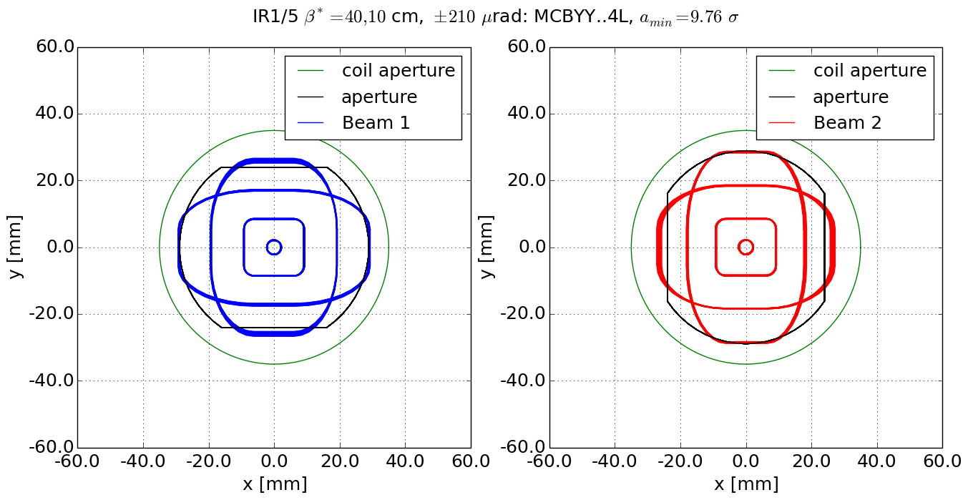
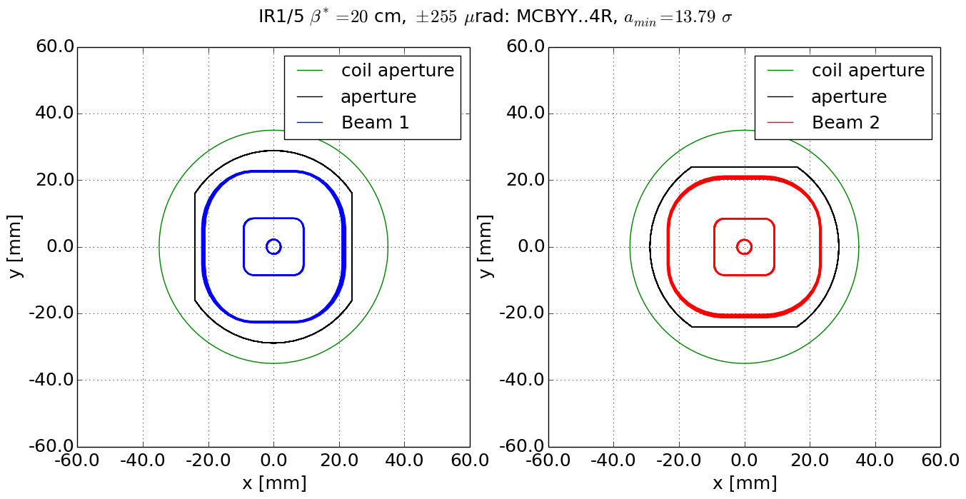

Q4: MQY with 70 mm coils
Round
Flat
Left
Right
Q4 with MQY not ok.

Slide 31
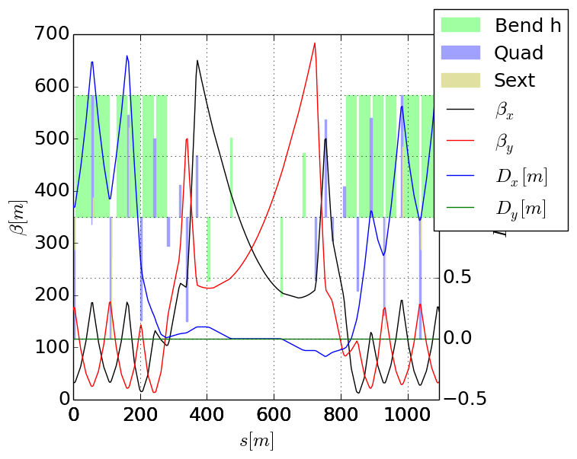
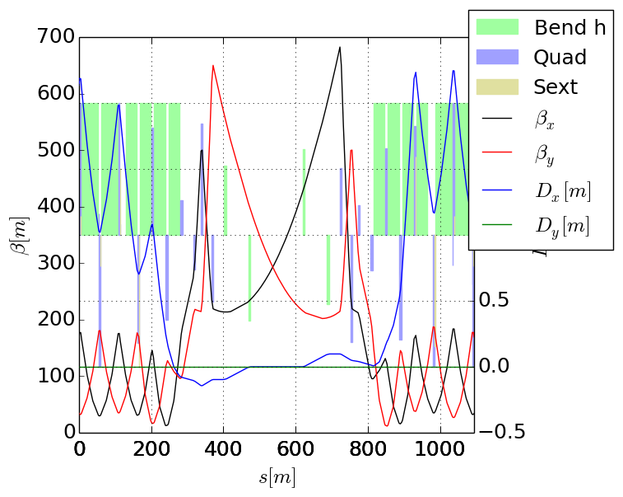
Alignment optics
Optics to align BPMs in the triplet at injection.
Compatible with injection strength, but aperture not exceptional in the arcs.

