Slide 1
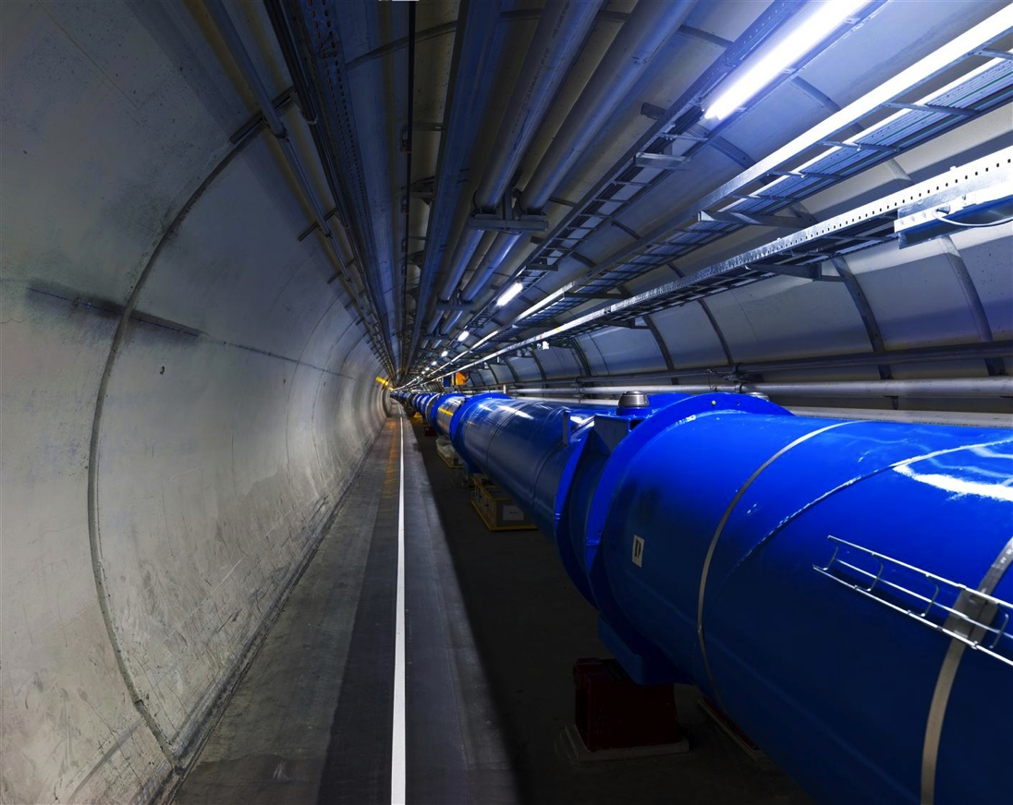
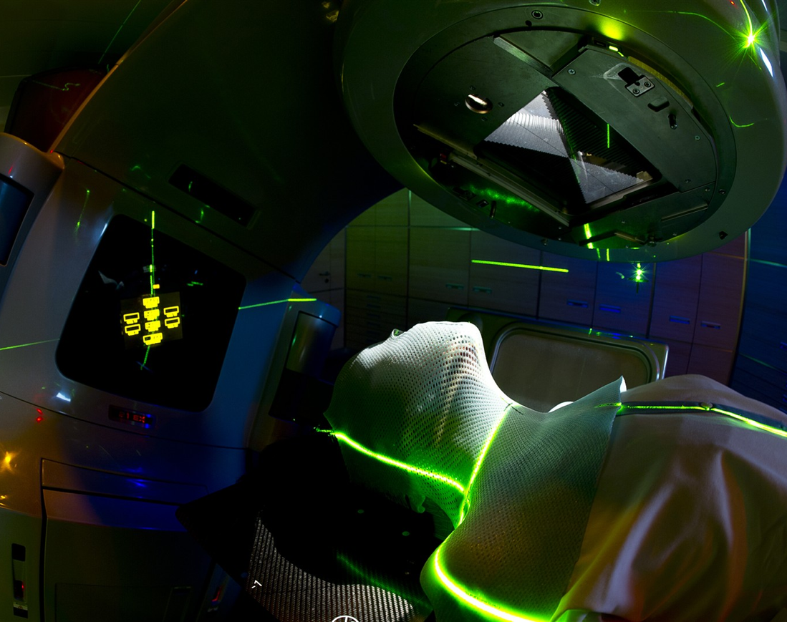
From Physics to Medical Applications
Manjit Dosanjh, CERN
manjit.dosanjh@cern.ch

Slide 2
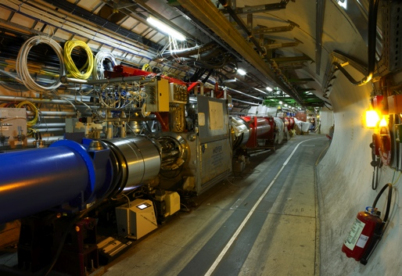

Physics technologies and innovation
accelerators, detectors and IT to fight cancer
Detecting
particles
Accelerating particle beams
Large-scale computing (Grid)
CANCER
Notes:
2

Slide 3
Catalysing collaboration in health field
Challenges:
Bring together physicists, biologists, medical physicists, doctors
Cross-cultural at European and global level
Why is CERN well placed to do this?
It is widely acknowledged as a provider of technologies and as a catalyst for collaboration.
It is international, non-commercial, not a health facility.
Notes:
ULICE Kick-off in 2009
ENVISION approval in 2009
Enlight meeting leading to subm. Of ENTERVISION
PARTNER: 21 researchers recruited last year.

Slide 4
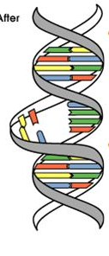
Conventional Radiotherapy in 21st Century
3 "Cs" of Radiation
Cure (40-50% cancer cases are cured)
Conservative (non-invasive, fewer side effects)
Cheap ( 5-10% of total cost of cancer on radiation)
(J.P.Gérard)
About 50-60% are treated with RT
No substitute for RT in the near future
No of patients is increasing
Present Limitation of RT:
~30% of patients tumour recurs
Notes:
4

Slide 5
How to improve outcome?
Physics technologies: higher dose, more localised
Imaging: accuracy, multimodality, real-time, organ motion
Data: storage, analysis, sharing, patient referral, second opinion
Biology: fractionation, radio-resistance, radio-sensitization
Collaboration: cancer is a multidisciplinary field
Notes:
5

Slide 6
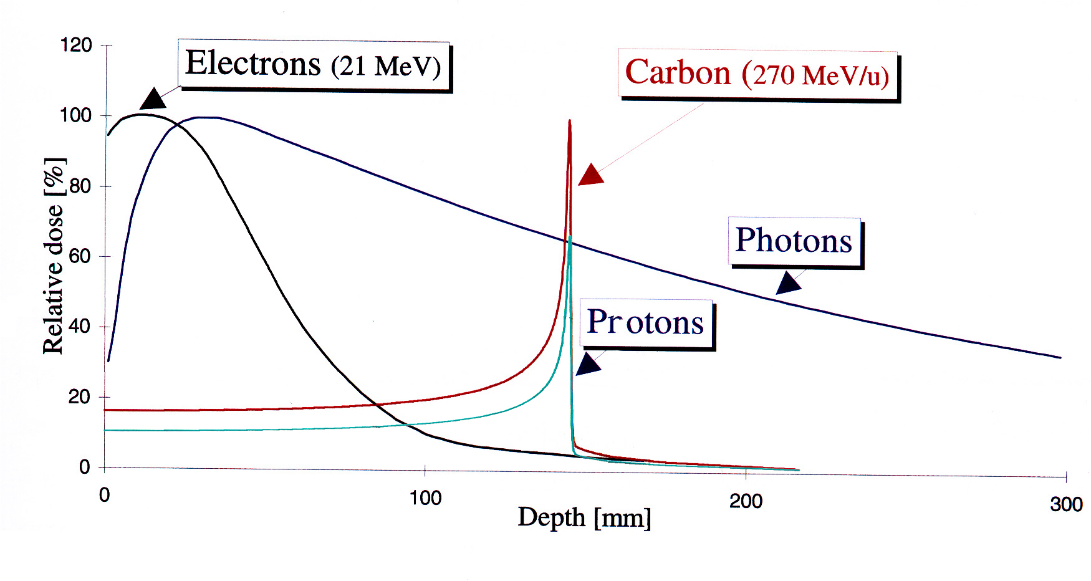
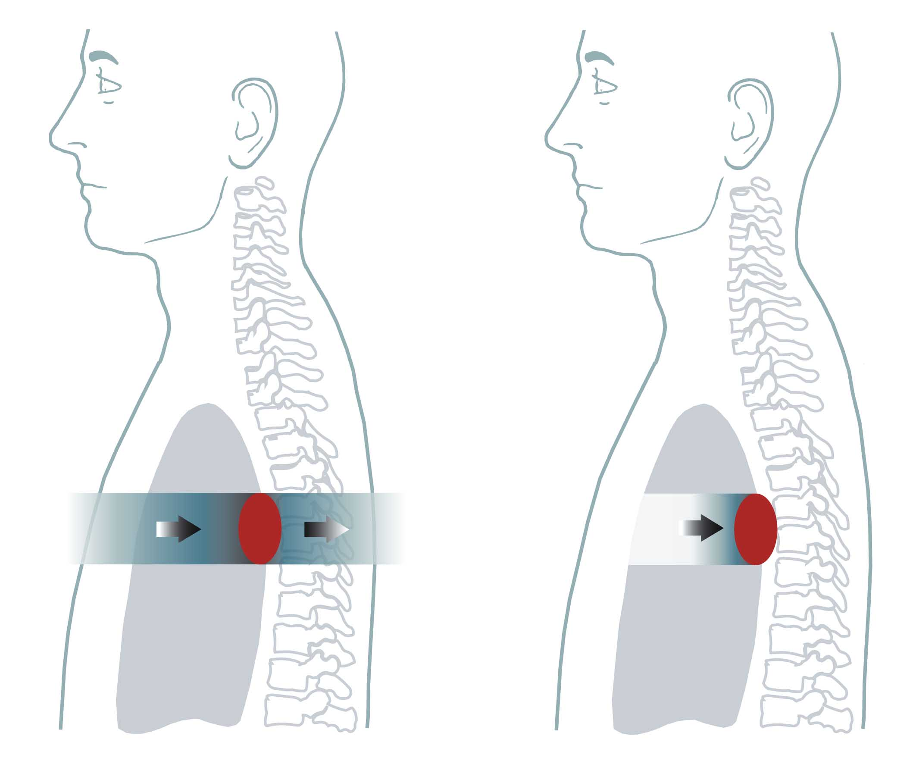
Hadrontherapy: all started in 1946
In 1946 Robert Wilson:
  Protons can be used clinically
  Accelerators are available
  Maximum radiation dose can be placed into the tumour
  Particle therapy provides sparing of normal tissues
- Tumours near critical organs
- Tumours in children
- Radio-resistant tumours
Conventional: X-Rays Ion Radiation
Depth in the body (mm)
Notes:
6

Slide 7
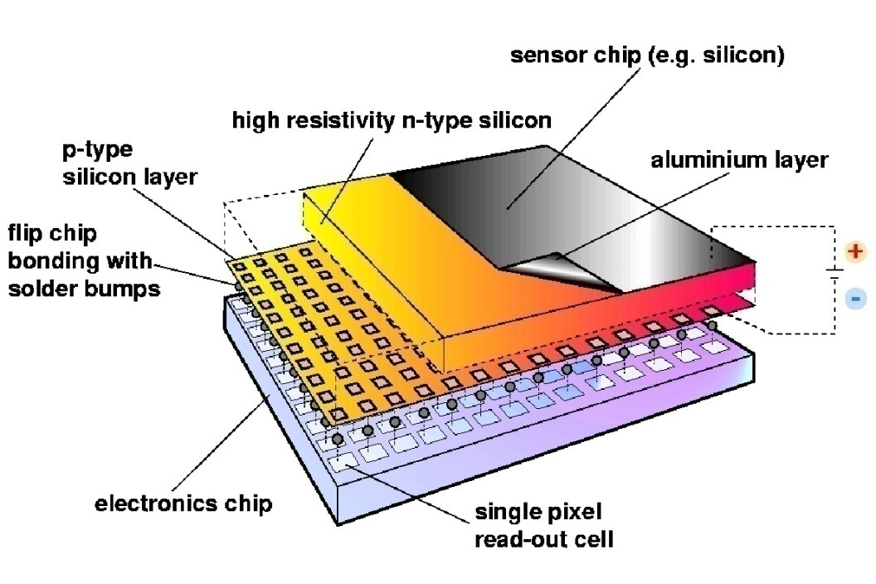
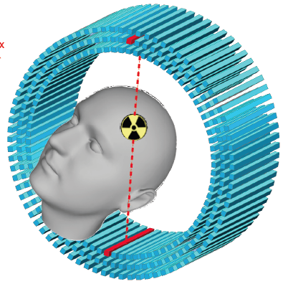
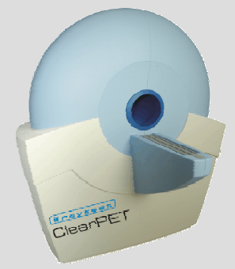
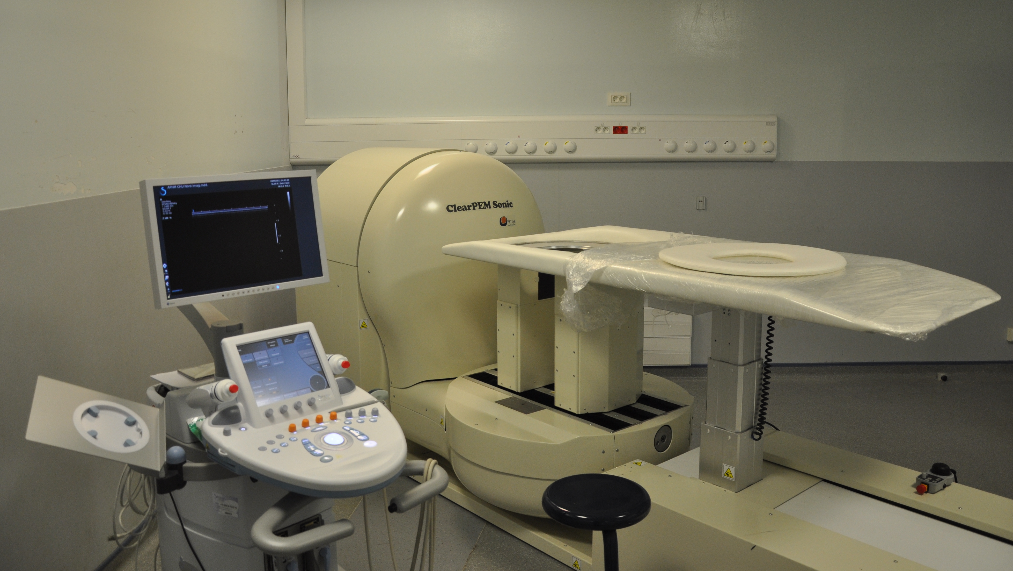
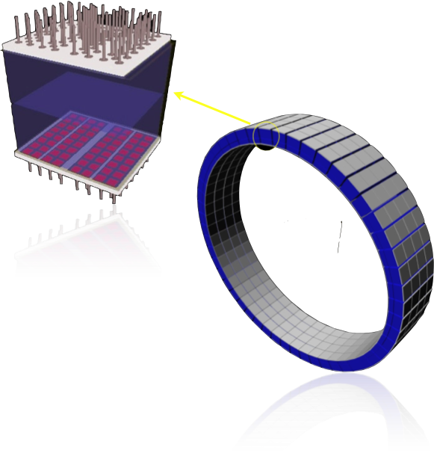
Effective treatment needs precise detection
  Since > 20 years CERN is active in medical imaging
MEDIPIX
AXPET
  Crystal Clear projects
ClearPET
ClearPEM & ClearPEM-Sonic
BrainPET

Slide 8
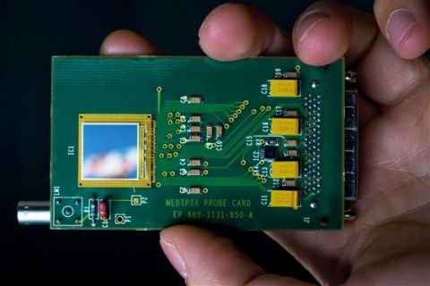
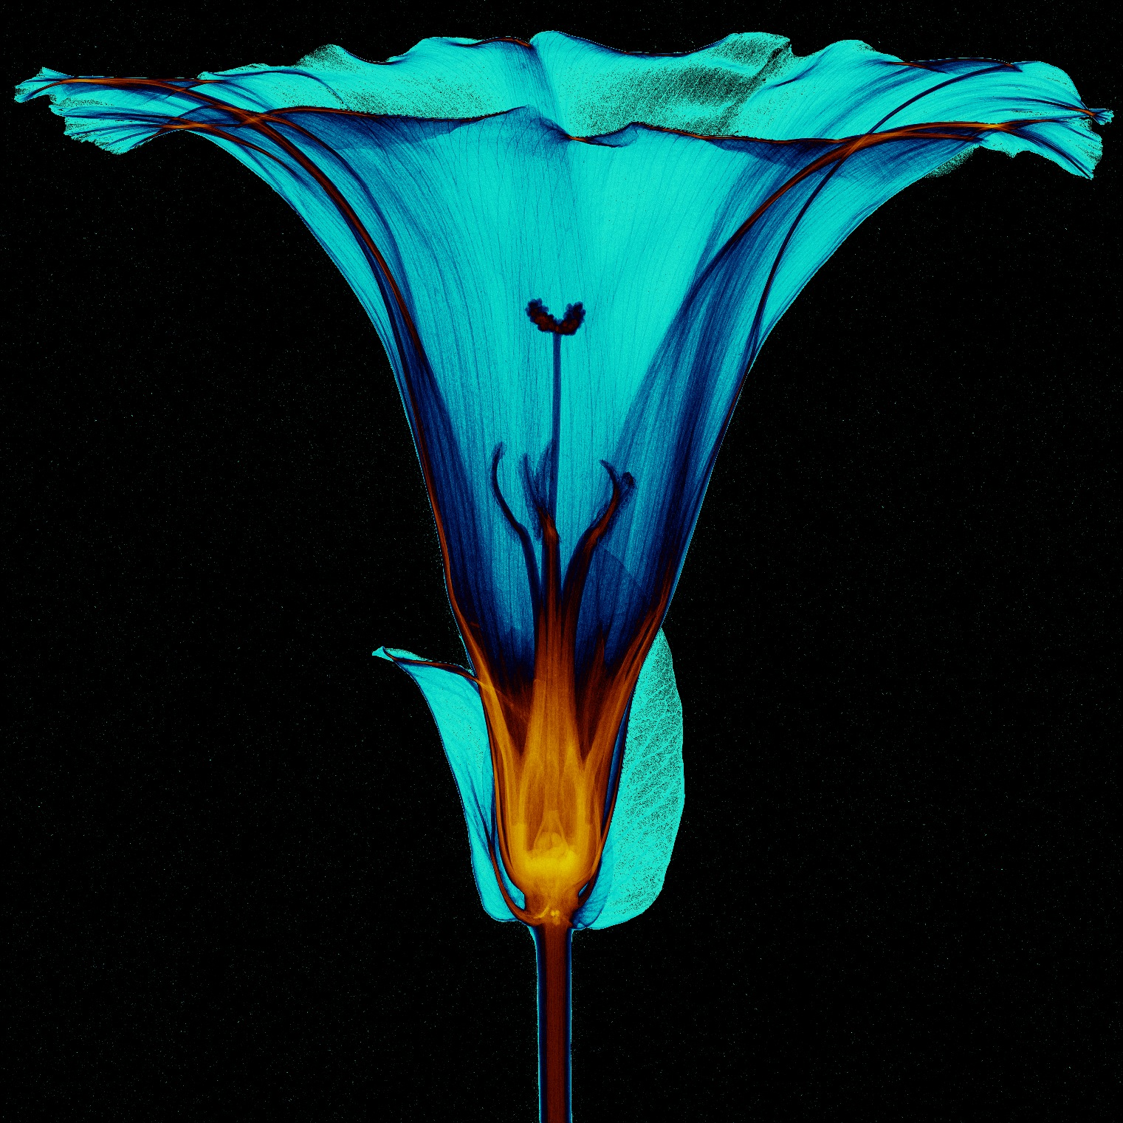
Medipix
High Energy Physics original development:
  Particle track detectors
  Allows counting of single photons in contrast to traditional charge integrating devices like film or CCD
Main properties:
  Fully digital device
  Very high space resolution
  Very fast photon counting
  Good conversion efficiency of low energy X-rays
Credits: Simon Procz, University of Freiburg

Slide 9
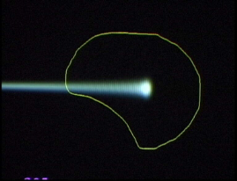
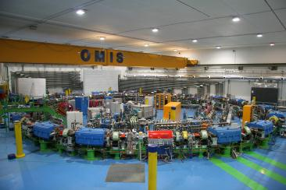
ENLIGHT: Importing Physics collaboration philosophy into a medical environment
  Create common multidisciplinary platform
  Cancer treatment
  Identify challenges
  Share knowledge
  Share best practices
  Harmonise data
  Provide training, education
  Innovate to improve
  Lobbying for funding
Notes:
9

Slide 10
The New (2014) CERN Medical Initiatives
Medical Accelerator Design
  coordinate an international collaboration to design a new compact, cost-effective accelerator facility, using the most advanced technologies
Biomedical Facility
  creation of a facility at CERN that provides particle beams of different types and energies to external users for radiobiology and detector development
  Iterative experimental verification of simulation results
Detectors for beam control and medical imaging
Diagnostics and Dosimetry for control of radiation
Radio-Isotopes (imaging and treatment)
Large Scale Computing (large data transfers and analysis, treatment planning and simulations)
Applications other than cancer therapy
Will be carried out in a global collaboration

Slide 11

History of CERN Participation in Hadron Therapy
1996 – Proton Ion Medical Machine Study (PIMMS) initiated
  Synchrotron optimised for the treatment of moving organs with carbon ions and protons
2000 – Design summarised in two reports
Design implemented: Italy and Austria

Slide 12
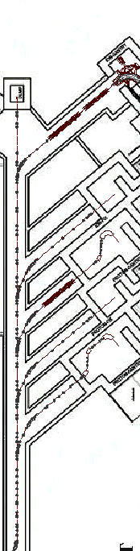
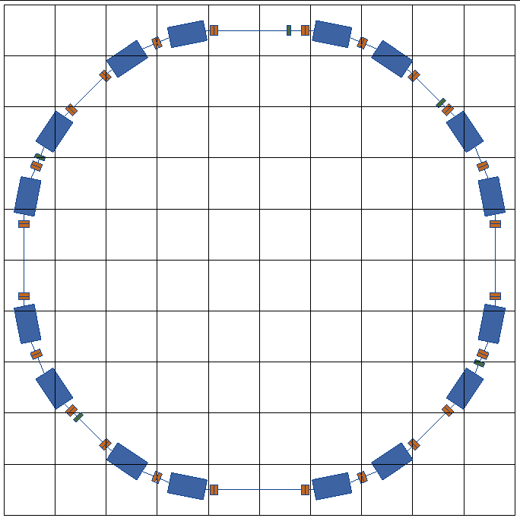
PIMMS at CERN (1996-2000)
linacs for
carbon ions
and protons
400 MeV/u synchrotron
p
p
p
C
C
RF cavity
Resonance sextupole
Sextupole horiz. chromaticity
Sextupole vert. chromaticity
Betatron
core
Circumference C = 76.84 m
Tune horizontal Q_{x} = 1.67
Tune vertical Q_{z} = 1.72
Sextupole vert.
chromaticity
Sextupole horiz. chromaticity
Electrostatic septum
CERN-TERA-MedAustron
Injection septum
Extraction septum

Slide 13

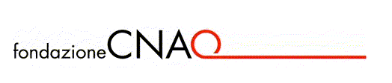
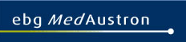
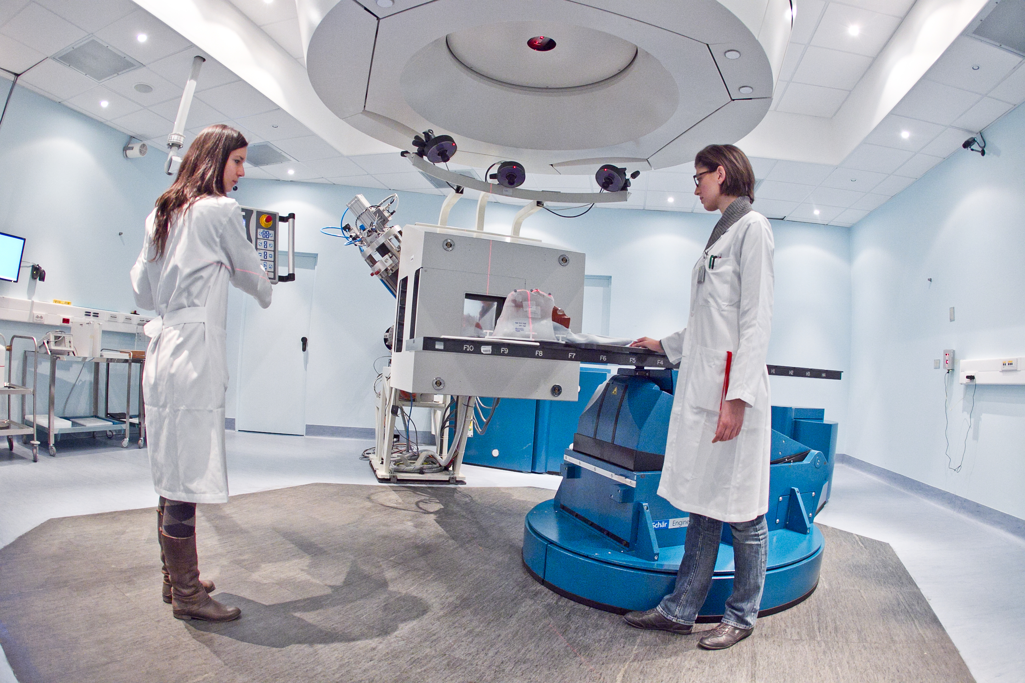
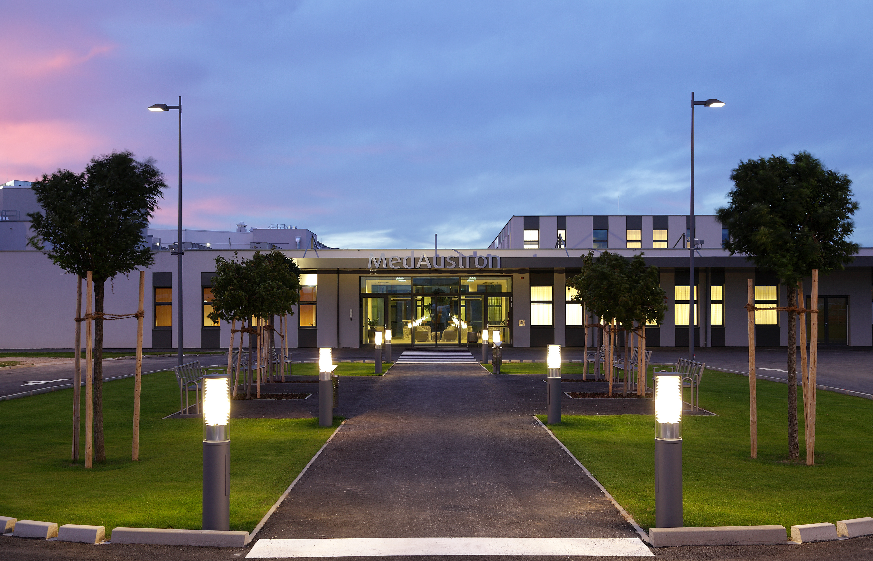
From PIMMS study coordinated by CERN
First patient with carbon ions Nov 2012
Will start treatments in 2016

Slide 14
What do we need in the future?
Treat the tumour and only the tumour
    control and monitor the ideal dose to the tumour
    ⇒ Minimal collateral radiation “outside” the tumour
    Minimal radiation to nearby critical organs
  Even if the tumour is moving
Be affordable
    Capital cost ?
    Operating costs ?
    Increased number of treated patients per year ?
Compact: Fit into every large hospital ?
Support from the community

Slide 15
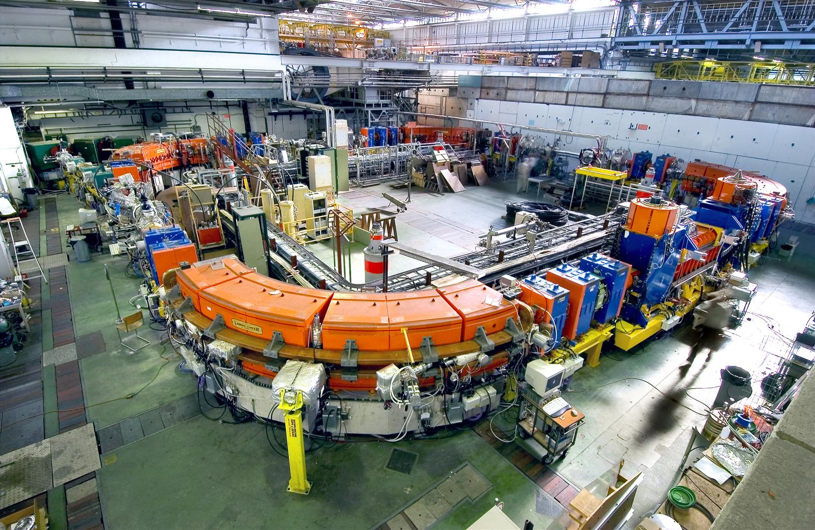
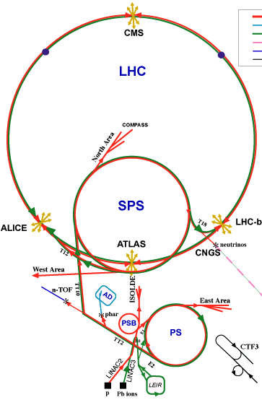
OPENMED: Biomedical Facility at CERN
Biomedical facility at CERN using LEIR:
  radiobiology
  fragmentation of ion beam
  Dosimetry
  Detector development
  test of instrumentation
LEIR

Slide 17
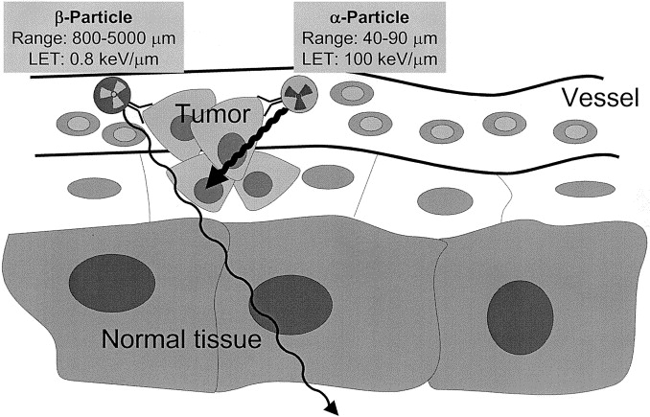
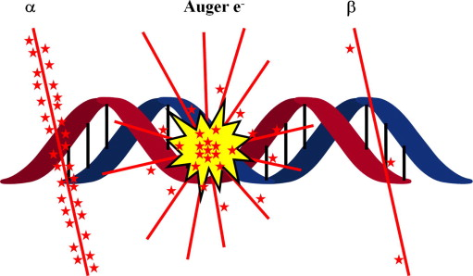
MEDICIS (ISOLDE)
Scope: Medicine
Innovative isotopes
Innovative protocols (brachytherapy)
Studies on cells, animals (« preclinical ») possibly extended to clinical phases
Field of Application | Radiation | Chemical elements | Half lives
PET | β⁺ | Alkaline earth Halogen Lanthanide Transition metals … | 10’s min. Hours Days Months
SPECT | γ
TAT | α
Beta therapy | β⁻
Auger therapy | e⁻

Slide 18
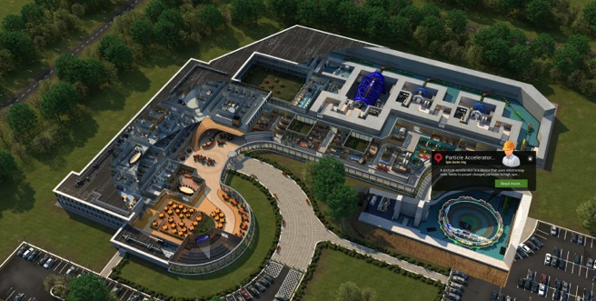
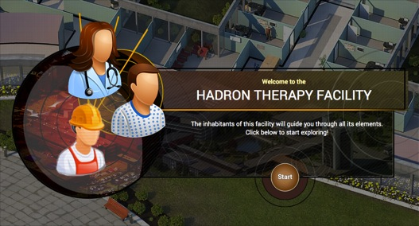
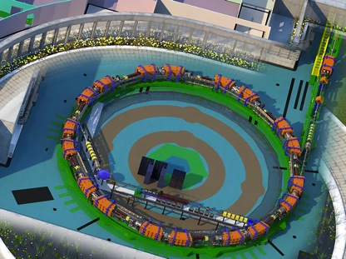
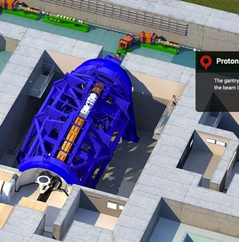
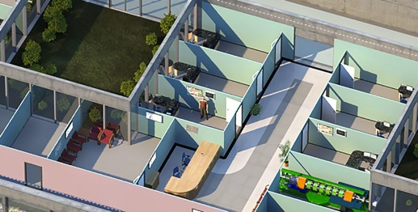
Virtual Hadron Therapy Centre
Starting point
Bird’s eye view of the entire facility
Accelerator
Gantry
Patient rooms
cern.ch/virtual-hadron-therapy-centre

Slide 19
