Slide 1

CERN-MEDICIS (MEDical Isotope Collected from ISolde): A new facility
Valentin Fedosseev,
Thierry Stora, EN-STI

Slide 2
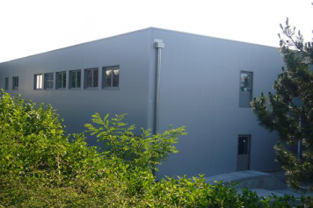
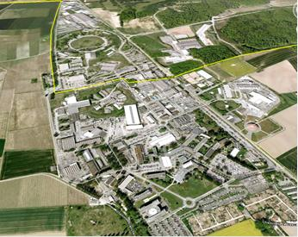
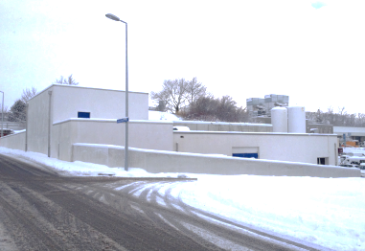
The Isolde facility … today

Slide 3
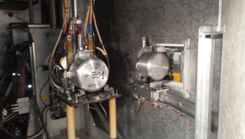
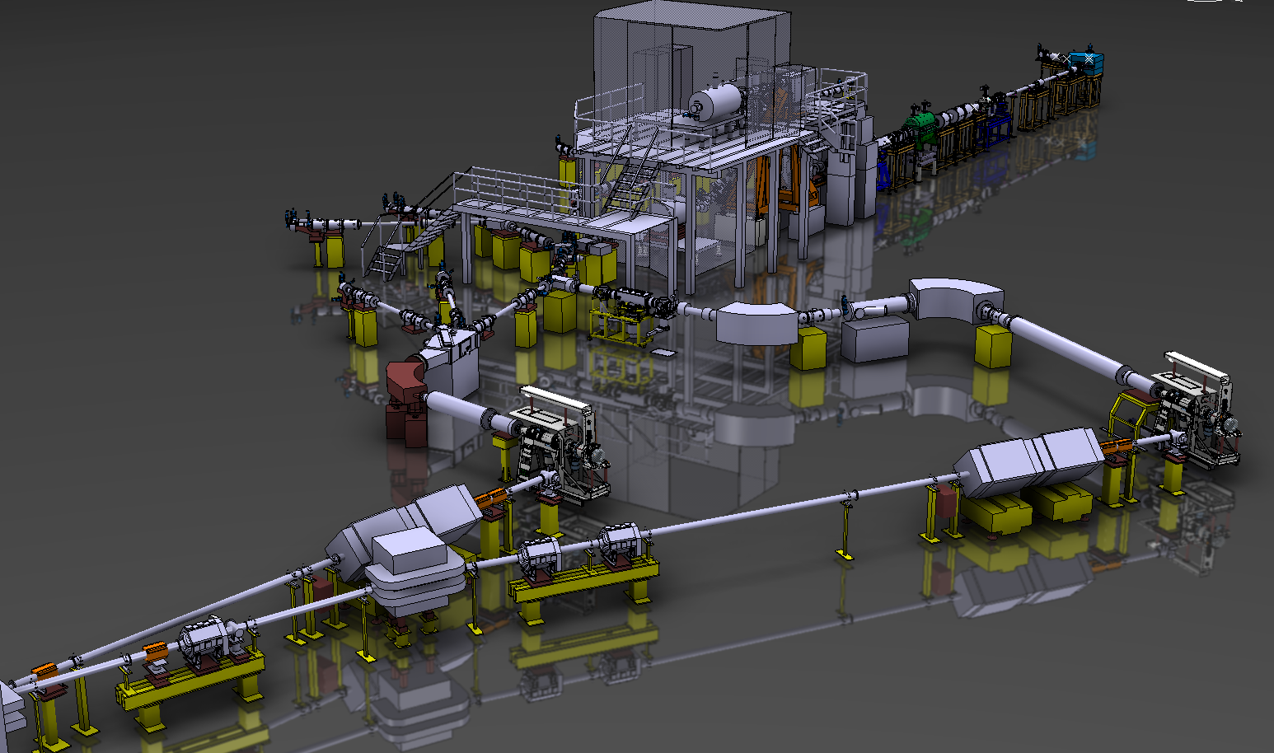
Mass spectrometers

Slide 4
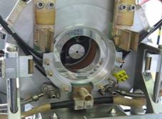
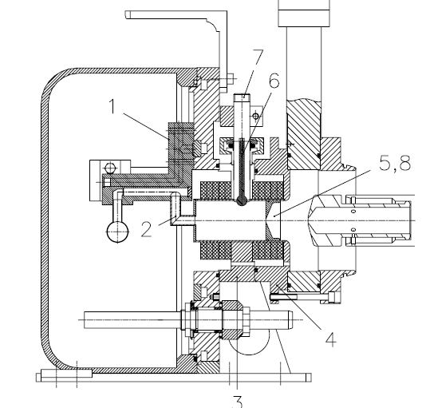
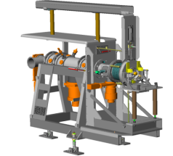
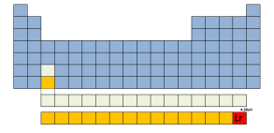
Principles of radioactive beam production
Primary beam
(MeV/u-GeV/u)‏
Plasma
Extracted
ion beam
~nA for Surface
~μA for FEBIAD
~mA for ECR
Target oven
Transfer line
Ion source
Extraction
Leaks
Leaks
Leaks
Neutrals
Release loss
Condensation
Condensation
Sidebands
Decay loss
Decay loss
Decay loss
Multiply charged
Ion sources: compact, simple and withstand 1 MGy
Ionize trace radioelements in larger impurities loads
Used to measure Ion. Pot. Lr (Z=103)
at “1 atom at a time” rate

Slide 5
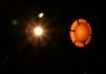
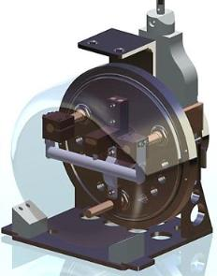
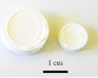
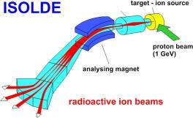
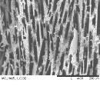
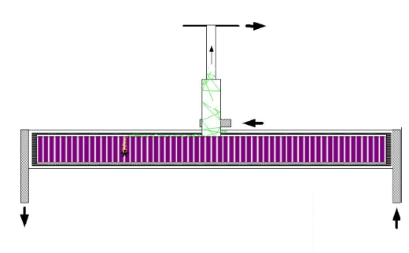
From production to beam formation
spallation
1.4 GeV protons
fragmentation
fission
1cm
10-100m
30cm
1mm

Slide 6
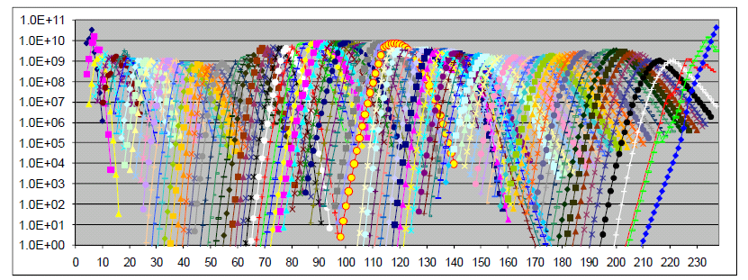
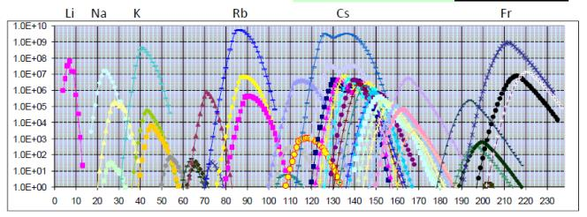
The « ISOL » filter
Isotope mass separation online
In-target production rate
1000+ isotopes
(for 73+ elements) “online”
I[pps] ~ Φ[pps] σ[barn] N[g/cm2] ε [%]
A=83
A=152
Intensity
Purity
Beam production rate
(Mass separation filter)

Slide 7
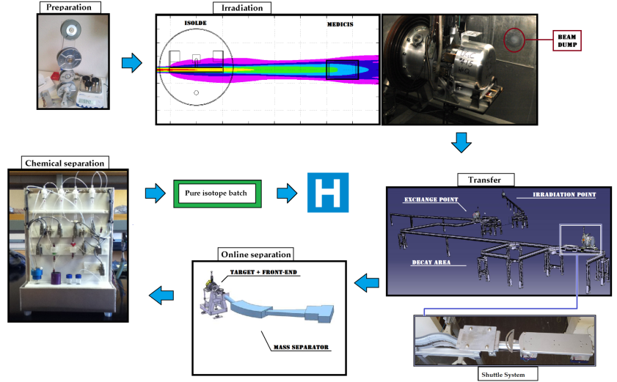
Why CERN-MEDICIS could be done *?
* Without an additional proton driver
Offline separation

Slide 8
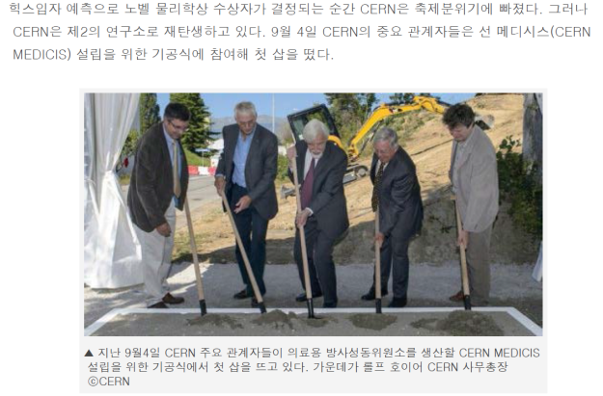
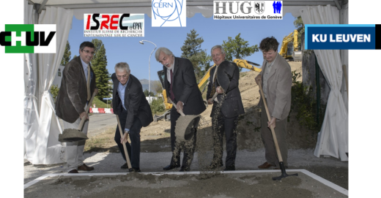
Some milestones in the project
Groundbreaking
3rd September 2013

Slide 9

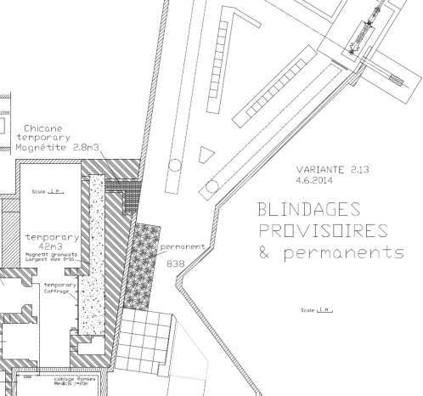
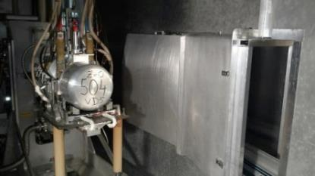
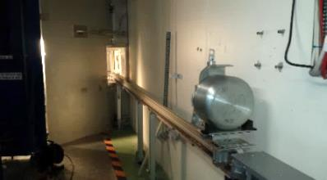
Irradiation station commissioned with beam
M. Vagnoni (EN-STI fellow), et al.
Proton Beam
60 kV
Cover earthed
Tests with protons:
Done successfully !

Slide 10

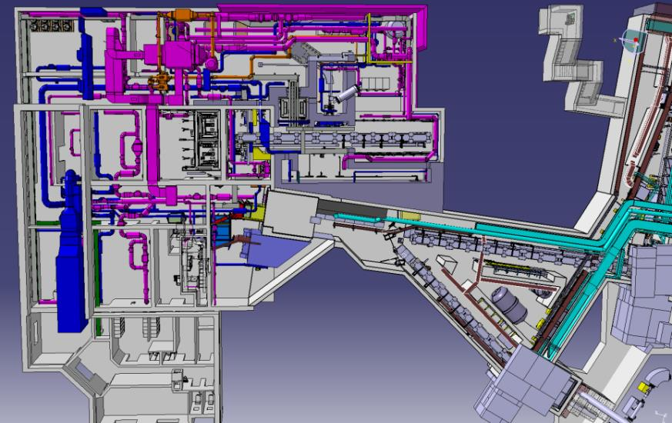
General Integration
V. Barozier

Slide 11
External partners
Dr. Forni (Clin. Carouge, Geneve)
Prof. Morel, Prof. Buehler, Prof. Y. Seimbille, Prof. Ratib (HCUGE, Geneve)
Prof. D. Hanahan (ISREC, EPFL, Lausanne)
Prof. F. Buchegger, Prof. J. Prior (CHUV, Lausanne)
Prof M. Huyse, prof. P. van Duppen (KUL, Univ. Leuven)
Prof. S. Lahiri (SINP, Kolkata)
Prof. I. dos Santos, prof P. Vaz (CT2N, Lisbon)
Prof. E. Piperkova (Nucl. Medicine, Sofia)
Prof. F. Haddad (ARRONAX)
JRC-ITU
Ongoing discussions
S. Buono (AAA)
Prof. K. Wendt (JGU)
Myrrha
ESS
NPL (UK)

Slide 12
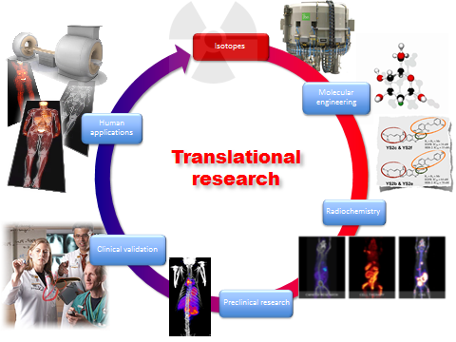
Courtesy prof. Ratib, in the context of the CERN-MEDICIS project

Slide 13
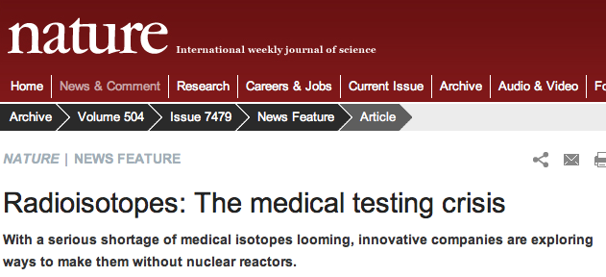
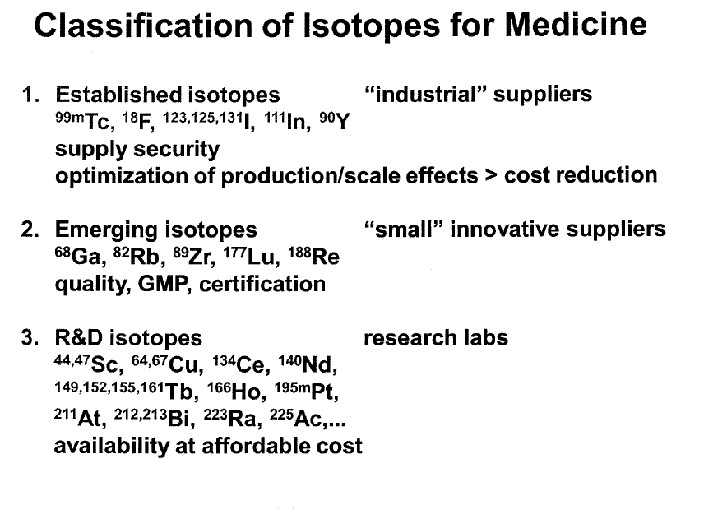
Radioisotopes and personnalized medicine
99Technecium supply shortage
(10’000 scintigraphy protocols
/Mi US residents/year)
From U. Koester,
workshop on physics for Health in Europe
CERN, Feb. 2010

Slide 14
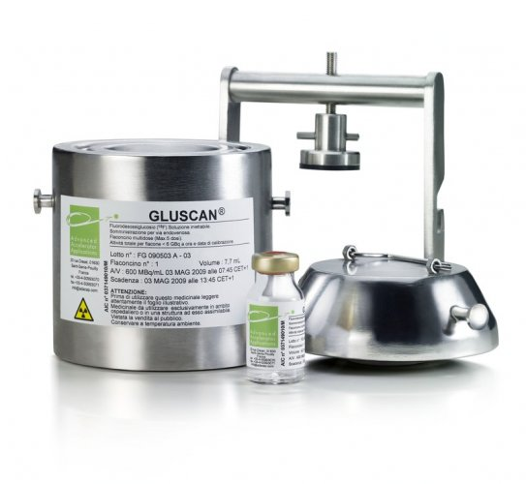
Classical medical isotope production
At medical cyclotrons (p/d/a,X)
9-70MeV
At nuclear reactors (n,X)
More prospective : compact Linacs,
Heavy ion cyclotrons, high energy p drivers

Slide 15
The Scope
Biomedicine
Innovative protocols (Surgery/brachytherapy/combination)
Innovative isotopes for imaging and treatment
Studies on cells, animals (« preclinical »)
possibly extended to clinical phases
(needs upgrades, but this can be reached)
Field of Application | Radiation | Chemical elements | Half lives
PET | β⁺ | Alkaline earth Halogen Lanthanide Transition metals … | 10’s min. Hours Days Months
SPECT | γ
TAT | α
Beta therapy | β⁻
Auger therapy | e⁻

Slide 16
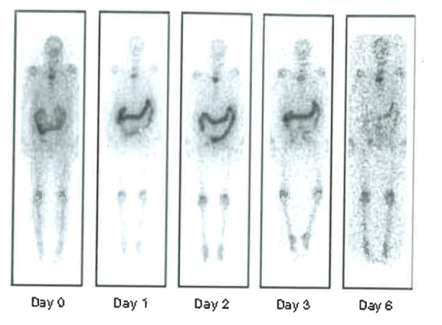
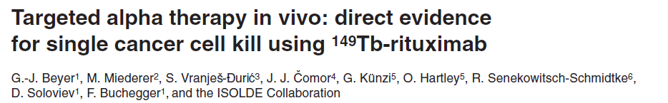
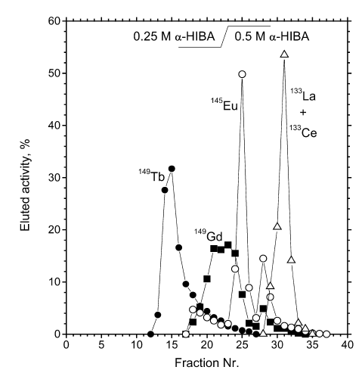
Targeted alpha-therapy
1st approval of ²²³RaCl₂ Xofingo drug to treat cancer with bone metastasis
From Isolde,
10-15 years ago

Slide 17
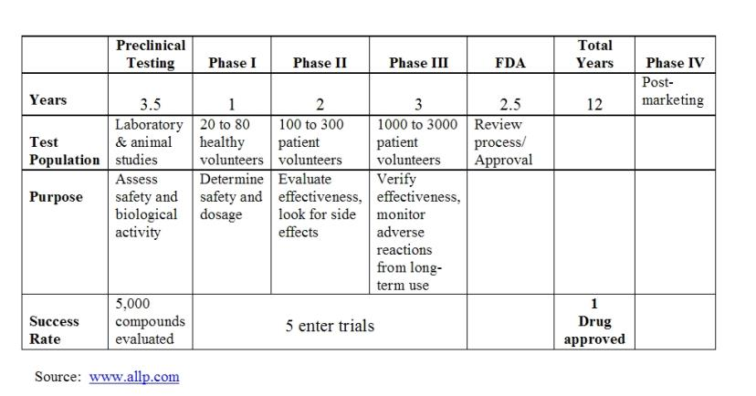
Drug development cycle

Slide 18
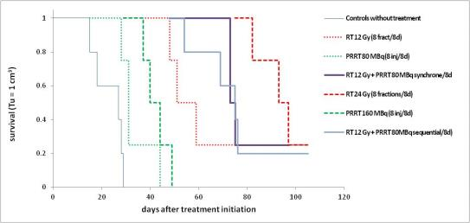
Systemic (intravenous) and external radiotherapy
A
B
C

Slide 19
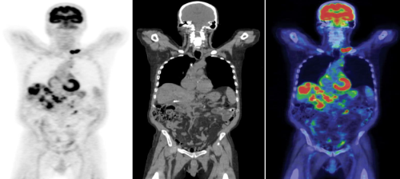
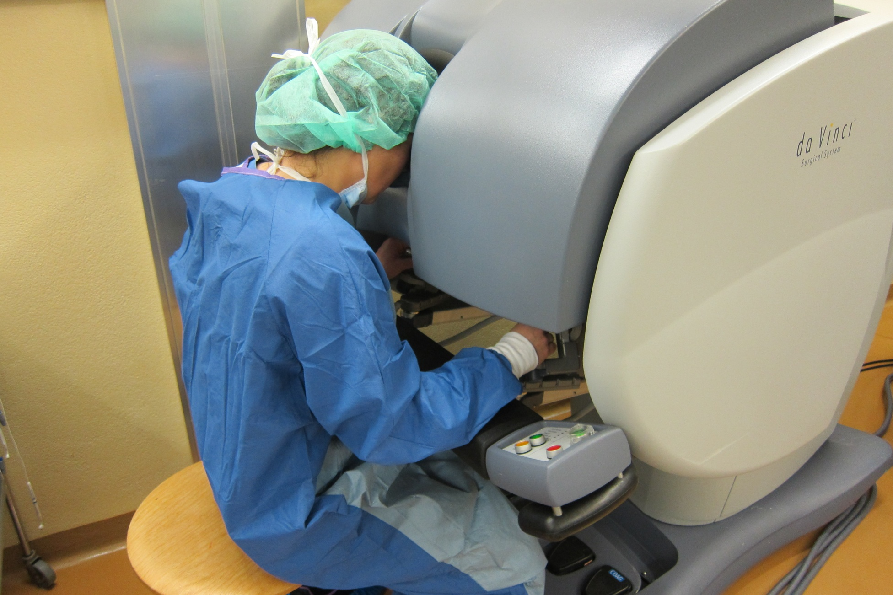
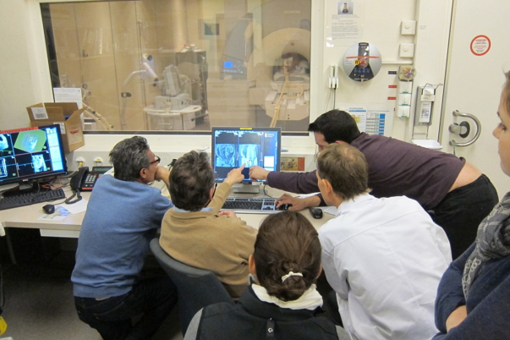
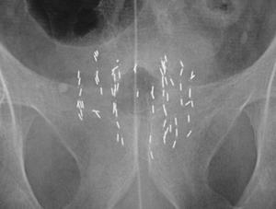

Plan for development of surgical methods
Brachytherapy

Slide 20
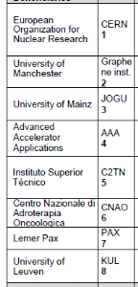
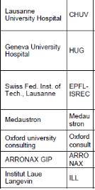
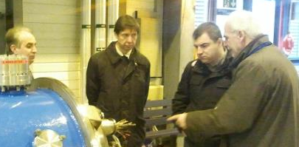
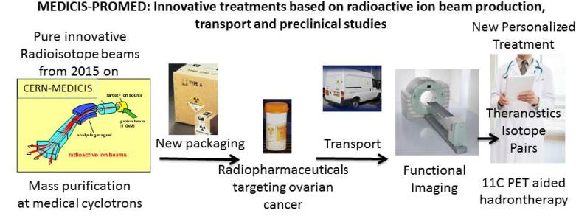
Marie-Curie ITN
Working with Prof. Novozelov :
Graphene as protective layer on metal foil
targets

Slide 21
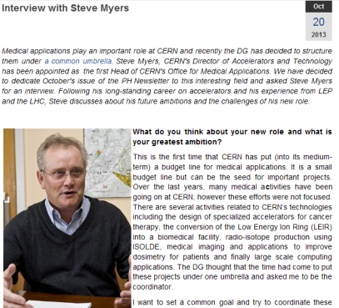
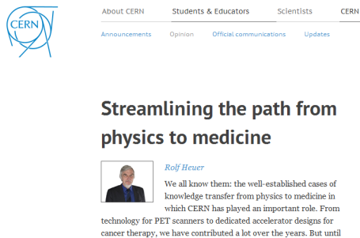
6 other CERN initiatives in Medical applications
Kick-off meeting : 22 Nov 2013
Session de brainstorming à Divonne Les Bains 15-16 Fév. 2014

Slide 22

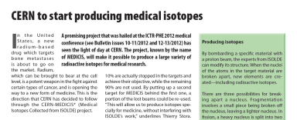
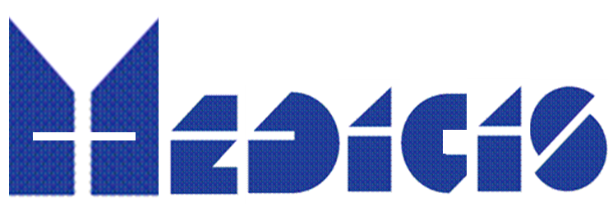


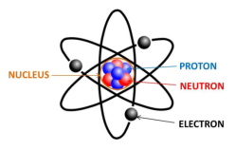






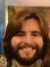

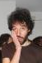

Thank you !
Core CERN-MEDICIS nucleus
And many orthers

Slide 24
Some yield estimates

