Slide 1
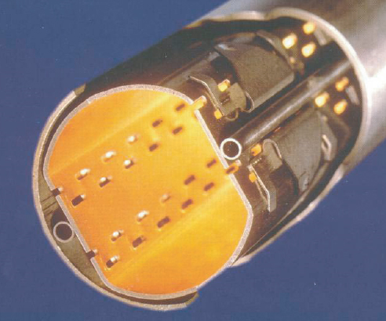
WP4
Cryogenic Beam Vacuum System Conception
Cryo Beam Vacuum
Summary
Francis Perez

Slide 2
Objectives
To develop the technical design concept for the cryogenic vacuum beam pipe,
with constrains:
Beam screen
Cryogenics
Magnet core bore
To test a beam screen prototype in the ANKA light source with similar synchrotron light conditions

Slide 3
Team
CERN | IEIO
KIT | Germany
INFN | Italy
ALBA | Spain
CIEMAT | Spain
STFC | United Kingdom
Japan
KEK
Finland
TUT
United Kingdom
STFC, UNILIV, UOXF
Netherlands
UT
Germany
KIT, TUD
Man power,
hardware cost is not included in EuroCirCol
France
CEA, CNRS
CERN
Switzerland
EPFL, UNIGE
Italy
INFN
Spain
ALBA, CIEMAT

Slide 4
Tasks
^{Task} ^{4.1:} ^{Work Package Coordination}
^{Task} ^{4.2:} ^{Study beam} ^{induced vacuum effects}
^{Task 4.3: Mitigate beam} ^{induced vacuum effects}
Task 4.4: Study vacuum stability at cryogenic temperature
Task 4.5: Develop conceptual design for cryogenic beam vacuum system
Task 4.6: Measurements on cryogenic beam vacuum system prototype

Slide 5
^{Task} ^{4.1:} Work Package Coordination (ALBA)
^{ALBA} with the assistance of CERN coordinates the work of all other tasks of this work package to ensure consistency of the work according to the project plan and to coordinate the WP technical and scientific scope with the tasks carried out by the other WPs.
Video meeting each 2 months
On person meeting each 6 months
week before the FCC Week
Specific Meetings when required

Slide 6
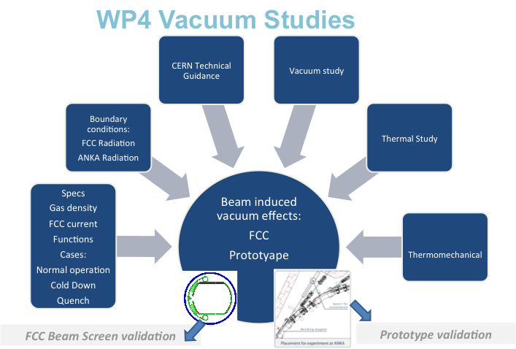
^{Task} ^{4.2:} ^{Study beam} ^{induced vacuum}
^{effects (ALBA, CERN)}
ALBA will model and compute the cryogenic beam vacuum system, both in static and in time constant (so called “dynamic”) .The model will include synchrotron radiation effects.
In a second stage, ALBA, in close correlation with CERN, will evaluate options to implement cryophoton absorbers.

Slide 7
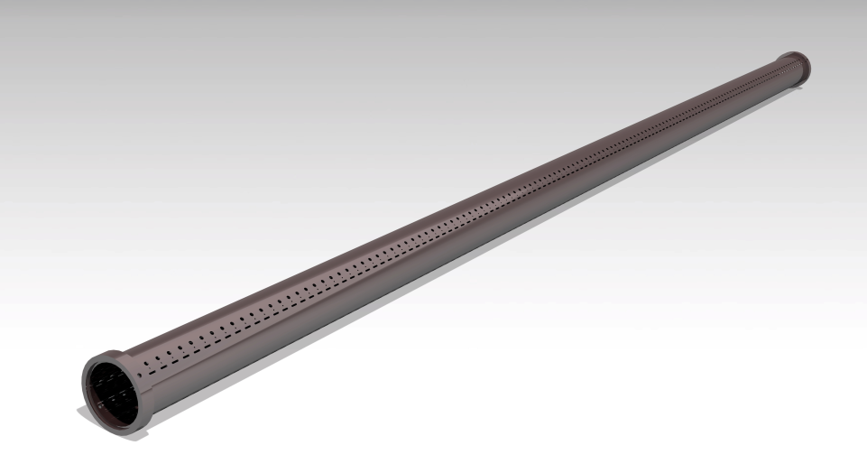
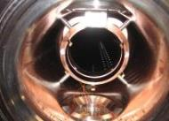
^{Task 4.3: Mitigate beam} ^{induced}
^{vacuum effects (STFC, CERN)}
STFC will study different coatings to mitigate beam induced electron cloud and ion instabilities
Compatibility of these coatings with cryogenics temperatures has to be demonstrated, in particular sticking and flaking of coatings after several cool down and warm up cycles.
~2.2 m, ID 67 beam screen
Internally coated with amorphous carbon
Tests Laser Surface Treatment
- Prototype samples of SS+Cu 150-300 um
Investigate other coatings:
- NEG, Carbon … coatings

Slide 8
Task 4.4: Study vacuum stability at cryogenic temperature (INFN, CERN)
INFN Frascati will determine vacuum stability and adsorption isotherms at different cryogenic beam screen operating temperature ranges.
It will perform complementary studies on beam induced stimulated desorption phenomena by photons, electrons and ions.
  Absortion isotherms
    Validation of temperature window: 20-80 K
    Cryoabsortion surface
  PSD + PEY (at room temp) (in relation with task 4.6)
  Photon reflectivity (in relation with task 4.6)
    Synchrotron Radiation in grazing incidence
  PSD + PEY at LN2 (in relation with task 4.6)

Slide 9
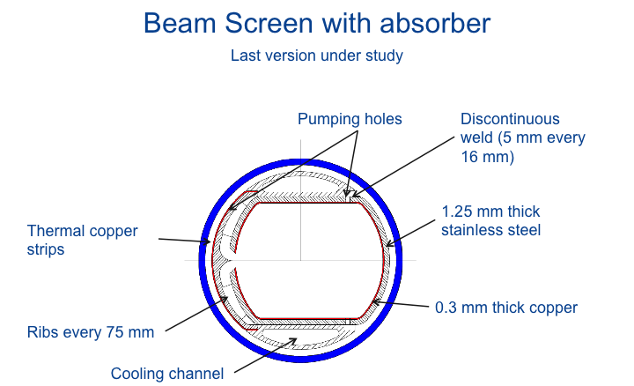
Task 4.5: Develop conceptual design for
^{cryogenic beam vacuum system}
^{(CERN, CIEMAT)}
CIEMAT will closely collaborate with CERN on the mechanical design of the cryo beam screen, ensuring compatibility with fast magnetic transitions and cryogenic cooling concepts
CERN will manufacture the beamscreen prototypes and qualify them in one of its magnet test stands at different beamscreen temperatures.
Coil diameter 50 mm (from WP5)
Inner dimension 32.5mm x 28mm
(to be confirmed by WP2 asap)
Prototype production

Slide 10
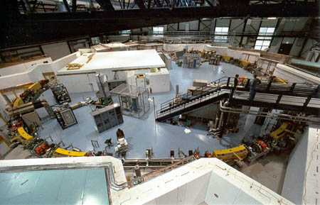
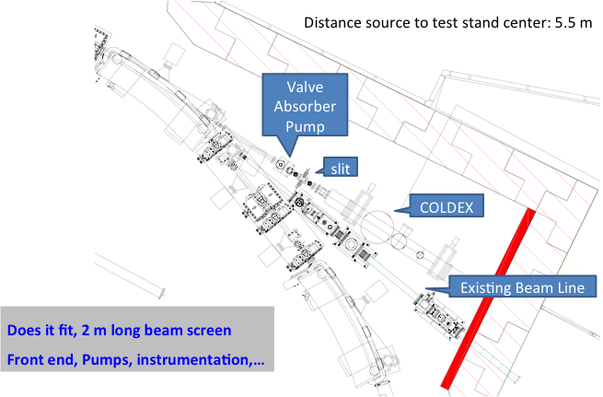
Task 4.6: Measurements on cryogenic
^{beam vacuum system prototype}
^{(KIT, INFN, CERN)}
KIT will be responsible for the “beam qualification” of the beamscreen prototype supplied by CERN. The goal is to determine synchrotron radiation heat loads and photoelectrons generation inside the beamscreen prototype.
This beamscreen will be qualified with beam by installing the CERN COLDEX experiment in the ANKA synchrotron ring and exposing the beamscreen prototype to significant levels of synchrotron radiation.
ANKA will assist for the installation and integration of COLDEX carried out by CERN and INFN. INFN will commission the experiment and perform the measurements under CERN advice.
Design to be started immediately

Slide 11
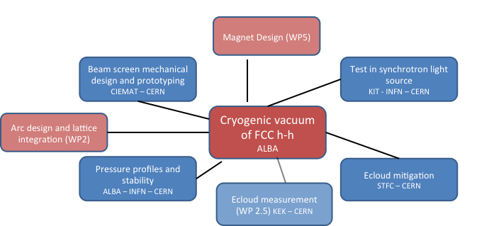
WP2 + WP4 (close follow needed)
- Dimensions agree
Injection concern
Vertical orbit sensitivity
- e-cloud
Proper data for PEY & reflectivity for simulation
- Input needed for Gas density/lifetime
- Impedance
Need of real Cu data for simulation

Slide 12
WP5 + WP4 (close follow needed)
- Coil inner diameter agree (50+- 2 mm)
- Baseline temperature for WP5 is 4.2K
but for WP4 is 1.9K
- Beam shall pass through the center of the magnets
- Test of quench feasible with 2 T room temperature pulsed magnet and beam screen cryo-cooled.

Slide 13
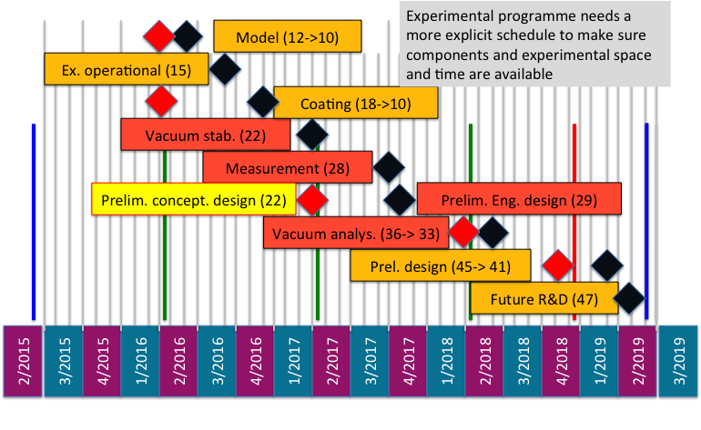
Re-schedule needed…
Careful analysis in following weeks

