Slide 1

Task 4.3: Mitigate beam-induced vacuum effects (STFC, CERN)
O.B. Malyshev and R. Valizadeh,
ASTeC Vacuum Science Group,
STFC Daresbury Laboratory, UK
EuroCirCol kick-off meeting, CERN, Geneva
2-4 June 2015

Slide 2
Report by Task Leaders (30 min)
“Each task leader should expose:
  The objective of his task
  How it relates to the other tasks
  The execution plan
  The man power structure of his team & status new recruitment”

Slide 3

What is in the proposal
P. 14. Table 2: Priorities of study topics concerning beam optics, technical feasibility and infrastructure realization issues:
  Cryogenic Beam Vacuum System
    Manage synchrotron radiation heat-load with higher-temperature beam-screens
    Mitigate impedance and electron cloud effects (e.g. photon stops, cleaning electrodes, mechanical design, superconducting material coating)
P. 29. Novel materials and material processing techniques
  In the scope of the cryogenic vacuum system design work package (WP 4), investigation of novel materials, their handling, behaviour and large scale industrial applicability are keys to come to a reliable beam-screen beam-pipe system. The system will need to absorb energy in the order of 50 W m at cryogenic temperature to protect the magnet cold bore from the heat load, needs to be resistant against electron cloud effects, be highly robust and stable under superconducting quench conditions, and has to give the possibility for fast feedback in presence of impedance effects. Designing such a system, both in terms of mechanics and material qualities is far from obvious today. … This proposal, in WP 4, complements these ongoing activities with investigations of superconducting thin-film coatings and Non Evaporable Getter (NEG) materials to be sputtered on the internal surface of the copper vacuum chambers.
P. 40:
  The cryogenic beam vacuum system work package (WP 4) will develop the technical design concept for the beam-pipe based on the requirements and constraints that emerge from the arc design work package (WP 2). … Based on the arc design, computation-intensive applications will integrate beam-induced dynamic vacuum stability phenomena with experimental surface material studies. The results will lead to optimized beam-screen designs, whose compatibility with fast magnetic transitions and cryogenic cooling concepts will have to be ensured.

Slide 4
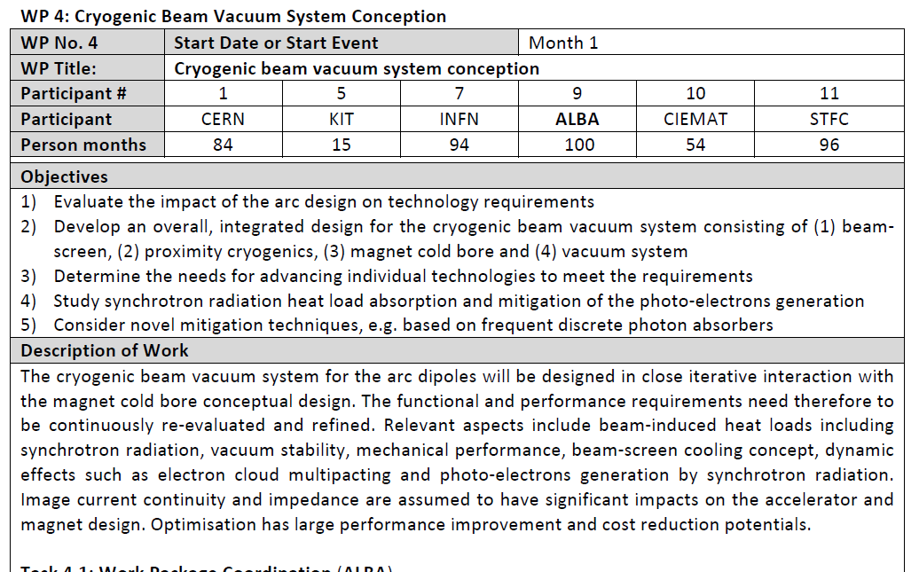
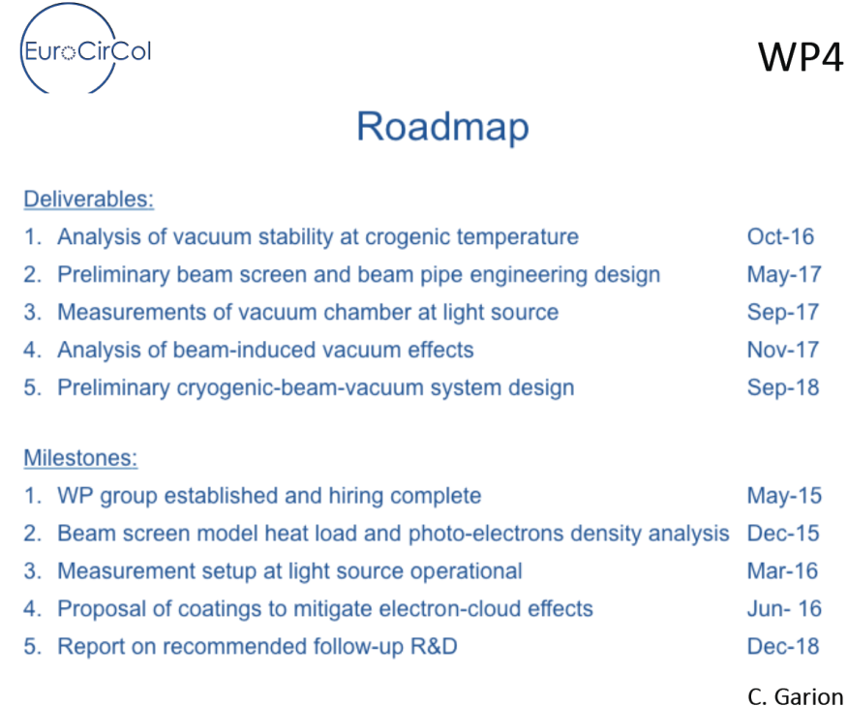
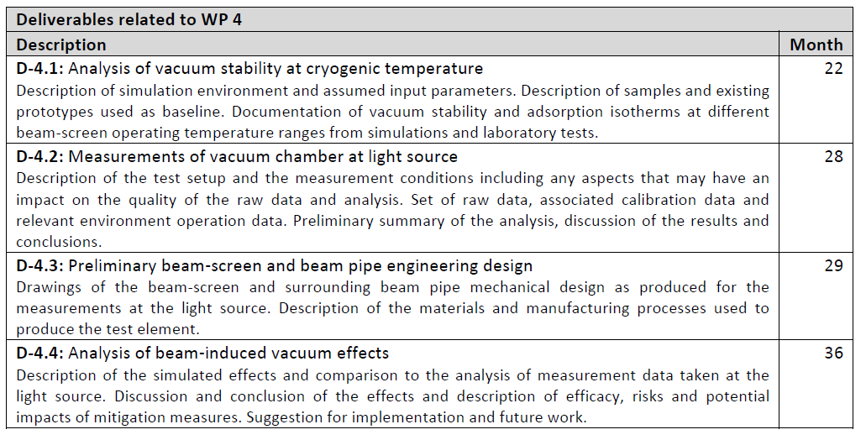
P. 47-49

Slide 5
Description of Work
Task 4.1: Work Package Coordination (ALBA)
  ALBA with the assistance of CERN coordinates the work of all other tasks of this work package to ensure consistency of the work according to the project plan and to coordinate the WP technical and scientific scope with the tasks carried out by the other WPs. Coordination duties include the organization of WP internal steering meetings, setting up of proper reviewing, reporting to project management and distribution of the information within the WP as well as to the other work packages. The task covers the organization of the annual meeting sessions dedicated to the WP activity review and possible workshops or specialized working sessions, implying the attendance of invited participants from inside and outside the consortium. In particular this WP requires coordination with other WPs on the following subjects:
    WP 2 (arc design and lattice integration)
    WP 5 (accelerator magnet design)
Task 4.2: Study beam-induced vacuum effects (ALBA, CERN)
  ALBA will model and compute the cryogenic beam vacuum system, both in static and in time-constant (so called “dynamic”) modes based on the input provided by CERN (D-4.4). CERN will contribute to the implementation of the time-constant modelling, providing expertise and training. The model will include synchrotron radiation effects. In a second stage, ALBA, in close correlation with CERN, will evaluate options to implement cryo-photon absorbers and will propose a conceptual design for these absorbers, which are compatible with the accelerator magnet design and accelerator layout.
Task 4.3: Mitigate beam-induced vacuum effects (STFC, CERN)
  STFC will study different coatings to mitigate beam-induced electron cloud and ion instabilities on flat samples and on beam-screen prototypes provided by CERN. Compatibility of these coatings with cryogenics temperatures has to be demonstrated, in particular sticking and flaking of coatings after several cool down and warm up cycles. CERN will review the testing conditions, results and analysis and will provide the beam-screen prototypes. This work flows into the engineering design (D-4.3)
Task 4.4: Study vacuum stability at cryogenic temperature (INFN, CERN)
  INFN Frascati will determine vacuum stability and adsorption isotherms at different cryogenic beam-screen operating temperature ranges (D-4.1). It will perform complementary studies on beam-induced stimulated desorption phenomena by photons, electrons and ions. These studies rely mainly on experimental samples and require beam-screen prototypes supplied by CERN.
Task 4.5: Develop conceptual design for cryogenic beam vacuum system (CERN, CIEMAT)
  CIEMAT will closely collaborate with CERN on the mechanical design of the cryo-magnet beam-screen, ensuring compatibility with fast magnetic transitions and cryogenic cooling concepts (D-4.3). CIEMAT and CERN will study and determine beam image current continuity and impedance issues on vacuum engineering and review the buckling safety factor accordingly. CERN will manufacture the beam-screen prototypes and qualify them in one of its magnet test stands at different beam-screen temperatures. CIEMAT will assist CERN with instrumentation, measurements and qualification of the beam-screens.
Task 4.6: Measurements on cryogenic beam vacuum system prototype (KIT, INFN, CERN)
  KIT will be responsible for the “beam qualification” of the beam-screen prototype supplied by CERN (D-4.2). The goal is to determine synchrotron radiation heat loads and photo-electrons generation inside the beam-screen prototype. This beam-screen will be qualified with beam by installing the CERN OLDEX36 experiment in the ANKA synchrotron ring and exposing the beam-screen prototype to significant levels of synchrotron radiation, comparable to the operation conditions at the hadron collider. CERN delivers to ANKA premises the COLDEX experiment together with all documents required to define and create the machine-COLDEX interfaces. ANKA will assist for the installation and integration of COLDEX carried out by CERN and INFN. INFN will commission the experiment and perform the measurements under CERN advice.

Slide 6
Task 4.3: Mitigate beam-induced vacuum effects (STFC, CERN)
STFC will study different coatings to mitigate beam-induced electron cloud and ion instabilities on flat samples and on beam-screen prototypes provided by CERN.
Compatibility of these coatings with cryogenics temperatures has to be demonstrated, in particular sticking and flaking of coatings after several cool down and warm up cycles.
CERN will review the testing conditions, results and analysis and will provide the beam-screen prototypes. This work flows into the engineering design (D-4.3)

Slide 7
Manpower – Task 4.3
Oleg Malyshev: 4 year × 3 months = 12 PM
  Task coordination
  PhD student supervision
  Gas dynamics in cryogenic beam pipe, NEG coating and low SEY surfaces development and application
Reza Valizadeh: 4 year × 3 months = 12 PM
  PhD student supervision
  NEG coating and low SEY surfaces development and application
PhD student 1: 3 year × 12 months = 36 PM
  NEG coating studies
PhD student 1: 3 year × 12 months = 36 PM
  Studies on low SEY surface engineering

Slide 8
What equipment is available for the NEG coating studies

Slide 9
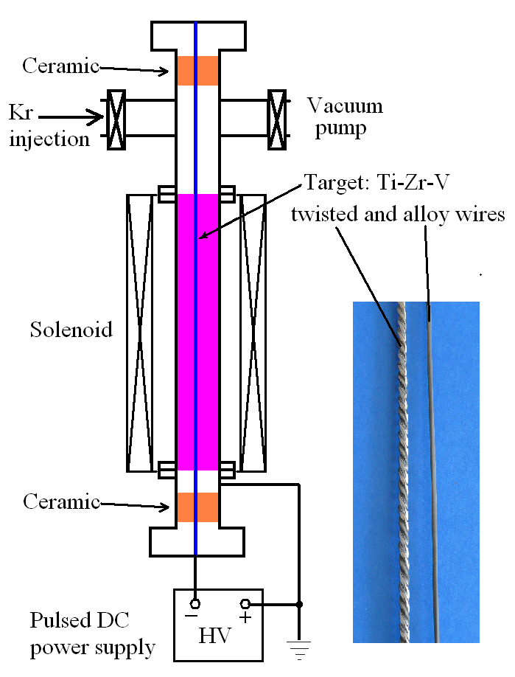
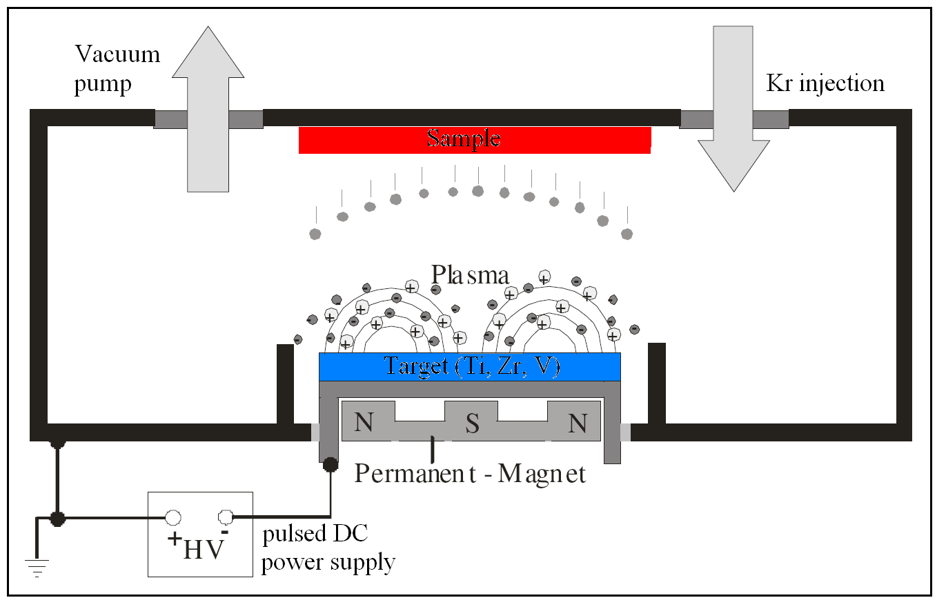
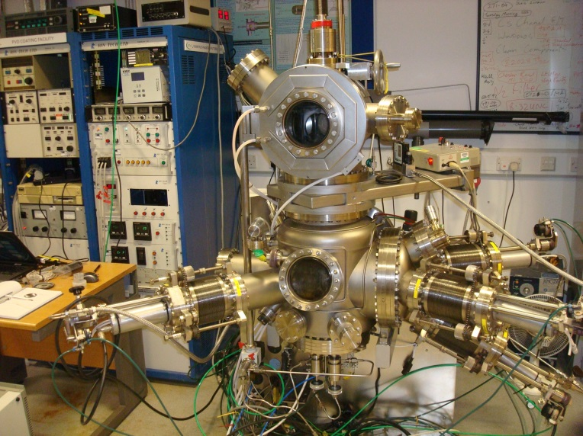
Deposition method: PVD
2D and 3D
Cylindrical magnetron deposition
Planar magnetron deposition
DC, pulsed DC, RF power supply,
HiPIMS

Slide 10
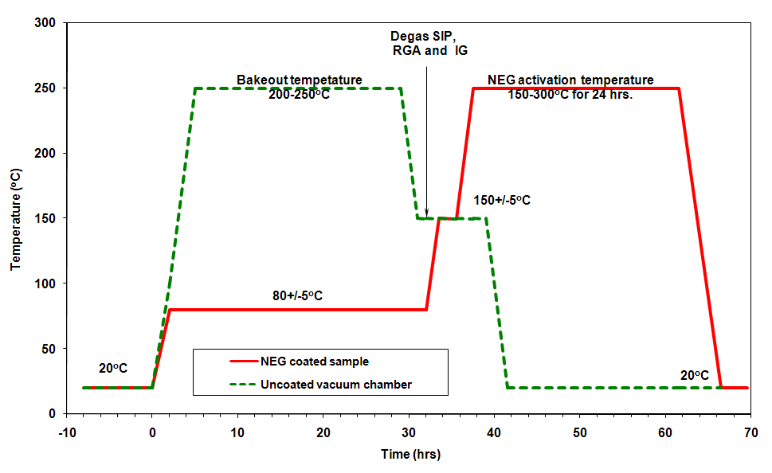
NEG pumping evaluation
ASTeC activation procedure
Set-up for NEG pumping evaluation
Sticking probability and pumping capacity measurements

Slide 11
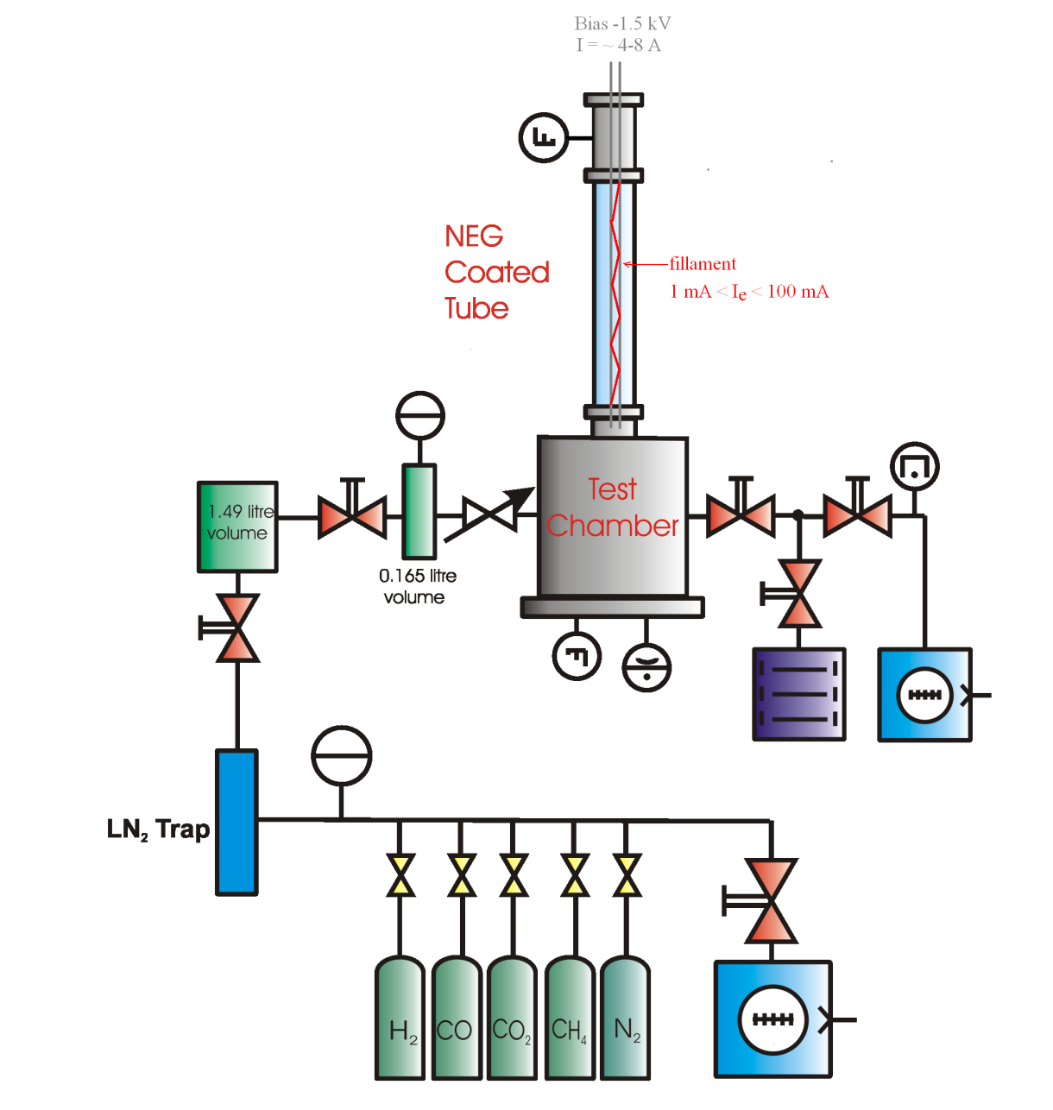
Electron stimulated desorption studies
ESD is studied as a function of
  Electron energy (10 eV – 6.5 keV)
  Dose (up to 4⋅10²⁵ e⁻ m²)
  Wall temperature (-5 to +70°C)
  Bakeout temperature
Usual sample dimensions:
  ID=36-42 mm
  L = 500 mm
Notes:
11

Slide 12
Possibility for ESD studies at cryogenic temperatures in ASTeC:
A cryo-pump compressor and a pump head
  T ≥ 20 K
  Max power 10 W at 20 K
Present ESD facility layout limits:
  ESD measurements at 10 W: 500 eV × 20 mA
  Filament heat: ~30 W
    Can be reduced to 10 W with thinner filament
Another possibility is using an electron gun:
  Advantage: no filament heat load on cryogenics
    Disadvantage: bombardment will be less uniform along the tube

Slide 13
What can be studied in ASTeC
Continuing studies at room temperature
  Comparison of samples prepared at CERN and ASTeC
  Repeatability of results for dense, columnar and dual layer
    Pumping properties after activation to 150-250 °C
    ESD after activation to 150-250 °C
Building a new set-up for ESD studies at cryogenic temperatures
  Pumping properties as a function of temperature
  ESD as a function of temperature
  ESD from cryosorbed gas (CO, CO₂, CH₄)
  Effect of unstable temperature

Slide 14
What can be studied in a collaboration using SR
Continuing studies at room temperature
  Compare of samples prepared at CERN and ASTeC
  Measure PSD for dense, columnar and dual layer
    PSD after activation to 150-250 °C
    Photon induced NEG activation
PSD studies at cryogenic temperatures
  PSD as a function of temperature
  PSD from cryosorbed gas (H₂, CO, CO₂, CH₄)
  NEG coated beam screen at various temperatures with a cold bore at 3.5 K
  Effect of unstable temperature of a beam screen
  PSD as a function of PSD dose

Slide 15
Use of results for modelling FCC vacuum
These results can be applied to the FCC beam pipe vacuum modelling
  Gas density with and without beam (and SR)
  Ion induced pressure instability
  ESD due to beam induced electron multipacting

Slide 16
What equipment is available for the SEY studies

Slide 17

Sample deposition with on a PVD facility

Slide 18
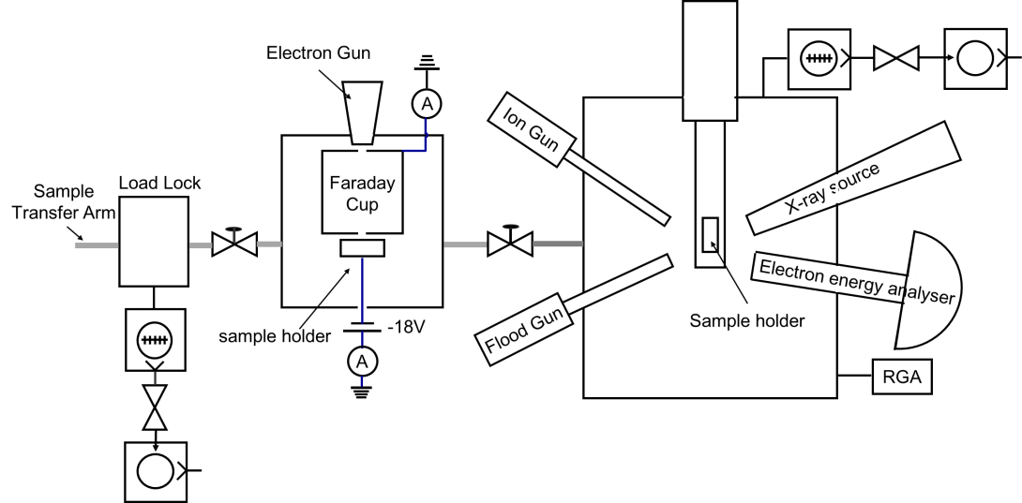
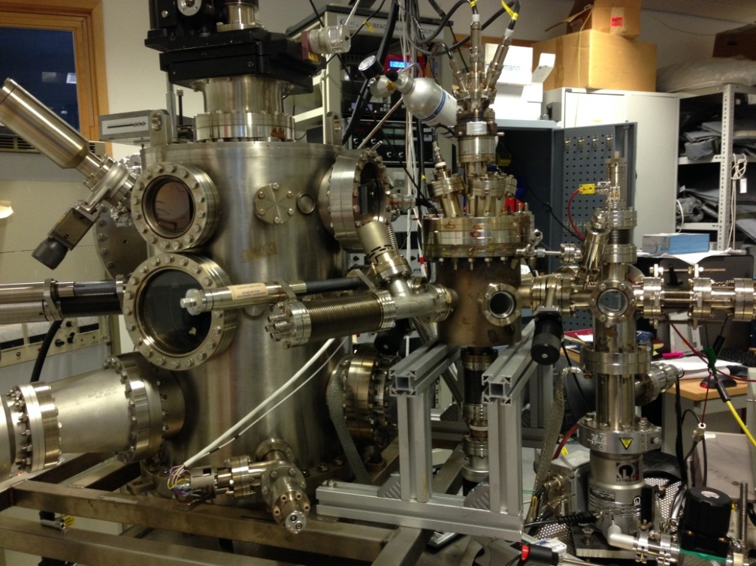
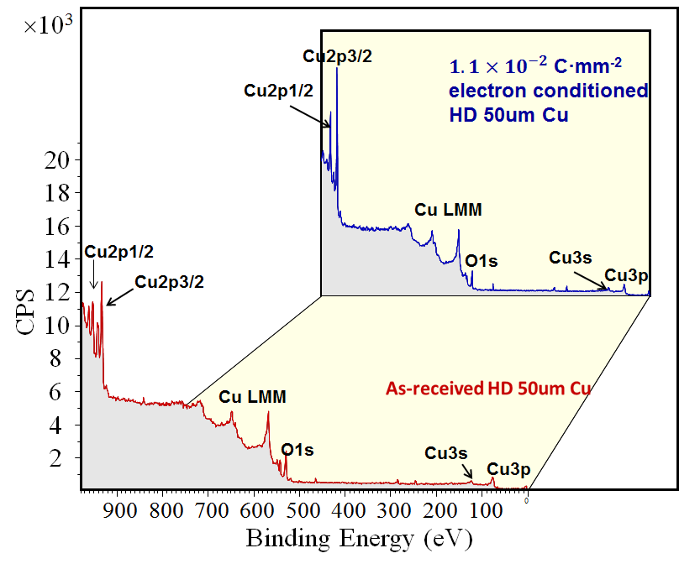
A facility for SEY studies

Slide 19
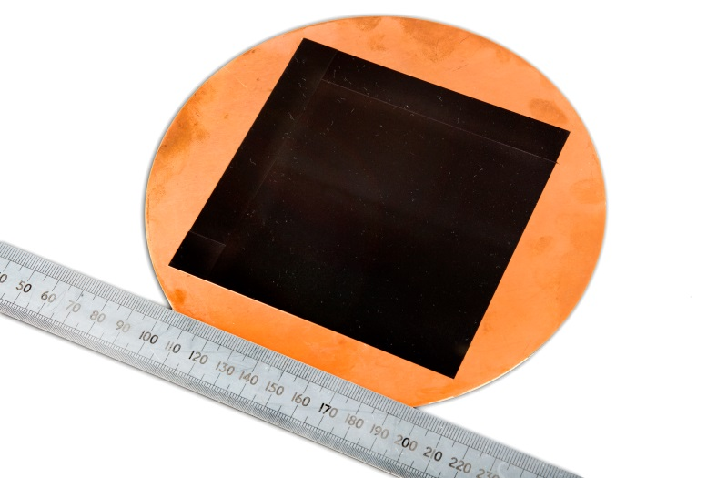
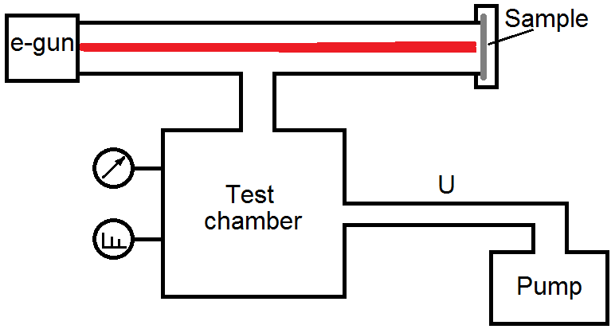
Thermal (TD) and Electron Stimulated Desorption (ESD)
Thermal outgassing in comparison to untreated surface
  For example on Cu blank gaskets ∅100-200 mm
ESD on:
  Cu blank gaskets ∅48 mm
  E_{e-} = 500 eV
Notes:
ESD yield is a number of desorbed molecules per incident electron. Bombardment with an electron gun, spot size is ~2 cm^2, i.e. less than the treated surface.

Slide 20
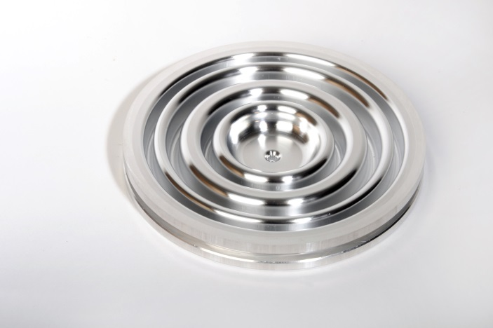
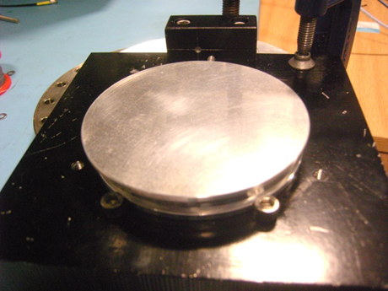
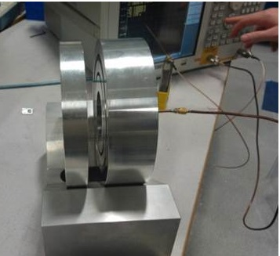
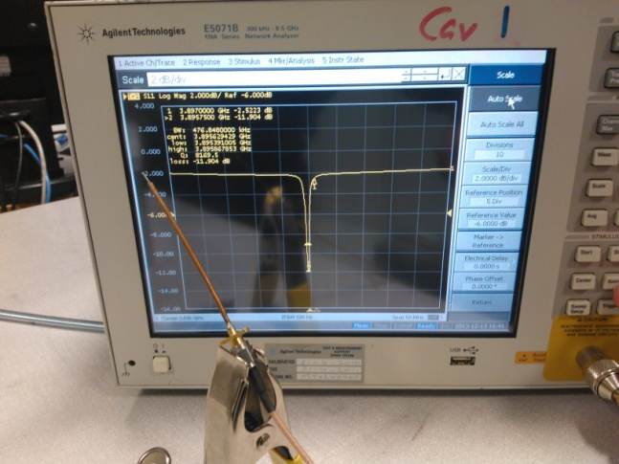
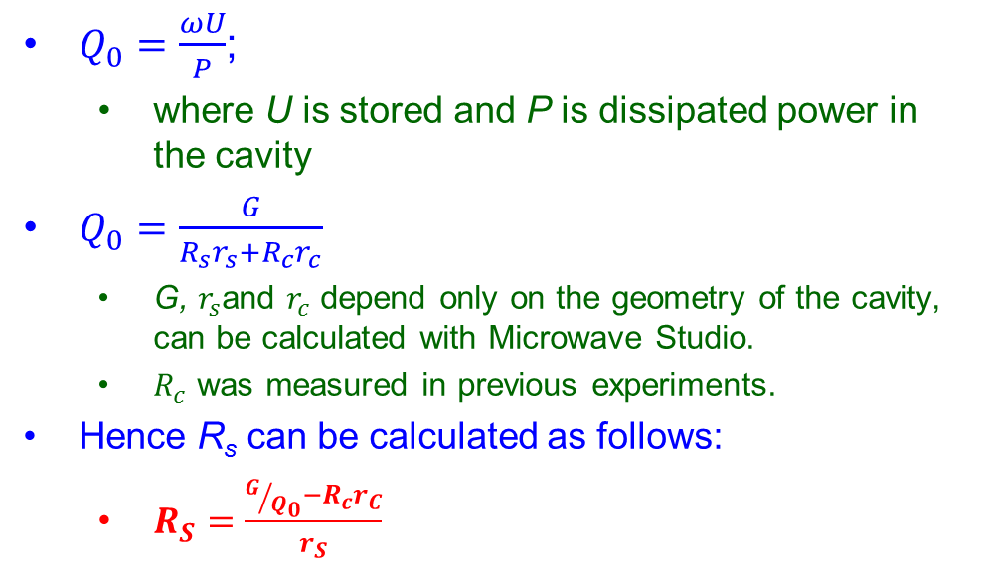
R_{s} measurement
A three-choked 7.8 GHz Al test cavity
A two-choked 3.9 GHz Al test cavity
Sample placed above cavity on spacers (i.e. rubber O-ring material)
$Q_{0}=\frac{ωU}{P}$;
  where U is stored and P is dissipated power in the cavity
$Q_{0}=\frac{G}{R_{s}r_{s}+R_{c}r_{c}}$
  G, $r_{s}$and $r_{c}$ depend only on the geometry of the cavity, can be calculated with Microwave Studio.
  $R_{c}$ was measured in previous experiments.
Hence R_{s} can be calculated as follows:
  $R_{S}^{}=\frac{G/{Q_{0}}−R_{c}^{}r_{C}}{r_{S}}$
Coaxial antenna connected to Vector Network Analyser (VNA) is axially mounted, used to induce and or analyse resonance within the cavity.
The method is described in paper:
Philippe Goudket at al. Surface Resistance RF Measurements Of Materials Used For Accelerator Vacuum Chambers. Proc. of IPAC-15, WEPHA053.

Slide 21
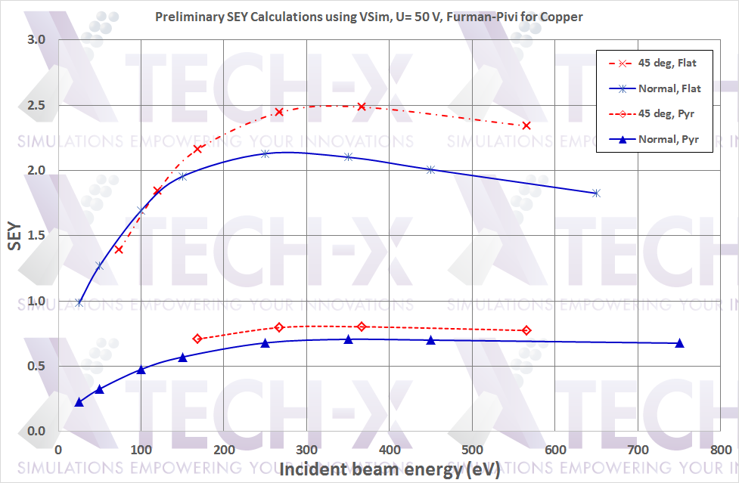
Modelling an effect of surface geometry
α₀
Electron generation:
E₀, α₀
Bias U
Collection of electrons
A 3D modelling of various structures with use of Vsim code
The code allows modelling of:
  Electron generated with initial energy E₀ and angle: 0 < α₀ ≤ 90°,
  Electric field dE/dz (or bias U),
  Bombarded surface:
    flat or structured.
  Generating of secondary electron energy and spatial distribution based on the Furman-Pivi model (SLAC-PUB-9912).
A cost of licence to be considered
Bombarded surface:
U=0,
Secondary electrons

Slide 22
What else could be studied
SEY as a function of initial angle α₀
SEY in a weak magnetic field B < 0.02 T
  requires a modification of an existing SEY measurement
SEY at cryogenic temperatures
SEY from a surface with condensed gases
SEY in a strong magnetic field B = 1.8 T
  can be done, requires a new testing facility
Photo-electron emission yield (PEY)
  PEY in a magnetic field
    requires an access to a SR beamline

Slide 23
Possibility for SEY studies at cryogenic temperatures in ASTeC:
Two options for cryogenics:
  A cryo-pump compressor and a pump head
    T ≥ 20 K; Max power 10 W at 20 K
  A cryogenic head with a compressor:
    T ≥ 4 K; Max power 1 W at 4.2 K
SC magnet:
  Up to 1.8 T
  Bore diameter 30 mm

Slide 24
What have to be decided during this meeting
How it relates to the other tasks
The execution plan

