Slide 1
WP2: SUMMARY
EuroCirCol kick-off meeting 3-4 June 2015 | Antoine CHANCE

Slide 2
TECHNICAL WP2 meeting
Wednesday June 3, 2015
  14:00 - 15:30 Work for the Extended Straight Section
      14:00 Welcome (Antoine CHANCE, CEA)
      14:15 Collimation (Maria FIASCARIS, CERN)
      14:30 Review on the collimation optics (Antoine LACHAIZE, IPNO)
      14:45 Extraction section optics (Wolfgang BARTMANN, CERN)
      15:00 Discussions
  16:00 - 17:30 Common session, basic parameters
      16:00 Status and needs for the dynamic aperture calculations (Barbara DALENA, CEA)
      16:20 WP3 (Experimental Insertion Region Design)
      16:40 WP5 (High Field Accelerator Magnet Design)
  18h30 Welcome drink at the restaurant 1 (Glass box)

Slide 3
TECHNICAL WP2 meeting
Thursday June 4, 2015
  09:00 - 10:30 Common session, WP2 WP4
      09:00 Aperture definition of the beam pipes (TBD)
      09:20 Electron cloud status (Lotta METHER, CERN)
      09:40 Impedance status (Oliver BOINE-FRANKENHEIM, TUD)
      10:00 Discussions
  11:00 - 12:30 Common session, WP2 WP3
      11:00 Status of the IR optics (TBD)
      11:20 Collimation in the IR (TBD)
      11:40 Interface between the DIS and the IR (Antoine CHANCE, CEA)
      12:00 Discussions
  14:00 - 15:30 WP2, 2nd session
      14:00 Status and plans of the arc and of the optics integration (Antoine CHANCE, CEA)
      14:20 Work repartition
      15:00 Tentative planning
  16:00 - 17:30 Plenary discussion
      16:00 WP2 summary
      16:15 WP3 summary
      16:30 WP4 summary
      16:45 WP5 summary

Slide 4
TASK 2.2 ARC OPTICS
STATUS
  Lattice integration similar to what was presented in FCC week 2015
      Realisation of the arc cells with some input parameters.
      Realisation of the optics of the whole machine with the existing lattice files.
      The naming convention is under application.
  Extraction optics: already 3 options. Lattice files already existing. Some refinement is nder study. These lattices are already matched to the arc opticla functions.
  Some second order schemes are under tudy to correct the chromaticity.
      The first results are promising with small variation of the betatron functions with momentum.
      More investigation is needed.

Slide 5
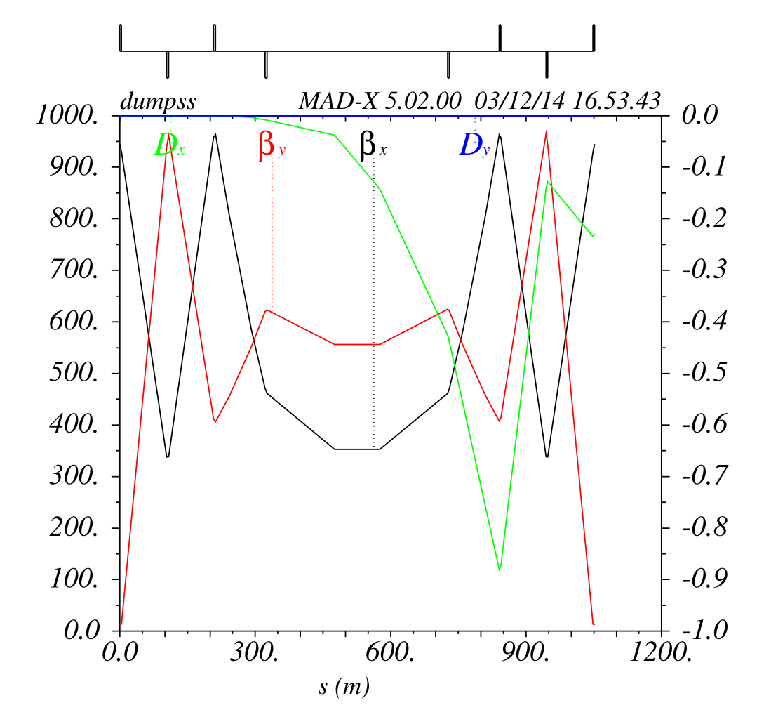
EXTRACTION SECTIOn STATUS
3 CONCEPTS
110 m
400 m
Rms beam size ~ 1 mm
  LHC scaled
  SSC like
  Asymmetric
Courtesy: Wolfgang BARTMANN

Slide 6
TASK 2.2 ARC OPTICS
WORKING PLAN
  For September 2015:
      Checking that the element names are conform to the naming convention.
      Adding the dipole and multipole correctors (setupole and decapole to correct. the b3 and b5 components in the dipoles) in the lattice.
      Adding some methods to adjust the global tune.
        Matching the Qpoles of the arcs.
        Using a dedicated section.
  For December 2015:
      Integrating the collimation lattice files (momentum collimation).
      Integrating a first aperture model (MAD-X model).
      Making the first calculations for obit correction.
      Refining the chromaticity correction scheme.
      Introducing the the coupling correctors.

Slide 7
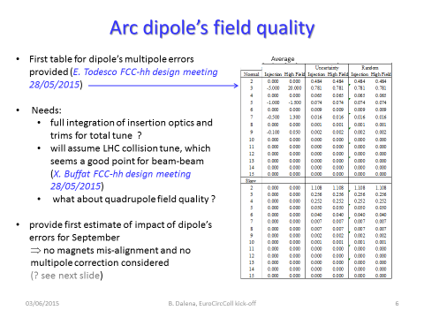
TASK 2.3: DYNAMIC APERTURE

Slide 8
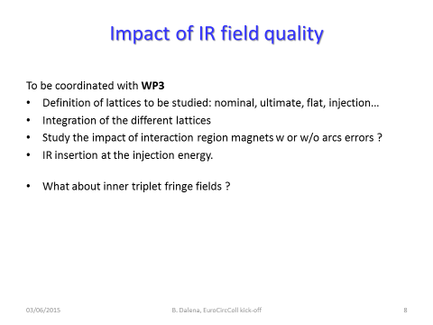
TASK 2.3: DIPOLE APERTURE

Slide 9
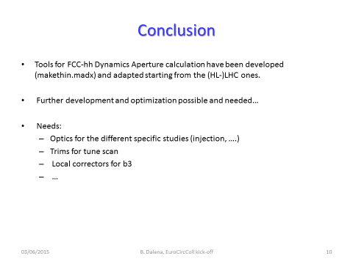
TASK 2.3: DIPOLE APERTURE

Slide 10
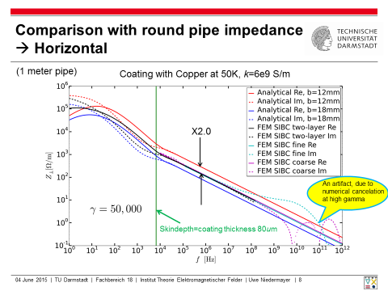
TASK 2.4: SINGLE BEAM INSTABILITY
Courtesy: Uwe NIEDERMYER

Slide 11
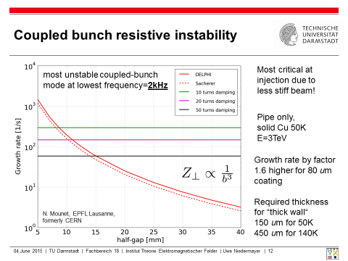
TASK 2.4: SINGLE BEAM INSTABILITY
Courtesy: Uwe NIEDERMYER

Slide 12
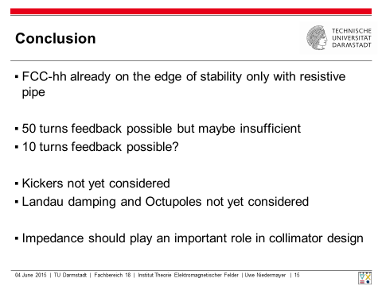
TASK 2.4: SINGLE BEAM STAbility
Courtesy: Uwe NIEDERMYER

Slide 13
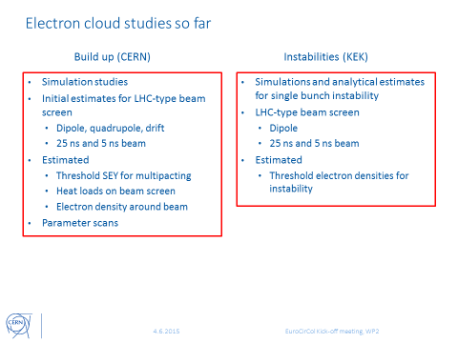
TASK 2.5: ELECTRON CLOUD
Courtesy: Lotta METHER

Slide 14
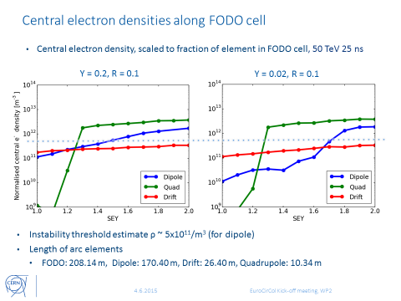
TASK 2.5: ELECTRON CLOUD
Courtesy: Lotta METHER

Slide 15
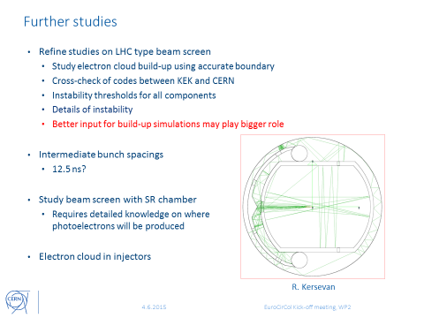
TASK 2.5: ELECTROn CLOUD
Courtesy: Lotta METHER

Slide 16
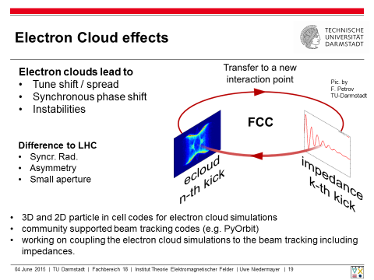
TASK 2.5: ELECTRON CLOUD
  Risk: a lack of people (12 person.months from KEK and less from CERN).
  More people needed
  September 2015: meeting beween Task 2.4 and 2.5
  Strong synergy between both expertises

Slide 17
Task 2.6: Develop optics concept for collimation systems

Slide 18
Task 2.6: Develop optics concept for collimation systems

Slide 19
Task 2.6: Develop optics concept for collimation systems
  Development of an aperture model and define baseline collimator settings - Oct. 2015 (CERN)
  Define specifications for momentum cleaning - soon (July 2015 ?)
  Decision on lattice layout - Sept. 2015
  Optics for momentum cleaning - Sept. 2015 (IPNO)
  Design of dispersion suppressor regions including TCLD collimators - Sept. 2015 (CERN)
  Integration of colliation optics lattice - Oct. 2015 (CEA)
  Performance evaluation with first collimation inefficiciency tracking- end of 2015 (LAL)
  ➡input for impedance evaluation and HW design
  EuroCirCol WP2 contribution: optics design for collimation

Slide 20
HIRING POSITIONS
  CEA post-doctoral position for task 2.2 and task 2.3
  3 candidates under review next week
  beam dynamics
  multi-turn tracking
  (MAD-X expertise will be very appreciated)
  CNRS post-doctoral position for task 2.6:
    INSPIRE link: https://inspirehep.net/record/1374276
    Experiment: Future Circular Collider - EurCirCol Design Study
    Deadline: 2015-07-20
    Position: Post-doctoral position in Accelerator Physics
    Topic: Performance Evaluation of the Future Circular Collider hadron
    beam collimation system

