Slide 1
LBNF
Materials and Profiles

Slide 2
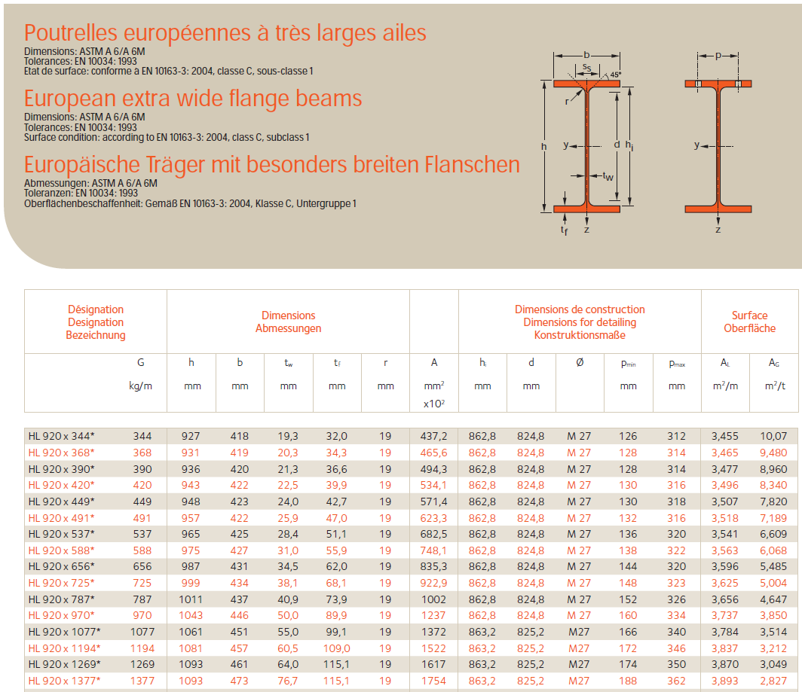


HL 1100 x 607
(W 44 x 16 x 408)
From a catalogue!

Slide 3
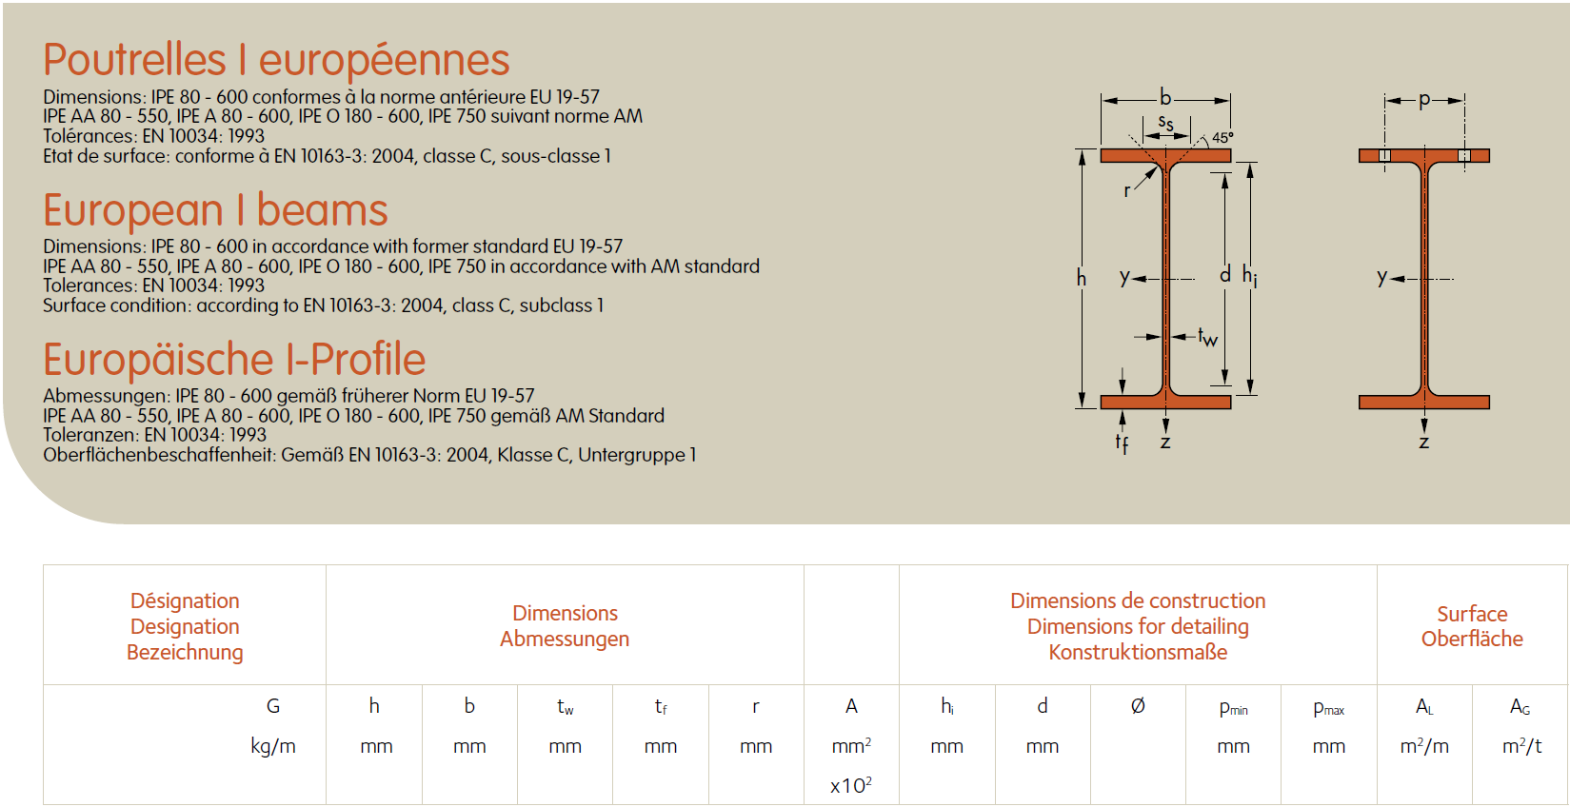
IPE 300

Slide 4
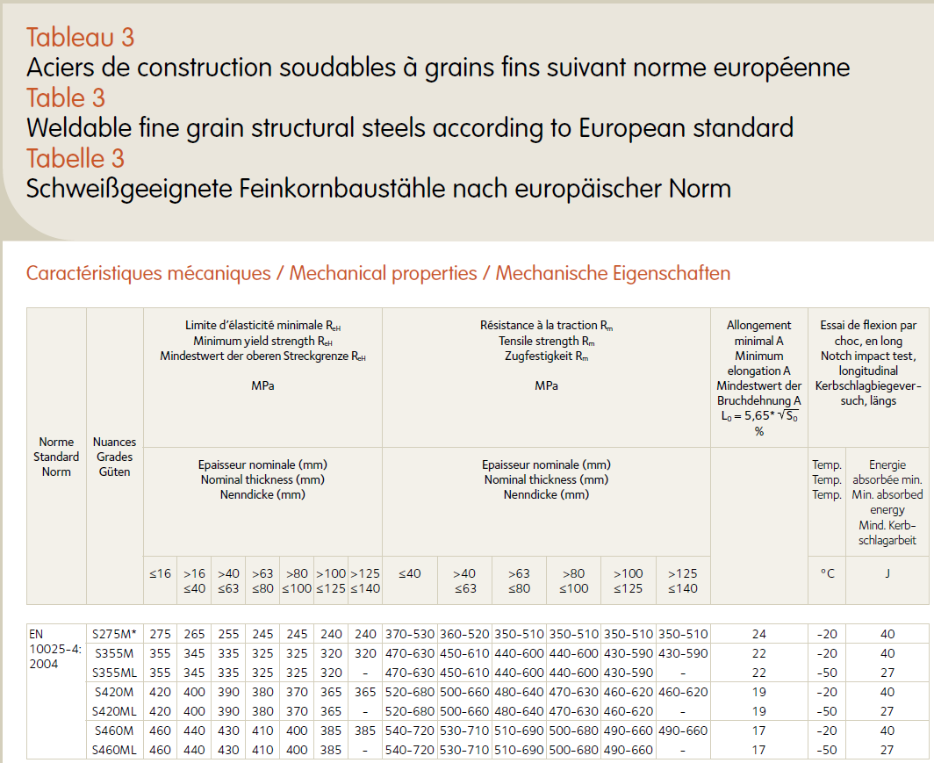
S355ML
&
S460ML

Slide 5
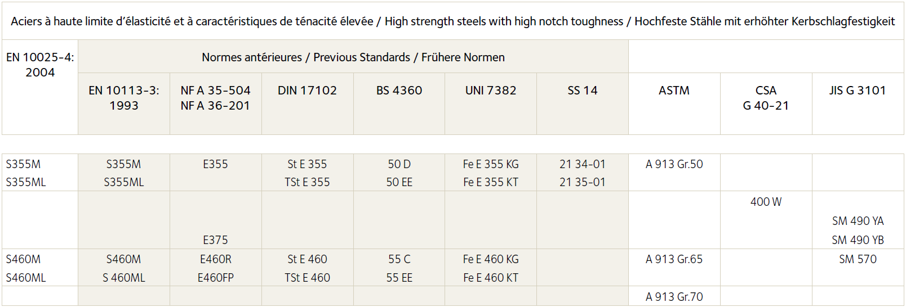
A913 Gr. 50
&
A913 Gr. 70

Slide 6
Thank you!

Slide 7





