Slide 1
TE-MSC-MDT

Slide 2
Splicing and Instrumentation
Coil 11T #110
TE-MSC-MDT
G. Maury
19 Mai 2015

Slide 3
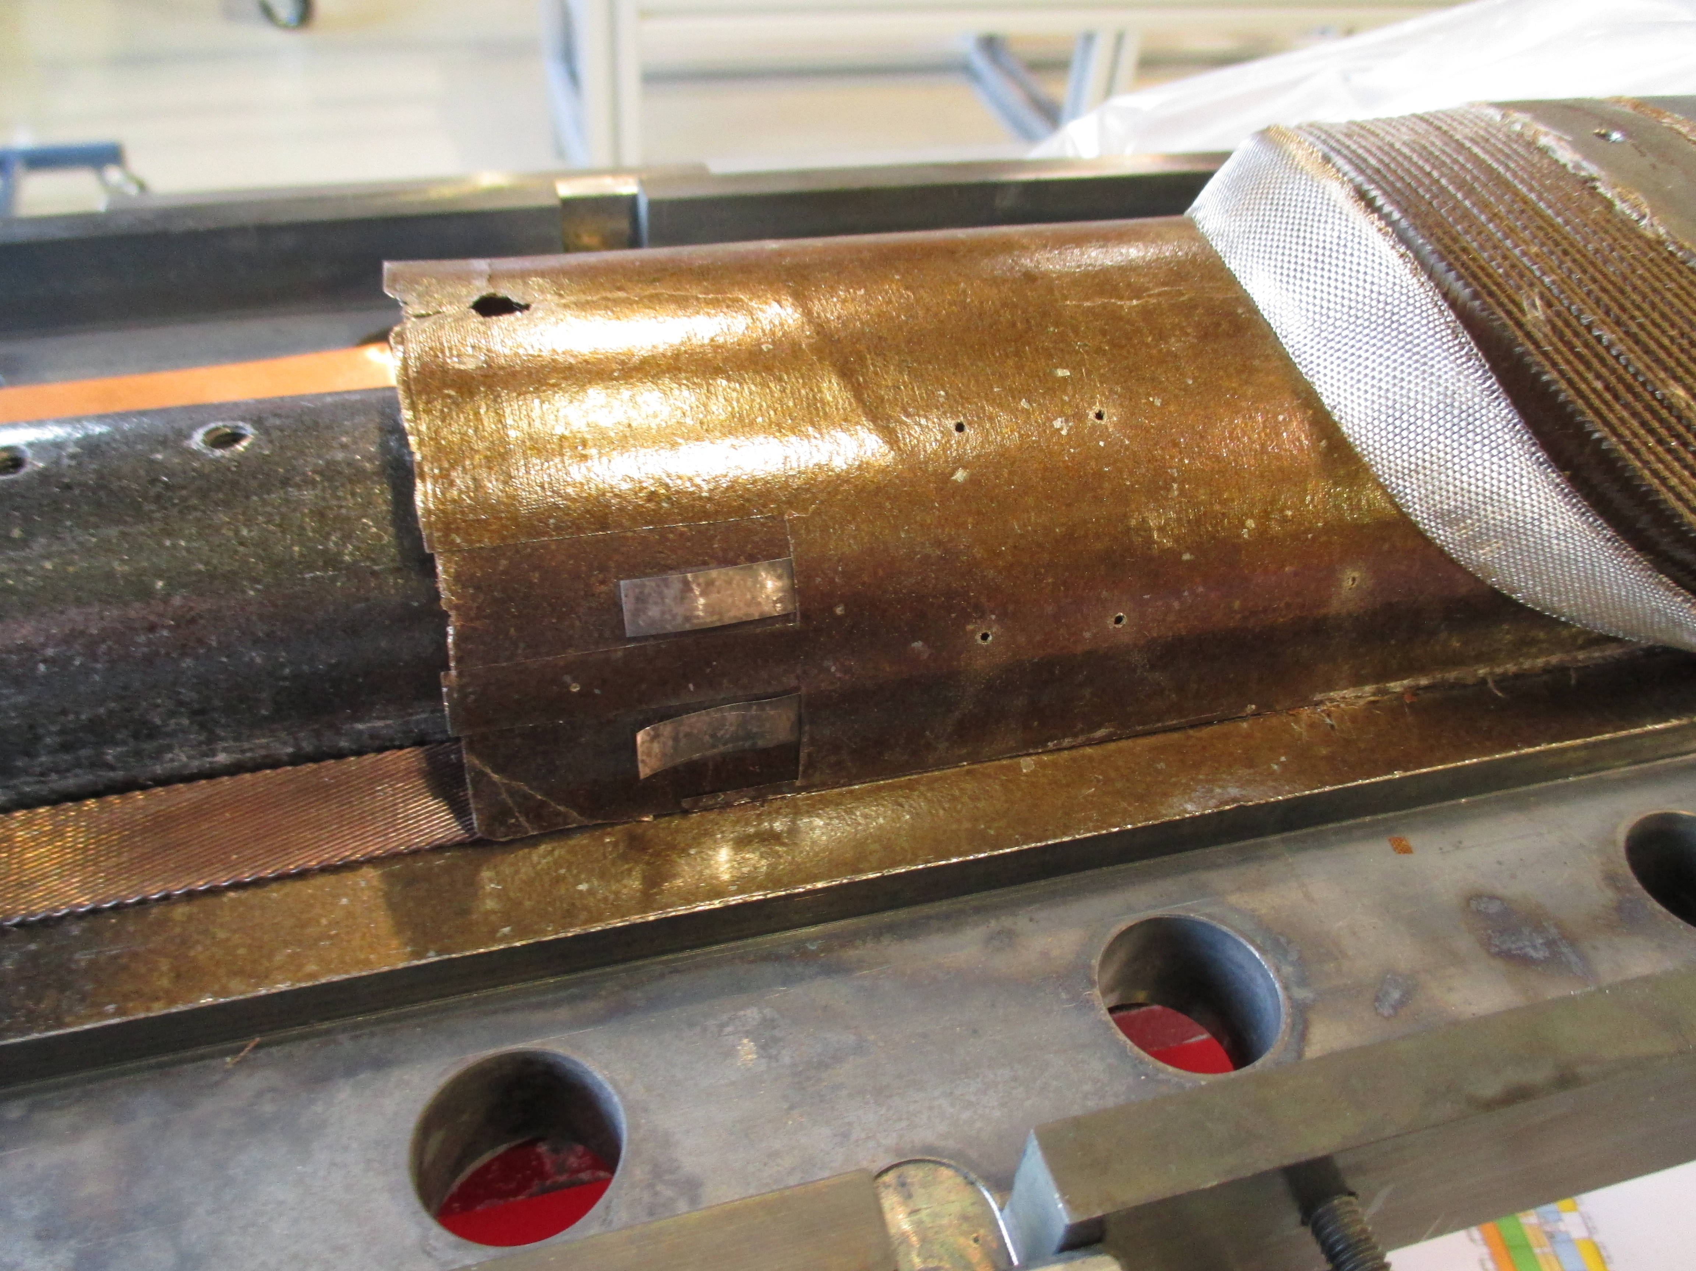
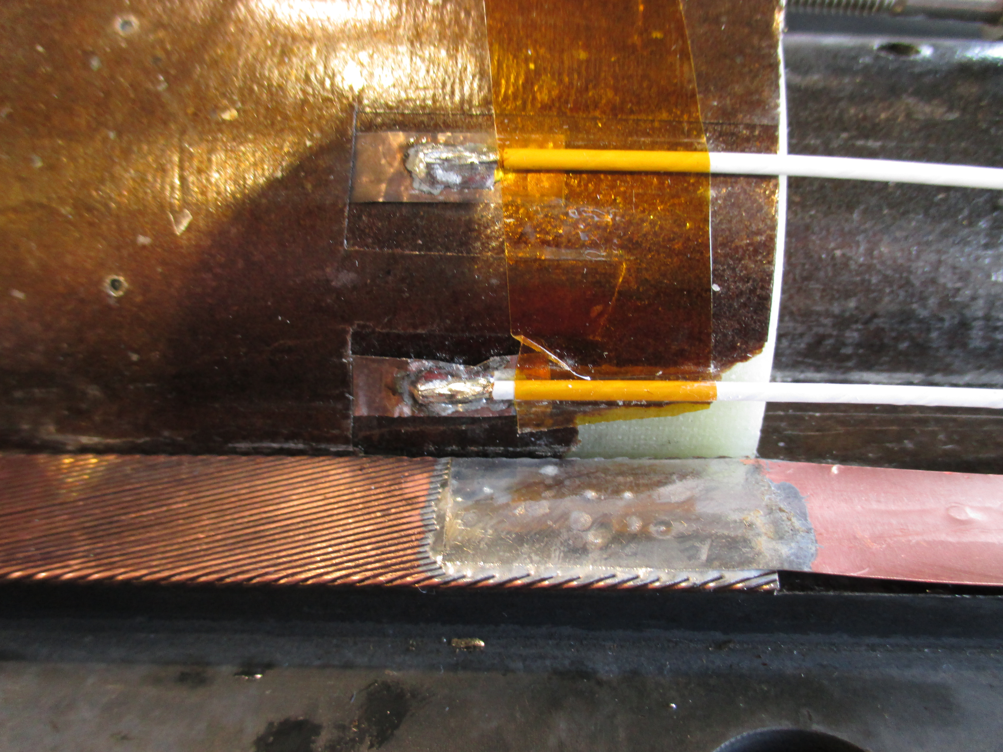
Splicing Operation
Soldering with Tin-Lead filler Metal (Sn60P40) and Flux FrontArgen F600
Quench heaters
Interlayer MICA 2x0.25mm
Copper Leads 2x0.2mm

Slide 4
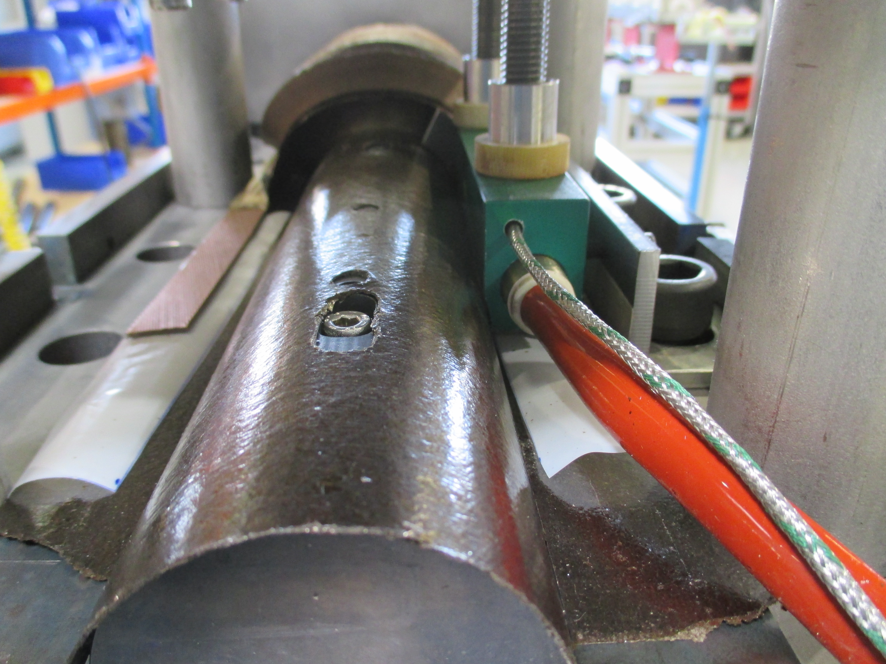
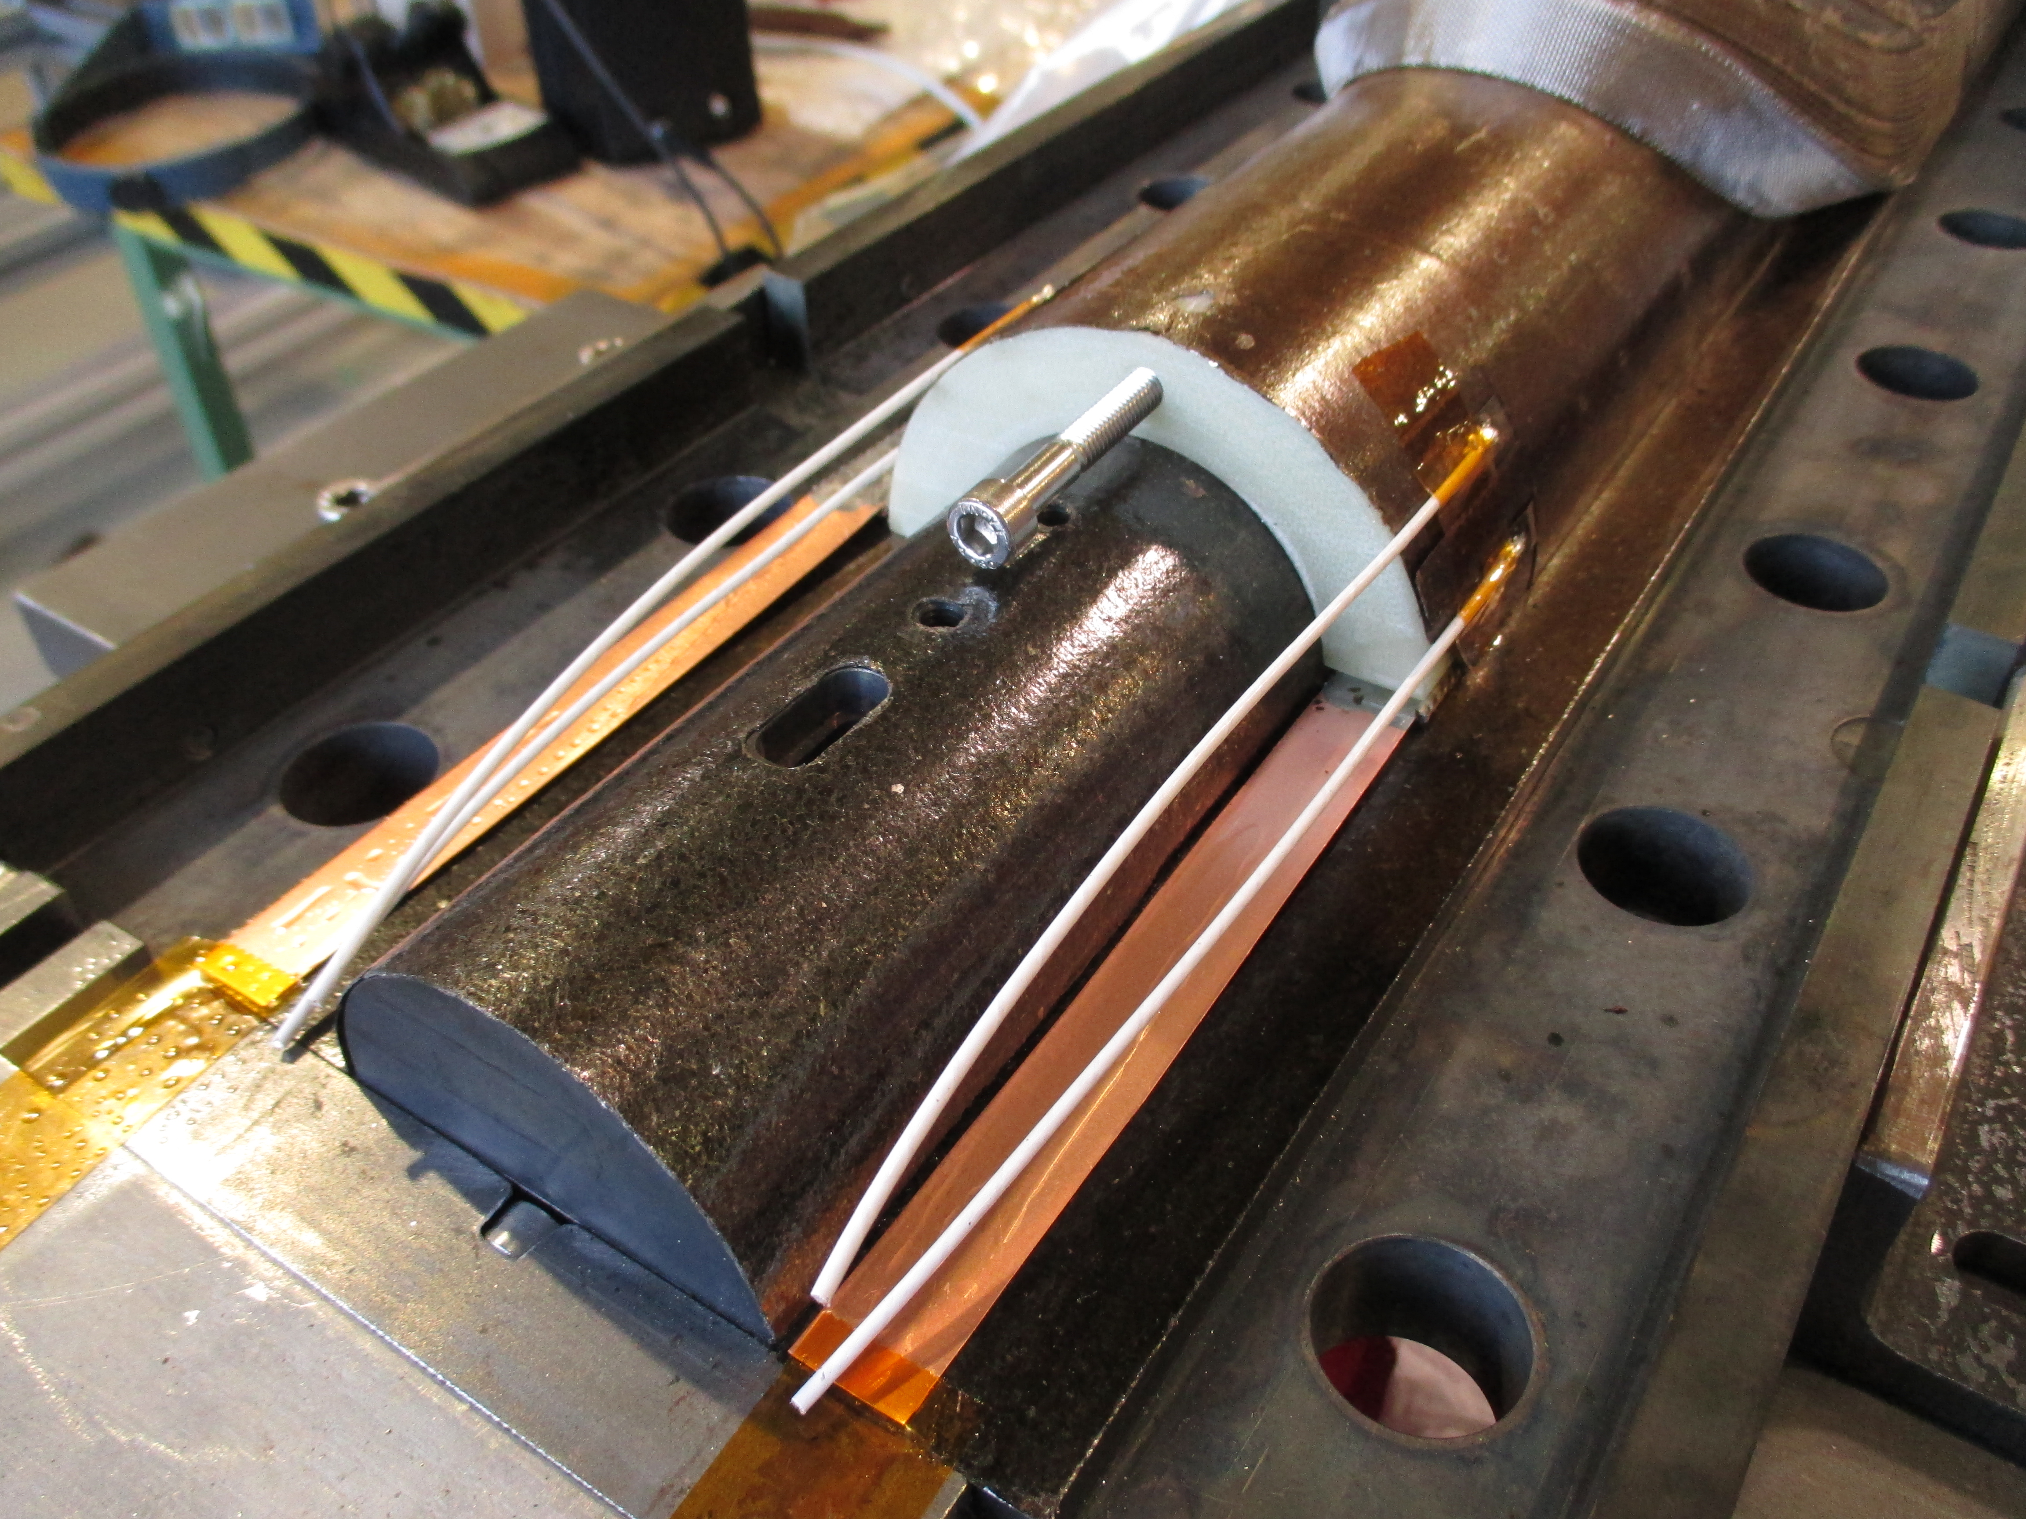
Difference with other Splicing
Splicing operation on Coil #109
Coil #110 with Interlayer?

Slide 5
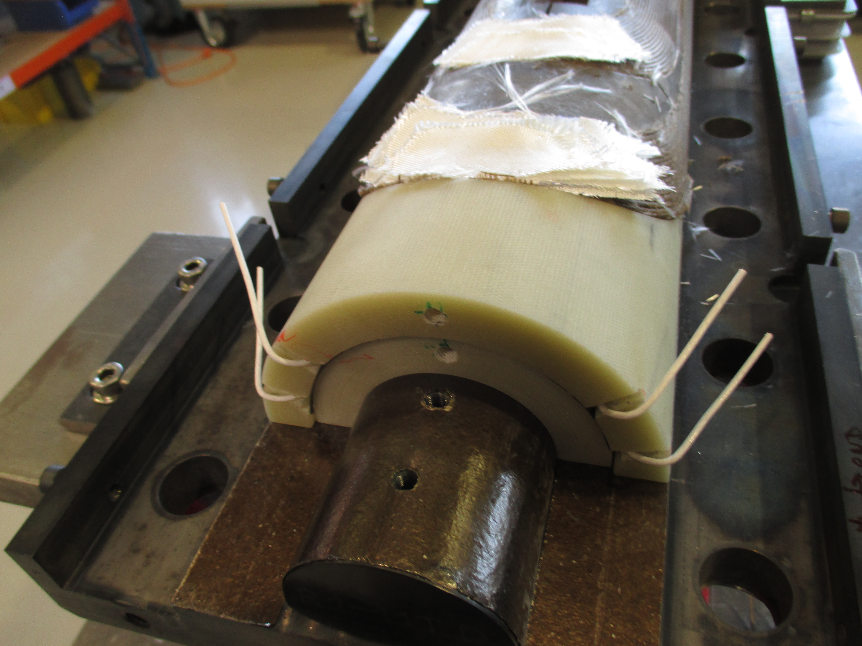
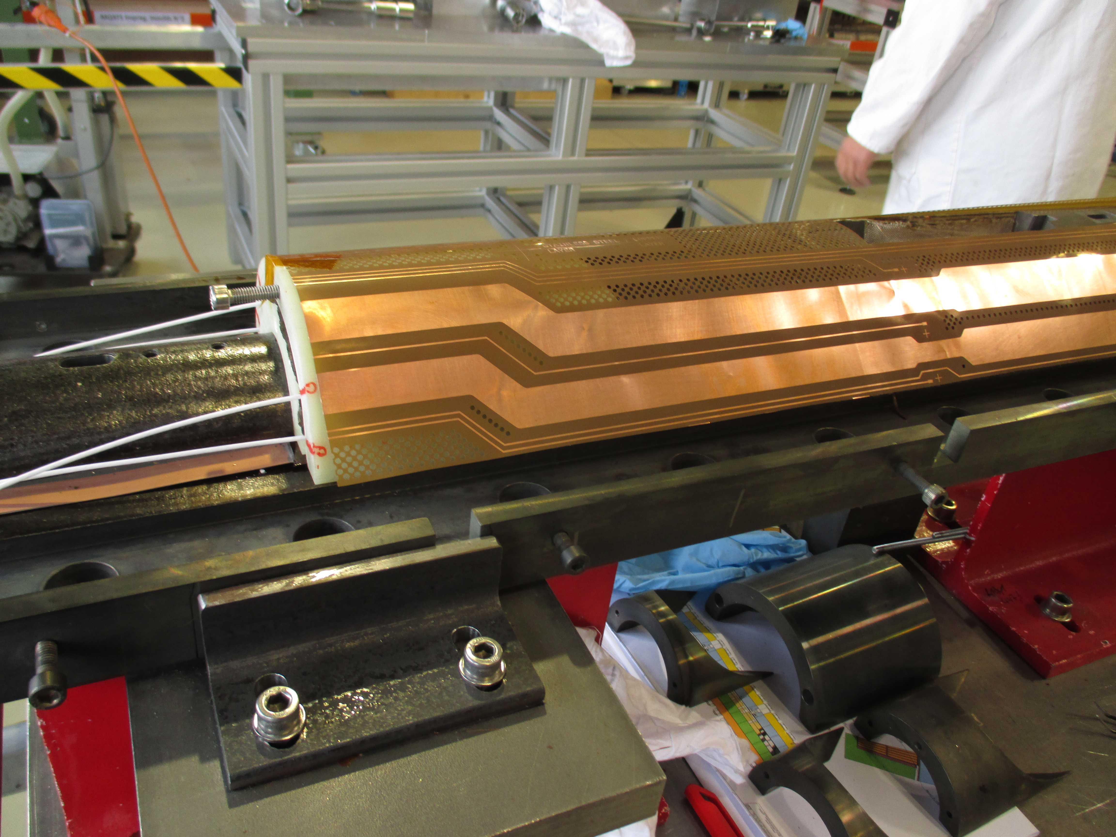
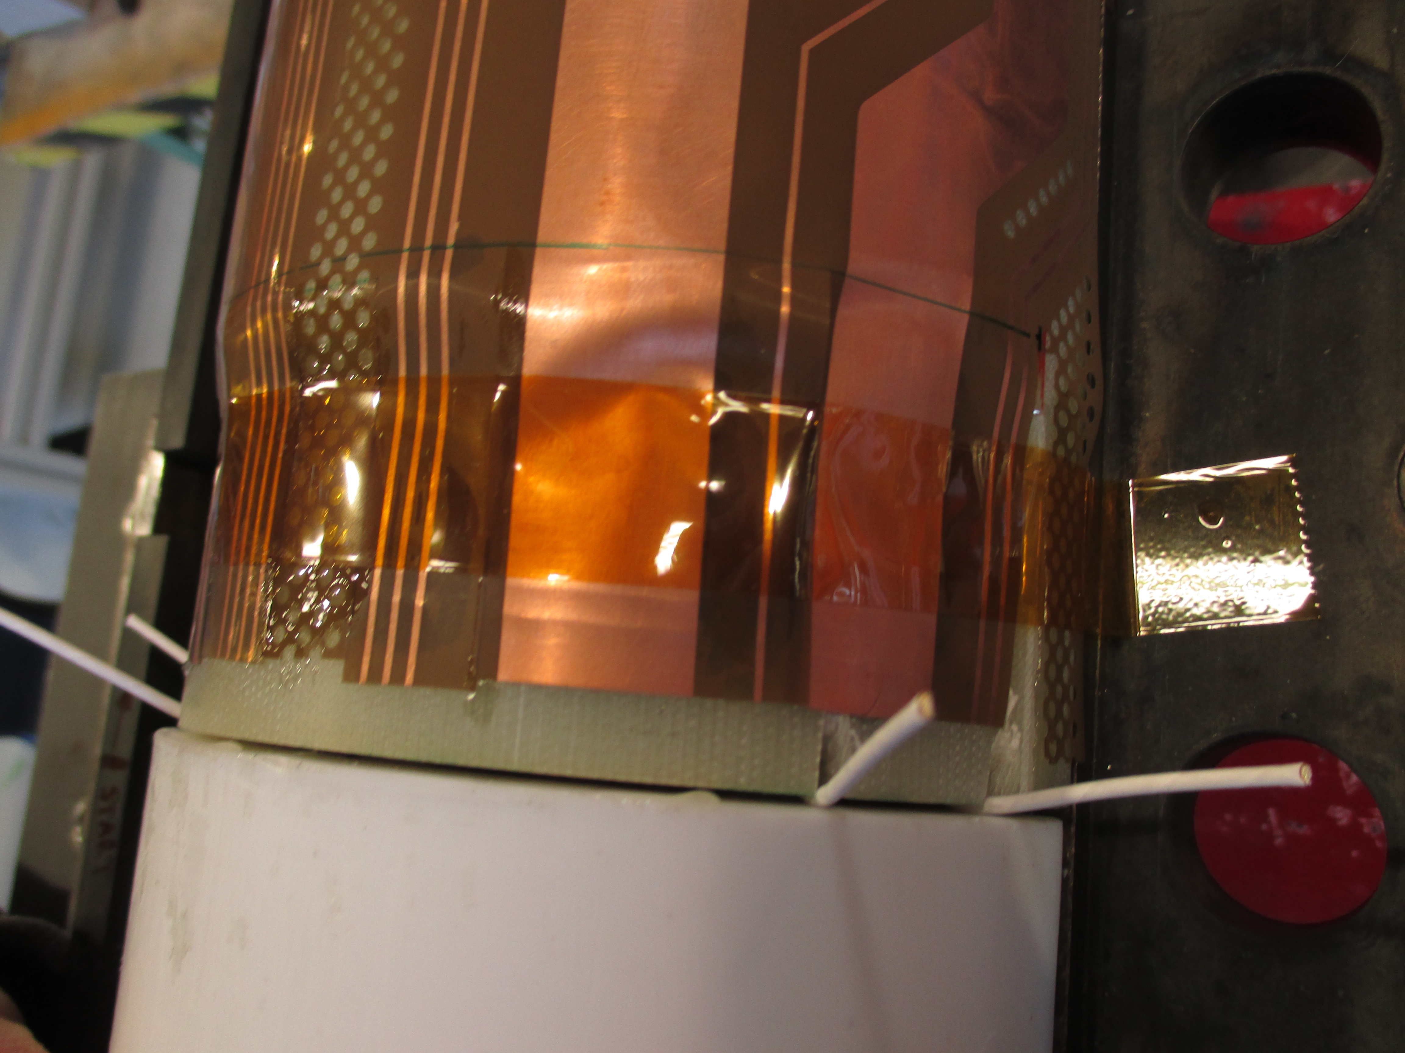
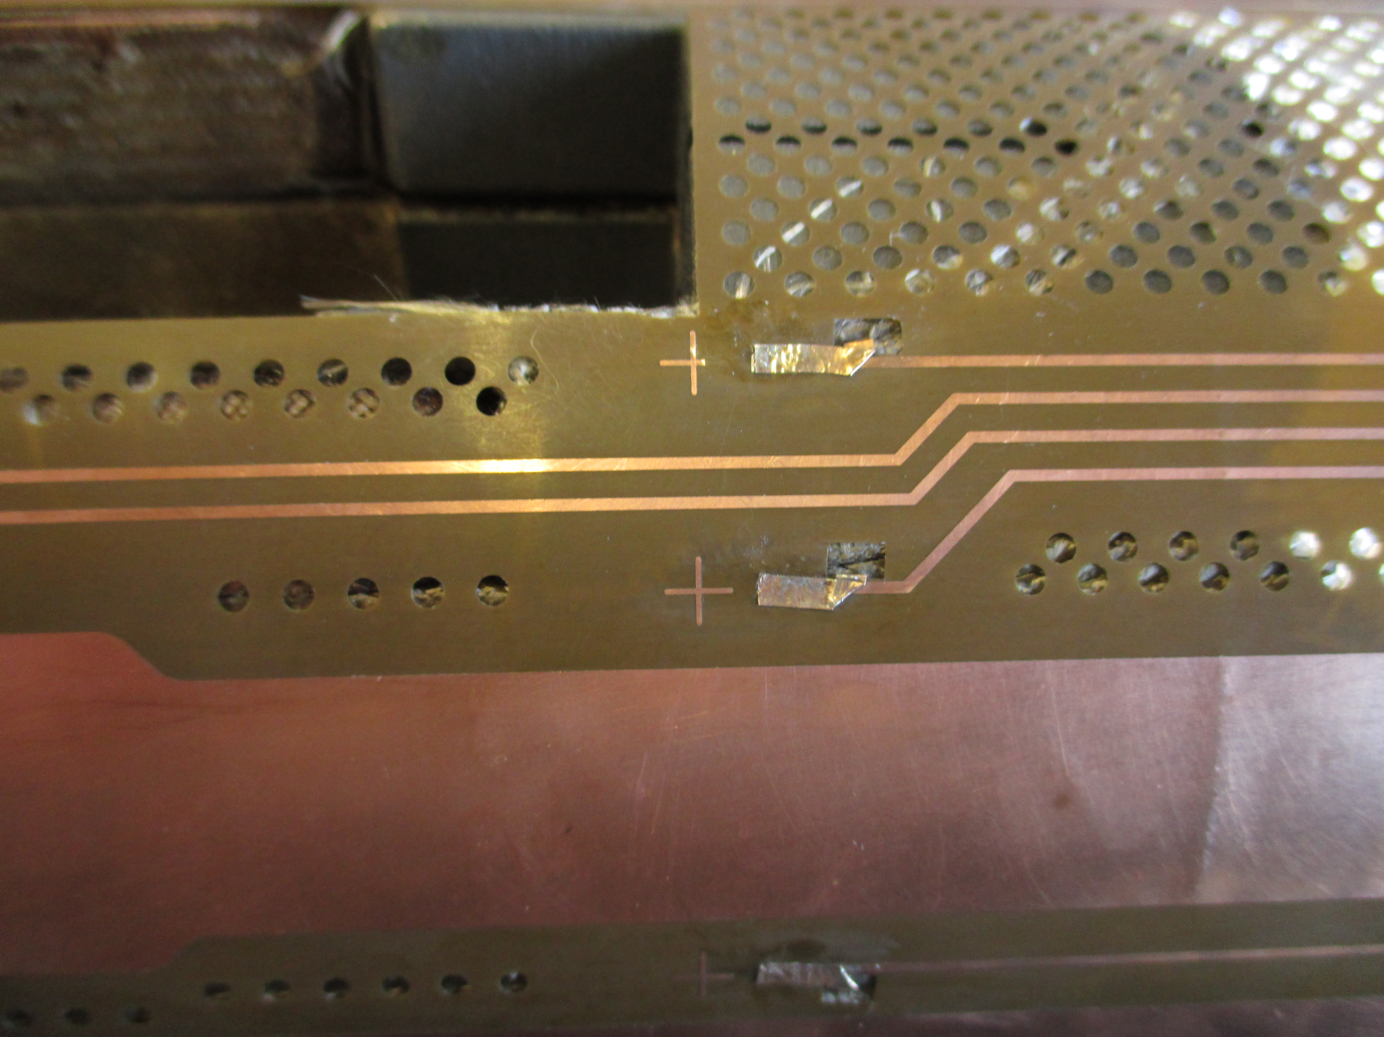
    Trace installation on outer layer
Trace 0.15 mm

Slide 6
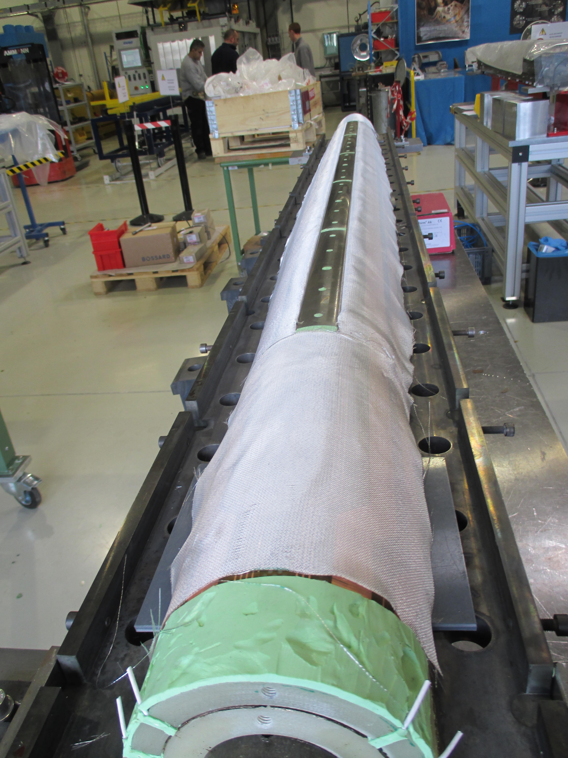
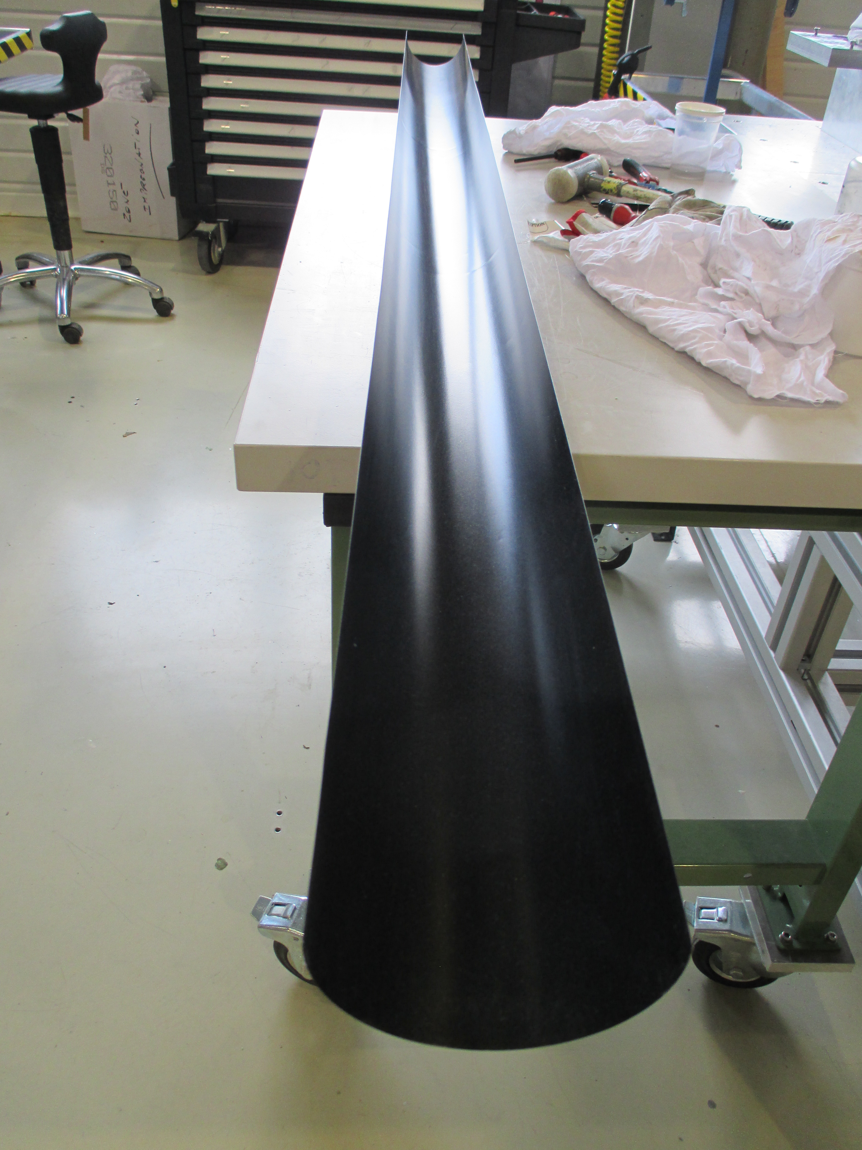
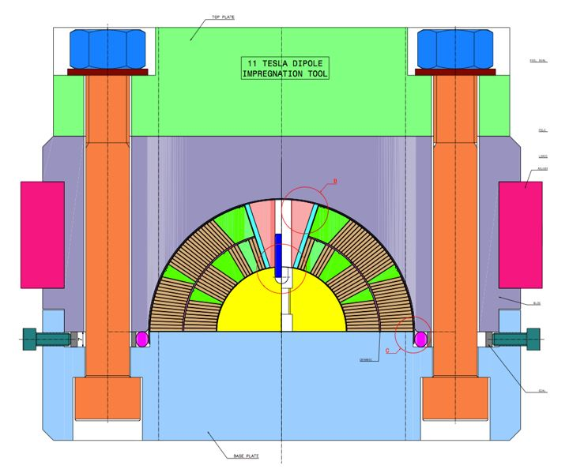
    Closing impregnation mold
Fiber Glass Type E 0.08mm
No-stick coating 0.08mm

Slide 7
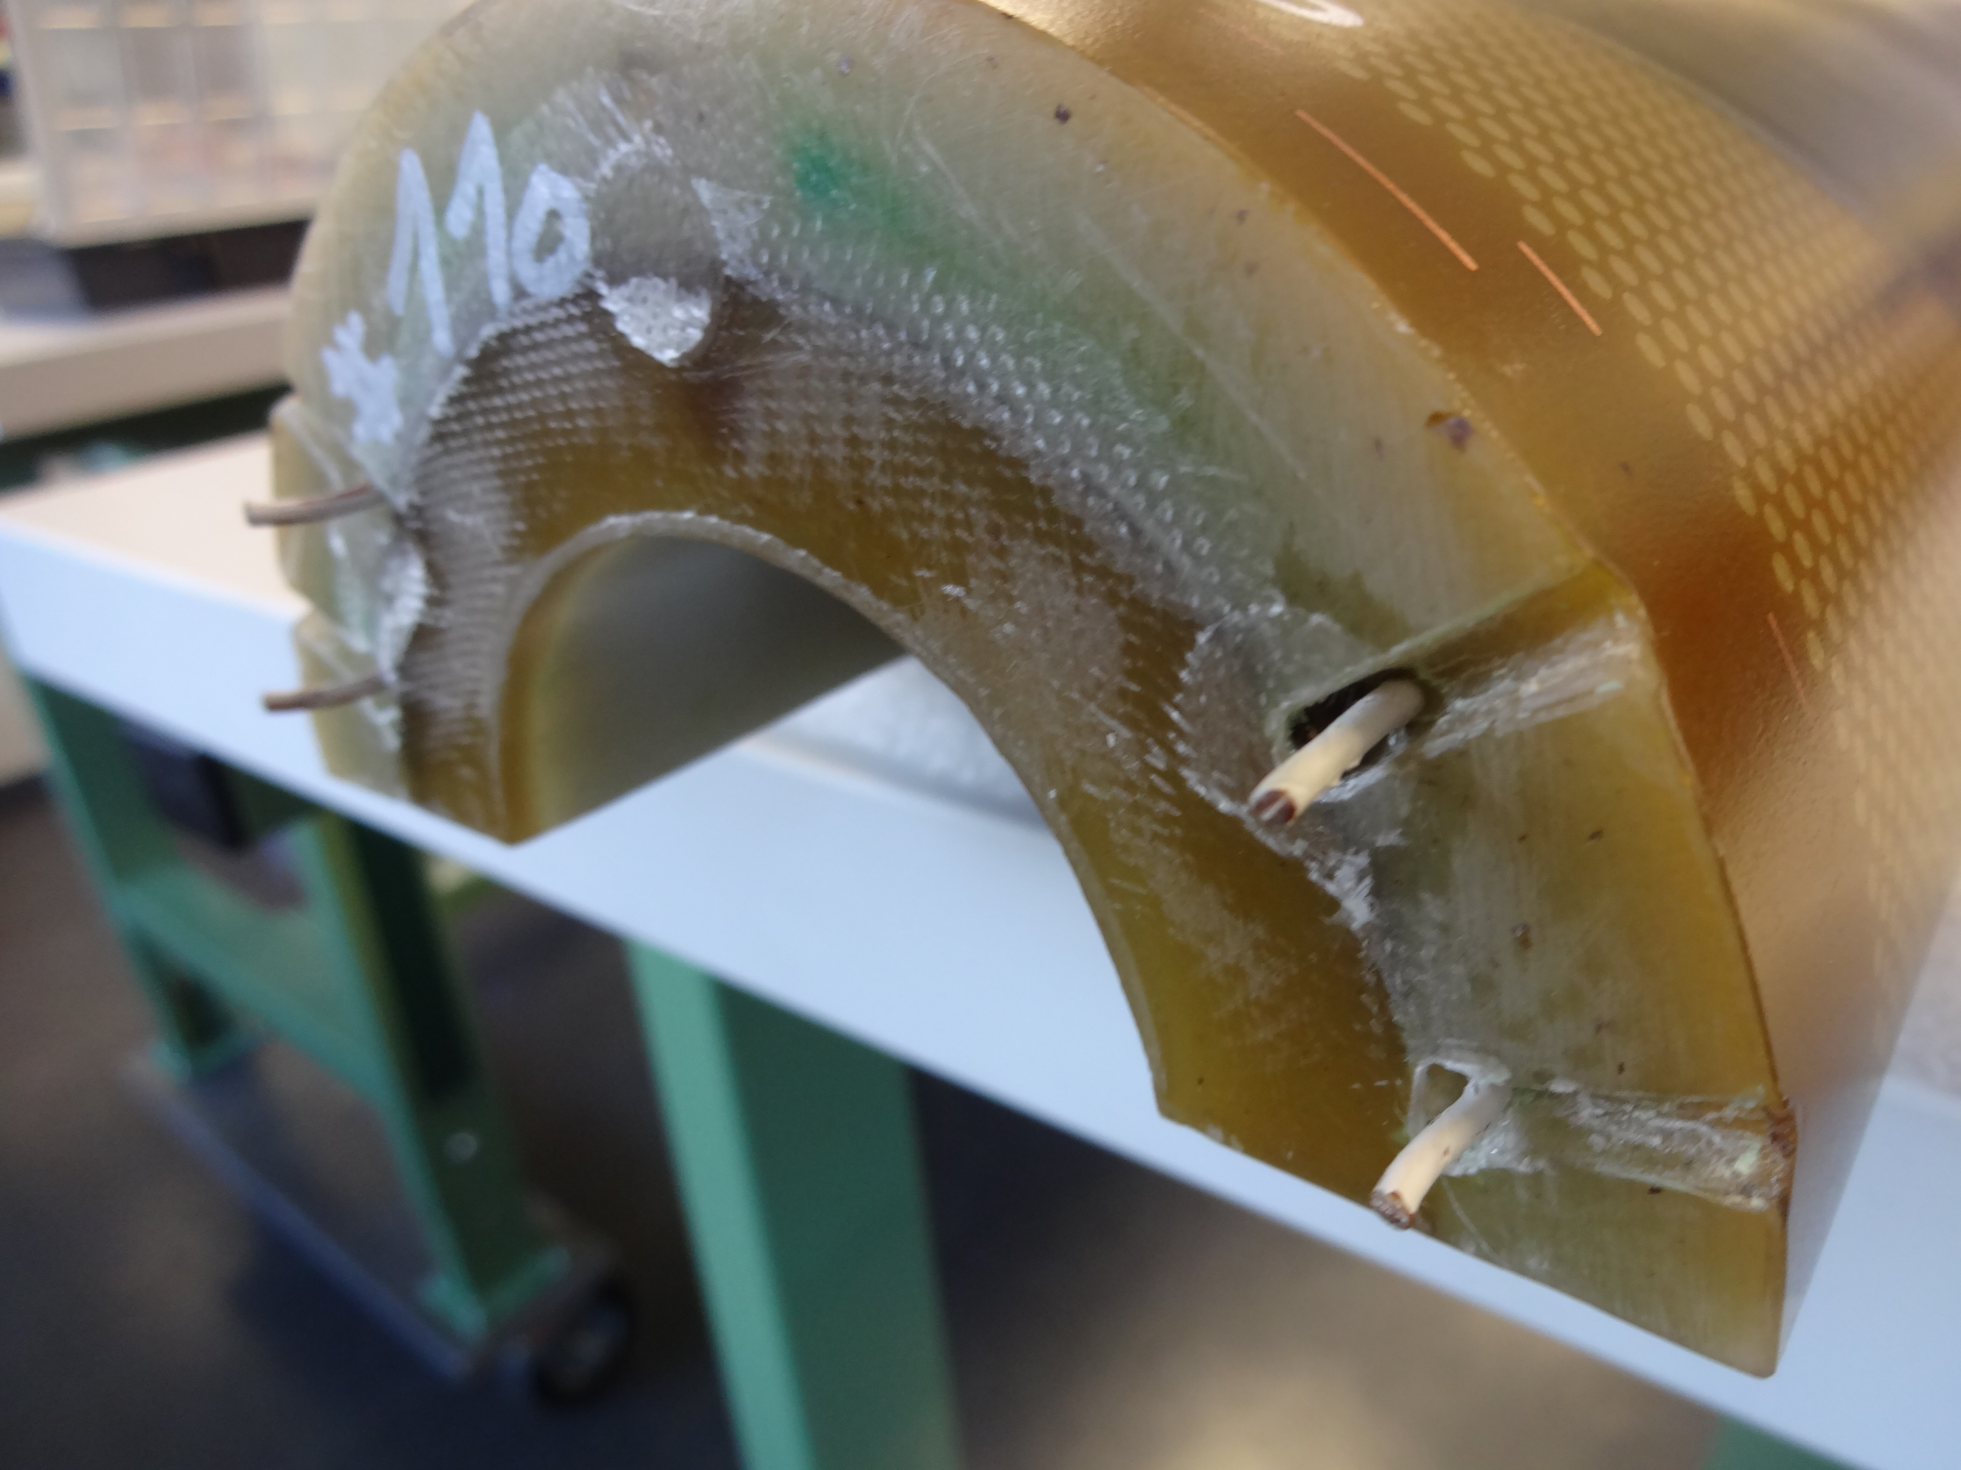
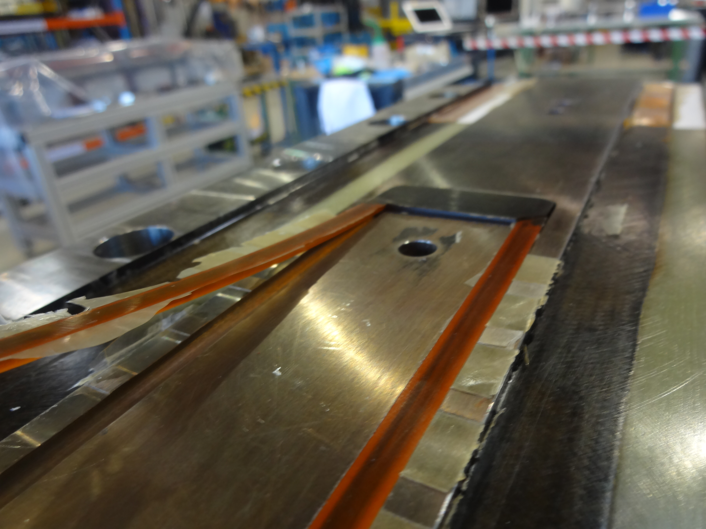
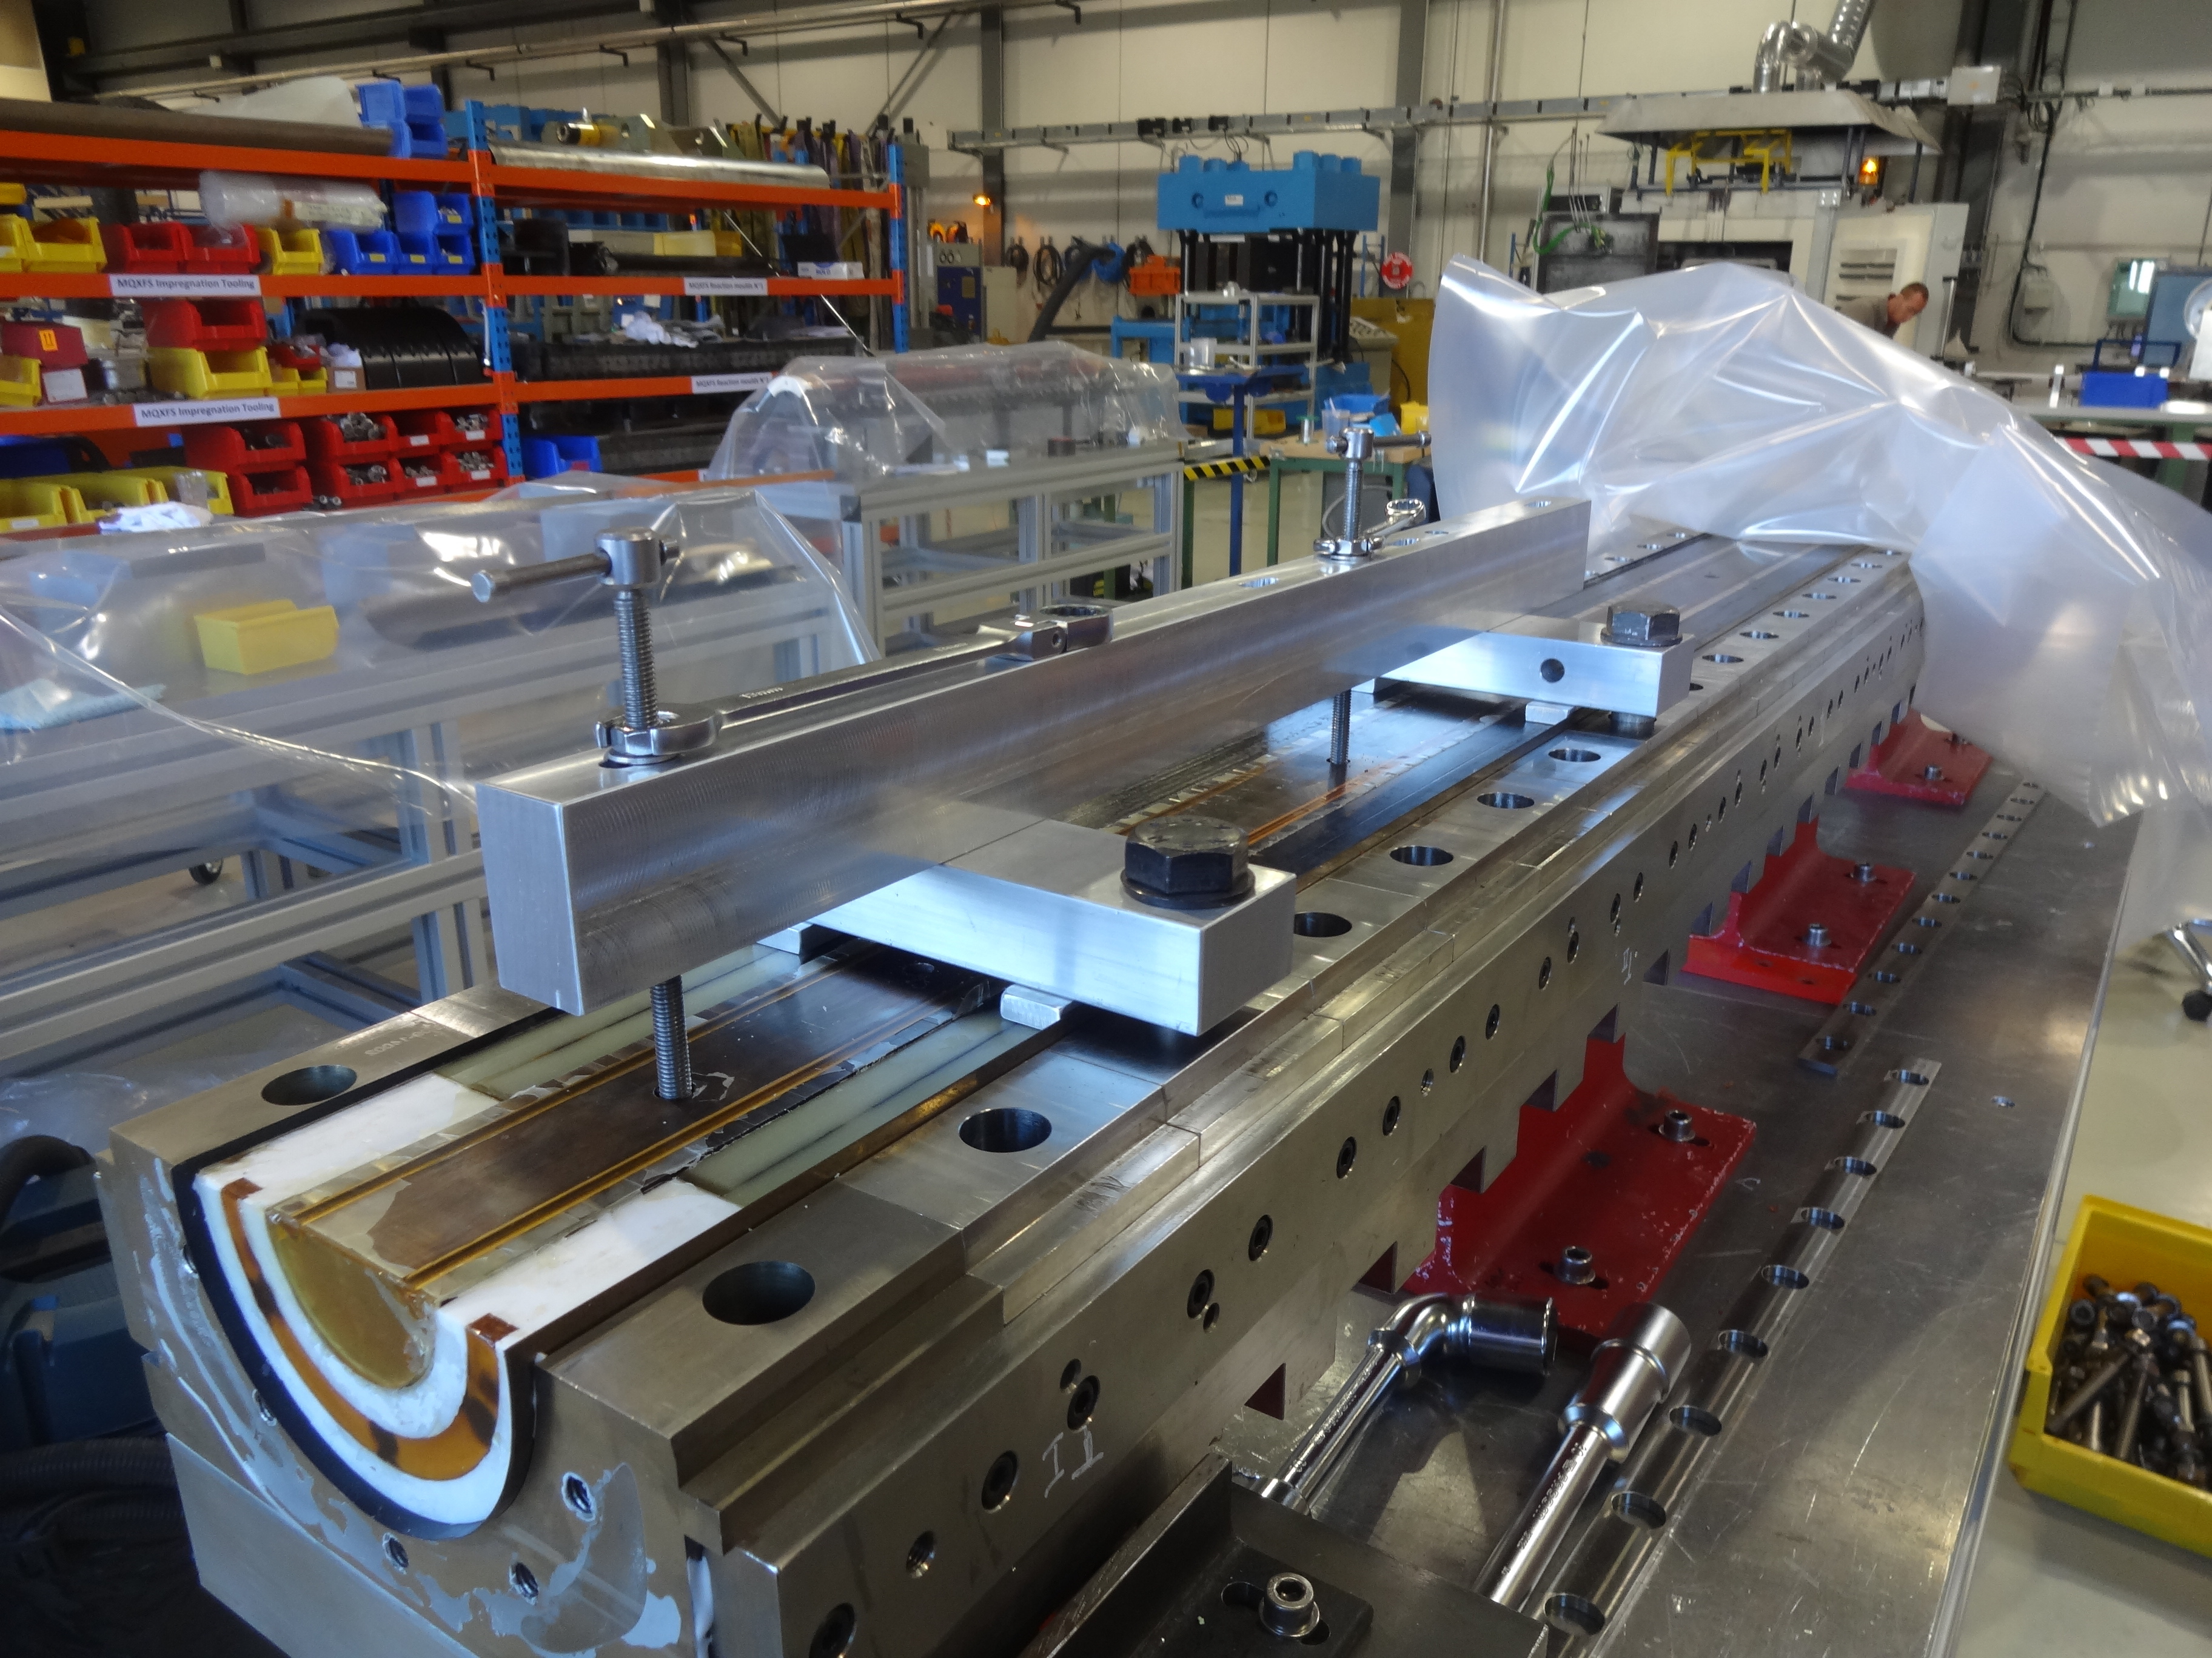
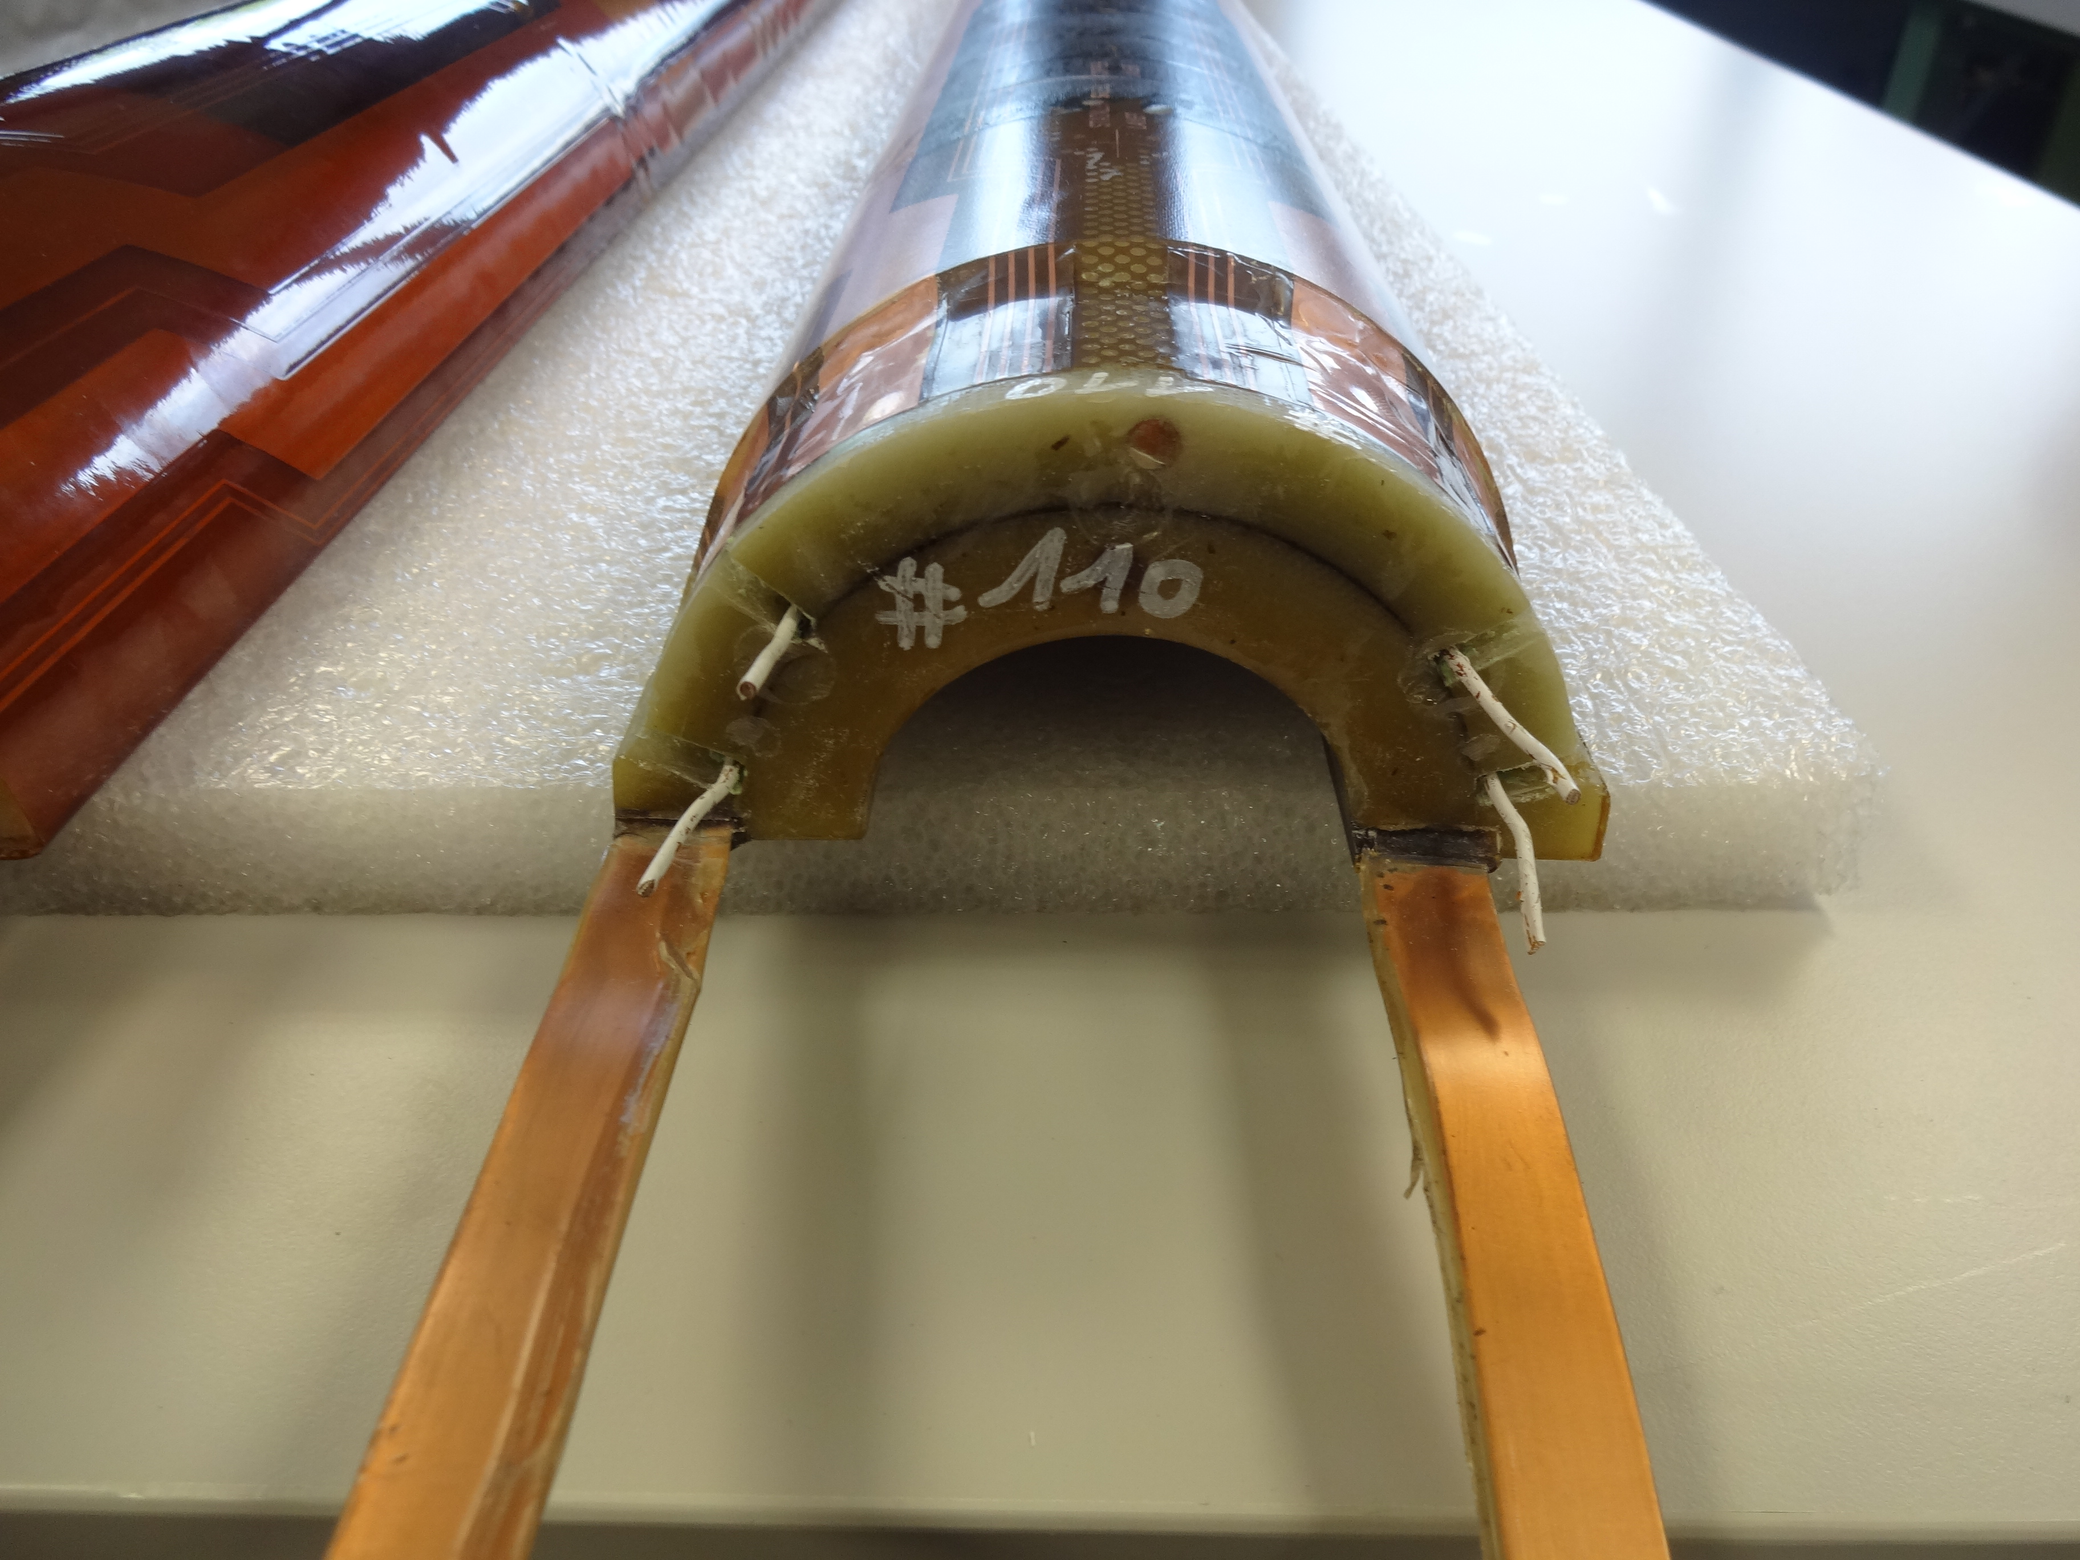
    Mold Opening after impregnation
Opening side down for before!

Slide 8
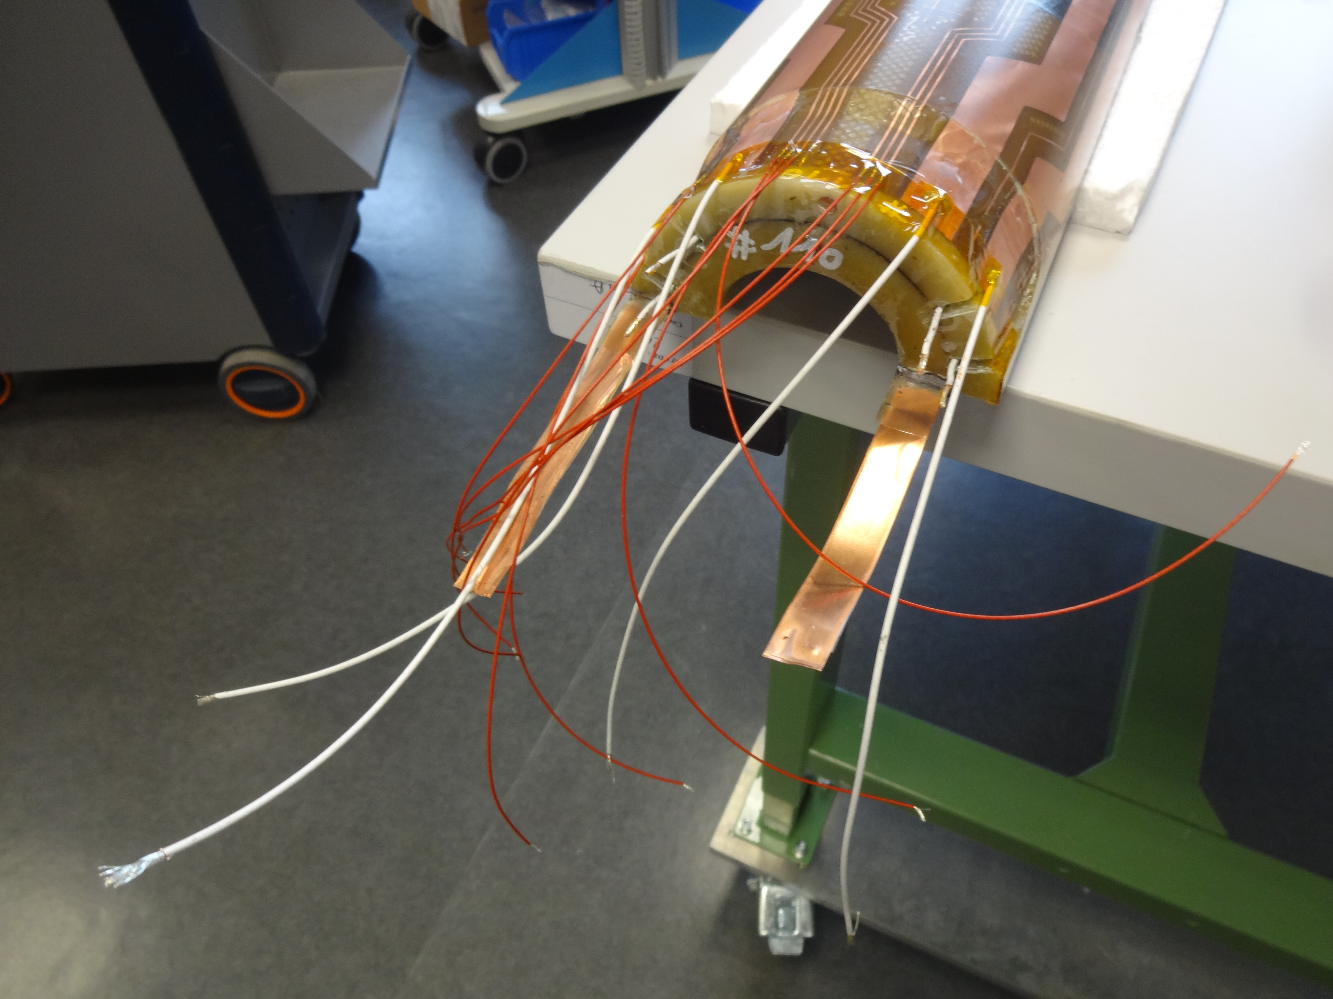
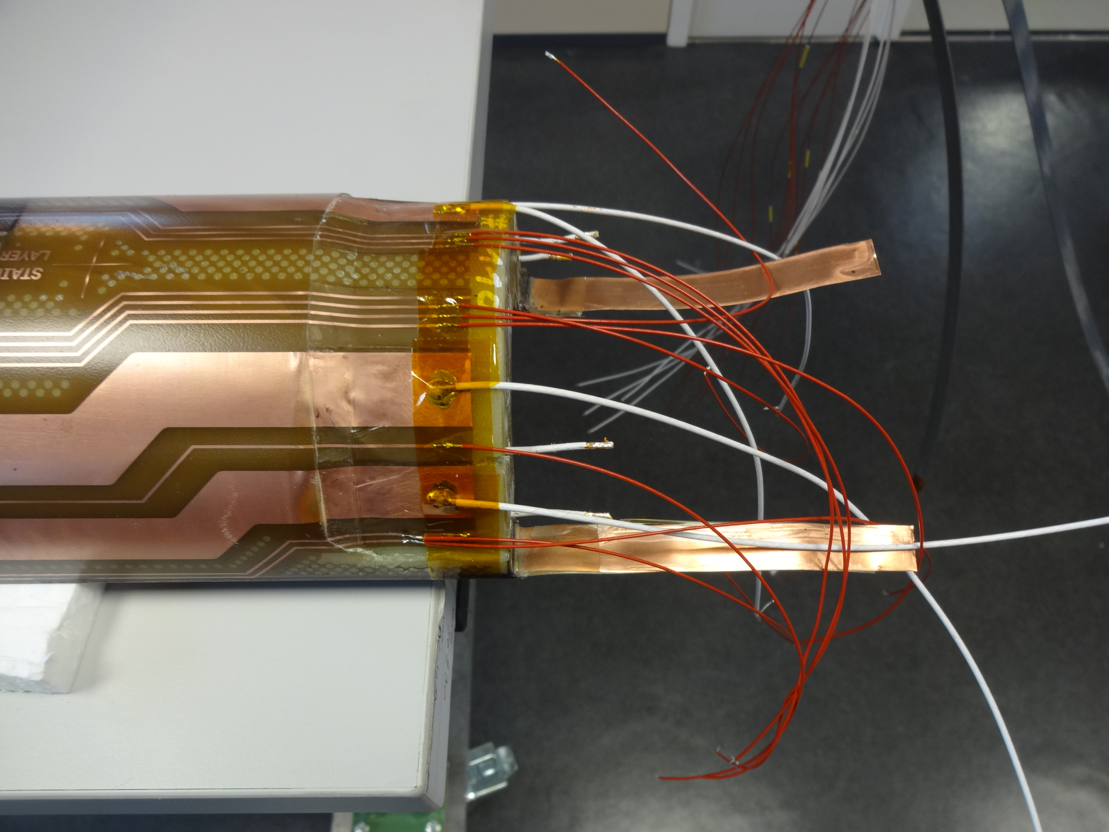
    Powering leads
Tin-Silver filler Metal (Sn96Ag4) for soft brazing

Slide 9
TE-MSC-MDT

