Slide 1
Results of 300 mm impregnation trial and Modification of impregnation mold for coil #110

Slide 2
OUTLINE
300 mm Trials
Initial idea
Tooling
Coil dummies
Results
2m Fixture Modification
Mechanical
Coating
Assembly

Slide 3
Disclaimer
All the work reported here has been carried out and is to the sole efforts of CERN TE-MSC-MDT :
A. Benfkih, S. Clement , R. Gauthier, R. Gavaggio, L. Lambert, G. Maury, J. Mazet, S. Tavares
(927, PolymerLab)
This presentation is on their behalf.

Slide 4
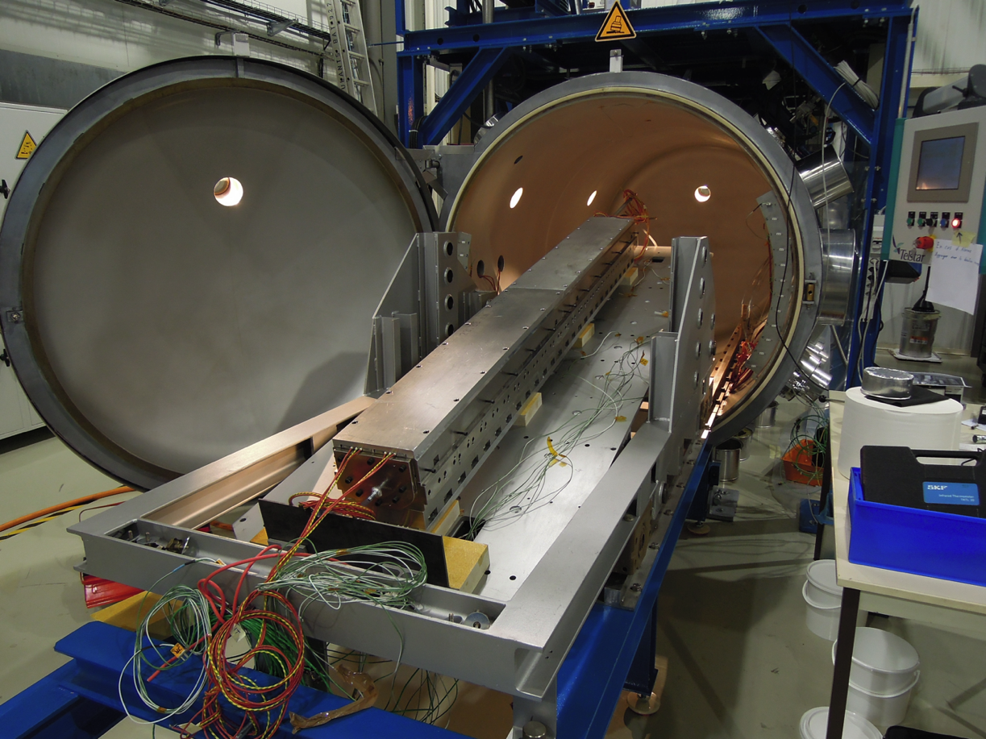
Impregnation-method
Current Standard:
Impregnation from Injection Point A to Exit point B.
Tested at CERN and US many times (Up to 4m length).
The 6m case:
Is the potting life too short?
What, if there is a blockade?
…
Decision to look into an alternative tool designs, which lead to multipoint-injection

Slide 5
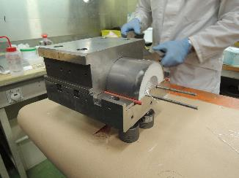
Experimental planning
First trials on 300 mm mock-up:
Test different injection schemes
Test demoulding
Look for major impregnation defaults
Investigation of cross section
Impregnation of 2m dummy coil from broken cable:
Scalability
Monitor process and feasibility of demoulding
Electrical testing
Optical investigation of cross sections

Slide 6
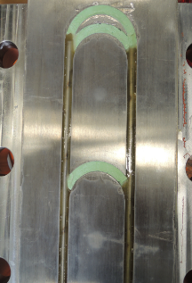
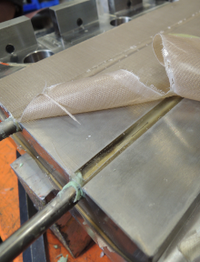
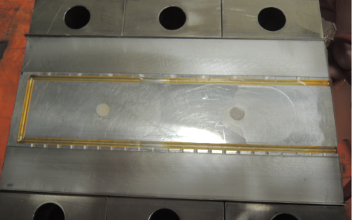
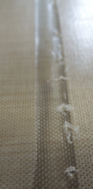
300 mm Trials
Two basic concepts for injection
Mandrel modification
Baseplate modification

Slide 7
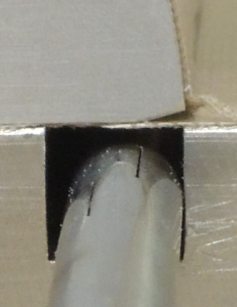
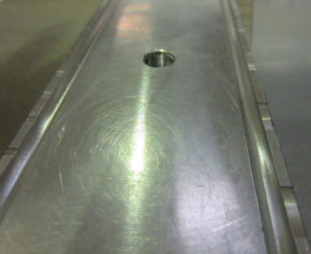
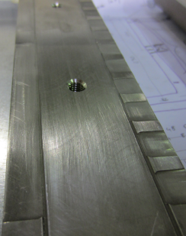
300 mm Trials
Variation of injection schemes
MIP1: Chamfer, continous
(BNG)
MIP2: Grooves, short, long
(Gauthier, Lambert, Mazet)
MIP3: Grooves, long, cont.
(Gauthier, Lambert, Mazet)
Depth: max. 0.1 mm !

Slide 8
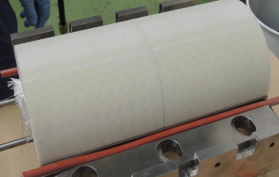
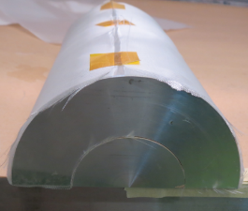
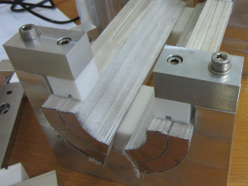
300 mm Trials
Impregnation coil dummies
A first test has been carried out with a 3d-printing material. After the material has proven to be not suited, an aluminium dummy has been machined for the first test. Another trial is to be carried out on a coil-like structure.
(Due to oversize 2 layers mid-plane layers removed)

Slide 9
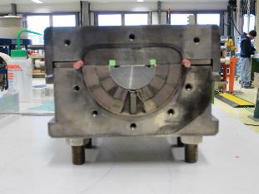
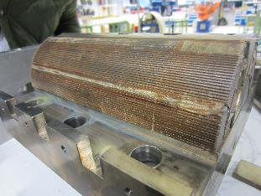
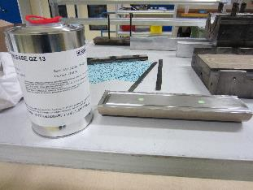
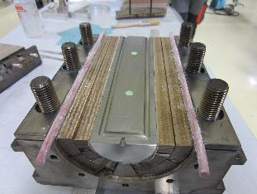
300 mm Trials
Impregnation coil #103 section
Impregnation conducted in the Polymer Lab, respecting inclination angle.

Slide 10
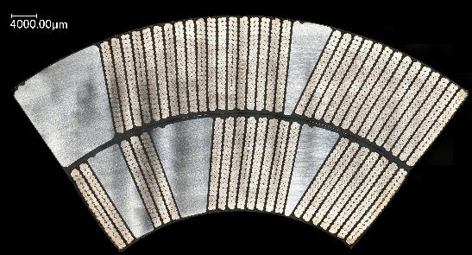
300 mm Trials
Impregnation coil #103 section – CUT RESULTS
Analysis:
Coil has been cut in several positions: Plot and Cote each at Injection and Exit
Cut
S. Langeslag (MME-MM)
No obvious defects at 50-fold magnification

Slide 11
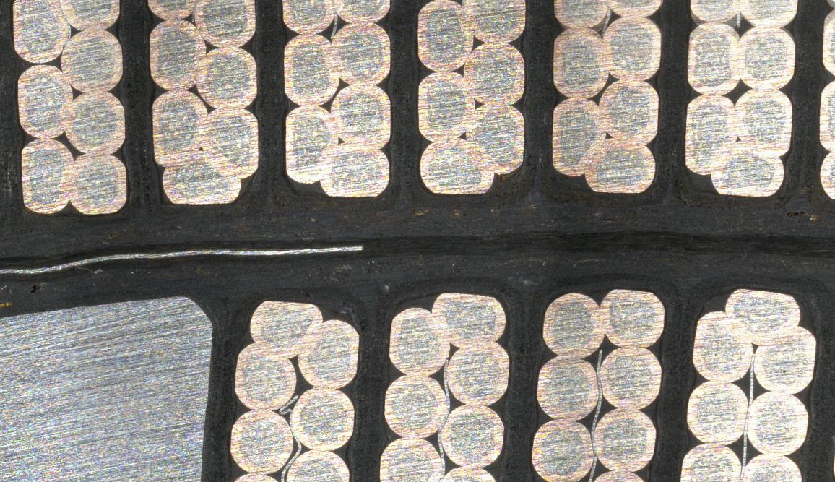
300 mm Trials
Impregnation coil #103 section – CUT RESULTS
Higher resolution investigation currently in progress at MME-MM
S. Langeslag (MME-MM)

Slide 12
300 mm Trials
Conclusion
Injection:
Both variants are working; GM preferred, for easier baseplate demoulding.
Patterns
Hollow grooves of 0.1 to 0.2 mm preferred; so far no difference of Muliple points to continous injection
Bubbles
So far no bubbles could be found
Demoulding
Good for multiple point grooves as described above (Auxiliary skrews by J. Mazet)
Quality Coil
Ongoing

Slide 13
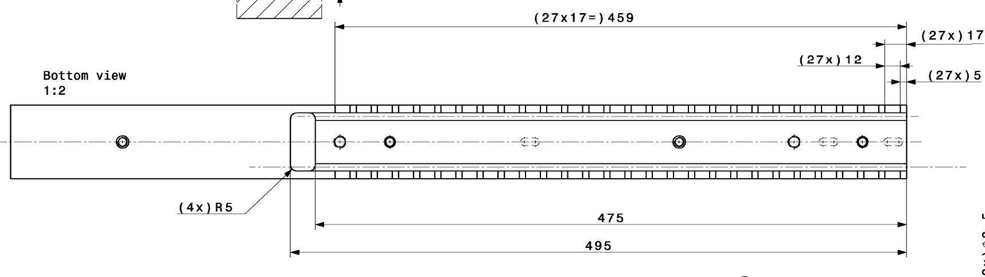
Modification of 2m tooling
Mechanical
Based on the experience gained with 300 mm tooling:
Implementation of Mazet-channels like in the last MIP4
Additional threads for removal (pressing against pole)
Pocket at arch in order to trap potential bubbles (J. Mazet)
LHCMBHST0598, LHCMBHST0599, LHCMBHST0600

Slide 14
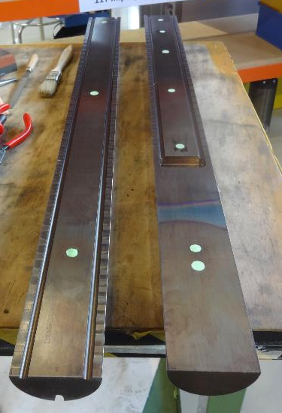
Modification of 2m tooling
Mechanical

Slide 15
Modification of 2m tooling
Surface coating
The removal adhesive has been replaced with Teflon-coating:
All mandrels on the outer surface, not midplane
Inner surface of the seal foil
 | Supplier | TYPE | Thickness mm | Tolerance mm
Teflon Adhesive | Aerovac / UMECO | FF03-PTFE | 0.114 | (applied by hand)
Teflon coating | TTM S.A. | PFA | 2 x 0.04 | 2x ( ±0.01 )

Slide 16
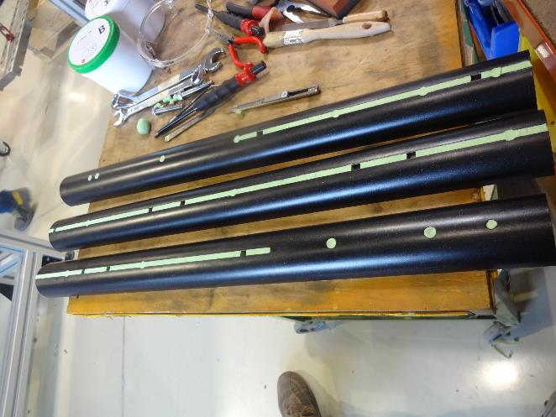
Modification of 2m tooling
Surface coating

Slide 17
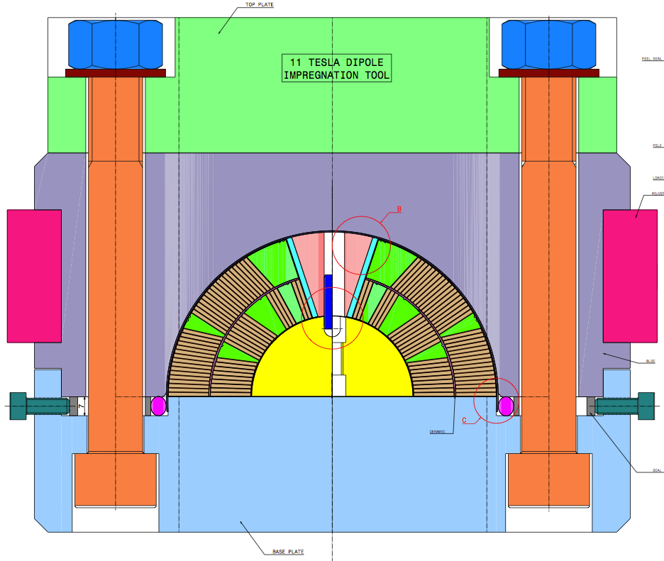
Modification of 2m tooling
Impact on cavity size
The parameters of the coil and the tooling decide for the quality of the impregnation
Coil R60.8
Block R61.425
Gap | 0.625
shell | - 0.5 | - 0.3
film | -0.11 | - 0.11
Assy gap | 0.015 | 0.215
D. Smekens

Slide 18
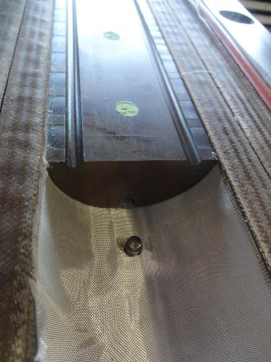
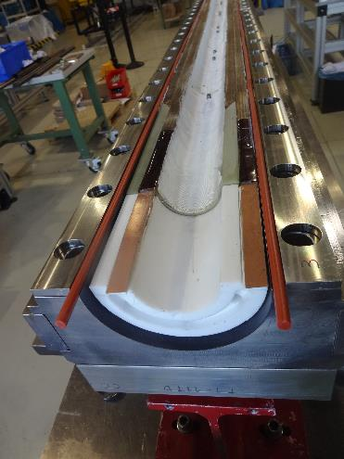
Modification of 2m tooling
Fixture assembly

Slide 19
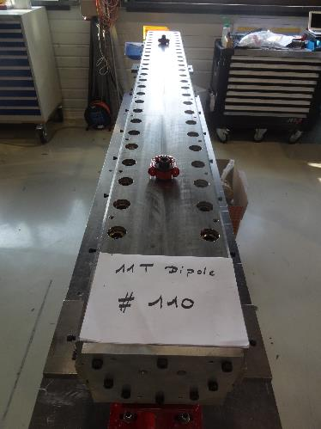
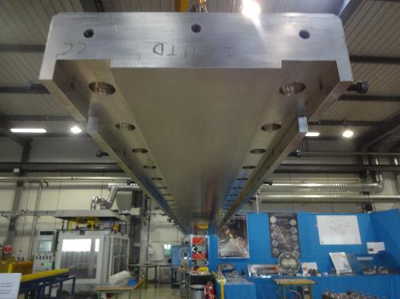
Modification of 2m tooling
Fixture assembly

Slide 20
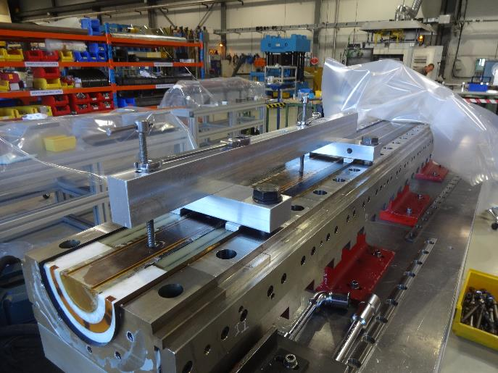
Modification of 2m tooling
Fixture disassembly

Slide 21
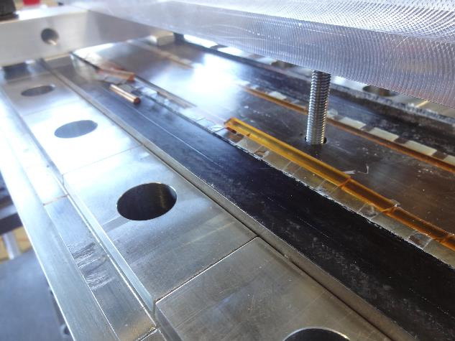
Modification of 2m tooling
Fixture disassembly

Slide 22
Conclusions
The 300 mm trials showed:
the tools work in small scale
the impregnated section looks promising
The modification of the 2m tooling was successful
The Quality of the impregnated coil: See the next talks:

Slide 23
Modification of 2m tooling
Fixture disassembly
Thank you!

