Slide 1
About: ML@Atlas/CMS, present and future
Cécile Germain
TAO (Apprentissage & Optimisation)
Université Paris Sud – INRIA - CNRS

Slide 2
Challenges: what we learned with HiggsML
What tool for what problem and Learn how-where to apply what MML for HEP
Crowdsourcing
  Finding a tool might be very difficult (1800+ submissions NIPS2015, 400+ accepted, 20+ workshops)
  Formulate your task as a machine learning problem, with adequate data. Easier said than done, highly non trivial, requires a small, balanced and dedicated team.
  Then a lot of people are eager to solve the problem
Positive results
  Gradient boosting considered of interest as a method and a tool
  Also raised awareness about validation eg k-fold
To improve
  Core ML-research involvement eg would be most beneficial for all image-related tasks
  Challenges with a classical (proxy) objective function will be easier to convert to a benchmark.

Slide 3
The tools approach
Can we do better with raw data ?
  The promise of deep learning: learning internal representation in place of feature engineering
  From the limited experience of HiggsML, not exactly the case
  Best observables not necessarily minimally correlated
Anomaly detection -> novelty detection = learning from positive and unlabeled examples. Unlabeled data definitely help
Cluster splitting Naive question: what about classical clustering (with very large datasets)?
Deep learning for event classification: what advantage do you expect (over other classification methods)?
Parallel tracking: muti-objective optimization – one figure of merit, but you might want to ask for more information
Systematics. Ongoing work at Orsay + IC on a principled ML formalization, with practical methods to follow.

Slide 4
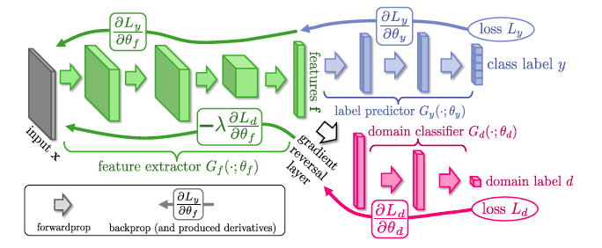
The tools approach
Systematics. Ongoing work at Orsay + IC on a principled ML formalization, with practical methods and benchmark dataset (worked out from the HiggsML one) to follow soon: domain adaptation
  For effective domain transfer to be achieved, predictions must be made based on a data representation that cannot discriminate between the training (source) and test (target) domains. Data representation = good motivation for DNN
    .
Data at training and test time come from similar but different distributions
From Ganin et al., NIPS 2015

Slide 5
Vision
ML: input all information and let machine learn
Basically true for supervised and non supervised learning– but active learning critical for many real-world tasks, eg anomaly detection. Experience in HEP?
Reinforcement learning is about providing external feedback
And beyond Can we combine ML and physics input in a smart way?
Integration of a priori knowledge
Most useful on an ad-hoc basis: identify/describe what is already encoded in the simulation data, how it is encoded, and the residual. Would greatly help for contributing to systematics analysis
Bayesian approaches – ad hoc, of course we need it
In the long run, domain scientist in the loop: within reinforcement learning, preference learning (related: apprenticeship learning)

Slide 6
Vision
We are physicits, not data scientists. We want to focus on physics. We want to make “optimal” use of our data.
Just like Facebook, Google, all the finance industry, health industry, et al. Data Scientist shortage is so terrible that IBM sells MLaaS – machine Learning as a Service, on the Cloud…
In the next years, how do you entice the best and the brightest young ML?
Possibly, partially, tentatively: by giving them an opportunity to demonstrate they actually are.
LHC name is great, but ordinary results with impact on the real world are not enough per se
Fortunately, HEP real problems are strongly related to fundamental and active ML questions, eg (a few)
  Systematics: infomation geometry: define/estimate/use « good » distance between distributions
  Model selection and parameter tuning, quality (questions about upper bounds on discrimination): beyond asymptotic analysis, data-dependent complexity estimates
  Your exotic learning objective functions: NP-learning, ranking
  Not knowing enough on the other themes, earger to learn about them.
Notes:
C’est du long terme

Slide 7


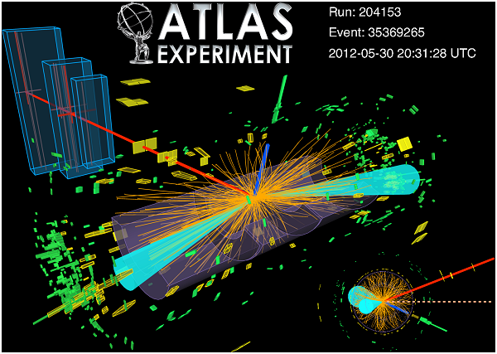

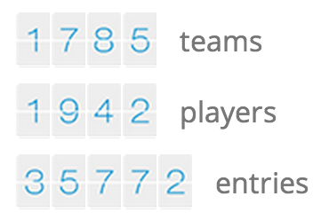









Conclusion
Vision + tools = benchmarks
$13,000

