Slide 1
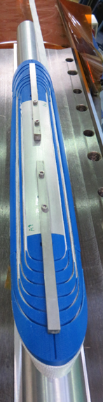
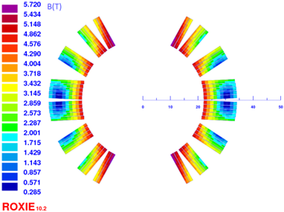
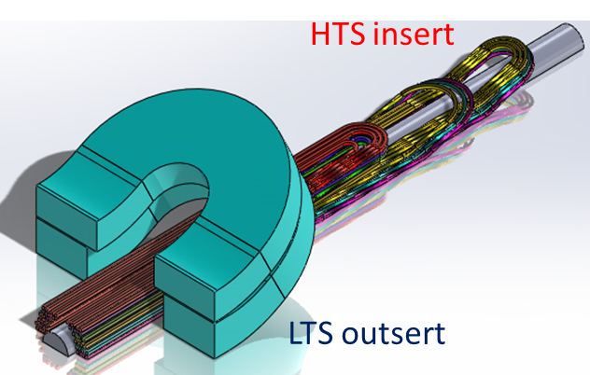
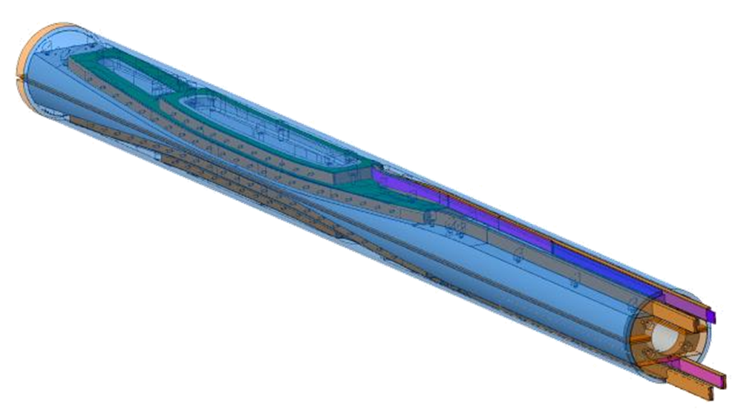
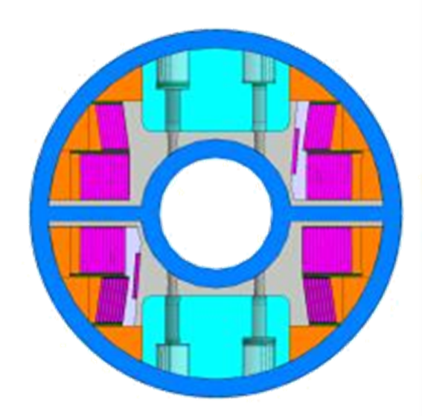
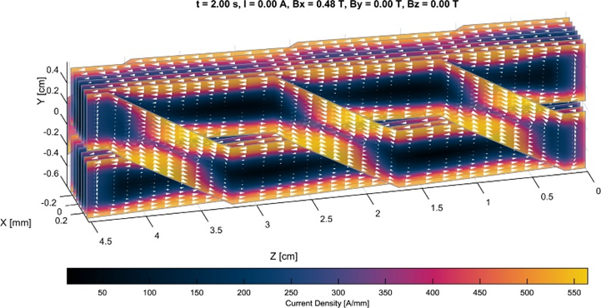
EuCARD2 WP10.3 progress 2015

Slide 2
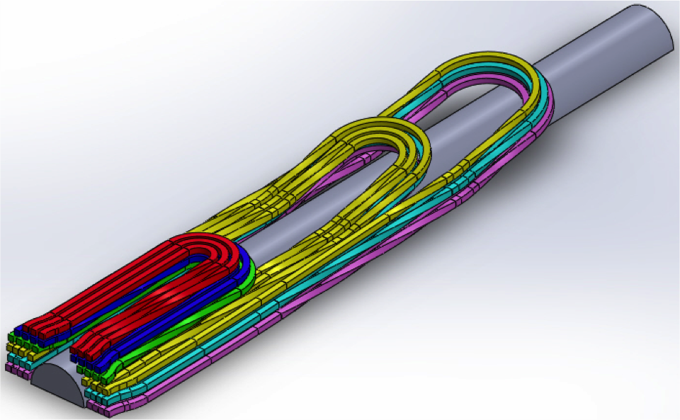
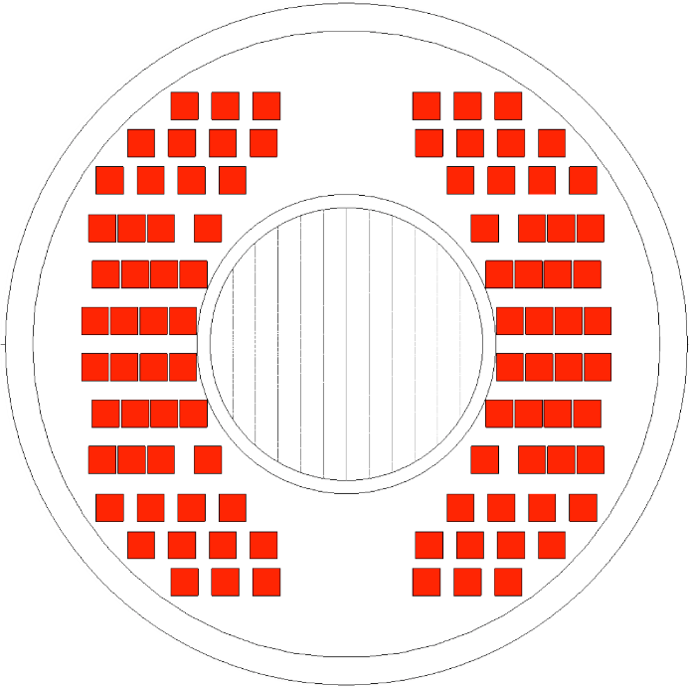
Twisted Stacked tapes design studies
  4 x 4 mm block-coil is used due to maximal use of space and operating current.
2D design slightly modified (24 to 23 turns block-coil).
3D field distribution under study
Since end of March, studies on cable design, especially on the current distribution of twist stack cable, are ongoing
6 double pancakes

Slide 3
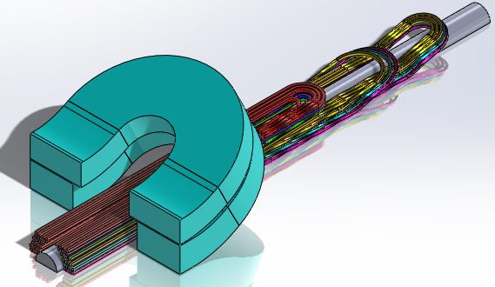
Next steps
Winding test with 4 mm wide dummy cable
  single pancake coil
  Single flared ends coil
  Double pancake
Influence of relative position between HTS insert and LTS outsert
  Impact on Je and force distribution
HTS insert
LTS outsert

Slide 4

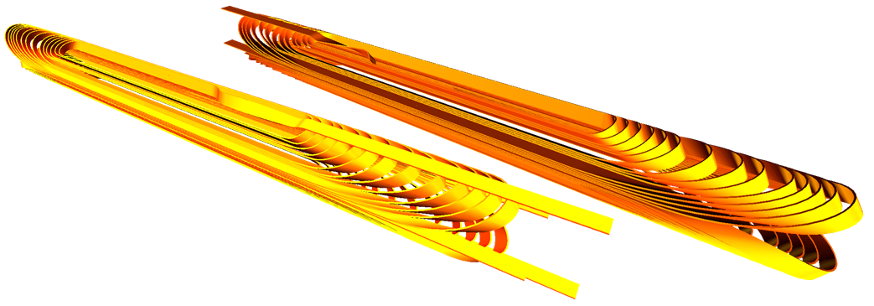
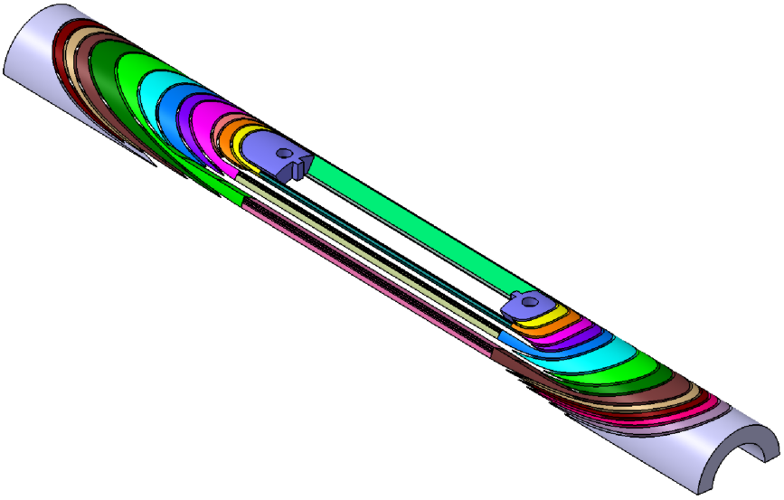
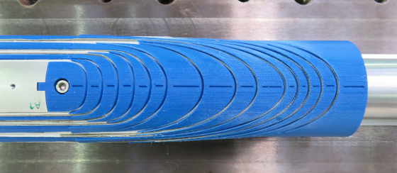
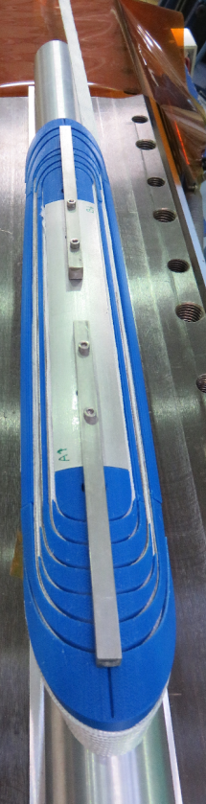
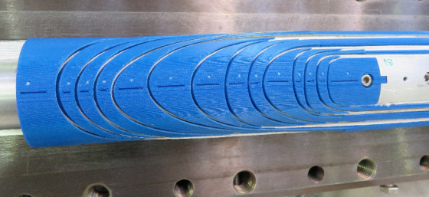
Cosine-theta option design studies
Detailed 3D end design completed
End spacers design under validation by winding tests
Whole magnet design (Roxie)
3D CAD coil end spacers

Slide 5
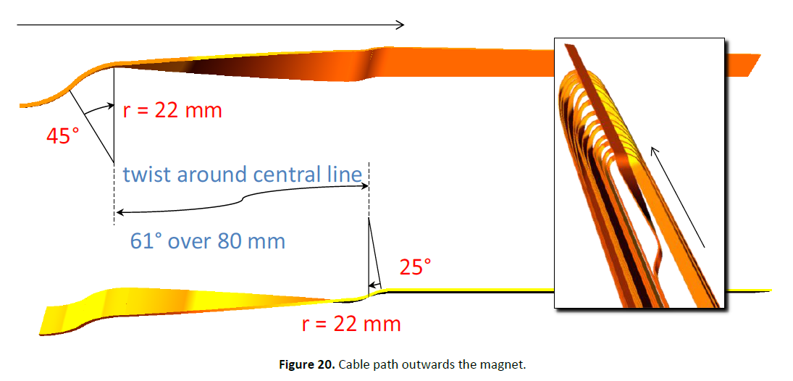
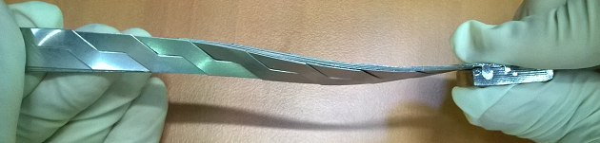
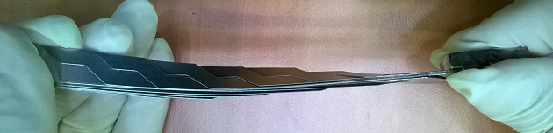
Cosine-theta option design studies
Cable going out options under study
Better to over-twist
or untwist Roebel cable ?
Need for twist tests on real conductor
3 options:
61° over 80 mm
77° over 80 mm
Coupled bend+twist
C. Lorin - Cosϑ magnet design option, CERN-ACC-2015-0043

Slide 6
Next steps
CAD detailed design started end of may : cable going–out region, then winding and impregnation tooling
Impregnation on ten stacks (dummy and sc cables ?)
Mechanical tests on ten stacks possible by the end of the year

Slide 7
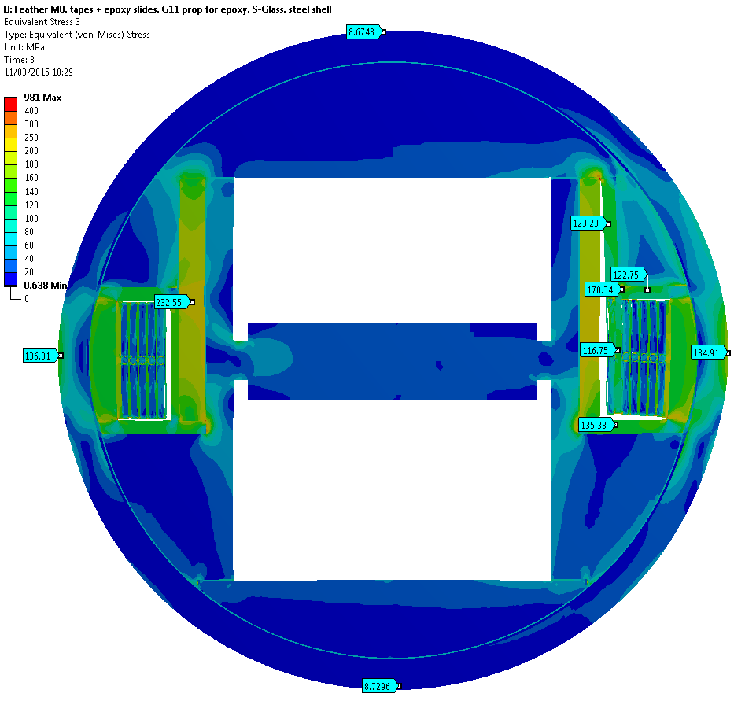
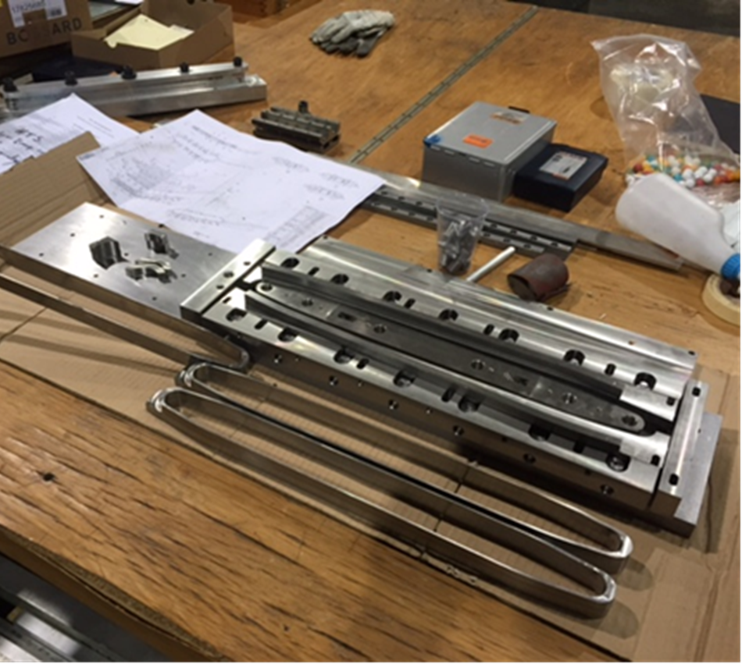
Feather M0 2D-cross section
-to assist in shell material selection, to understand how to model coils
-Cooling, standalone, background field
Models done so far

Slide 8
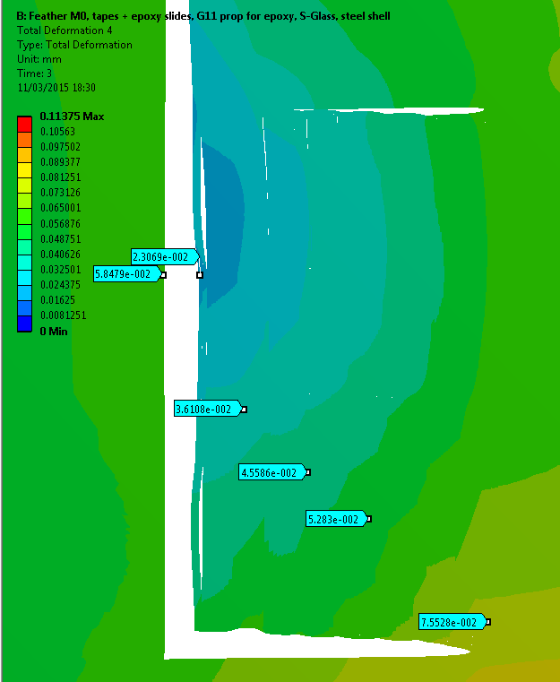
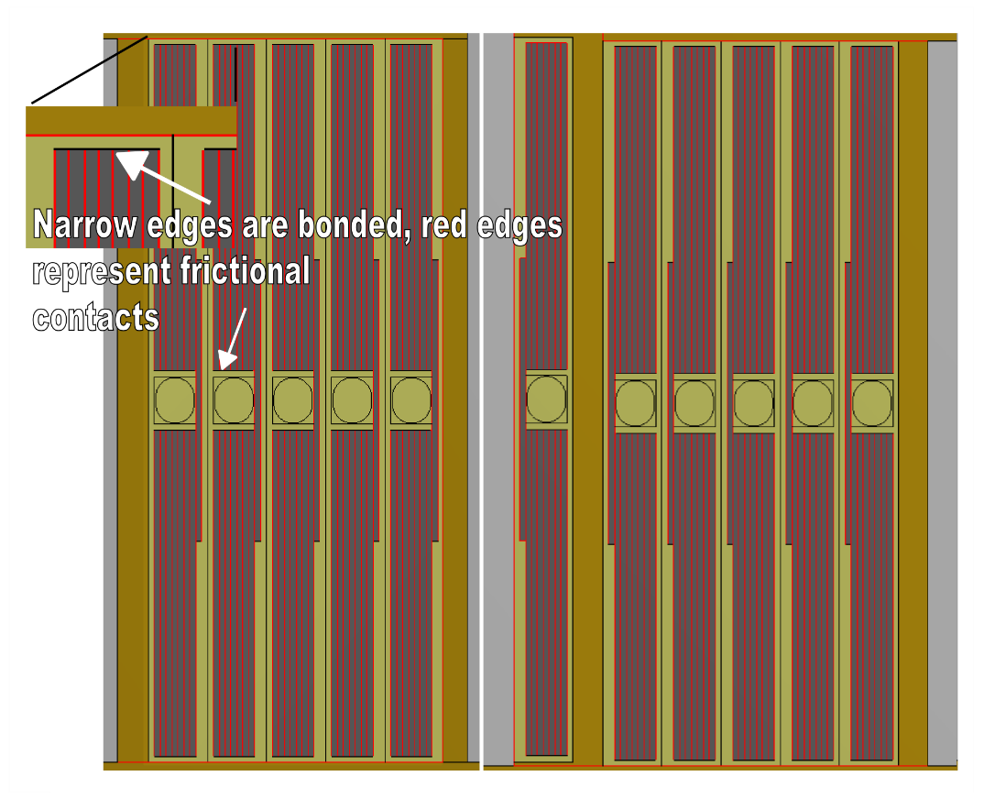
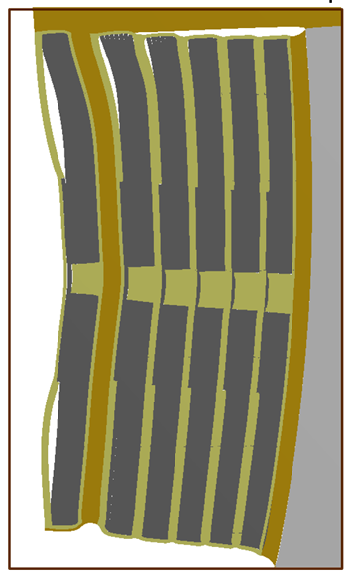
Feather M0 2D-cross section
Total displacement after cool down + powering to 10T. Assumptions: Tapes+epoxy interfaces frictional f=0.8, S-Glass core in the gap, G11 prop. for glass fiber sock + epoxy, steel shell. 18 X scaling for the deformed geometry.
The gap ~35 microns in 10T!

Slide 9
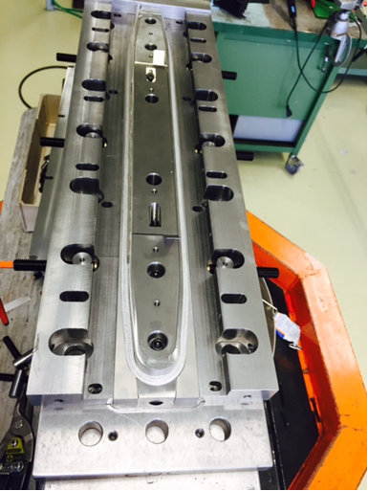
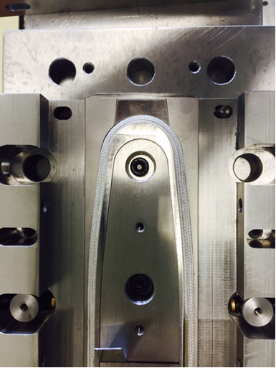
Feather Zero 1st coil

Slide 10
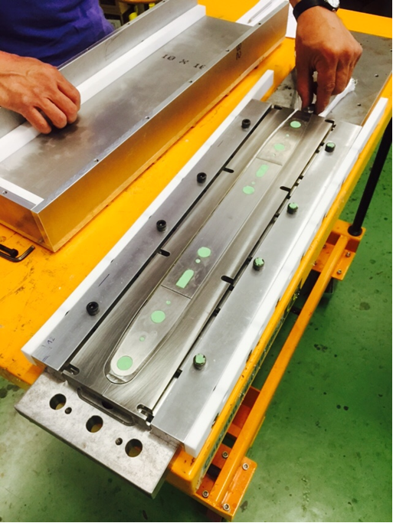
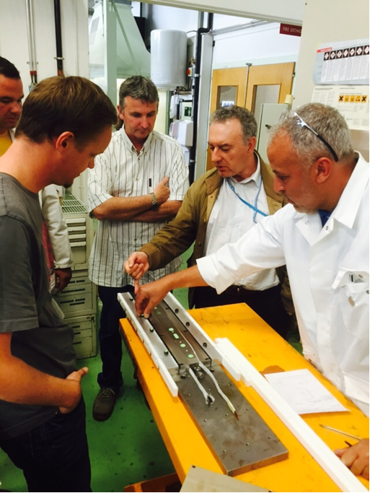
Preparation for impregnation of first coil

Slide 11
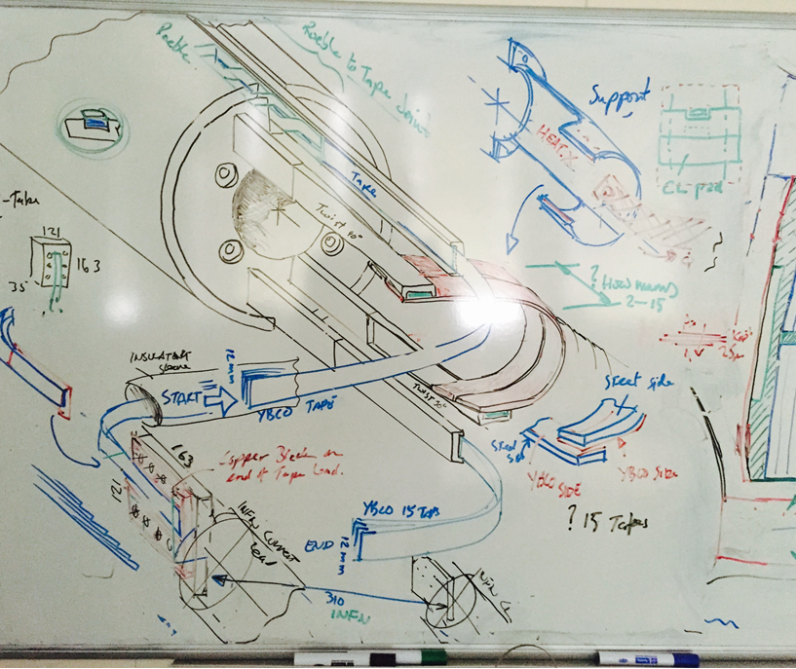
Joints Feather2
Joint development,
Roebel -to- Stack Tape.
Stack tape to stack tape with 90° change of direction
Stack tape to copper block for connection to current lead.

Slide 12

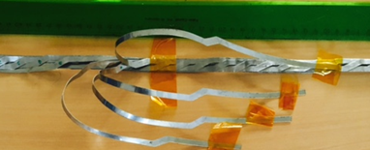
Joint tests,
Test joint resistances:
  Good side to good side of tapes
  Good side to bad side of tapes
  Bad side to bad side of tape.
15 tape Roebel cable to Stacked tape joint.
At the edge of the coil we make a joint between the 15 strand Roebel to a 15 stack a 12mm wide tapes:
  Helps with impregnation
  Gives a high temp current link between magnet and cryostat current leads.
  For Feather2, the joint to a stacked tape extends cable length.

Slide 13
Cable lengths Feather zero & Feather2
We prefer 0.8mm thick cable, 9 tapes with BRUKER’s thick tape and 15 tapes with other 0.1mm thick tapes

Slide 14
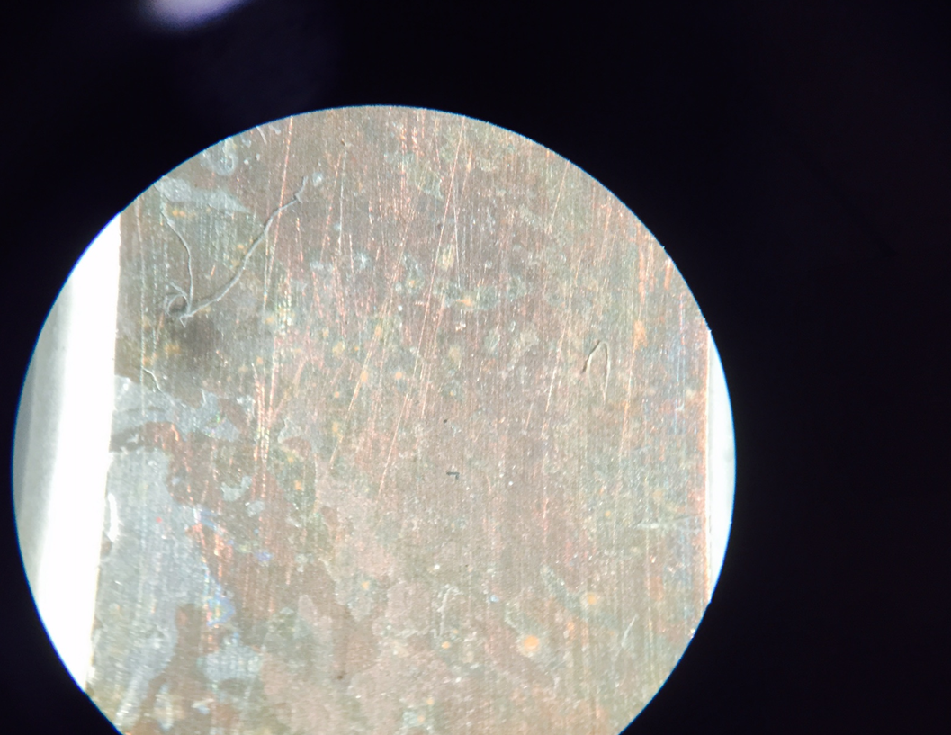
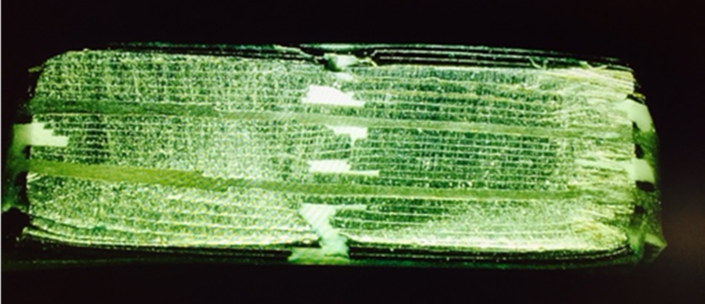
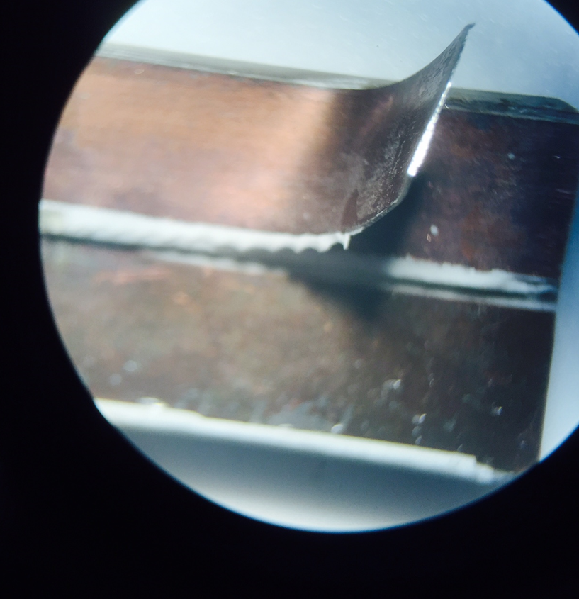
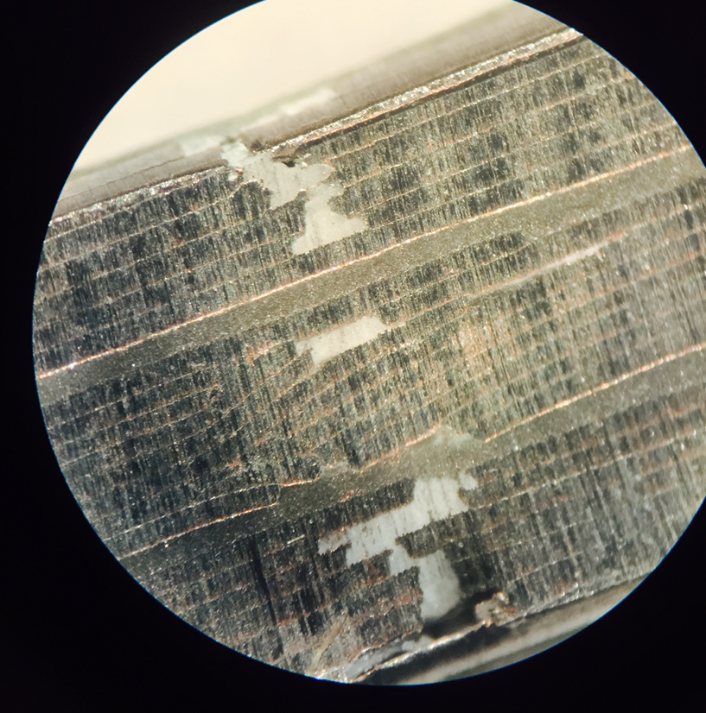
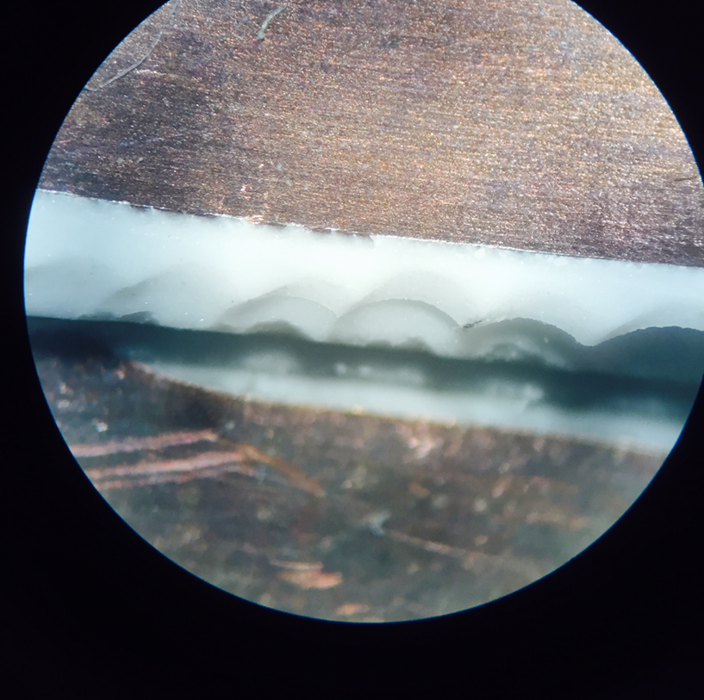
3 cable in glass sleeve, from the last few mm at the of end the sample
Resin between tapes,
We see the glass sleeve, centre filled,
Later we realise that the cable width is reduced,
But the mould was the correct size,

Slide 15
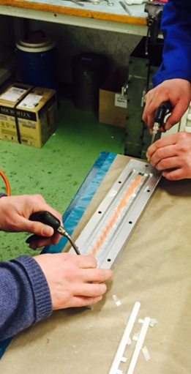
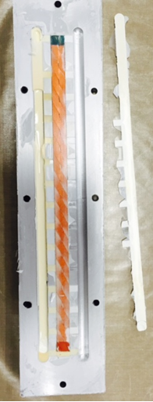
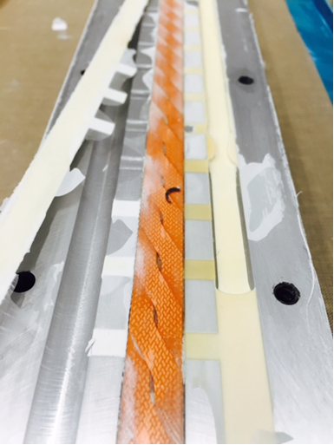
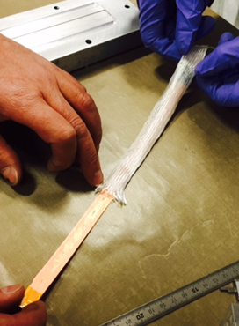
New single cable mould, for the cable sample for magnetisation tests
300mm sample,

Slide 16
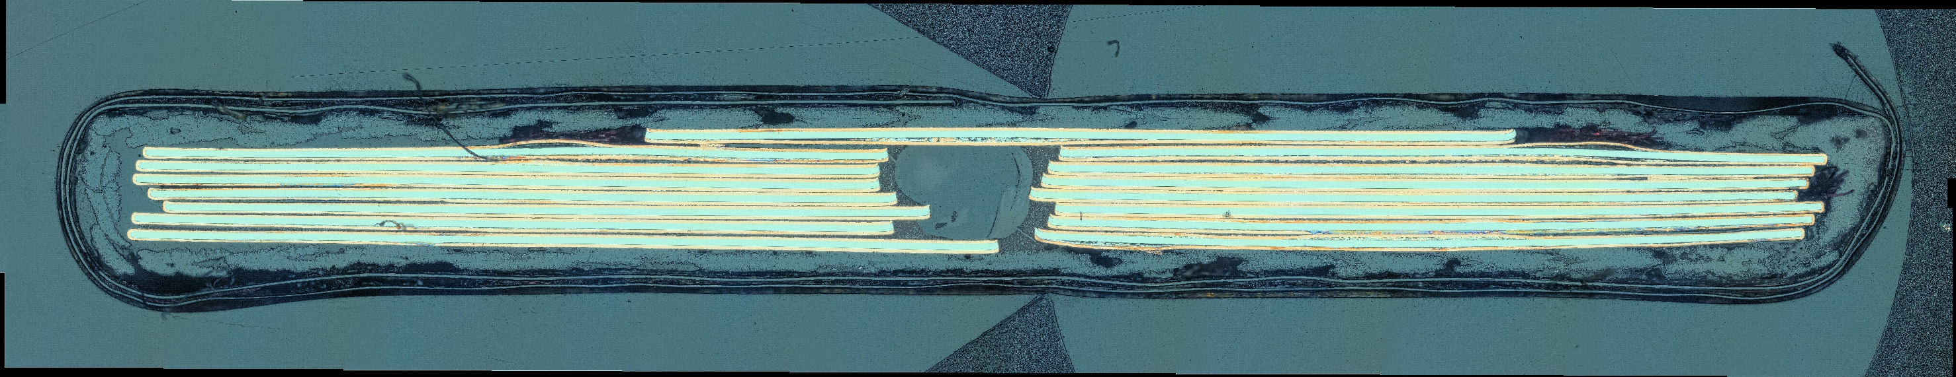
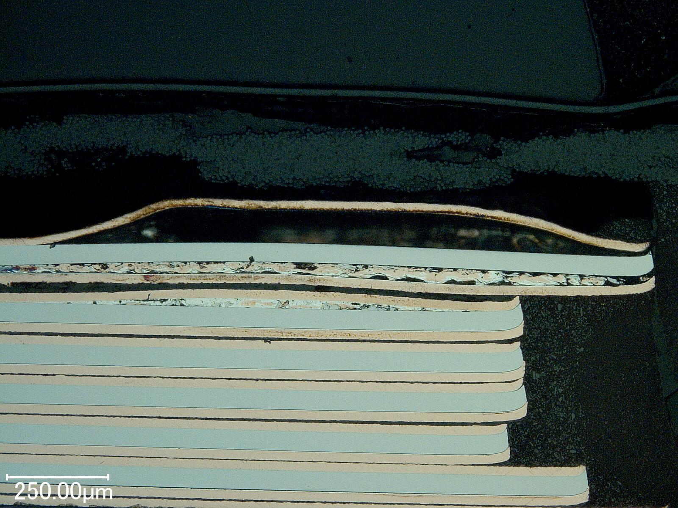
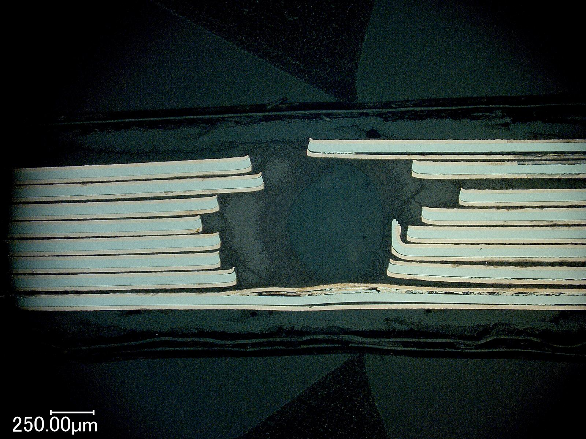

Slide 17
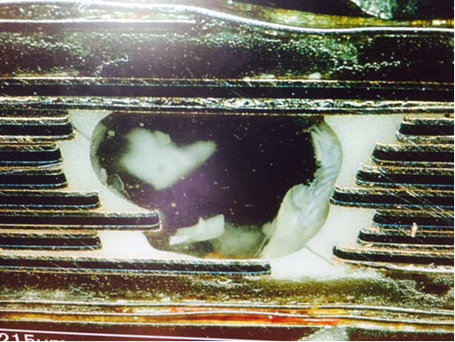
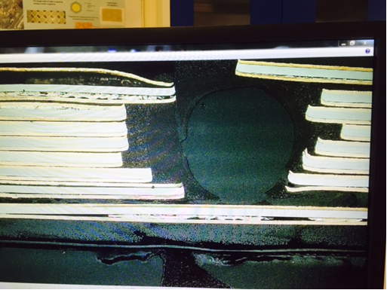
Roebel centre hole
A second impregnation was used in order to polish the sample. This impregnation filled up the remaining holes.

Slide 18
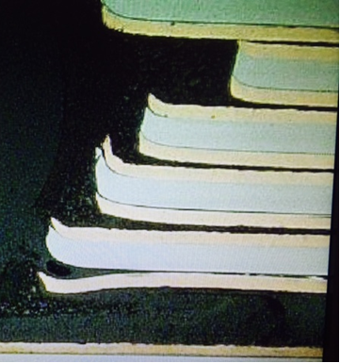
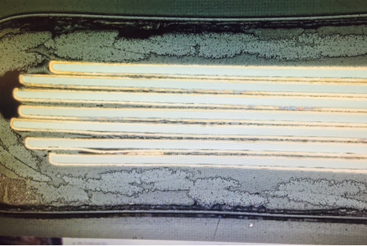
Most tapes are pushed into contact, but some are separated by resin (inside this cross section).
Delamination at edges, need to correct this: 1)so tapes lye flat on each other, plus………

Slide 19
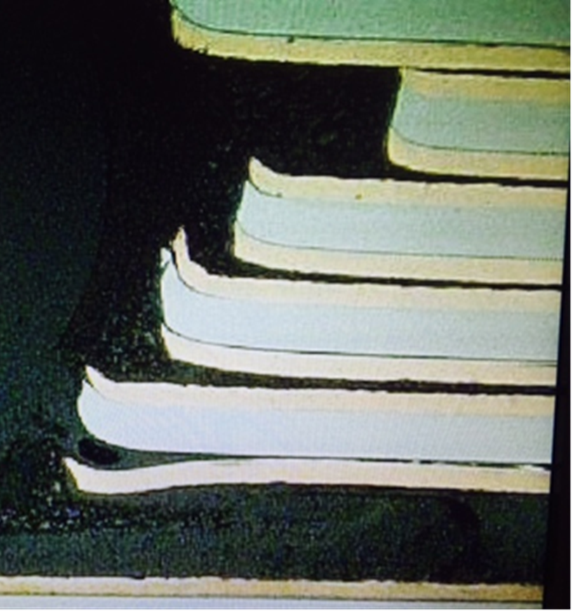
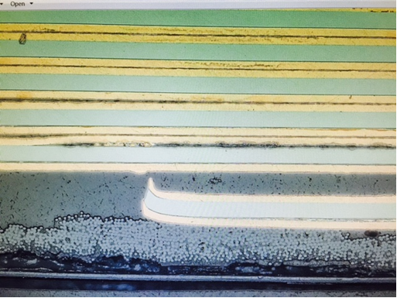
- Punched edge of tape is deformed and acts as crack initiation point.
- Also it prevents the tapes from being in good electrical contact.

Slide 20


Cable list of points
Centre hole in cable, fill with rope or wire ,
  To help with cable geometry
  May be needed for stress but confirm with cold tests.
More dummy cable ! Needed for winding tests , impregnation tests.
No sharp edges!
No delaminated edges?
Tape catches on glass sleeve, add radii or Cu plating after stamping.
Joint development!

Slide 21
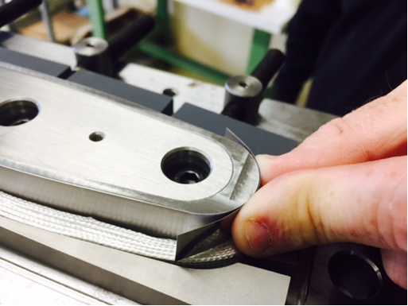
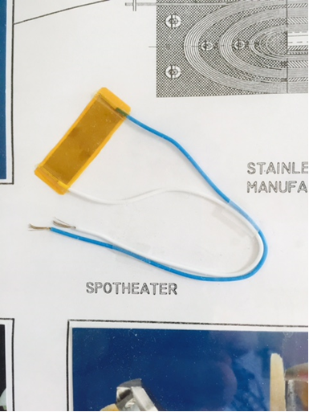
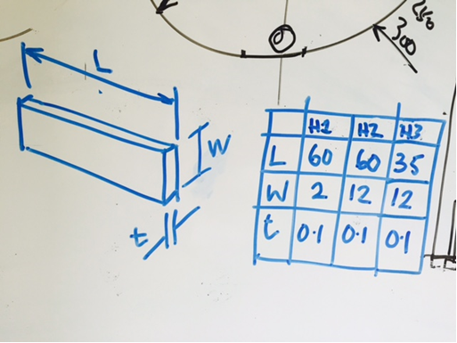
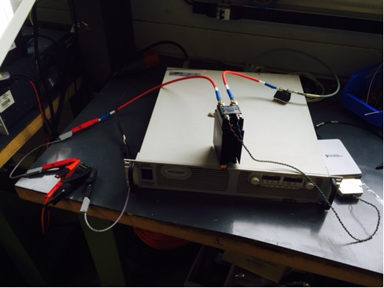

Square wave spot heater and power supply
LabView programmable current profile.

Slide 22



SM18, INFN, and FRESCA2 cryostats .
SM18 Super critical helium supplied at a wide range of temperature
Planned Testing 70K to 4K ,

Slide 23



EuCARD2 5T Feather2
HTS Magnet
G.KIRBY, J.VAN NUGTEREN, L.GENTINI, J.MURTOMAKI, M.CANALE

Slide 24


Feather M2 2D-cross section, various shell configurations
-to assist in shell configuration selection, pressure on the coil?
-Cooling, standalone 5T, background field 5T + 10 to 15T
Models done so far
20 T structure
5 Tesla structure

Slide 25




- Lorenz forces
- Iron pole magnetization

Slide 26


Slide 27

3D print for test winding Feather2 coils

Slide 28

Feather2 coil winding

Slide 29



Feather2 Assembly

Slide 30


Feather2 model 20T support system

Slide 31






Electrical Network Model for Coated Conductor Cables
Energy, Materials & Systems
UPDATE ON
Jeroen van Nugteren

Slide 32










Recap: Electrical Network Model
$$\left[\begin{matrix}0 \\ V_{nl}\left(I\right)+V_{mut}\left({dI}/{dt}\right) \\ 0\end{matrix}\right]\left[\begin{matrix}G & M_{kcl} & 0 \\ M_{kvl} & R & 0 \\ 0 & −P & Q_{k}\end{matrix}\right]\left[\begin{matrix}V \\ I \\ T\end{matrix}\right]+\left[\begin{matrix}0 & 0 & 0 \\ 0 & L_{self}+M_{s2t} & 0 \\ 0 & 0 & −C_{p}\end{matrix}\right]\left[\begin{matrix}{dV}/{dt} \\ {dI}/{dt} \\ {dT}/{dt}\end{matrix}\right]+M_{E}\left[\begin{matrix}{dB_{x}}/{dt} \\ {dB_{y}}/{dt} \\ {dB_{z}}/{dt}\end{matrix}\right]−\left[\begin{matrix}V_{s} \\ I_{s} \\ P_{e}\end{matrix}\right]=r=0$$
To be able to model the hysteresis the superconducting tapes are modeled as ribbon shaped meshes of elements (PEEC)
At this moment there are three cable geometries implemented
  Roebel
  Cable on Round Core (CORC)
  Stacked
Network Elements
X [mm]
[1]

Slide 33



Recap: Multi-Level Fast Multipole Method
$$\left[\begin{matrix}0 \\ V_{nl}\left(I\right)+V_{mut}\left({dI}/{dt}\right) \\ 0\end{matrix}\right]\left[\begin{matrix}G & M_{kcl} & 0 \\ M_{kvl} & R & 0 \\ 0 & −P & Q_{k}\end{matrix}\right]\left[\begin{matrix}V \\ I \\ T\end{matrix}\right]+\left[\begin{matrix}0 & 0 & 0 \\ 0 & L_{self}+M_{s2t} & 0 \\ 0 & 0 & −C_{p}\end{matrix}\right]\left[\begin{matrix}{dV}/{dt} \\ {dI}/{dt} \\ {dT}/{dt}\end{matrix}\right]+M_{E}\left[\begin{matrix}{dB_{x}}/{dt} \\ {dB_{y}}/{dt} \\ {dB_{z}}/{dt}\end{matrix}\right]−\left[\begin{matrix}V_{s} \\ I_{s} \\ P_{e}\end{matrix}\right]=r$$
Instead of using a dense matrix the the induced voltages can be calculated at each element every time step using MLFMM
Uses spherical harmonics (multipoles) as a “middle man” to reduce the computational complexity from O(NxM) to O(N+M)
An octtree-grid ensures that all the interactions are included
Implemented using highly parallelized code using NVIDIA CUDA GPU programming language
Graphics Processing Unit
(GPU)
L. Greengard, “The rapid evaluation of potential fields in particle systems,” tech. rep., Cambridge, 1988.
J. Kurzak and B. M. Pettitt, “Fast multipole methods for particle dynamics,” Molecular Simulation, vol. 32, no. 10-11, pp. 775–790, 2006.

Slide 34




Recap: Element Current Sharing
Superconducting power law element in parallel with resistive (matrix) element (implicit equation)
Non linear elements introduce hysteresis (special thanks to Antti Stenvall for pointing this out)
Current Sharing
$$I0−\frac{E0}{ρ\left(B,T\right)}{\left[\frac{I_{sc}}{I_{c}\left(B,T,α\right)}\right]}^{N}−Isc=0$$
Inc
Inc
Isc
Isc
I [A]
T [K]

Slide 35



Recap: Contact Elements
Size of contact area calculated using the overlap between the Voronoi Cells of the nodes
For Roebel and Stacked in Cartesian and for CoRC in Cylindrical coordinates
White lines represent contact elements
Contact resistances used
  1x10⁻⁸ Ωm² [1]
  100 watt/(m² K)
Voronoi Cells
Example
Tape2
Aoverlap
[1]
Tape1

Slide 36



Improvement over last weeks
The AC-losses did not converge properly to steady solution with increasing number of elements
  Found unit error in the calculation of the self inductance matrix Lself (shame)
  After correction the mutual inductances play a much larger role slowing the calculations down significantly
  However more complex behavior in the cable is observed (such as shielding)
$$L_{self}=0.002l\left[log\left(\frac{2l}{w+t}\right)+0.5+0.235\left(\frac{w+t}{l}\right)\right]$$
Input in cm, output in muH D:
Ribbon Inductance
Radio Engineers Handbook, McGraw-Hill, New York, 1945.
Field Lines around Cable
Current density in tapes
needs better plotting
x-axis not to scale
shielded

Slide 37

Modifications Speeding Up the Code
To get speed back up for large systems several notable modifications were made to the code
  S2T calculations are no longer part of MLFMM but are calculated using a sparse Ms2t matrix instead
    The matrix is included in the pre-pre-conditioner systems
    Matrix vector product is calculated using GPU
  Solution of Triangular LU matrices are now performed using
    cs_utsolve and cs_ltsolve from suite-sparse (surprisingly much faster than MATLAB)
  Many other pre-(pre)-conditioners were tried but no speed up was achieved
  Using METIS from sparse suite instead of COLAMD to increase sparsity of LU decomposition
~10X Speed-up
Cable Geometry
Setup INI
Roebel, Cork, Stacked
BICGSTAB
PrecSetupFun
Field Model
LU-decomposition
Setup Matrices
Sundials IDA
PrecFun
PrecPrecFun
MR, Ms2t, Mkcl, Mkvl, …
cs_utsolve, cs_ltsolve
MLFMM setup
GMRES
grow octree
write2disc
JTVfun
SubPrecFun
build interaction lists
Jacobian V
Electrical Network Construction
MLFMM
contact, superconductor, Sources, sinks, etc.
SystemFun
CUDA
Data Analysis and Plotting

Slide 38


Preliminary Study of influence of Elements
Preliminary comparison between 14 and 24 elements shows similar current pattern
Need to confirm with magnetization loops and losses
Computation time and memory scales more-or-less linearly with the number of elements (need plot)
14 Elements
24 Elements

Slide 39




How to go from here
Validation
  Reproduce University of Twente // Southampton Roebel Cable AC-loss measurement data (electrical)
  Reproduce quench propagation data (thermal)
  Paper for EuCAS End Summer 2015
Model different simplified coil geometries and analyze harmonics
  Cosine theta // Aligned block // Block // Pancake Coils etc.
Analyze different cable structures
  Roebel // CORK // Stacked // (implement Rutherford?) …
  Effect of striation in superconducting tapes on Magnetization currents
  Quench propagation and current redistribution within cable structures
Also need to start writing my thesis D:

