Slide 1
Status Report – Injection Working Group
Working group to find strategy for more efficient start-up of injectors and associated facilities after long stops
V. Kain, B. Mikulec, members of IRWG

Slide 2
Working Group Approach – Transparency from December
Representatives from all machines around the table
Analyze commissioning and start-up after LS1
  What worked well? And why?
  Which areas need improvement? And why?
Define common approach across different machines
  Learn from each other; learn from the LHC if applicable
  Define how to test, what to test, when to test and who should test
  Formalize testing and follow-up: check lists
  E.g.: collaborative testing between equipment groups, OP and controls already before machine check-out – “Dry runs"

Slide 3
Working Group Composition
The core: 2 members of each machine/facility (often shifters)
  SPS, PS, PSB, ISOLDE, LEIR, AD
Chair : V. Kain. Deputy: B. Mikulec
Scientific secretary: B. Lefort
Meetings in indico: https://indico.cern.ch/category/6174/
  6 meetings so far since end of January

Slide 4
Status
Discussed the start-up approach, testing procedures and issues of ALL machines
  also had presentation from the LHC
  nTOF and EA will be invited to participate
Many common issues found
We are in the process of establishing new approach

Slide 5
Main Common Issues
Partial test coverage; missing or incomplete check lists
  Settings preparation and verification from physics to hardware parameter incomplete: optics preparation,…
  Conventions not established for polarity checks
  Missing references for BI systems e.g. mini scans..
  …
Testing starting too late
Priority issues LHC ⬅➔injectors
Single expert not always available
  Holiday period
Interfaces between multiple systems not sufficiently tested
  access ⬅➔ equipment, SPS PS
Control tools’ readiness: e.g. FESA 3
  Readiness requirements need to be clearly communicated
Insufficient communication of modifications of equipment and controls to OP

Slide 6
Main proposed improvements
Preparation of check lists
  Skeleton prepared by working group
  Each machine prepares check list
    Polarity checks will become obligatory. Convention to be established
1 (or 2) person per machine/facility in OP responsible for machine preparation
  Ensure check-lists complete
  Follow-up, progress tracking
  Organization of coordination meetings before test period. Communication with equipment experts for readiness, modifications,…
  Organize tests
Start testing earlier
  With equipment experts in dry runs: “full” vertical slices with “all” interfaces

Slide 7
Introduction of New Phase
Machine preparation tests coordinated by OP
  Coordination with equipment experts and MEF
  Equipment experts to participate in the tests
Hardware test and accesses: coordinated by OP and MEF
Machine responsible point of view
Machine Preparation
Beam
Equipment expert point of view
Hardware tests
Checkout
Beam
Access periods foreseen
No access foreseen
time

Slide 8
To be answered: How to deal with modifications?
In case of introduction of “major” machine modifications during long stops
  Involve machine responsible (OP/ABP) during specification phase
  If possible, staged deployment of different features followed by dry runs “long before end of stop
  Example: deployment of FGCs in the SPS
Introduce test mode in equipment for realistic testing without beam
  Where necessary
  Example: FGC simulation mode
  Caution: need protect against accidently leave equipment in simulation during beam operation

Slide 9
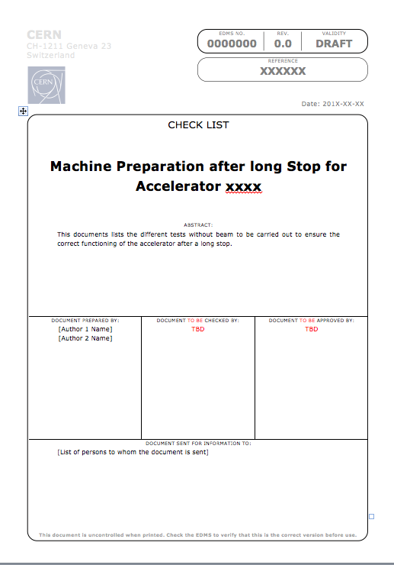
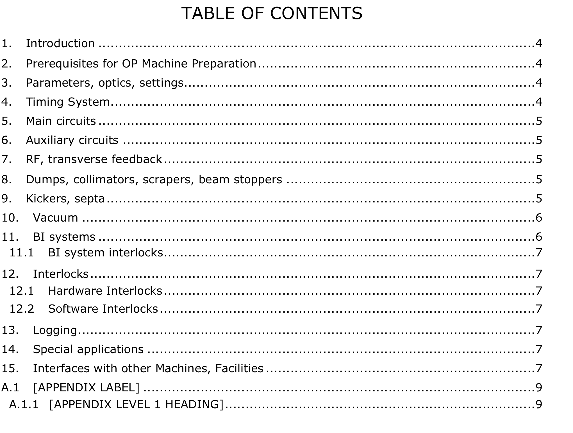
Skeleton check list – EDMS document
To be filled in by each machine.
To be published after each re-commissioning.
Work in progress

Slide 10
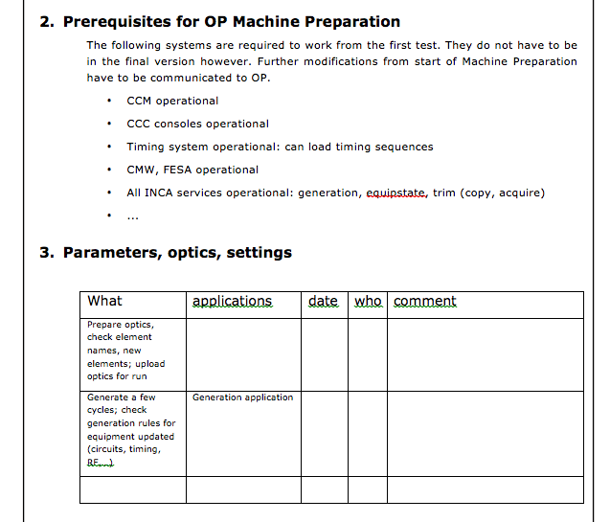
Skeleton check list – EDMS document
Work in progress

Slide 11
Conclusion
Close to finishing analysis of start-up after LS1 in the injector complex
Many common issues found. Résumé: direction for improvement clear
Improvements will include
  Definition of “machine preparation” responsible
    For communication, coordination meetings, test programme
  “Complete” check lists; more tests
    Learn from each other: polarity checks, test modes,…
    Need to ensure that check lists stay “alive”
  Start testing early
    Dry runs long before machine check-out. Staged deployment of modifications followed by test of new functionality as early as possible
IRWG: very pleasant experience to see all machines working together

