Slide 1
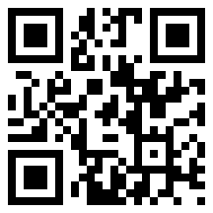
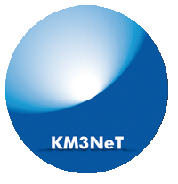
KM3NeT 2.0
Astro-particle and Oscillations Research
with Cosmics in the Abyss
(ARCA & ORCA)
MANTS
17−18 October 2015, Amsterdam.
Maarten de Jong

Slide 2
Introduction¶
KM3NeT is a new Research Infrastructure
  network of cabled observatories
  located in deep waters of Mediterranean Sea
  hosting multi-km³ Neutrino Telescope
Discovery and subsequent observation of
high-energy neutrino sources in Universe
Measurement of neutrino mass hierarchy
Synergy with Earth & Sea sciences
¶ Outlined in KM3NeT strategy document.

Slide 3
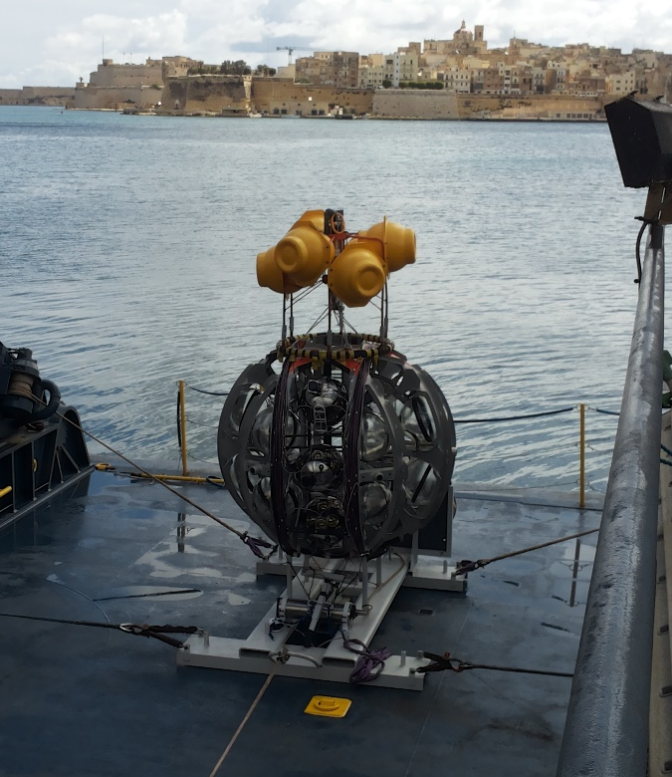
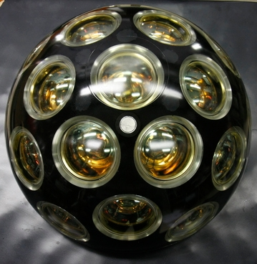

Design
Launcher vehicle
Optical module
~ 600 m
17”
31 x 3” PMTs
low-power HV
LED & piezo inside
FPGA readout
White Rabbit
DWDM
rapid deployment
autonomous unfurling
recoverable

Slide 4
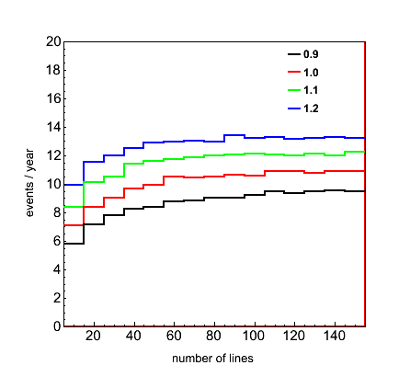
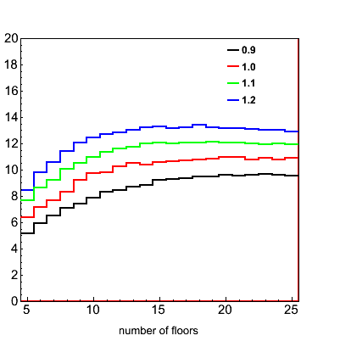
Building block
λ_{abs} scaling factor
λ_{abs} scaling factor
RXJ1713 events / year
number of lines
number of floors
Smallest detector with optimal efficiency ~ 1/6 total size

Slide 5
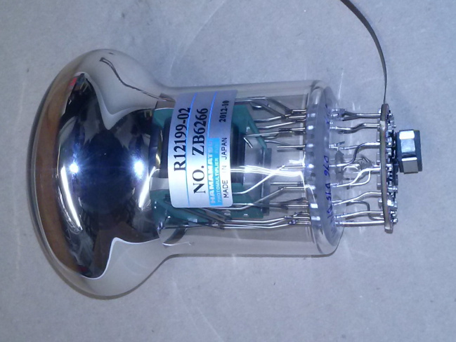
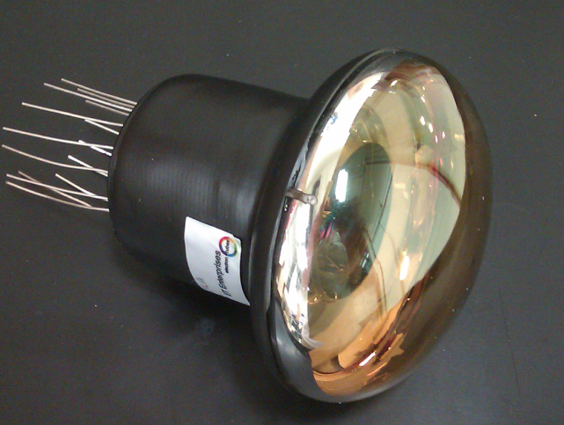
3-inch PMTs
Key features:
  timing ≤ 2 ns (RMS)
  QE ~ 30%
  collection efficiency ≥ 90%
  photon counting purity 100% (by hits, up to 7)
  price/cm² ≤ 10” PMT
ETEL
ETEL D792
Hamamatsu R12199
HZC XP53B20

Slide 6
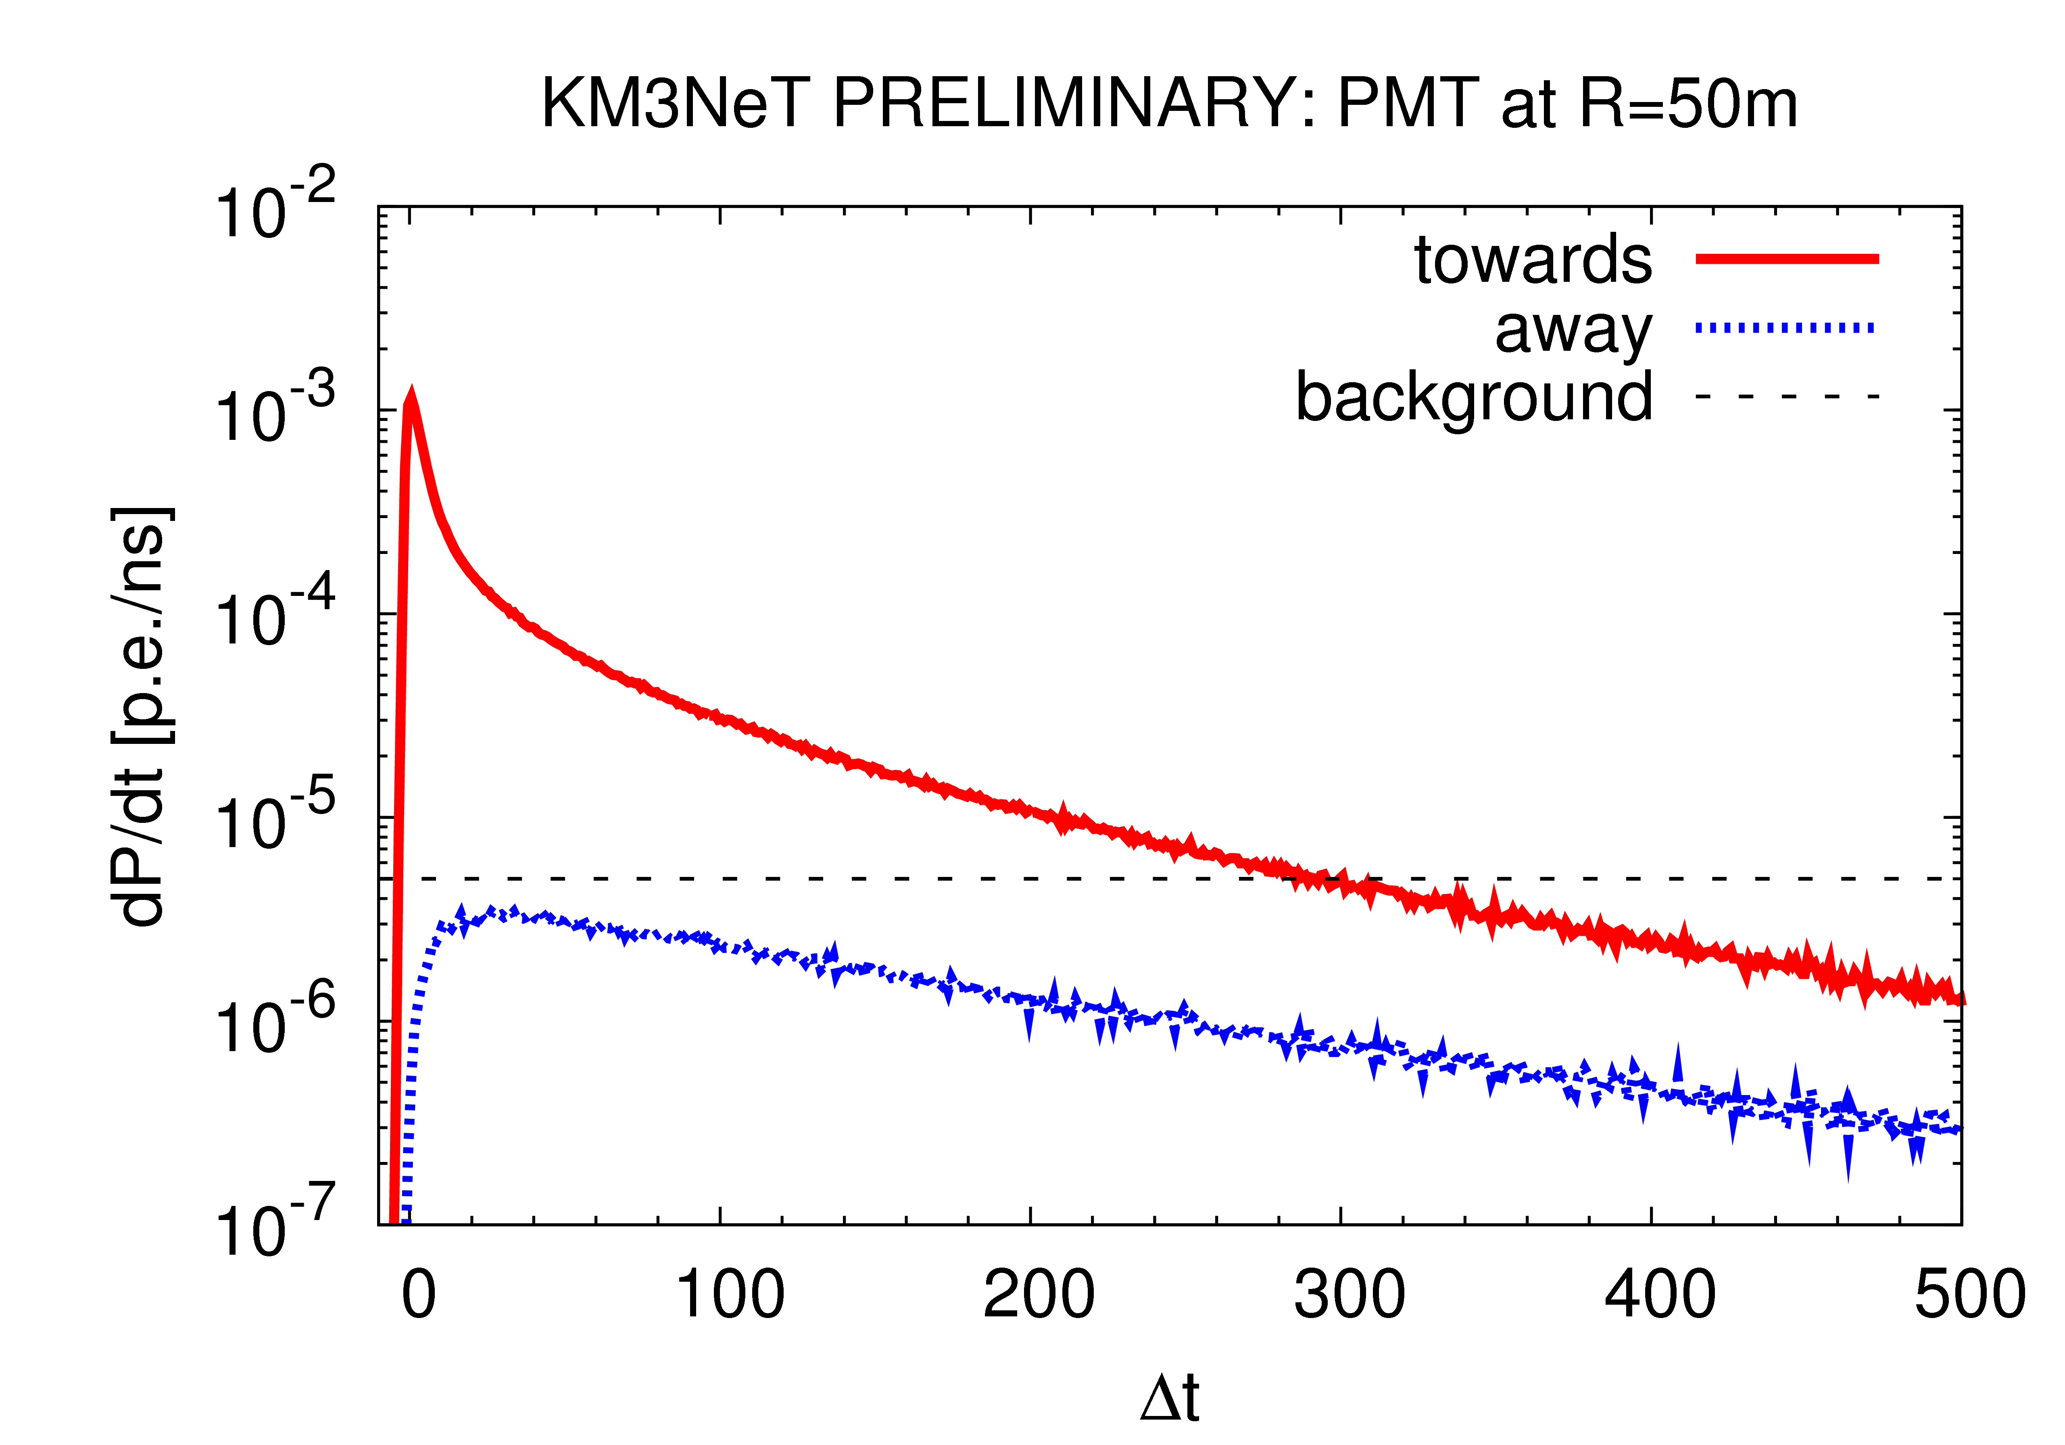
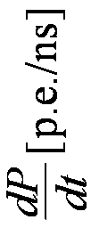

PDF of muon light
PMT
50 m
1 TeV muon
Δt [ns]
Angular resolution 0.1 degrees

Slide 7
Phased implementation
Phase | Blocks | Primary deliverables
1 | 0.2 | Proof of feasibility and first science results;
2.0 | 2 ARCA | Measurement of neutrino signal reported by IceCube; All flavor neutrino astronomy;
 | 1 ORCA | Neutrino mass hierarchy;
3 | 6 (+1) | Neutrino astronomy including Galactic sources;

Slide 8
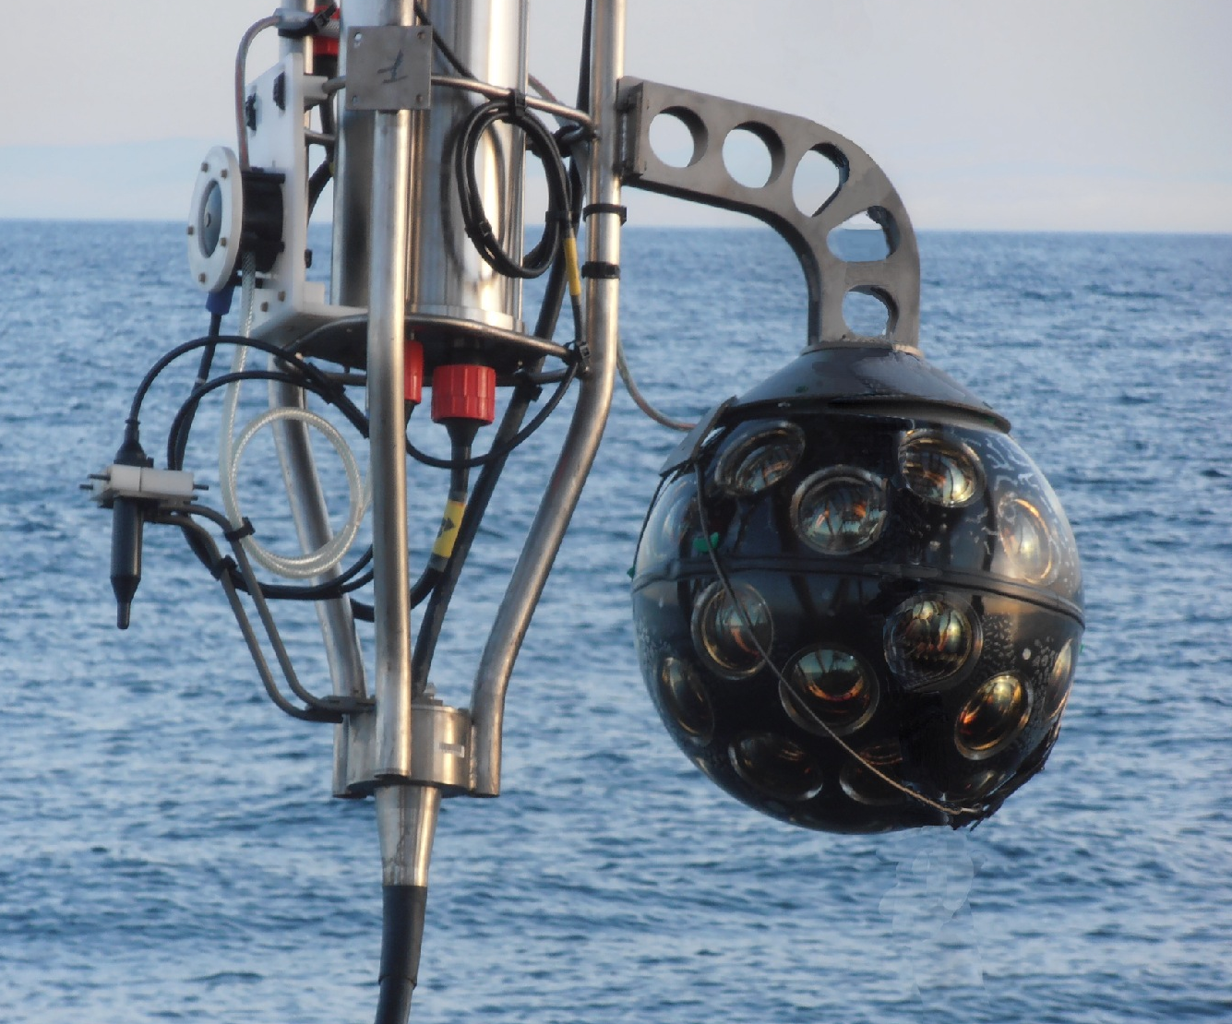
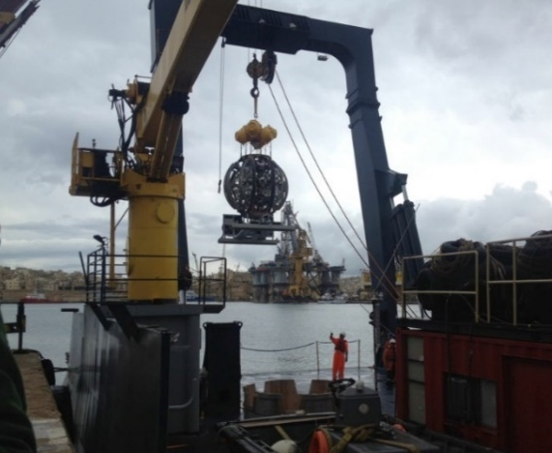
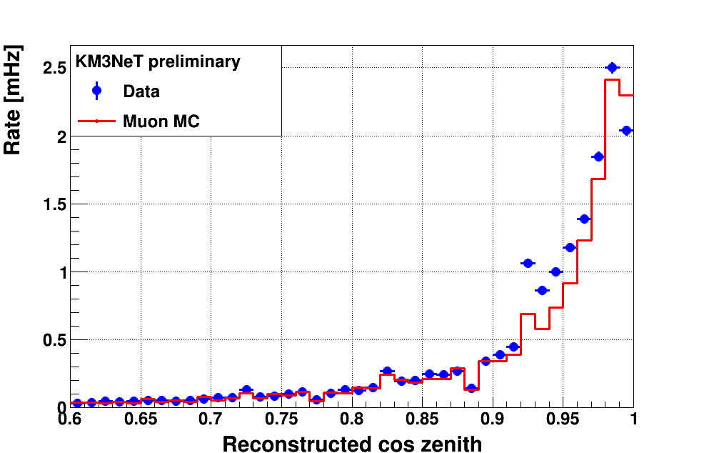
Prototyping
Optical module deployed at Antares April 2013 (2500 m)
Mini string deployed at Capo Passero May 2014 (3500 m)
Eur. Phys. J. C (2014)
74:3056
Rate [Hz]
Multiplicity
To be submitted
Eur. Phys. J. C
Rate [mHz]
cos(θ)

Slide 9
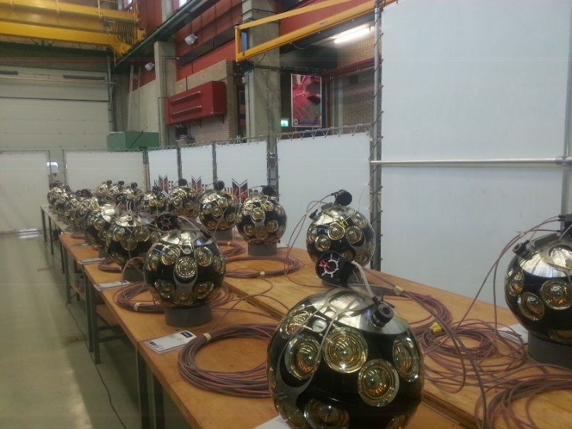
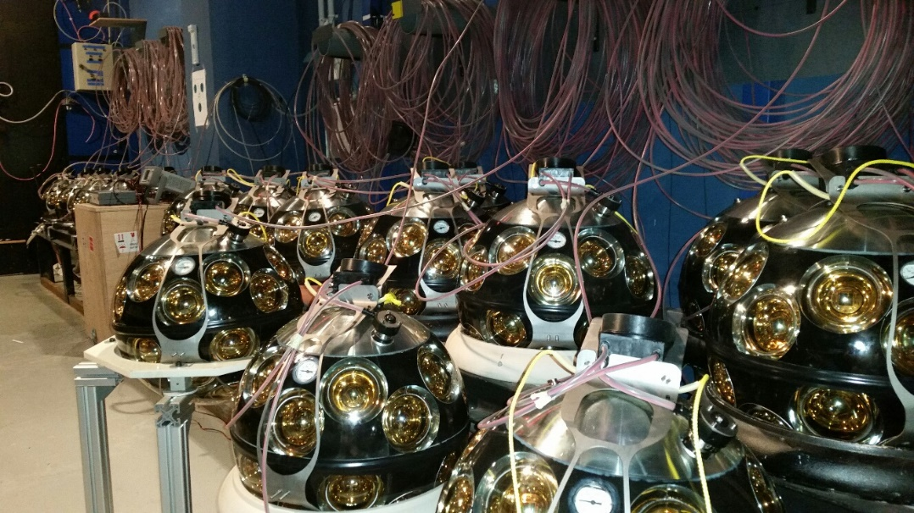
Phase-1
First string ready for deployment
  to be deployed at KM3NeT-Fr following repair operation
Second string assembled
  to be deployed at KM3NeT-It in December
Phase-1
  24 strings à la ARCA in KM3NeT-It
  6 strings à la ORCA in KM3NeT-Fr

Slide 10
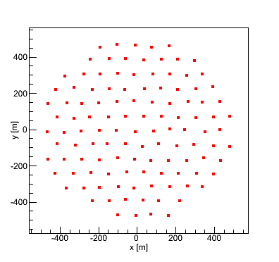
ARCA (I)
Measurement of neutrino signal reported by IceCube
1 building block
1 building block
~1 km
~1 km
@ KM3NeT-It

Slide 11
ARCA (II)
Diffuse flux analysis
significance [σ]
observation time [y]

Slide 12

ARCA (III)
Point source sensitivity
5σ in 3 years
muon
cascade
E²Φ [GeV cm⁻² s⁻¹]
sin(δ)

Slide 13
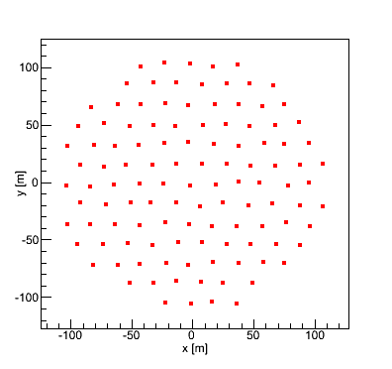
ORCA (I)
Measurement of
neutrino mass hierarchy
1 building block
200 m
@ KM3NeT-Fr

Slide 14
ORCA (II)
Design fixed
  115 strings with 18 optical modules (same as ARCA)
    horizontal spacing 20 m
    vertical spacing 6−12 m
Site agreed
  Toulon, France
Qualification
  plan endorsed
  first string to be deployed before end 2016

Slide 15
ORCA (III)
3 years
significance [σ]
θ₂₃ [deg]

Slide 16
Future prospects (I)
1 building block
1 building block
1 building block
~1 km
~1 km
~1 km
1 building block
1 building block
1 building block
~1 km
~1 km
~1 km

Slide 17
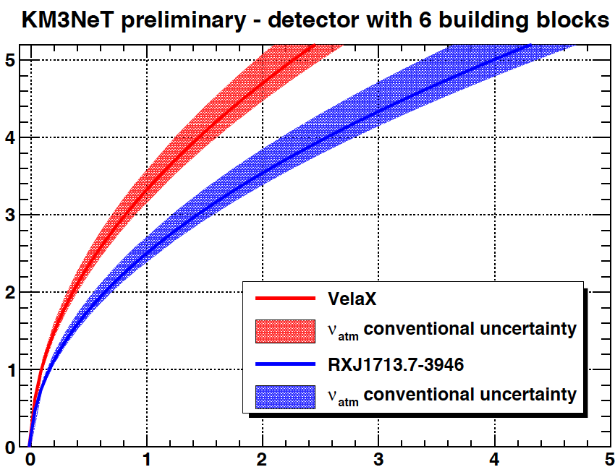
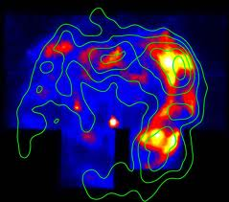
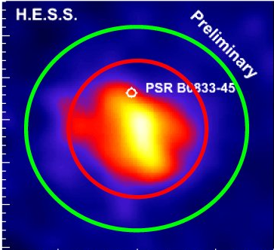
Future prospects (II)
RXJ1713¶
(binned analysis)
significance [σ]
Vela X§
observation time [y]
¶ S.R. Kelner, et al., Phys. Rev. D 74 (2006) 034018.
§ F.L. Villante and F. Vissani, Phys. Rev. D 78 (2008) 103007.

Slide 18
ESFRI
Submitted proposal March 2015
  request position on road map 2016
  total (additional) budget 95 M€
Hearing September 2015
Verdict December 2015

Slide 19
KM3NeT status & outlook
R&D
  developed cost-effective technology
  feedback from prototypes confirm key specifications
  interest from other groups
Phase-1
  going ahead as planned
Phase-2
  ARCA
    measurement of IceCube flux with different methodology,
    complementary field of view and improved resolution
    all flavour neutrino astronomy
  ORCA
    measurement of neutrino mass hierarchy
Future prospects
  exploration of our Galaxy

