Slide 1
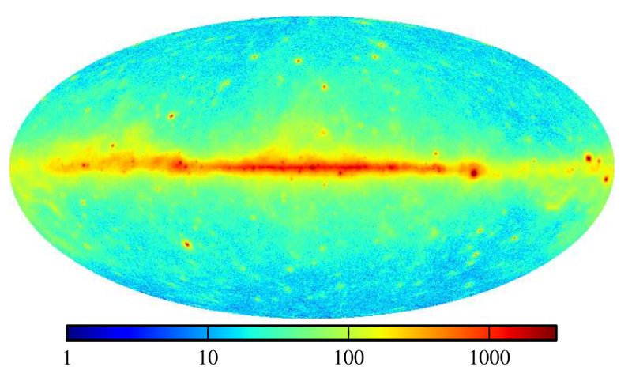


A Search for Neutrinos from the Galactic Plane
Jon Dumm w/ Chad Finley & Martin Wolf
MANTS Meeting - Amsterdam
Oct 17, 2015

Slide 2

Overview
Summarize latest evidence for a galactic component in our measured neutrino flux
  IceCube data
  New models of CR transport, gamma rays & neutrino emission
Analysis method
  Maximum likelihood spatial template analysis on 6 years of IceCube point-source data
Sensitivity and comparisons to ANTARES

Slide 3
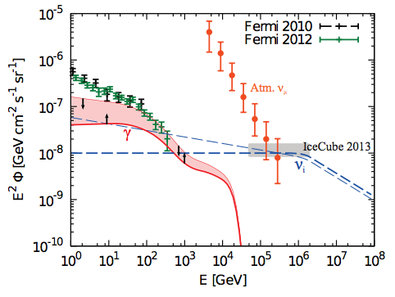
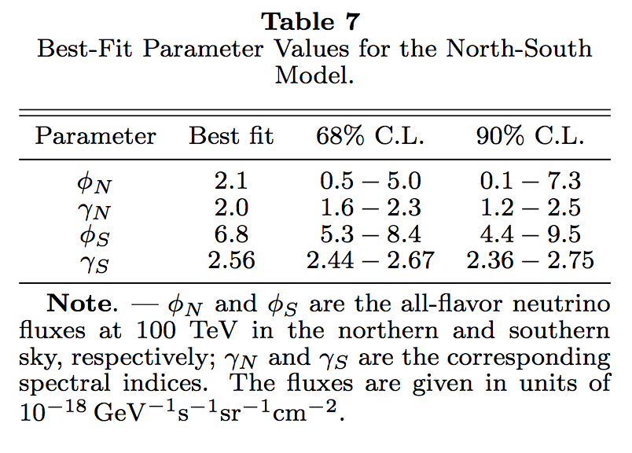
IceCube Hints
High-Energy Starting Events skymap
  p=2.5% in gal plane scan within ±7.5° gal latitude
Global fit spectrum and N/S hemisphere check
  Soft extragalactic ν spectrum overproduces GeV gamma rays
  Murase, Ahlers, Lacki 2013 (arXiv:1306.3417)
  Spectral index North vs South
arXiv:1507.03991v2

Slide 4
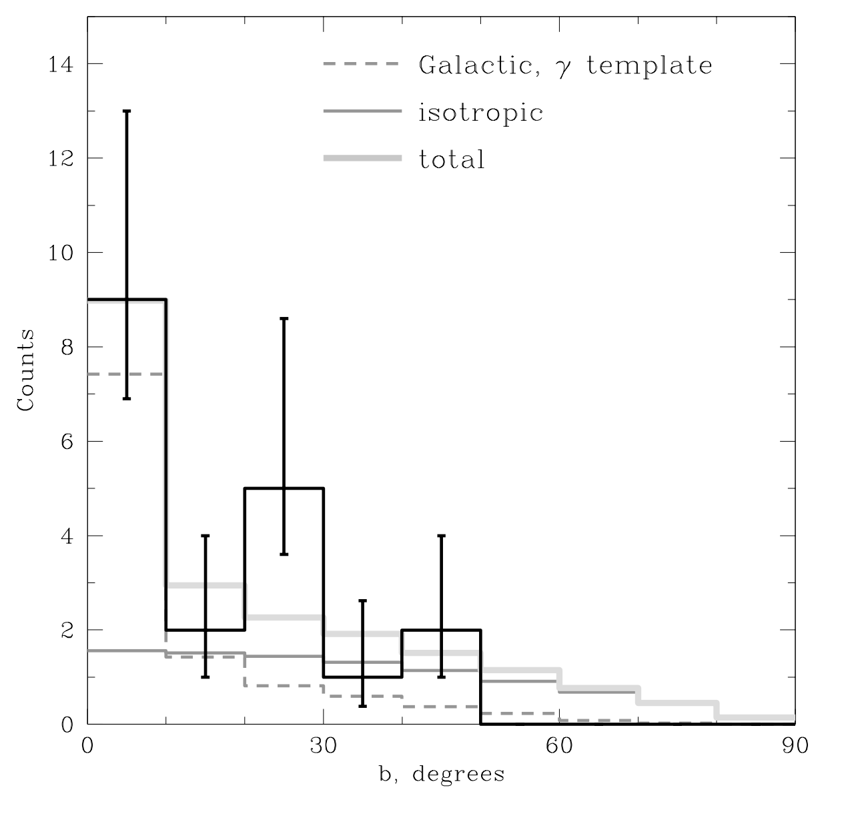
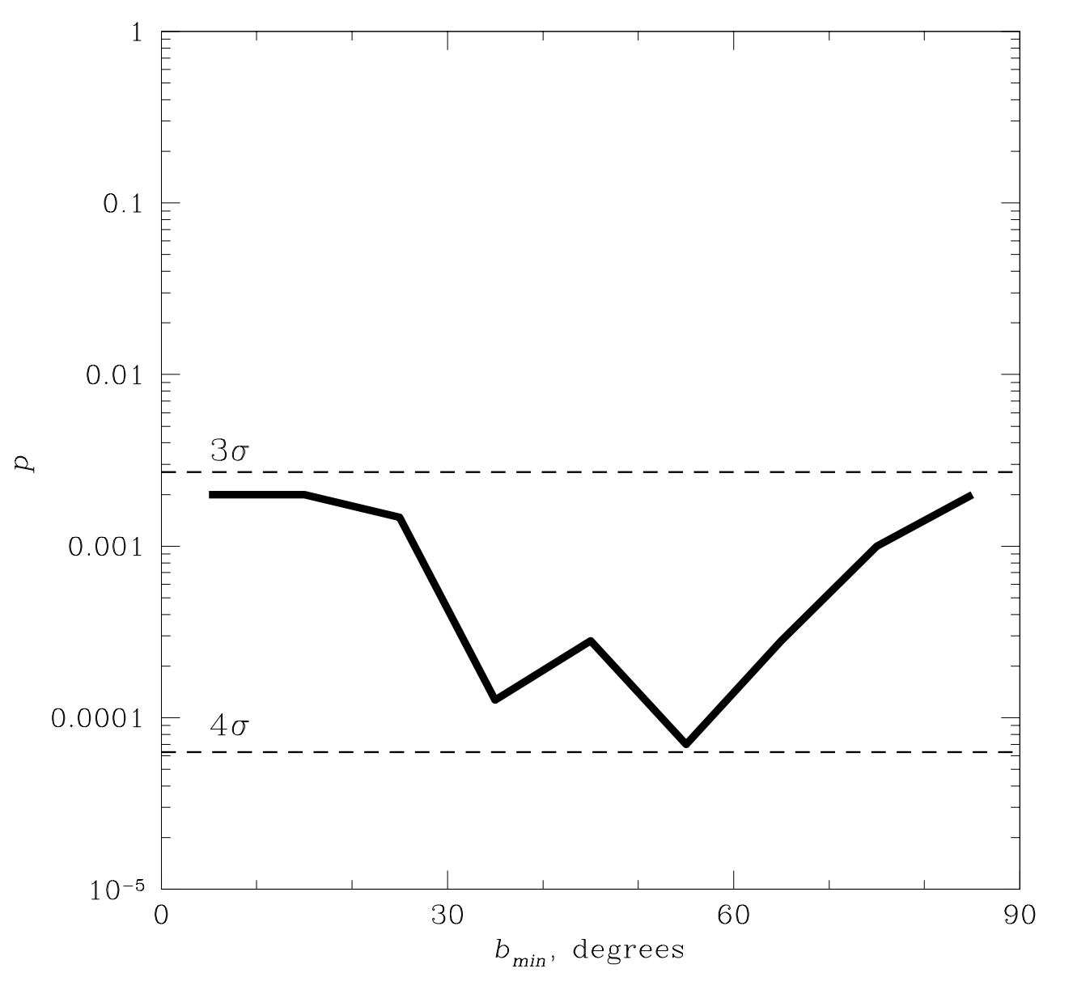
>100 TeV A Posteriori
trial correction factor for E_{min}?
“...the inconsistency of the isotropic signal model with the data is at > 3σ level.”
[high-energy starting events]
“A model which contains 50% contributions from the galactic and extragalactic components provides a satisfactory fit to the data [left].”
Neronov & Semikoz 2015 (arXiv: 1509.03522)

Slide 5
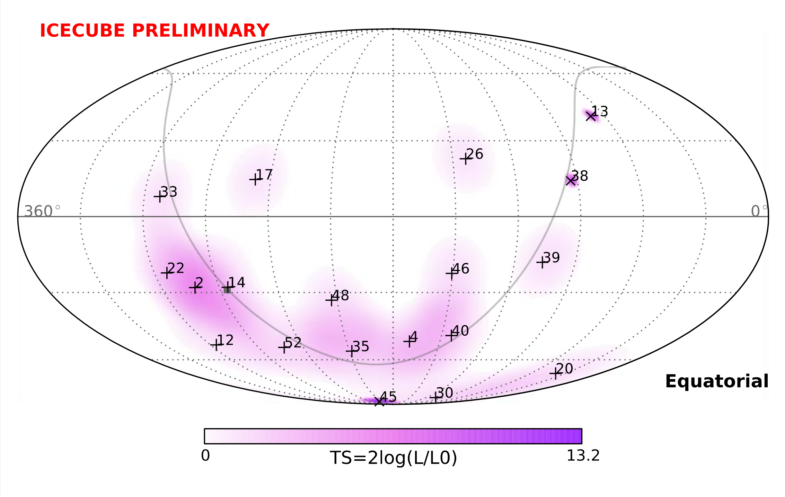
>100 TeV A Posteriori

Slide 6
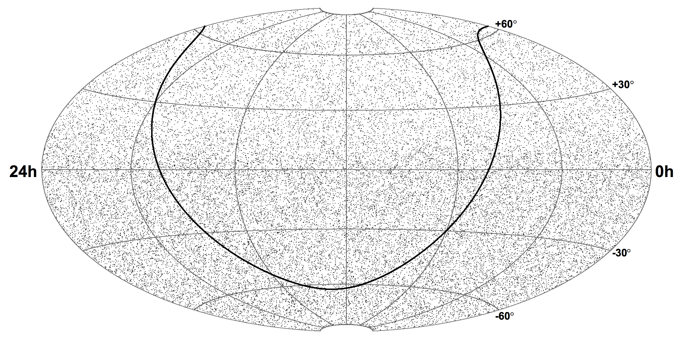
Point Source Sample
1 year – IC40
36,900 events
Too many events to show full sample – 40-string sample for illustration
Extrapolate diffuse flux down: <N_{sig}>=208 events in skymap above
Can we determine if these few events are distributed along the plane?

Slide 7
6 Years of PS Data
6 years
~500k events
(arXiv:1507.03991v2)
Extrapolating Global Fit paper diffuse flux down in energy: <Nsig> ~ 2400 events in 6-year PS sample
Too many events to show full sample – 40-string sample for illustration
Extrapolate diffuse flux down: <N_{sig}>=208 events in skymap above
Can we determine if these few events are distributed along the plane?

Slide 8
GP Emission Mechanisms
Two likely origins for ν flux from plane:
  Gal CR interactions with interstellar gas (p-p)
    Conventional models: If flux ~ E^{-2.7} as observed at Earth is uniform throughout galaxy → relatively small neutrino flux
    Large scale, gamma-rays act as CR-interaction tracers
  Unresolved gal CR sources and interactions with local material
    Perhaps very many point sources → nearly diffuse in plane
    Perhaps a handful of sources along the plane

Slide 9
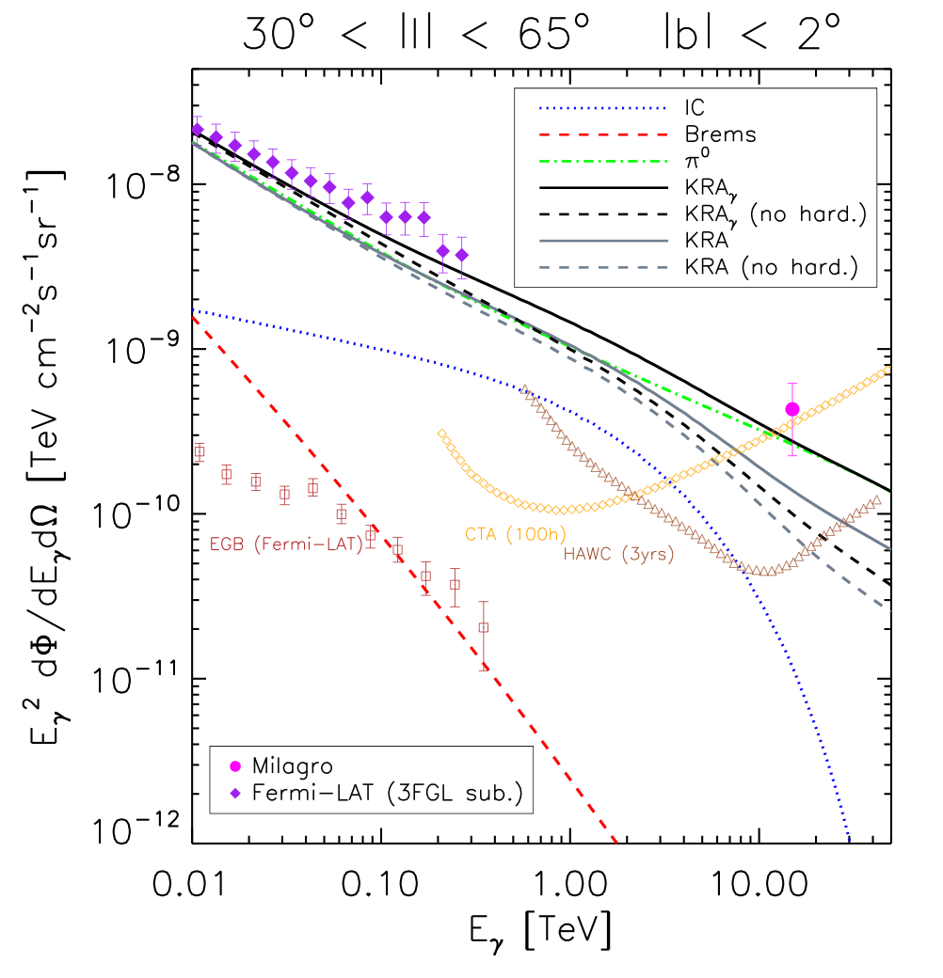
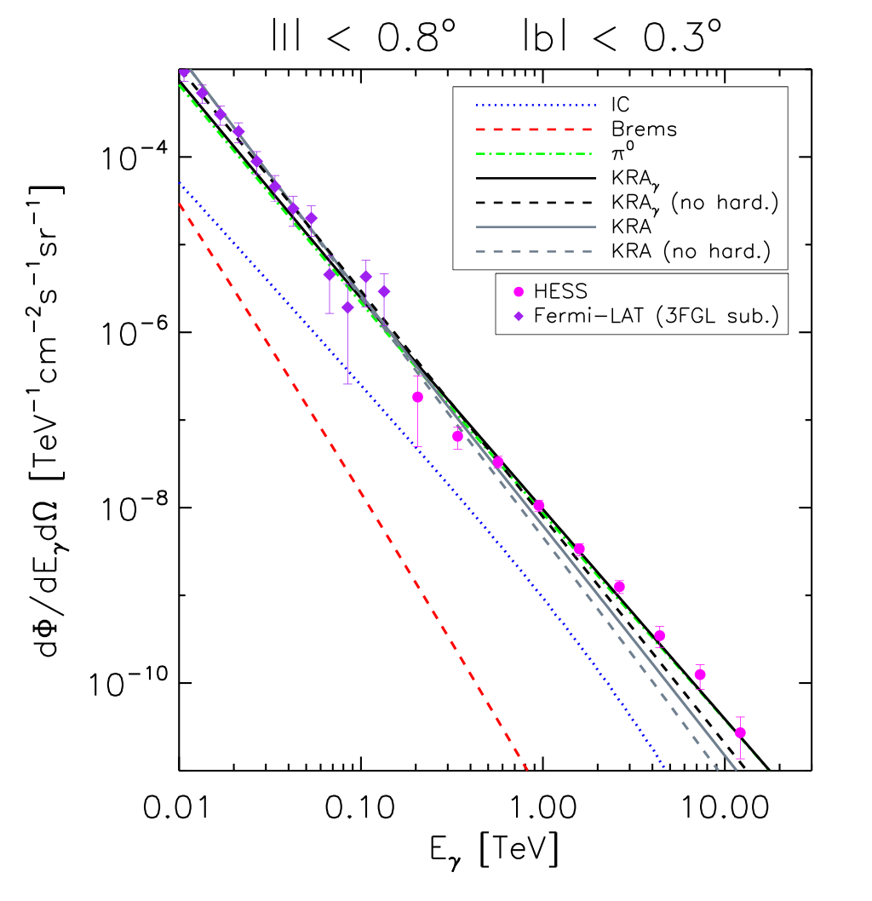
Gal CR Interactions
Until now, CR spectral index observed at Earth assumed same everywhere
  Fermi+Milagro+HESS ϒ-rays now allow us to test this assumption
Tuned
ϒ-ray Models
Tuned
Conventional
Conventional
New: Incorporate PAMELA/AMS measured p & He hardening and allow CR diffusion to change with gal. radius
Gaggero et al 2015
arXiv:1504.00227v2

Slide 10
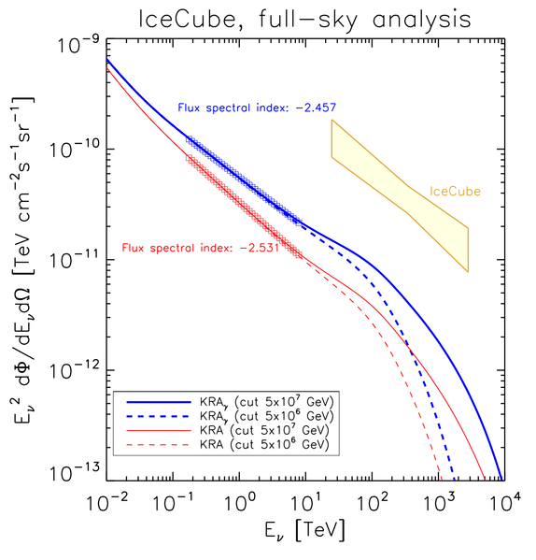
Gal CR Interactions
Until now, CR spectral index observed at Earth assumed same everywhere
  Fermi+Milagro+HESS ϒ-rays now allow us to test this assumption
After tuning CR propagation to the gamma-ray data: up to ~20% of our diffuse neutrino flux comes “for free”
Specifics:
Assumes PAMELA/AMS p & He hardening is global
Gal CR cutoffs: 5 (dotted), 50 (solid) PeV
red = Conventional + global hardening
blue = Tuned to ϒ-ray observations
(Fermi-LAT, HESS, & Milagro)
ϒ-ray Models → ν predictions
New: Incorporate PAMELA/AMS measured p & He hardening and allow CR diffusion to change with gal. radius
Gaggero et al 2015
arXiv:1504.00227v2

Slide 11
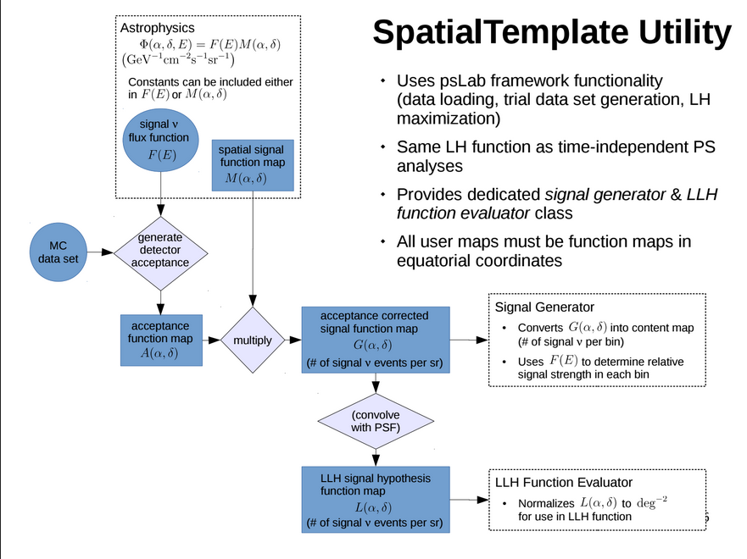
Max LH Spatial Template
Spatial Template Maximum Likelihood Analysis Flowchart
Built into existing point-source analysis framework, psLab
Accepts any maps over the full range of Equatorial coordinates
Provides dedicated signal generator and likelihood spatial terms

Slide 12
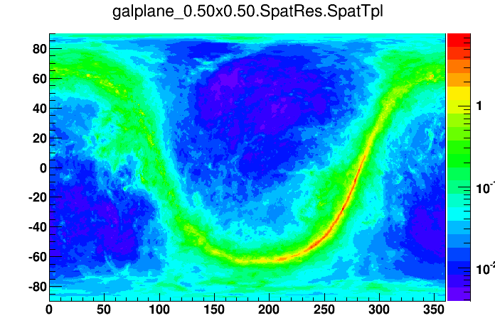
Max LH Spatial Template
Dec (deg)
Map built from H surveys of the galaxy
CR intensity fit to gamma-ray data in galactic radius bins
Pion-decay component used as template for neutrinos
RA (deg)
Pion-decay Gal Plane Map
from Fermi-LAT

Slide 13
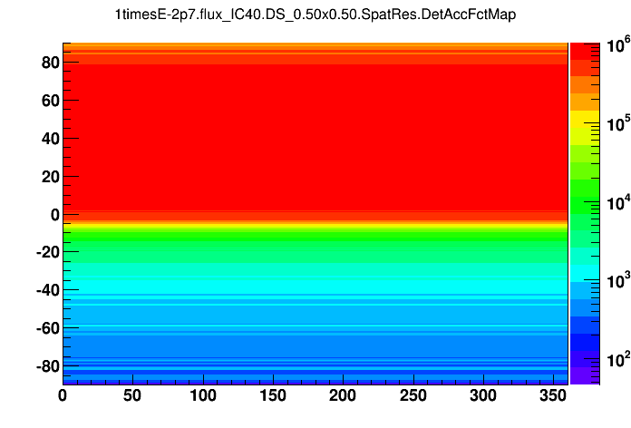
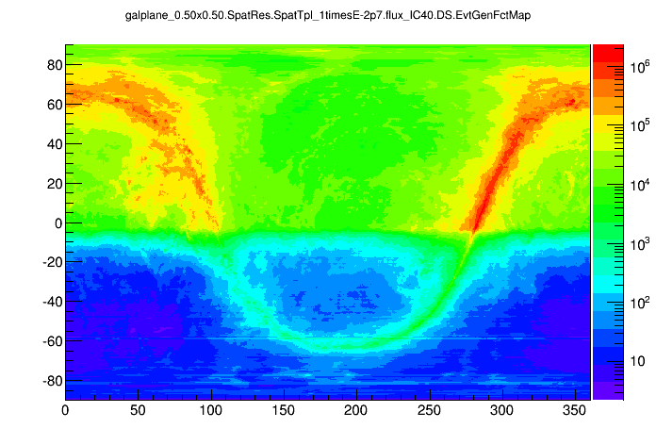
Max LH Spatial Template
Dec (deg)
x
=
RA (deg)
Pion-decay Gal Plane Map
from Fermi-LAT
IceCube Eff Area
(IC40 PS sample, E^{-2.7})
Where we should see neutrinos
originate before PSF smearing
One more step (see next slide): convolve with event-wise PSF
Generic Spatial Template Maximum Likelihood
  Martin Wolf is using same code for DM Halo analysis
  In revamping this method, we found some bugs relating to square bins/spherical sky leading to distortions in PDF near poles
    Previous IC40/59 unblinding never published

Slide 14
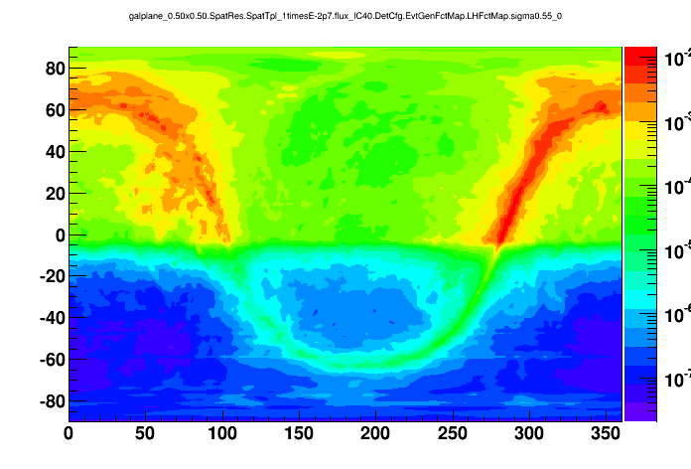
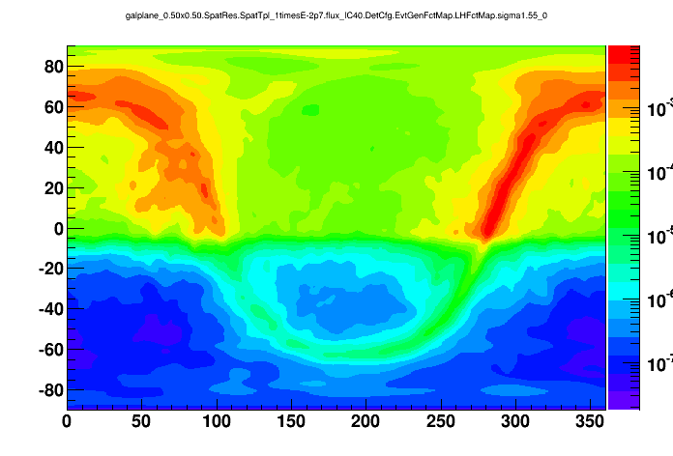
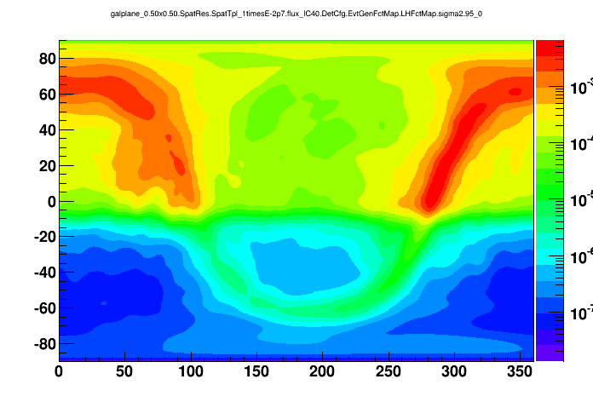
Convolutions – PSF Smearing
None
0.5°
Dec (deg)
1.5°
3.0°
Analysis uses step size of 0.1° for smearing
RA (deg)

Slide 15
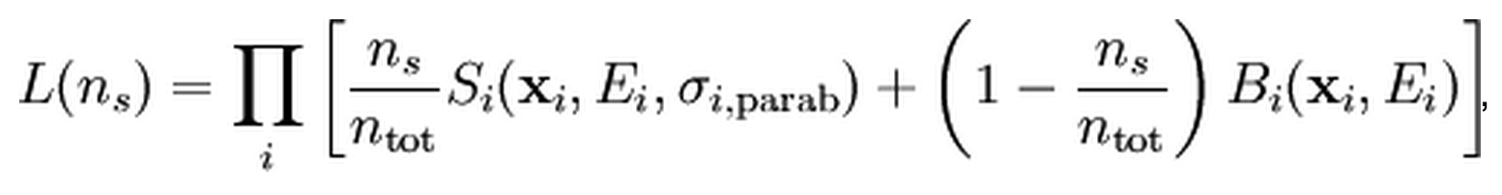
Likelihood Function
Signal extends to all regions of the sky – no clear “off” regions
Likelihood function derives background pdf by subtracting off scrambled version of signal pdf from the data
(spatial component)
1.5°

Slide 16
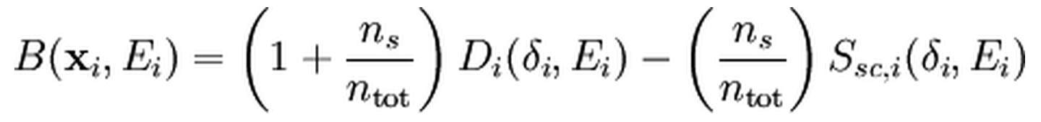
Likelihood Function
Signal extends to all regions of the sky – no clear “off” regions
Likelihood function derives background pdf by subtracting off scrambled version of signal pdf from the data
(spatial component)
1.5°
Data
Signal Scrambled in RA
Tried using standard PS likelihood
  Assumption: all data are background
This ‘signal-subtracted’ likelihood important for unbiased results

Slide 17
GP Sensitivity
Preliminary Sensitivity: dN/dE = (1.21×10⁻⁵) × (E/GeV)^{-2.5} GeV⁻¹ cm⁻² s⁻¹

Slide 18
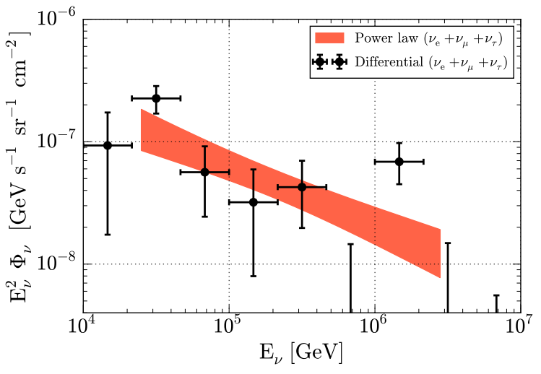
GP Sensitivity
Preliminary Sensitivity: dN/dE = (1.21×10⁻⁵) × (E/GeV)^{-2.5} GeV⁻¹ cm⁻² s⁻¹
Latest, best characterization of the diffuse neutrino flux (arXiv:1507.03991v2)

Slide 19
GP Sensitivity
Preliminary Sensitivity: dN/dE = (1.21×10⁻⁵) × (E/GeV)^{-2.5} GeV⁻¹ cm⁻² s⁻¹
Benchmark
Latest, best characterization of the diffuse neutrino flux (arXiv:1507.03991v2)
(Energy range approximated from PS analysis)

Slide 20
GP Sensitivity
Preliminary Sensitivity: dN/dE = (1.21×10⁻⁵) × (E/GeV)^{-2.5} GeV⁻¹ cm⁻² s⁻¹
IceCube Preliminary
Benchmark
13.5% of the extrapolation
Galactic Plane Sensitivity
(Energy range approximated from PS analysis)

Slide 21
GP Discovery Potential
Preliminary Sensitivity: dN/dE = (1.21×10⁻⁵) × (E/GeV)^{-2.5} GeV⁻¹ cm⁻² s⁻¹
IceCube Preliminary
Benchmark
Galactic Plane Discovery Potential
56% of the extrapolation
Galactic Plane Sensitivity
(Energy range approximated from PS analysis)

Slide 22
Comparison to Model
IceCube Preliminary
IceCube sensitivity allows us to set limit near the latest models (in the absence of an excess)
IC Galactic Plane Sensitivity
Gaggero et al 2015
arXiv:1504.00227v2
Caveat on left: model represents an average flux over the whole sky but flux is higher towards gal center where IC analysis insensitive

Slide 23
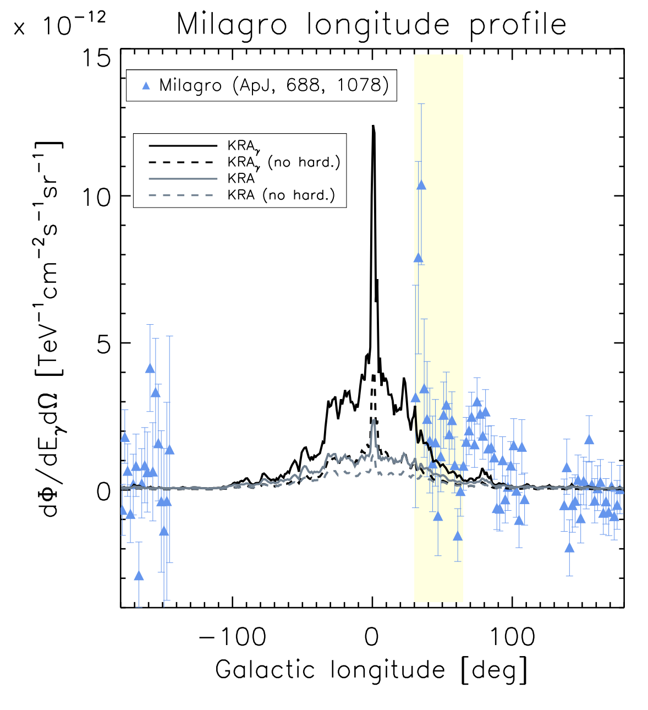
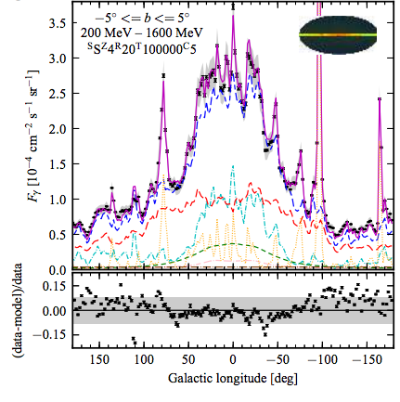
Longitude Profiles
Fermi Pion-decay profile in red
Longitude Profile
tuned
conventional
Northern Sky: IC Sensitive
Large uncertainty in flux from inner galaxy!
M. Ackermann et al 2011
arXiv:1202.4039v2
Gaggero et al 2015
1507.07796v1.pdf

Slide 24
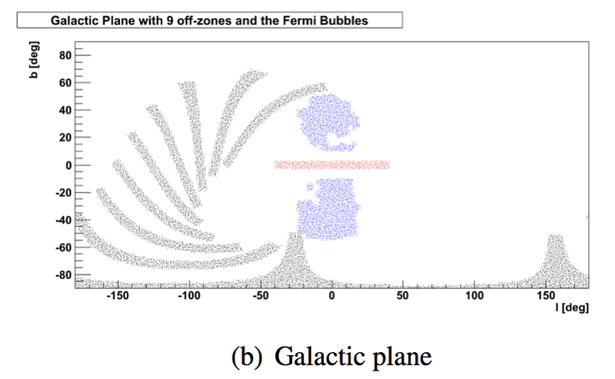
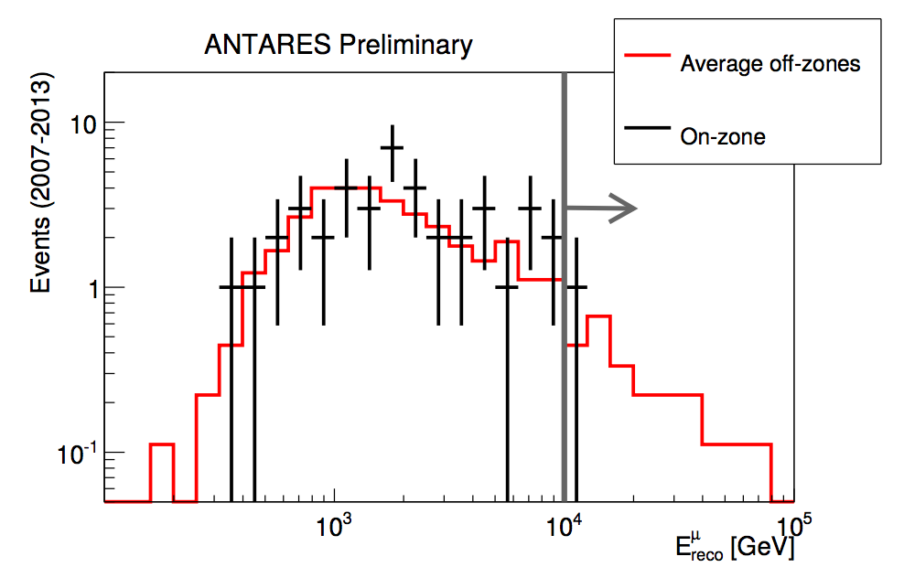
ANTARES Results
1 event observed on a background expectation of 2.5 events
ANTARES results from
Luigi Antonio Fusco,
shown at VLVNT

Slide 25
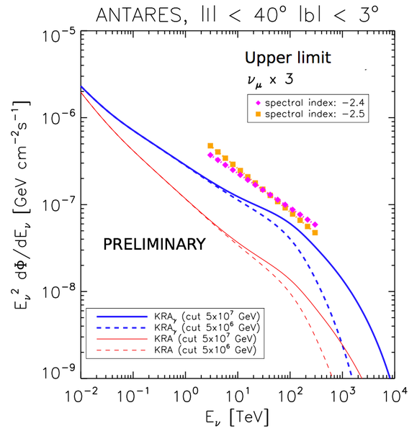
IceCube/ANTARES limits
IceCube Preliminary
IC Galactic Plane Sensitivity
Gaggero et al 2015
arXiv:1504.00227v2
Caveat on left: model represents an average flux over the whole sky but flux is higher towards gal center where IC analysis insensitive
Sensitivities to new GP model comparable
between ANTARES/IceCube

Slide 26
Roadmap
IceCube unblinding of 6 years of PS muon tracks currently undergoing collaboration review
  Possible to add cascades
  Possible to add lower energy threshold tracks in southern sky
Galactic plane is ideal target for a joint analysis
  Rely on experience gained in joint PS analysis
  IceCube+ANTARES together could probe deeper into the model space or help characterize any excess

Slide 27
Summary
Lots of recent work suggests there may be a sizable galactic component to IceCube’s measured diffuse neutrino flux
  High-energy neutrino data correlations with small gal latitude
  New consistent CR-transport models tuned to gamma-ray measurements
Best upper limits of neutrino flux from galactic plane < ~50% of diffuse flux
  External analysis of HESE events: Ahlers et al, 2015 (arXiv:1505.03156v1)
  If 50% of the diffuse flux is coming from the plane, could yield a 5-σ discovery in this IceCube analysis
If no excess, new CR transport models in the galaxy begin to be tested
A joint analysis between IceCube & ANTARES is on the horizon

Slide 28
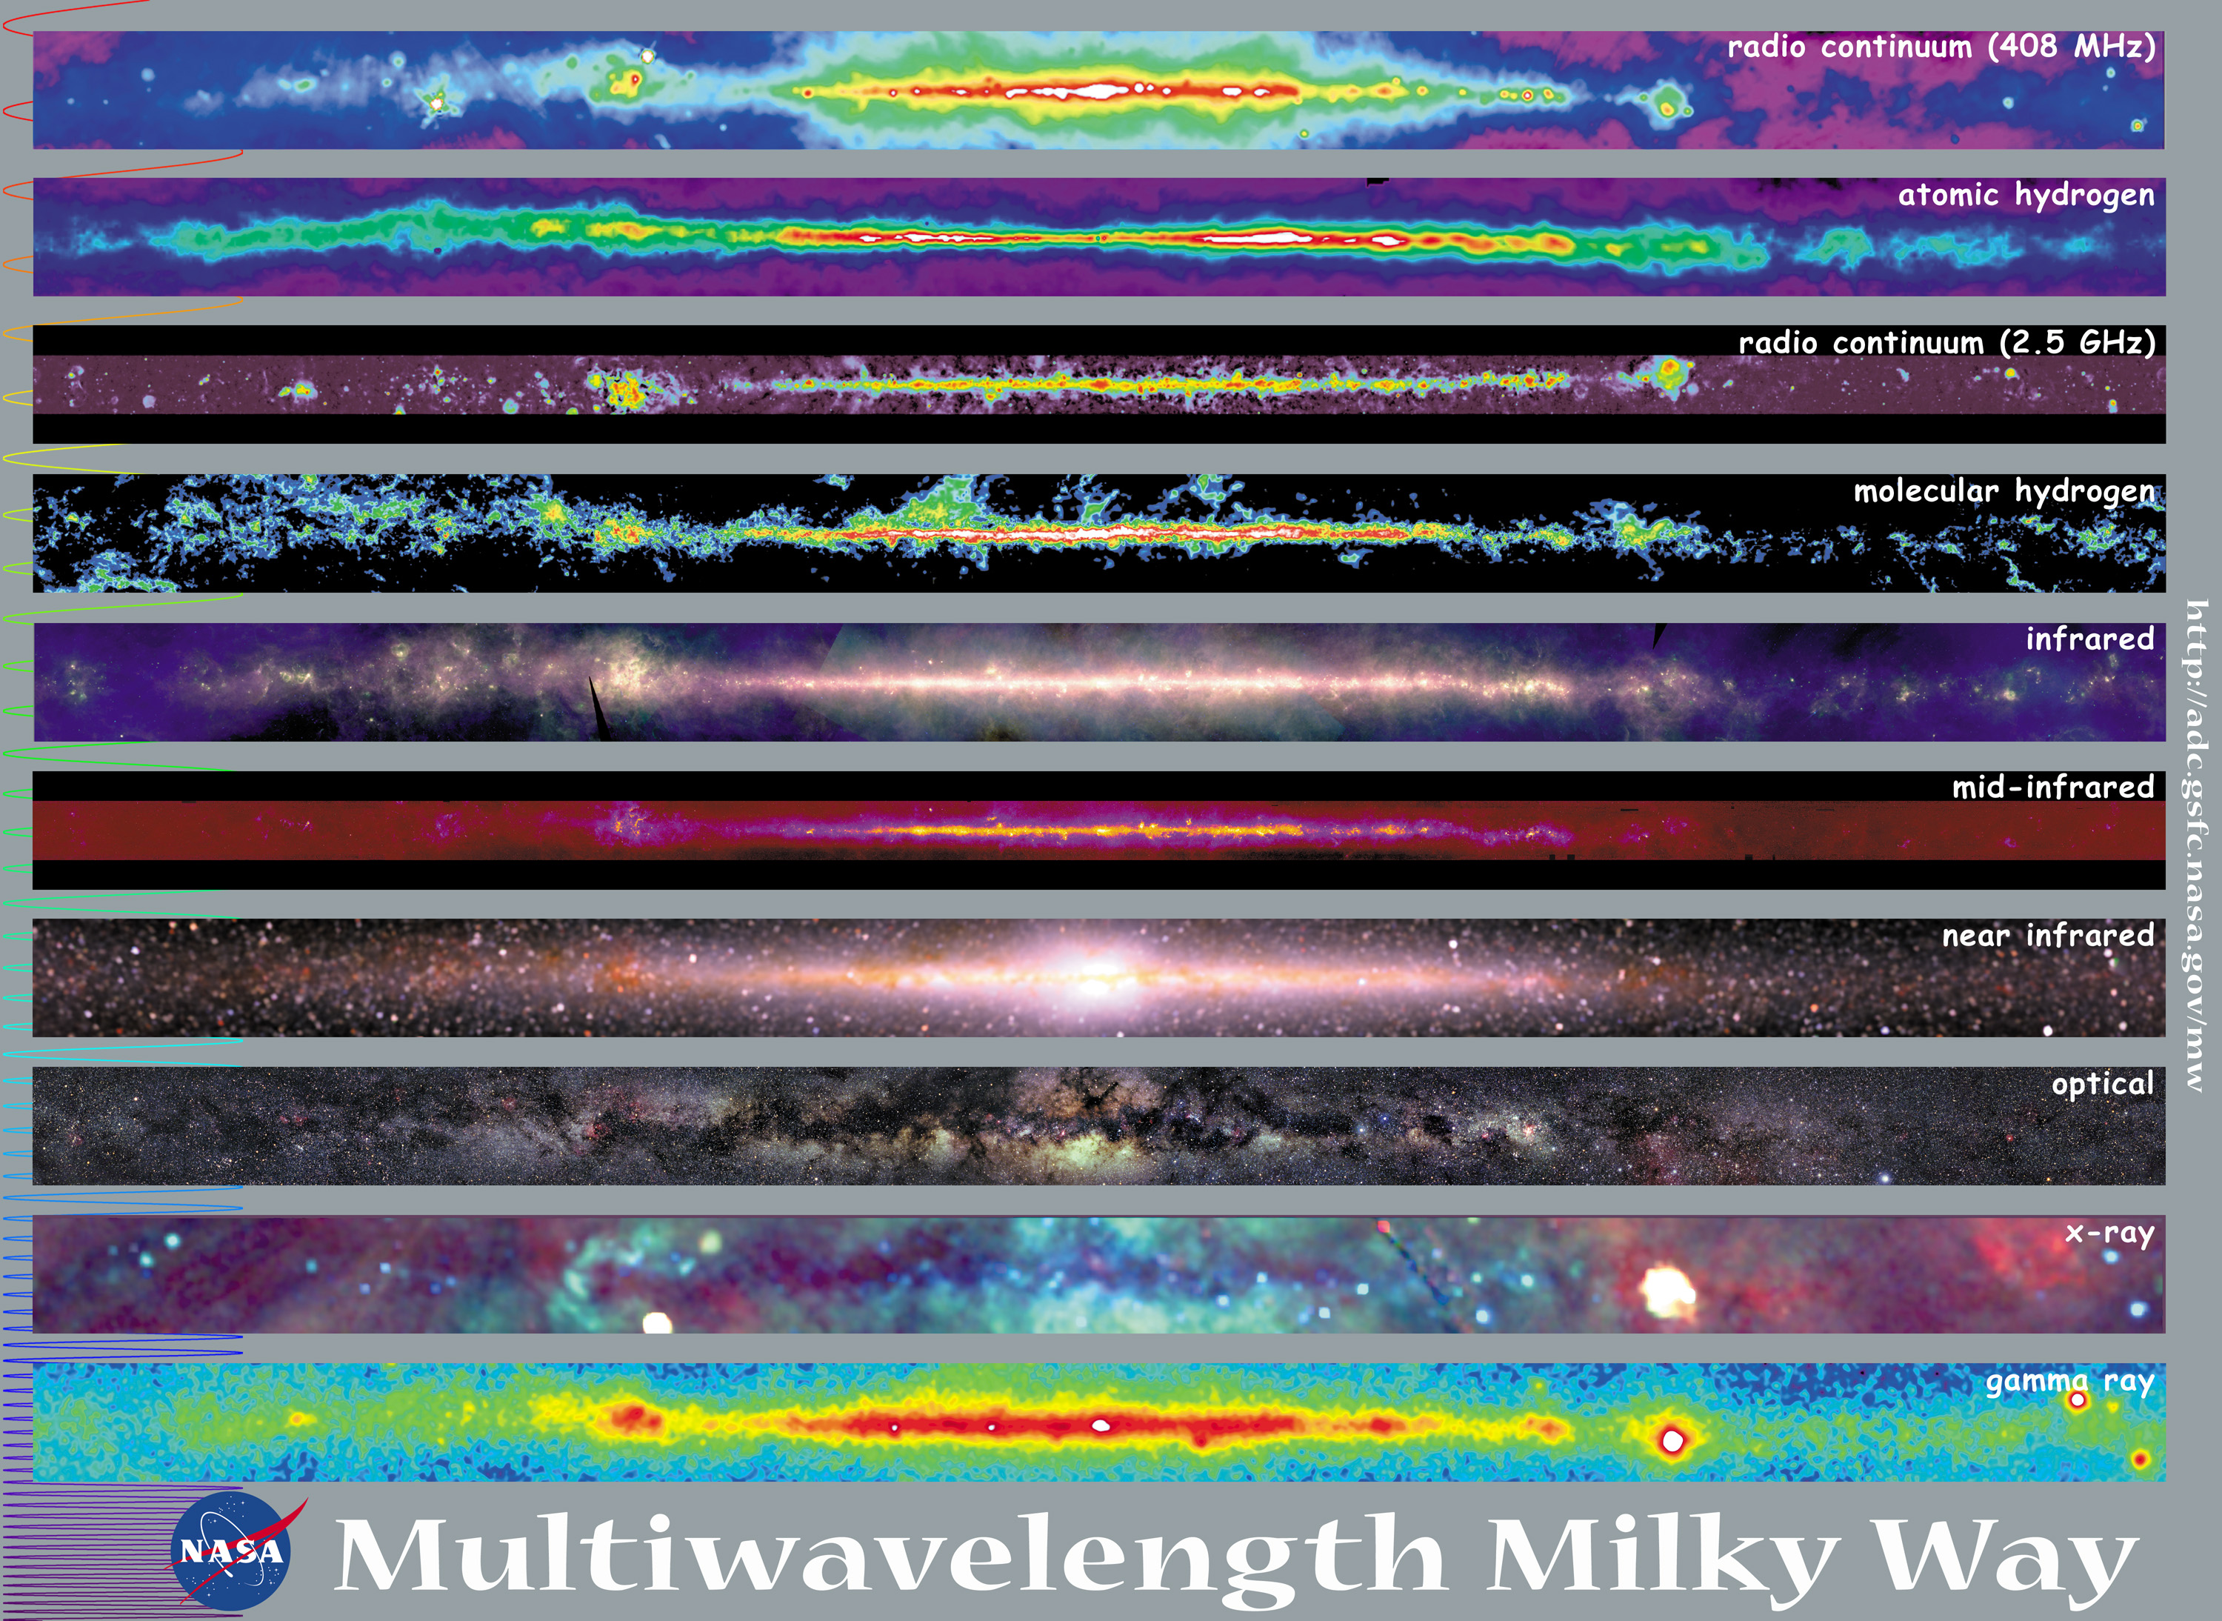
Thanks!
IceCube Gen2 + KM3NeT?
ν

Slide 29
Backup

Slide 30
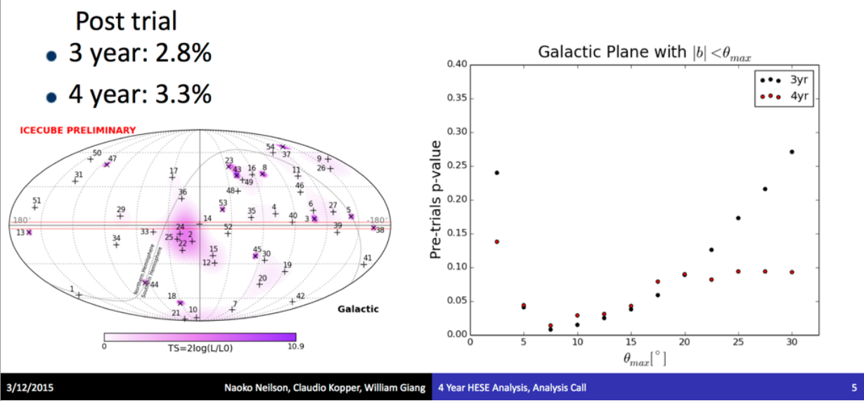
High-Energy Starting Events
2.5%
  p=2.5% in gal plane scan within ± 7.5° gal latitude

Slide 31
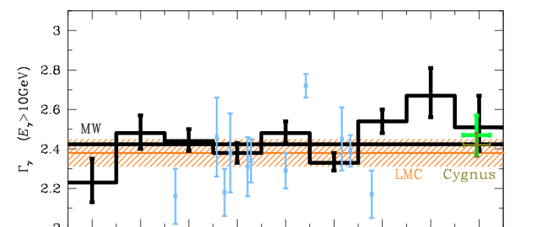
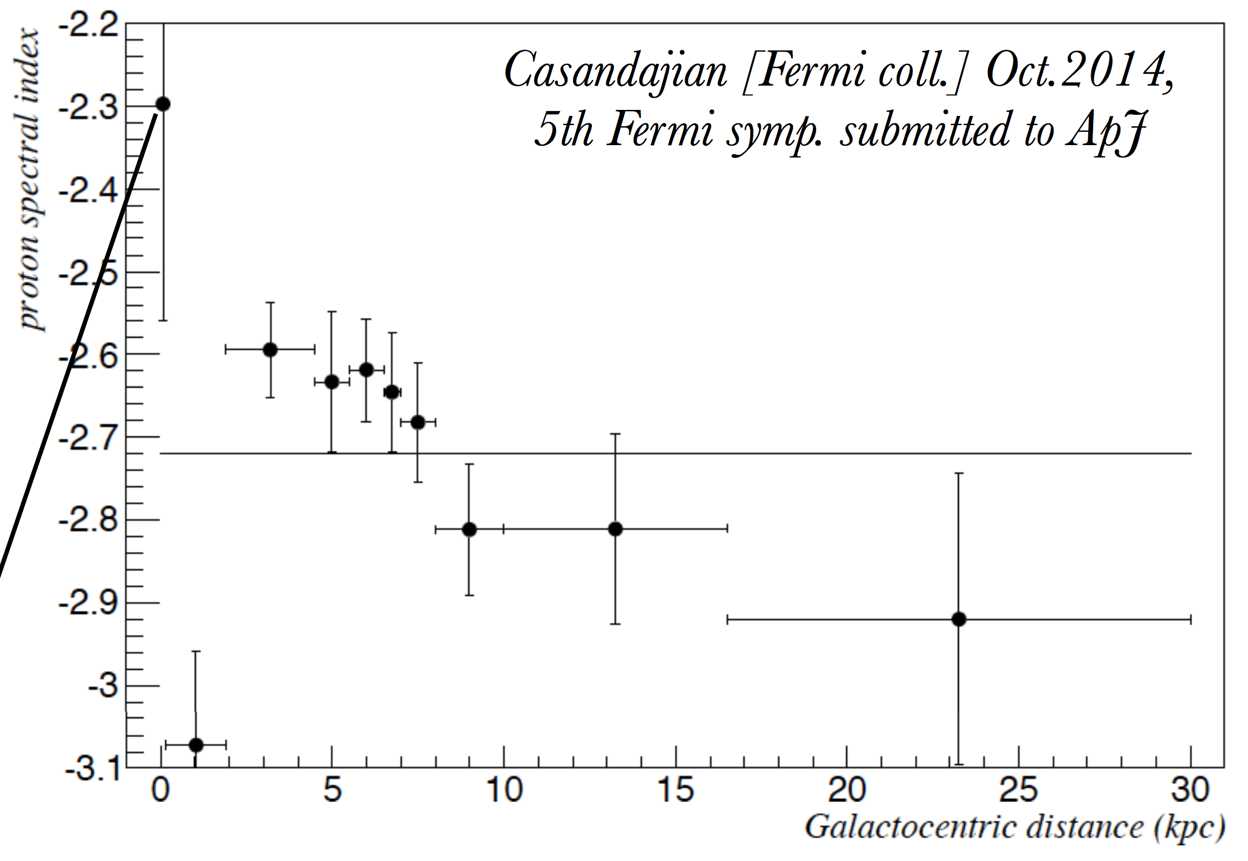

Remote CR Spectrum
ϒ-ray spectral index vs gal lon.
Neronov & Malyshev 2015
(arXiv:1505.07601v1)
Claim: Average CR spectral index: E^{-2.5}
  Universal? Seen in both MW & LMC
Earth in softer-than-typical fluctuation due to discrete sources
Fermi-LAT work in progress
Claim: CR spectral index varies with galactic radius
Earth in softer region of the galaxy

Slide 32
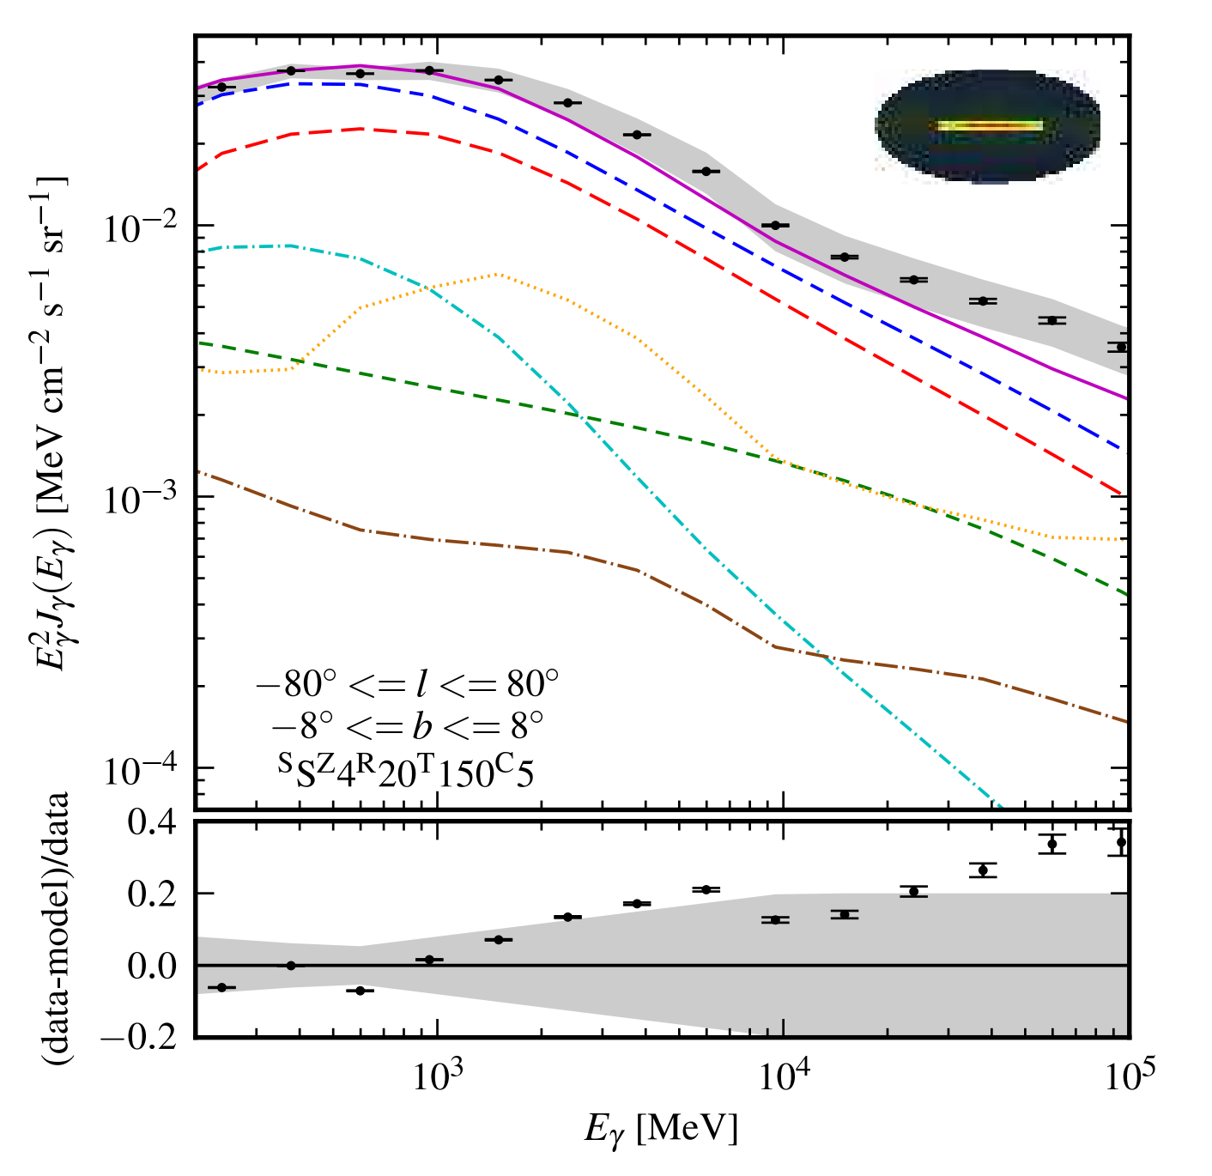
Fermi Model Spectrum
Gamma-ray spectrum from Inner Gal Plane
Diffuse emission from the plane dominated by
pion decay
Total ‘characterized’ emission
Diffuse Galactic emission
Pion decay
Sources
Inverse Compton
Isotropic Extragal.
Bremsstrahlung
M. Ackermann et al 2011
arXiv:1202.4039v2

Slide 33
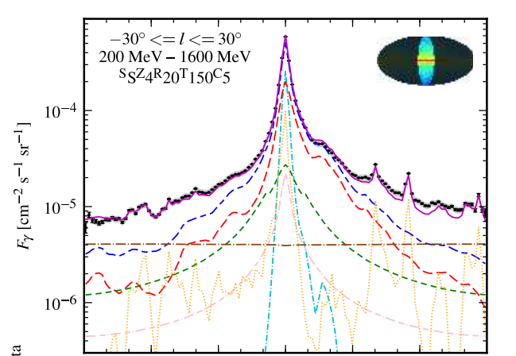
Model Profiles
Northern sky integrates about 1/3 of the pion decay model
Latitude Profile
Total ‘characterized’ emission
Diffuse Galactic emission
Pion decay
Sources
Inverse Compton
Isotropic Extragal.
Bremsstrahlung
Longitude Profile
Northern Sky: IC Sensitive
M. Ackermann et al 2011
arXiv:1202.4039v2

Slide 34
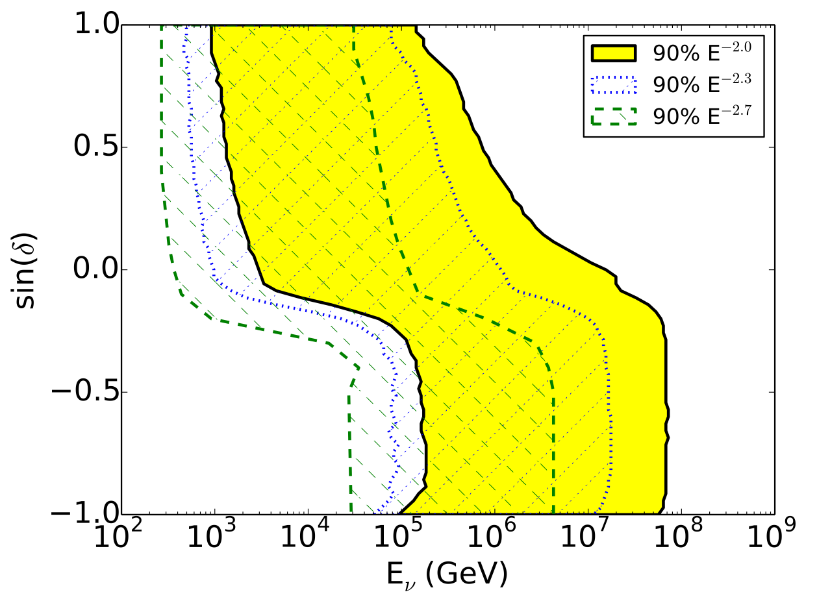
Energy Range of 4-year PS

Slide 35
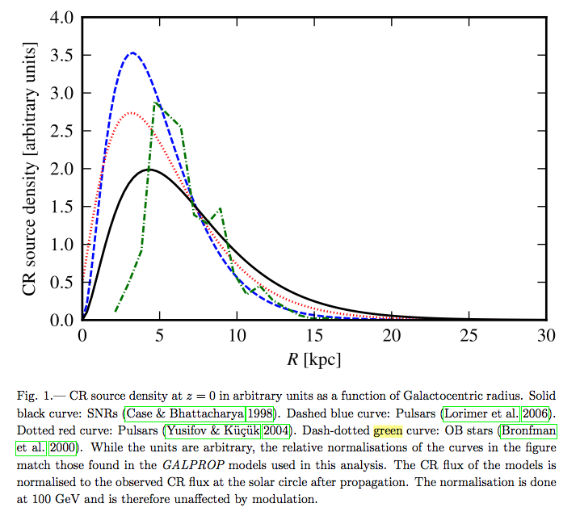
Unresolved Source Pops
Next step: set up a MC to generate source populations and see what kinds of limits we can set to these scenarios

