Slide 1
CMS Detector

Slide 2
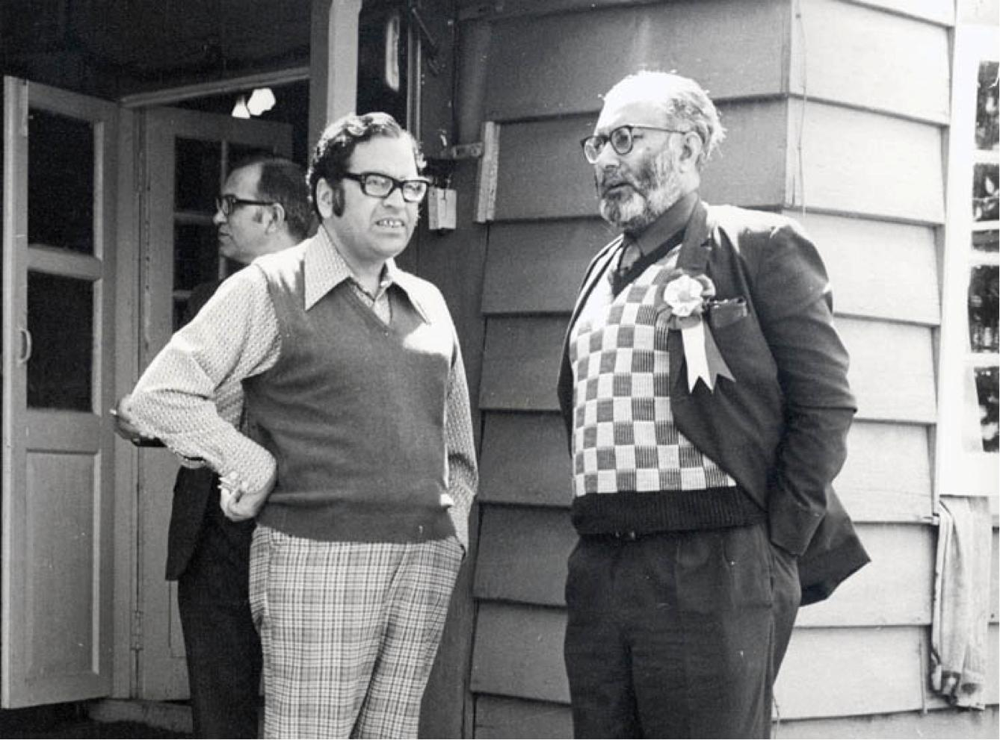
PIONEERS OF HIGH ENERGY PHYSICS IN PAKISTAN
Prof. Riazuddin and Dr. Abdus Salam
2/30

Slide 3
Introduction

Slide 4
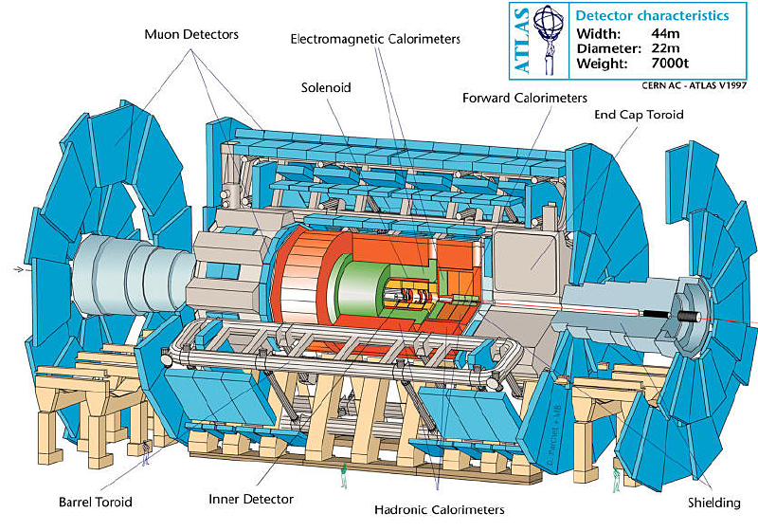
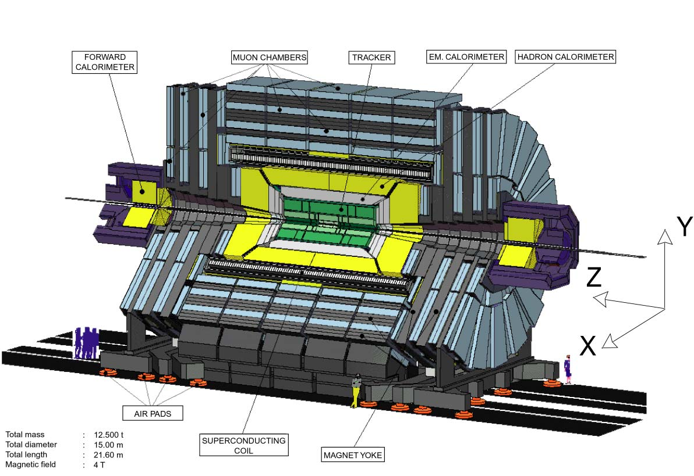
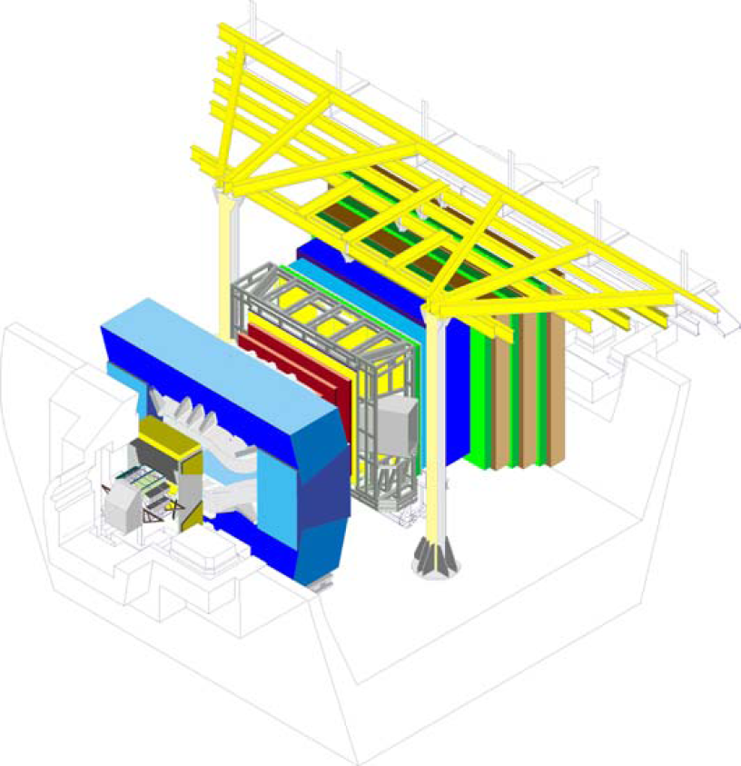
LHC experiments
ATLAS
ALICE
LHC-b
CMS

Slide 5
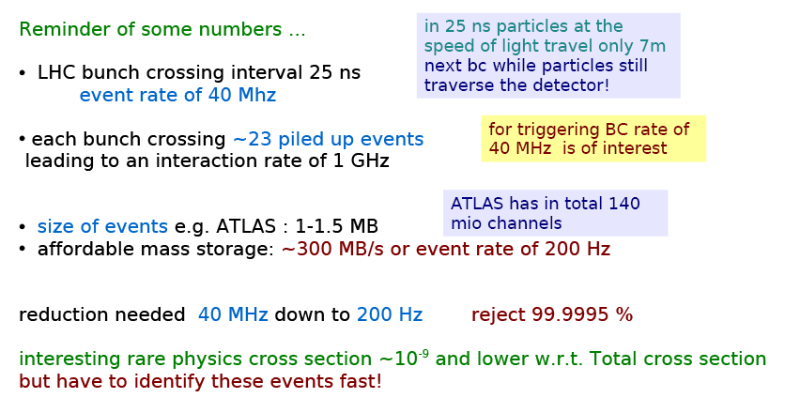
Triggering at LHC

Slide 6
Detector Requirements
The signatures we look for ...
● Leptons and photons at high pT
● missing Energy --> Etmiss
● b quarks, tau leptons
● Jets
with high backgrounds and low pT pile up
Detector requirements ...
● radiation hardness
● timing 25 ns
● identify and measure leptons, photons at high pT lepton ID over huge background e/jet ~ 10⁻⁵
● good measurement of missing transverse energy measurement in forward region (|h|<5)
● b and t tag (silicon detectors)
● highly selective and fast trigger

Slide 7
Physics Goals
To explore physics at the TeV scale
To discover the Higgs boson
To look for evidence of physics beyond the standard model, such as supersymmetry, or extra dimensions
To study aspects of heavy ion collisions

Slide 8
What is CMS

Slide 9
Specific Design
Lessons from LEP
Cylindrical onion shape
A high performance system to detect and measure muons,
A high resolution method to detect and measure electrons and photons (an electromagnetic calorimeter),
A high quality central tracking system to give accurate momentum measurements, and
A “hermetic” hadron calorimeter, designed to entirely surround the collision and prevent particles from escaping

Slide 10
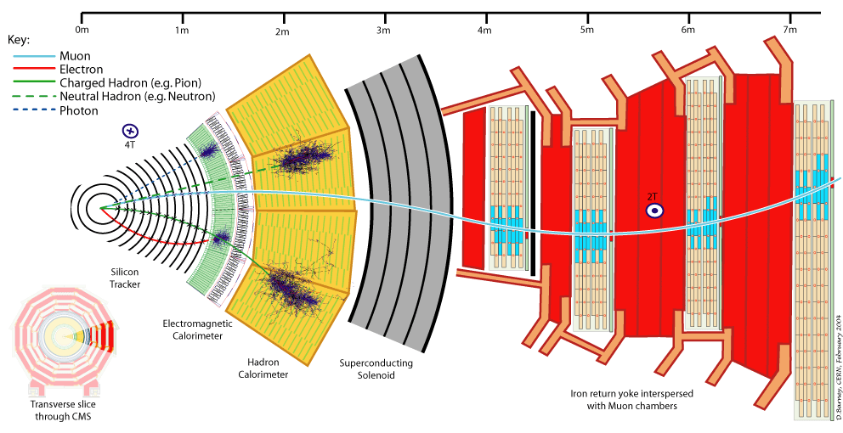
Working Principle
Detector is like a giant filter
Huge solenoid magnet with return yoke
Tracker
Calorimeter
Muon System

Slide 11
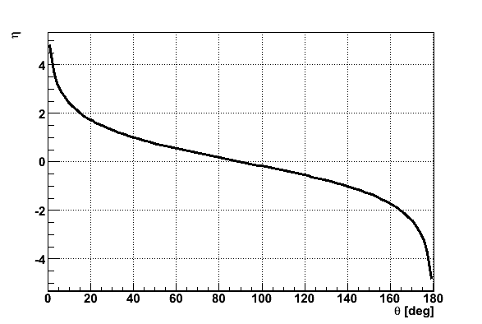
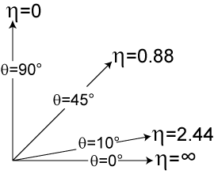
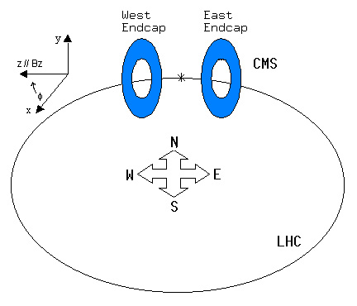
Coordinate conventions
Pseudorapidity
θ (degrees) | η
0 | infinite
5 | 3.13
10 | 2.44
20 | 1.74
30 | 1.31
45 | 0.88
60 | 0.55
80 | 0.175
90 | 0

Slide 12
CMS Detector overview

Slide 13
Experimental Challenge
LHC Detectors (especially ATLAS, CMS) are radically different from the ones from the previous generations
High Interaction Rate
pp interaction rate 1 billion interactions/s
Data can be recorded for only ~10² out of 40 million crossings/sec
Level-1 trigger decision takes ~2-3 μs
a electronics need to store data locally (pipelining)
Large Particle Multiplicity
~ <20> superposed events in each crossing
~ 1000 tracks stream into the detector every 25 ns
need highly granular detectors with good time resolution for low occupancy
a large number of channels (~ 100 M ch)
High Radiation Levels
a radiation hard (tolerant) detectors and electronics

