Slide 1
Novati Next Steps
We received 5 wafers fabricated at the Tezzaron/Novati facility in Austin, Texas in April. Sinan has reported on the initial tests. What we see is:
Acceptable IV characteristics
Guard ring breakdown before active area
  Breakdown voltage decreases upon second test, then seems to stabilize
Multiguard structures break down earlier than HPK type
Depletion of 500 micron wafers at 400V ~6 kOhm-cm resistivity
This behavior is roughly consistent with punch-through although at a few hundred volts below the
We now have distributed some of the diced sections of a 500 and a 725 micron wafer.
SLAC has suggested sending two wafers for under bump metalization for the pixel devices on the wafers

Slide 2
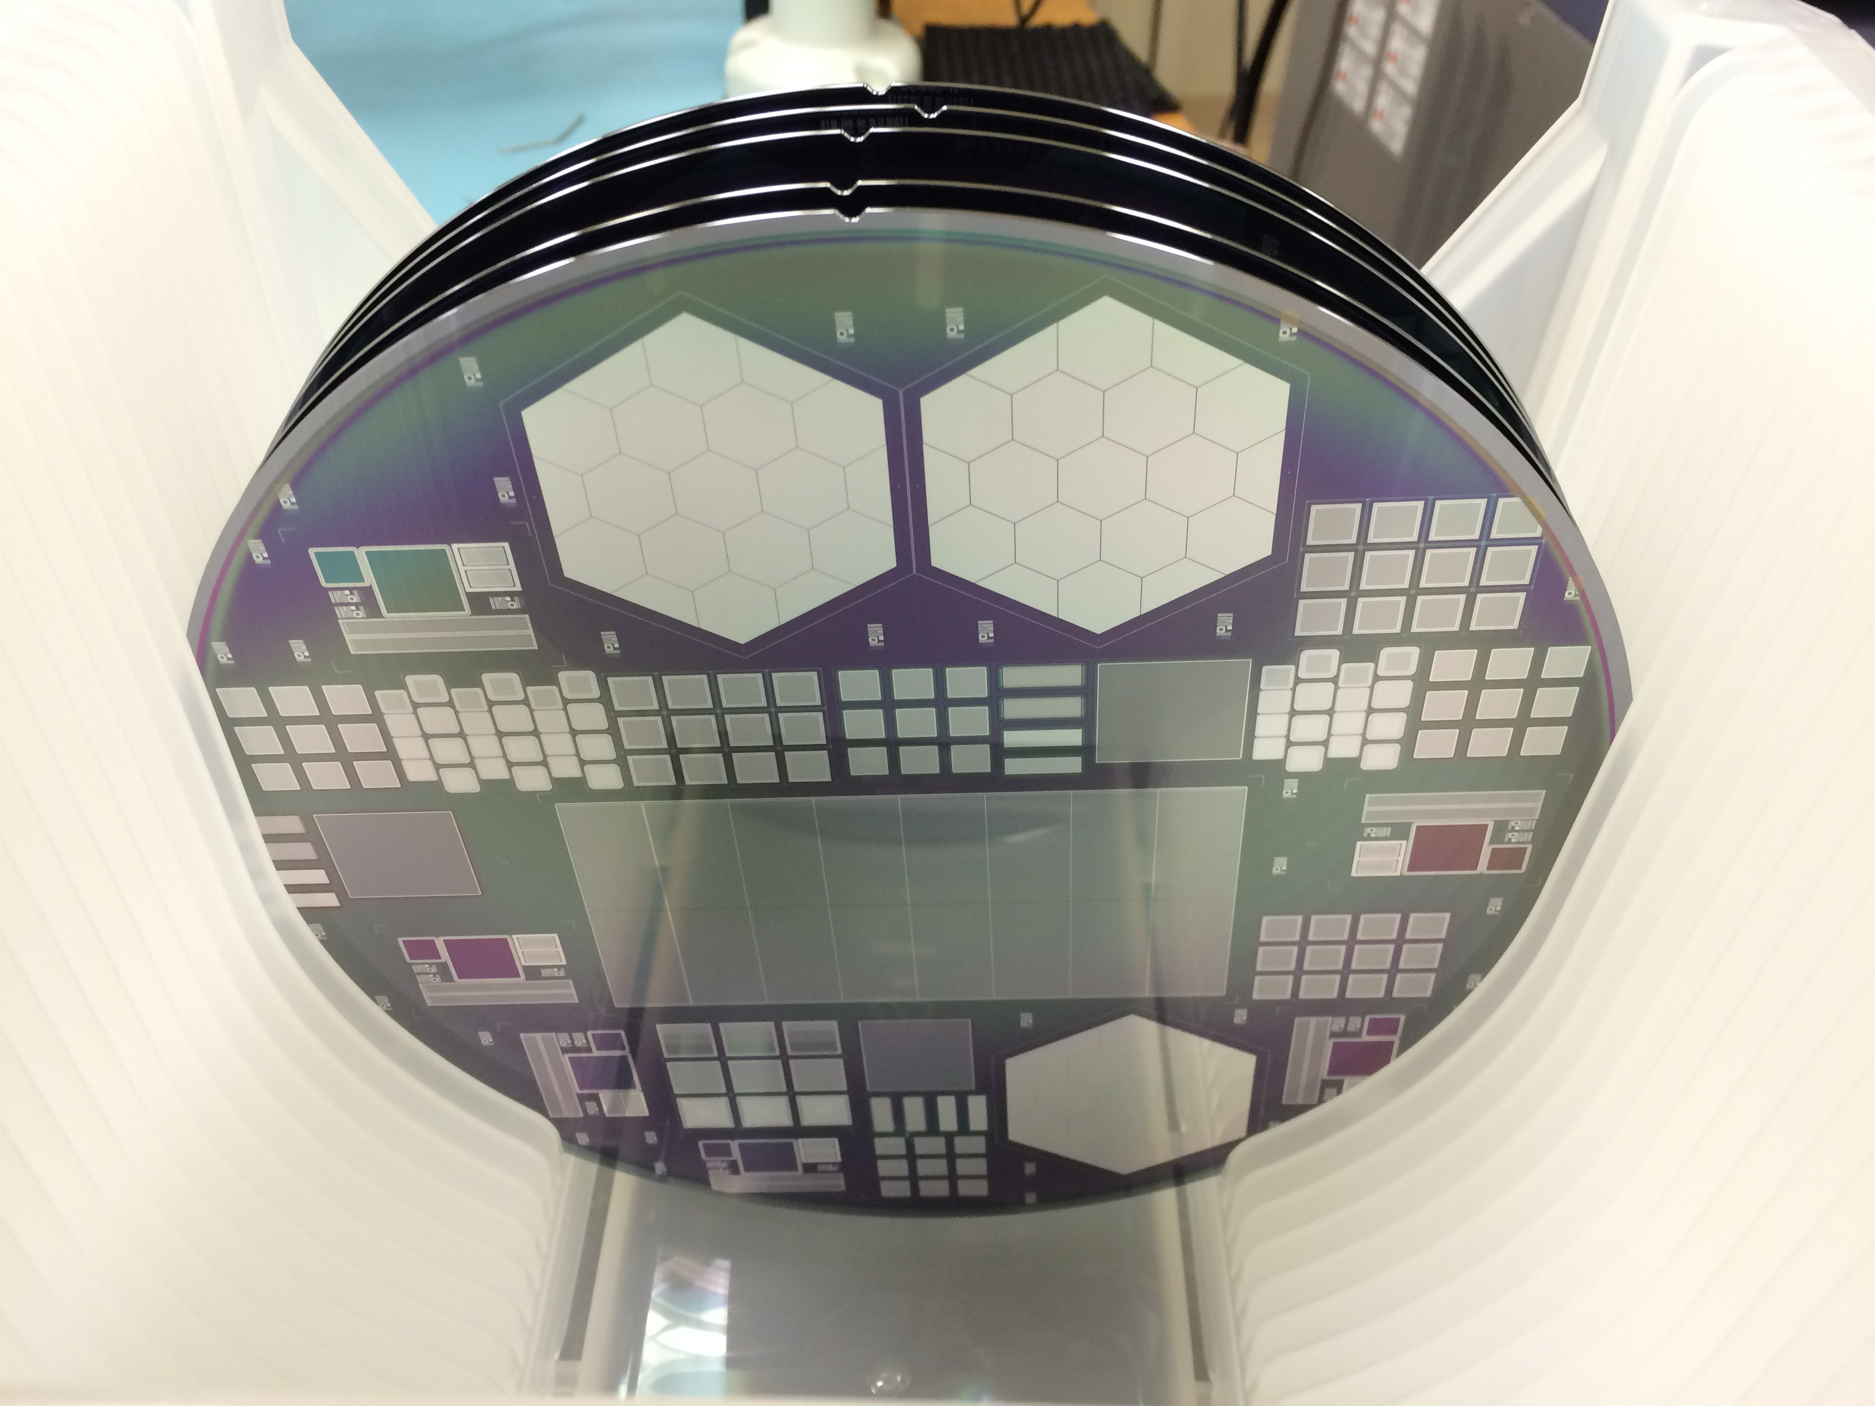
Wafer numbers
4 - 725μm no p spray
5 - 725μm
6 - 725μm
8 - 500μm
9- 500μm

Slide 3
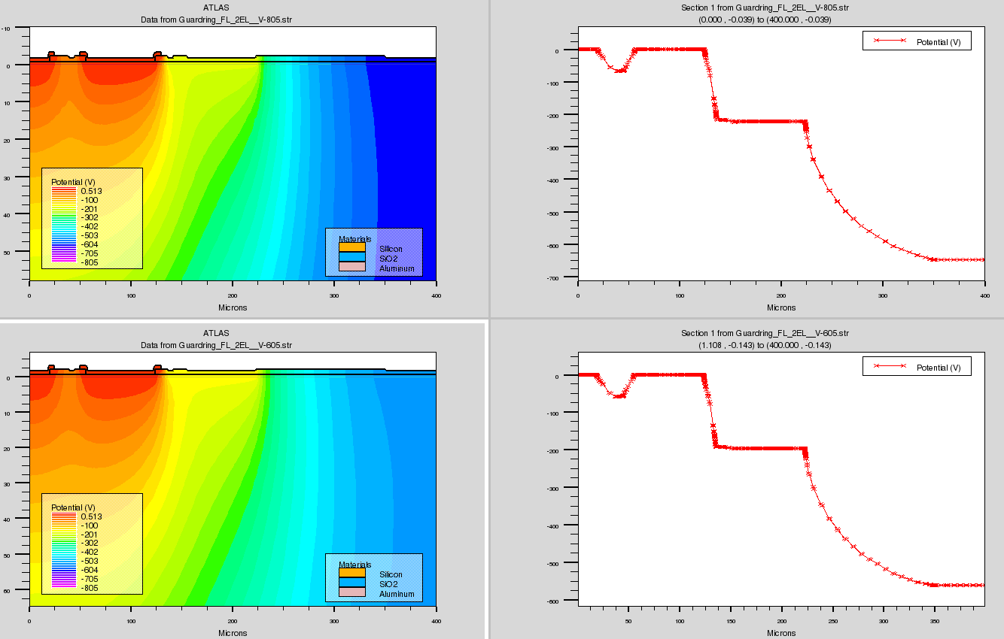
Silvaco Model of TS edge
Model of edge of test structure 605, 805V

Slide 4
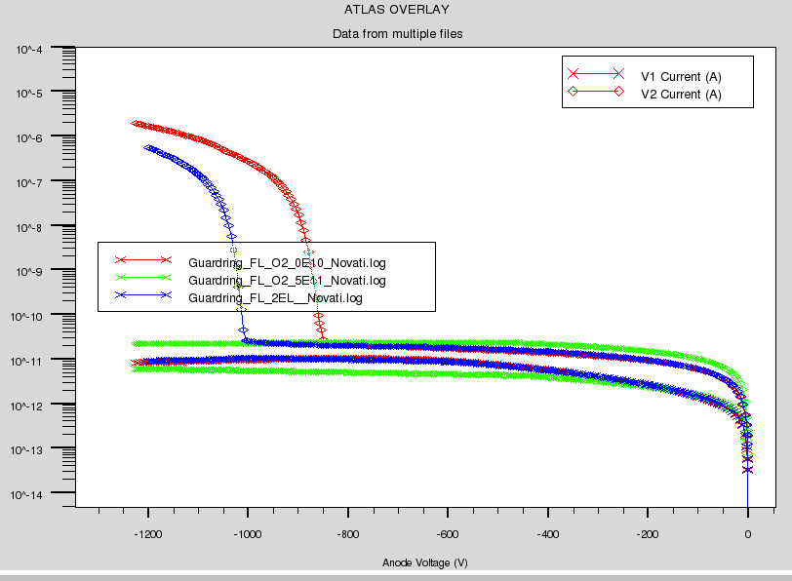
Oxide charge effect on guard breakdown
Varied oxide charge from 0, 5e10, 5e11. Breakdown decreases with increasing oxide charge

Slide 5
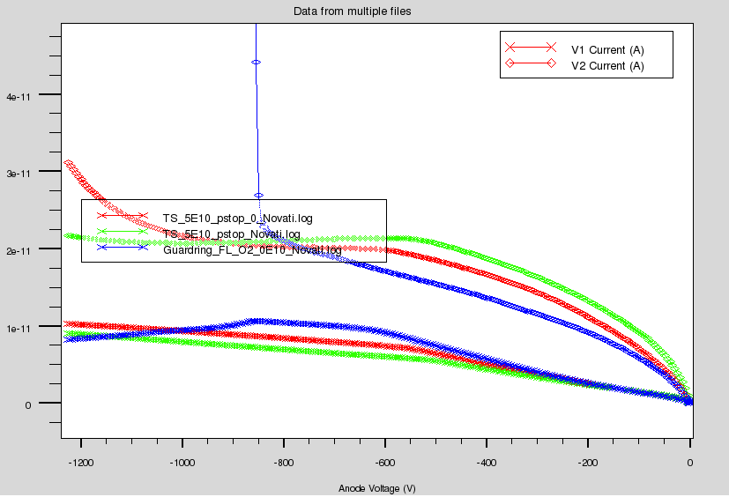
Pstop Vs Pstop+pspray
P stop + p spray 0 oxide charge
P stop only 0 oxide charge
Guard Currents
P stop only 5E10 oxide charge

Slide 6
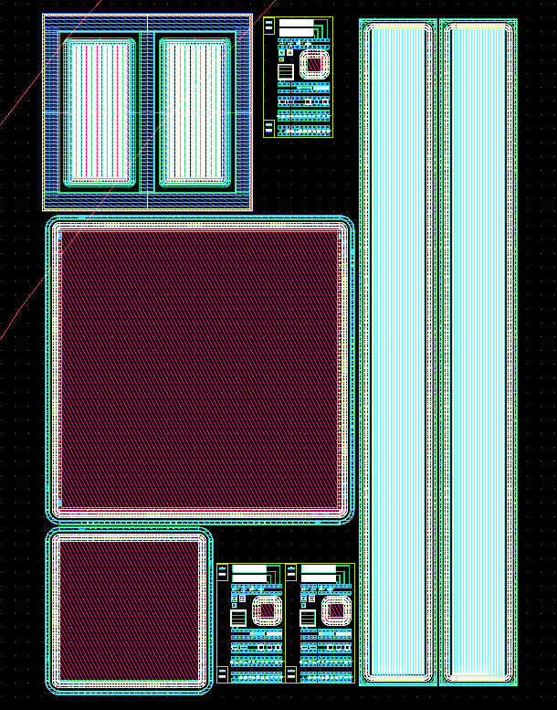
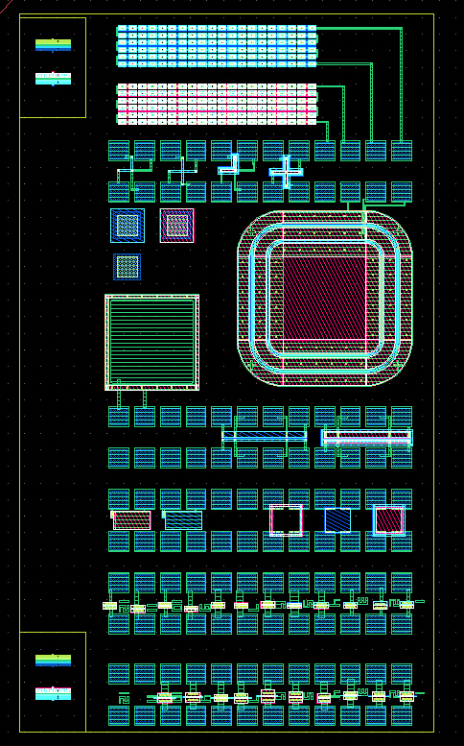
Test Structure Map
TS – large test Structures
  LD – large diode
  MD – medium diode
  GD – gate controlled diode
  DCS – DC coupled strips
  ACS – punchthrough strips
  SS – small test structures
    VC – via chains
    VDP - Van de Paw
    MOS structure
    SD – small diode
    PT – Punchthrough
    BS – bridge sheet resistance
    SIMS
HGC – HGC hexagons
CS – CMS small pixels
CL – CMS large pixels
SR – SLAC right
SL- SLAC left
ST – SLAC total
AL – Argonne pixels
PS – CMS PS strip sensor

Slide 7
Tests on Current Wafers
We need to understand the magnitude (and sign) of the oxide charge. Utilize the MOS test structure
HGC test structures – uniformity of leakage current, inter-pad capacitance (vs bias)
Interstrip capacitance
Less crucial
  Gate Controlled Diode test structures – surface currents.
  Compare p-stop only with p stop + p spray structures
  Can also check via chains and sheet resistance structures, although not crucial

Slide 8
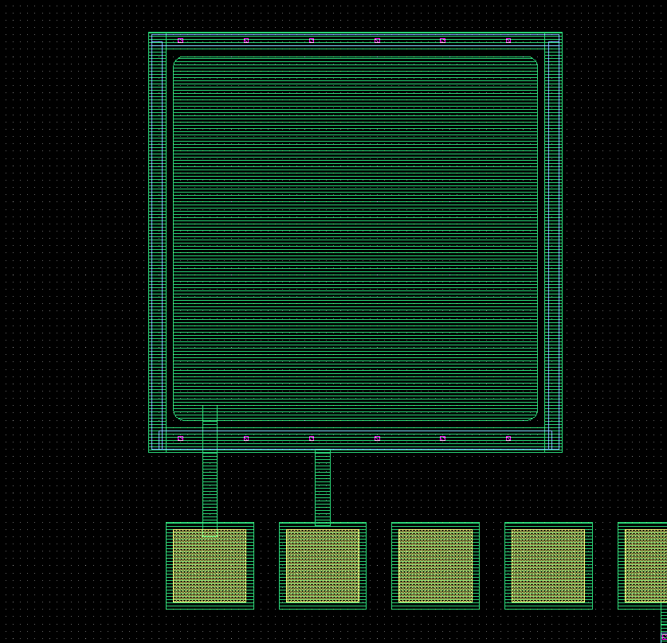
MOS Capacitor
This measures some of the basic
parameters of the process
  Oxide thickness
  Flat band voltage

Slide 9
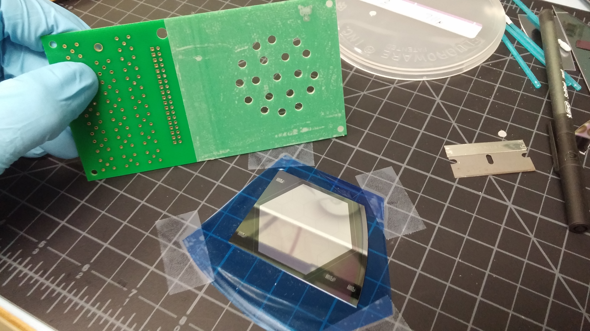
HGC Stuctures
We have assembled 6 HGC hexagon test boards with each pad wirebonded to a connector. This allows us to test inter-pad capacitance and individual leakage currents in a controlled environment.

Slide 10
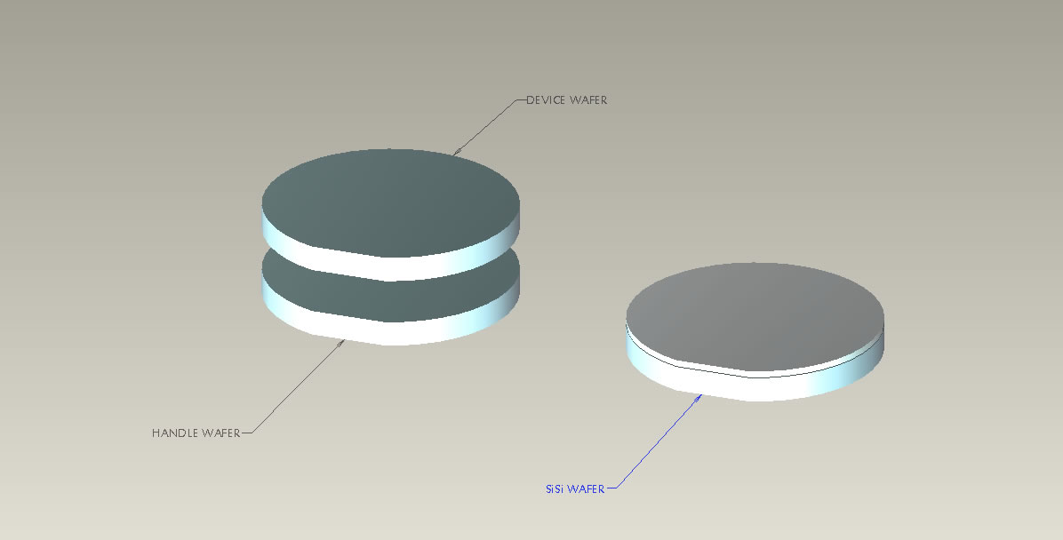
Next Steps – Phase 1
Tezzaron has received an Phase 1 SBIR for further development
This phase will be aimed at ~200 micron thick devices on 8”wafers with minor changes in process and device layout
Challenge is to provide a good backside ohmic contact in a thinned wafer
  Si-Si bonding
  SOI bonding
  Laser annealing

Slide 11
Novati Phase 2
The Phase II should finalize development of the p-on-n process, polysilicon resistors, and AC coupling. It should result in prototype devices for both the tracker and HGC.
We will also change the structures if time is available for design.

