Slide 1
HF PMT Hits Analysis
Samet Lezki
Yalcin Guler
Shuichi Kunori, Isa Dumanoglu,
Bayram Tali, Emine Gurpinar

Slide 2
Introduction
Analyzed data set is /MinimumBias/Run2012D-PromptReco-v1/RECO ~34M Events
For this analysis, we use CMSSW_7_1_7
Main purpose is new HF PMTs (HFM iphi=43 24 PMTs).
Checked PMT hits, Energy Reconstruction and Noise Rate.
PMT Hits : Do not pass through HF Noise Filter
LS Filter
S8S1 Filter
Timing Error Filter
In Time Window Filter
PET Filter
Found opportunity to analyze for all HF in these time.
Compared the New and Old PMTs in terms of energy reconstruction and noise rate.
Calculated noise rate according to prescale factor. Both all HF and New/Old PMTs.
Rate Calculation : [(Number of PMTHits) /(Total Time Duration)]x(Pre Scale Factor)
Total Run Time Duration : 2035357 second.

Slide 3
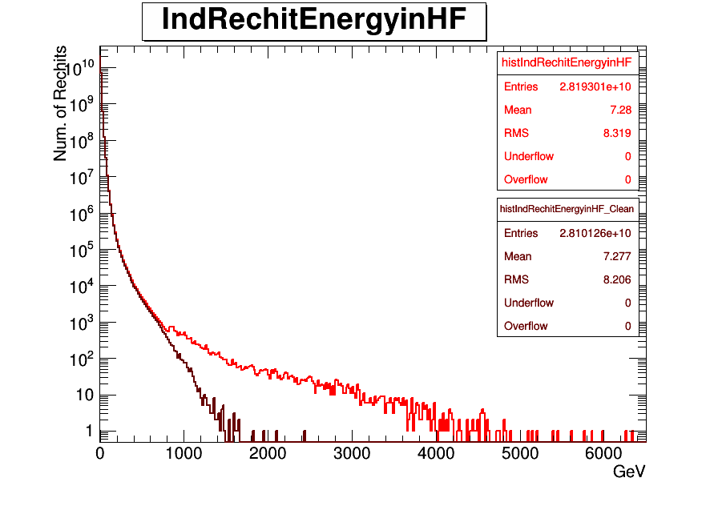
Individual Rechit Energy before and after Noise filter for all HF
Before and after filter

Slide 4
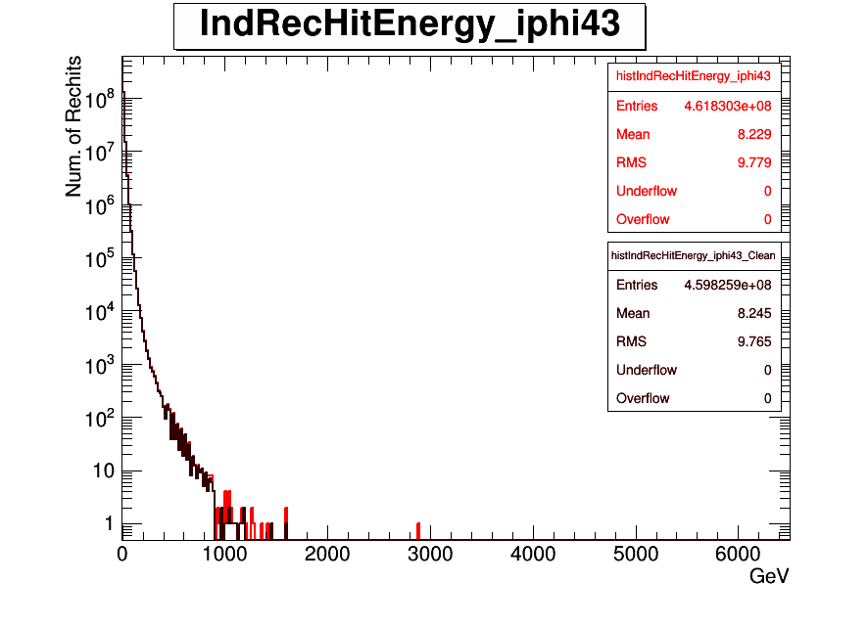
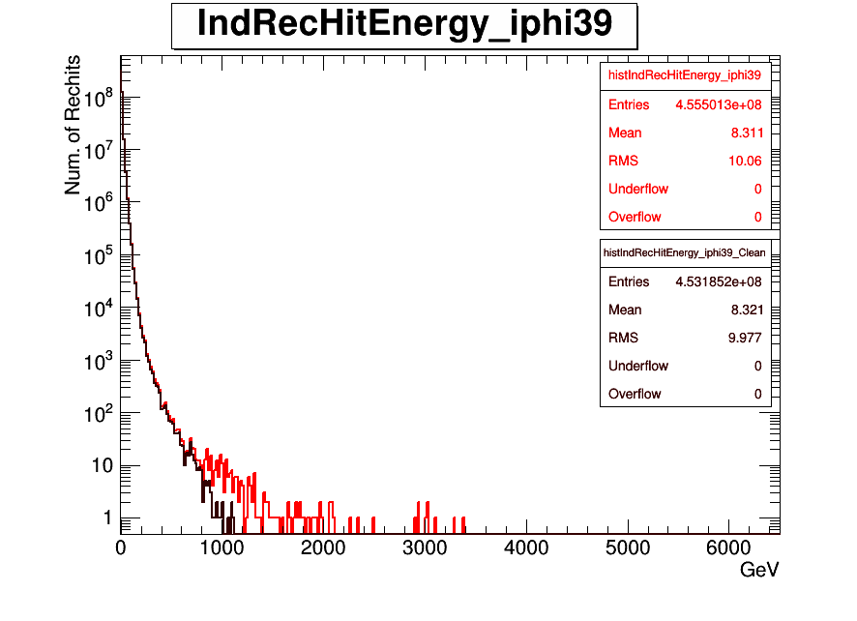
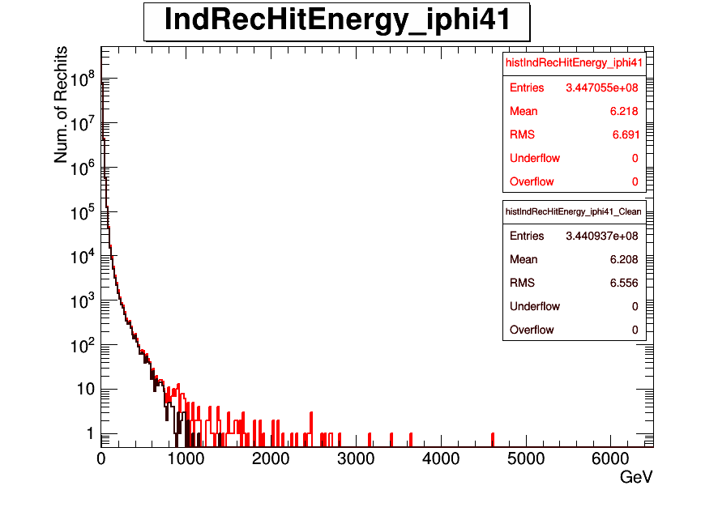
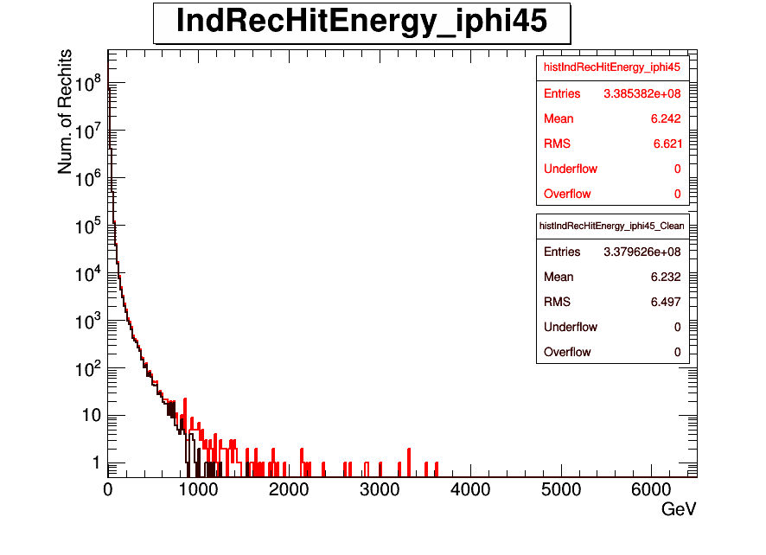
Individual Rechit Energy before and after Noise filter for iφ=43,39,41,45
New PMTs
iφ=43
Old PMTs
iφ=39
Before and after Noise filter
Old PMTs
iφ=45
Old PMTs
iφ=41

Slide 5
Following results were obtained using
/MinimumBias/Run2012D-PromptReco-v1/RECO data set and it was filtred by "HLT_ZeroBias_v7"
The total prescaling factor is 10,000 (L1) * 150 (HLT) = 1.5E6

Slide 6
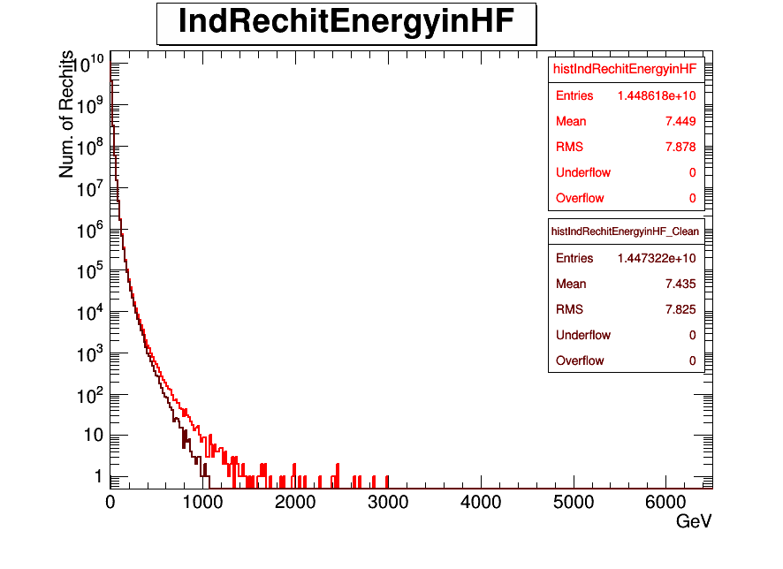
Individual Rechit Energy before and after Noise filter for all HF
Before and after Noise Filters

Slide 7
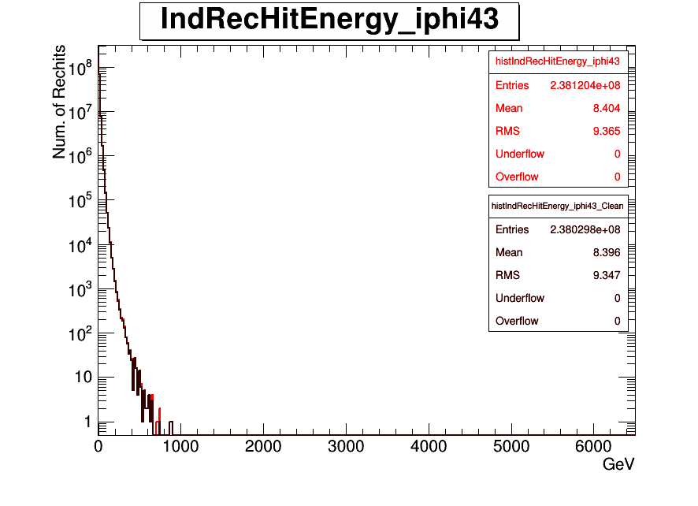

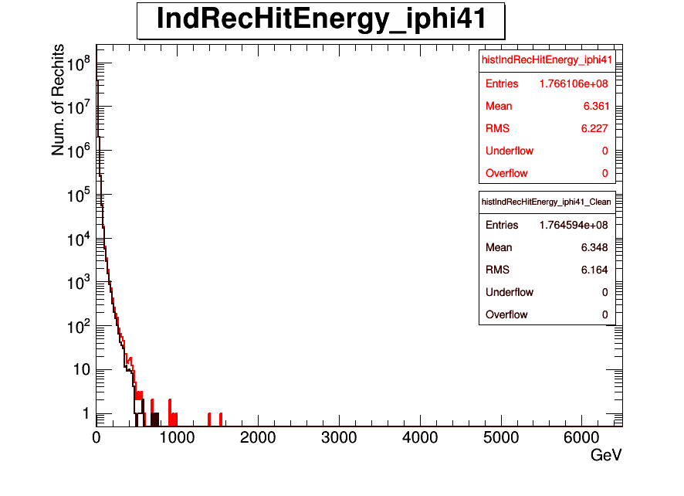
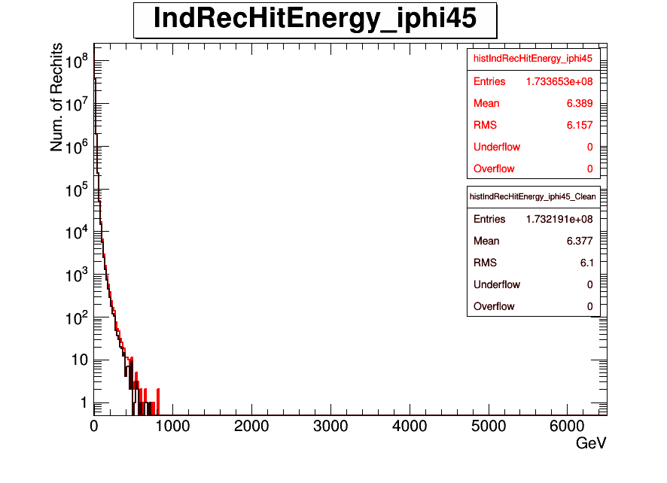
Individual Rechit Energy before and after Noise filter for iφ=43,39,41,45
New PMTs
iφ=43
Old PMTs
iφ=39
Before and after filter
Old PMTs
iφ=45
Old PMTs
iφ=41

Slide 8
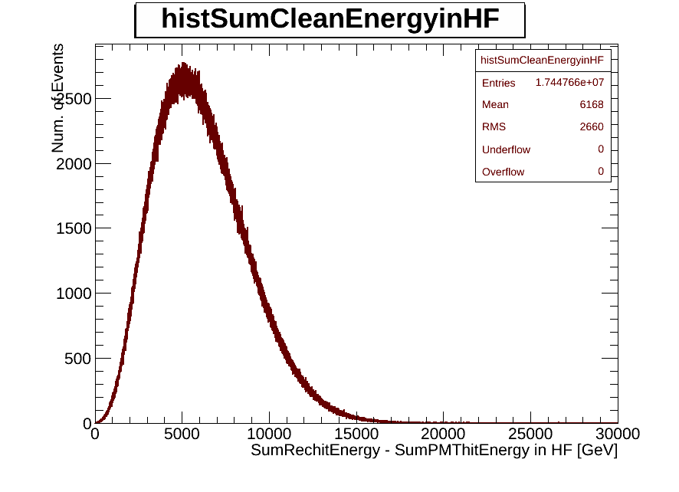
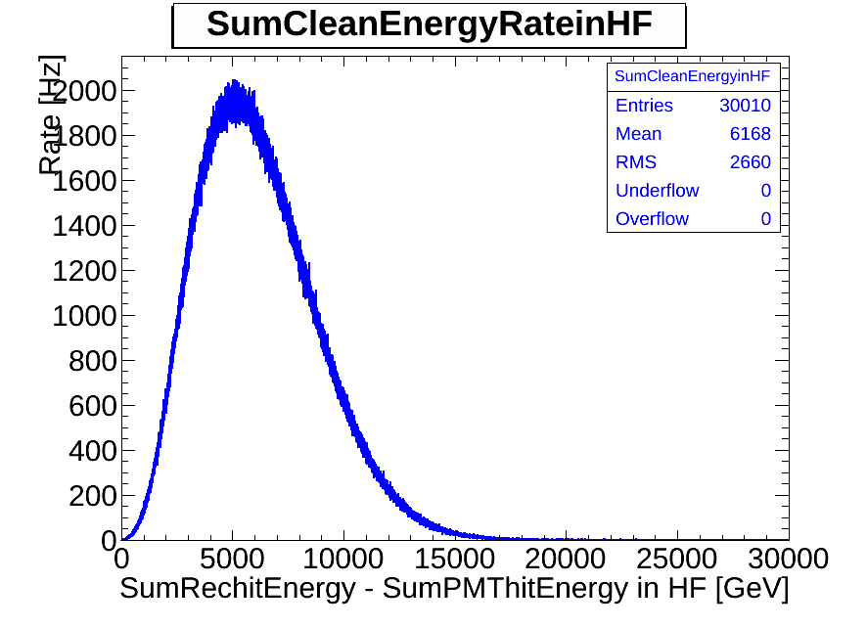
Clean Energy and Clean Energy Rate Plots
Sum Clean Energy
Sum Clean Energy Rate. After using Pre Scale Factor .

Slide 9
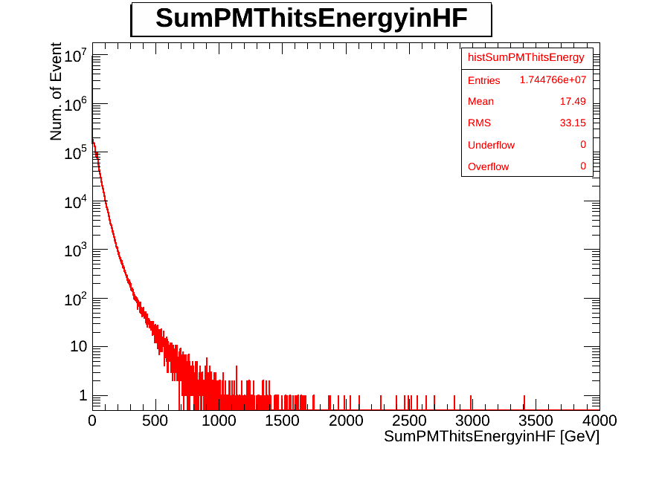
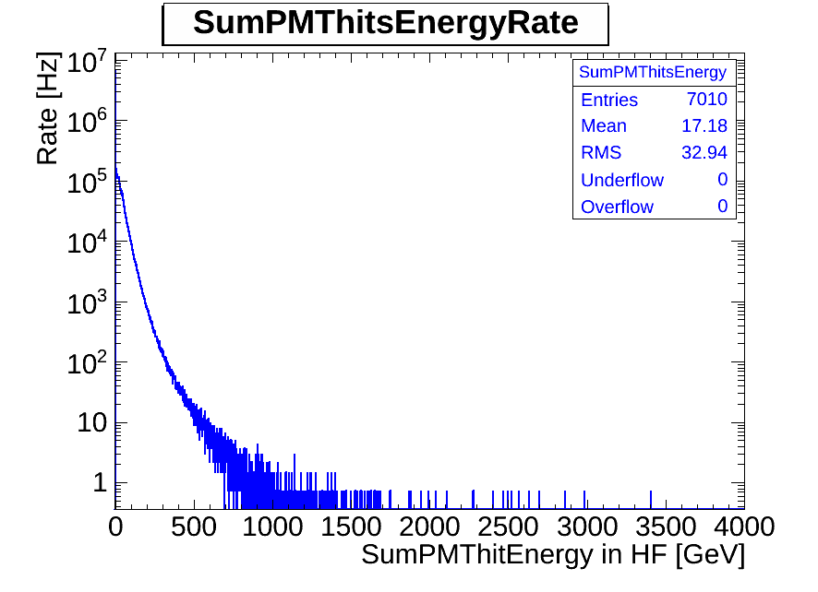
PMT Hits Energy and PMT Hits Energy Rate Plots
Sum PMThits Energy
Sum PMThits Energy Rate. After using Pre Scale Factor .

Slide 10
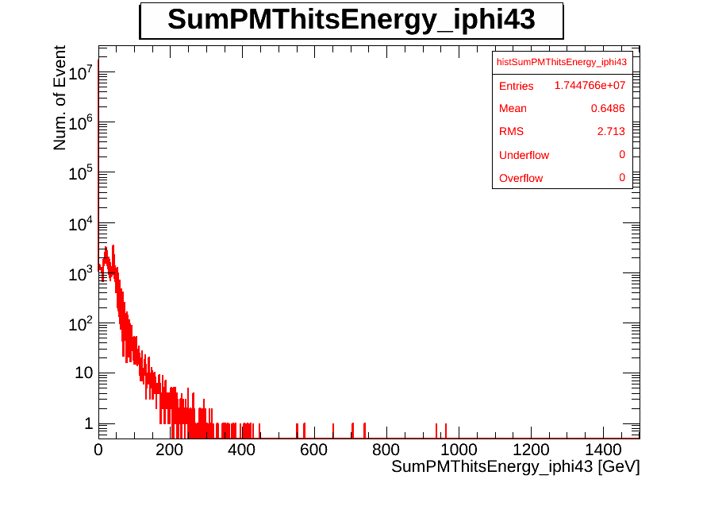
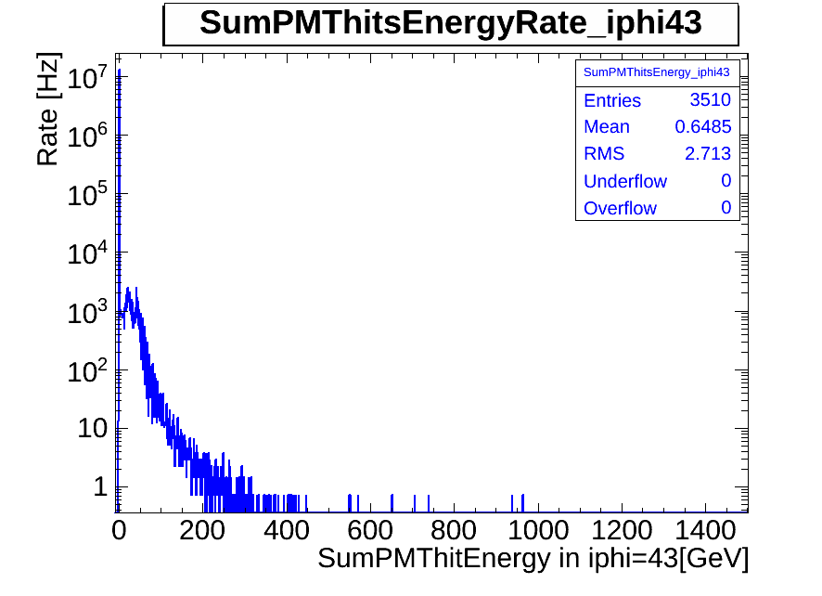
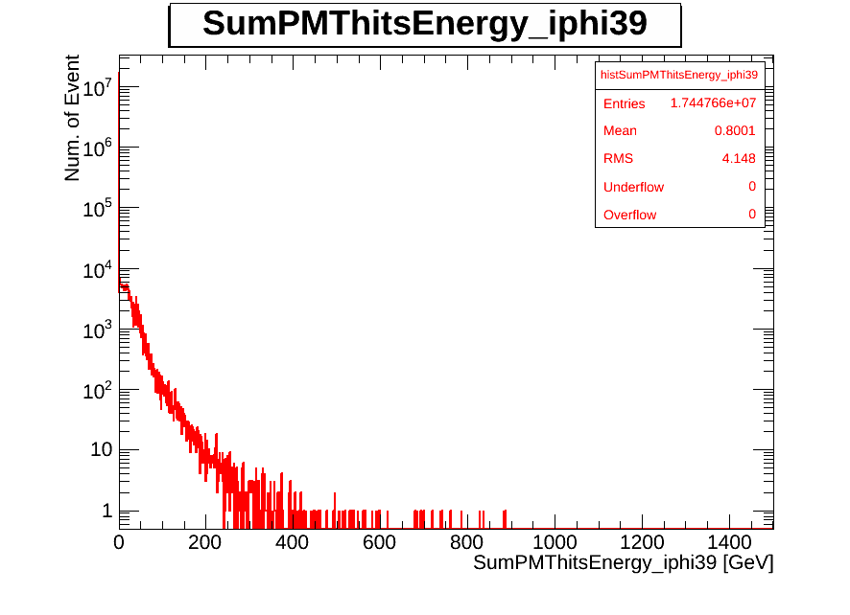
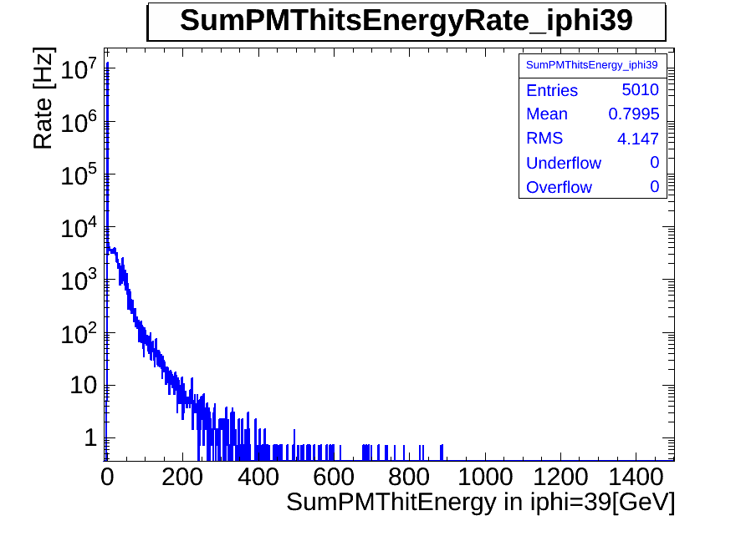
PMT Hits Energy and PMT Hits Energy Rate Plots for iPhi=43 and iPhi=39
New PMTs
iφ=43
New PMTs
iφ=43
Old PMTs
iφ=39
Old PMTs
iφ=39

Slide 11
Following results were obtained using
/MinimumBias/Run2012D-PromptReco-v1/RECO data set and it was filtred by "HLT_Physics_v5 "
The total prescaling factor is 8000 (HLT) = 8000

Slide 12

Individual Rechit Energy before and after Noise filter for all HF
Before and after filter

Slide 13


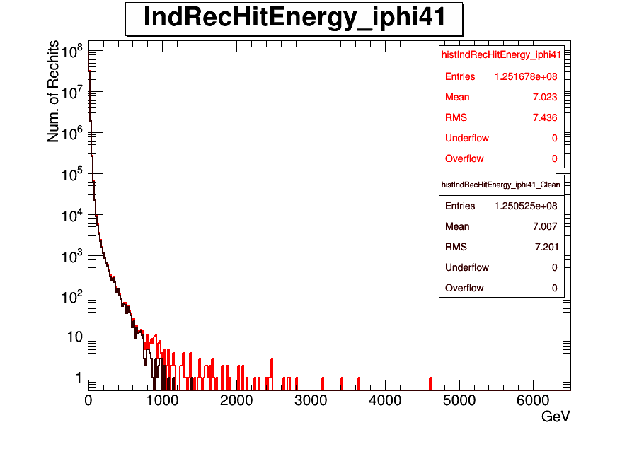

Individual Rechit Energy before and after Noise filter for iφ=43,39,41,45
New PMTs
iφ=43
Old PMTs
iφ=39
Before and after Noise filter
Old PMTs
iφ=45
Old PMTs
iφ=41

Slide 14
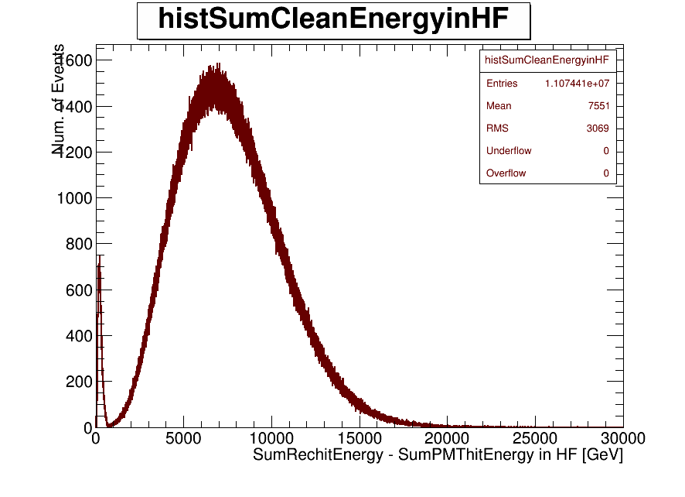
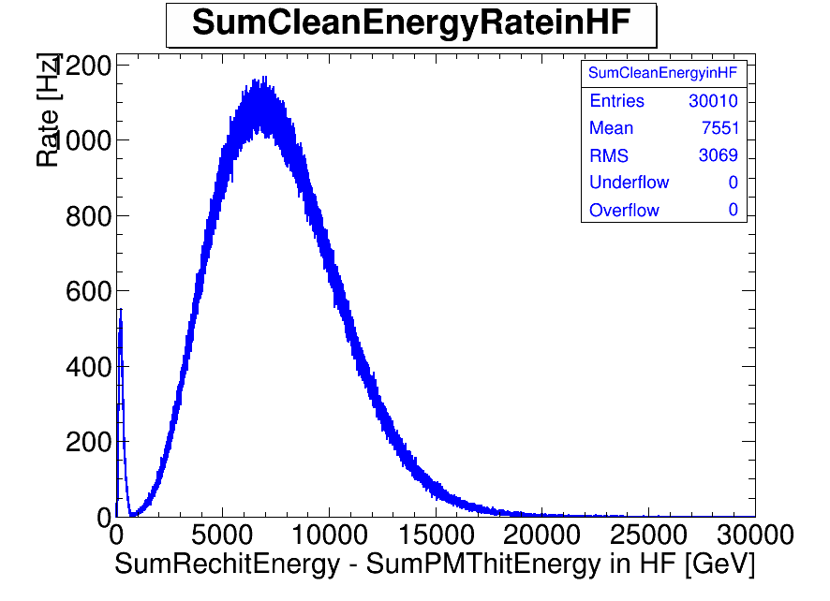
Clean Energy and Clean Energy Rate Plots
Sum Clean Energy
Sum Clean Energy Rate. After using Pre Scale Factor .

Slide 15
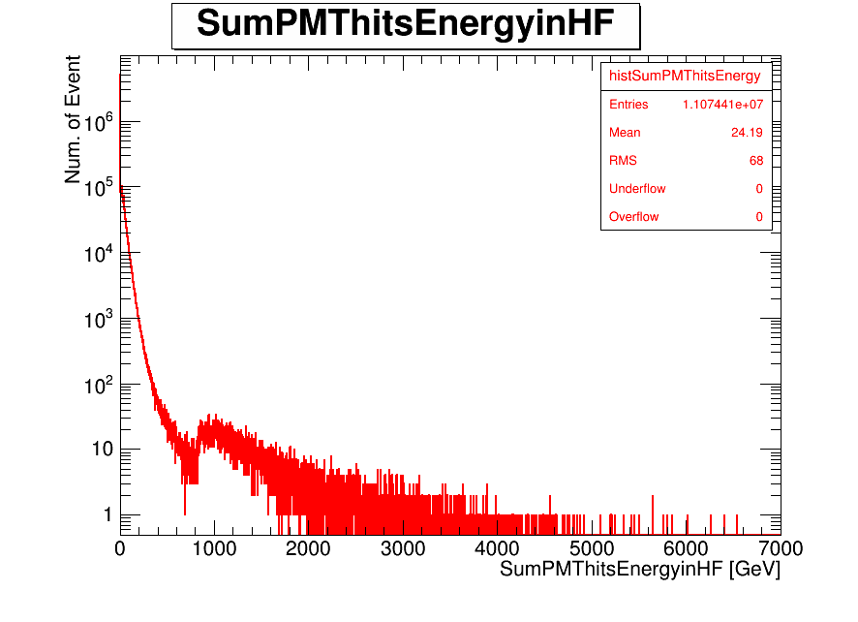
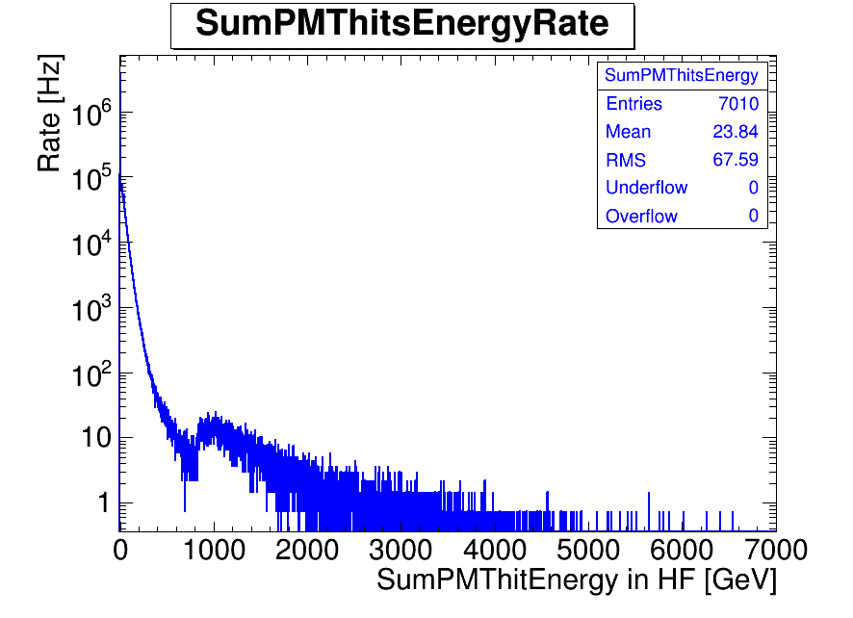
PMT Hits Energy and PMT Hits Energy Rate Plots
Sum PMThits Energy
Sum PMThits Energy Rate. After using Pre Scale Factor .

Slide 16
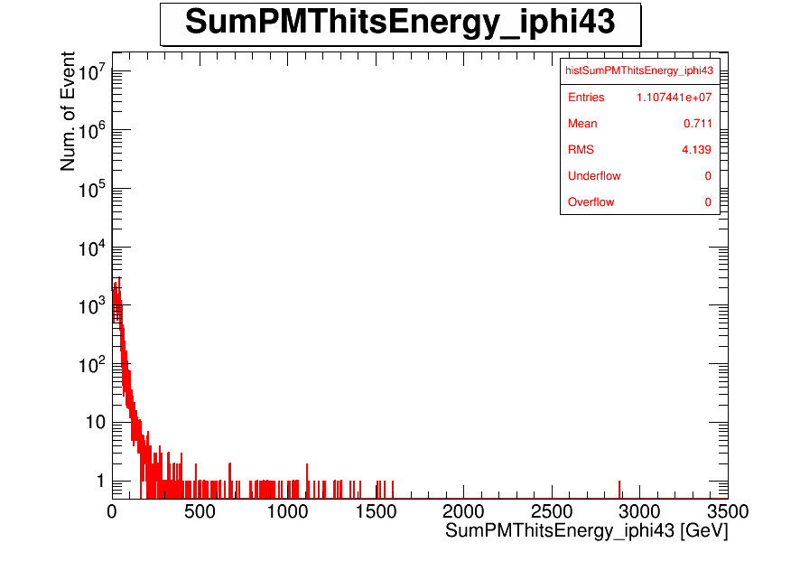
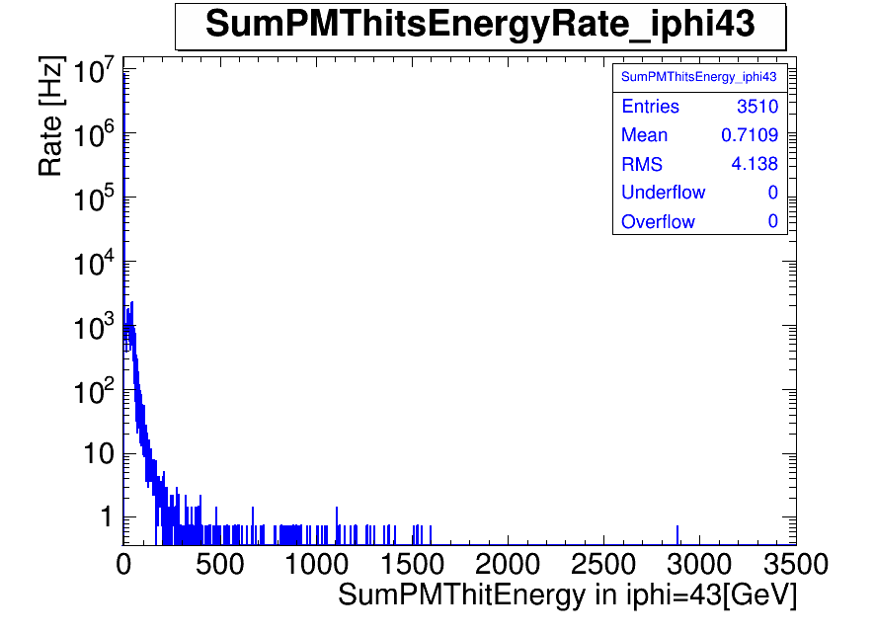
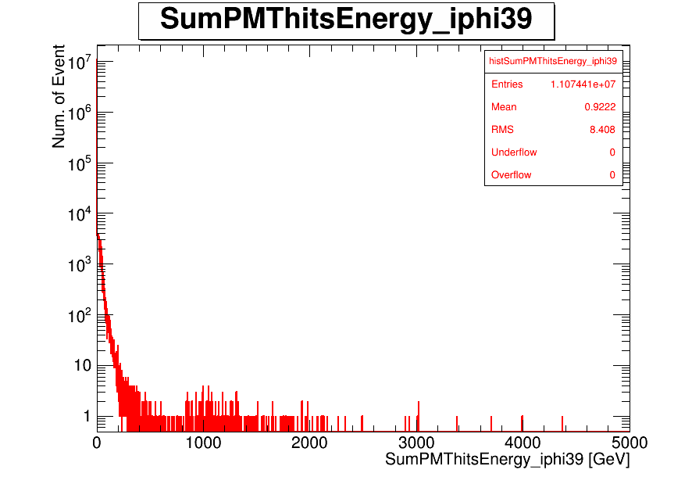
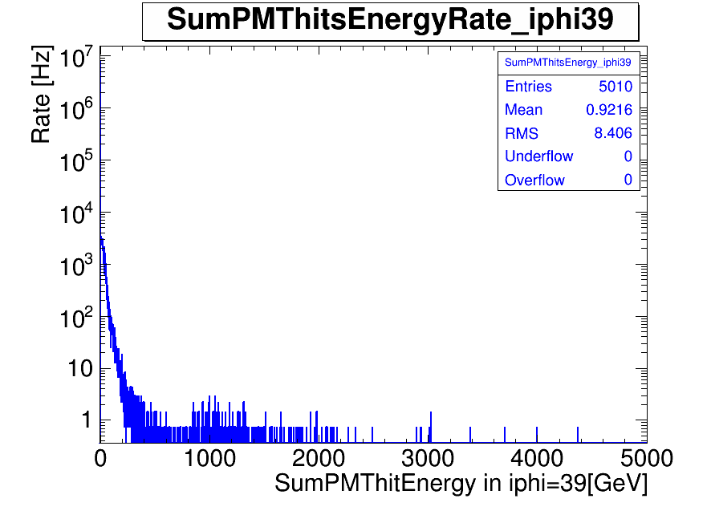
PMT Hits Energy and PMT Hits Energy Rate Plots for iPhi=43 and iPhi=39
New PMTs
iφ=43
New PMTs
iφ=43
Old PMTs
iφ=39
Old PMTs
iφ=39

Slide 17
sqrt(s)=13 TeV
We have analyzed collision data at 13 TeV for Run:245162
We used CMSSW_7_4_0 and Global Tag is GR_E_V47
Using data:
/store/express/Commissioning2015/ExpressPhysics/FEVT/Express-v1/000/245/162/

Slide 18
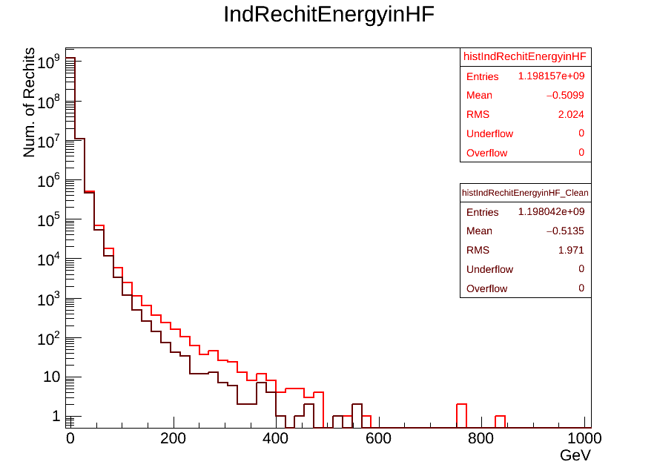
Individual Rechit Energy before and after Noise filter for all HF
Before and after filter

Slide 19
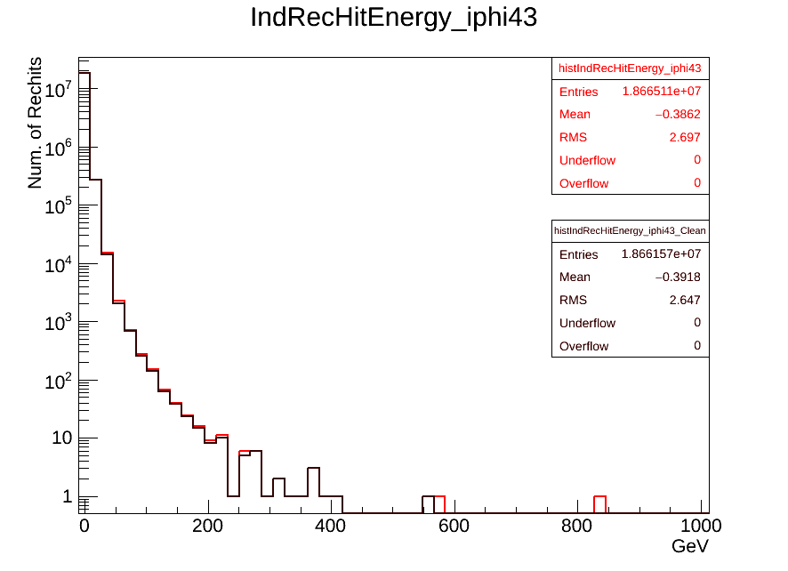
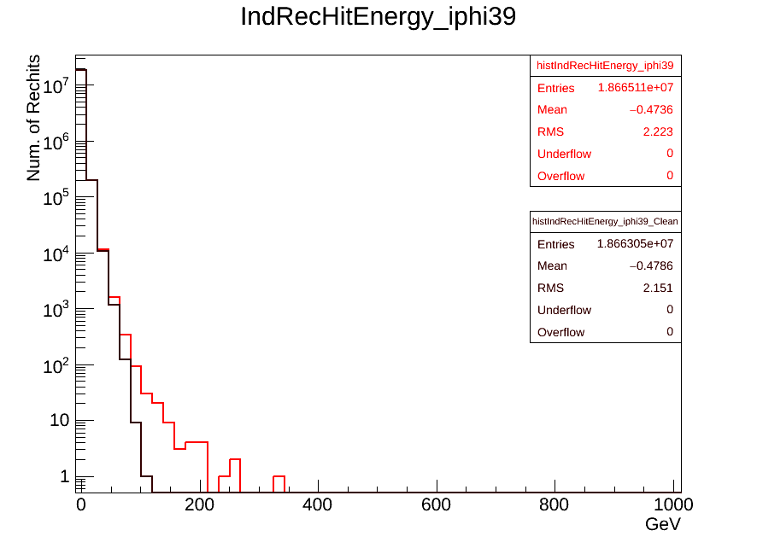
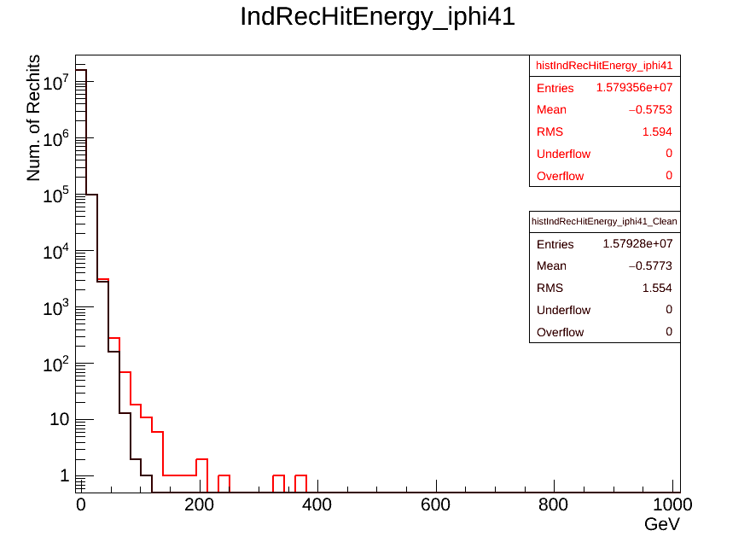
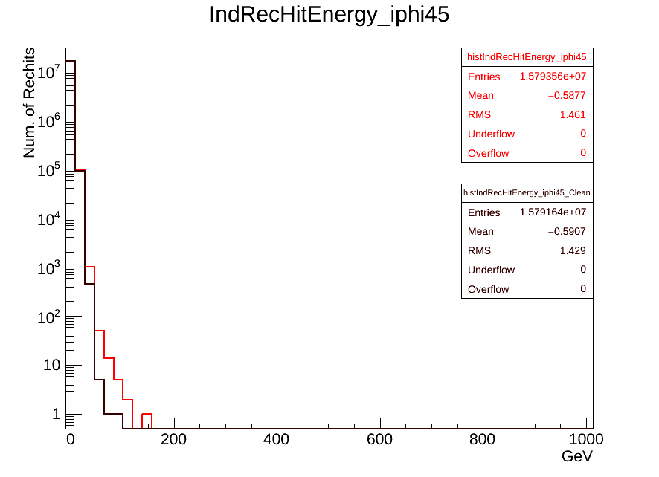
Individual Rechit Energy before and after Noise filter for iφ=43,39,41,45
Changed YTS1 in 2012
New PMTs
iφ=43
New PMTs
iφ=39
Before and after Noise filter
New PMTs
iφ=45
New PMTs
iφ=41

Slide 20
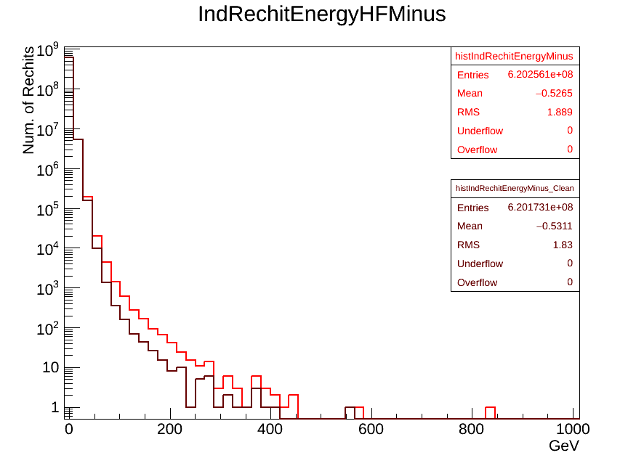
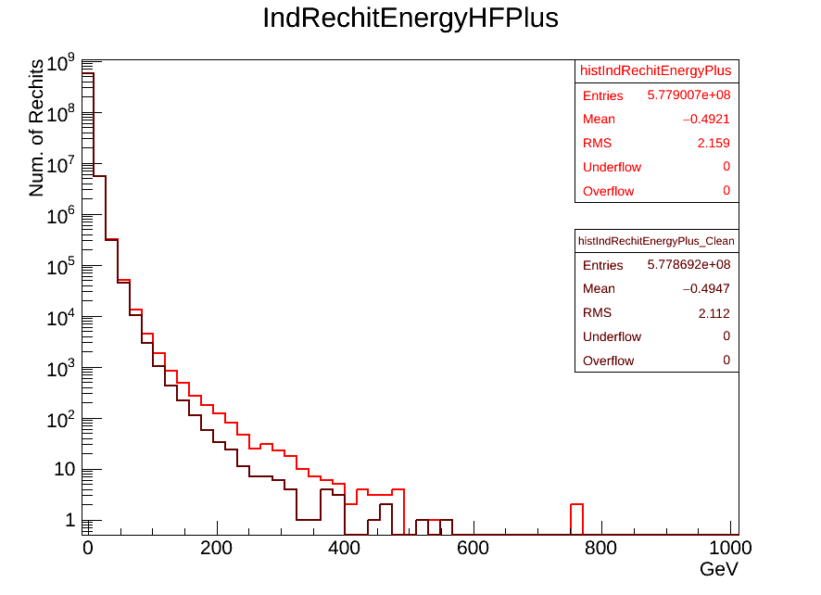
Individual Rechit Energy before and after Noise filter for HF Minus and HF Plus
HF Minus
HF Plus

Slide 21
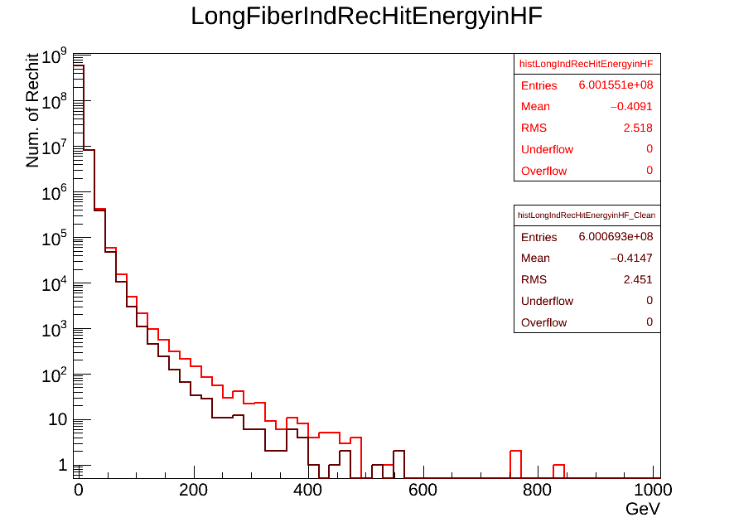
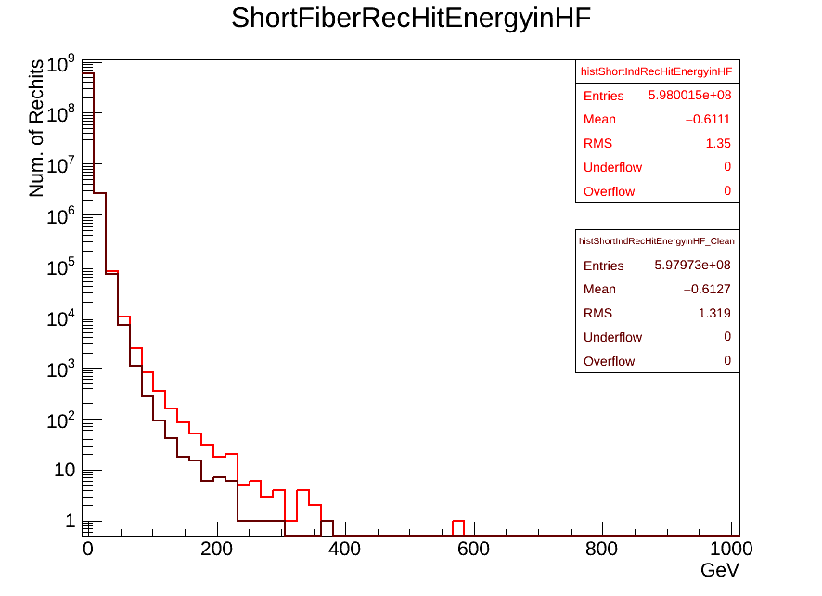
Individual Rechit Energy before and after Noise filter for Long and Short Fibers in HF
HF Long Fiber
HF Short Fiber

Slide 22
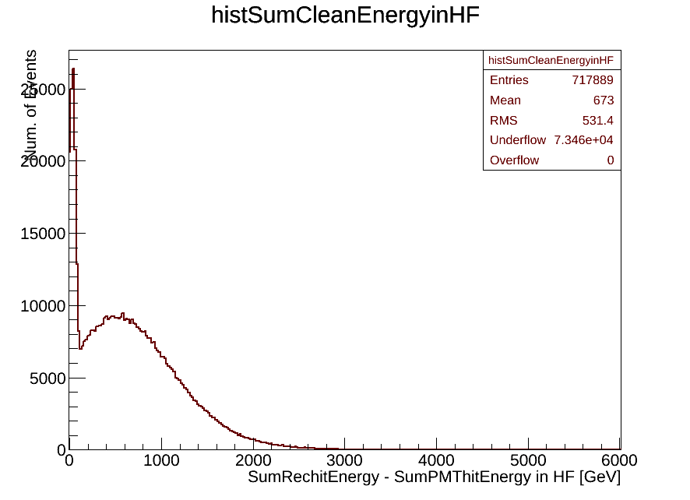
Clean Energy Plot

Slide 23
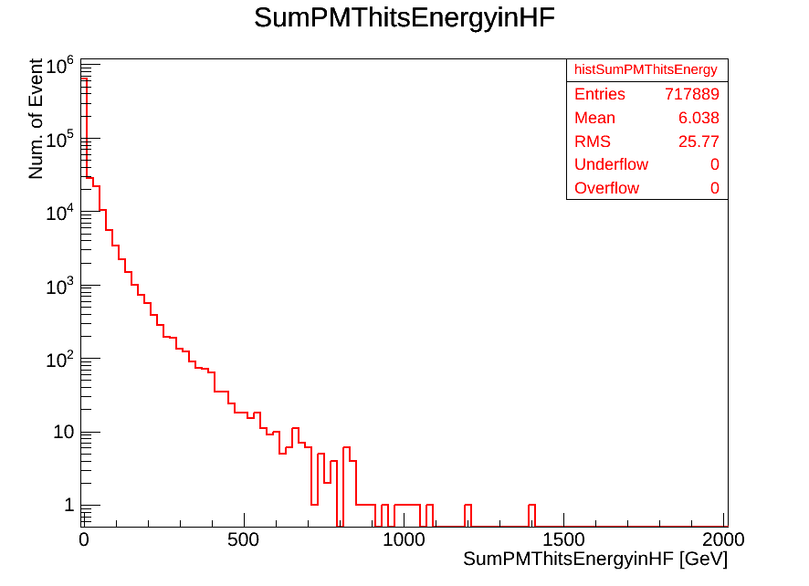
PMT Hits Energy Plot

Slide 24
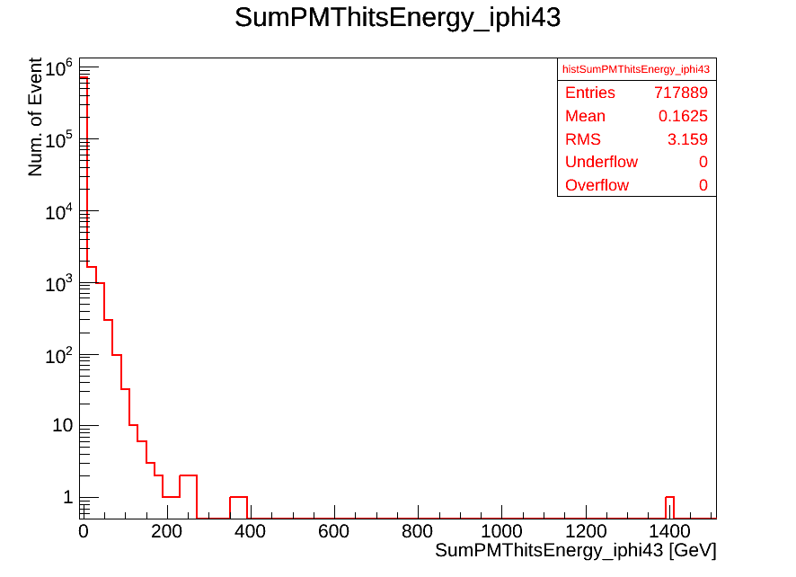
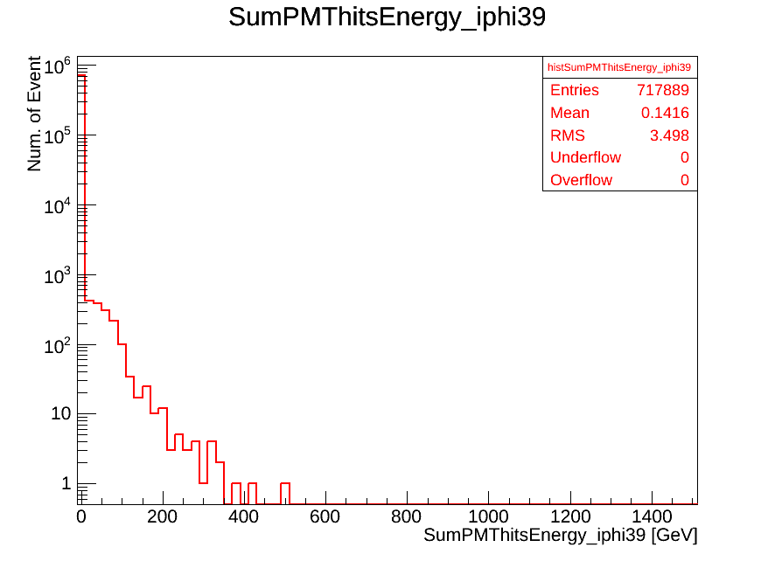
PMT Hits Energy Plots for iφ=43,39
Changed YTS1 in 2012
New PMTs
iφ=43
New PMTs
iφ=39

Slide 25
Conclusion
Analysed data set was /MinimumBias/Run2012D-PromptReco-v1/RECO
We found opportunity to analyse both all HF and New PMTs in these study.
As I mentioned before this. The new PMTs still have noise hits. But they have much less than old PMTs.
We have started analysis for data at 13 TeV. But new PMTs still have noise hits and noise filters are not working properly.

Slide 26
Back up

Slide 27
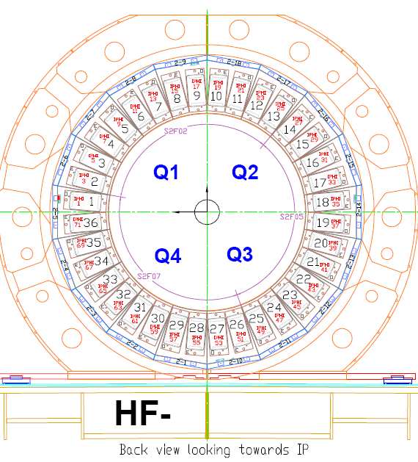
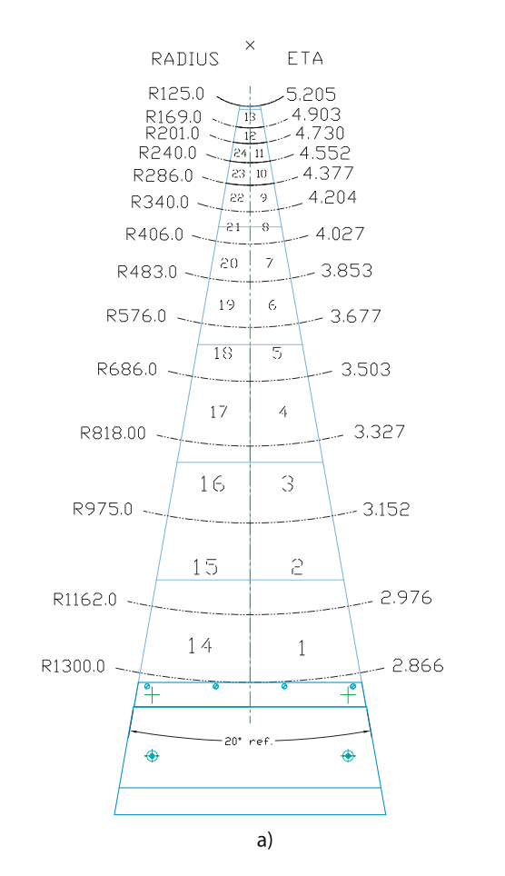
HF Map
In HCAL, towers are indexed according to their η (pseudorapidity) and ϕ (azimuthal angle) intervals.
Mid-point η and ϕ values are integerized and used as ieta and iphi indices.
In HF, ieta ranges from 29 to 41. On the other hand, the angle ϕ is divided into iphi towers that range from 1 to 71 in steps of two.
Installed New PMTs at iphi 43
https://cms-docdb.cern.ch/cgi-bin/DocDB/RetrieveFile?docid=4776&version=1&filename=hf_mapping.pdf

Slide 28
FlagHFLS
Bit Name: HFLongShort Set via: HcalHF _S9S1algorithm.cc and HcalHF _PETalgorithm.cc Purpose: Overall topological flag. Compares energy of a channel to its neighbors, using the results of the S9S1, S8S1, or PET algorithms.
(RecHits at different depths or ieta positions use different algorithms for determining this 'topological' noise.)
FlagHFS8S1
Bit Name: HFS8S1Ratio Set via: HcalHF _S9S1algorithm.cc (with special boolean cfg to turn S9S1 to S8S1) Purpose: make a comparison of S8/S1 for HF channels. Feeds the HFLongShort bit.
FlagTimingError
Bit Name: HFDigiTime Set via: HcalHFStatusBitFromDigis::hfSetFlagFromDigis Purpose: Checks pulse shape of digi signal. Flags digis in which bulk of the pulse shape is outside of time slice #4.
FlagHFInTimeWindow
Bit Name: HFInTimeWindow Set via: HcalHFStatusBitFromDigis::hfSetFlagFromDigis Purpose: Flags channels outside of given time window. Available starting in 3_7_X.
FlagHFPET
Bit Name: HFPET Set via: HcalHF _PET1algorithm.cc Purpose: make a comparison of L-S/L+S for HF channels, using the PET (Polynomial expansion technique). Feeds the HFLongShort bit.
https://twiki.cern.ch/twiki/bin/viewauth/CMS/HcalRecHitFlagAssignments

