Slide 1
FCC-hh MDI 6th Meeting
Wednesday 27th May 2015
CE Update – Service Caverns & FCC kink
Charlie Cook (GS-SE-FAS), John Osborne (GS-SE-FAS)

Slide 2


Outline
Updated Experimental Cavern CATIA drawings
Typical underground service caverns from the CLIC study
First results from putting a ‘kink’ in the tunnel, and its impact on Experimental Cavern depths
Experimental Cavern design : next steps

Slide 3
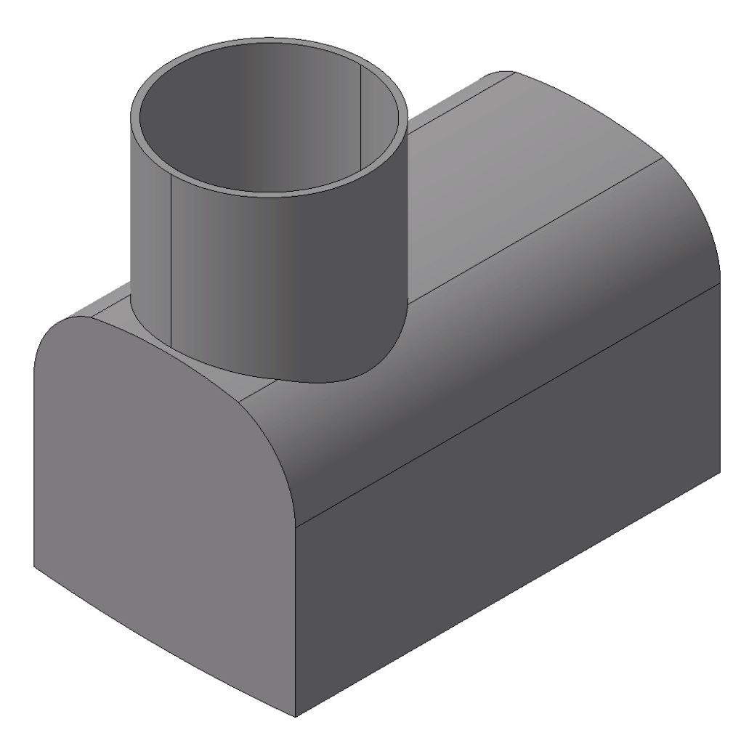
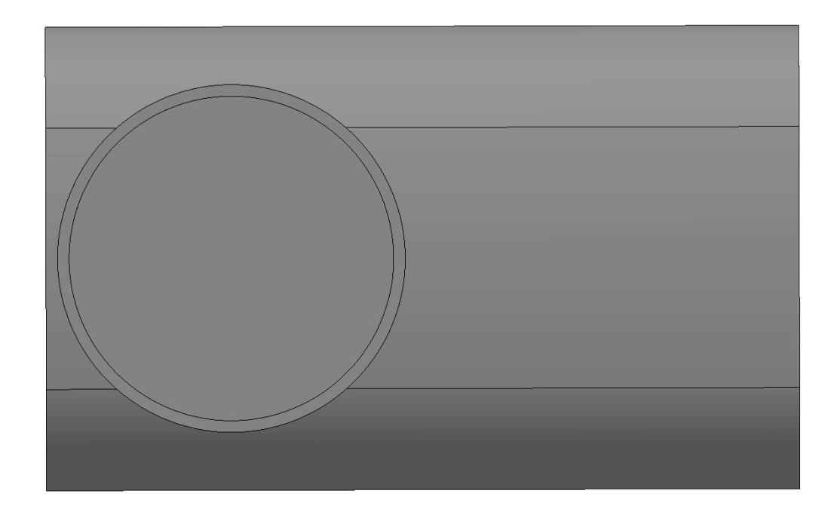
Updated CATIA Experimental Cavern Drawings
BA5
CERN SITG VUE

Slide 4
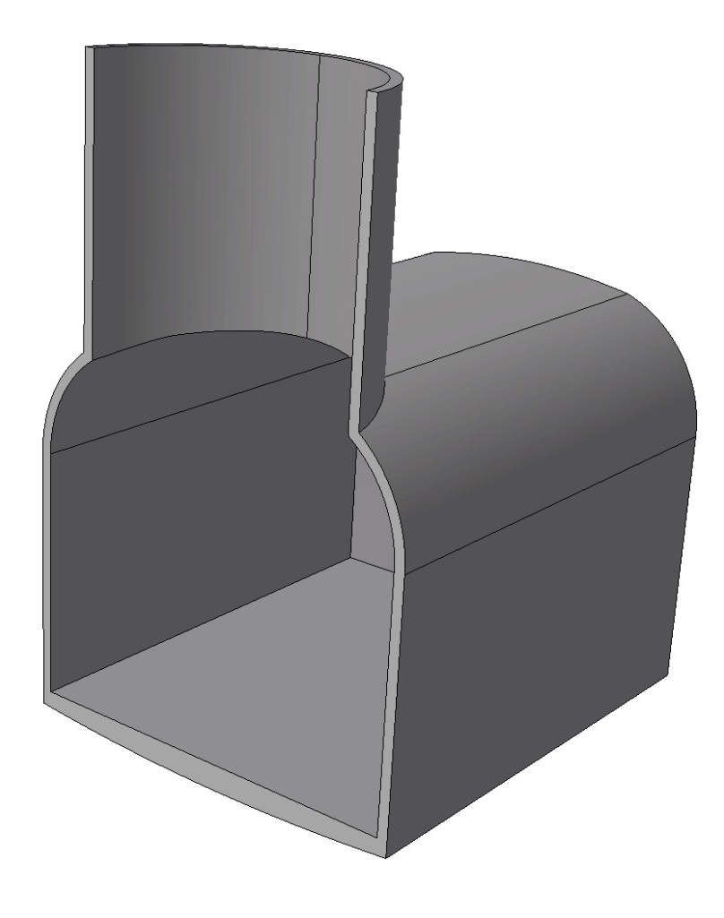
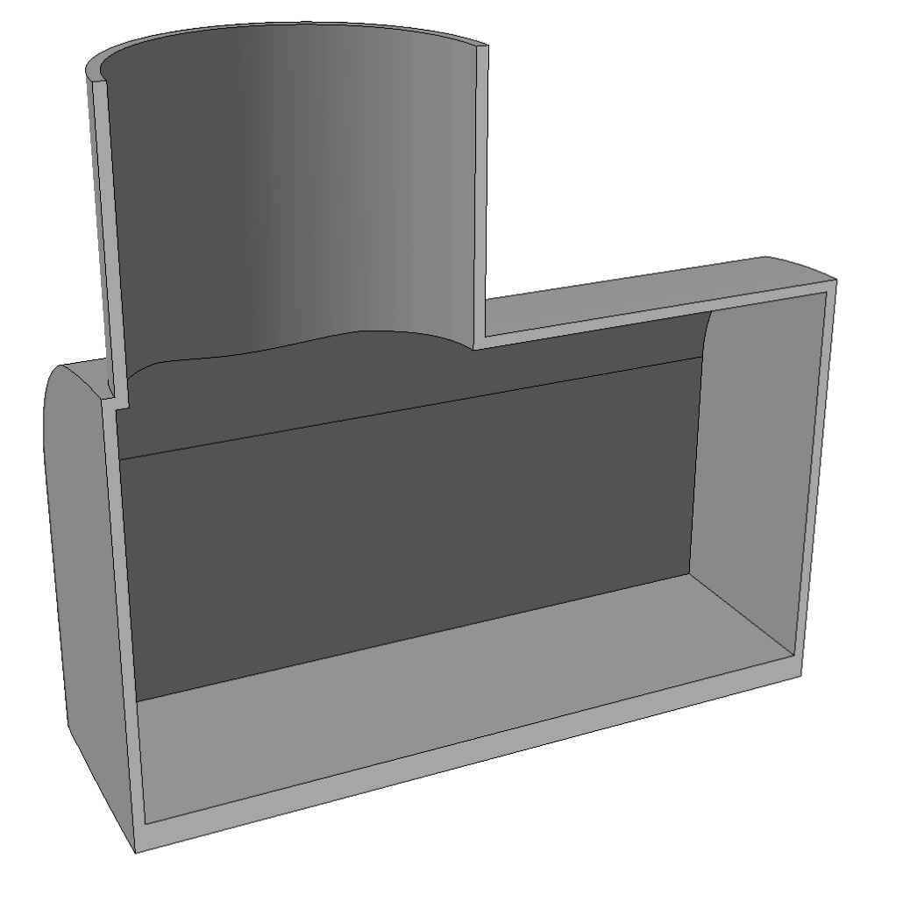
Updated CATIA Experimental Cavern Drawings
CATIA Model: ST0666403_01
Ø28 m
36 m
38 m
65 m

Slide 5
Updated CATIA Experimental Cavern Drawings

Slide 6
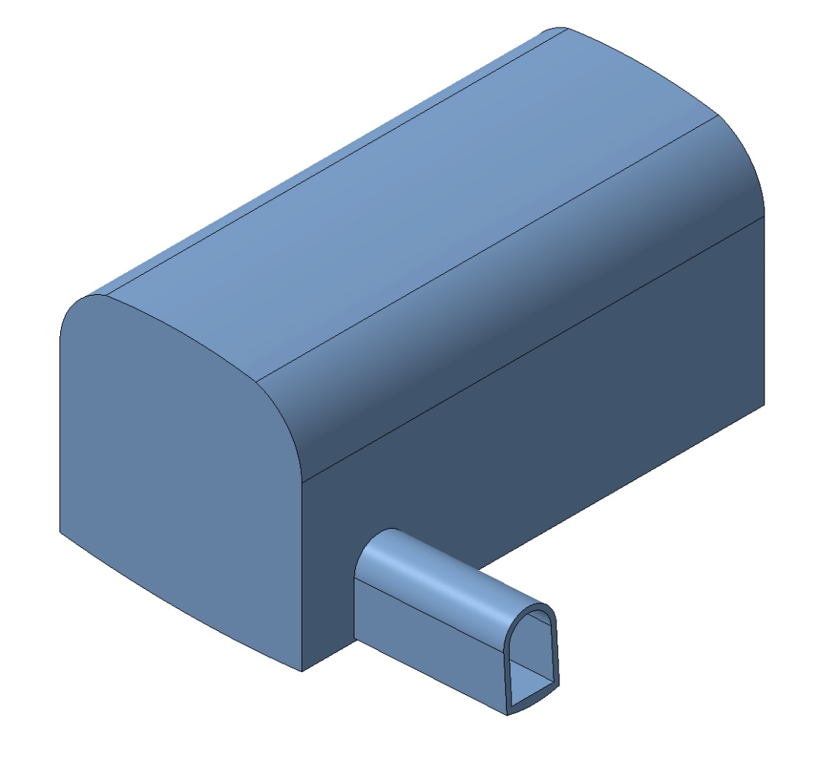
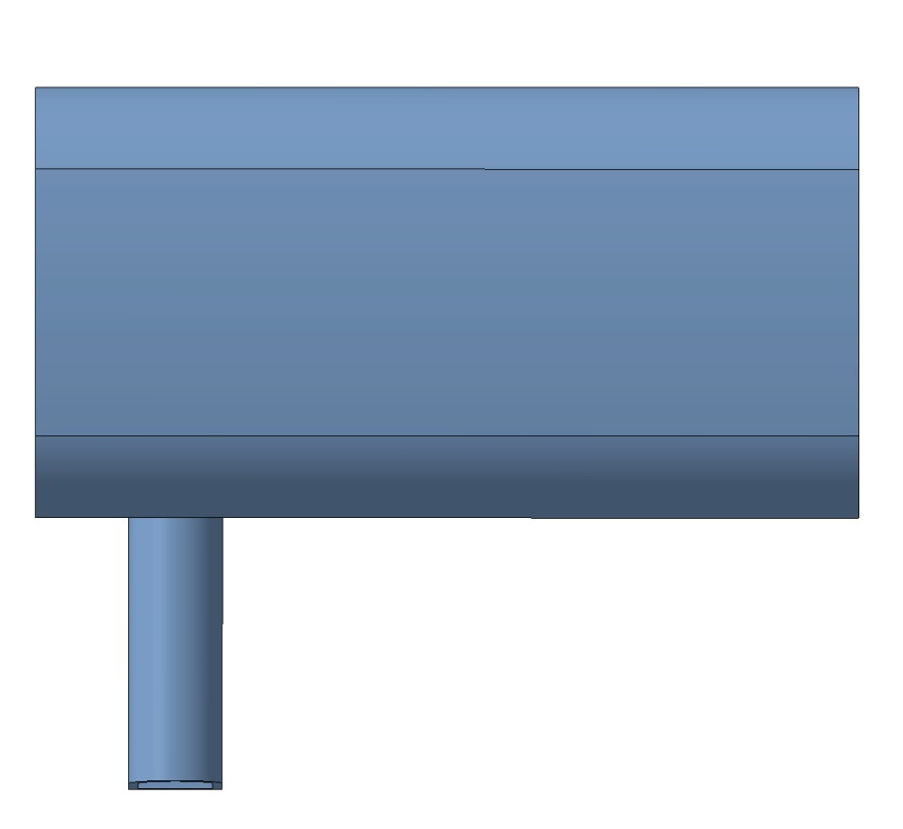
Updated CATIA Experimental Cavern Drawings

Slide 7
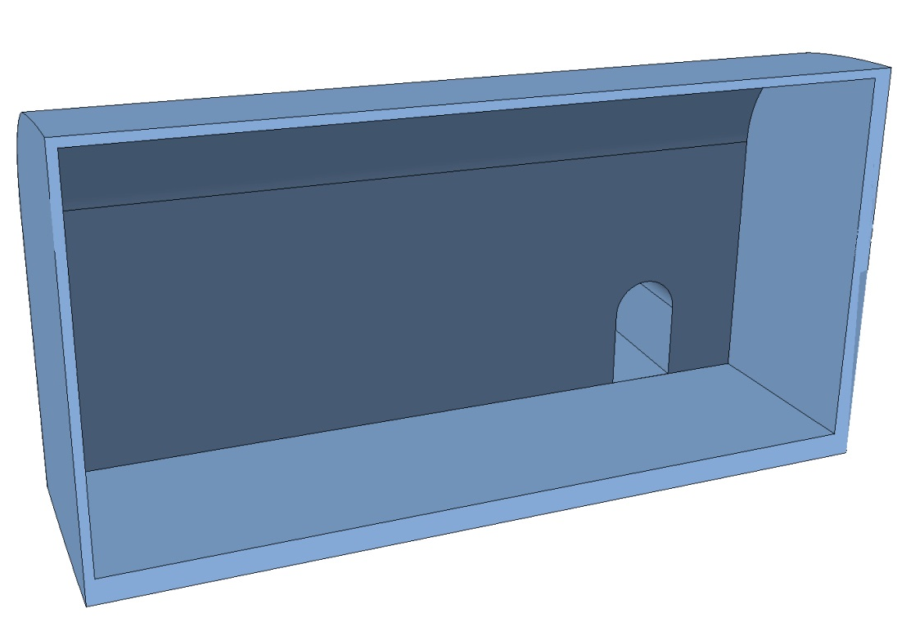
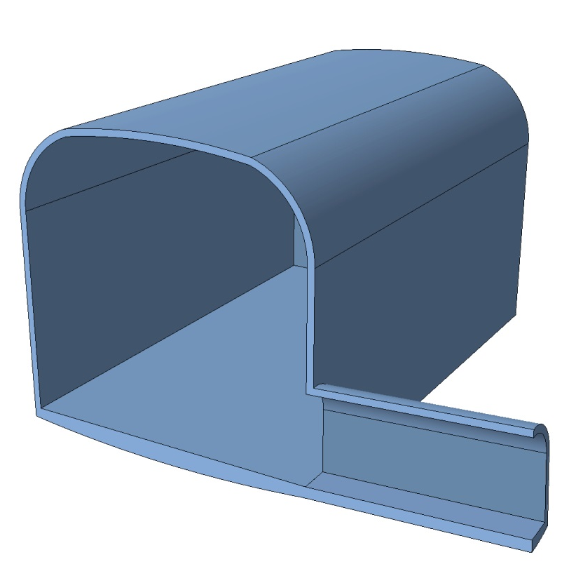
Updated CATIA Experimental Cavern Drawings
CATIA Model: ST0666529_01
44 m
42 m
86 m
13 m
8 m

Slide 8
Updated CATIA Experimental Cavern Drawings

Slide 9
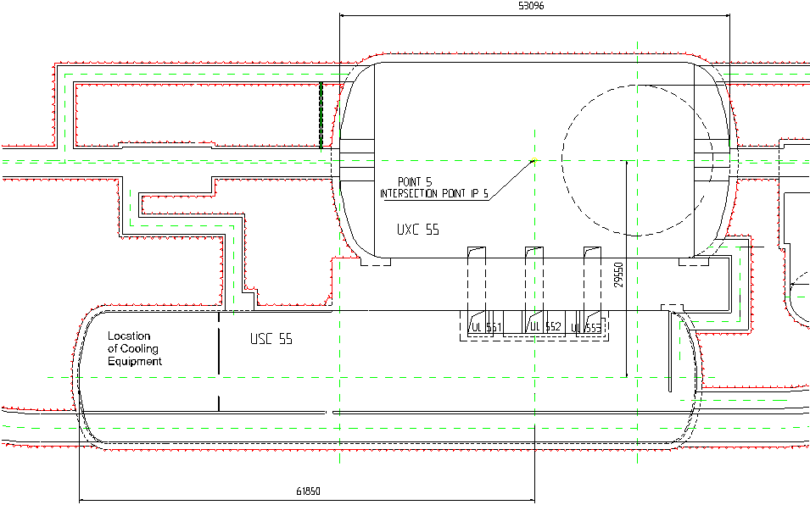
Service Caverns – Initial Layout Sketches
Cavern Layout1,
shaft on top of cavern,
35m high
50m
30m
22m
80m
20m

Slide 10
Service Caverns – Initial Layout Sketches
80m
Cavern Layout2,
45m high
45m
25m
90m
20m

Slide 11
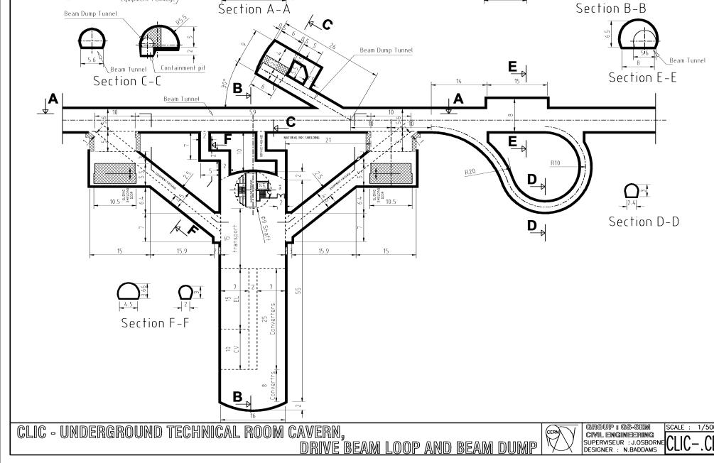
Typical underground service caverns from the CLIC study

Slide 12
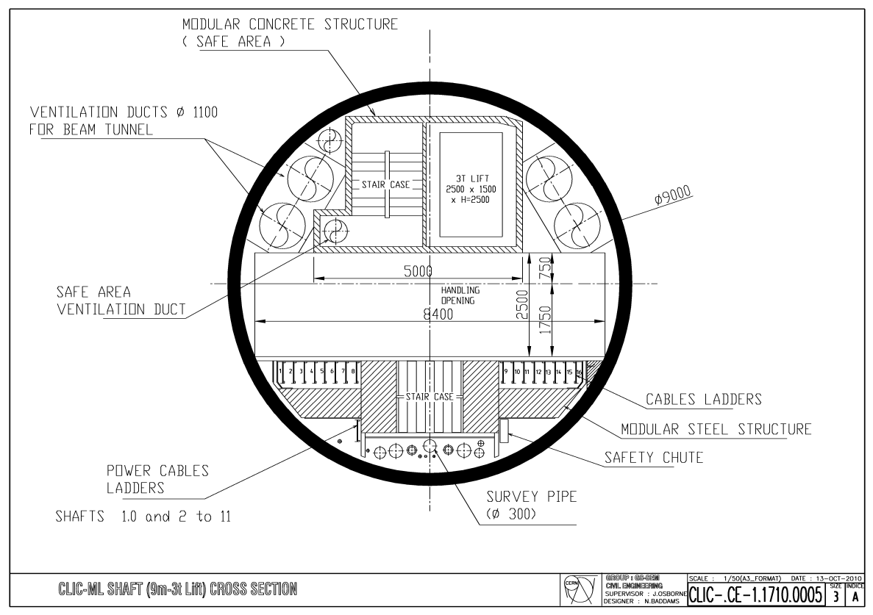
Typical underground service caverns from the CLIC study

Slide 13
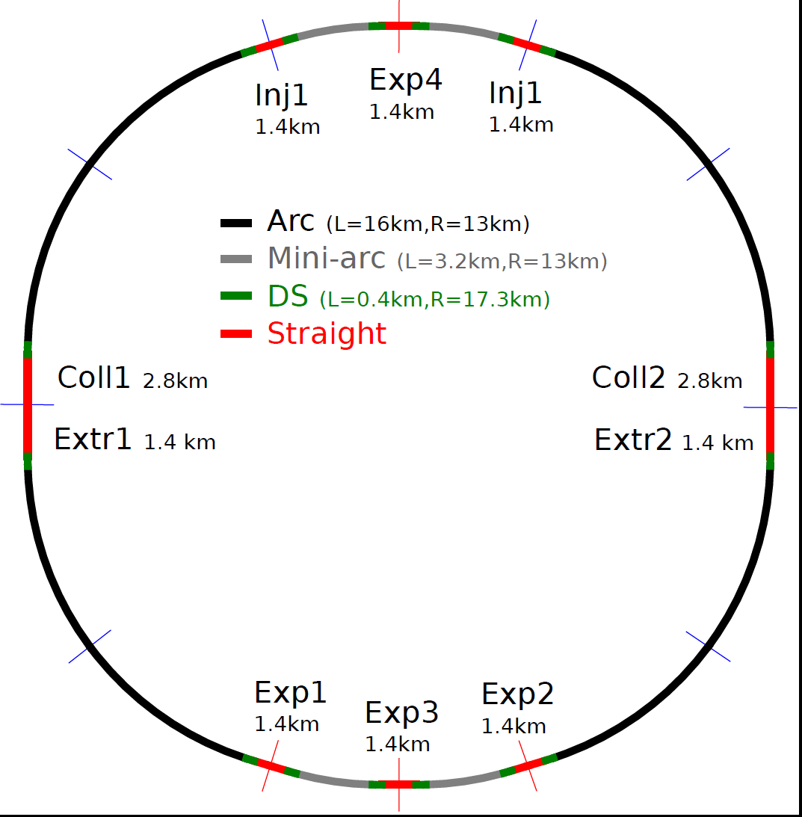
Single Kink – 100km Example
Point A
Point L
Point B
Point K
Point C
Point J
Point D
Kink
Point I
Point E
Point H
Point F
Point G

Slide 14
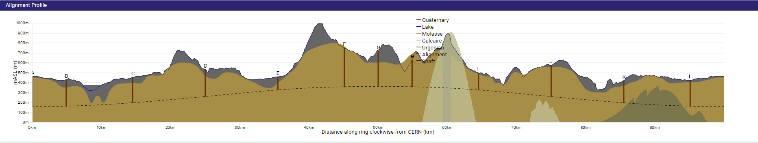
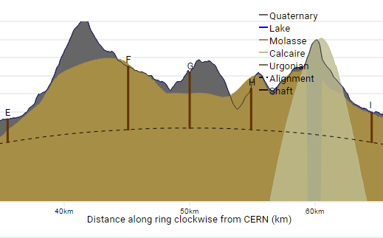
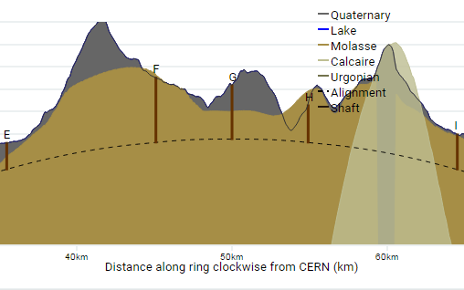
Single Kink – 100km Example
Option 2a [100km] – no kink [slope = 0.5%]
Option 2a [100km] – single kink [slope = 1.4%]
Kink 1
Chainage = 34892m
Dist. To E = 600m
Kink 2
Chainage = 64487m
Dist. To I = 600m
Option 2a [100km] – single kink [slope = 2.4%]

Slide 15

Single Kink – 100km Example
100km Example
Maximum kink for CE (in this example)
2.4% slope after kink [change in slope at kinks = 1.75%]
100km Example
 |  | Shaft Depths
Slope after kink [%] | Change in slope [%] | E | F | G | H | I | Total depth (of all 12 shafts) | Shaft depths % Reduction
0.65 | 0.0 | 132 | 392 | 354 | 268 | 170 | 3211 | 0%
0.9 | 0.25 | 131 | 378 | 339 | 254 | 169 | 3166 | 1%
1.4 | 0.75 | 128 | 350 | 307 | 226 | 166 | 3072 | 4%
2.4 | 1.75 | 110 | 290 | 241 | 166 | 157 | 2859 | 11%

Slide 16
Kink Conclusions
For CE, the optimal position for a “single kink” design would be one kink near point E and one kink near point I for all four options (80km, 87km,93km, 100km). The two kinks could be symmetrical about Point G.
100km example
Kinks of equivalent gradient in the 100km example give similar reductions in depth in terms of meters but slightly less % reductions in total shaft depths (due to a larger total shaft depth than the 93km example)
Overall
There is a clear opportunity for a kink in the FCC tunnel to reduce the depth of some of the most problematic shafts. The benefit to CE could be a reduction of 100m at experimental points F,G and H and a 10% reduction in total shaft depths. The greatest advantage to CE may be as a method of mitigating issues with cavern construction at large depths and rock squeezing in the tunnel - as these may prove to be significant feasibility issues at a later stage – as well as the removal of excavated material from the tunnel.

Slide 17
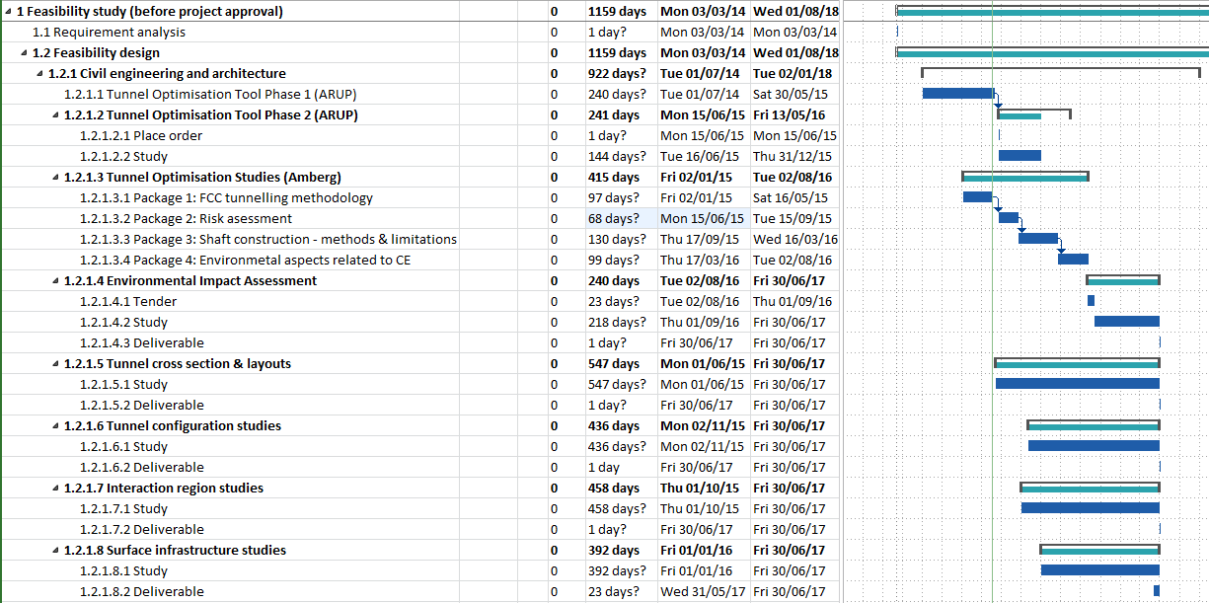
Experimental Cavern Design: next steps
Study proposals for stage 2 of FCC CE study:
  Cost-benefit analysis of vertical shaft vs. inclined tunnel access to caverns
  Feasibility studies for experimental cavern construction at depth
To be decided after FCC Review meeting, June 11th

