Slide 1
Q5 replacement at point 6 left
--
Integration proposition for new Q5L6
C. Magnier

Slide 2
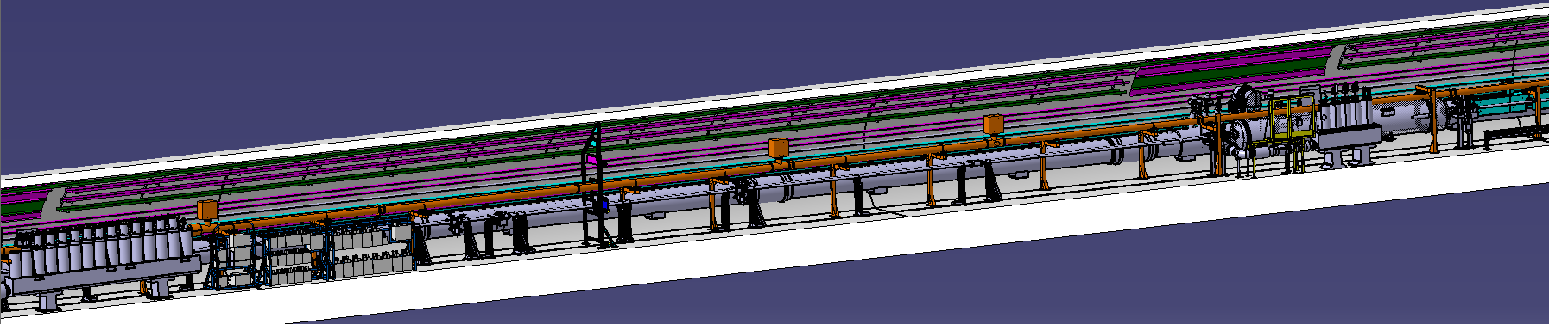
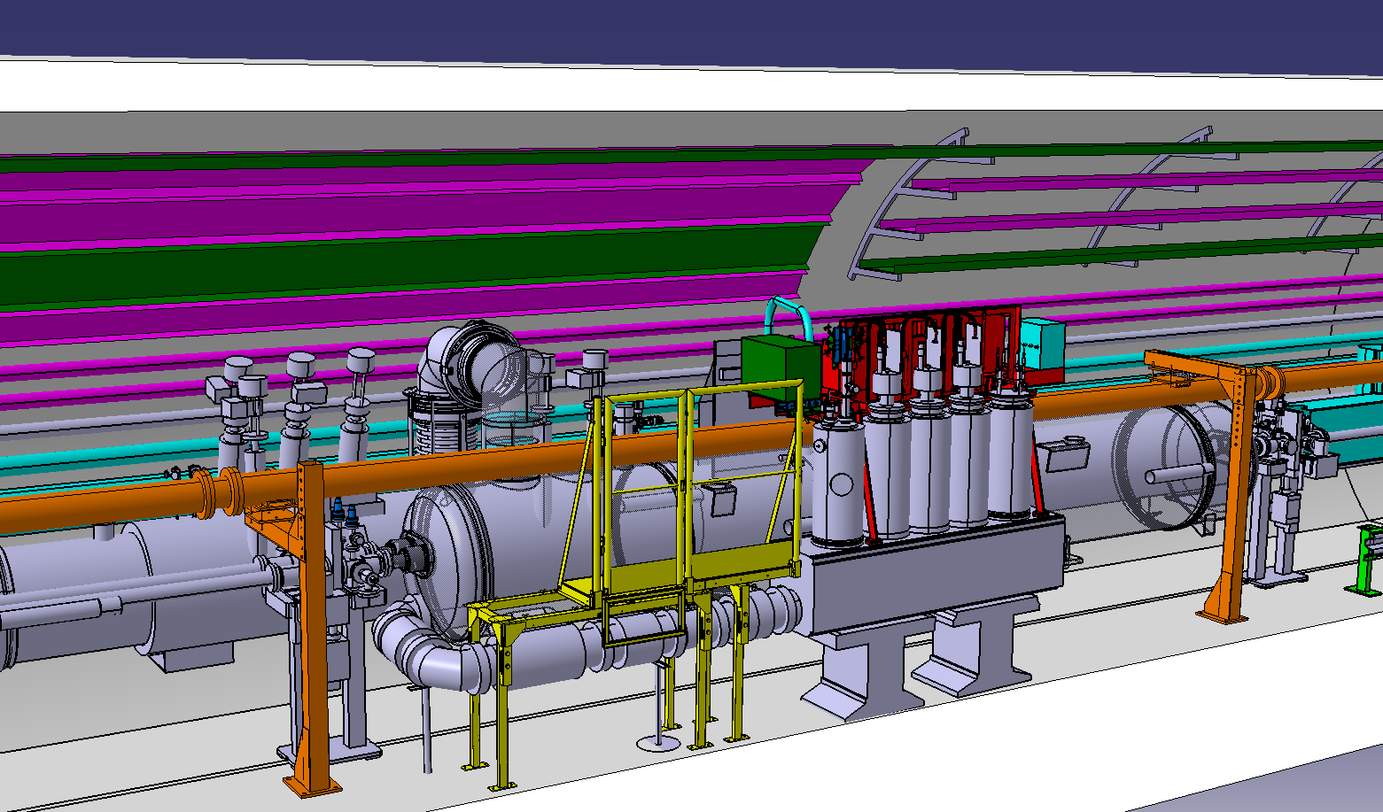
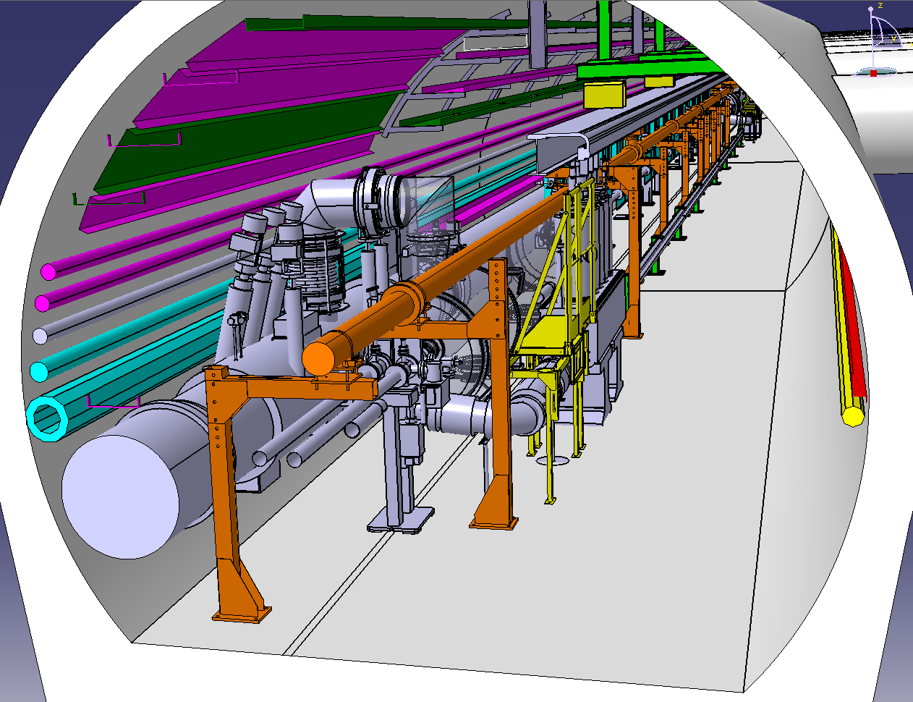
Actual situation
Frames DFBAK
Q5L6
BEAM DUMP
DFBAK
Frames DFBMM
DUMP
BEAM DUMP

Slide 3
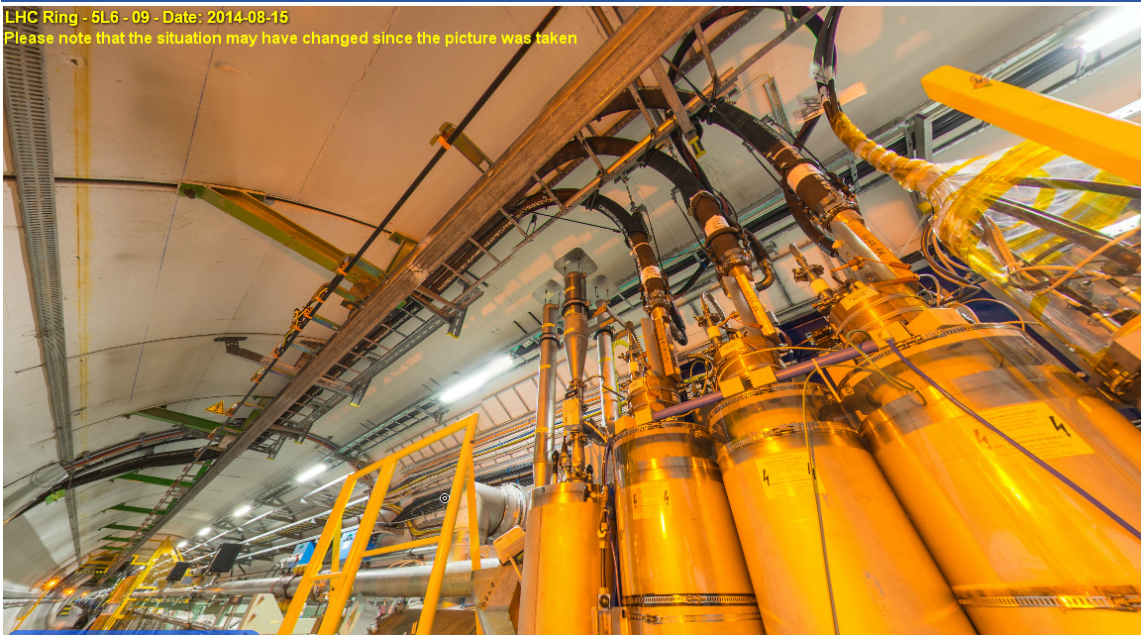
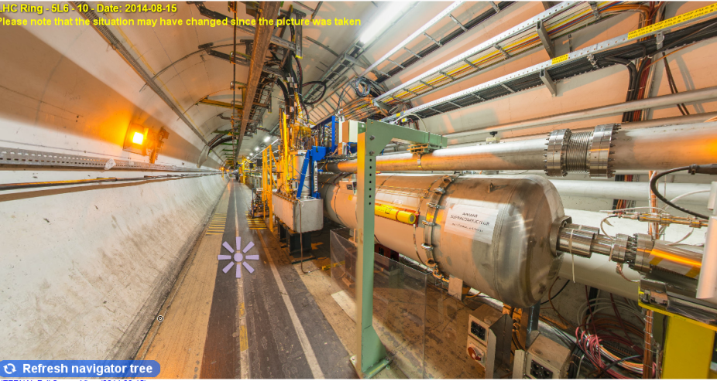
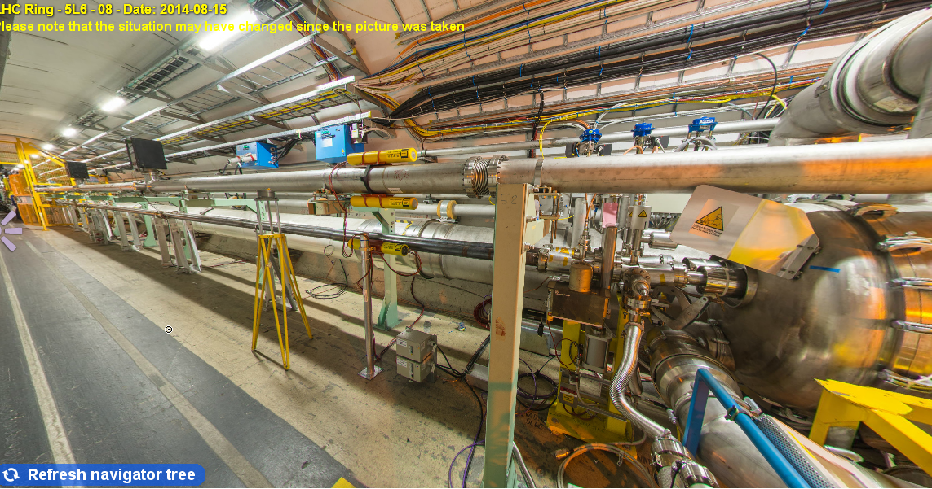
3D pictures
View on DFBMM warm cables
TRIPODE SURVEY

Slide 4
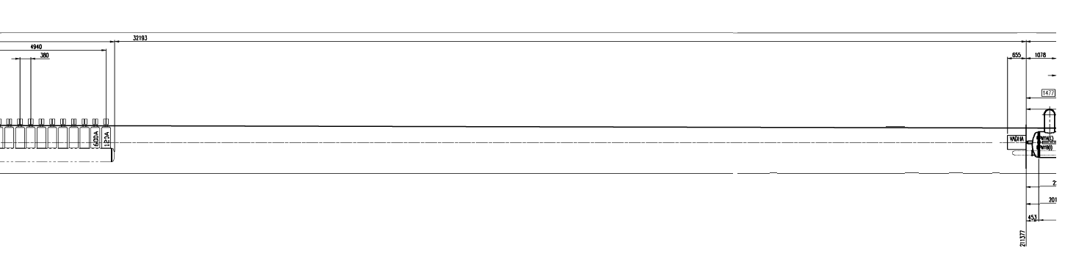
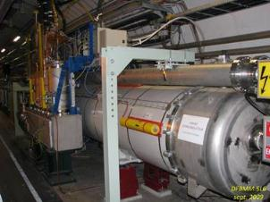
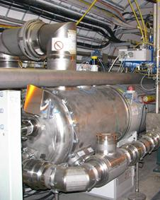
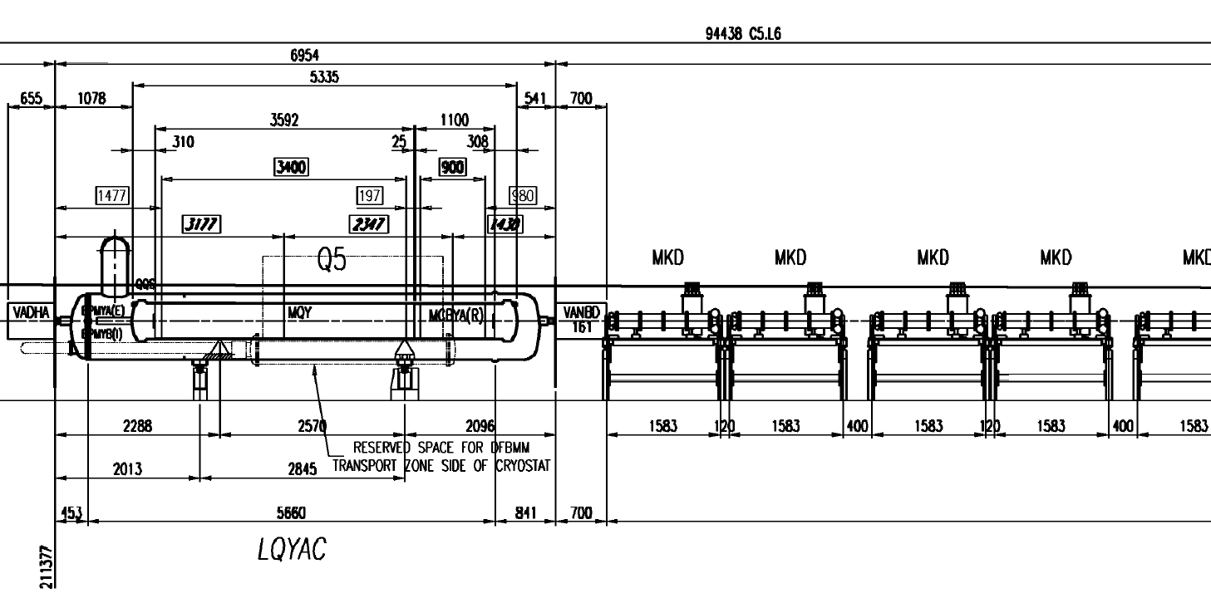
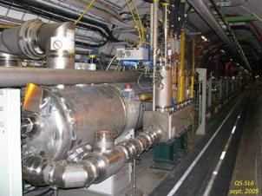
Q5L6 actual layout
211377mm/IP6

Slide 5
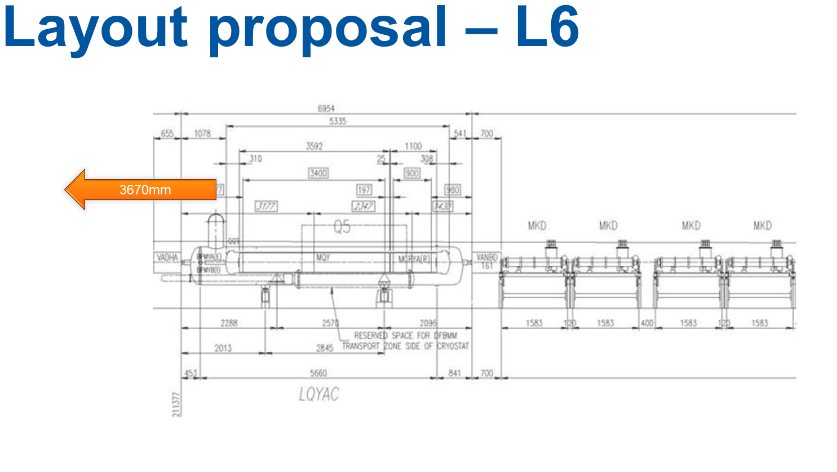
Q5L6, new magnet
Doc H. Prin

Slide 6
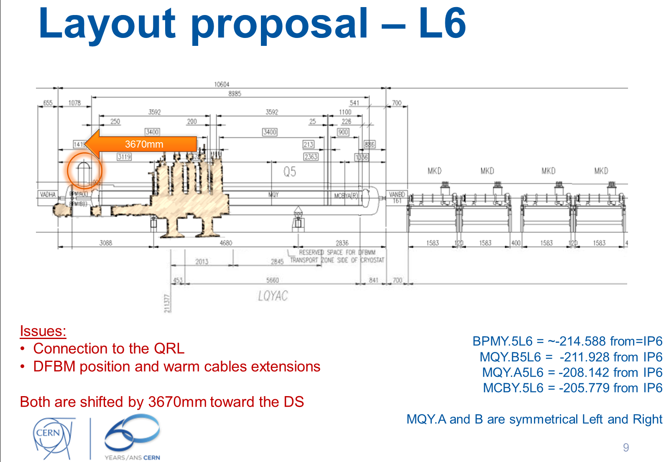
Doc H. Prin

Slide 7
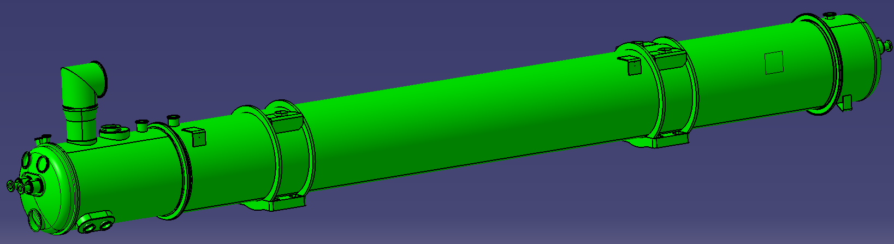
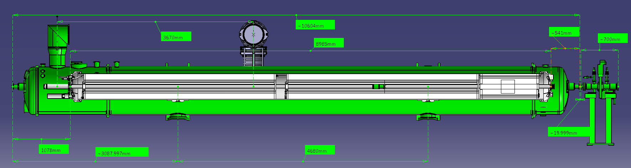
New integration proposition
Turned jumper
LHCQQS_S0253
DIPOLE TYPE CRYOSTAT
LHCQQS_S0254
NEW Q5L6
LHCQQA_S0177
LHCQQS_S0255
Existing service module
MCBYA
MQY
MQY
-215047mm/IP6

Slide 8
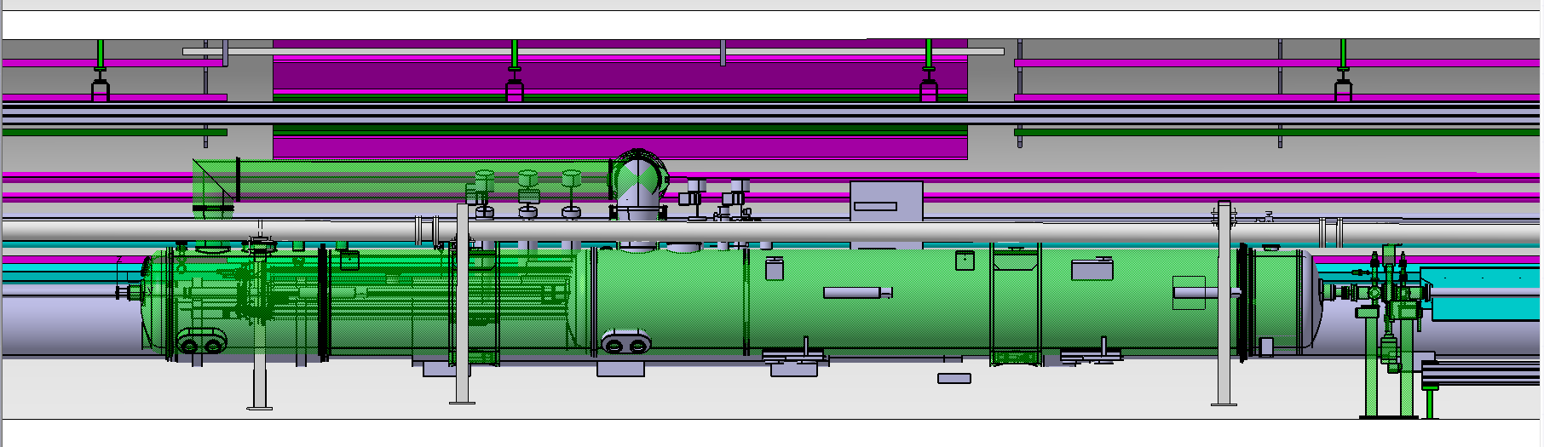
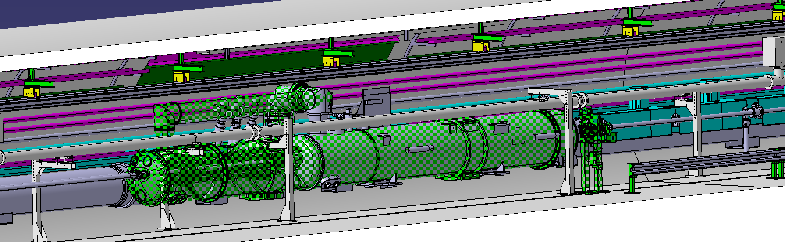
New Q5L6 in place
Old Q5 limit
MKD
MKD

Slide 9
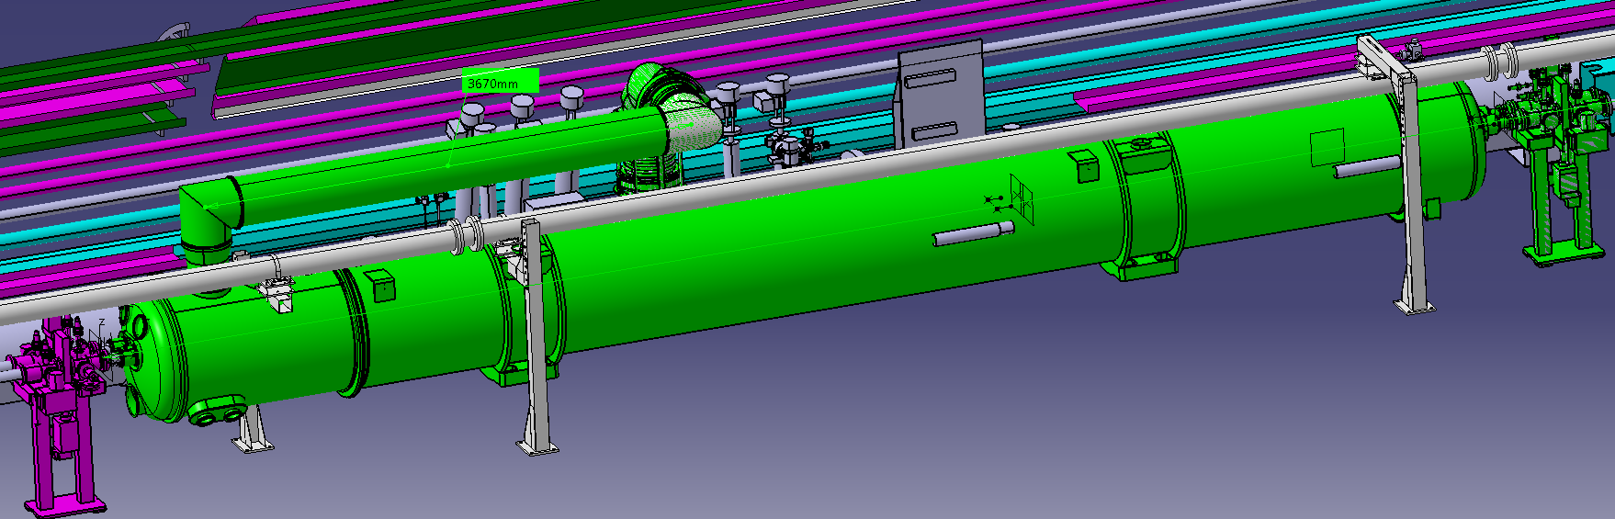
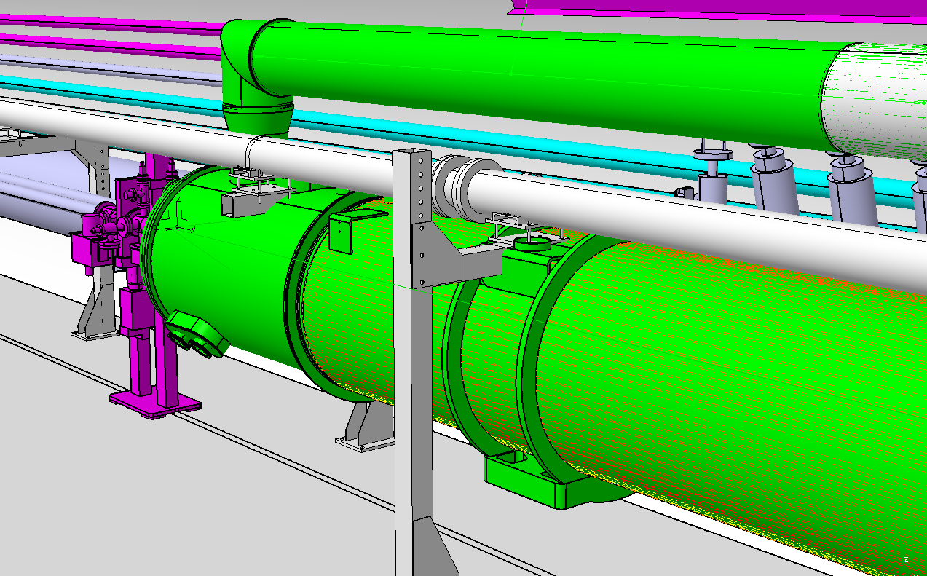
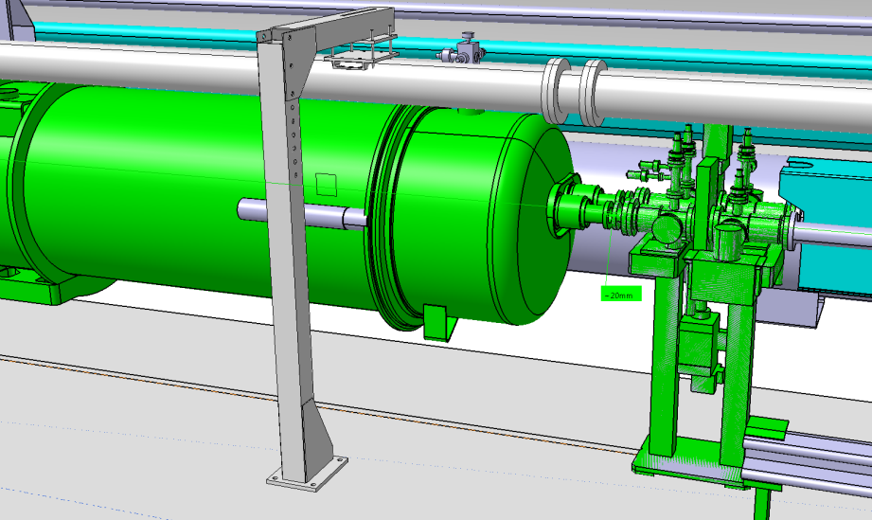
Q5L6 integration
!
!!

Slide 10
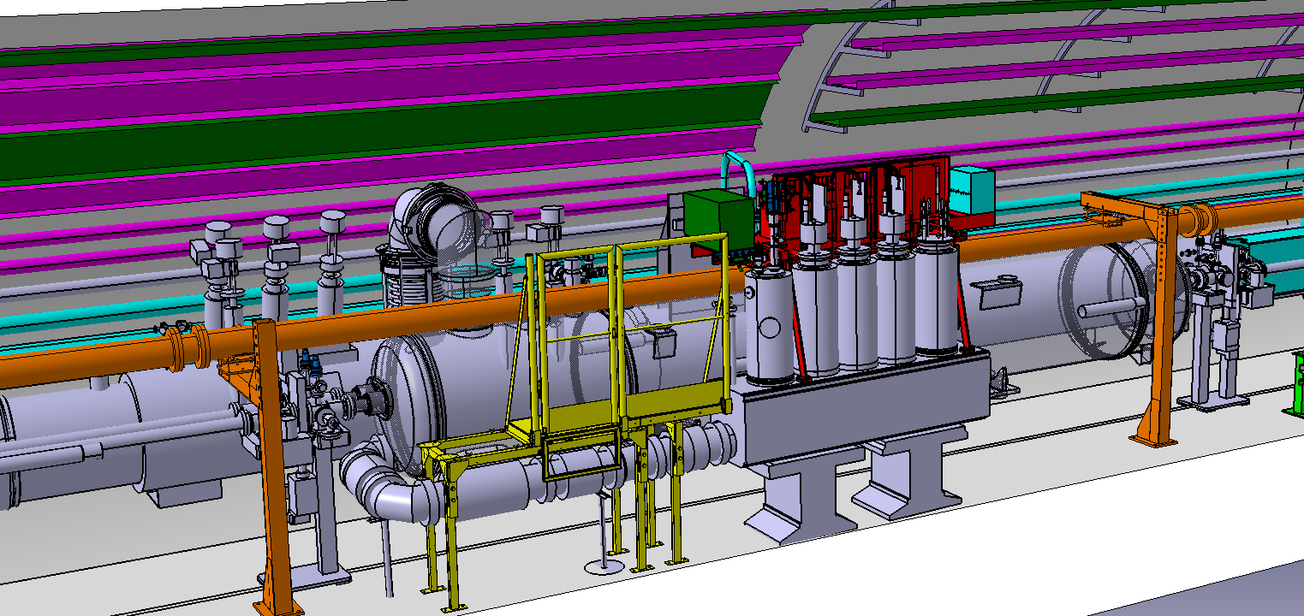
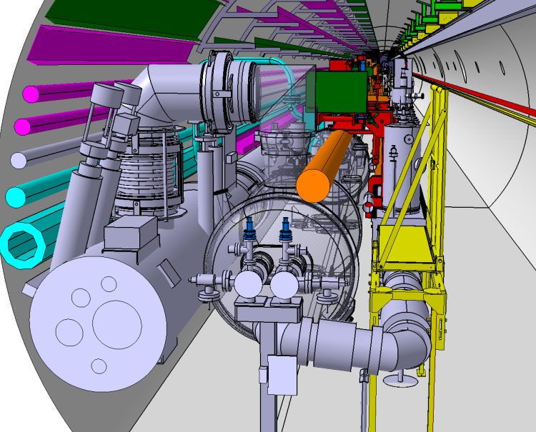
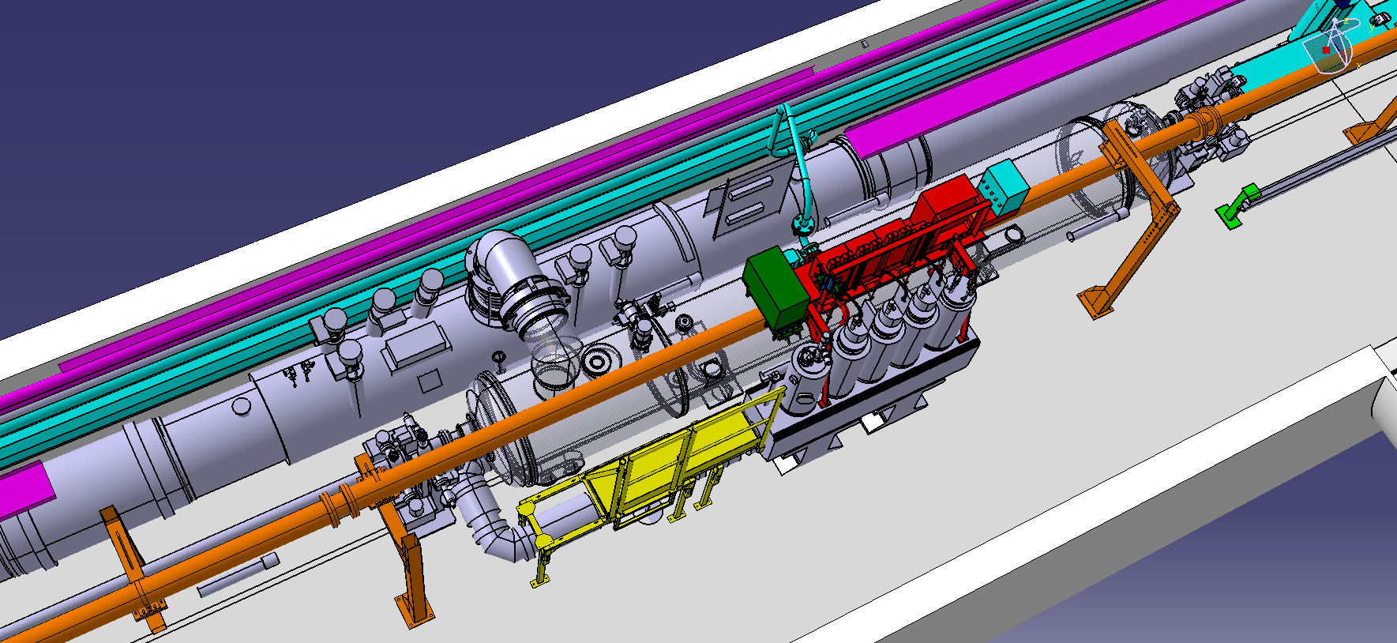
DFBMM CONNECTION : actual situation
DFBMM
WRL connection
FRAMES
DUMP

Slide 11
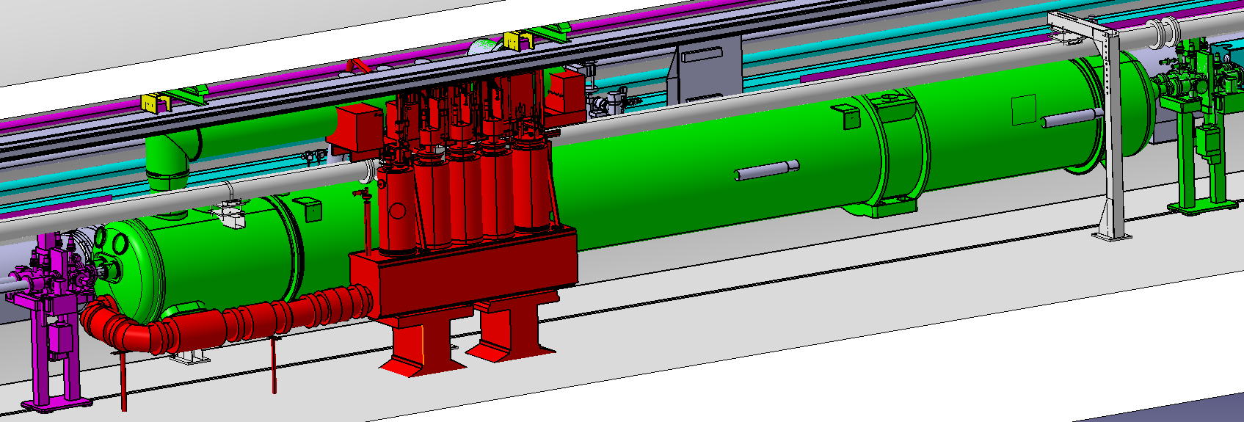
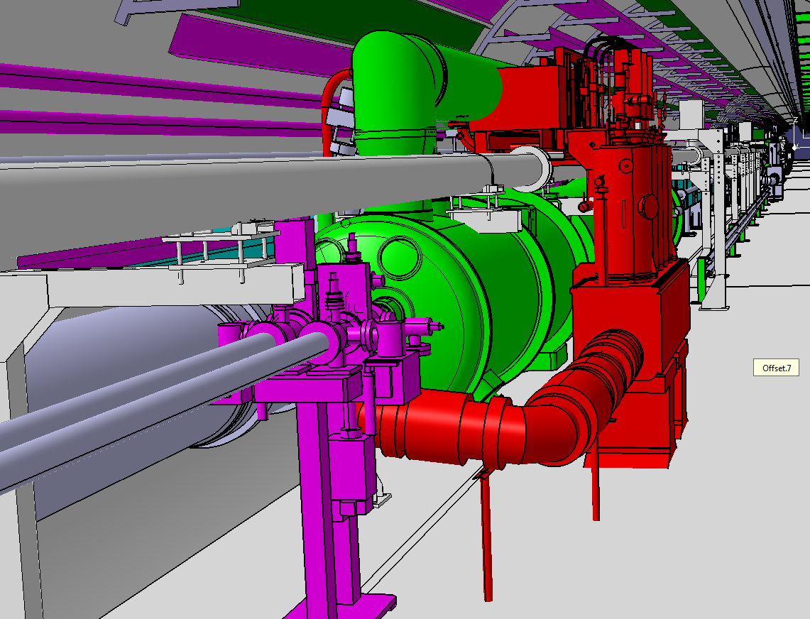
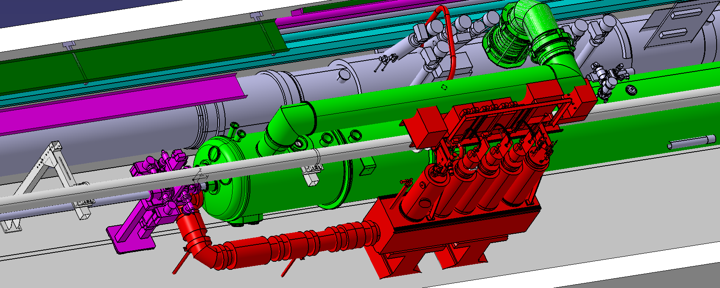
Position of the DFBMM
Conflict between frames and cryogenic extension

Slide 12
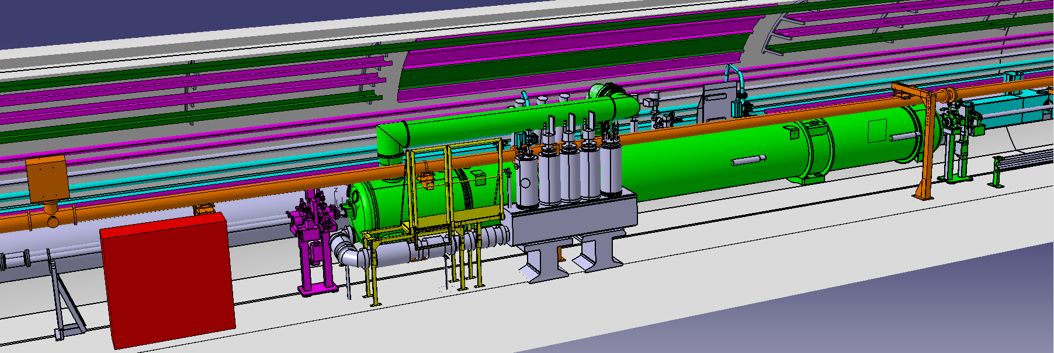
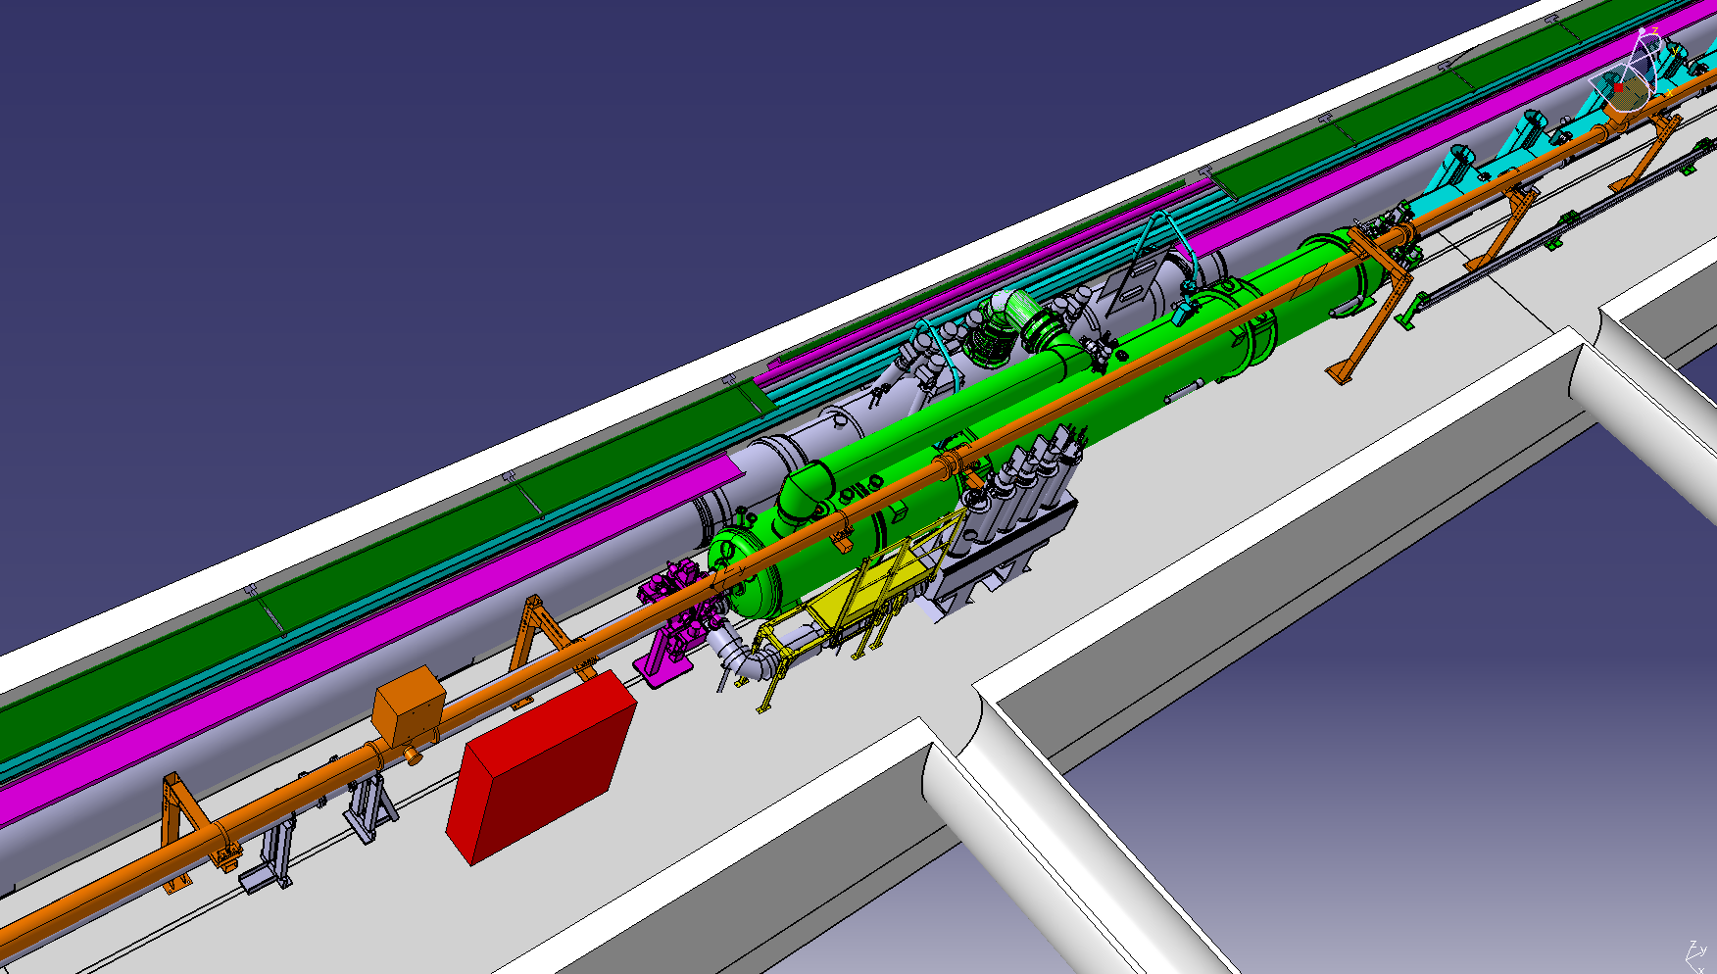
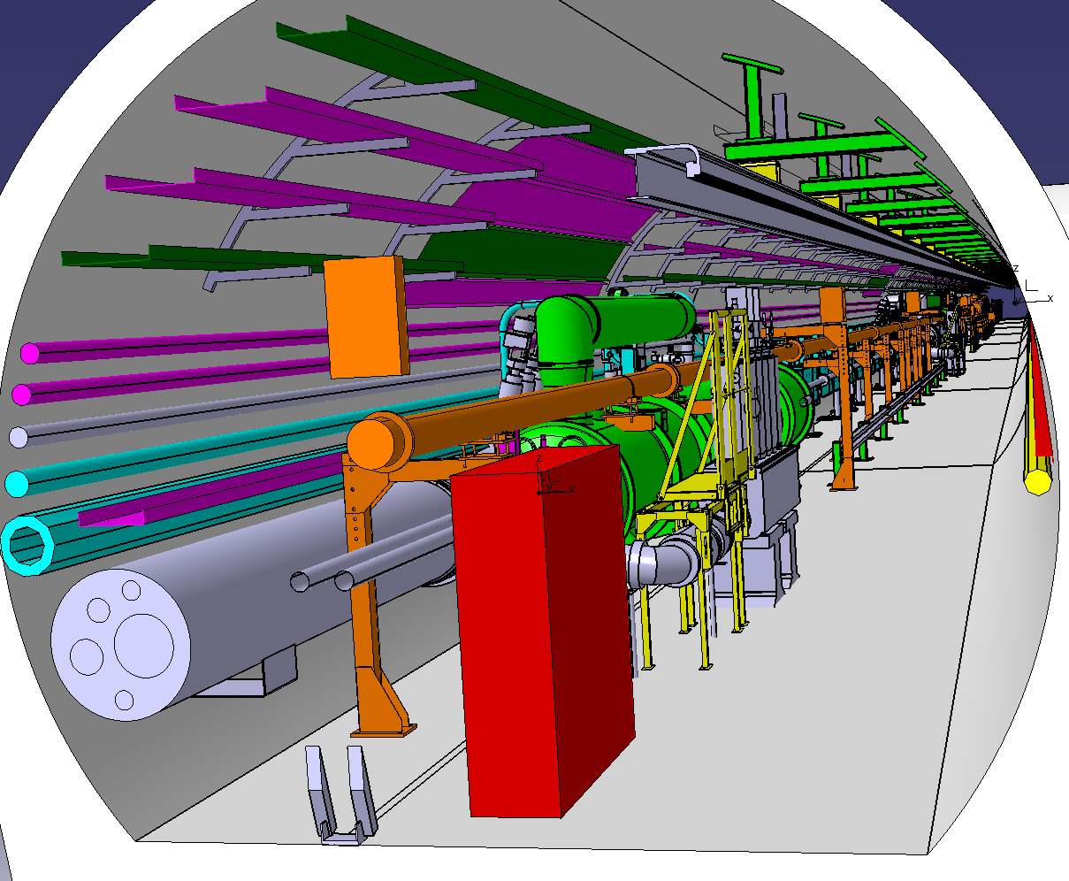
Possibility 1 : moving DFBMM and put frame along the VC (like DFBAK)
DFBMM
FRAMES

Slide 13
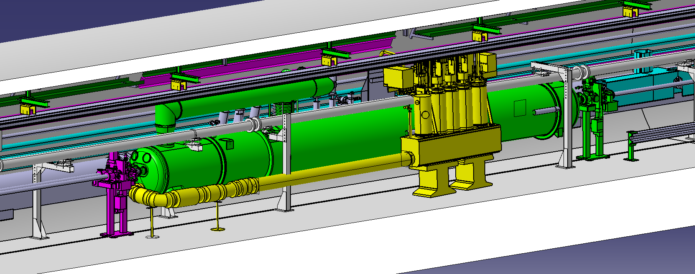
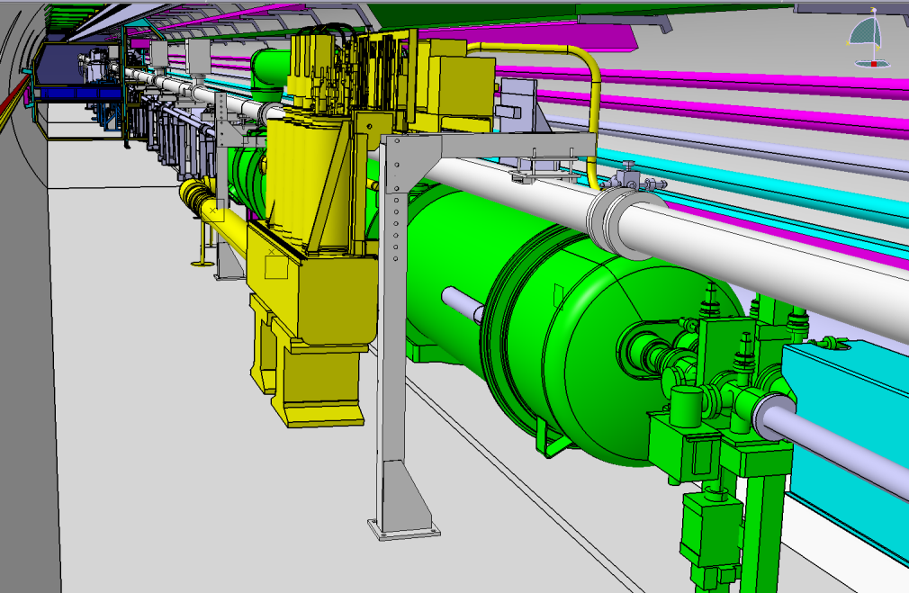
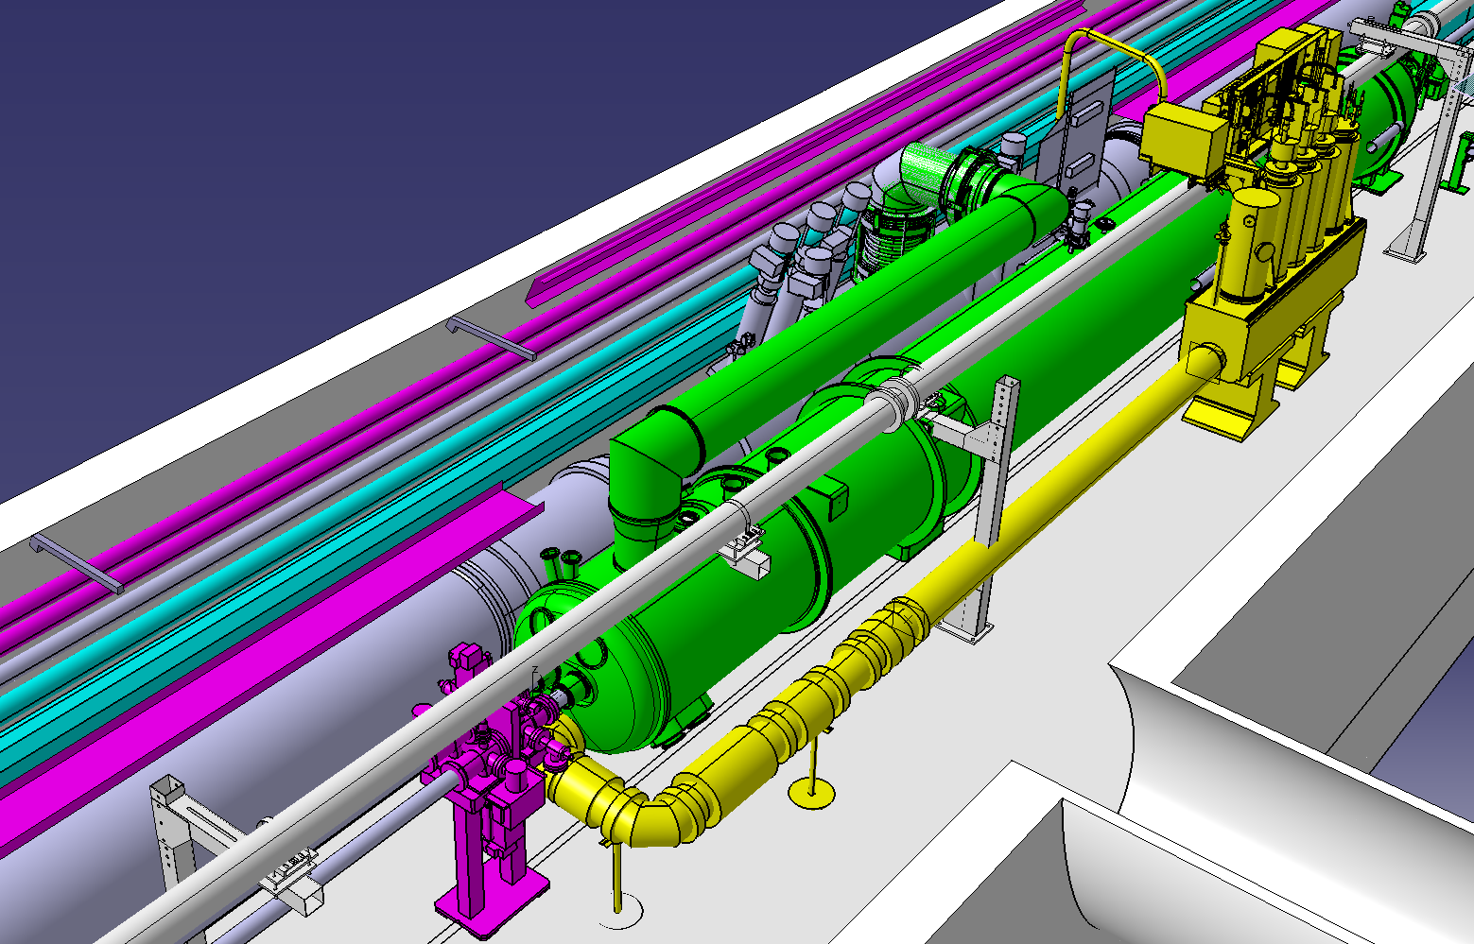
Possibility 2 : Not moving DFBMM but modification of the link (+3570mm)

Slide 14
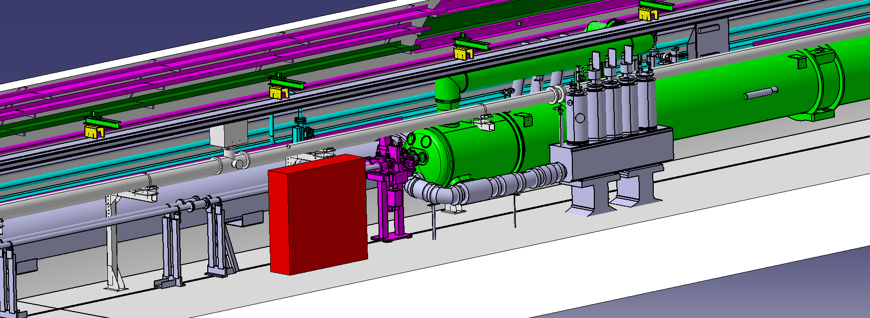
ABSTRACT
Impossible to keep frames on the DFBMM
Prop 1 : Moving frames toward DFBAK and modifications between frames and DFBM
Prop 2 : Keep DFBMM and frames at the actual place. Modification of the link between Q5 and the DFBMM

Slide 15
Conclusions
  Vacuum supports and vacuum chambers to be modified in the new Q5 sector
  At least 2 beam dump support to replace
  Survey space reservation to be change according to the new Q5 cryostat
  BLM position to be check (beam dump and LHC beam lines)
  Modifications for DFBMM and/or it’s frames (see prop 1&2)
  In all cases modification of electrical connexions for DFBMM
  Modification of the connection of the DFBMM WRL
  In Prop 2 the work stand have to be change, DFBMM link need to be redone.
  Modification of the connexion to the QRL (extension)

