Slide 1
Q5 for IR6
H. Prin
With inputs from D. Ramos Duarte, M. Souchet, M. Bajko, H. Kos

Slide 2
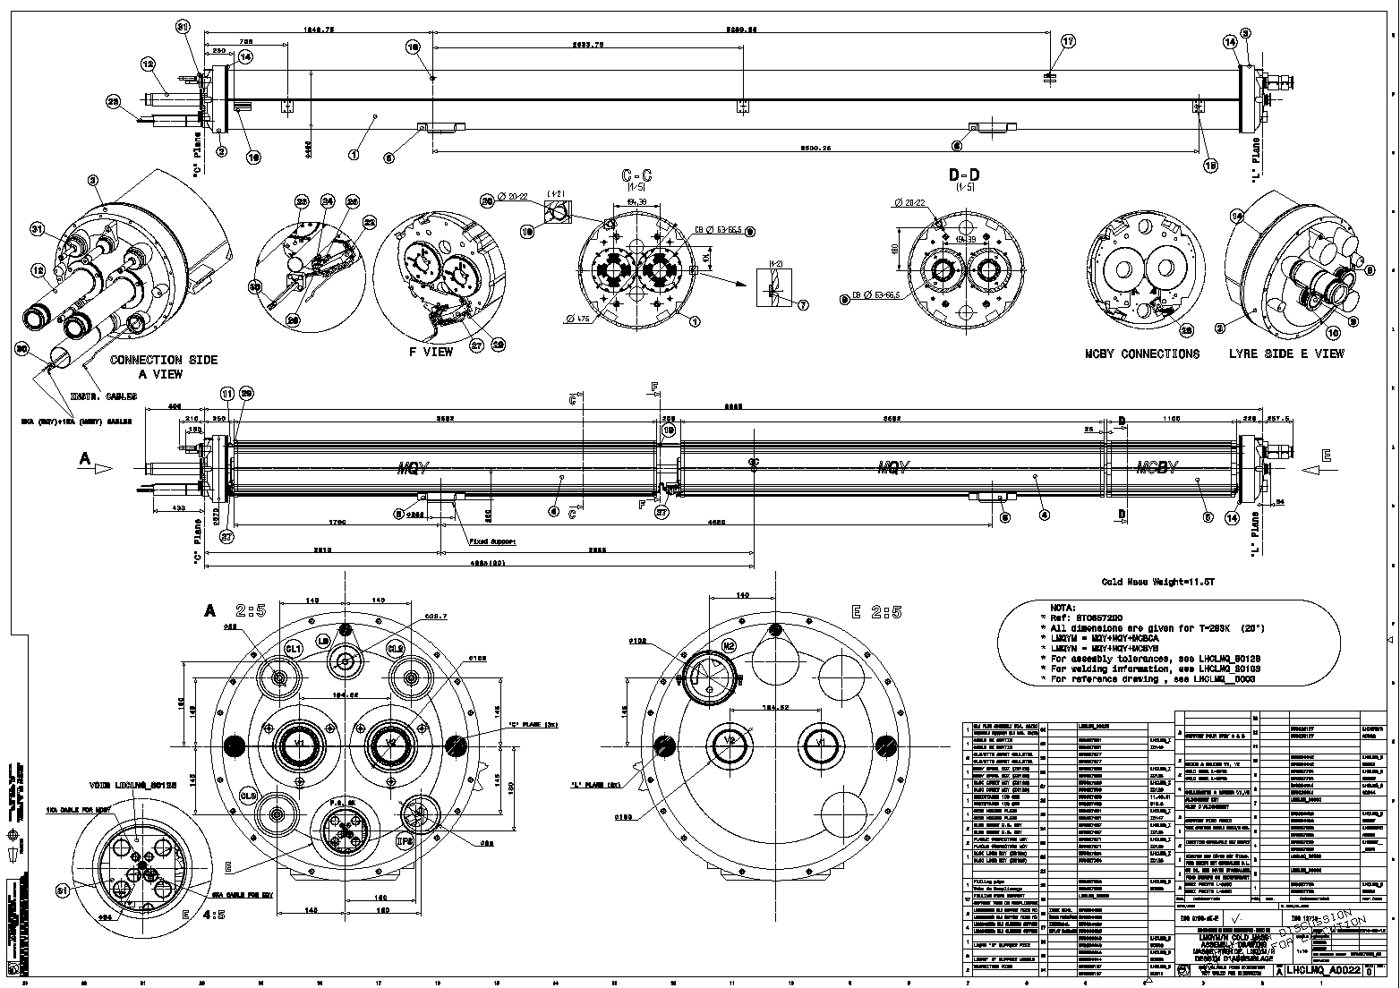
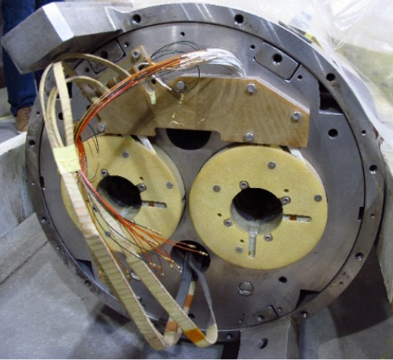
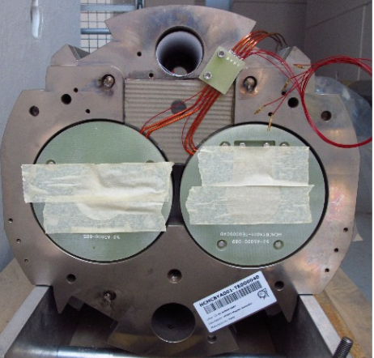
Q5 cryomagnets for point 6
Feasibility study ✓
  Assembly procedures ✓
  Assembly drawings (LHCLMQ_A0022) ✓
Components availability ✓
  4 MQY needed out of 7 existing spares (MQY20,21,27,28,29,30,31) ✓
  1 MCBYA needed out of 3 existing spares (MCBYA39,40,41) ✓
  1 MCBYB needed out of 3 existing spares (MCBYB42,43,44) ✓
    To be chosen according to the performance ✗
    To be cold test before assembly ?
  Shells ✓
  End covers ✓
  Cold bore tubes ✓
  Connection kits ✓
Tooling availability ✓
    Recovered from the insertion cold masses production
    Qualified in bldg. 180 during the spared Q5L8 prod. For LS1
    Welding press upgrade could be performed
Cold Masses
Cold mass assembly drawing
Stored MQY and MCBY magnets
Feasibility study ✓
  Assembly procedures to be adapt from present Q5IR6 cryoassemblies ✓
  Assembly drawings ✗
Components availability ✗
  Vacuum vessel ✗
  Bottom tray ✗
  QQS service module ✗
  End covers ✗
Tooling availability ✓
    Recovered from the insertion cold masses production
    Qualified in bldg. 180 during the spared Q5L8 prod. For LS1
    Welding press upgrade to be performed
On Going
Cryomagnet
About one year for procurement

Slide 3
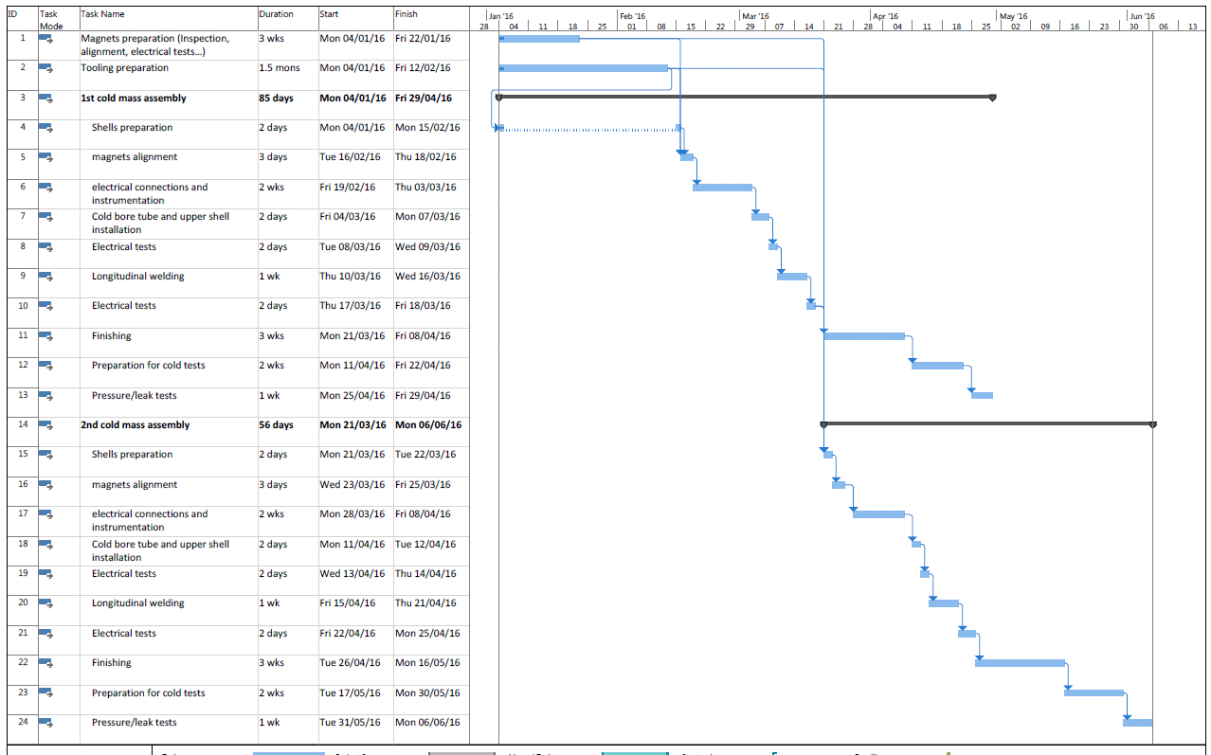
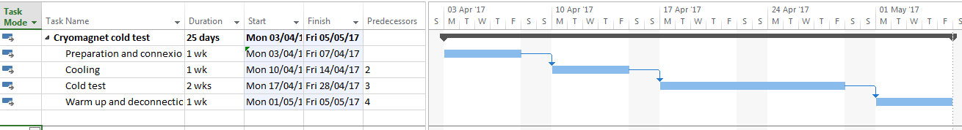
Production schedule
About 6 months to assemble the 2 cold masses.
The assembly can start once:
The press is reconfigured
5 consolidated dipole cold masses to be welded before
Magnets are identified
Magnets are cold tested if required
Cold Masses
TE-MSC-LMF
⇨Start during 2016?
2 months for the cryostating per cold mass
The assembly can start once:
The components are delivered (including the cold mass)
Cryostating
TE-MSC-CMI
⇨Start in the beginning of 2017?
Cold Tests
TE-MSC-TF
About 5 weeks for each cryoassembly
Stripping for installation
TE-MSC-TF
TE-VSC-DLM
Less than 1 month for each cryoassembly
⇨Should be ready by the beginning of LS2

