Slide 1
Heavy Ions during HL-LHC
John Jowett
Thanks for contributions:
Tom Mertens, Michaela Schaumann, Pascal Hermes
Comments from:
Gianluigi Arduini, Oliver Brüning and many others

Slide 2
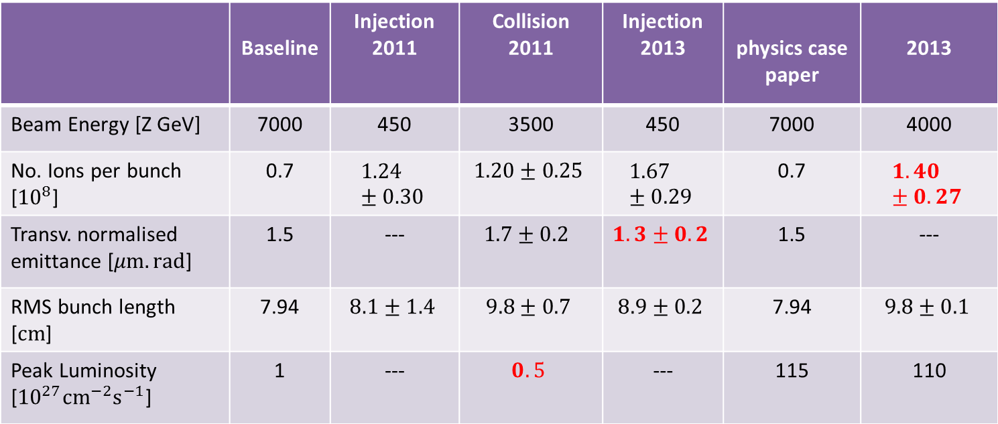
Design Baseline and Performance Achieved
“p-Pb not part of baseline”
Pb-Pb
p-Pb
 | Baseline | Injection 2011 | Collision 2011 | Injection 2013 | physics case paper | 2013
Beam Energy [Z GeV] | 7000 | 450 | 3500 | 450 | 7000 | 4000
No. Ions per bunch [${10}^{8}$] | 0.7 | $$1.24±0.30$$ | $$1.20±0.25$$ | $$1.67±0.29$$ | 0.7 | $$1.40±0.27$$
Transv. normalised emittance [$μm.rad$] | 1.5 | --- | $$1.7±0.2$$ | $$1. 3±0.2$$ | 1.5 | ---
RMS bunch length [$cm$] | 7.94 | $$8.1±1.4$$ | $$9.8±0.7$$ | $$8.9±0.2$$ | 7.94 | $$9.8±0.1$$
Peak Luminosity [${10}^{27}{cm}^{−2}s^{−1}$] | 1 | --- | $$0.5$$ | --- | 115 | 110

Slide 3
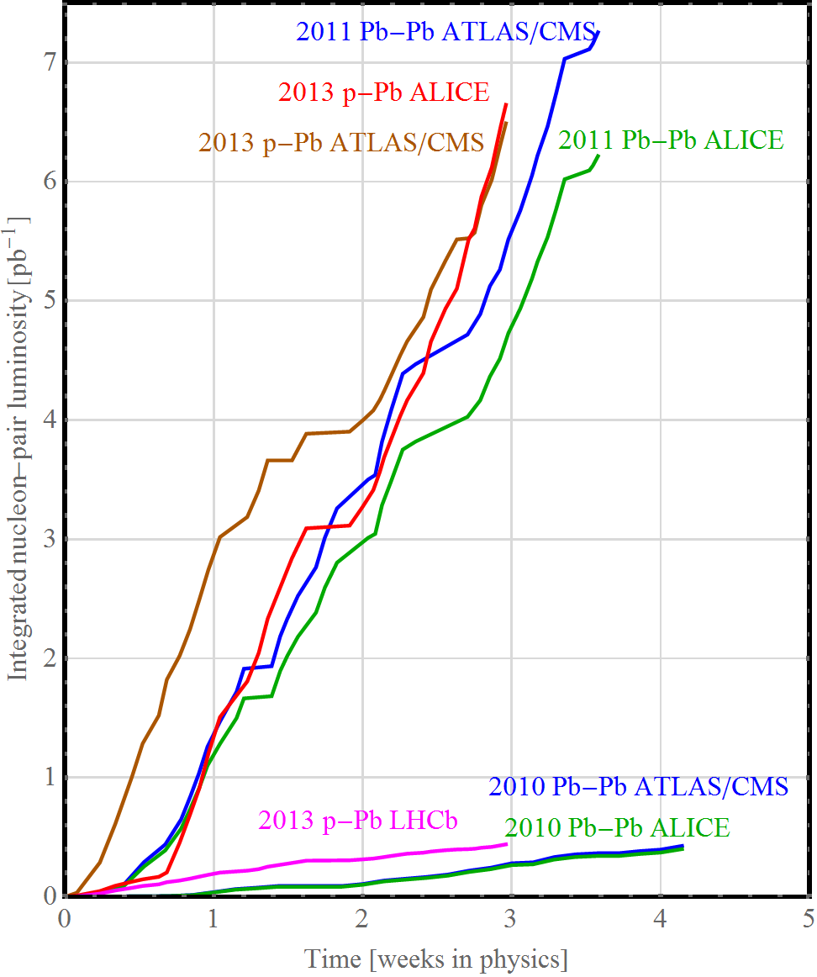
Integrated nucleon-nucleon luminosity in Run 1
Goal of the first p-Pb run was to match the integrated nucleon-nucleon luminosity for the preceding Pb-Pb runs.
Runs seem to be getting shorter …

Slide 4
ALICE operating conditions outlined in the LoI
The plan is to run at a maximum interaction rate of 50 kHz in Pb-Pb.
In the LoI we assume: peak luminosity of 6x10²⁷ cm⁻²s⁻¹ and an average luminosity of 2.4x10²⁷ cm⁻²s^{-1.}
The upgrade program assumes an integrated luminosity of 10 nb⁻¹ in PbPb at top energy
In addition
  one special PbPb run at reduced magnetic field for low-mass dileptons (O~ 3 nb⁻¹)
  one p-Pb run with about 50 nb⁻¹
  pp reference run at 82/208 * top energy
time horizon: to be completed by LS4 under the basic assumption of about one month LHC heavy ion operation per year.

Slide 5
Scheduling after LS2
Tentative plan (modulo start of Run3) as stated in the
LoI of the upgrade (CERN-LHCC-2012-012)
  Possible running scenario after upgrade:
    2020 – Pb–Pb 2.85 nb⁻¹
    2021 – Pb–Pb 2.85 nb⁻¹ (low magnetic field)
    2022 – pp reference run
    2023,2024 – LS3
    2025 – Pb–Pb 2.85 nb⁻¹
    2026 – ½ Pb–Pb 1.5 nb⁻¹ + ½ p–Pb 50 nb⁻¹
    2027 – Pb–Pb 2.85 nb⁻¹
Notes:
state ref to loi

Slide 6
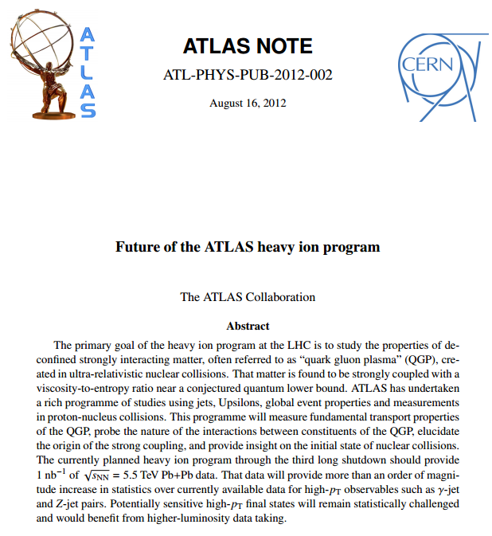
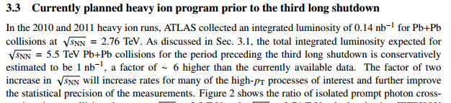
CMS –
probably requests ≥ ALICE …
Balance of luminosity among experiments to be decided elsewhere but strongly affects our projections (LHCb?)

Slide 7
Motivation
Predictions of Pb-Pb luminosity beyond LS2 have been given elsewhere (JMJ et al at RLIUP workshop 2013)
  https://indico.cern.ch/event/260492/ + write-up + various papers, thesis of M. Schaumann, etc.
  Based on empirical data from 2011 and 2013 Pb beams and incorporating all expectations for improvement
  Very detailed luminosity model for initially injected beams and their evolution
  Optimising injection into SPS for maximum luminosity in LHC
  Close collaboration with LIU heavy-ion
  Best realistic estimates of integrated luminosity do not fulfil ALICE request
Request from LIU to specify injected beam parameters in LHC that would fulfil ALICE request for Pb-Pb

Slide 8
Tentative ideal parameter specification
Highly simplified scenario: assume
  All bunches are equal (consider single bunch pair simulation)
  Initial bunch intensity (start of stable beams)
  Initial emittance (start of stable beams)
  Other bunch parameters as Design Report nominal
  Three luminosity-sharing scenarios

Slide 9
Simulation
CTE program (many runs by Tom Mertens)
  Macro-particle, macro-turn simulation, slow kinetic effects
  Luminosity burn-off (very strong!)
  Luminosity with crossing angles (150,100,150) µrad
  IBS with non-Gaussian longitudinal distribution
  Debunching longitudinally (small here)
  Synchrotron radiation damping (strong!), quantum excitation (tiny)
  Simulates one bunch from each beam, experiencing collisions at 3 IPs
The realistic luminosity model (RLIUP etc, not today) combines simulations of varying bunch parameters along trains from SPS

Slide 10
Required parameters at start of collisions
Parameters
Bunch spacing (basic) | 50 ns
Number of bunches | 1100
Number of colliding pairs (ATLAS, ALICE, CMS) | 1160,1100,1160
Bunch intensity (RMS) | 1.9×10⁸
Transverse emittance in x and y (mean) | 1.5×10⁻⁶ m
Bunch length (RMS) | 0.075 m
Half-crossing angles (ATLAS,ALICE,CMS) | (170,100,170) μrad

Slide 11
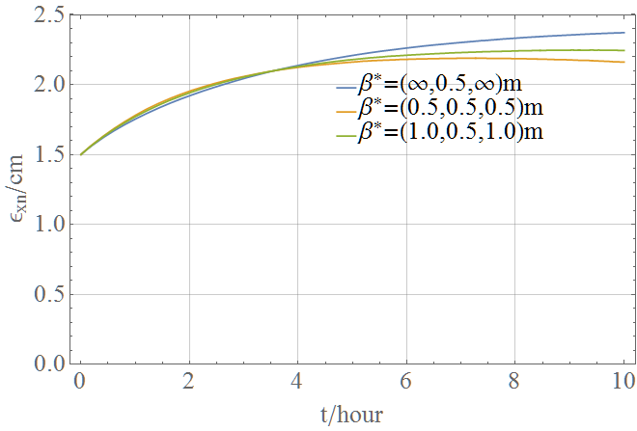
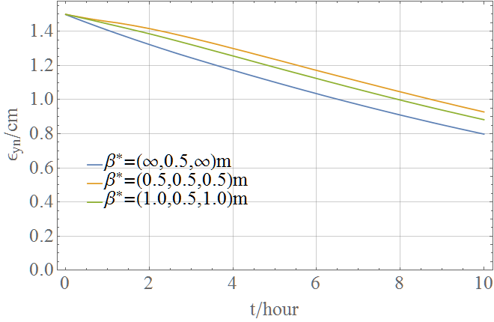
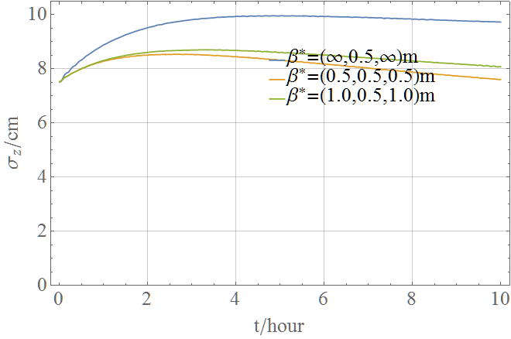
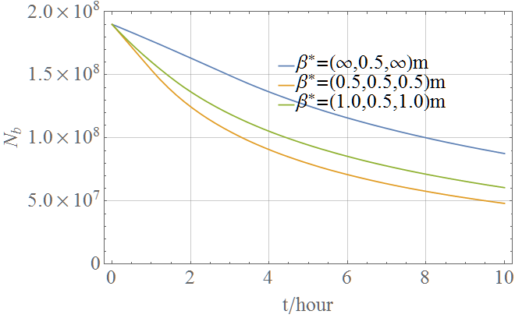
Simulation of single colliding bunch pair
Interplay of radiation damping, IBS, luminosity burn-off couples all 4 quantities.
Different evolution according to luminosity-sharing scenario.

Slide 12
Filling scheme
Assume 1100 bunches colliding in ALICE, 1160 colliding in ATLAS/CMS
  Approximation: neglect different collision histories of a few bunches, bunches all see the same burn-off
Estimate based on
  Recent LIU baseline (50 ns basic spacing in LHC)
  LEIR improvements to allow bunch splitting
  SPS injection kicker for 100 ns rise time
  Slip-stacking injection in SPS
  Assumed no intensity decay in SPS so all bunches are the same!!!
Filling schemes with fewer bunches would require larger single bunch intensities – limits in injectors, faster IBS in LHC, … 50 ns is essential (can we consider 25 ns?)

Slide 13
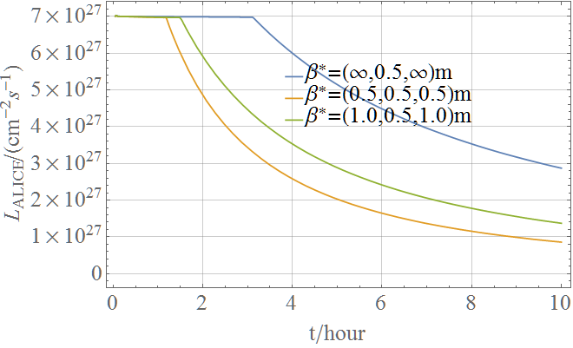
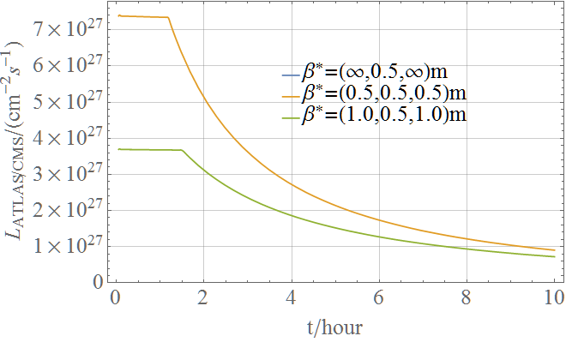
Experiments’ luminosities in an ideal (prolonged) fill
ALICE, levelling at maximum acceptable (rates around 50 kHz), assuming 1100 bunches colliding
ATLAS or CMS, assumed levelling at corresponding levels to ALICE (not strictly necessary, assumption)

Slide 14
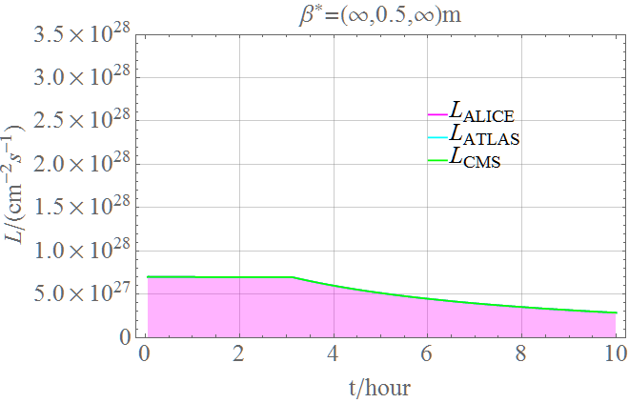
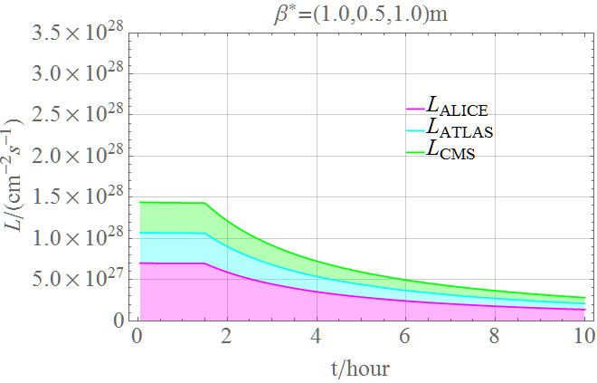
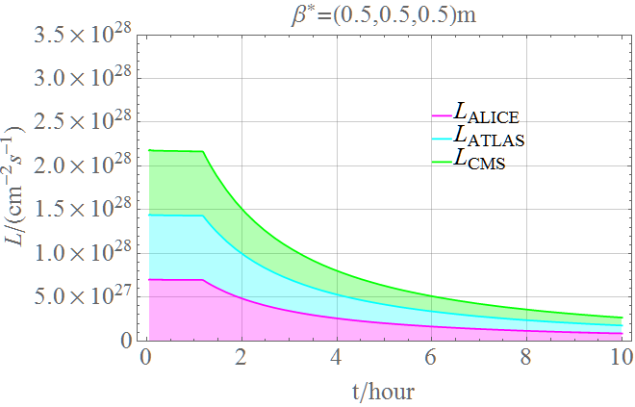
Luminosity sharing in the 3 scenarios
Equal (maximum) luminosity scenario gives the maximum summed over all experiments.
Other scenarios give more to ALICE.
(This is the same information as the last slide, just summed over experiments).

Slide 15
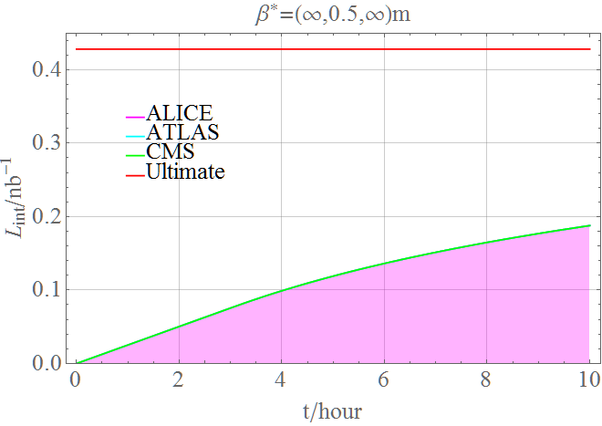
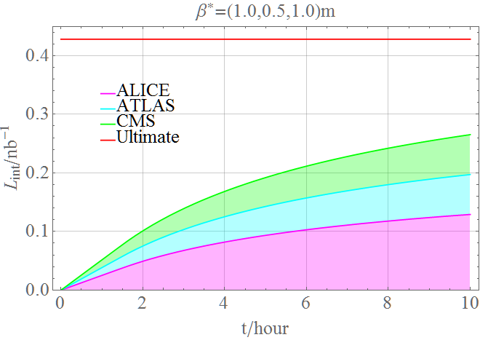
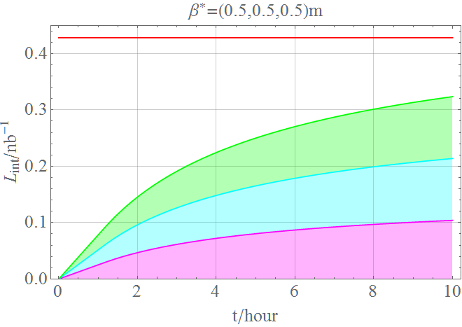
Integrated luminosity in fill
Potential for a stochastic cooling system

Slide 16
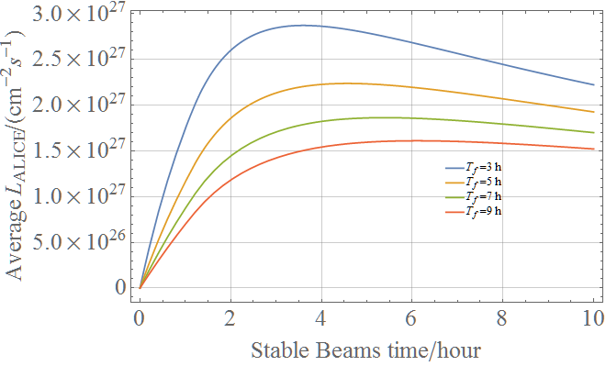
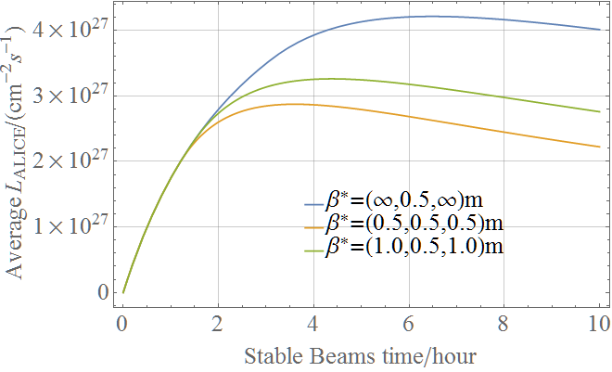
Effect of turn-around time on average luminosity

Slide 17
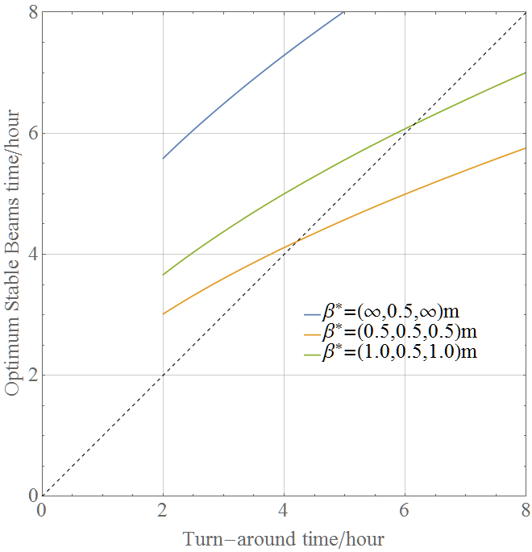
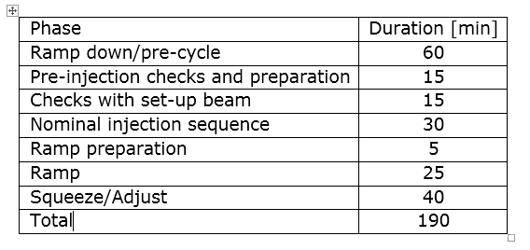
Optimum time spent in Stable Beams
Assumes the operators know that the next turn-around time will be the same value.
Break-down of the minimum turn-around time as for p-p

Slide 18
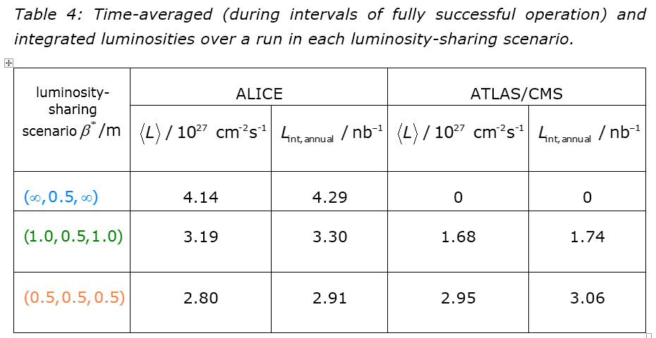
Integrated luminosity in annual Pb-Pb run

Slide 19
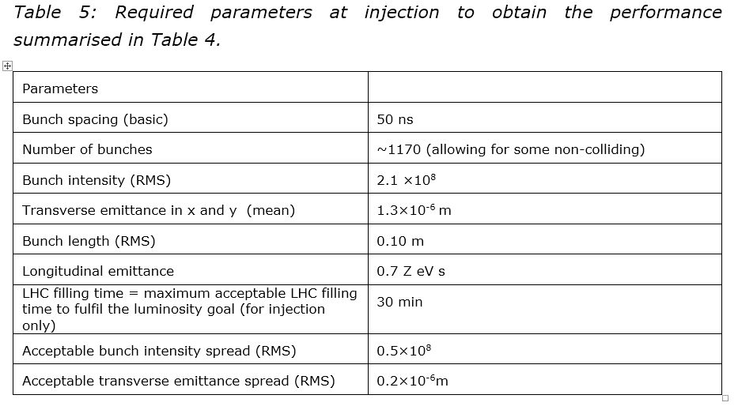
Required parameters at injection
Margins on intensity and emittance from injection to collision (see RLIUP for past runs), also roughly comparable to assumptions for protons.

Slide 20
Reminder of realistic projections
These numbers were computed backwards from the requested integrated luminosity.
Realistic estimates, given the known performance of the injectors and known expectations for future improvements were given at RLIUP and still stand.

Slide 21
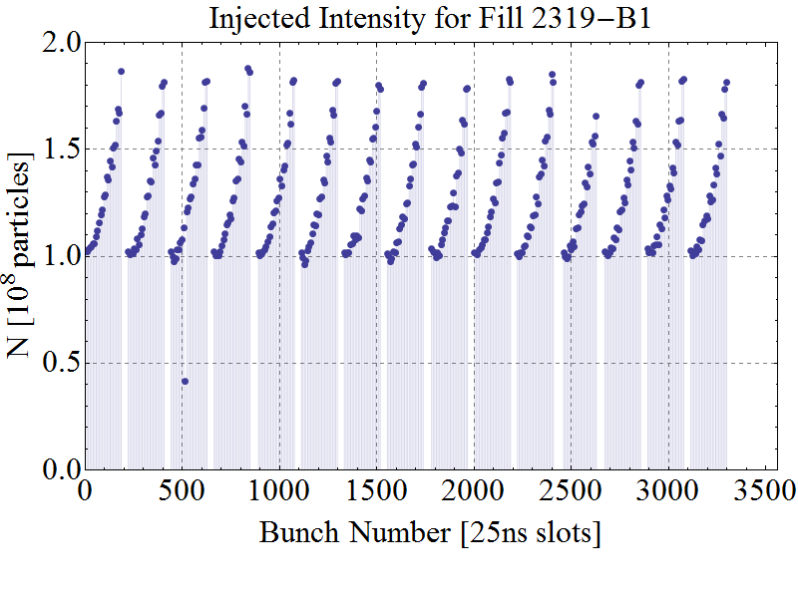
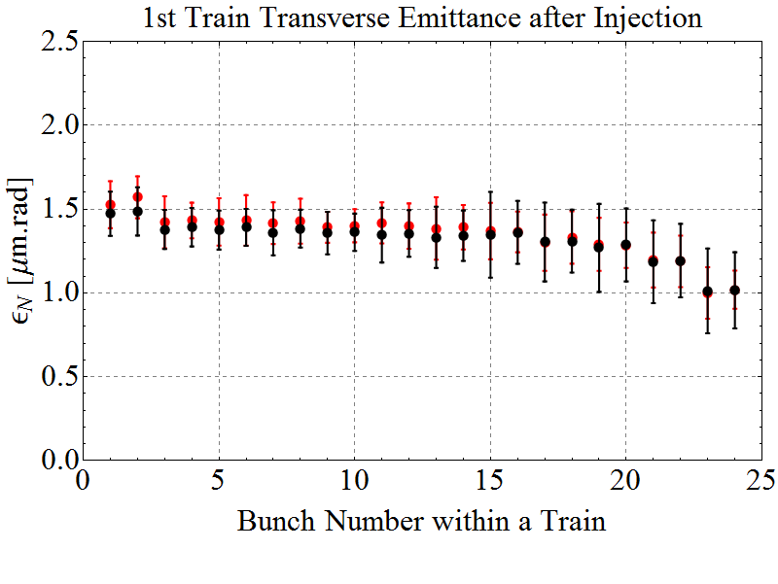
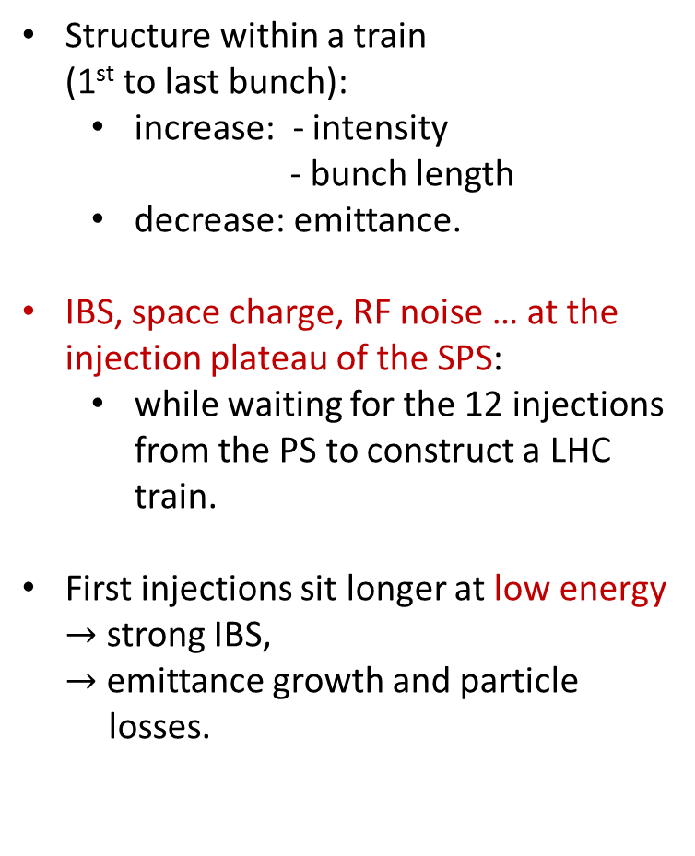
Bunch-by-Bunch Differences after Injection in the LHC
E = 450 Z GeV
Structure within a train
(1st to last bunch):
  increase: - intensity
  - bunch length
  decrease: emittance.
IBS, space charge, RF noise … at the injection plateau of the SPS:
  while waiting for the 12 injections
  from the PS to construct a LHC
  train.
First injections sit longer at low energy
$→$ strong IBS,
$→$ emittance growth and particle
losses.
Design
1 train
Intensity
Design
Horizontal / Vertical
Emittance

Slide 22
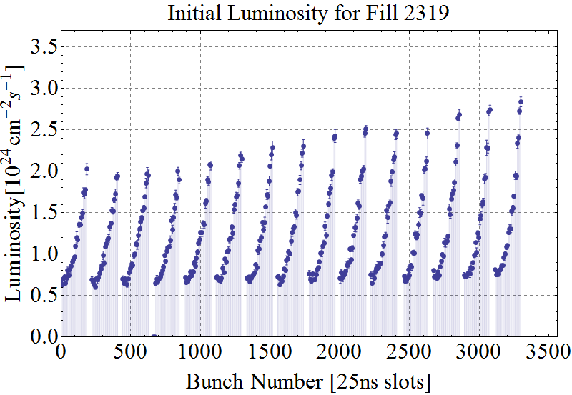
Bunch-by-Bunch Luminosity
E = 3.5Z TeV
Initial Luminosity
ATLAS data

Slide 23
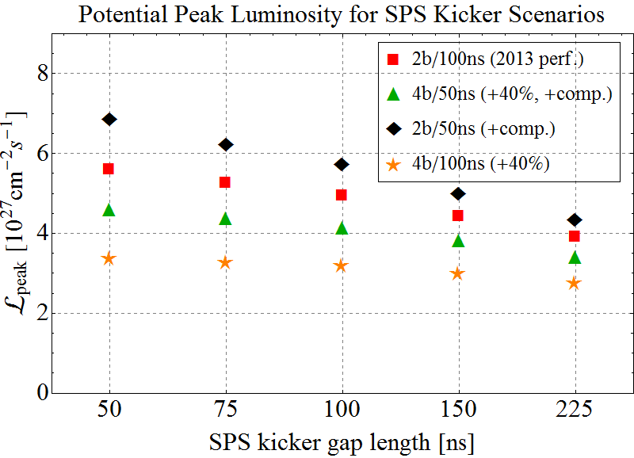
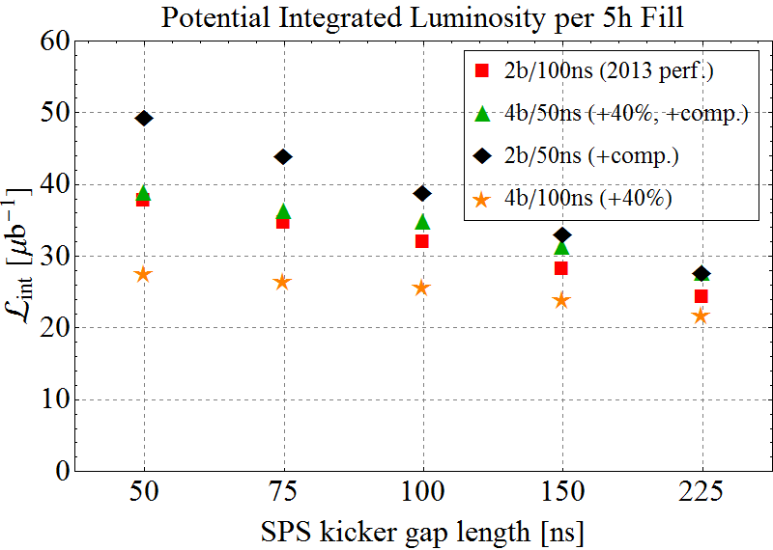
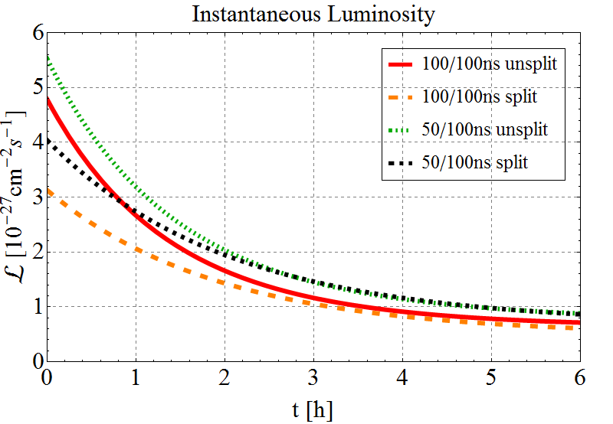
Estimates for after LS2 from RLIUP (realistic)
Peak luminosity higher for 100ns PS spacing with unsplit bunches.
→ Higher brightness bunches decay faster.
→ Higher integrated luminosity for 50ns PS spacing with split bunches.
Peak Luminosity
50/100ns split → ~1000 bunches/beam
100/100ns unsplit → ~600 bunches/beam
Integrated Luminosity

Slide 24
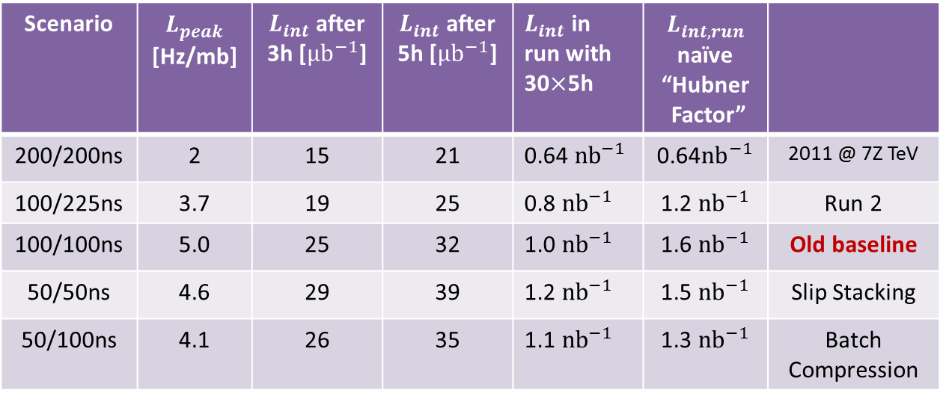
Luminosity projection summary (RLIUP realistic)
  Does not include any improvements beyond injection schemes and natural change of β*=0.5 m and beam size at 7 Z TeV. Some will be mentioned on next slide.
  Model will be re-fitted to real injector chain performance in the run-up to a given Pb-Pb run to re-optimise the length of the SPS trains. Improvements on SPS flat bottom can have a big impact.
Scenario | $L_{peak}$ [Hz/mb] | $L_{int}$ after 3h [${μb}^{−1}$] | $L_{int}$ after 5h [${μb}^{−1}$] | $L_{int}$ in run with 30$×$5h | $L_{int,run}$ naïve “Hubner Factor”
200/200ns | 2 | 15 | 21 | 0.64 ${nb}^{−1}$ | 0.64${nb}^{−1}$ | 2011 @ 7Z TeV
100/225ns | 3.7 | 19 | 25 | 0.8 ${nb}^{−1}$ | 1.2 ${nb}^{−1}$ | Run 2
100/100ns | 5.0 | 25 | 32 | 1.0 ${nb}^{−1}$ | 1.6 ${nb}^{−1}$ | Old baseline
50/50ns | 4.6 | 29 | 39 | 1.2 ${nb}^{−1}$ | 1.5 ${nb}^{−1}$ | Slip Stacking
50/100ns | 4.1 | 26 | 35 | 1.1 ${nb}^{−1}$ | 1.3 ${nb}^{−1}$ | Batch Compression

Slide 25
Evolution of DS Collimation for LHC
Need for DS collimators emerged at Chamonix 2003 but too late to modify original design of cold DS regions
DS collimators may be needed, with varying degrees of likelihood/urgency, for:
  Pb-Pb luminosity losses (BFPP, EMD, …) around ALICE
  Pb-Pb and p-Pb collimation losses in IR7 and IR3
  p-p collimation losses in IR7 and IR3
  Pb-Pb luminosity losses (BFPP, EMD, …) around ATLAS, CMS
  p-p luminosity debris around ATLAS, CMS at HL-LHC
Original solution (moving magnets to make space) dropped in favour of modular scheme, replacing standard MB dipole magnet with
(2×11 T dipoles+TCLD) unit, applicable in all potential locations.
  Synergy with high-field magnet development.
Following 2013 Collimation Review:
  First installation (2 TCLD units) foreseen for ALICE Pb-Pb in LS2, subject to confirmation after 2015 Pb-Pb run and tests of bump mitigation techniques
  Further installations elsewhere in LS3, depending on experience at higher energy and luminosity, quench test results, etc

Slide 26
Alternative TCLD installation for IR2
Bump mitigation as in 2011 experiment is less effective in IR2 than in IR1/IR5
  Some effect predicted in 2009 paper, could be marginally enough, depending on true quench limit, plan to test in 2015
  Hence IR2 was given priority for possible TCLDs
Alternative proposed at ColUSM 1 August 2014 http://indico.cern.ch/event/333525/
Because of the form of the dispersion function in IR2, there is a possibility that we can combine bumps and an alternative location of the TCLD in the connection cryostat (missing MB)
  No 11 T magnets required
  Different but apparently simpler integration
  Significant orbit bump during luminosity operation !
  Option to include an additional horizontal corrector beside it.

Slide 27
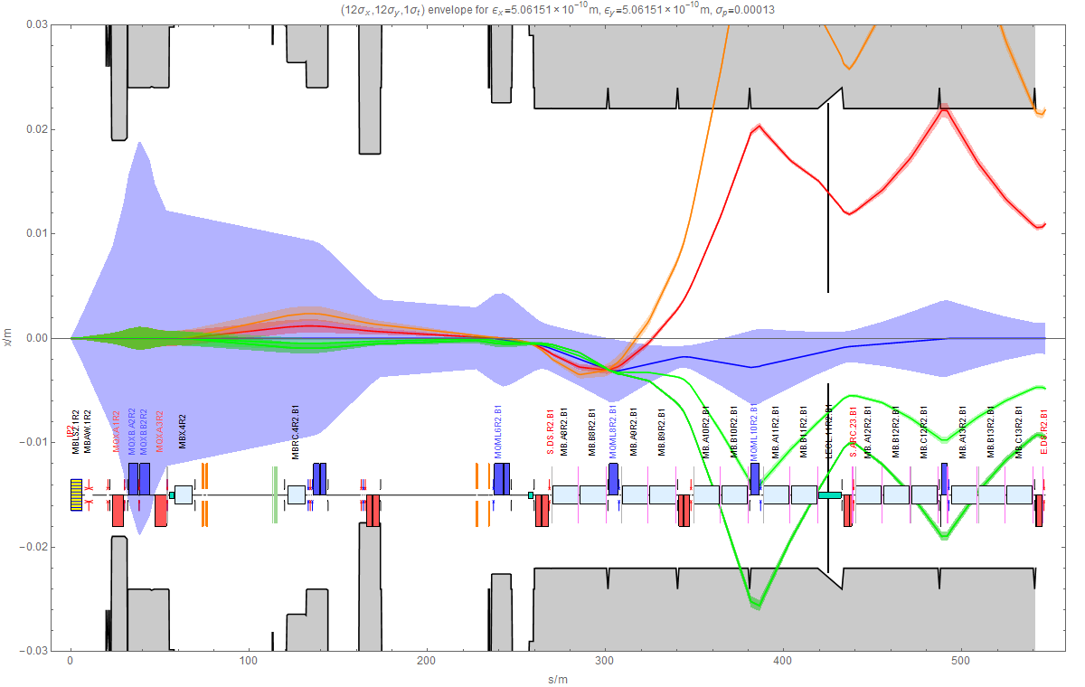
TCLD in connection cryostat at IR2
Variations of optics, bump and use of available orbit correctors studied (Tom Mertens, detailed document coming). Solution only applicable in IR2.

Slide 28
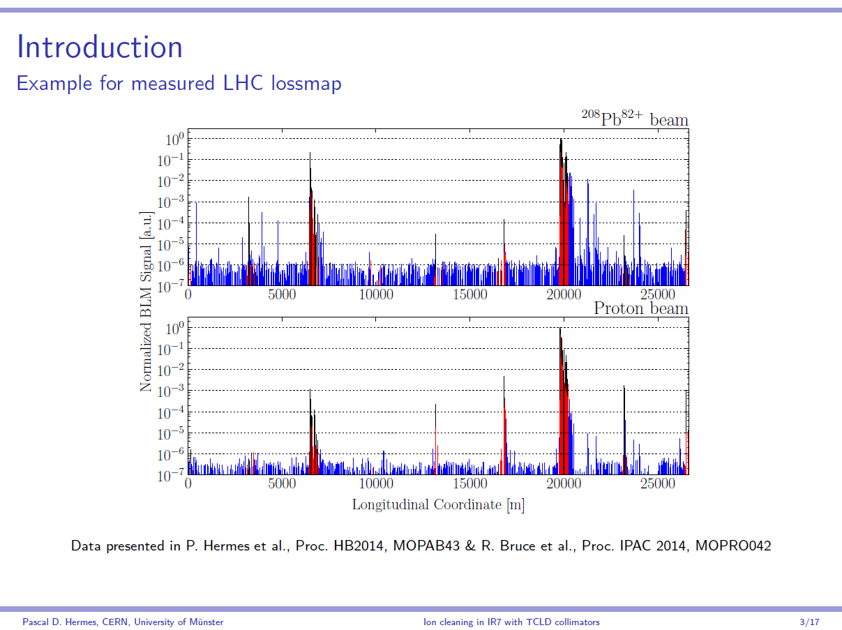

Slide 29
Collimation of Pb beams
IR7 DS is the limiting location in terms of cleaning inefficiency
Heavy-ion cleaning performance even worse than for protons (by two orders of magnitude)
Planned increase of ion intensity in run 3 might be limited by the ion cleaning performance
Possible solution for better proton cleaning : TCLD collimators: replace dipole by two shorter dipoles with collimator inbetween
Gain in cleaning efficiency for heavy-ion beams ?

Slide 30
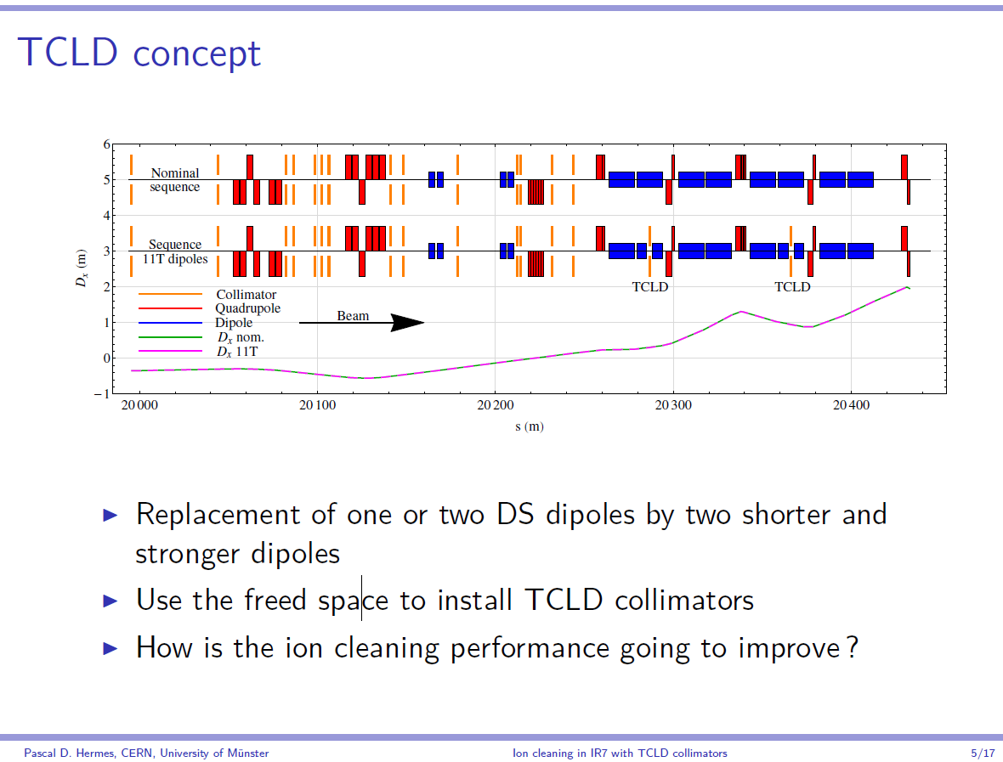

Slide 31
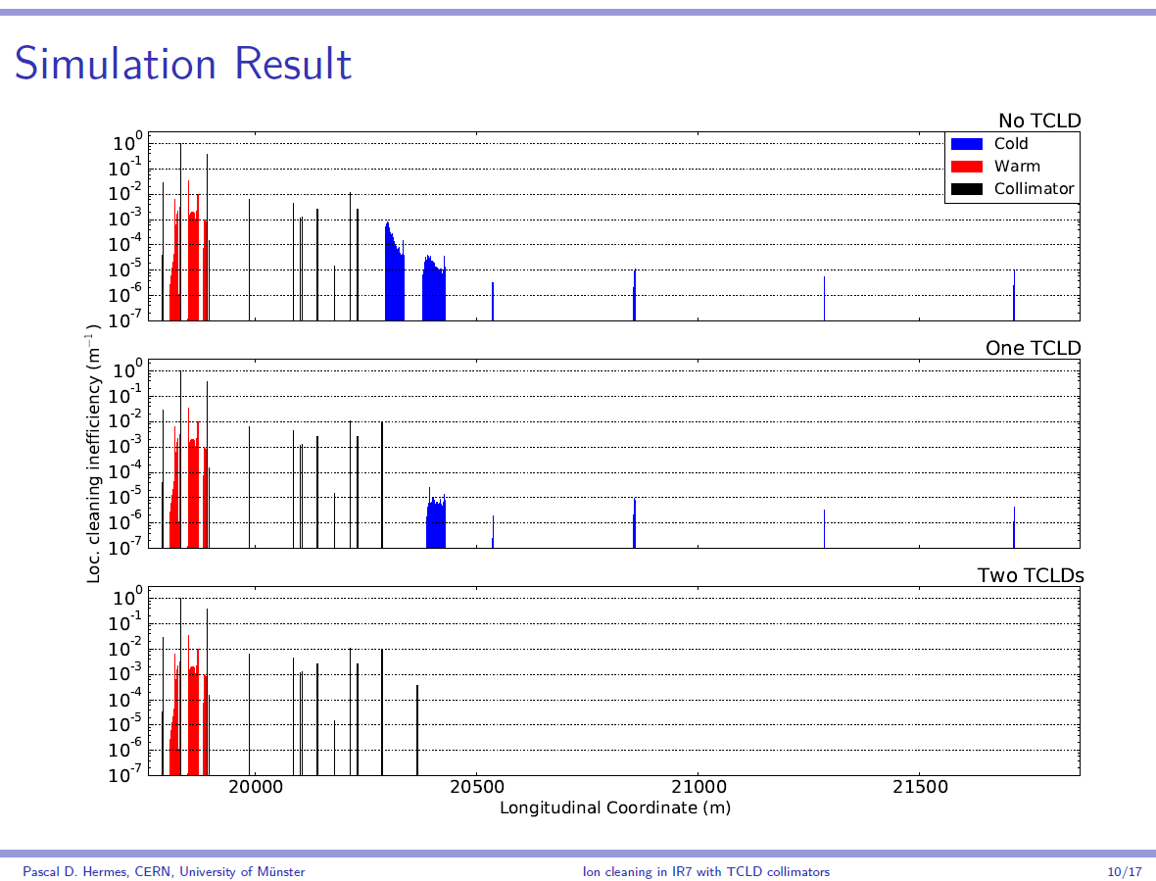

Slide 32
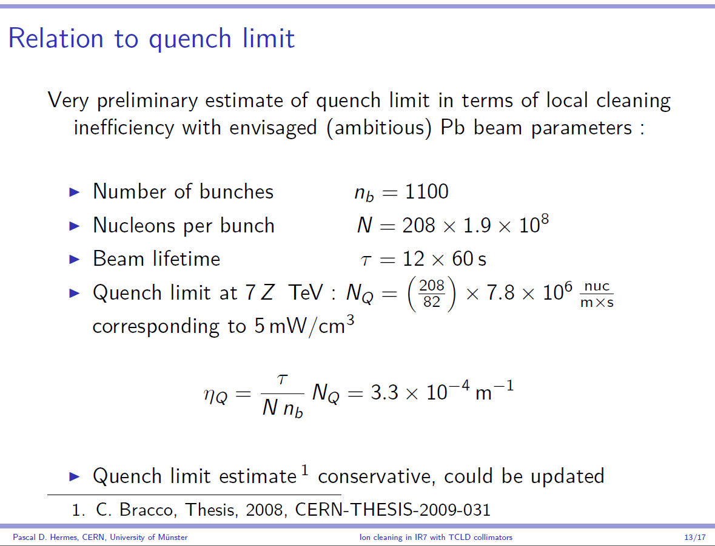

Slide 33
Status of DS collimators for heavy-ion operation
The scheme with 2 TCLDs in connection cryostats seems the best option for IR2
  Lower cost, does not depend on 11 T magnets
May need TCLDs + 11 T magnets in IR7
Bump mitigation (to be tested) probably adequate for IR1, IR5 (less likely to need TCLD+11 T magnets in LS3)
Need to be confirmed by quench tests (p, Pb) and operational experience with mitigation schemes during 2015

Slide 34
Summary
For LIU needs, we can propose the bunch parameters in the last table, ie, essentially nominal but with, in a mean-square sense over all bunches perhaps,
  EDMS note giving functional spec
Filling scheme should allow ~1100 colliding bunch pairs in ALICE
  Crossing angles chosen for 50 ns basic spacing
Integrated luminosity sharing among experiments is crucial …
TCLD in connection cryostat is a good option for IR2
May need TCLD + 11 T magnets in IR7

Slide 35
BACKUP SLIDes

