Slide 1
TEST PLANS and
HL LHC IT STRING
M Bajko
for the TC of HL LHC the 4th of June 2015

Slide 2
SUMMARY
HL LHC Magnets TEST PLAN
  TIMELINE
  PERFORMANCE
  TEST PLAN. Distribution over the next years
IT STRING for HL LHC
    SCOPE
    MANDATE
Short term actions
CONCLUSIONS

Slide 3
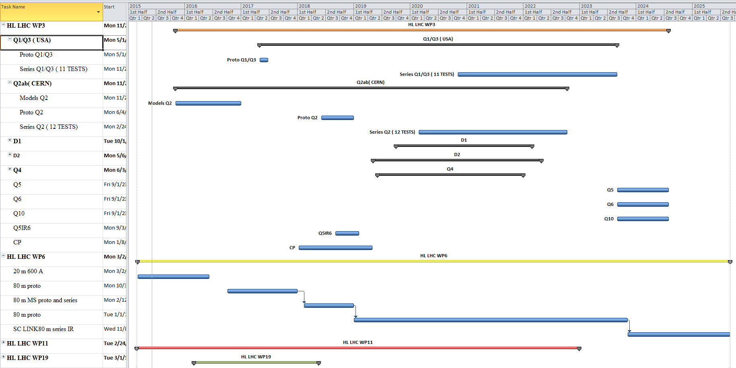
TIMELINE for the different test for HL LHC magnets
From these it was defined the test stand readiness requirements ( see the presentation of Volker)

Slide 4
How this TIMELINE is made?
Every single magnet test is part of the GLOBAL HL LHC planning set up for the C&S Review and most of the cases is linked to the fabrication of the magnets.
It is designated to a test bench and we take as resources:
Cryogenic cooling
Electrical powering
Those are services which are shared between benches and users
Typical test is over 7 weeks and systematically includes a thermal cycle (TC) unless is produced in the USA and tested before sent to CERN. In that case no TC is considered so a total of 5 weeks for series and 6weeks for prototypes.
PERFORMANCE TEST CAPACITY estimated to :
20 quench /magnet
+ Corrector test, Splice resistance, Magnetic measurement, High Voltage test
From these It was defined the nr of test stands and integrated service ( demineralised water, cryogenic, electricity ect)
capacity and availability for a given period. See presentation of Volker

Slide 5
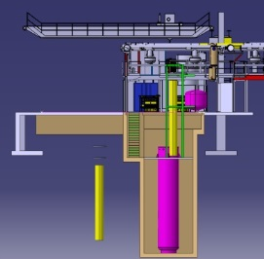
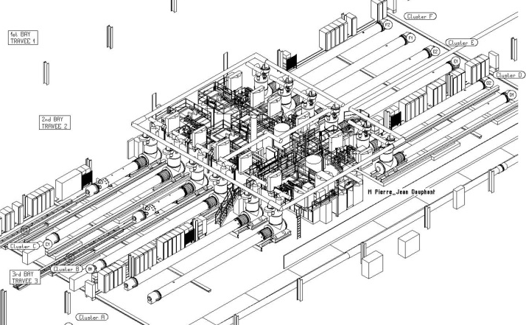
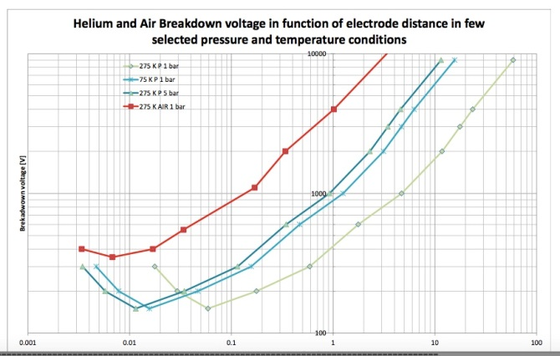
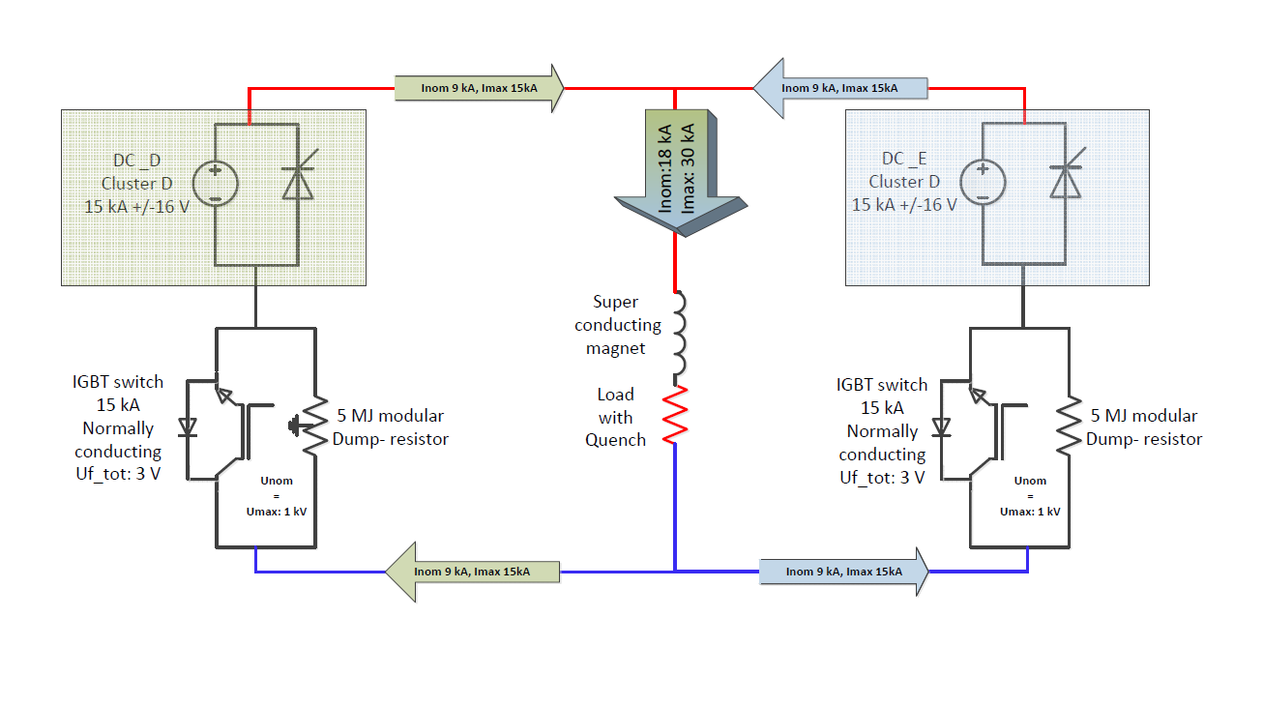
PERFORMANCE test
+ magnet dimension
This is the Cluster D vertical test stand for model magnet test
During the TRAINING I_{accept} SHOULD be attained and kept for 3h CONTINOUSE powering without quench
After Thermal Cycle to RT MEMORY should be proven by 2nd quench > I nominal
I_{SS} = 22 kA
( we wish this for the model)
Courtesy of P. Perret
No CRITERIA is defined for the :
level of the FIRST QUENCH
NUMBER of QUENCHES to I_{accept}
It is too EARLY for this… but we will be able to do 20 quenches/test
I_{accept proto} = 90% I_{SS} = 20 kA
I_{accept series} = 108% I_{nominal}= 18 kA
I_{nominal} = 75% I_{SS} = 16.5 kA
First cool down to 1.9K
Second cool down to 1.9K
These are the horizontal benches: A, and B or C
Courtesy of P. Fessia
ELECTRICAL INTEGRITY
U _{acceptance} = 2 x U_{max} + 500
_{and this is in aprox.} 3 kV in He
PROTECTION is with EE, time reaction in the 2-3 ms range, with dump resistor of 50-300 mOHM
Courtesy of G. J. Coelingh
From these it was defined the test stand specification. See the presentation of Volker.

Slide 6
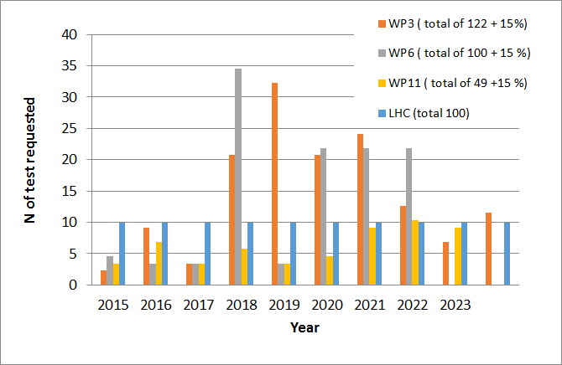
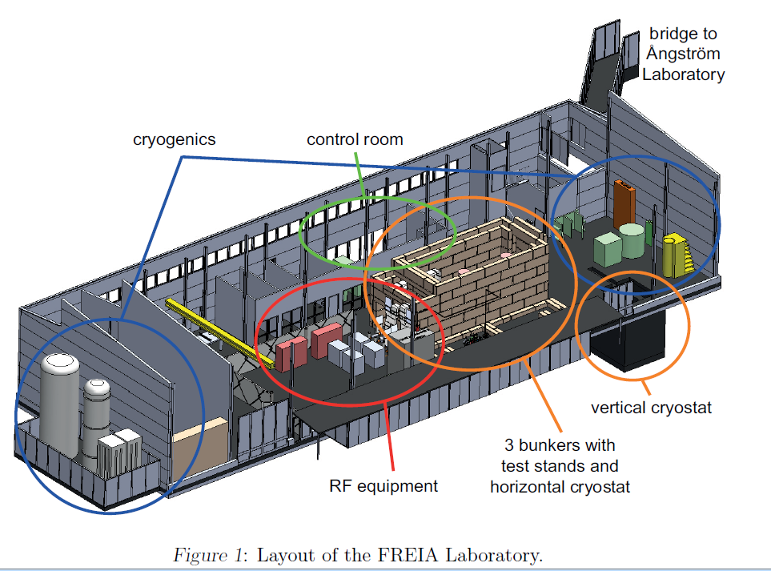
TEST distribution over the years. Alternative solutions.
We build a test station for all type of magnets, but some of them will be tested elsewhere….
This peak is due to the high number of orbit correctors
Ex. Alternative option under study for test
50% @ CERN and 50% in Uppsala
15 % of re-test has been included into the cost and schedule
Courtesy of R.Ruben

Slide 7

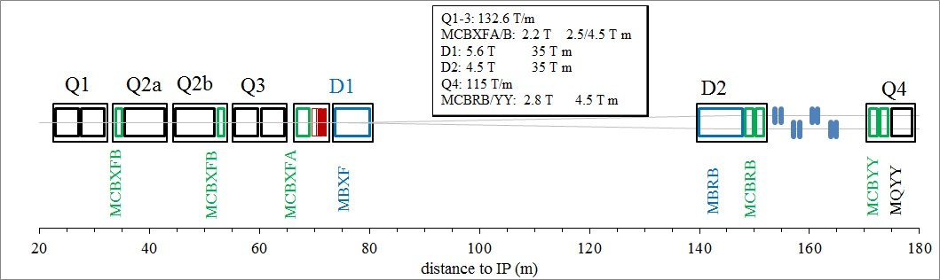
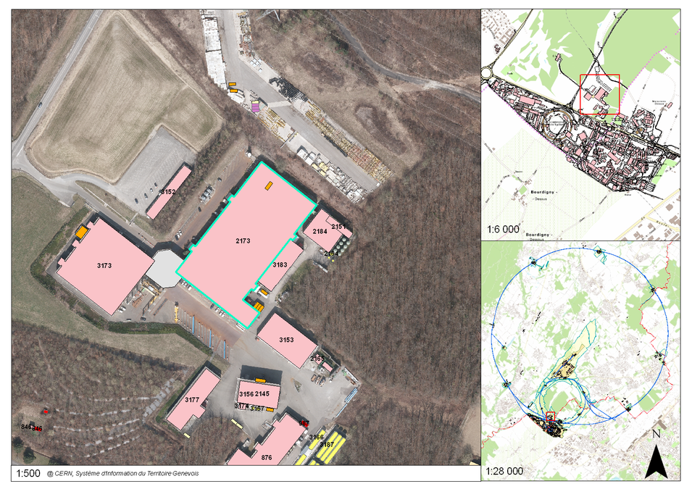
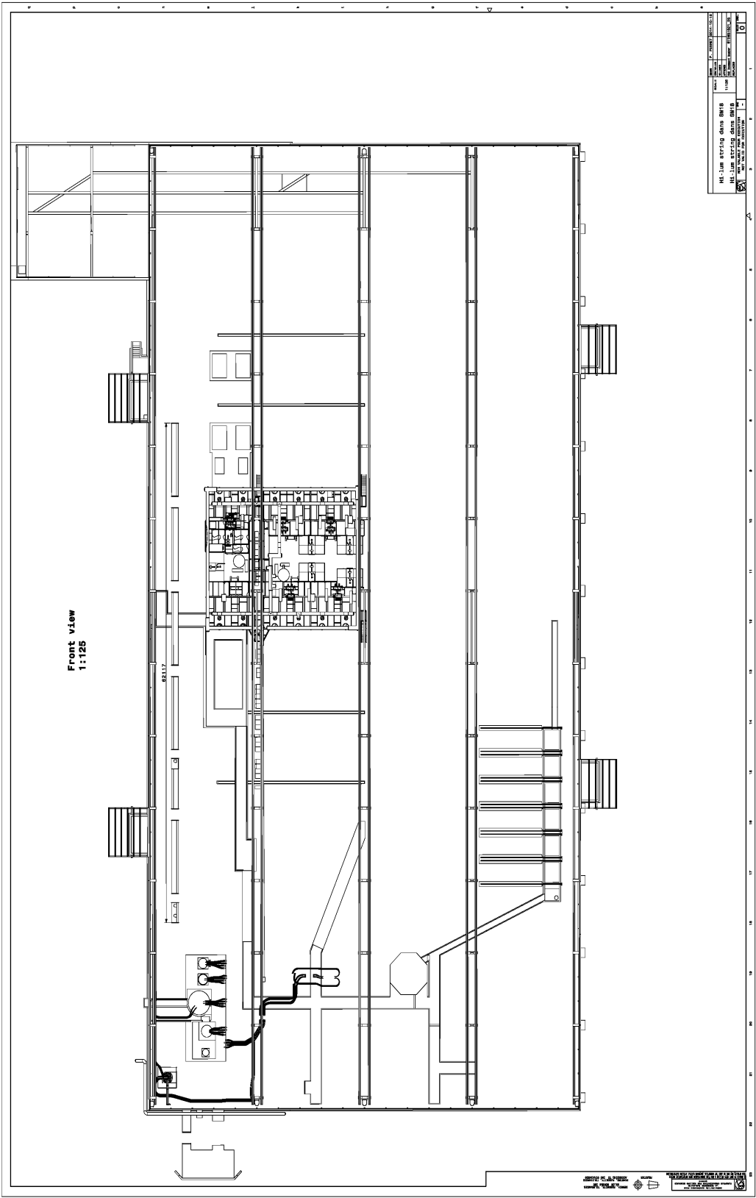

IT STRING SCOPE
IR STRING DSH
DFH + CL IR PC
Cluster D
Cluster A
Cluster E
Cluster B
Cluster F
Cluster C

Slide 8
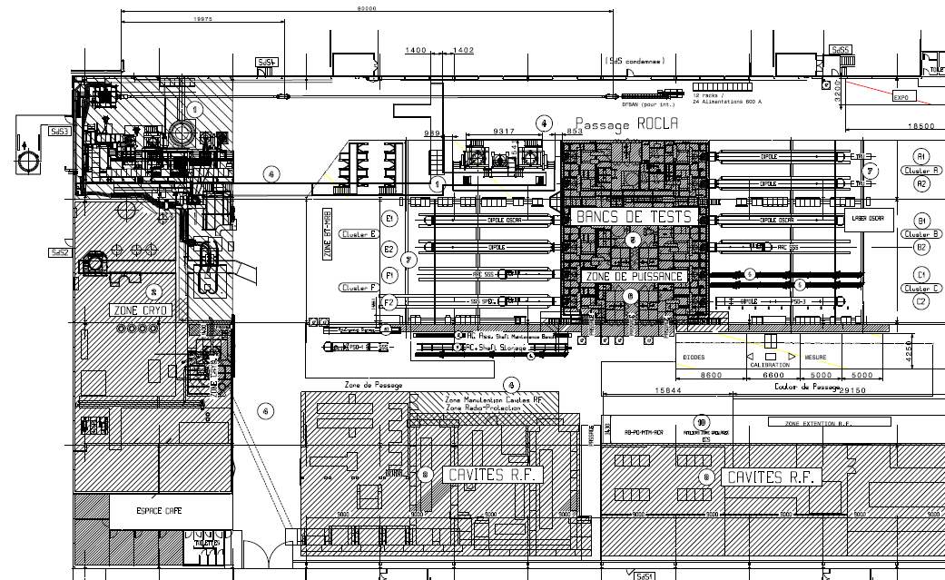
THE ZONES in the Building 2173
SC LINK TEST STATION
VERTICAL TEST CRYOSTATS
CLUSTERS
F E D
HORIZONTAL TEST BENCHES
CLUSTERS
C B A
CRYOGENIC ZONE
Superconducting RF CAVITY TEST ZONE
LN₂ TEST ZONE

Slide 9
IT STRING short term ACTIVITIES
Extract from the Mandate
….
Based on scope , the preliminary studies and cost estimates
Set up a TEAM and the modus operandi with GL and WPLs
ESTABLISH a COMPLET list of INGREDIENTS
Set up a possible TIMELINE and agree on that
WORK out a TEST plan
Work out a BUDGET and RESOURCES
Check specifically those equipment which are only be used in Sm18

Slide 10
1. Set up a team and a modus operandi

Slide 11

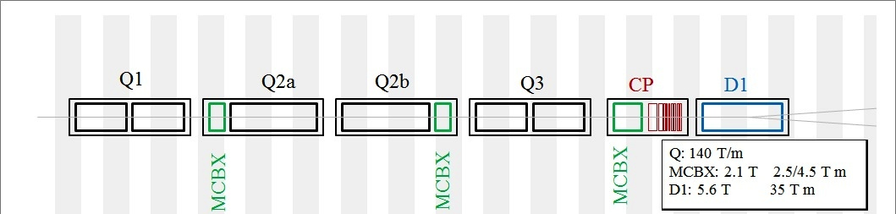
2. IT STRING INGREDIENTS
Test the COLLECTIVE BEHAVIOUR of ingredients tested individually
HL LHC STRING Ingredients… mainly from the WPs and possibly series equipment
Magnets: Q1, Q2a, Q2b, Q3,CP, D1
Power converters: 3 x 20 kA, 6 x 3 kA, 9 x 120 A
Power distribution: DFH and Current leads + SC link ( DSH)
Protection and EE system: 3 x switches x 20 kA, 3 x Dump
Cryogenic equipment ( cooling and cryo distribution)
Vacuum equippment
DAQ, Interlock, Software for Analysis ect is to be test in the STRING
He gas recovery
Switch & Dump
Shuffling Module
D1
CP
Q3
Q2b
Q2a
Q1
DFH
LHe 4.2 K
20 kA
20 kA
12kA
Cryogenic feed box
Bus Bars
6 x3 kA
9 x 0.12 kA
Connection Module
SC Link (DSH)
Connection Module
80 m
Converters
SERVICE UPGRADE needed for :
Cryogenic cooling: additional 6 kW power plant
Demineralised water cooling: additional 55 m³/h ( aprox.0.5 MW) ✓
Primary water cooling: additional 2.5 MW for cryogenics
Electricity : tbc
These was defined and is part of the SM18 Test Facility UPG Project. See the presentation of Volker.

Slide 12
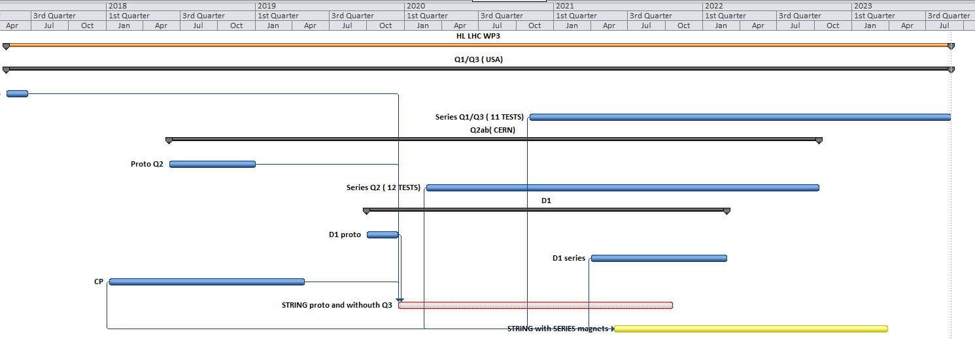
3. HL LHC STRING TIMELINE
2018
2019
2020
2021
2022
2023
STRING Phase1 can start in 2019 end with prototypes but Q3 will missing
STRING Phase2 can not start before mid 2021 due to late arrival of the 1st series of D1

Slide 13
4. HL LHC STRING preliminary TEST PLAN
Validation of a layout- integration
Validation of installation sequence and procedures
Validation of a system (of components)
Validation of their collective behaviour
Quench: provoked, natural, holding current, propagation, detection, protection, clic, dump, switch
Cryogenics: cooling- warming speed ( Nb₃Sn), heat load, recovery after quench, pressure, temperature, shielding
Integration: layout, interconnections, systems around ( racks, cables trays, control cables et), total weight
Powering: bus bar, connections, current leads, power distribution at warm and at cold, converters, water cooled cables
Electrical integrity: splice resistance, electrical insulation
Interlock
Vacuum: leak detection, beam screen
Instrumentation , DAQ systems, DB , QA, QC: specific or not to string
Alignment
GOALS in parallel:
Develop methods, techniques
Develop tooling
Develop procedures
Installations
Test
Operation
X
definition of
2
support
HWC
OP

Slide 14
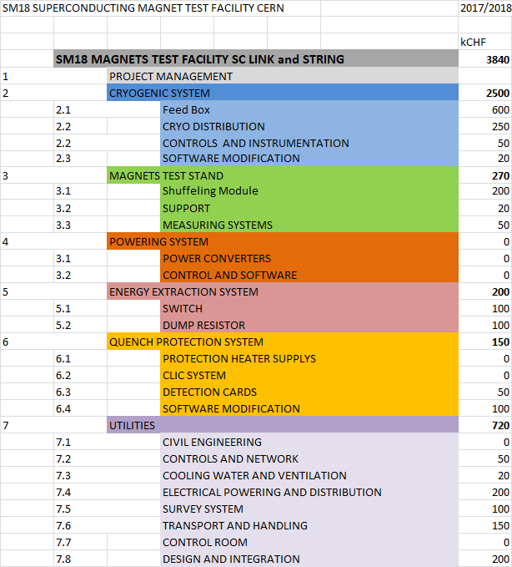
5. Set up THE IT STRING BUDGET
This is a very preliminary budget probably a lot under estimated but gives an idea what can be….but it contains only non HL LHC items.
The main ingredients will be paid and produced within the WPs and used for the time of the STRING before transforming them to spares.

Slide 15
CONCLUSIONS
For all type of The HL LHC magnets we plan to have a test station @ CERN although some of the will be tested elsewhere.
The test plan is done including all magnets but the high order correctors
The test plan is part of the general HL LHC planning and the corresponding test stand is identified for each of them ( vertical or horizontal A,B,C cluster ect, )
The definition of the performance test is well advanced
These work led to a specification of the test stands , the ancillary ( ex. water cooling) or main ( cryogenic) services and a requirements for their readiness . It is giving also the indication of what and when should be done in simultaneous way ( STRING, SC link and magnet test)
IT STRING activity has been started but is all preliminary. Actions are listed for the next coming mounts. Proposed timeline is given for 2 years of operation and in two phases starting at 2019 and in 2021. All services but electrical powering has been defined.

