Slide 1
Baby MIND Magnet
10th June Meeting
E.N.

Slide 2
Meeting goals
10th June meeting goals:
  Magnet design endorsement
  Choice of coil option
  Steel procurement strategy
  Review timeline
  Resources commitment
    integration of detector modules and magnet

Slide 3
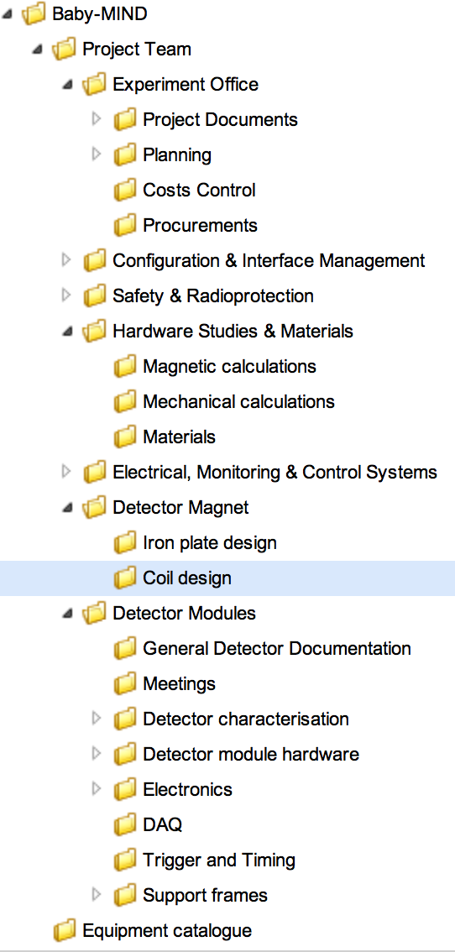
Documents and info
Use EDMS for now
Baby-MIND magnet technical description:
  to be reviewed (EDMS 1464949)
Coil options:
  Aluminium folded strip option:
  slides (EDMS 15166866)
  Integral coil option:
  slides (EDMS 1516863) and video
  Criteria for choice: one slide
Steel procurement:
  procedure to follow
  technical specifications
  list of suppliers
  how to pay (team account vs CERN account)
Project timeline:
Resources:

Slide 4
Magnet design constraints and concept

Slide 5
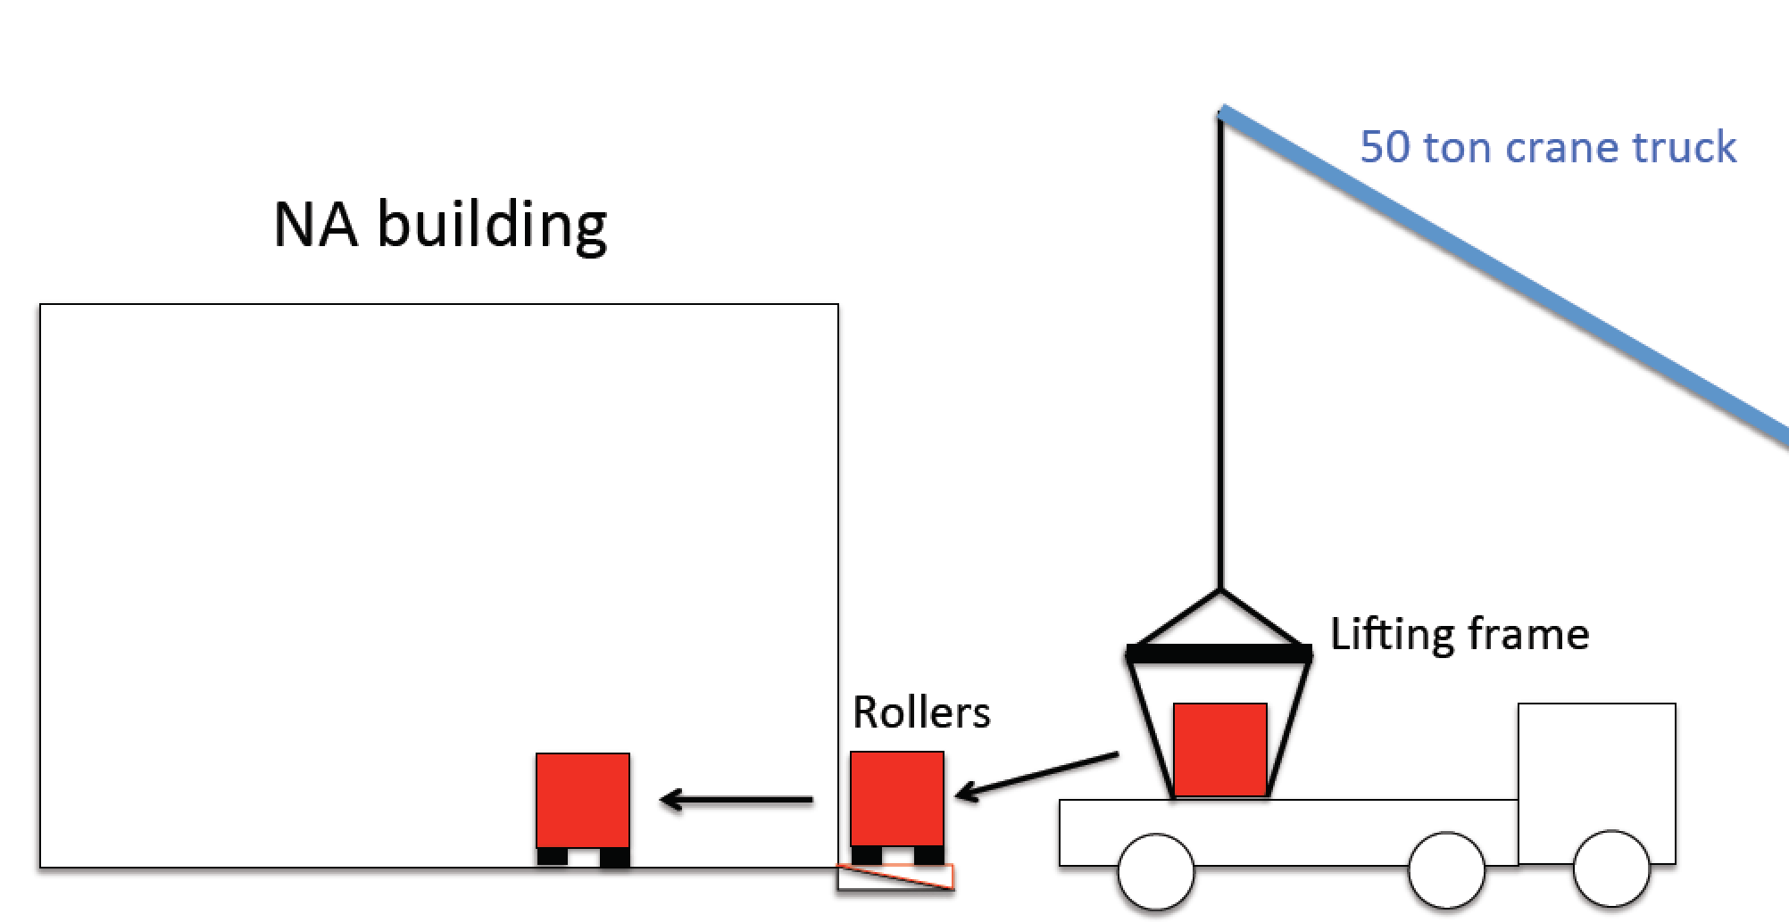
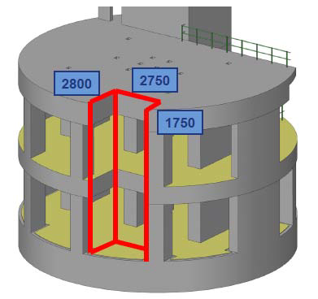
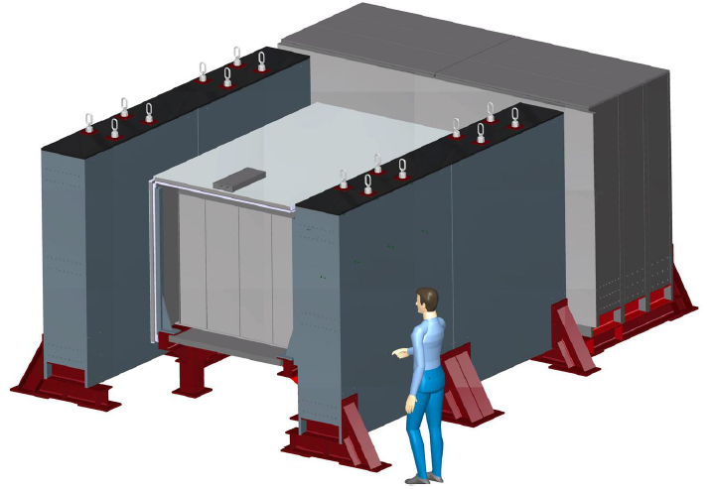
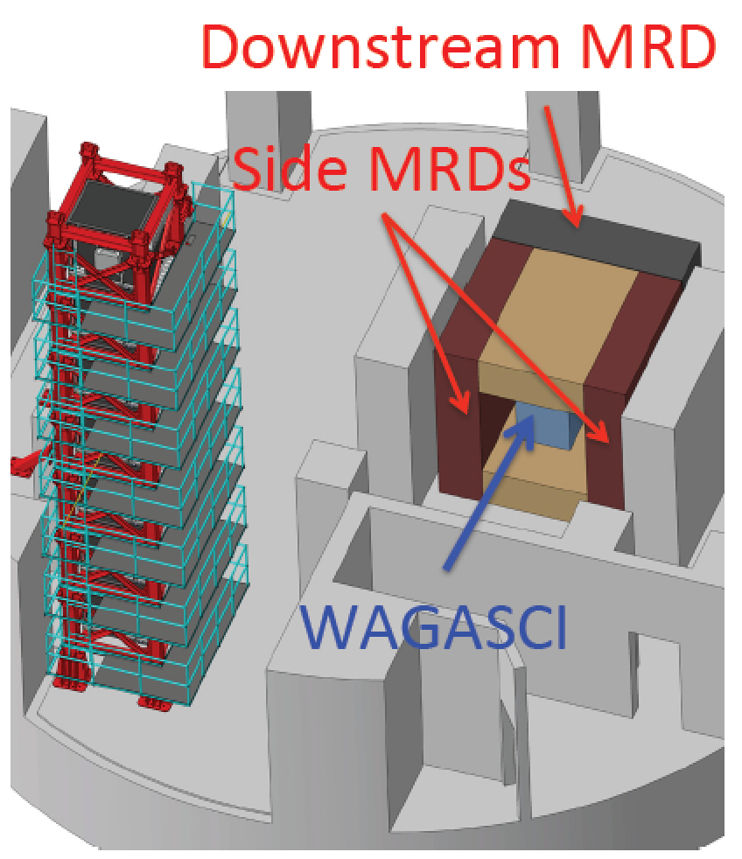
Magnet design constraints
Handling: access to shaft
Peak field: 1.5 T (1.4 T)
Knowledge of B field in steel to few %
Size and cost:
Fe depth: 1 m (stop 1 GeV μ)
Fe ~ 60 t (3.5 x 2 x 1 m roughly)
Baby-MIND
Wagasci
Power: < 10 kW
Side MRDs

Slide 6
Magnetized steel plates
Inserts that connect the two plates: to be optimised for mechanical rigidity and flux lines
side view
3500 mm
Coil: Al + insulation
1800 mm
45
or 90
10
Upper
half-plate
Upper Aluminium coil:
20 to 100 turns
Fe
Fe
Dimensions to be confirmed
200
20
2020 mm
Lower Aluminium coil:
20 to 100 turns
Lower
half-plate
a)
b)
a)
b)

Slide 7
Coil options

Slide 8
Integral coil wrapped on independent jig:
Folded strip option:
one per turn:
mechanical bolting + welding
Preparation
fix steel thickness
procedure & tooling
scale 1:1
scale 1:y
Preparation
Purchase steel plate
Engineering
Aluminium coil
Insulator tape
Structural materials
Engineering
Coil element design
Insulation
Connectivity
Coil thickness
2.5 + n [mm]
NO
NO
YES
Feasibility
Feasibility
YES
Selection criteria [TBC]
Prototyping
Design
Validation
[cost estimate]
Fe plate engineering
Production
x40
Procurement
Plate module production

Slide 9
Comparing coil options
 | Integral coil option | Folded strip option
Prototyping status | Partially completed | Partially completed
Tooling | Substantial (but available) | Light
Process complexity | Complex winding | Multiple connections
Process scalability | Not trivial | Excellent
Aluminium engineering | None required – straight off reel | Strip, folding and contact design
Steel plate procurement | Not required | Steel required?
Insulation | Well understood | Validation required
Completed coil production rate (incl. insertion on steel) | 2-3 days | 1 day
Manpower for production | x2 people | x1 person
Hardware costs | Al: < 10 kCHF Insulator: < 10 kCHF Tooling: 10 kCHF | Al machined: ?? Insulator: ??
Handling and storage | More steps | Fewer steps

Slide 10
Steel procurement

Slide 11
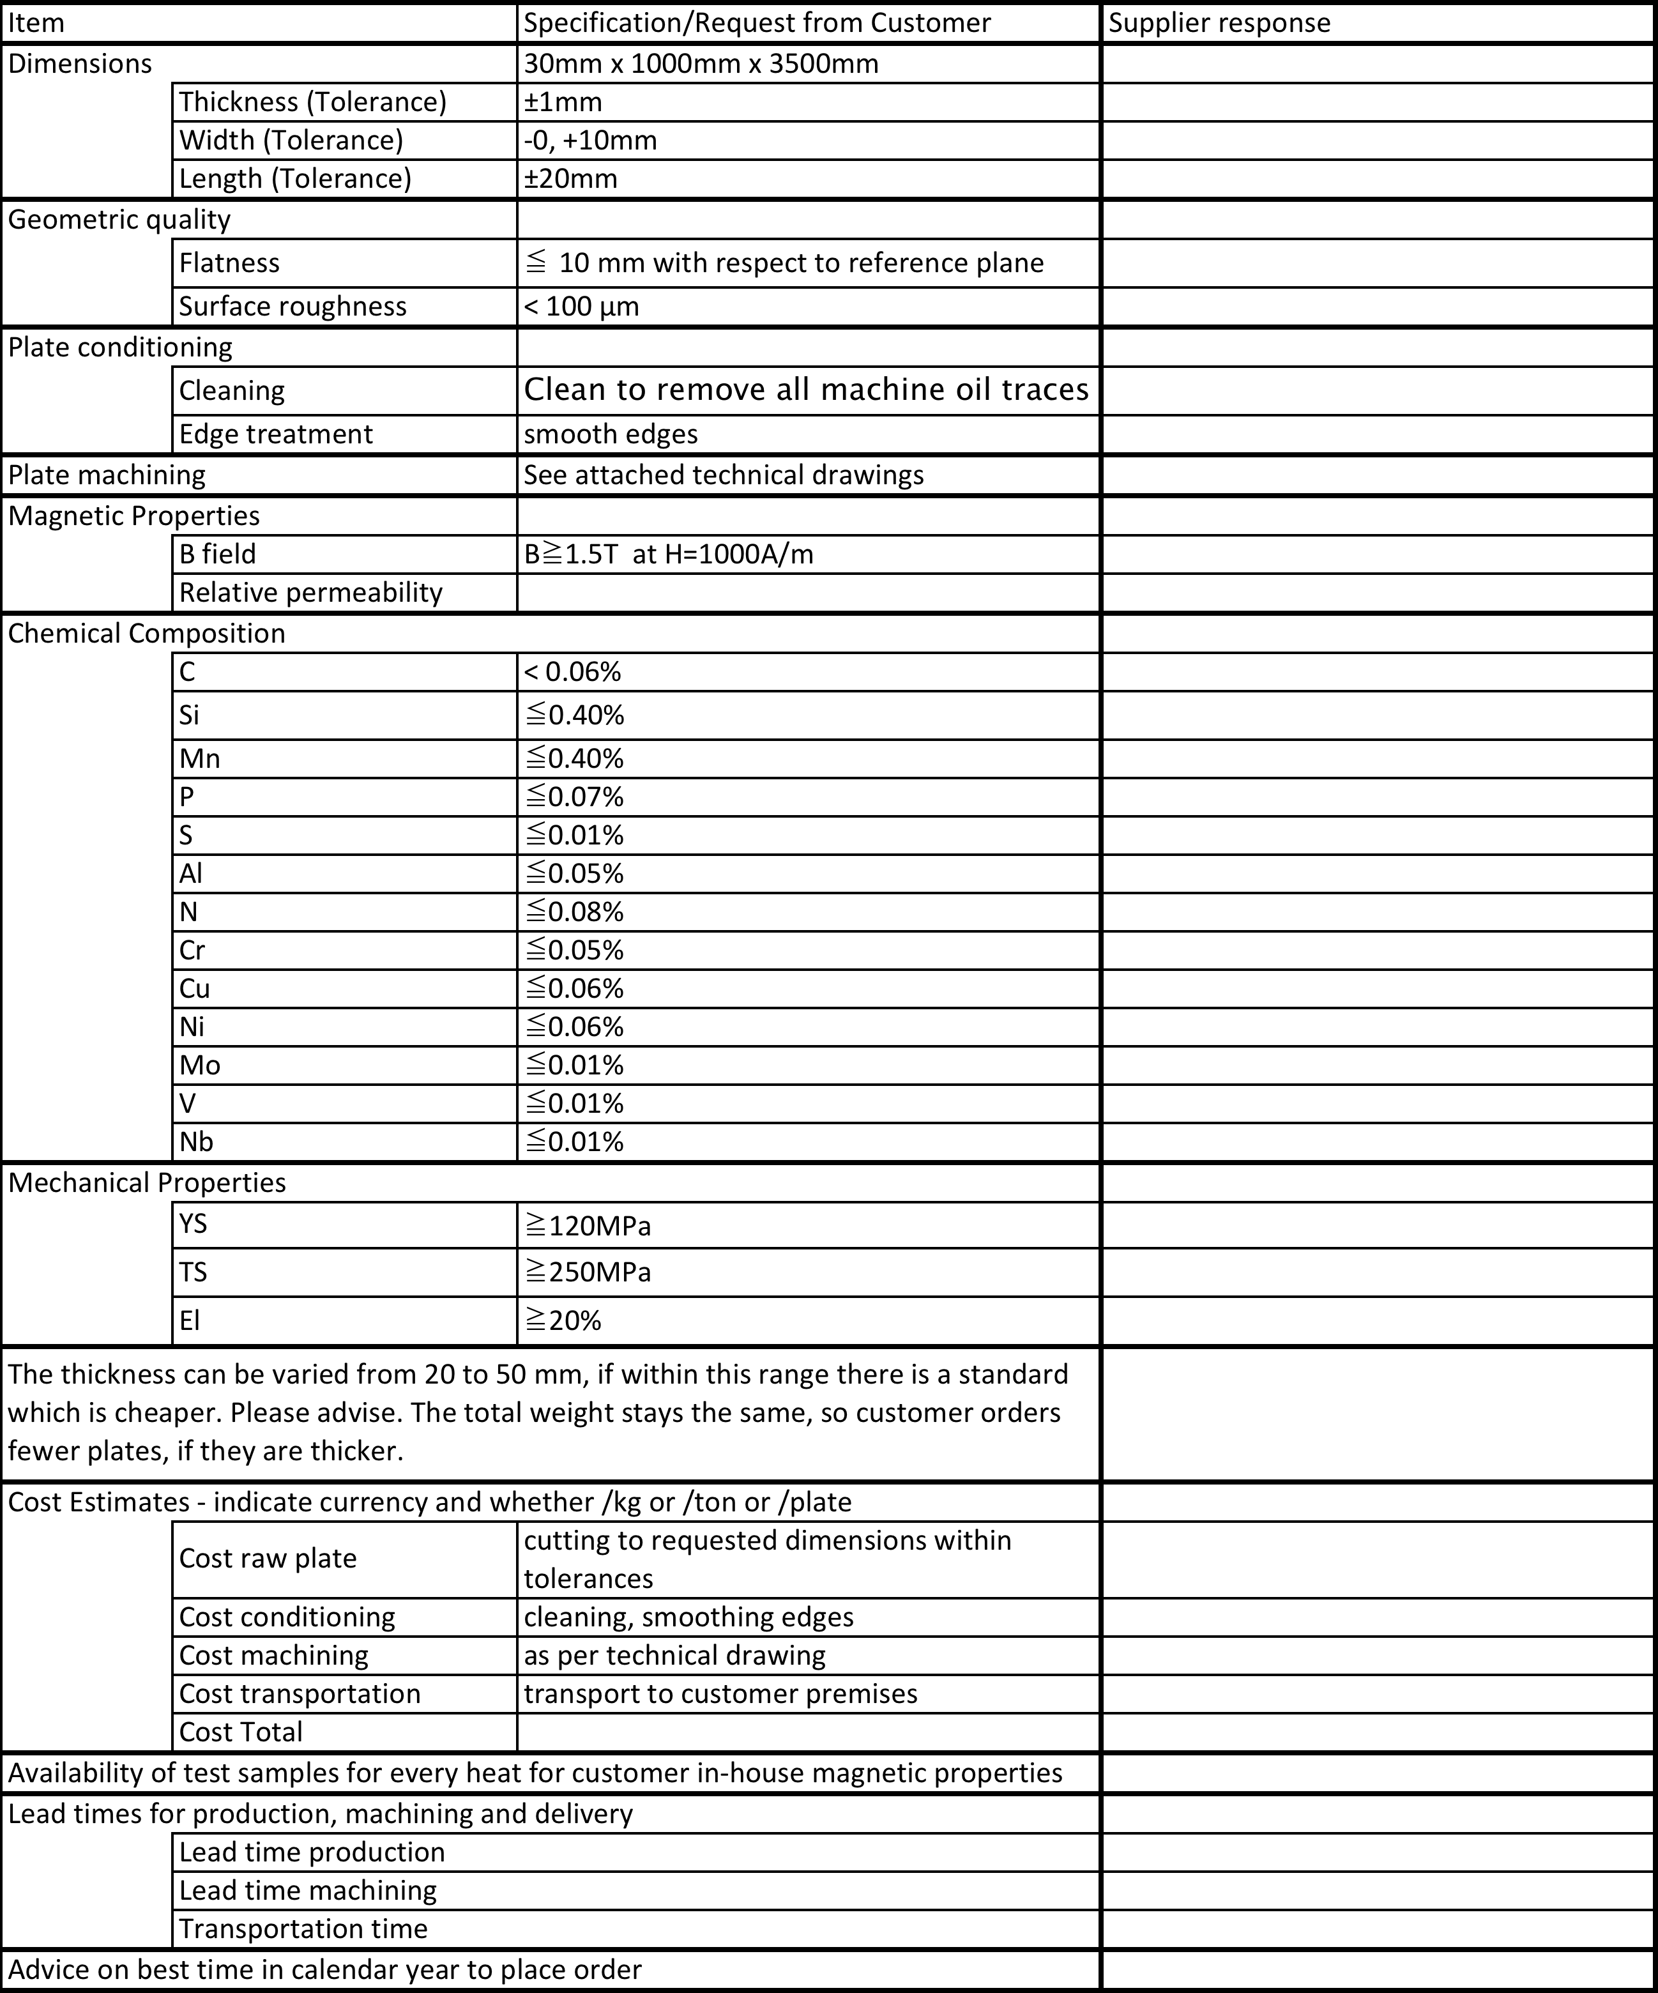
Steel specifications
JFE-EFE Steel (JAPAN):
2.66 Eur/kg ($3/kg)
2.79 Eur/kg incl. transport to GVA
Lead time 4mo + 2mo transport
ARMCO (AKSteel - Europe):
2.3 Eur/kg (EXW Germany)
Lead time 4mo

Slide 12
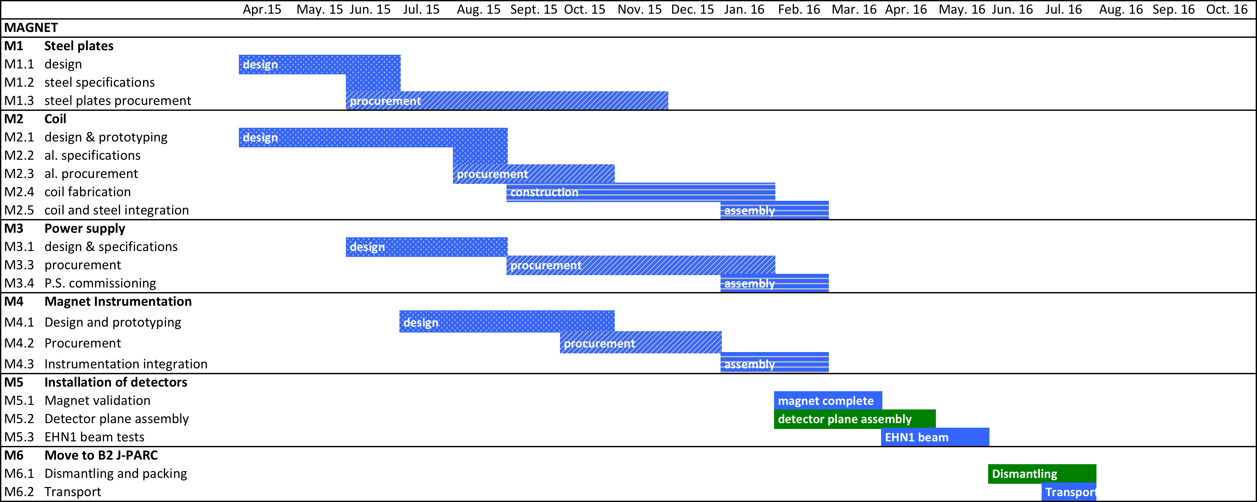
Timeline (Apr. 2015)

Slide 13
Back-up

Slide 14
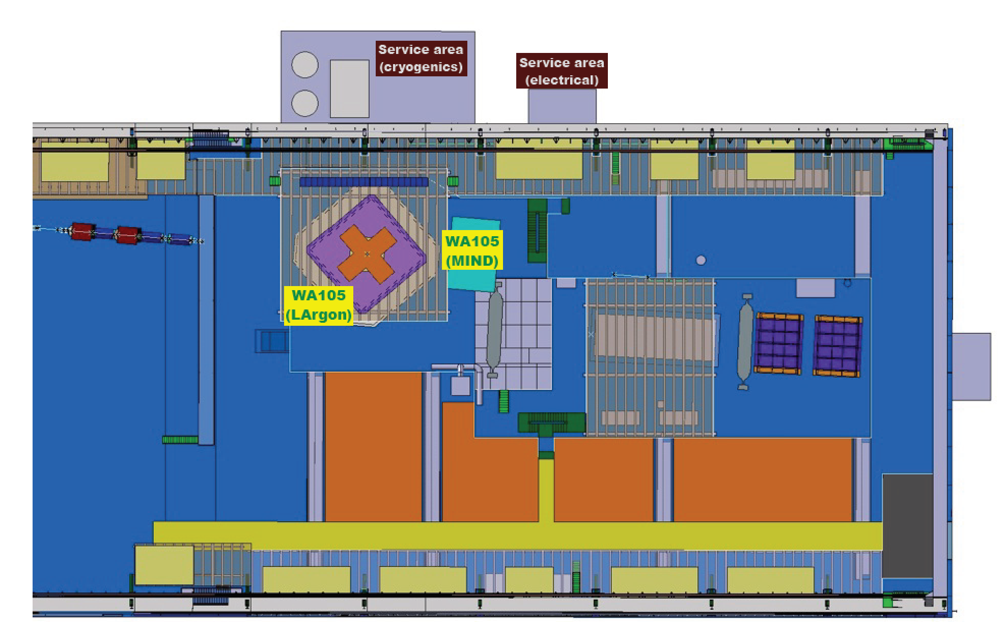
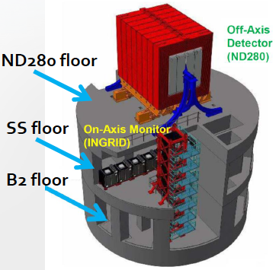
Planned use of Baby-MIND type detector
WA105 @ EHN1 extension
Modularity in design simplifies proposed use at various facililities, downstream of:
  WAGASCI at J-PARC (2016 onwards) : anti-nu selection efficiencies > 90%.
  LAr (WA105) (2017 onwards): Use of MIND detectors integrated from start of studies or Long Baseline experiments in Europe (LBNO): muon charge ID and momentum, tail catching of hadronic showers. Baby MIND could provide partial acceptance for events in 6×6×6m³ of WA105 LAr.
  ANNIE at Fermilab.
WAGASCI @ J-PARC
Baby-MIND
positioned here
Wagasci
Side MRDs

Slide 15
CAD of steel plate (to be updated)
Will be simplified to reduce machining steps and costs

Slide 16
M. Capeans proposal: 18 march 2015
Coordination
Overall coordination
Mechanics integration
Procurement?
UNIGE
Magnet production
Magnet design
P.S.
System Eng.
M. Capeans
H. Ten Kate
TE-EPC
Prototype construction
Coordination of final magnet construction
Design & calculations
Safety aspects
Technical specs.
Prototype validation
Commissioning of final magnet
Power supply definition and procurement

Slide 17
Magnetized steel plates: B-field
Stray fields: up to 2 cm from surface of steel along z
# of plates not representative of final detector
Bx [T]
By [T]
Bz [T]

Slide 18
Costing
# | Item | Qty | Total [kCHF] | CERN [kCHF] | INR [kCHF] | SOFIA [kCHF] | UNIGE [kCHF] | UK [kCHF] | Start | End
Detector modules: passive components
1 | Plastic scintillators | 10000 | 85 |  | 40 |  | 45 |  | Sep. 13 | May 15
2 | WLS fiber | 6000m | 25 |  |  |  | 25 |  | Nov. 13 | Jul. 14
3 | Photosensor connectors | 20000 | 20 |  |  |  | 20 |  | Sep. 13 | Jan. 15
4 | Module mechanics | 50 | 60 |  |  |  | 60 |  | Sep. 14 | Jul. 15
 | total detector modules passive comp. |  | 190 | 0 | 40 | 0 | 150 | 0
Detector modules: photosensors and electronics
5 | Photosensors | 3000 | 70 |  |  |  |  | 70 | Jun. 14 | May 15
6 | Electronics & DAQ | 3000ch. | 90 |  |  | 15 | 75 |  | Jan. 14 | Dec. 15
 | total photosensors and electronics |  | 160 | 0 | 0 | 15 | 75 | 70
Magnet: steel and coils
7 | Steel plates | 50 | 150 | 150 |  |  |  |  | Mar. 15 | Dec. 15
8 | Magnet mechanics | - | 60 |  |  |  | 60 |  | Mar. 15 | Mar. 16
9 | Magnet coil prototype | 1 | 25 | 25 |  |  |  |  | Mar. 15 | Sep. 15
10 | Magnet coils | 64 | 125 | 125 |  |  |  |  | Sep. 14 | Mar. 16
 | total magnet steel and coils |  | 360 | 300 | 0 | 0 | 60 | 0
Magnet: p.s. and instrumentation
11 | Magnet power supply | 1 | 50 | 25 |  |  | 25 |  | May. 15 | Feb. 16
12 | Magnet safety and instrumentation | - | 25 | 25 |  |  |  |  | Jun. 15 | Apr. 16
 | total magnet power supply and instr. |  | 75 | 50 | 0 | 0 | 25 | 0
 |  |  | Grand total | CERN contrib. | INR contrib. | SOFIA contrib. | UNIGE contrib. | UK contrib.
 | Project totals [kCHF] |  | 785 | 350 | 40 | 15 | 310 | 70

Slide 19
Case i): Module and Fe plate configuration
m: detector module
s: steel plate
m0
m1
m2
m3
m4
m5
m6
m7
m8
m9
m10
m11
m12
m13
m14
m15
m16
s1
s2
s3
s4
s5-6
s7-9
s10-13
s14-18
s19-23
s24-29
s30
20
2000
500
500
100
500
500
Case i) and ii):
90 mm
Case i): 30 mm
For all other Fe plates:
Case i): 30 mm
Except this Fe plate:
90 mm
Case i): 30 mm

