Slide 1

Baby MIND magnet design
or
“how to best magnetise a steel plate”
Alexey, Etam, Gabriella, Helder, Herman
Baby Mind Magnet Meeting @ CERN
June 10, 2015

Slide 2
1. Constrains and goals
Plate length is 3500 mm (size of the vertical pit)
Plate thickness is 30 mm (optimized for physics)
Plate height is 2000 mm
Coil thickness less than 10 mm
Power dissipation to be minimised (stacking and no active cooling)
The plate has to be magnetised by low current and predictable (homogeneous) field (around 1.5 T) distribution has to be guaranteed

Slide 3
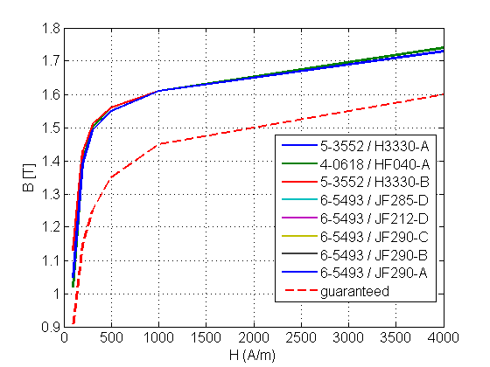
2. Magnetisation of a steel plate
For an infinitively long plate with good properties, a < 300 A/m coil will do the job, but when plate properties are only as “as guaranteed”, the power dissipation will be 40 times higher!

Slide 4
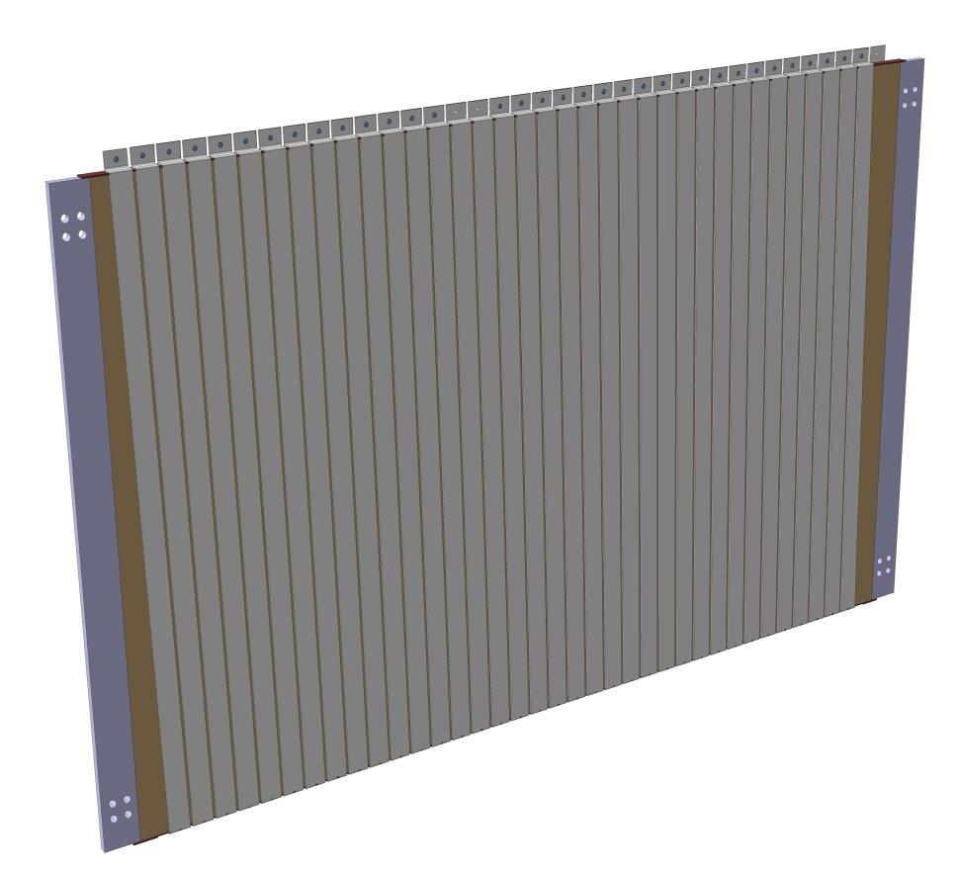
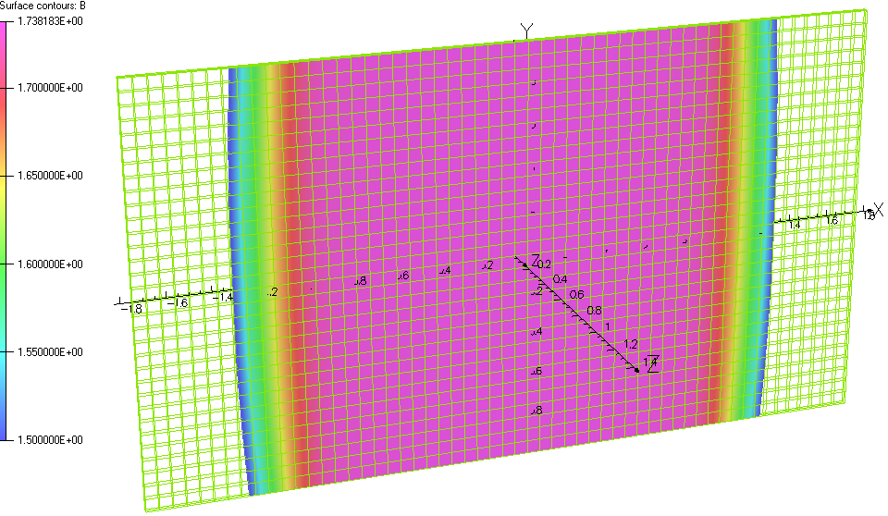
3. “Ideal” plate with no gap
300 A / 1 m of coil (4 mm thick Al) corresponds to a power dissipation of less than 3 W/m
but with a total of 50 kA it will be more than 6 kW/m!

Slide 5

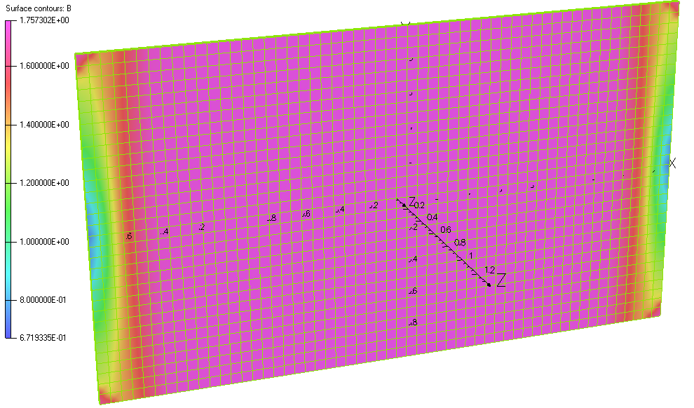
4. Repulsion force between neighbouring plates
“Plus” and “Minus” current make “Zero” field outside the plate.
The only interaction is due to effects at the plate edges where the field lines go outside.
But even in the case of no flux return it is small and affordable.
Example:
Force between two plates with 100 kA total current and no gap between coils is only 650 kg.

Slide 6
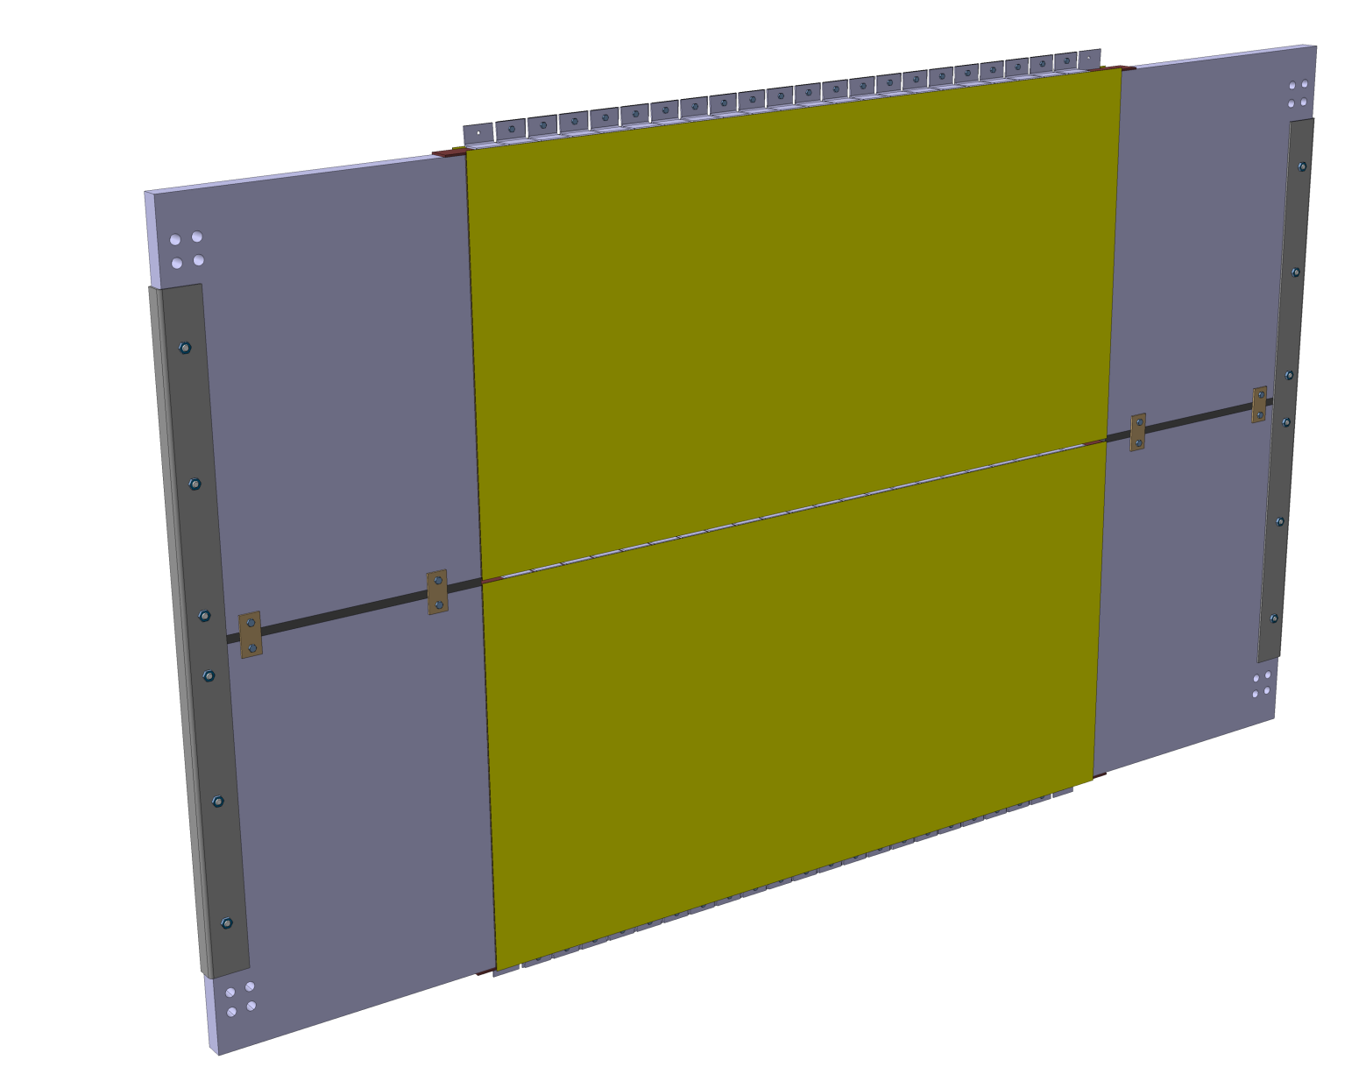
5. Flux return
Magnetic circuit is like in a “transformer”.
6

Slide 7
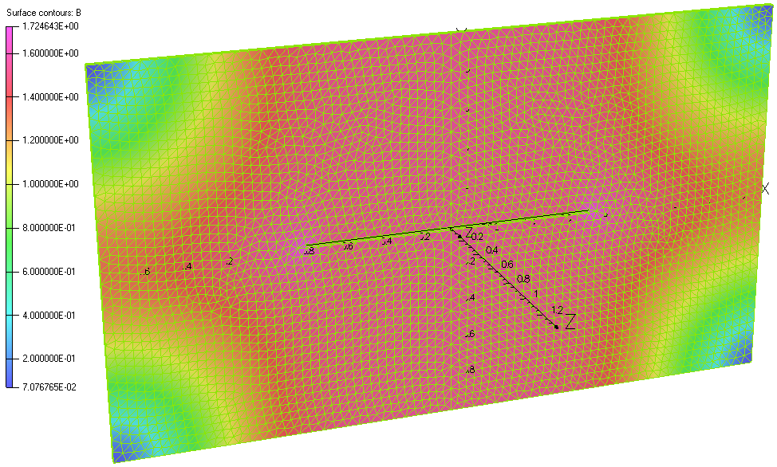
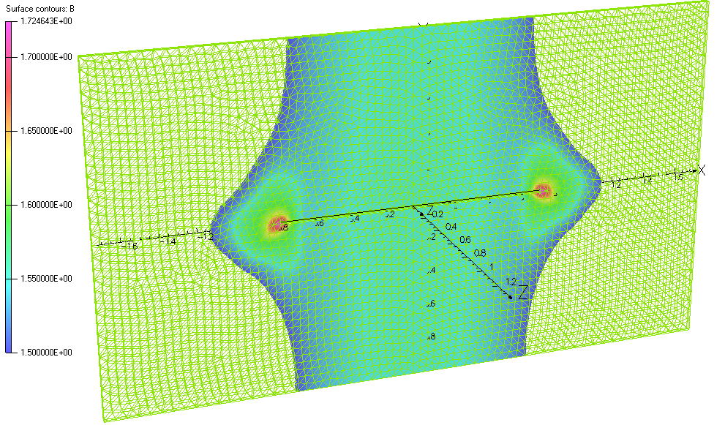
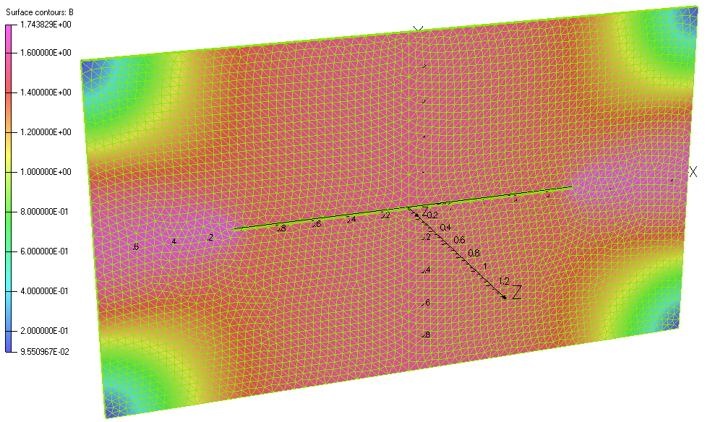
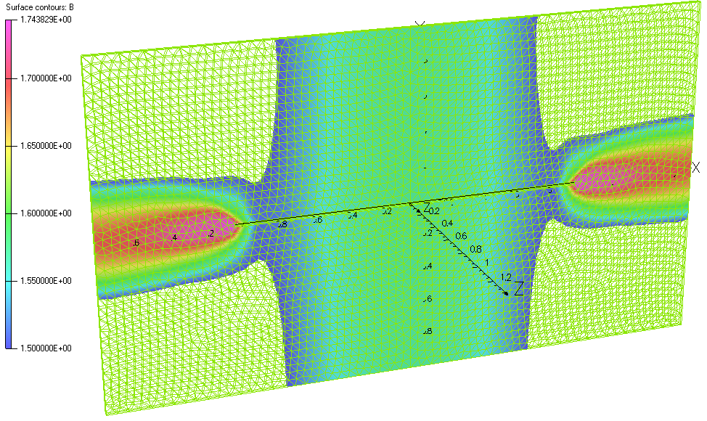
6. Single plate with 20 mm slot
1.5 m coils with current of 2*800 A
2.0 m coils with current of 2*1500 A

Slide 8
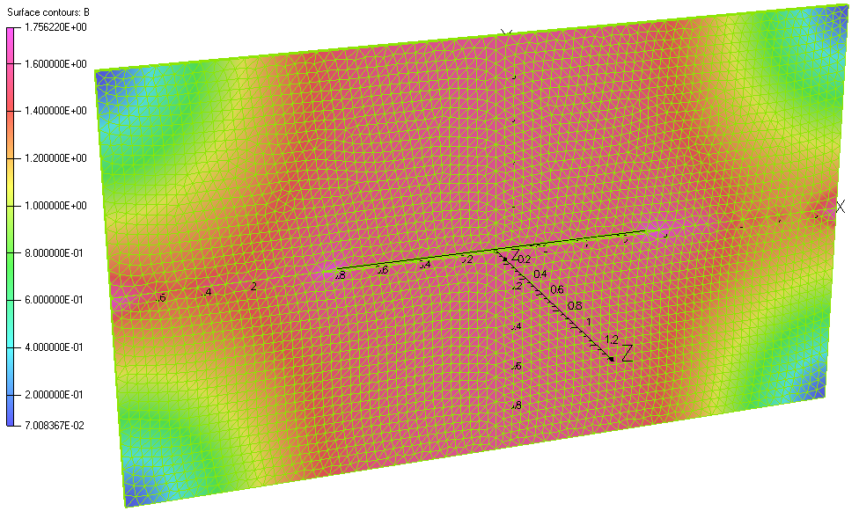
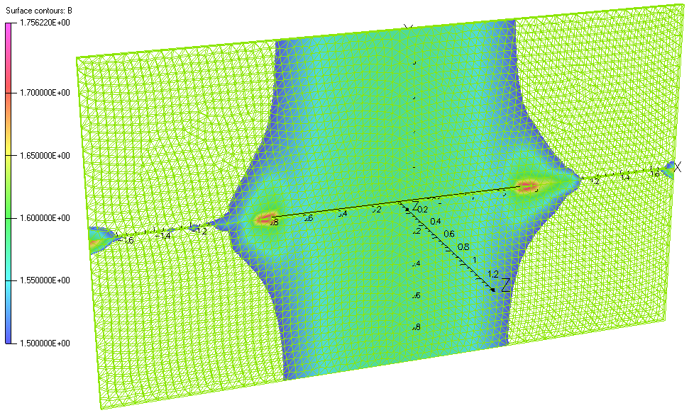
7. Single plate (top) vs two plates with gap 1 mm (bottom)
1.5 m coils with current of 2*800 A
1 mm gap
1.5 m coil with current of 2*1500 A

Slide 9

8. To return flux properly extra material has to be added
2.8 m for
10 mm plates to stay within coil envelope
9

Slide 10
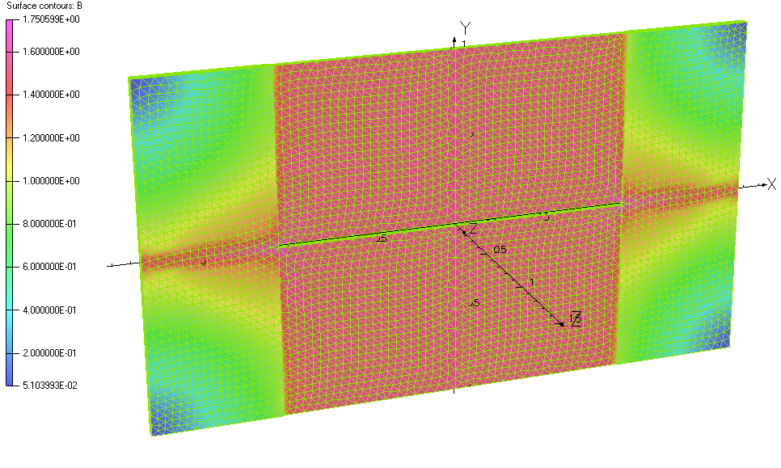
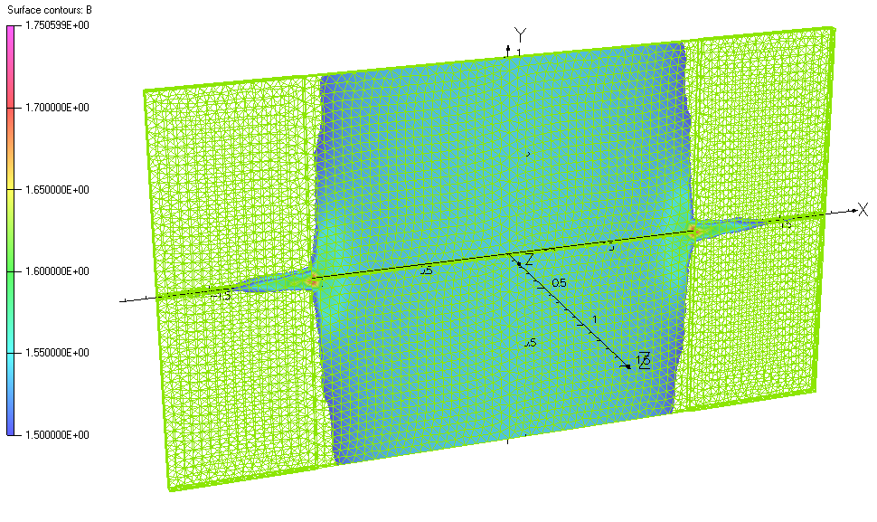
9. Single plate no gap (top) vs two plates with shim, 2 mm gap, and 10 mm extra side plates (bottom)
2.0 m coils with no gap at current of 2*1500 A
2.0 m coils with current of 2*800 A

Slide 11
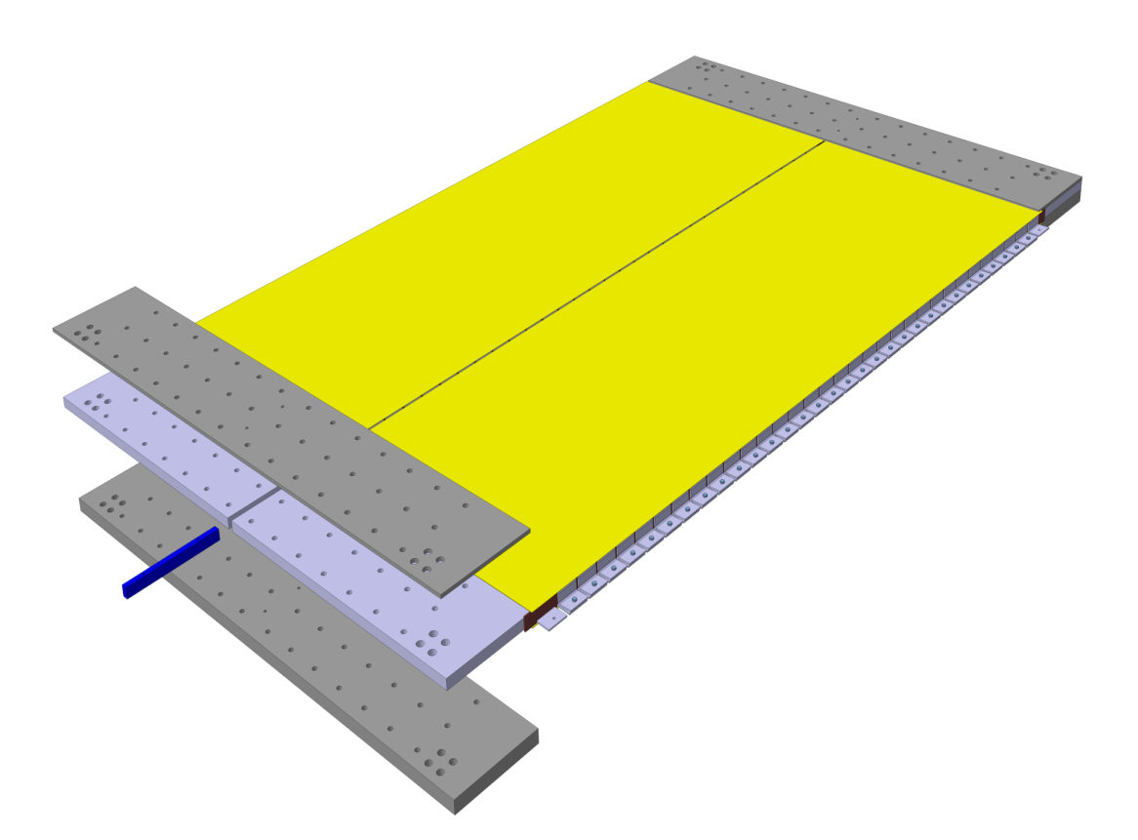
10. Baby MIND detector module (for 3.5 m)
2.8 m for
detector panel

Slide 12
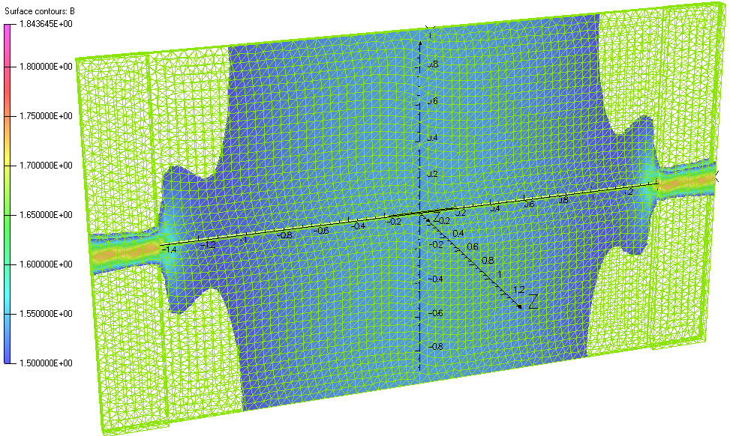
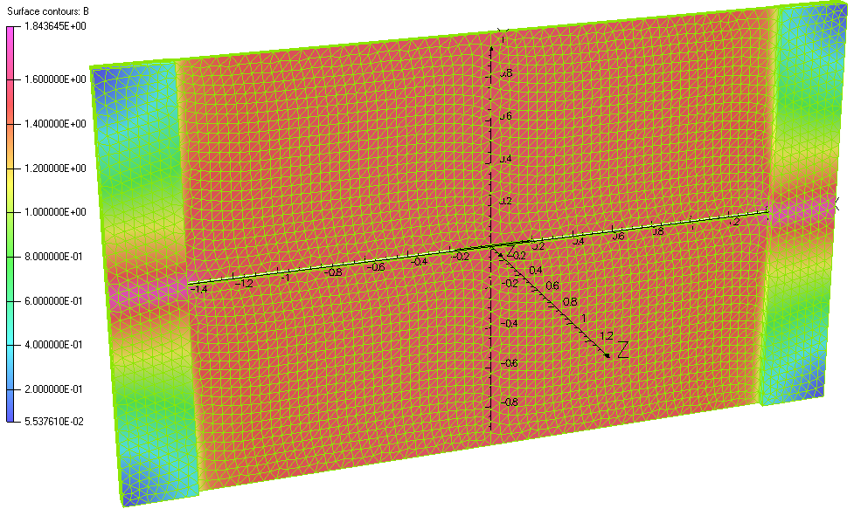
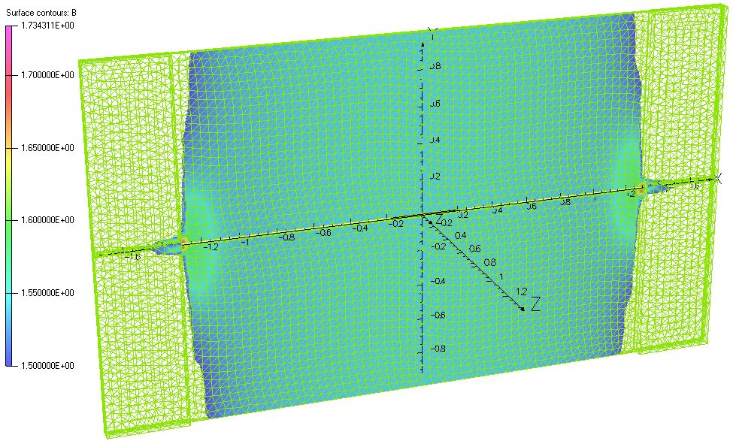
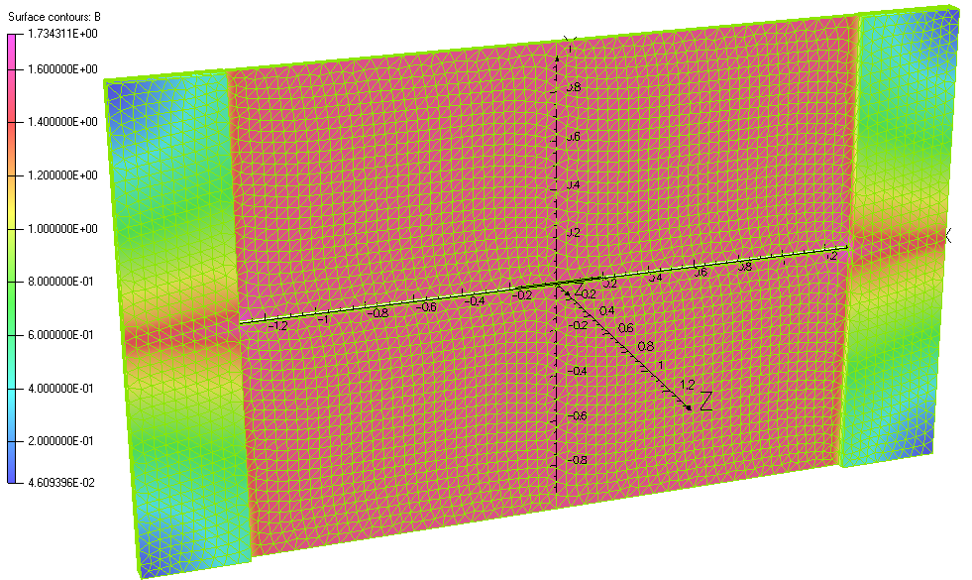
11. Variants to be selected
2.8 m coils with current of 2*1500 A
2.6 m coils with current of 2*1200 A

Slide 13
12. Current, voltage and power consumption
For all cases the power dissipation is less than 100 W per module if the conductor thickness is >2 mm.
Operating current depends on number of turns but it will be less than 100 A.
Voltage is also low and stays within a few volt, a single power supply can charge all modules.
Example:
In the case of two 2.6 m coils with 2*1.2 kA the power dissipation per module is less than 40 W or less than 1 kW for the entire magnet.

Slide 14
13. Conclusion
Magnetic design made based on using raw iron plates with minimum machining.
Effect of slit size and gaps between the two plates in one module analysed.
Optimum flux return, and thus most uniform field across detector surface is achieved by adding extra side plates adjacent to the coils.
Magnetic design is fully understood and can be optimised.
Final dimensions to be agreed, where after the design can be frozen and production start.

