Slide 1



Quench protection of Bi-2212 magnets
Tengming Shen
Fermi National Accelerator Laboratory
WAMHTS-3, Lyon, France, Sept 11, 2015
Work supported by U.S. DOE-OHEP through a U.S. DOE Early Career Award, and performed in collaboration with my colleagues at Fermilab including Pei Li, Liyang Ye, Dan Assell, and Dan Turrioni, members of BSCCo especially the FSU 2212 group and Arup Ghosh with BNL, and other university and industry partners, especially Justin Schwartz with NCSU.
1

Slide 2
Designing a quench protection system depends crucially on knowing:
At what hot spot temperature can a normal zone be detected?
    NZPV at cm/s gives small normal zones with a length of ~10s cm or less
Quench degradation limits of Bi-2212 wires
    What role does stress/strain have?
They determine the time constant of quench protection.
2

Slide 3
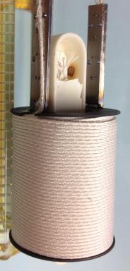
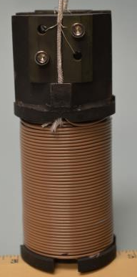
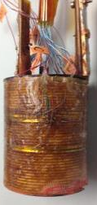
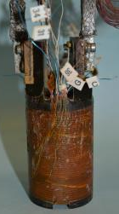
Samples - two 6-layer, epoxy impregnated Bi-2212 solenoids (1 bar HT) made from 1.2 mm OST wire
Coil A: mullite insulation
(~100 μm thick)
Coil B: nGimat/NCSU TiO₂ insulation (~22 μm thick)
OST, Φ1.2 mm, 85x18 wire,
Pei Li, Dan Assell
3

Slide 4
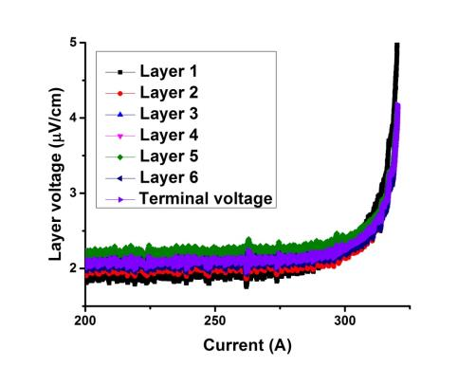
I_{c}-B of these coils and uniformity of I_{c}
Coil B@14 T
Coil A quenched during
I_{c} measurements.
No electric shorts.
Quite uniform I_{c}.
Liyang Ye, Dan Turrioni
4

Slide 5
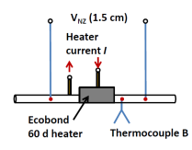
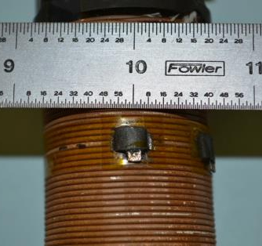
Heater induced quench experiments and temperature measurement
Coils A + B have survived more than 100 quenches without degradation.
Epoxy heater
Kapton (33 mm thick) separates
heater and coil windings except
the turn to be quenched.
Liyang Ye
5

Slide 6

Coil A: High hot spot temperature is needed to see 0.1 – 1 V for high J_{o} operation. Strong influence of J_{o} on quench detection
Shen, Ye, Li, Turrioni, Supercond. Sci. Technol. 28 (2015) 075014
Coil A – 100 μm mullite insulation
Note: Temperature from voltage measurement, not from TCs. TCs tend to underestimate T_{max} when dT/dt>10 K/s.
6

Slide 7

Coil B: Moderate hot spot temperature is needed to see 0.1 – 1 V. Small influence of J_{o} on quench detection
Coil B – 20 μm nGimat TiO₂
Note: Temperature from voltage measurement, not from TCs. TCs tend to underestimate T_{max} when dT/dt>10 K/s.

Slide 8



Dependence of quench degradation limit of Bi-2212 wires on axial stress up to 160 MPa for high critical current density, overpressure processed Bi-2212 wires*
Liyang Ye^{1,2}, Pei Li¹, Jan Jaroszynski³, Justin Schwartz², and
Tengming Shen¹
Fermi National Accelerator Laboratory
North Carolina State University
National High Magnetic Field Laboratory
* Will be included in L Ye NCSU PhD thesis work
Work was supported by U.S. DOE-OHEP through a U.S. DOE early career award. LY thanks Joint University-Fermilab Doctoral Program in Accelerator Physics and Technology. TS thanks NHMFL for 31 T DC magnet time. Special thanks go to Dan Assell with Fermilab and NHMFL staffs especially Dima Abraimov, Ulf Trociewitz, David Labarlestier.
8

Slide 9
Earlier Ye thesis works investigating quench degradation limits and degradation mechanisms provide strong motivation for examining the role of strain state on quench degradation limit
L. Ye et al., manuscript in final preparation.
I_{c}-axial strain of Bi-2212 wires (ten Haken and ten Kate,
Cheggour, Godeke)
Quench degradation is driven by local straining of 2212 filaments with T_{max} limit close to 500 K.
    Irrespective of dT_{max}/dx, conductor design, heat treatment, porosity levels et al.
    Quenched degraded filaments develop cracks.
    Reversible and irreversible behavior consistent with J_{c} dependence on T_{max}.
Reversible
How strongly would quench degradation limit depend on axial stress/strain states of conductor?

Slide 10
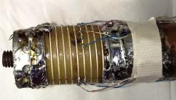
I_{c} measurement using ITER barrels – results consistent with standard I_{c} measurement of short straight samples on G-10 sample holders
OP produces high J_{c}
Force pointing inward, hoop stress ≈ 0
PMM101108-2, 37x18, 0.8 mm,
Nexans’ 521 composition powder
With collaborations with Arup Ghosh@BNL
Ye, Li, Ghosh, Shen, ICMC2015, poster
10

Slide 11
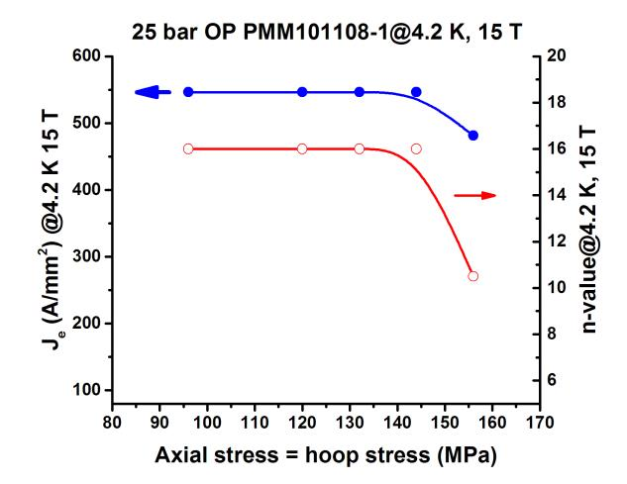
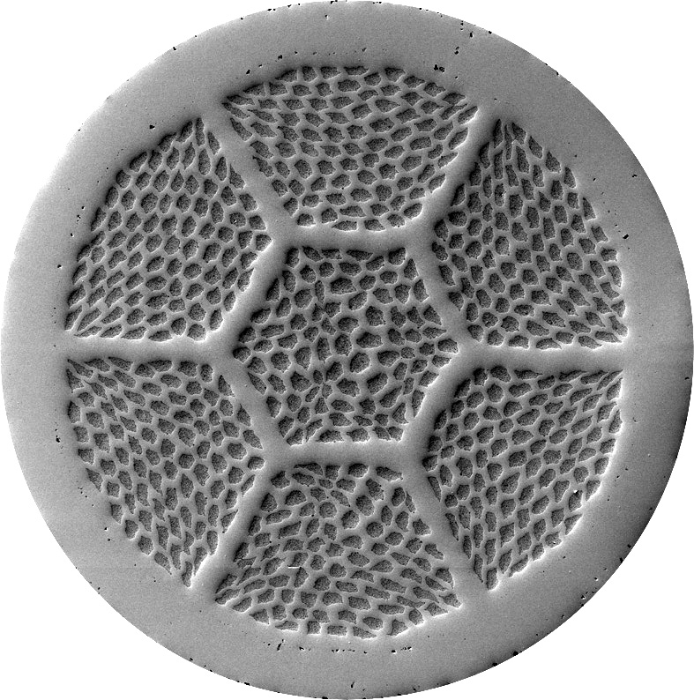
Determining axial stress limit using ITER barrels
5% I_{c} degradation at 156 MPa @4.2K and 15 T for 25 bar OP PMM101108-2
Force pointing outward
Hoop stress ≈ BJR
11

Slide 12
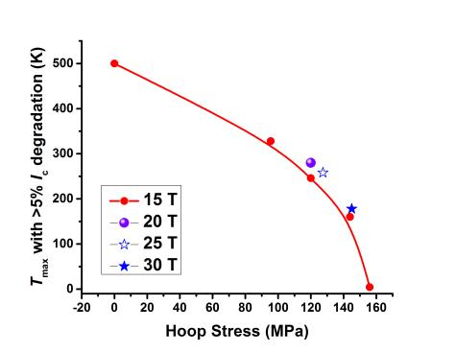
Dependence of quench degradation temperature limit on axial stress up to 145 MPa in a 25 bar OP Bi-2212 wire at 4.2 K in field of 15-30 T
Decreasing from 500 K at zero hoop stress to ~150 K with increasing hoop stress to 146 MPa at 4.2 K and 15 T
4.2K, 15T
12

Slide 13
Summary
For 2212/HTS magnets, hot spot temperature at which a normal zone can be detected depends strongly on voltage detection criterion, operating current density, and fabrication methods such as insulation used
    So is quench detection and protection
    Many other implications such as thin insulation or non-insulation winding method that promote 3-D propagation are strongly encouraged.
Quench degradation temperature limit for Bi-2212 wires.
    Strongly depends on the axial stress/strain states.
    >500 K when not stressed, 320 K with 100 MPa axial stress, 160 K with 140 MPa axial stress. Axial stress limit~156 MPa for a high J_{c} OP wire.
    Good news for dipole magnets.
13

