Slide 1






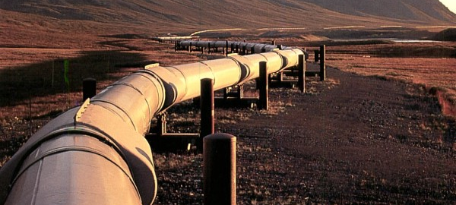

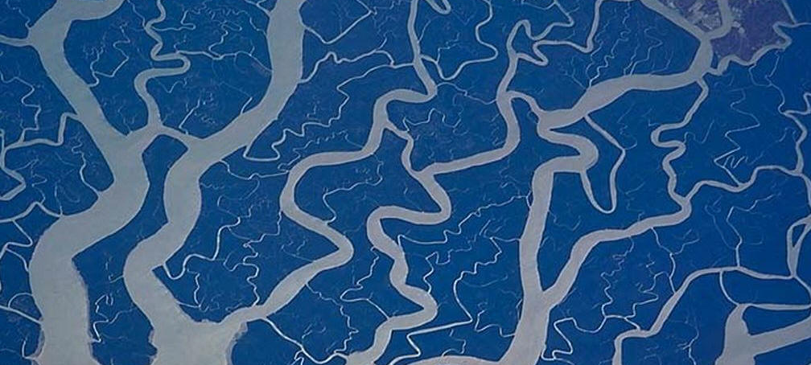
Influence of Current Redistribution on Quench and Stability
Energy, Materials & Systems
In REBCO Coated Conductor Roebel Cables
J. van Nugteren

Slide 2
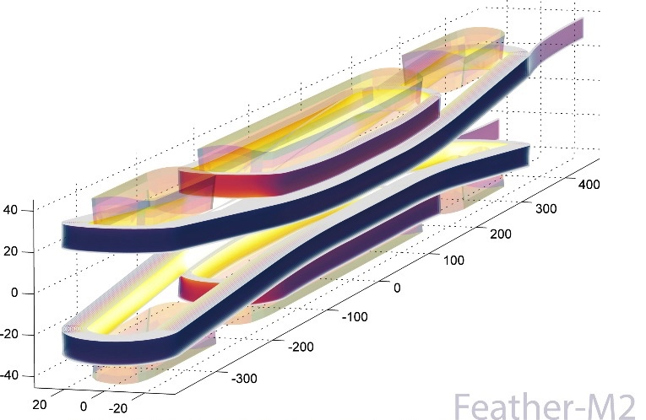
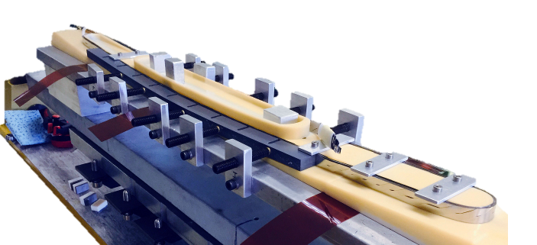
Future HTS Accelerator Magnets
The critical current of REBCO keeps improving
  Cost per ampere decreases
  Very high current density wires are already demonstrated on short lengths (Houston University)
  High current density close to the aperture leads to highly efficient magnets
  At these current densities classical quench detection and protection no longer work.
This leads to many questions regarding quench and stability
  What is the origin of heating and how fast is it deposited?
  Can we detect thermal drift before the current sharing temperature is reached?
  What margin would be sufficient in an accelerator?
  …

Slide 3
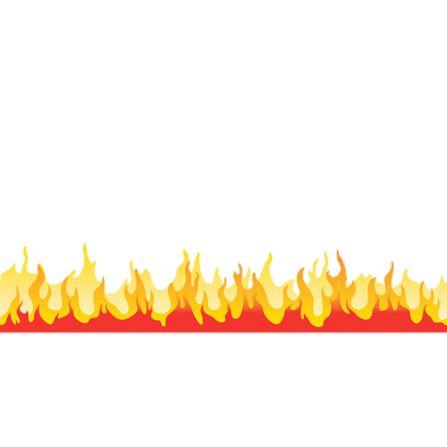
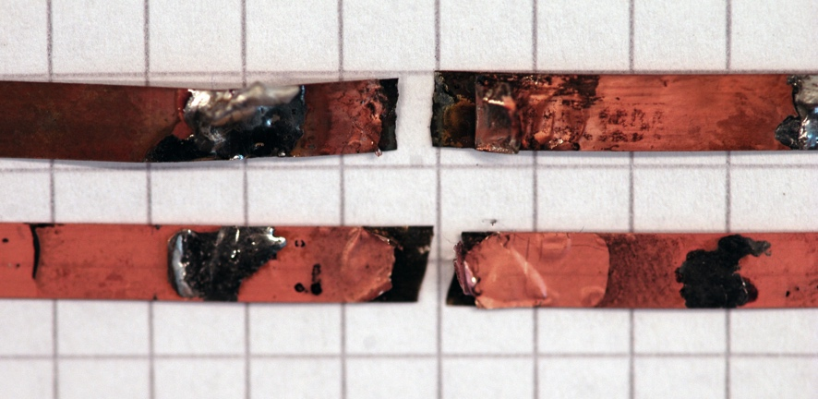

Where Could This Heating Come From?
Ramp over critical current most likely cause for roasted coil (=
Beam loss (should be caught by beam loss monitors dumping beam immediately)
Cryogenic failure (very slow large time to detect)
Conductor movement (need more than 0.5 cm bad design, should not happen)”
Mechanical failure (bad design, should not happen)
AC-Loss (need to ramp slowly)
An idiot with a forklift driving into the magnets …
Act of god i.e. Meteor strike …
Can we make the magnets easyer to replace?

Slide 4
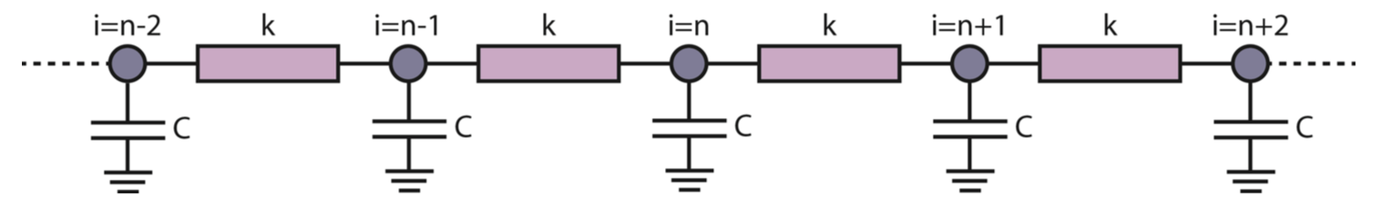
One-Dimensional Quench Propagation model

Slide 5
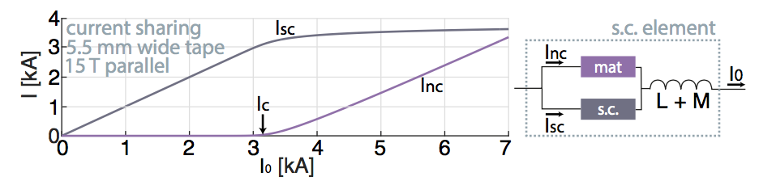
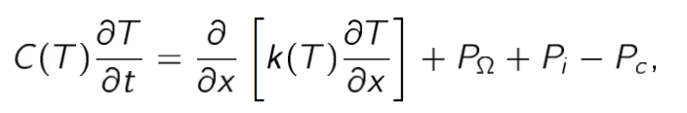
Finite Difference Heat Transfer Model
This model runs quick
10 secons calculation
time per case

Slide 6

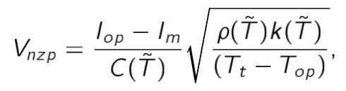
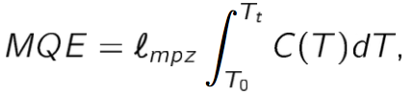
Validation with Analytic and Measurment
The model and the measurement at Twente agree fairly well
Model and analytic have some deviation especially at low current
Wilson-Stekly

Slide 7
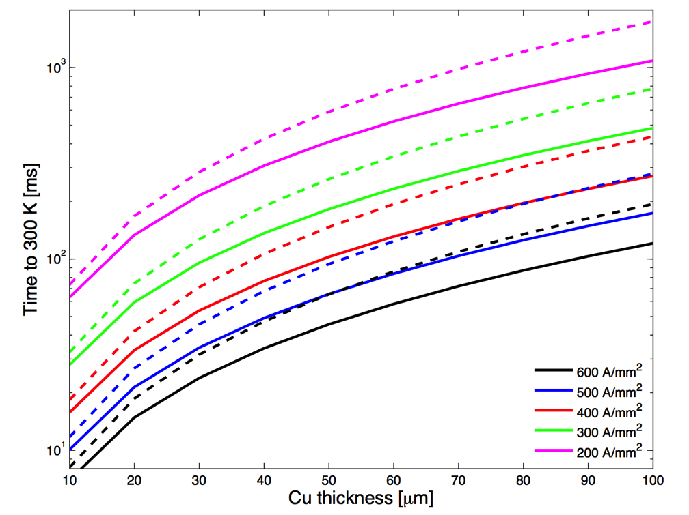
Tampere Model Cross-Check
Checked 1D adiabatic model with University of Tampere data for Feather-M0 and we see good agreement
Tampere
CERN (adiabatic)

Slide 8
MQE with Copper Thickness
Maximize conductor stability
  At low thickness high Jc and large thermal margin
  At high thickness good heat capacity
  Gives shallow optimum (which we can calculate easilly)
Optimum changes depending on application (J,B,T), tape performance [A/m] and field orientation
Perpendicular
With 100 mu hs tape
FM2 Conditions
With 100 mu hs tape

Slide 9
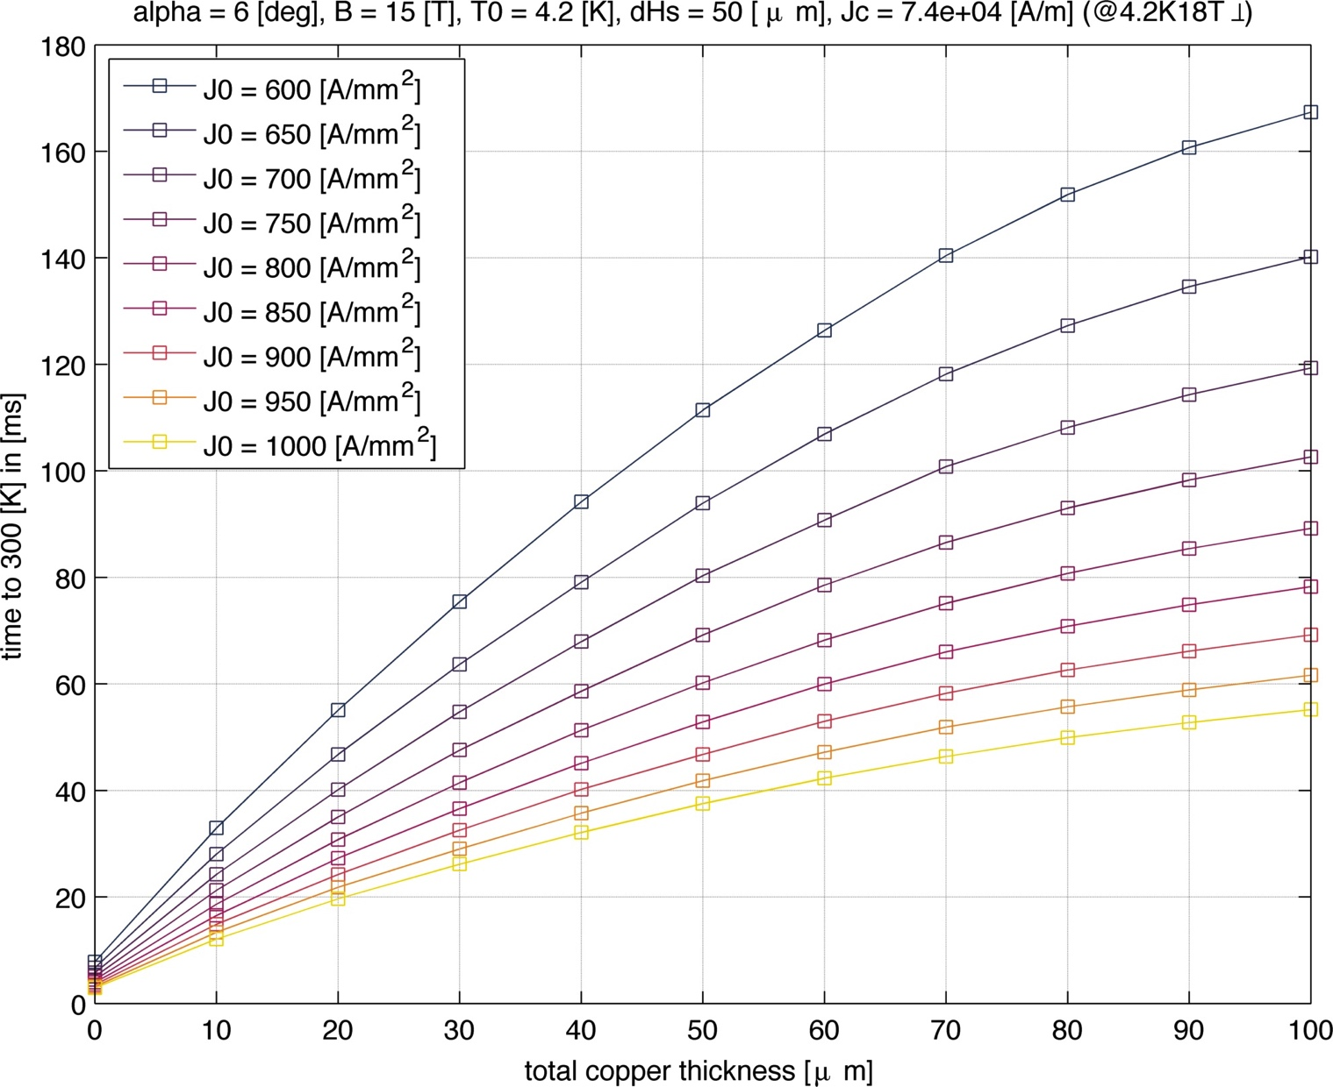
Reaction Time for Feather-M2 Aligned Conditions
Jcu is 2100 A/mm² for 50 mu hs and 3100 A/mm² for 100 mu hs tapes
The time to 300 K is about 30-40 ms
Variable temperature test should provide us the safety to study the detection-protection system
With 100 mu hs Tape
Feather-M2 Target
(in near-parallel field)
Feather-M2 Target
(in near-parallel field)
But it might go much higher?!
With 50 mu hs Tape

Slide 10
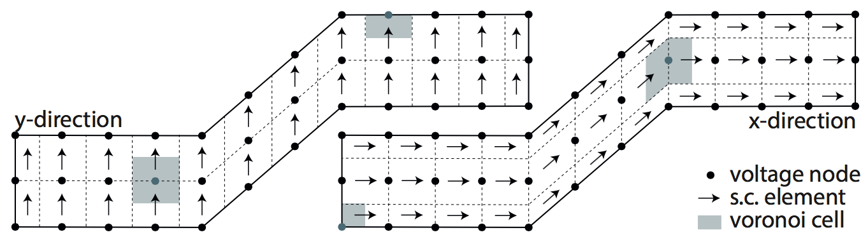
Current Re-Distribution Inside a Tape

Slide 11
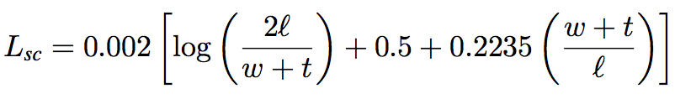
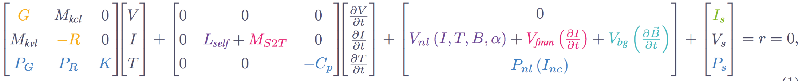
Network Geometry and Kirchoff’s Equations
The problem in Kyoto
Shown at EUCAS (paper submitted for publication)
Tape surface modelled as a (PEEC) network of superconducting elements and nodes
System of equations is shown below
  First row represents Kirchoff’s current law
  Second row represents Kirchoff’s voltage law
  Third row represents the Heat Equation
Input in cm, output in muH D:
Radio Engineers Handbook, McGraw-Hill, New York, 1945.

Slide 12
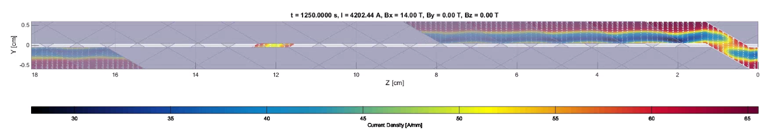
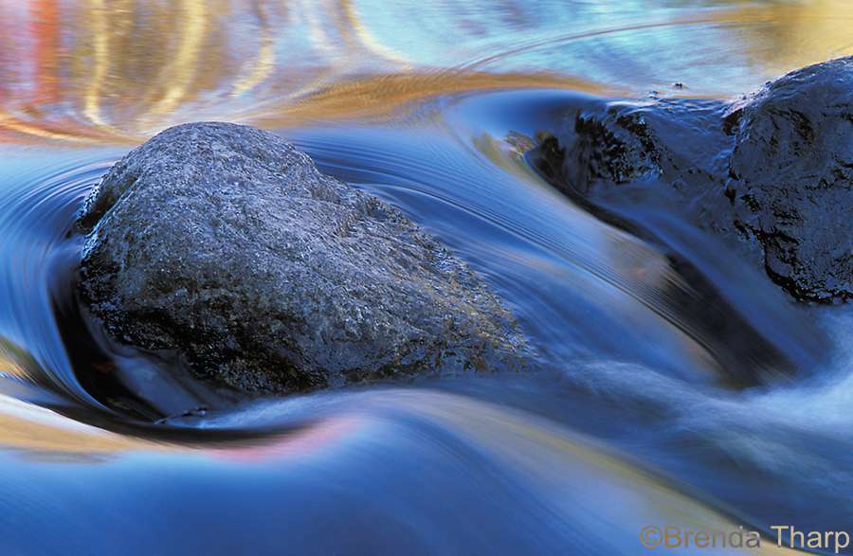
Preliminary Tests
Transport current
If you add current source and sinks on either end of the cable the transport current can be simulated
It flows mainly on the edge of the tapes (screening)
A normal zone can be created by fireing a heater (like placing a stone in the river)
What we see is that the current flows around it creating higher current density areas next to the normal zone
This causes the tape to quench very quickly over its width, afterwards it becomes a 1D problem
The problem we have in the model is that the

Slide 13
Then Coated Conductor Cable is like Multiple Rivers

Slide 14
What We Want to get out of it
Effect of transport current on hysteresis and coupling
Dynamic field quality due to magnetization currents and its time constants
Study of detection methods
  Behaviour of the cable near the critical current (balance between heating and cooling)
  Minimal Quench Energies with current redistribution
  Normal Zone Propagation (peak temerature and voltage against time) with current redistribution
Complex mechanical behavior due to current distribution (Jaakko)

Slide 15
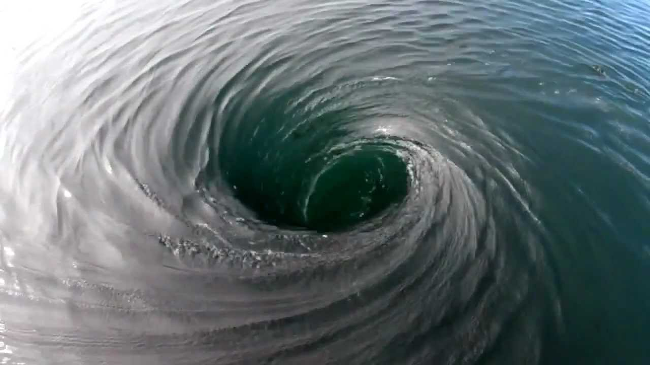
Hysteresis and Coupling Losses

Slide 16
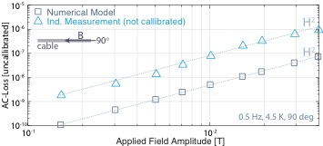
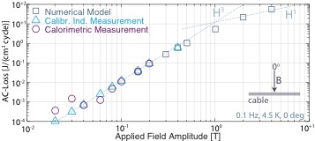
Hysteresis and Coupling Losses
Our EUCAS 2015 paper and presentation
Overcurrent in superconductor provides macroscopic description of flux line movement
Perpendicular gives mainly Hysteretic losses (good agreement)
Parallel gives mainly coupling loss
Besides validation provides means to determine contact resistance order magnitude 10⁻⁸ Ohm.m² looks reasonable estimate (more experiments needed)
Screening Currents
Mainly Coupling
Mainly Hysteresis

Slide 17
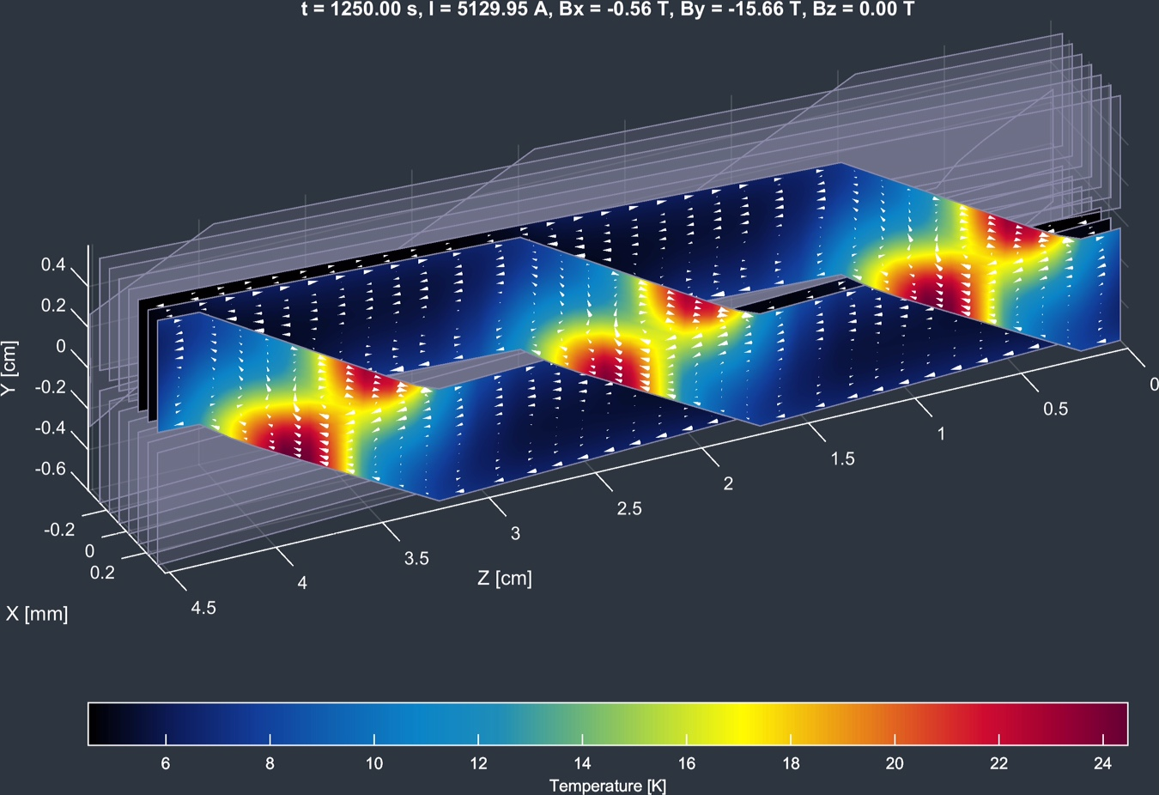
CLIQ
First application of the model
Its actually HyLIQ for HTS
Mainly hysteresis loss driven
See talk Emanuelle

Slide 18
Stuff I could Use
Better more representative Jc(B,T,theta) but also N(B,T,theta) fit or new better description of the soft transition (need to be measured in vacuum can inside dipole?)
More magnetization data (we’re already working on this)
Magnetization with transport current
Contact resistance both electrical and thermal between tapes in cable directly measured
Normal zone propagation experiment (with MQE) in cable also good opportunity to test quench detection and impregnation ideas (i.e. a full scale cable test)
Tape with very high critical current
New resin impregnation that is liquid as water and when solid has the same thermal contraction as the coil

Slide 19
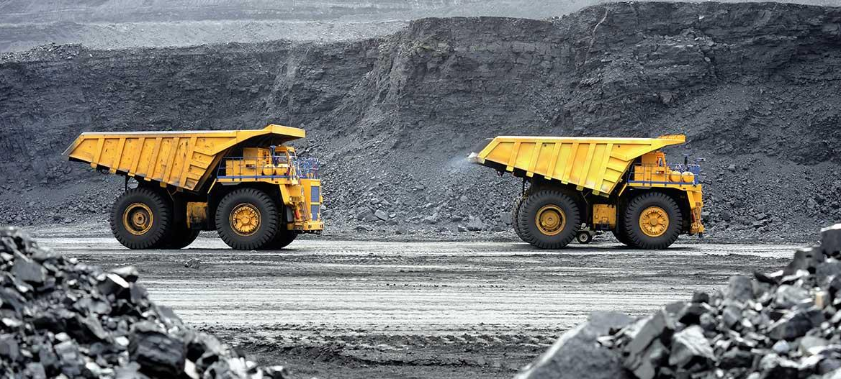
Conclusion
Loads of data mining to be done

Slide 20
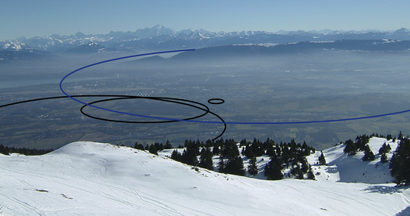
Source: http://tlep.web.cern.ch/
Thanks

Slide 21
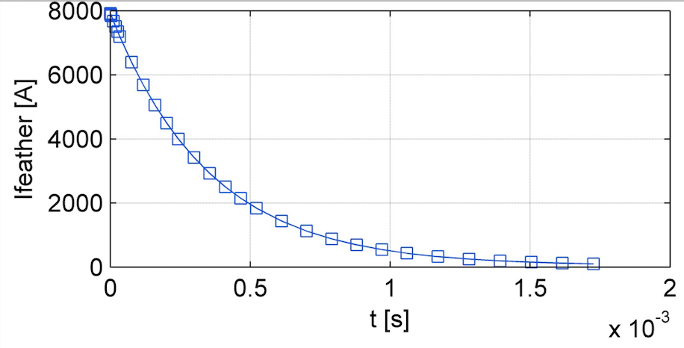
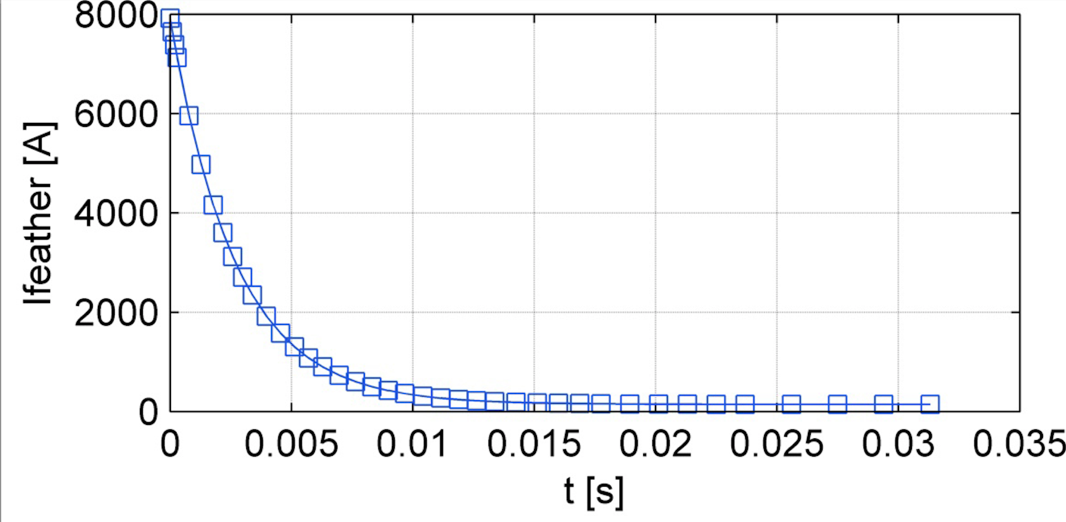
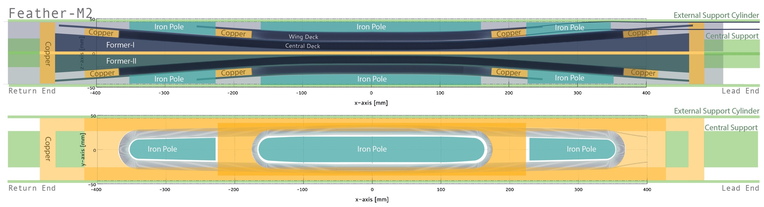
Copper Rings, Some sort of Transformer

Slide 22
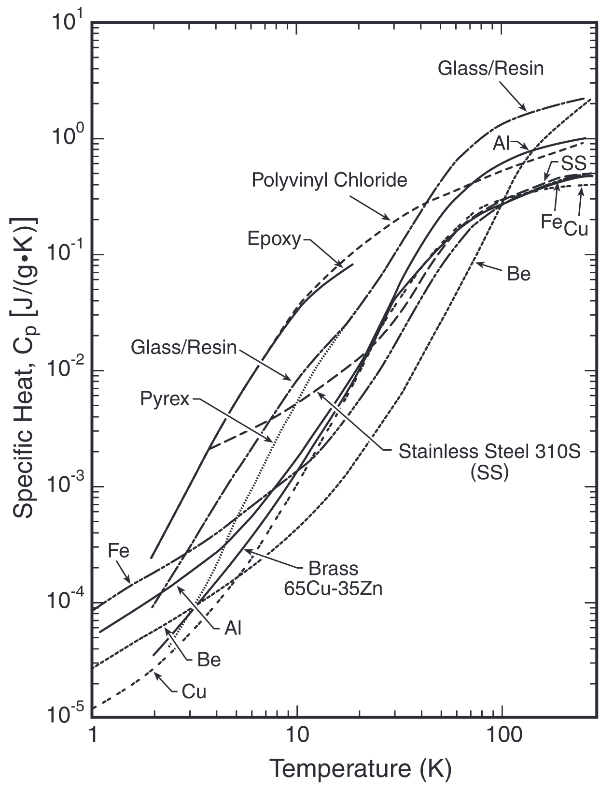
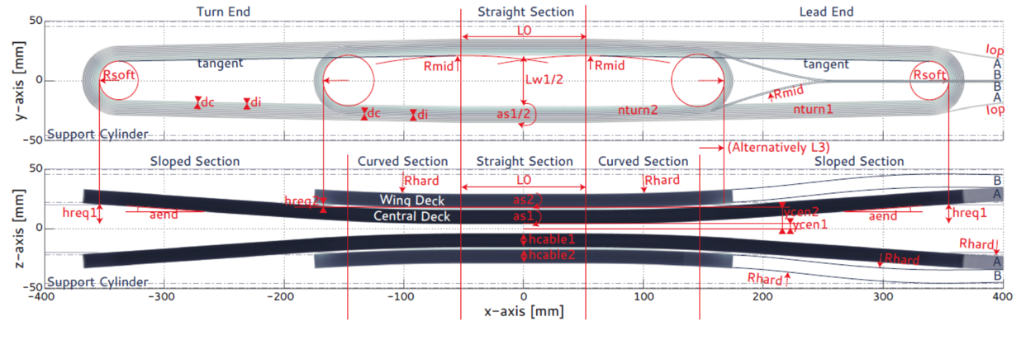
Stability
  The temperature margin on Feather-M2 is ~40 K at worst point (if not better)
This is excelent news because the heat capacity increases rapidly with temperature
MQE is estimated to be on the order of 100 mJ per tape
How well do the strands work together and thus the question on the current sharing?

